Slide 1
固定格子間隔で行う有限温度格子QCD計算
梅田貴士 広島大学大学院教育学研究科
研究会「有限温度密度系の物理と格子ＱＣＤシミュレーション」
筑波大学 計算科学研究センター 2015年9月5日
Notes:
Today I would like to talk about thermodynamics in the fixed scale approach with the shifted boundary conditions

Slide 2
金谷さんとの繋がり（梅田の経歴）

Slide 3
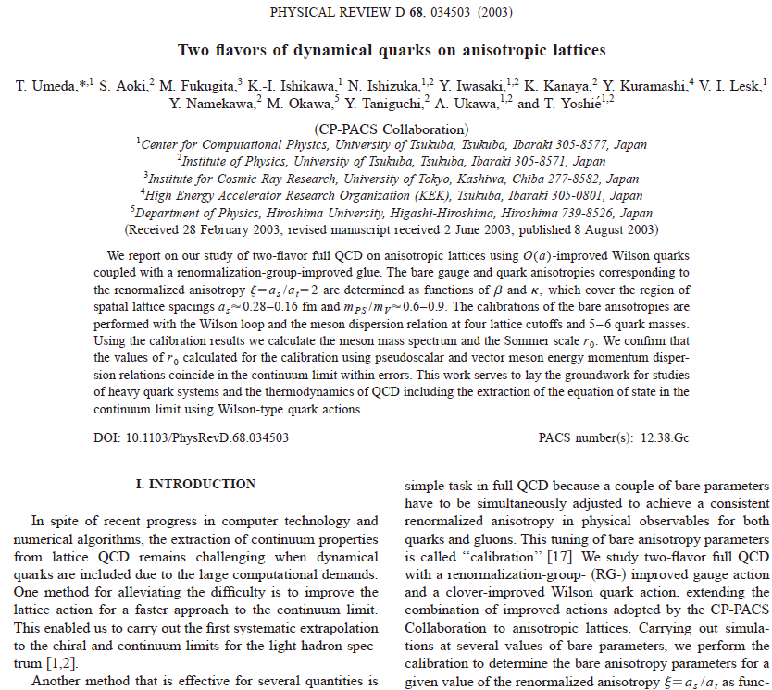
2001~2002年 CP-PACS Collab.

Slide 4
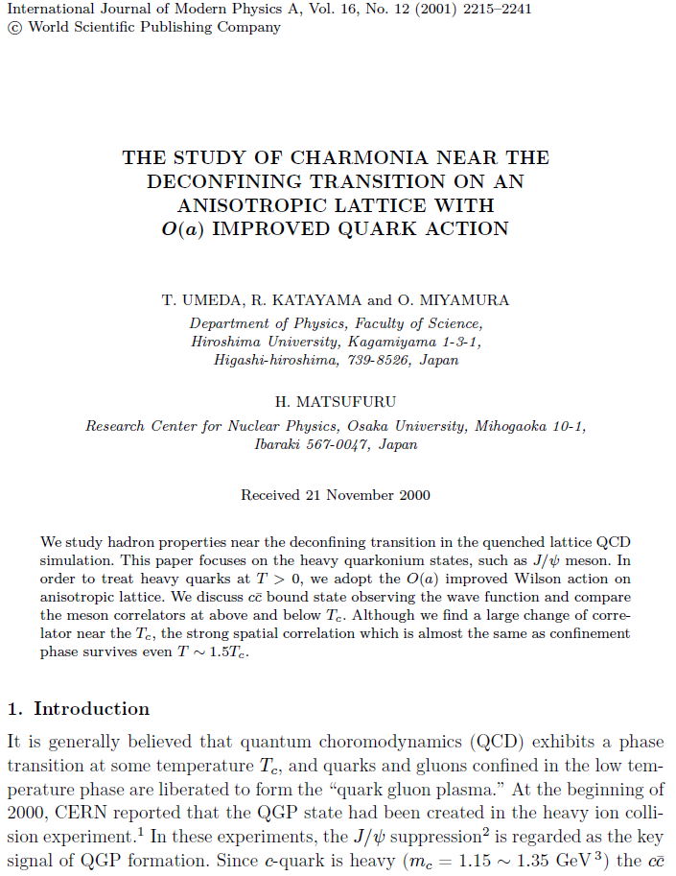
相転移近傍でのチャーモニウムの性質

Slide 5
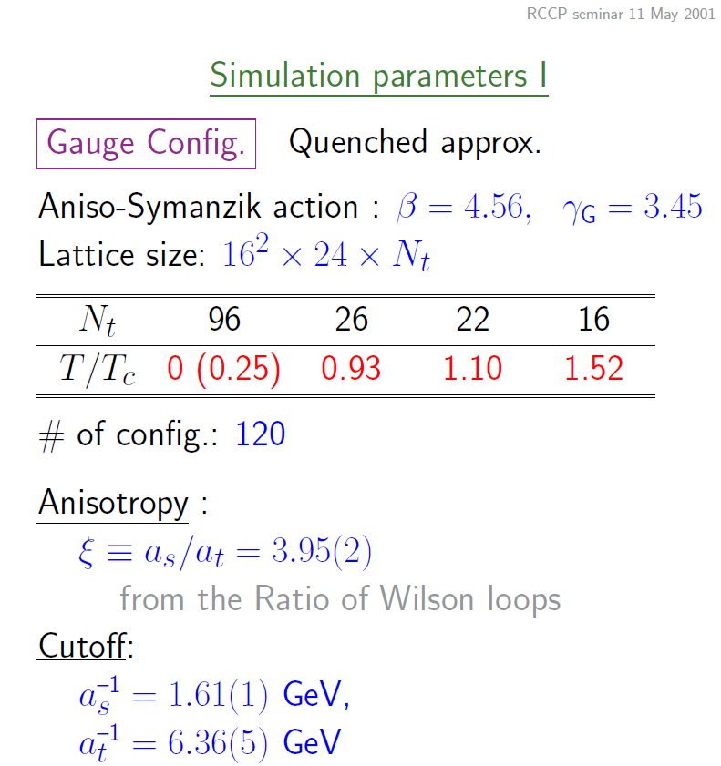
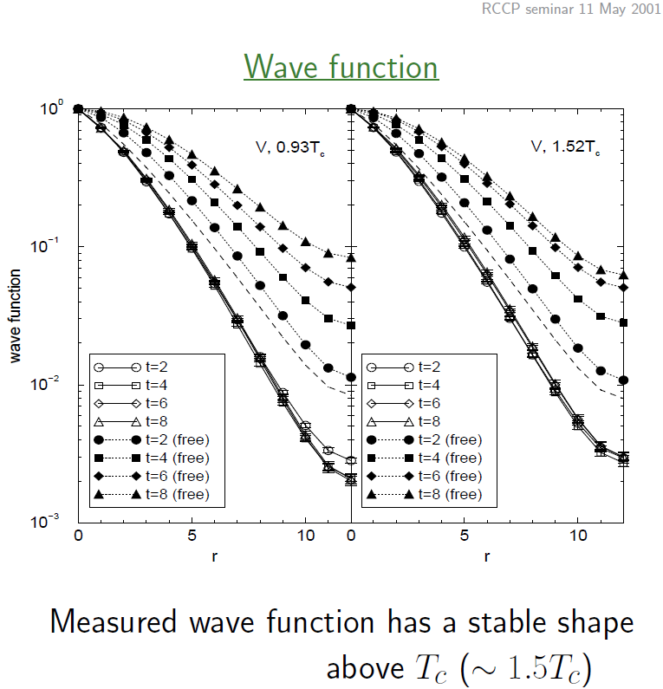
相転移近傍でのチャーモニウムの性質

Slide 6
固定格子間隔のメリット
純粋に温度依存性が分かる
体積、格子間隔、クォーク質量などが一定
ゼロ温度での性質が共通
“素性”の分かっているパラメータを使える
ゼロ温度の解析が十分にできる
ハドロンスペクトル、クォークポテンシャルなど
非等方格子など

Slide 7
2007~2008年 WHOT-QCD Collab.
W(ilson quark を用いた)Hot(&Dense)-QCD (研究の為の) Collaboration

Slide 8
Wilson quark で有限温度QCDの研究
状態方程式などの有限温度計算を行う準備として
（ゼロ温度計算での）大規模なパラメータサーチが必要
Line of Constant Physics
T=0 subtraction
Beta-function
固定格子間隔のアプローチは使えないだろうか？
（状態方程式を計算する手法である積分法は使えない）
（温度積分法）
→ Wilson quark では計算コストが大変

Slide 9
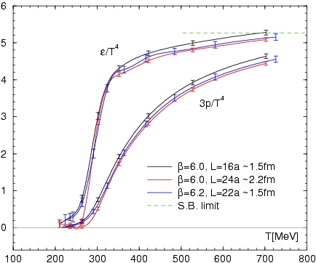
Equation of State in quenched QCD @ Lattice2008
Integration
is performed with the cubic
spline of (e-3p)/T⁴
Our results are roughly
consistent with previous results.
-- mild scale violation
-- Large volume is important
Unlike the fixed N_{τ} approach,
scale/temp. is not constant.
→ Lattice artifacts increase
as temperature increases.
T. Umeda et al. (WHOT-QCD) Phys.Rev.D79 (2009) 051501.
/16
Notes:
Most of this talk is not so recent studies

Slide 10
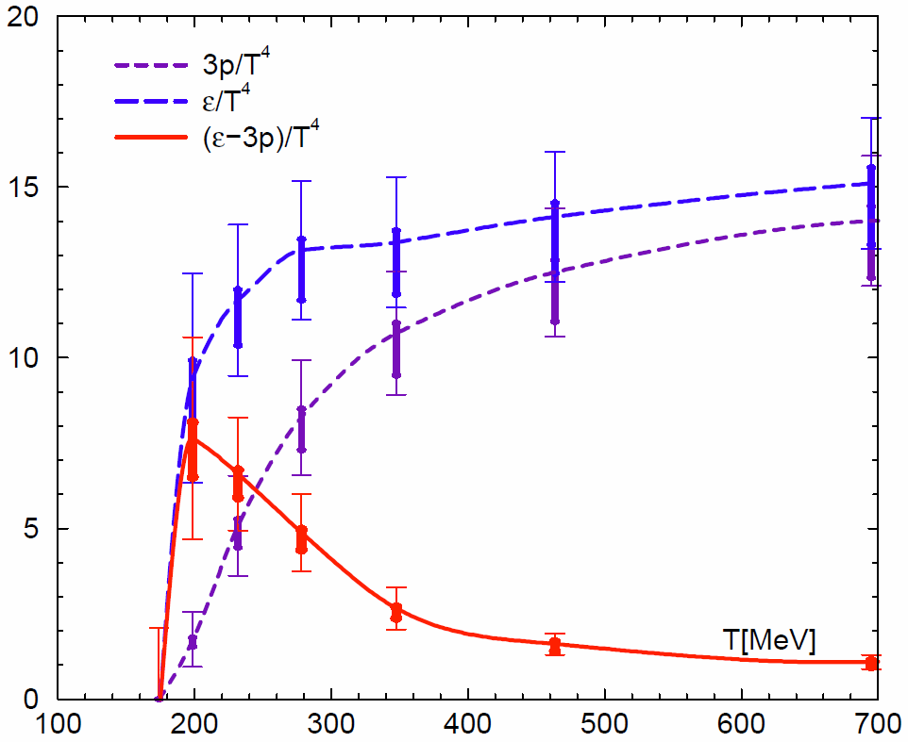
Equation of State in N_{f}=2+1 QCD @ Lattice2012
EOS is obtained by
temperature integration
in the Fixed scale approach
Some groups adopted the approach
- tmfT, arXiv:1311.1631
- Wuppertal, JHEP08(2012)126.
SB limit
T. Umeda et al. (WHOT-QCD)
Phys. Rev. D85 (2012) 094508
However possible temperatures are restricted by integer N_{t}
Notes:
In the fixed scale approach we can calculate the EOS by the T-integration method which is the temperature integration of the trace anomaly.
So we have performed the first study of the EOS with 2+1 flavor Wilson type quarks.
Recently some groups adopted the approach to calculate the EOS.
However, as you know, in the approach, possible temperatures are restricted by integer Nt.
This is a main drawback of the approach.

Slide 11
Toward the physical point @ Lattice2015

Slide 12
Shifted boundary conditions at the fixed scale
L. Giusti and H. B. Meyer, Phys. Rev. Lett. 106 (2011) 131601.
$$t=aN_{t}=L_{0}$$
$$a\sqrt{N_{t}^{2}+{\vec{n}}^{2}}$$
time
$$a\vec{n}$$
$$T=\frac{1}{a\sqrt{N_{t}^{2}+{\vec{n}}^{2}}}$$
space
$$t=0$$
$$a\vec{n}$$
By using the shifted boundary
various T’s are realized with the same lattice spacing
T resolution is largely improved
while keeping advantages of the fixed scale approach
Notes:
In the conditions, literally there is spatial shift at the boundary in temporal direction at finite temperature.
As a result, length of the compact direction, in other words inverse temperature, is larger than the temporal extent.
By using the shifted boundary various temperatures are realized with the same lattice spacing.
Therefore temperature resolution is largely improved while keeping advantages of the fixed scale approach.

Slide 13
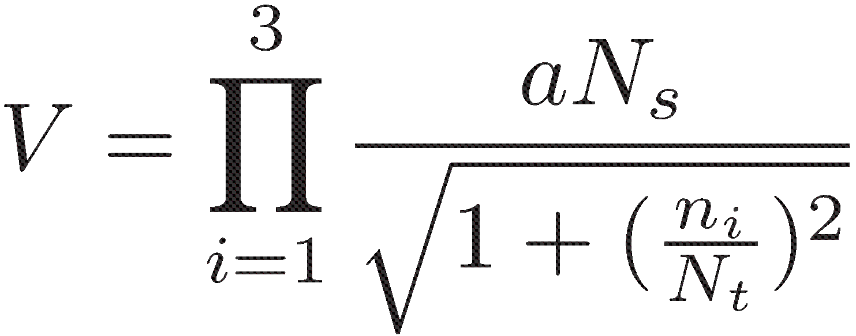
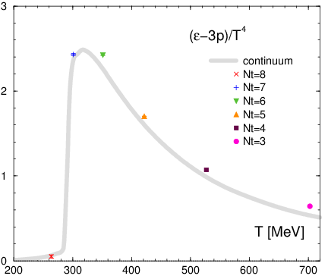
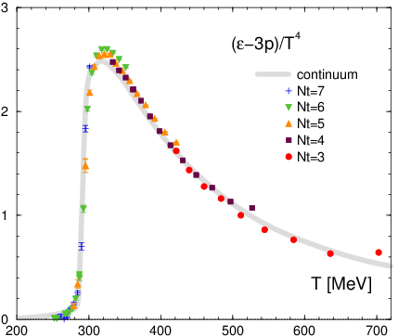
Trace anomaly ( e-3p )/T⁴
$$T=\frac{1}{a\sqrt{N_{t}^{2}+{\vec{n}}^{2}}}$$
w/o shifted boundary
w/ shifted boundary
T. Umeda, Phys. Rev. D90 (2014) 5, 054511
Notes:
And, in the right panel, the data of shifted boundary is added in the same figure.
We can largely increase a number of temperature at single lattice spacing.
These are roughly consistent with the conventional continuum result.
But we can find some deviation from the continuum one at no shift results.
In the next slide we focus on the deviations.

Slide 14
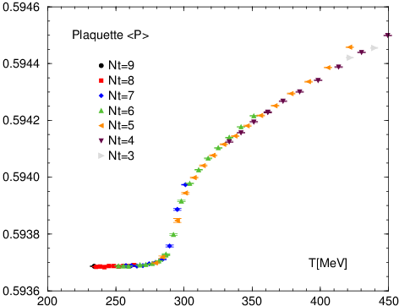
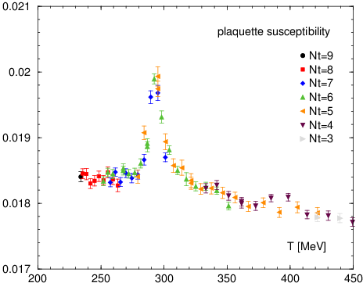
Critical temperature Tc
Plaquette value
Plaquette susceptibility
T. Umeda, Phys. Rev. D90 (2014) 5, 054511
Plaq. suscep. has a peak
around T = 294 MeV
Notes:
Instead of the Polyakov loop, we use the plaquette susceptibility to identify the critical temperature.
The left panel shows the plaquette as a function of temperature.
And the right panel shows its susceptibility, which is defined with the equation.
We can find that plaquette susceptibility has a peak around an expected temperature.
Such calculation was difficult in the fixed scale approach without shifted boundary condition.

Slide 15
Gradient flow を用いた熱力学量の計算

Slide 16
まとめ
固定格子間隔による有限温度QCDの研究
従来のアプローチとは異なる強み
Physical point の計算を目指して
固定格子間隔のデメリットの克服
Shifted boundary condition
Gradient flow
金谷さんとの共同研究
要所要所で金谷さんのエッセンスを吸収しつつ研究をしてきた
これからも有限温度QCDの研究を発展させていきたい

Slide 17
金谷さん還暦おめでとうございます
Lattice2002@MIT のエクスカージョン(?)にて

