Slide 1

Thermodynamics in the fixed scale approach with the shifted boundary conditions
Takashi Umeda (Hiroshima Univ.)
Lattice2014, Columbia University, New York, 23-28 June 2014
Notes:
Today I would like to talk about thermodynamics in the fixed scale approach with the shifted boundary conditions

Slide 2
Fixed scale approach to study QCD thermodynamics
Fixed scale approach
a : lattice spacing
N_{t} : lattice size
in t-direction
Temperature T=1/(N_{t}a) is varied by N_{t} at fixed a
T. Umeda et al. (WHOT-QCD) Phys.Rev.D79 (2009) 051501.
Coupling parameters are common at each T
To study Equation of States
- T=0 subtractions are common
- beta-functions are common
- Line of Constant Physics is automatically satisfied
Cost for T=0 simulations can be largely reduced
Notes:
To study the QCD thermodynamics we proposed the fixed scale approach.
In this approach temperature is varied by temporal lattice extent at fixed lattice spacing in contrast to the conventional fixed Nt approach
There are several advantages in the approach because coupling parameters are common at each temperature.
To study the equation of state, zero temperature subtraction and beta functions are common.
And conditions of the line of constant physics are automatically satisfied.
Therefore cost for zero temperature simulations can be largely reduced in the approach.

Slide 3
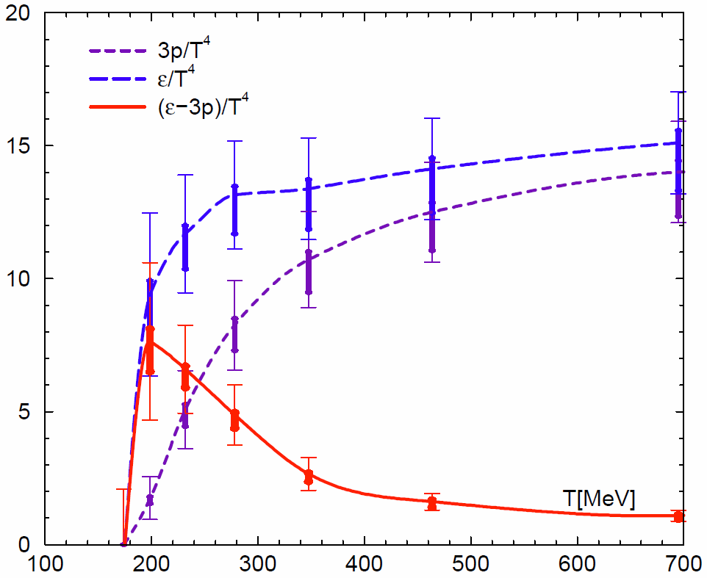
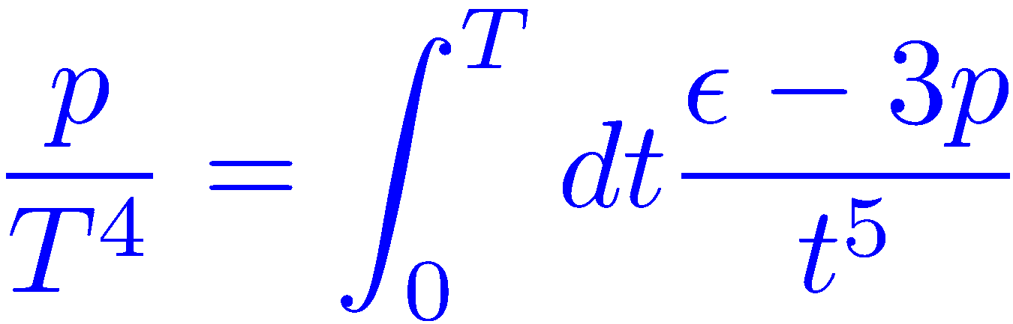
Equation of State in N_{f}=2+1 QCD
EOS is obtained by
temperature integration
in the Fixed scale approach
Some groups adopted the approach
  - tmfT, arXiv:1311.1631
  - Wuppertal, JHEP08(2012)126.
SB limit
However possible temperatures are restricted by integer N_{t}
T. Umeda et al. (WHOT-QCD)
Phys. Rev. D85 (2012) 094508
Notes:
In the fixed scale approach we can calculate the EOS by the T-integration method which is the temperature integration of the trace anomaly.
So we have performed the first study of the EOS with 2+1 flavor Wilson type quarks.
Recently some groups adopted the approach to calculate the EOS.
However, as you know, in the approach, possible temperatures are restricted by integer Nt.
This is a main drawback of the approach.

Slide 4
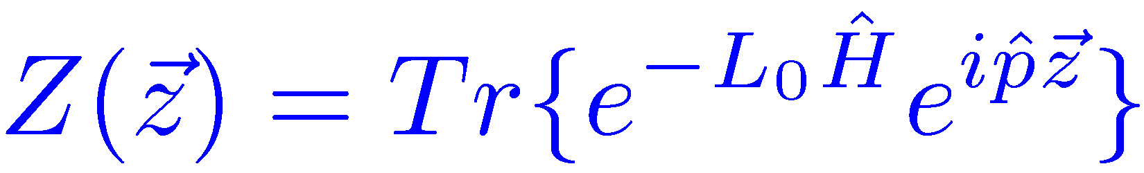
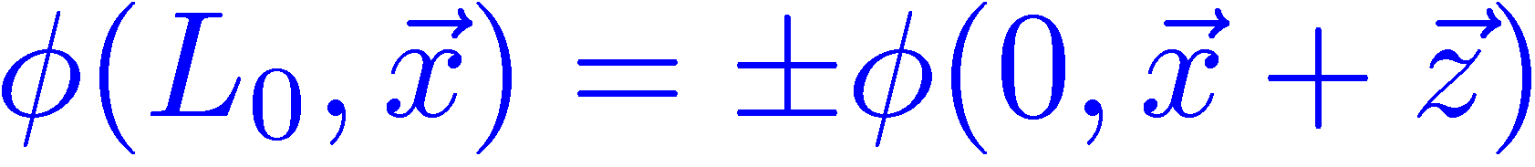
Shifted boundary conditions
L. Giusti and H. B. Meyer, Phys. Rev. Lett. 106 (2011) 131601.
Thermal momentum distribution from path integrals
with shifted boundary conditions
New method to calculate thermodynamic potentials
(entropy density, specific heat, etc. )
The method is based on the partition function
which can be expressed by Path-integral with shifted boundary condition
L. Giusti and H. B. Meyer, JHEP 11 (2011) 087
L. Giusti and H. B. Meyer, JHEP 01 (2013) 140
L. Giusti and M. Pepe, arXiv:1403.0360.
Notes:
In order to overcome these drawback, we utilize the shifted boundary conditions.
This is originally proposed for the new method to calculate thermodynamic potentials by Giusti and Meyer in the paper.
The method is based on the following partition function, which can be expressed by path integral with the shifted boundary conditions like this.

Slide 5
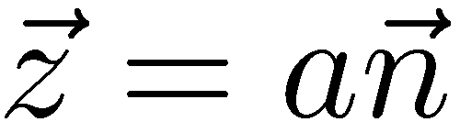


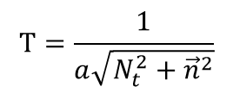


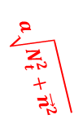
Shifted boundary conditions
$$t=aN_{t}=L_{0}$$
$$a\sqrt{N_{t}^{2}+{\vec{n}}^{2}}$$
time
$$a\vec{n}$$
$$T=\frac{1}{a\sqrt{N_{t}^{2}+{\vec{n}}^{2}}}$$
space
$$t=0$$
$$a\vec{n}$$
By using the shifted boundary
various T’s are realized with the same lattice spacing
T resolution is largely improved
while keeping advantages of the fixed scale approach
Notes:
In the conditions, literally there is spatial shift at the boundary in temporal direction at finite temperature.
As a result, length of the compact direction, in other words inverse temperature, is larger than the temporal extent.
By using the shifted boundary various temperatures are realized with the same lattice spacing.
Therefore temperature resolution is largely improved while keeping advantages of the fixed scale approach.

Slide 6
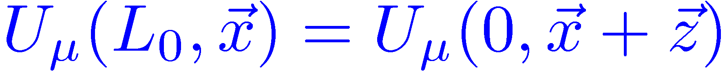
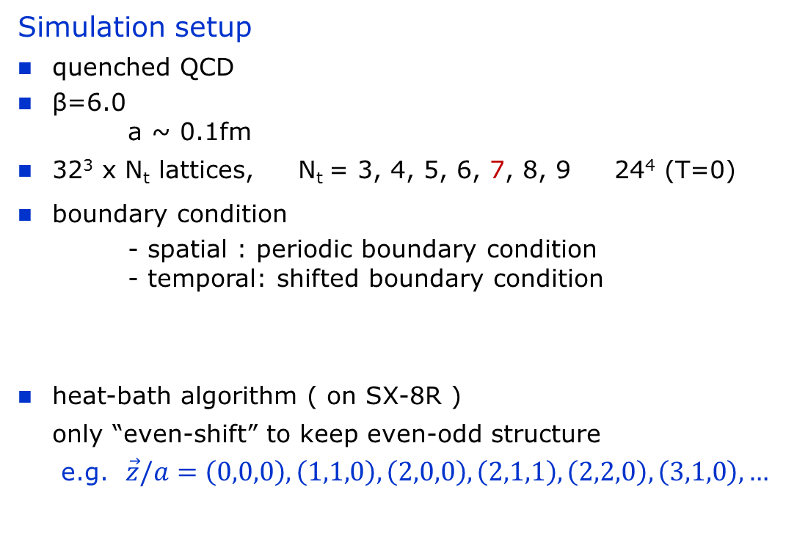
Test in quenched QCD
Simulation setup
quenched QCD
β=6.0
a ~ 0.1fm
32³ x N_{t} lattices, N_{t} = 3, 4, 5, 6, 7, 8, 9 24⁴ (T=0)
boundary condition
- spatial : periodic boundary condition
- temporal: shifted boundary condition
heat-bath algorithm ( on SX-8R )
only “even-shift” to keep even-odd structure
e.g. $\vec{z}/a=\left(0,0,0\right), \left(1,1,0\right), \left(2,0,0\right), \left(2,1,1\right), \left(2,2,0\right), \left(3,1,0\right), …$
Notes:
In this talk, we test this idea in quenched QCD simulations.
Simulation setup is as the following.
Beta is 6.0, its lattice spacing is about 0.1fm.
Lattice size is 32 cube times Nt.
Nt are from 3 to 9 and 24^4 for the symmetric zero temperature lattice.
Periodic boundary condition for spatial direction and
Shifted boundary condtions for temporal direction.
Our update program is developed on the vector machine.
The program adopt even-odd technique, then only even shifts are used in our study.

Slide 7
Test in quenched QCD
Choice of boundary shifts
Notes:
This is detail of the boundary shifts.
The vector n are shift vector in lattice unit.
This is n-squared, these are elements of the n-vector.
These zero means even shift vector.
These numbers are inverse temperatures at each Nt.
Totally 80 temperature simulations were performed in the study.

Slide 8
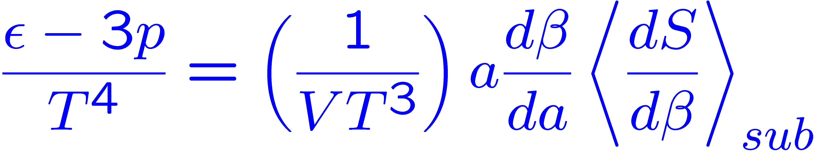
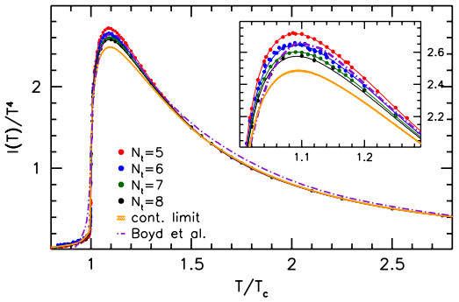
Trace anomaly ( e-3p )/T⁴
Reference data
S. Borsanyi et al., JHEP 07 (2012) 056
Precision SU(3) lattice thermodynamics
for a large temperature range
N_{s}/N_{t} = 8 near T_{c}
small N_{t} dependence at T>1.3Tc
peak height at Nt=6 is about
7% higher than continuum value
assuming T_{c}=294MeV
The continuum values are referred as “continuum”
Notes:
Before presentation of our results, we explain the reference data of trace anomaly.
They calculate the trace anomaly in quenched QCD and take the continuum limit.
The continuum values are referred as continuum in the study.
In their result, there is cut off dependence around the peak, but not so at higher temperatures.
Please keep it in your mind.

Slide 9
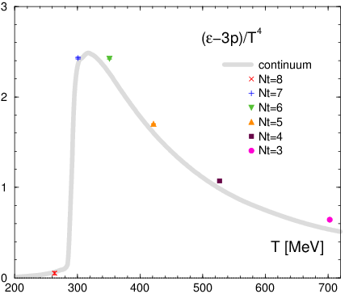
Trace anomaly ( e-3p )/T⁴
w/o shifted boundary
beta-function: Boyd et al. (1998)
Notes:
This is our result of the trace anomaly without shifted boundary as a function of physical temperature.
The thick line shows the continuum values.

Slide 10
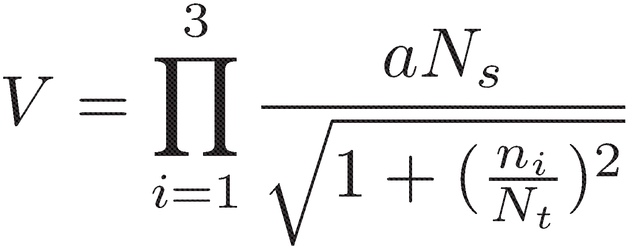
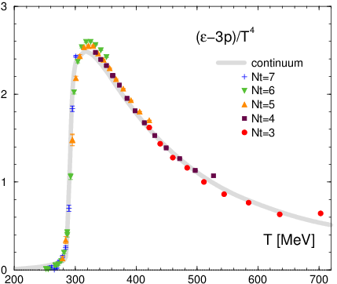
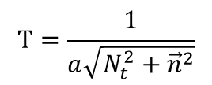
Trace anomaly ( e-3p )/T⁴
$$T=\frac{1}{a\sqrt{N_{t}^{2}+{\vec{n}}^{2}}}$$
w/o shifted boundary
w/ shifted boundary
beta-function: Boyd et al. (1998)
Notes:
And, in the right panel, the data of shifted boundary is added in the same figure.
We can largely increase a number of temperature at single lattice spacing.
These are roughly consistent with the conventional continuum result.
But we can find some deviation from the continuum one at no shift results.
In the next slide we focus on the deviations.

Slide 11
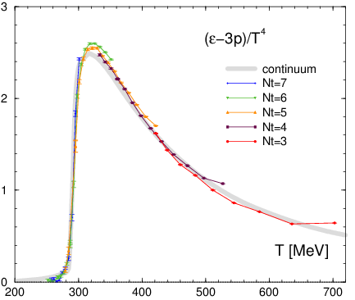
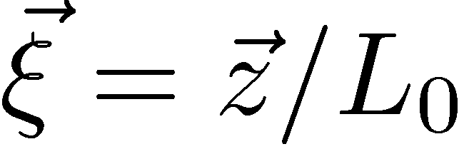
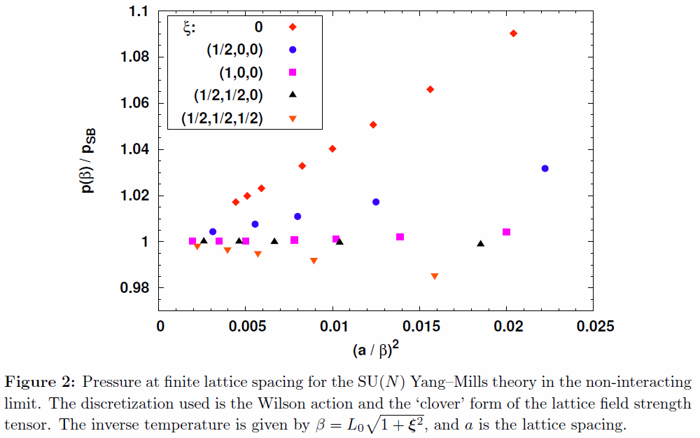
Lattice artifacts from shifted boundaries
L. Giusti et al. (2011)
Shifted boundary reduces lattice artifacts of EOS
in the non-interacting limit
We confirmed that the shifted boundary reduces lattice artifacts
even in the interacting case numerically.
Notes:
The left figure has the same data but different symbols.
It is obvious that no shift results deviate from the other result and continuum one.
We can understand the deviations by the right figure by Giusti et al.
The figure shows pressure divided by stephan boltmann limit as a function of lattice cutoff in case of non-interacting limit.
The different symbols show different boundary shift.
Of course all data converges to unity at continuum limit by definition.
Their result shows shifted boundary reduce lattice artifact in EOS of the non-interacting limit.
From this point of view, we confirmed that the shifted boundary suppresses lattice artifacts even in the interacting case numerically.
When such suppression will be held in case of full QCD,
Larger shift simulations are good way to investigate the QCD EOS.

Slide 12
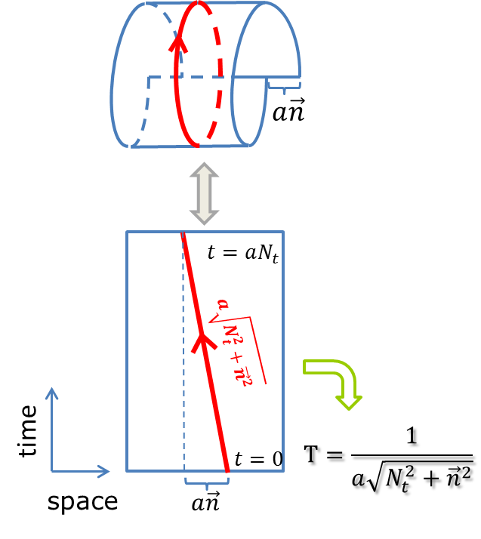
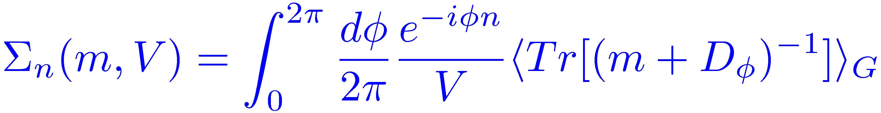
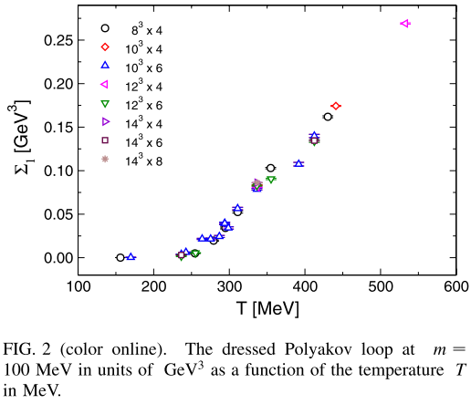
Critical temperature T_{c}
Polyakov loop is difficult to be defined
because the compact direction has
an angle to the temporal direction
Dressed Polyakov loop
E. Bilgici et al.,
Phys. Rev. D77 (2008) 094007
is defined with light quarks
Notes:
Next we discuss about the critical temperature.
Usually, in the quenched QCD, the temperature is defined by the Polyakov loop susceptibility.
However it is difficult to define the Polyakov loop in case of shifted boundary conditions because the compact direction has an angle to the temporal direction.
If we use the Dressed Polyakov loop, which is defined with light quarks, it can be calculated with the shifted boundary conditions.
But it is just an idea, it is not tried yet.

Slide 13
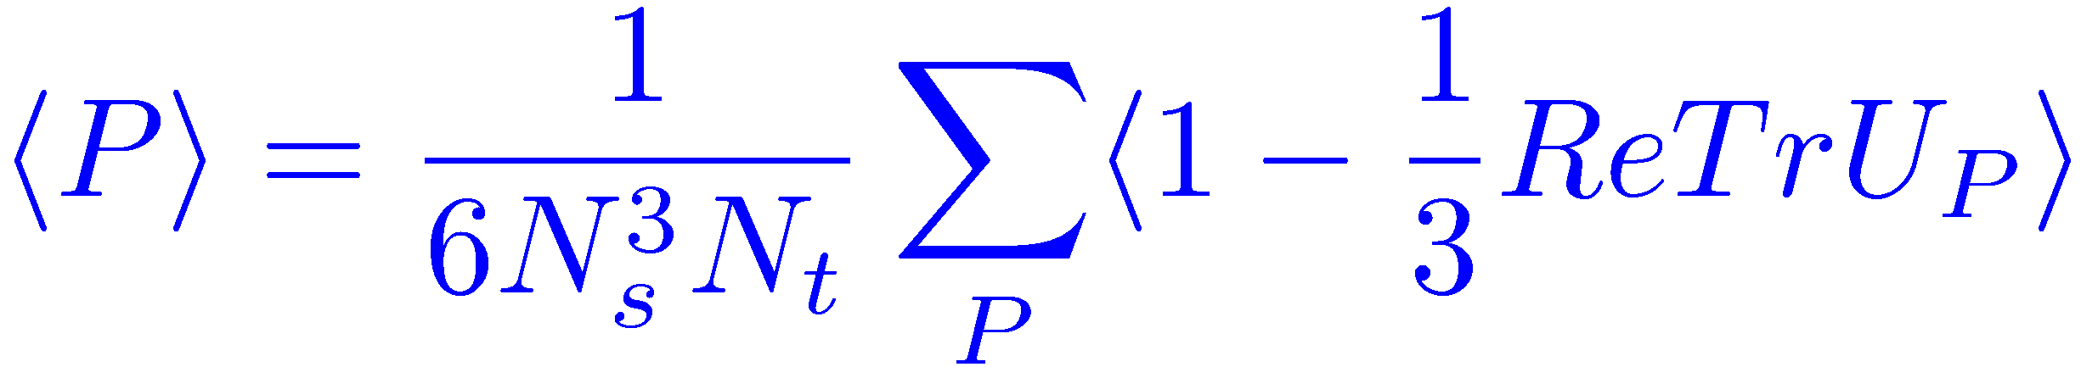
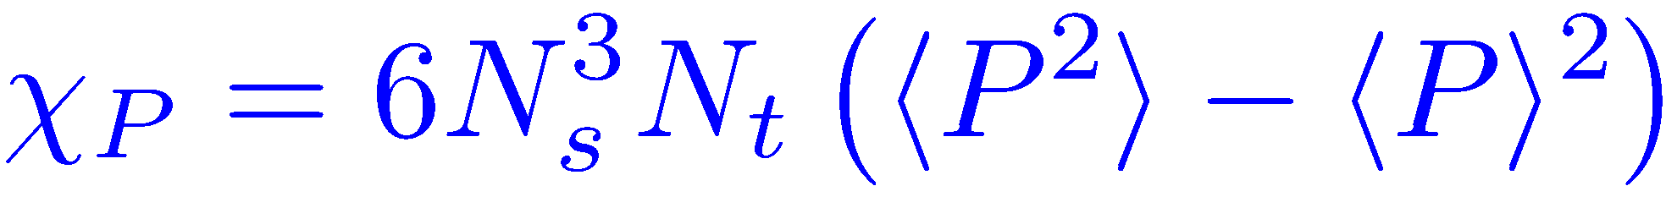
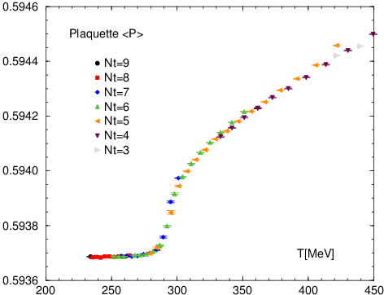
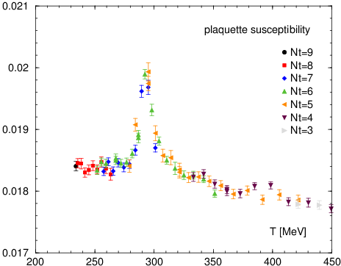
Critical temperature Tc
Plaquette value
Plaquette susceptibility
Plaq. suscep. has a peak
around T = 294 MeV
Notes:
Instead of the Polyakov loop, we use the plaquette susceptibility to identify the critical temperature.
The left panel shows the plaquette as a function of temperature.
And the right panel shows its susceptibility, which is defined with the equation.
We can find that plaquette susceptibility has a peak around an expected temperature.
Such calculation was difficult in the fixed scale approach without shifted boundary condition.

Slide 14
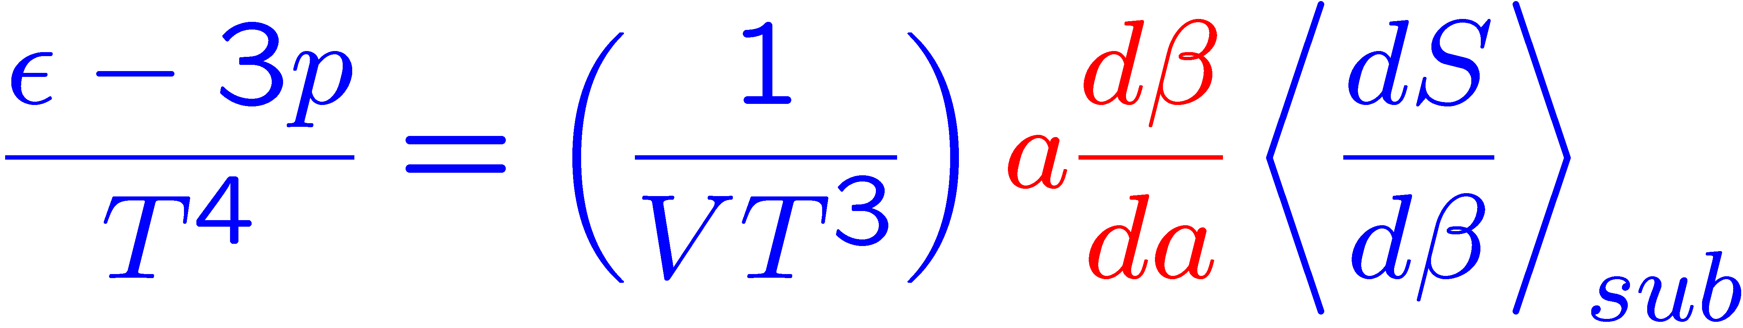
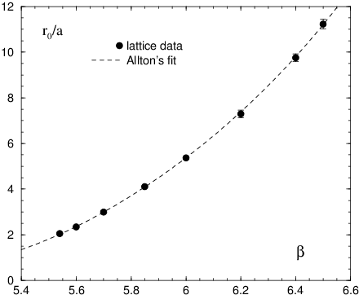
Beta-functions ( in case of quenched QCD )
In order to calculate the beta-function
additional T=0 simulations near
the simulation point are necessary
We are looking for
new methods to calculate beta-function
- Reweighting method
- Shifted boundary / Gradient flow
entropy density is calculated from
only finite temperature configs.
L. Giusti, H.B.Meyer, PRL106(2011)131601.
M. Asakawa et al. [FlowQCD Collab.], arXiv:1312.7492
Notes:
Finally we comment on an idea to calculate the beta-function.
Even in the fixed scale approach, the beta-function is necessary to calculate the trace anomaly.
Because the beta-function is determined by a coupling parameter dependence of lattice scale,
In order to calculate the beta-function, additional zero temperature simulation near the simulation point are necessary.
This spoils the advantage of the fixed scale approach.
Therefore we are looking for new method to calculate the beta functions.
One candidate is by using the reweighting method.
The other idea is to use the shifted boundary condition or the Yang-Mills gradient flow.
Both are recently proposed ideas.
In both methods, the entropy density is calculated from only finite temperature configurations.

Slide 15
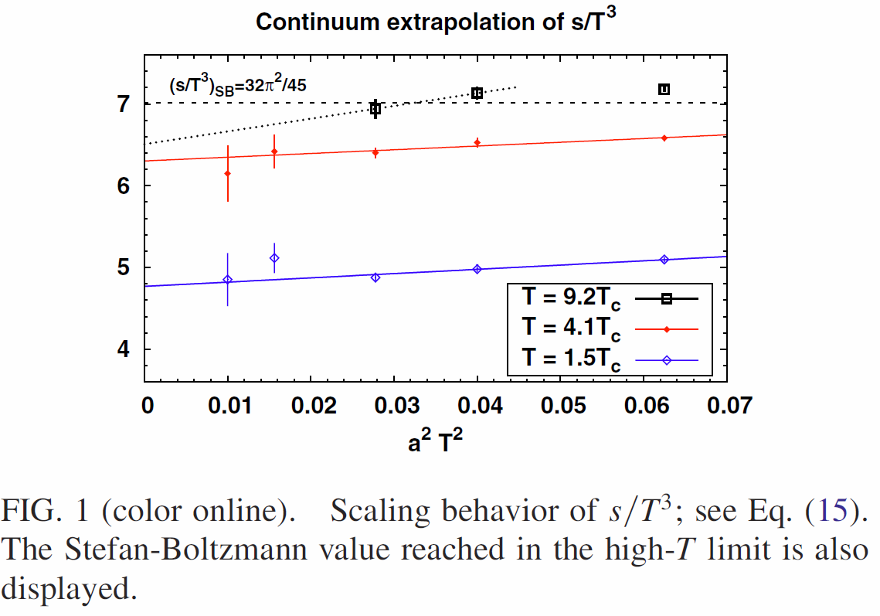
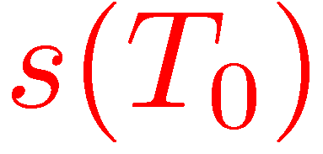
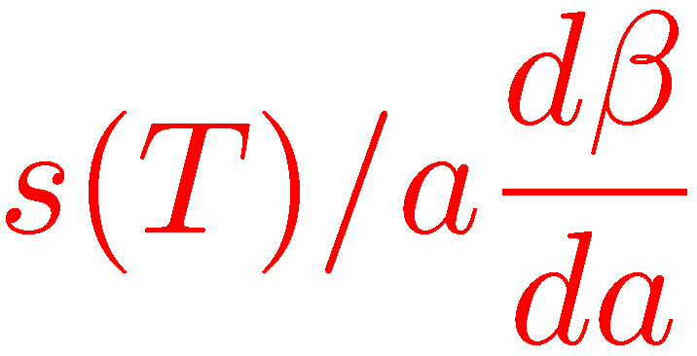
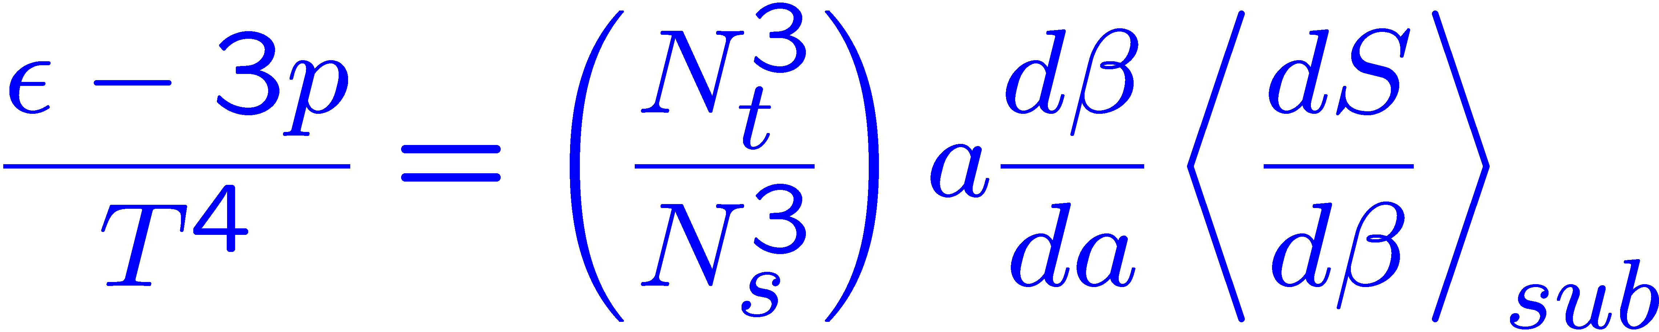
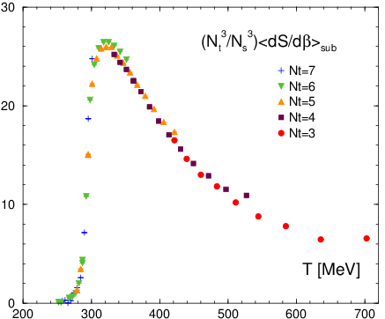
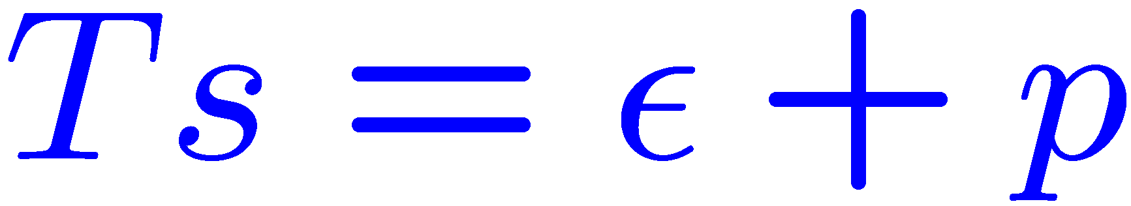
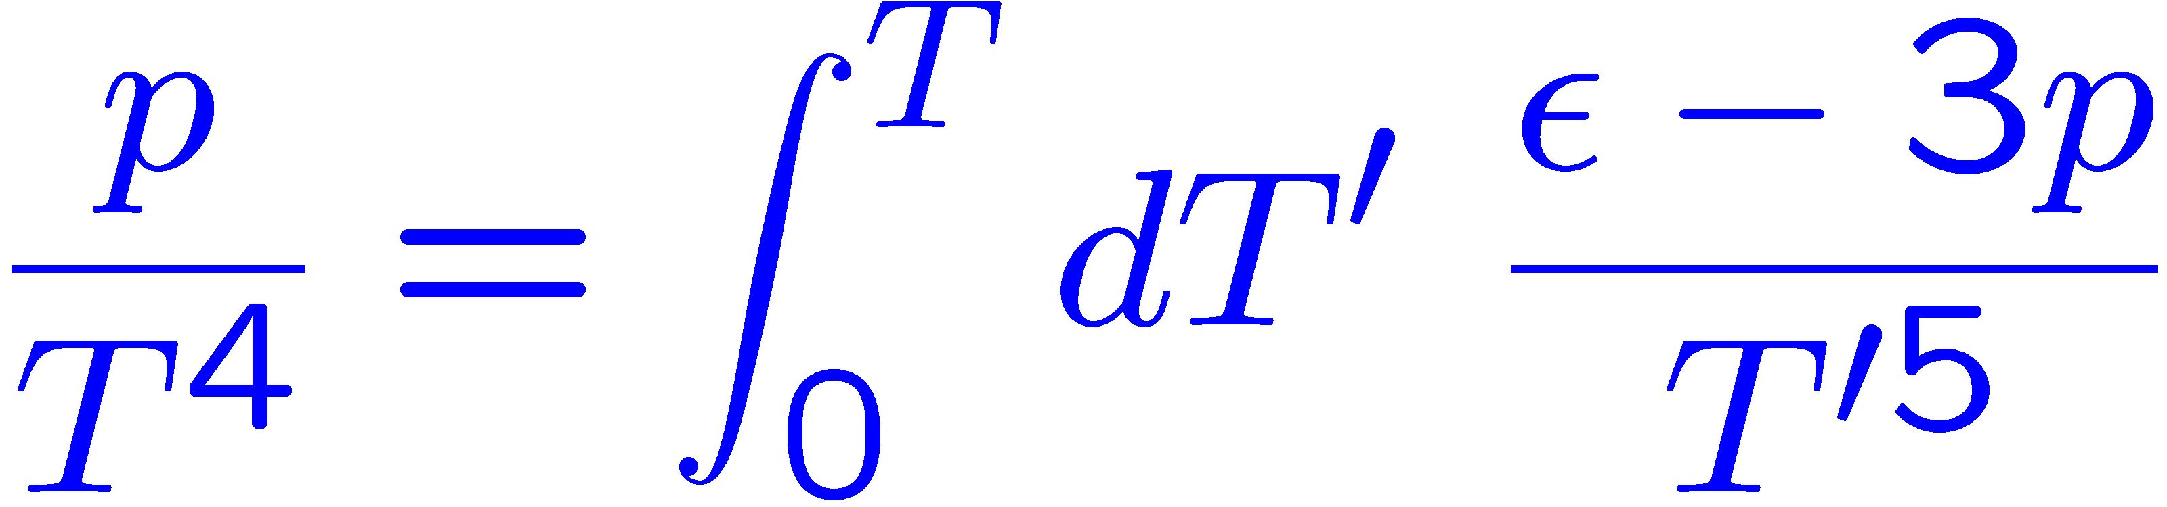
Entropy density from shifted boundaries
Entropy density at a temperature (T₀)
by the new method
Entropy density w/o beta-function
by the T-integration
Beta-func is determined by
matching of entropy densities at T₀
Notes:
So we can get the entropy densiy at a temperature by the new method.
By the T-integral method in the fixed scale approach, we can get the entropy density at whole temperature
Except for beta-function, which is an overall factor in the fixed scale approach.
Then we can get the beta-function by matching of entropy density at a temperature.

Slide 16
Summary & outlook
We presented our study of the QCD Thermodynamics
by using Fixed scale approach
and Shifted boundary conditions
Fixed scale approach
- Cost for T=0 simulations can be largely reduced
- first calculation in N_{f}=2+1 QCD with Wilson-type quarks
Shifted boundary conditions are promising tool
to improve the fixed scale approach
- fine temperature scan
- suppression of lattice artifacts at larger shifts
- Tc determination could be possible
- New method to calculate beta-functions
Test in full QCD → Nf=2+1 QCD at the physical point
Notes:
Let me summarize this talk.

Slide 17
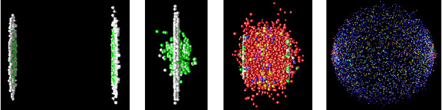
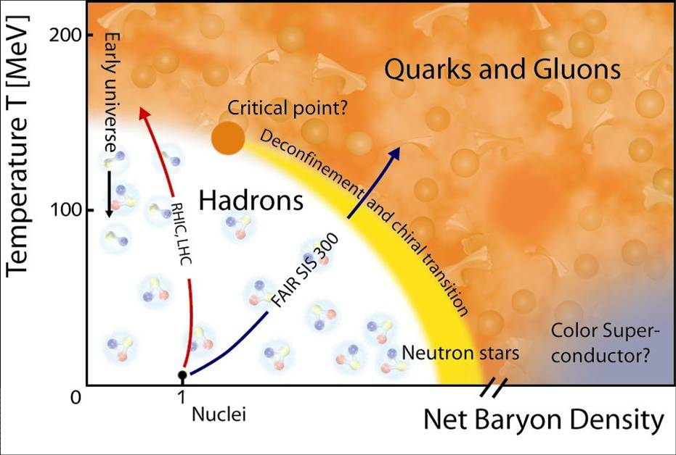
Quark Gluon Plasma in Lattice QCD
from the Phenix group web-site
Observables in Lattice QCD
  Phase diagram in (T, μ, m_{ud}, m_{s})
  Critical temperature
  Equation of state ( ε/T⁴, p/T⁴,...)
  Hadronic excitations
  Transport coefficients
  Finite chemical potential
  etc...
http://www.gsi.de/fair/experiments/

Slide 18
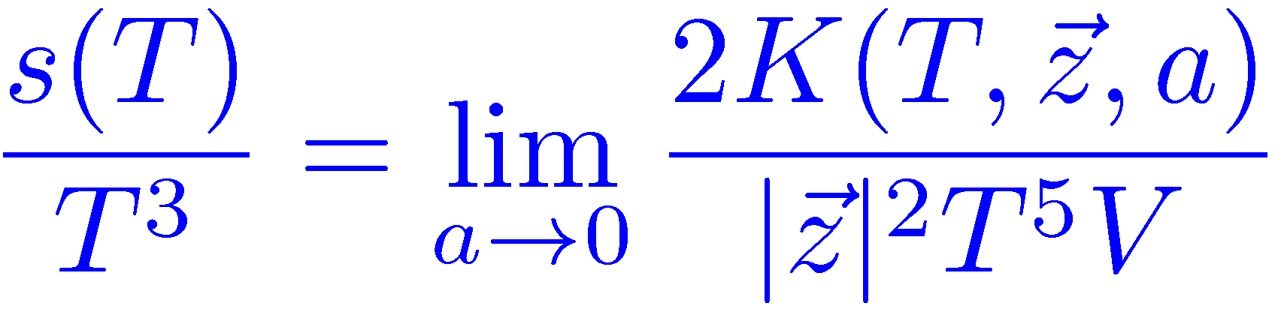
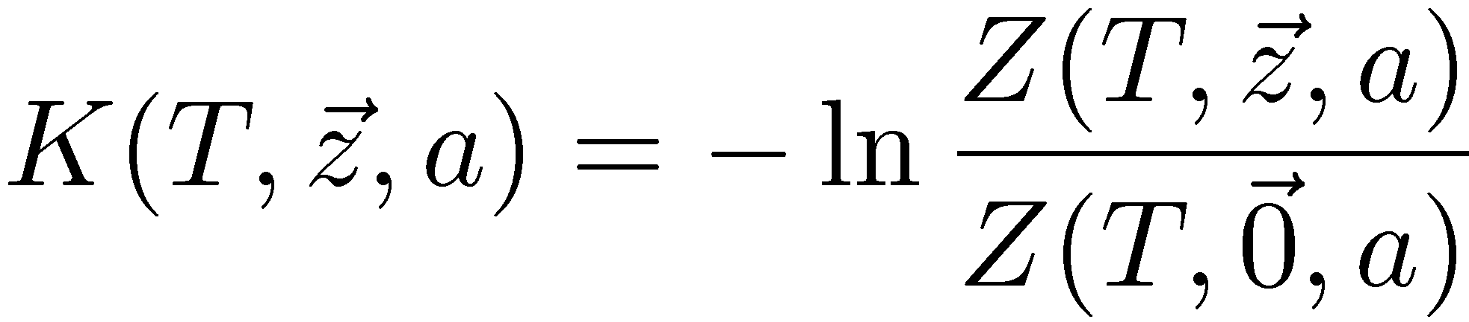
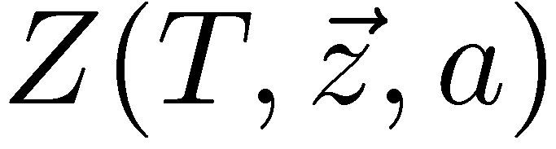
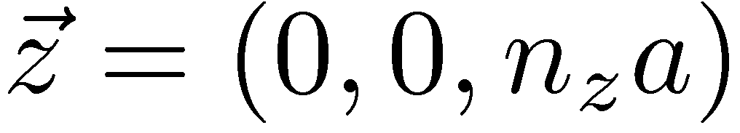
Entropy density from shifted boundaries
Entropy density s/T³
from the cumulant of the momentum distribution
L. Giusti and H. B. Meyer, Phys. Rev. Lett. 106 (2011) 131601
: partition function
with shifted boundary
where ,
n_{z} being kept fixed when a→0
L. Giusti et al. (2011)

