Slide 1
The MOT and Venture Business
５ Guiding Principles
The Pursuit of Peace
The Creation of New Forms of Knowledge
The Nurturing of Well-Rounded Human Beings
Collaboration with the Local, Regional, and International Community
Continuous Self-Development
Intensive Course of
Prof. Takao Ito,
Doctor of Economics, PH.D. of Engineering,
Graduate School of Advanced Science and Engineering, Hiroshima University
E-Mail: itotakao@Hiroshima-u.ac.jp

Slide 2
Schedule
MOT and Venture Business (An Intensive Course)
08:50-16:20, Saturday and Sunday
No. | Date |  | Lecture
1 | 2023/10/21 | Sat | Outlines and Introduction | 08:50-10:20
2 | 2023/10/21 | Sat | The evolution of Management | 10:30-12:00
3 | 2023/10/21 | Sat | Key Issues in Corporate Management | 13:10-14:40
4 | 2023/10/21 | Sat | Break-Even Point Analysis | 14:50-16:20
5 | 2023/10/22 | Sun | Cost Benefit Analysis and Ethics | 08:50-10:20
6 | 2023/10/22 | Sun | Stock Control | 10:30-12:00
7 | 2023/10/22 | Sun | Case Studies and Group Discussion | 13:10-14:40
8 | 2023/10/22 | Sun | Kaizen and Quality Control | 14:50-16:20
9 | 2023/11/11 | Sat | Motivation (self Learning) | 08:50-10:20
10 | 2023/11/11 | Sat | Organization Structure | 10:30-12:00
11 | 2023/11/11 | Sat | Decision-making and Strategy | 13:10-14:40
12 | 2023/11/11 | Sat | Leadership | 14:50-16:20
13 | 2023/11/12 | Sun | Business Plan | 08:50-10:20
14 | 2023/11/12 | Sun | Entrepreneur and Venture Business | 10:30-12:00
15 | 2023/11/12 | Sun | Presentation and/or Final Examination | 13:10-14:40
16 | 2023/11/12 | Sun | Review and Free Discussion | 14:50-16:20

Slide 3
Topic 10 Organization Structure

Slide 4
Agenda
Organization Structures
Network Organization

Slide 5
1. Organization Structures
The plan for the systematic arrangement of work is the organization structure
The formalized organizational chart has been around since 1854, when Daniel McCallum became general superintendent of the New York and Erie Railroad—one of the world's longest railroads.

Slide 6
Organizational structure types
Pre-bureaucratic structures
Bureaucratic structures
Post-bureaucratic
Functional structures
Divisional structures
Traditional structures
Modern structures
Other characteristics

Slide 7
Bureaucratic organizations
Pre-bureaucratic structures
Lack standardization of tasks
Bureaucratic structures
It has certain degree of standardization.
Post-bureaucratic
Generic: total quality management, culture management, and matrix management
Specific: based on dialogue and consensus rather than authority and command.
Notes:
Dictator democracy

Slide 8
Traditional structures
Line structures
chain of command
Line-and-staff structures
line structure with the staff departments that service, advice, and support them.
Functional structures
functional divisions of different specialized set of tasks

Slide 9
Other structures
Divisional structures
Matrix structures
Flat structures
Team
Network
Boundary-less structures
Virtual organizations

Slide 10
Main characteristics
Centralization
Decentralization
Departmentalization

Slide 11
Centralization vs. Decentralization
 | Centralization | Decentralization
Scale | Small | Large
Workers | Physical workers (Blue-collar workers) | Brain workers (White-collar workers)
Geographic condition | Concentration | Dispersion
Styles of the leader | Strong | Weak

Slide 12
Success factors
Decentralized reporting
Flat hierarchy
High transient speed
High transparency
Permanent monitoring
Rapid response
Shared reliability
Matrix hierarchy

Slide 13
2. Network Organization
”Internet”: Computer and Network
“Internet of things”: Network of things using computer technology
“Network”: Social Network, Information Exchange Network, Computer Network, Human-being network, etc.
Notes:
Basically internet could be explained as computer network.
Therefore, we can say that Internet of things is a network of thing connecting with computer technology.
Then what is Network? Network consists of node and arc. Arc cold be considered as relationship. The network is called social network when the node is man and/or women, and the arc express one kind of social relationships. The network is called information exchange network when the node is man and/or women, and the arc is information. The network is called computer network when the node is computer, and the arc is cable.

Slide 14
“Computer Network” = Information Processing + Communication
“Human-Being Network”: Friendship Network, Workflow Network, Information Exchange Network, etc.
Notes:
Computer network has two main characteristics: one is information processing, and other is communication.
Information processing means word file, Spread sheet, and data base. All of them are with high speed and precision.
Communication means exchange information electronically with each other. That is to say, remote communication instead of face to face communication..
Remote communication needs a lot of technology; such as protocol, System Architecture, Human Interface and Security.

Slide 15
Background
“The History of Network Research”: in the 1930s, group of German Emigres: cognitive ad social psychology → sociometry and group dynamics.
In the 1950s, the concept of networks: anthropology, psychology, sociology, mental health, and molecular biology.
Notes:
Network is not a new idea.
Group of German Emigres influenced by Wolfgang Kohler’s ‘gestalt’ theory
Informal interpersonal relations social systems.

Slide 16
Background
“The beginning of Internet”: in the 1950s and developed in the 1980s.
“Why we use internet” = use it as a tool to attain our goal in an effective and efficient manner through planning, organizing, leading and controlling our resources.
Notes:
(Definition of Management)

Slide 17
Background
“Strong ties and weak ties” = qualitative description and Granovetter’ dilemma
“Small World Problem”: to contact any two people only takes an average of five people.⇒Six Degrees of Separation
Notes:
Granovetter’ dilemma (the strength of weak ties: weak ties help find jobs that respondents find more satisfying than jobs through strong ties.)
to contact any two people in a country of over 250 million inhabitants, only takes an average of five people. (Travers and Milgram, 1969)

Slide 18
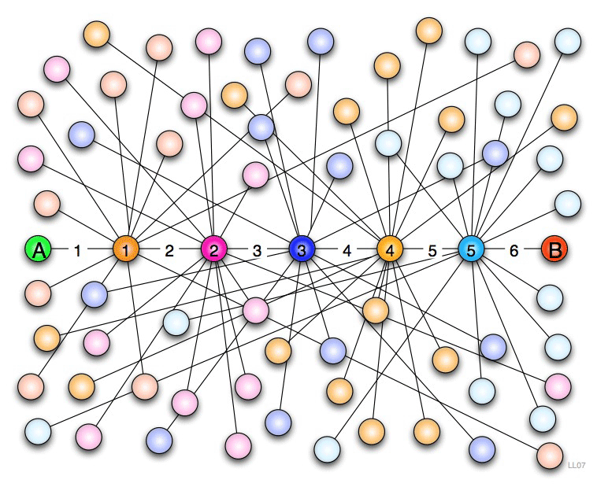
Six Degrees of Separation

Slide 19
Six Degrees of Separation
Mr. A: 44 friends
Mr. 1, one of the friends of Mr. A: 44 friends ( No overlap with Mr. A)
Mr. 2, one of the friends of Mr. 1: 44 friends ( No overlap with Mr. A and Mr. 1)………
Total number of Mr. A within 6 degrees of separation
Total population in the world
Notes:
https://ja.wikipedia.org/wiki/%E5%85%AD%E6%AC%A1%E3%81%AE%E9%9A%94%E3%81%9F%E3%82%8A
70億＝7 billion
44 to the 6th power

Slide 20
Measurement of Network
To measure the network structure
“Structure indices” : Centrality (Degree, Betweenness, Closeness, etc.), Capacity, Influence, Density, Effective Size, Balance, Block, Clique, Efficiency, etc.

Slide 21
Network and its Application
“Keiretsu” = a system of organizations with integrated and interlocking business relationships and joint shareholdings
“Panasonic” = A group company
“Accounting System” = formation of accounting system under the impact of decision-maker’s

Slide 22
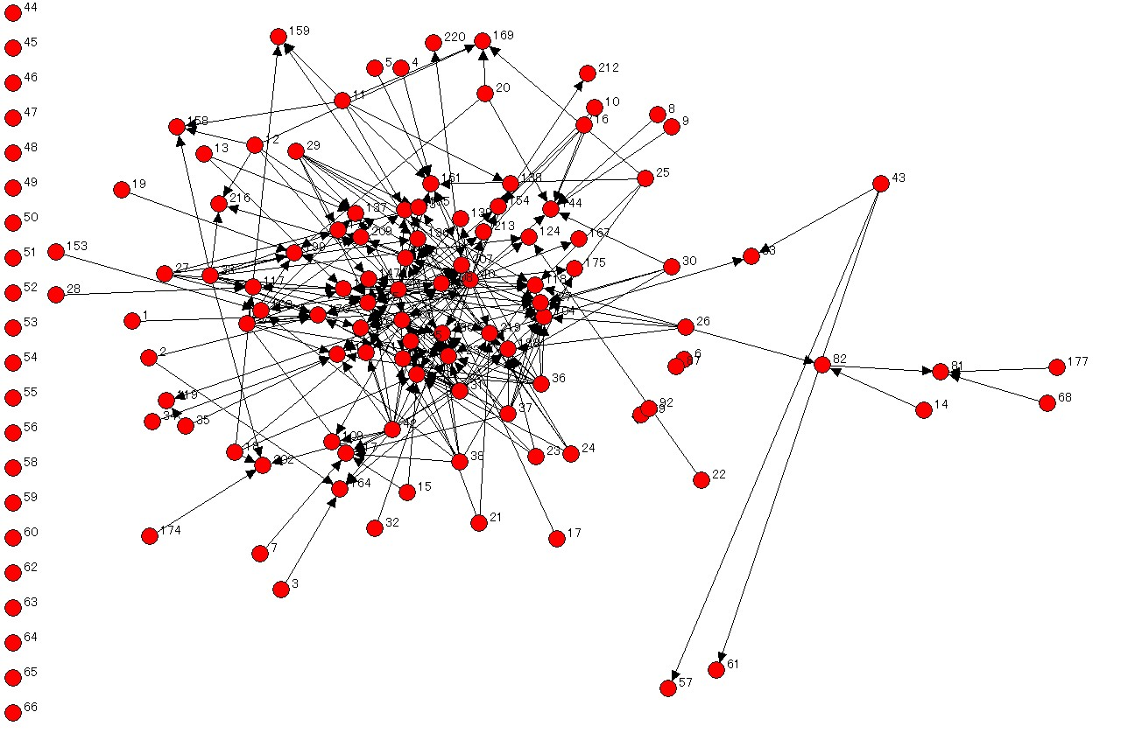
Cross shareholdings relationship between car-maker Mazda and its Suppliers in 2004

Slide 23
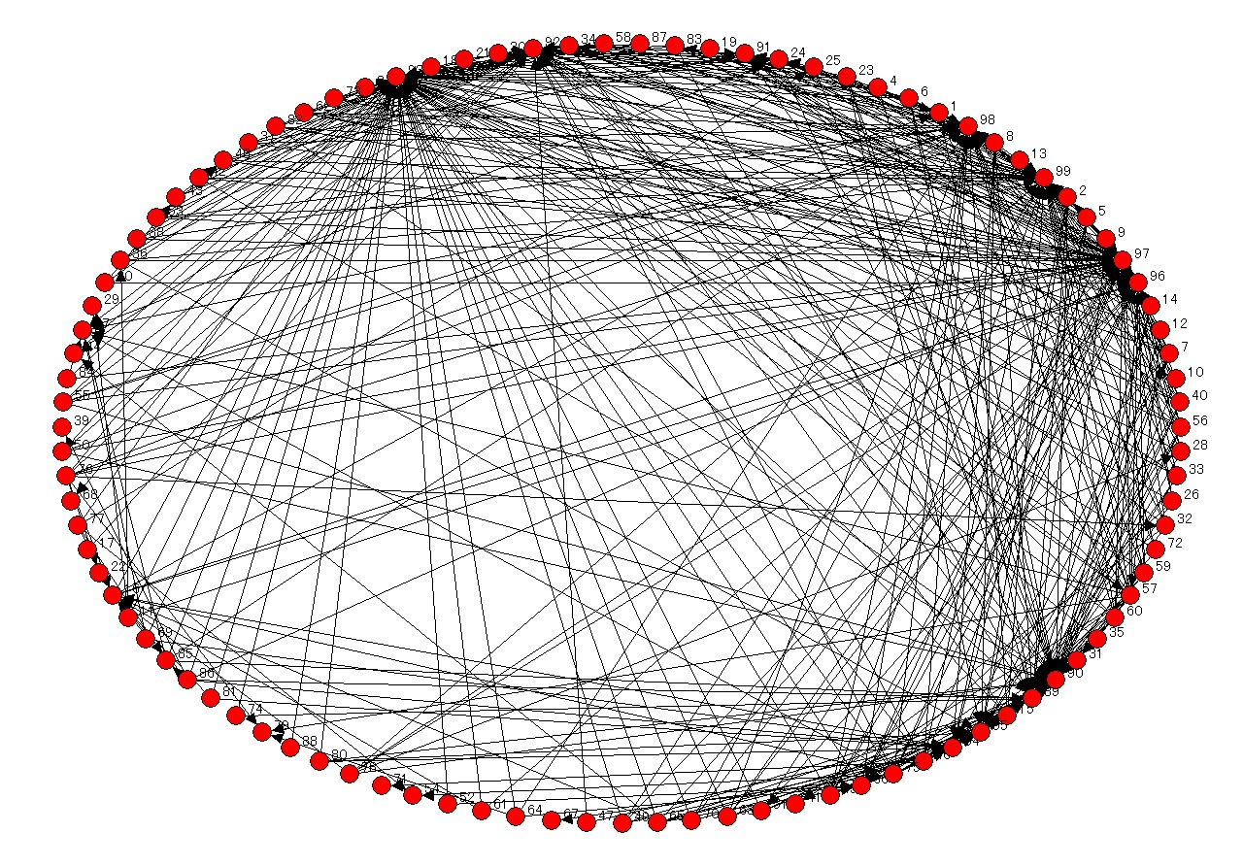
Transaction relationship between car-maker Nisan and its Suppliers in 2004

Slide 24
Centrality: Degree
i≠k;
a (p_{i}, p_{k}) = 1 if and only if p_{i} and p_{k}
are connected by a line
a (p_{i}, p_{k}) = 0 otherwise
Notes:
It means the number of nodes that connect with it directly.
The number of nodes adjacent to a given node in a symmetric network is the degree of that node. For asymmetric network the in-degree of a node p_{k} is the number of ties received by p_{k} and the out-degree is the number of ties initiated from p_{k}.
The degree means the proportion of other nodes that are adjacent to p_{k} and is viewed as important index of its potential communication activity.

Slide 25
Centrality: Betweenness
i≠j≠k;
g_{ij}: the number of geodesics linking
p_{i} and p_{j}
g_{ij}(p_{k}): the number of geodesics linking p_{i}
and p_{j} that contains p_{k}
Notes:
It could be expressed as probability that node p_{k} falls on a randomly selected geodesic linking p_{i} with p_{j}.
Betweenness is the ratio of the number of geodesics linking p_{i} and p_{j} that contains p_{k} (numerator) and the geodesics linking p_{i} and p_{j} (denominator).
Betweenness is useful as an index of the potential of the node for control of communication, and it is also useful as an index of network structure.
Numerator, denominator

Slide 26
Centrality: Closeness
i≠k;
d (p_{i}, p_{k}): the number of edges in the geodesic linking p_{i} and p_{k}
Notes:
It is distance from p_{k} to all other nodes linking with p_{k} directly or indirectly.
The third is an index of closeness that is a distance from p_{k} to all other node linking with p_{k} directly or indirectly.
Closeness index may be useful when measures based upon independence or efficiency is desired.
Closeness index is excluded because all nodes in the networks of transactions and cross shareholdings are not connected with each other (the distance among firms is infinite). It could not be calculated technically.

Slide 27
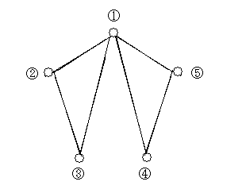
Demonstrate: five-node network
Notes:
It is distance from p_{k} to all other nodes linking with p_{k} directly or indirectly.
The third is an index of closeness that is a distance from p_{k} to all other node linking with p_{k} directly or indirectly.
Closeness index may be useful when measures based upon independence or efficiency is desired.
Closeness index is excluded because all nodes in the networks of transactions and cross shareholdings are not connected with each other (the distance among firms is infinite). It could not be calculated technically.

Slide 28
Demonstrate: Result
No. | Degree | Betweenness | Closeness
1 | 4 | 4 | 4
2 | 2 | 0 | 6
3 | 2 | 0 | 6
4 | 2 | 0 | 6
5 | 2 | 0 | 6
Notes:
It is distance from p_{k} to all other nodes linking with p_{k} directly or indirectly.
The third is an index of closeness that is a distance from p_{k} to all other node linking with p_{k} directly or indirectly.
Closeness index may be useful when measures based upon independence or efficiency is desired.
Closeness index is excluded because all nodes in the networks of transactions and cross shareholdings are not connected with each other (the distance among firms is infinite). It could not be calculated technically.

Slide 29
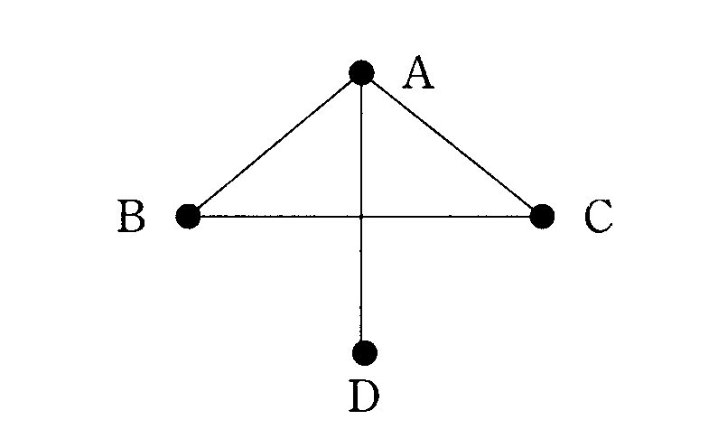
Demonstrate: Relative centrality
Fig. A
Fig. B
Notes:
It is distance from p_{k} to all other nodes linking with p_{k} directly or indirectly.
The third is an index of closeness that is a distance from p_{k} to all other node linking with p_{k} directly or indirectly.
Closeness index may be useful when measures based upon independence or efficiency is desired.
Closeness index is excluded because all nodes in the networks of transactions and cross shareholdings are not connected with each other (the distance among firms is infinite). It could not be calculated technically.

Slide 30
Centrality: Relative Degree
C_{D} (p_{k}) = Degree of node p_{k}
n = Number of the nodes
Notes:
It means the number of nodes that connect with it directly.
The number of nodes adjacent to a given node in a symmetric network is the degree of that node. For asymmetric network the in-degree of a node p_{k} is the number of ties received by p_{k} and the out-degree is the number of ties initiated from p_{k}.
The degree means the proportion of other nodes that are adjacent to p_{k} and is viewed as important index of its potential communication activity.

Slide 31
Centrality: Relative Betweenness
C_{B} (p_{k}) = Betweenness of node p_{k}
n = Number of the nodes
Notes:
It could be expressed as probability that node p_{k} falls on a randomly selected geodesic linking p_{i} with p_{j}.
Betweenness is the ratio of the number of geodesics linking p_{i} and p_{j} that contains p_{k} (numerator) and the geodesics linking p_{i} and p_{j} (denominator).
Betweenness is useful as an index of the potential of the node for control of communication, and it is also useful as an index of network structure.

Slide 32
Demonstrate denominator in C’_{B}(p_{K})
Maximum of the possible connection lines between any two nodes : (n,2)=n(n-1)/2,
maximum of the possible lines connected to node p_{k} : n-1,
then we get

Slide 33
Centrality: Relative Closeness
C_{C} (p_{k})⁻¹ = Closeness of node p_{k}
n = Number of the nodes
Notes:
It is distance from p_{k} to all other nodes linking with p_{k} directly or indirectly.
The third is an index of closeness that is a distance from p_{k} to all other node linking with p_{k} directly or indirectly.
Closeness index may be useful when measures based upon independence or efficiency is desired.
Closeness index is excluded because all nodes in the networks of transactions and cross shareholdings are not connected with each other (the distance among firms is infinite). It could not be calculated technically.

Slide 34
Demonstrate centrality
No. | Relative Degree |  | Relative Betweenness |  | Relative Closeness
 | Fig. A | Fig. B | Fig. A | Fig. B | Fig. A | Fig. B
1(A) | 1 | 1 | 0.67 | 2 | 1 | 1
2(B) | 0.5 | 0.67 | 0 | 0 | 0.67 | 0.75
3(C) | 0.5 | 0.67 | 0 | 0 | 0.67 | 0.75
4(D) | 0.5 | 0.33 | 0 | 0 | 0.67 | 0.6
5 | 0.5 |  | 0 |  | 0.67
Notes:
It is distance from p_{k} to all other nodes linking with p_{k} directly or indirectly.
The third is an index of closeness that is a distance from p_{k} to all other node linking with p_{k} directly or indirectly.
Closeness index may be useful when measures based upon independence or efficiency is desired.
Closeness index is excluded because all nodes in the networks of transactions and cross shareholdings are not connected with each other (the distance among firms is infinite). It could not be calculated technically.

Slide 35
Demonstrate entire centrality
Fig. A
Fig. B
Notes:
It is distance from p_{k} to all other nodes linking with p_{k} directly or indirectly.
The third is an index of closeness that is a distance from p_{k} to all other node linking with p_{k} directly or indirectly.
Closeness index may be useful when measures based upon independence or efficiency is desired.
Closeness index is excluded because all nodes in the networks of transactions and cross shareholdings are not connected with each other (the distance among firms is infinite). It could not be calculated technically.

Slide 36
Centrality: The Entire Degree
C_{D} (p*) = Maximum degree of node p_{i}
C_{D} (p_{i}) = Degree of node p_{i}
n = Number of the nodes
Notes:
It means the number of nodes that connect with it directly.
The number of nodes adjacent to a given node in a symmetric network is the degree of that node. For asymmetric network the in-degree of a node p_{k} is the number of ties received by p_{k} and the out-degree is the number of ties initiated from p_{k}.
The degree means the proportion of other nodes that are adjacent to p_{k} and is viewed as important index of its potential communication activity.

Slide 37
Demonstrate denominator in C_{D}
The entire centrality

Slide 38
Demonstrate denominator in C_{D}
The question: how to determine the denominator in centrality
Star or wheel : the biggest network
Notes:
The question is how to determine the denominator in centrality.
Star or wheel should be considered as the biggest network.

Slide 39
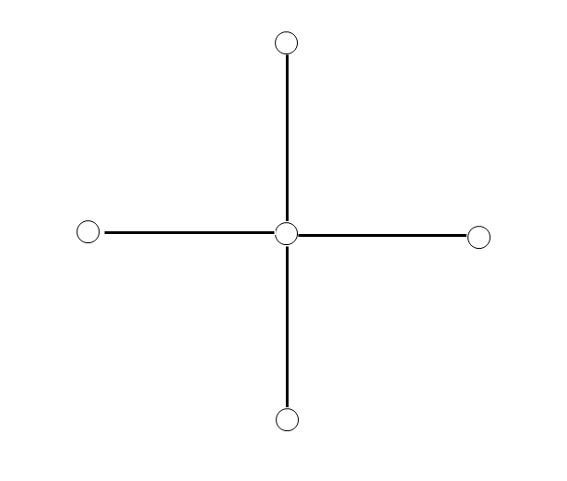
Demonstrate denominator in C_{D}

Slide 40
Demonstrate denominator in C_{D}

Slide 41
Demonstrate denominator in C_{D}

Slide 42
Centrality: The Entire Betweenness
C_{B} (p*) = Maximum betweenness of
node p_{i}
C_{D} (p_{i}) = Betweenness of node p_{i}
n = Number of the nodes
Notes:
It could be expressed as probability that node p_{k} falls on a randomly selected geodesic linking p_{i} with p_{j}.
Betweenness is the ratio of the number of geodesics linking p_{i} and p_{j} that contains p_{k} (numerator) and the geodesics linking p_{i} and p_{j} (denominator).
Betweenness is useful as an index of the potential of the node for control of communication, and it is also useful as an index of network structure.

Slide 43
Demonstrate denominator in C_{B}
The entire betweenness should be calculated as follows.

Slide 44
Demonstrate denominator in C_{B}

Slide 45
Centrality: The Entire Closeness
C_{C} (p*) = Maximum closeness of
node p_{i}
C_{D} (p_{i}) = Closeness of node p_{i}
n = Number of the nodes
Notes:
It is distance from p_{k} to all other nodes linking with p_{k} directly or indirectly.
The third is an index of closeness that is a distance from p_{k} to all other node linking with p_{k} directly or indirectly.
Closeness index may be useful when measures based upon independence or efficiency is desired.
Closeness index is excluded because all nodes in the networks of transactions and cross shareholdings are not connected with each other (the distance among firms is infinite). It could not be calculated technically.

Slide 46
Demonstrate denominator in C_{C}
The distance from central node to all other nodes : 1.
The distance from certain node to the central node : 1, to all other nodes : 2
Then we get
Notes:
The distance from central node to all other nodes is 1. The distance from certain node to the central node is 1, and to all other nodes is 2 respectively. Then we get

Slide 47
Demonstrate denominator in C_{C}
The gap between the central node to all other nodes
Then we get

Slide 48
Demonstrate centrality
The Entire Degree |  | The Entire Betweenness |  | The Entire Closeness
Fig. A | Fig. B | Fig. A | Fig. B | Fig. A | Fig. B
0.67 | 0.67 | 0.67 | 0.67 | 0.78 | 0.75
Notes:
It is distance from p_{k} to all other nodes linking with p_{k} directly or indirectly.
The third is an index of closeness that is a distance from p_{k} to all other node linking with p_{k} directly or indirectly.
Closeness index may be useful when measures based upon independence or efficiency is desired.
Closeness index is excluded because all nodes in the networks of transactions and cross shareholdings are not connected with each other (the distance among firms is infinite). It could not be calculated technically.

Slide 49
New network approaches
“Network Formation Theory” = All of the nodes are decided by choice, but not by chance.
“Spatial Graph Theory” = New approach using 3-Dimensional Spatial graph theory to identify structure
Notes:
it differs from random graph theory. All of the nodes are decided by choice, but not by chance.

Slide 50
Thank you for your attention!

