Slide 1


The MOT and Venture Business
５ Guiding Principles
The Pursuit of Peace
The Creation of New Forms of Knowledge
The Nurturing of Well-Rounded Human Beings
Collaboration with the Local, Regional, and International Community
Continuous Self-Development
Intensive Course of
Prof. Takao Ito,
Doctor of Economics, PH.D. of Engineering,
Graduate School of Advanced Science and Engineering, Hiroshima University
E-Mail: itotakao@Hiroshima-u.ac.jp

Slide 2
Schedule
MOT and Venture Business (An Intensive Course)
08:50-16:20, Saturday and Sunday
No. | Date |  | Lecture
1 | 2023/10/21 | Sat | Outlines and Introduction | 08:50-10:20
2 | 2023/10/21 | Sat | The evolution of Management | 10:30-12:00
3 | 2023/10/21 | Sat | Key Issues in Corporate Management | 13:10-14:40
4 | 2023/10/21 | Sat | Break-Even Point Analysis | 14:50-16:20
5 | 2023/10/22 | Sun | Cost Benefit Analysis and Ethics | 08:50-10:20
6 | 2023/10/22 | Sun | Stock Control | 10:30-12:00
7 | 2023/10/22 | Sun | Case Studies and Group Discussion | 13:10-14:40
8 | 2023/10/22 | Sun | Kaizen and Quality Control | 14:50-16:20
9 | 2023/11/11 | Sat | Motivation (self Learning) | 08:50-10:20
10 | 2023/11/11 | Sat | Organization Structure | 10:30-12:00
11 | 2023/11/11 | Sat | Decision-making and Strategy | 13:10-14:40
12 | 2023/11/11 | Sat | Leadership | 14:50-16:20
13 | 2023/11/12 | Sun | Business Plan | 08:50-10:20
14 | 2023/11/12 | Sun | Entrepreneur and Venture Business | 10:30-12:00
15 | 2023/11/12 | Sun | Presentation and/or Final Examination | 13:10-14:40
16 | 2023/11/12 | Sun | Review and Free Discussion | 14:50-16:20

Slide 3
Topic 11 Decision-making and Strategy

Slide 4
Agenda
Decision Making
Decision Making in a Crisis
Strategy and Corporate Strategy

Slide 5
1. Decision Making
The thought process of selecting a logical choice from the available options through information gathering, Alternative calculation, and decision.

Slide 6
The stages of decision making
Identifying and diagnosing the program
Generating alternative solutions
Evaluating alternatives
Making the choice
Implementing the decision
Evaluating the decision

Slide 7
Premises of your decision making
Value premise: It will be very difficult to say your decision is correct or not because of impossible calculation.
Factual premise: It is easy to say that your decision is better or worse because the results of your decision will be determined scientifically.

Slide 8
Two kinds of decision making
Programmed decisions
Decisions encountered and made before, having objectively correct answers, and solvable by using simple rules, policies, or numerical computations.
Non-programmed decisions
New, novel, complex decisions having no problem answers.

Slide 9
Difference between programmed and non-programmed decision
 |  | Programmed Decisions | Non-programmed Decisions
Problem |  | Frequent, repetitive, routine. Much certainty regarding cause-and-effect relationships | Novel, unstructured. Much uncertainty regarding cause-and -effect relationships.
Procedure |  | Dependence on policies, rules, and definite procedures. | Necessity for creativity, intuition, tolerance for ambiguity, creative problem solving.
Examples | Business firm | Periodic reorders of inventory. | Diversification into new products and markets.
 | University | Necessary grade-point average for good academic standing. | Construction of new class-room facilities.
 | Health care | Procedure for admitting patients. | Purchase of experimental equipment.
 | Government | Merit system for promotion of state employees. | Reorganization of state government agencies.

Slide 10
Organizational decision making
Models of organizational decision processes
Decision makers cannot be truly rational because 1) they have imperfect, incomplete information about alternatives and consequences; 2) the problems they face are so complex; 3) human beings simply cannot process all the information to which they are exposed; 4) there is not enough time to process all relevant information fully; and 5) people, including managers within the same firm, have conflicting goals.

Slide 11
Organizational decision making
Constraints on decision makers
You cannot do whatever you want because of various constraints you face: financial, legal, market, human, and organizational that inhibit certain actions.

Slide 12
Some useful concepts in decision making
Bounded rationality: A less-than-perfect form of rationality in which decision makers cannot be perfectly rational because decisions are complex and complete information is unavailable.
Incremental model: Model of organizational decision making in which major solutions arise through a series of smaller decisions.
Notes:
Rationality is the quality or state of being reasonable, based on facts or reason

Slide 13
Decision making in groups
Potential advantages | Potential disadvantages
Larger pool of information | One person dominants.
More perspectives and approaches | Satisficing.
Intellectual stimulation | Groupthink.
People understand the decision | Goal displacement.
People are committed to the decision
Notes:
Groupthink: A phenomenon that occurs in decision making when group members avoid disagreement as they strive for consensus.
Goal displacement: A condition that occurs when a decision-making group loses sight of its original goal and a new, less important goal emerges.

Slide 14
Managing group decision making
Leadership
Avoid domination;
Encourage input;
Avoid groupthink and satisficing;
Remember goals.
Constructive conflict
Air legitimate differences;
Stay task-related;
Be impersonal;
Play devil’s advocate.
Effective group decision making
Creativity
Brainstorm;
Avoid criticizing;
Exhaust ideas;
Combine ideas.
Notes:
Air legitimate difference: cognitive difference; differences in perspectives or judgements about issues.
Devil’s advocate: A person who has the job of criticizing ideas to ensure that their downsides are fully explored.
Brainstorming: A process in which group members generate as many ideas about a problem as they can; criticism is withheld until all ideas have been proposed.

Slide 15
2. Decision Making in a Crisis
You must make decisions under a great deal of pressure in crisis situations.
Your organization should prepare for crises in advance.
You should be able to answer the following questions:
What kinds of crises could your company face?
Can your company detect a crisis in its early stages?
How will it manage a crisis if one occurs?
How can it benefit from a crisis after it has passed?

Slide 16
Common but mistaken beliefs: how not to handle crisis management
We don’t have a crisis.
We can handle a crisis.
Crisis management is a luxury we can’t afford.
If a major crisis happens, someone else will rescue us.
Accidents are just a cost of doing business.
Most crises are the fault of bad individuals; therefore, there’s not much we can do to prevent them.
Only executives need to be aware of our crisis plans; why scare our employees or members of the community?
We are tough enough to react to a crisis in an objective and rational manner.

Slide 17
Examples of Decision making
Product Line A： Payroll costs=USD15,000/Month, Depreciation cost and other fixed costs=USD500/Month, Unit variable costs=USD100;
Product Line B： Payroll costs=USD22,000/Month, Depreciation cost and other fixed costs=USD800/Month, Unit variable costs=USD50;
What is your decision?
Production Line A
Production Line B

Slide 18
Demand
We choose B if the demand is 300 pcs.
If the demand will be changed depends on probabilities as below.
Better | 400 | 0.3
Same as before | 300 | 0.5
Worse | 100 | 0.2
Better | 400 | 0.2
Same as before | 300 | 0.2
Worse | 100 | 0.4

Slide 19
Demand
We choose B if the demand is 300 pcs.
If the demand will be changed depends on probabilities as below.
Better | 400 | 0.3 | 120
Same as before | 300 | 0.5 | 150
Worse | 100 | 0.2 | 20
 |  |  | 290
Better | 400 | 0.2 | 80
Same as before | 300 | 0.2 | 60
Worse | 100 | 0.4 | 40
 |  |  | 180

Slide 20
3. Strategy and Corporate Strategy
The art and science of planning and marshalling resources for their most efficient and effective use.
The overall scope and direction of a corporation and the way in which its various business operations work together to achieve particular goals.

Slide 21
The strategic Management Process
Establishment of mission, vision, and goals
Strategy formulation
Strategy implementation
Strategic control

Slide 22
Analysis of internal strengths and weaknesses
Establishment of mission, vision, and goals
SWOT analysis and strategy formulation
Strategy implementation
Strategy control
Analysis of external opportunities and threats

Slide 23
Tools of strategy formulation and strategy formation
① The BCG matrix
② The GE-McKinsey matrix
③ SWOT analysis
④ Porter’s basic strategies
⑤ Competitive advantage
23

Slide 24
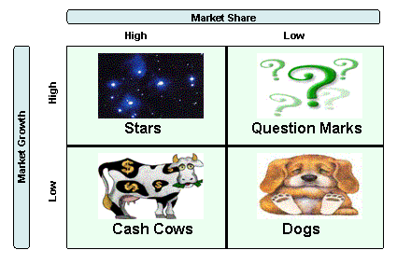
The BCG matrix
On the horizontal axis: relative market share - this serves as a measure of SBU strength in the market
On the vertical axis: market growth rate - this provides a measure of market attractiveness

Slide 25
Star Strategies
Leader expanding industry
Generates large profits
Requires substantial investments to sustain growth
Farthest down on experience curve relative to competition
Increase sales – e.g. new markets, new channels of distribution
Increase market share

Slide 26
Problem Child or ?
Low market share in expanding industry
Needs substantial cash to improve its position
Slow progress on experience curve
Increase sales (limit to niche or increase market share (limit to niche)
Leave market

Slide 27
Cash Cow
Leader in mature or declining industry
Can generate funds for other SBUs
Maintain market share e.g. ensure quality, build customer loyalty, develop substitute brands
Maximize Cash Flow e.g. increase usage rate, rate of replacement, modify expense structure, raise prices

Slide 28
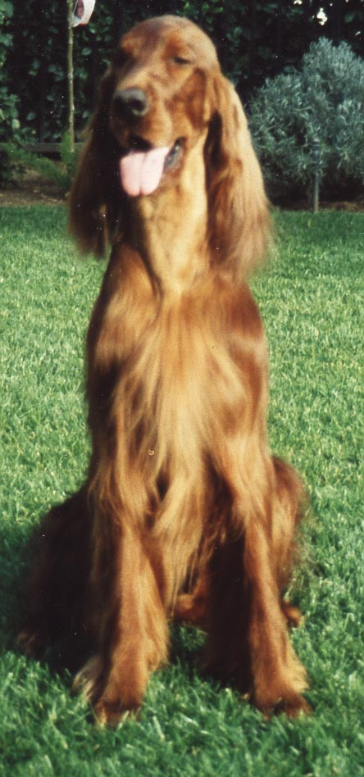

Dogs
Low market share in a mature or declining industry
Slow progress on experience curve
Cost disadvantages and few growth opportunities
Harvest or Divest
Concentrate on niches requiring limited effort

Slide 29
Strategy Implications BCG
Star – Leader in Expanding Industry
  BUILD - Continue to increase market share – if necessary at expense of short-term earnings
Problem Child – Low market share in Expanding Industry
  HARVEST if weak, BUILD if strong.
  Assess chances of dominating segment. If good, go after share. If bad, redefine business or withdraw.

Slide 30
Strategy Implications BCG
Cash Cow – Leader in mature or declining industry
  HOLD - Maintain share and cost leadership until further investment becomes marginal
  Maximize cash flow
Dogs – Low market share in a mature or declining industry
  DIVEST Plan an orderly withdrawal so as to maximize cash flow or concentrate on niches that require limited effort

Slide 31
Assumptions of Growth /Share Matrix
High market share generates cash revenues ?
High Market growth uses more cash resources ?

Slide 32
Issues with Growth/Share Matrix
Market growth is not the only factor related to cash usage.
Market growth is not necessarily related to cash usage.
Market share is not necessarily related cash generation.
Multiple factors lead to profitability.
Cash is not the only factor in evaluating a portfolio.

Slide 33
Issues With Growth/Share Matrix
Limited to industries where experience curve is relevant
Appropriate for volume industries
Overlooks perils of growth
Measurement problems
Product-market definition problems
Difficult to implement strategies

Slide 34
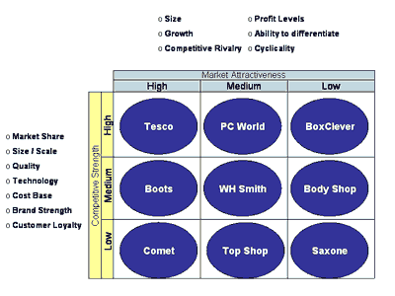
The GE-McKinsey matrix

Slide 35
SWOT Analysis matrix
Internal analysis | External analysis
Strengths | Opportunities
Weaknesses | Threats
35

Slide 36
Strategies
The business portfolio is the collection of businesses and products that make up the company. The best business portfolio is one that fits the company's strengths and helps exploit the most attractive opportunities.

Slide 37
Basic Competitive strategy
Competitive advantages
Low cost
Differentiation
Cost Leadership
Differentiation
Strategy target
Cost focus
Differentiation Focus
Focus
37

Slide 38
The five forces affecting industry competition
Potential New Entrants
Threat of new entrants
Bargaining power of suppliers
Bargaining power of buyers
The firm’s rivalry vs. industry competitors
Suppliers
Buyers
Threat of substitute products
Substitute products from other industries
38

Slide 39
Thank you for your attention!

