Slide 1
The MOT and Venture Business
５ Guiding Principles
The Pursuit of Peace
The Creation of New Forms of Knowledge
The Nurturing of Well-Rounded Human Beings
Collaboration with the Local, Regional, and International Community
Continuous Self-Development
Intensive Course of
Prof. Takao Ito,
Doctor of Economics, PH.D. of Engineering,
Graduate School of Advanced Science and Engineering, Hiroshima University
E-Mail: itotakao@Hiroshima-u.ac.jp

Slide 2
Schedule
MOT and Venture Business (An Intensive Course)
08:50-16:20, Saturday and Sunday
No. | Date |  | Lecture
1 | 2023/10/21 | Sat | Outlines and Introduction | 08:50-10:20
2 | 2023/10/21 | Sat | The evolution of Management | 10:30-12:00
3 | 2023/10/21 | Sat | Key Issues in Corporate Management | 13:10-14:40
4 | 2023/10/21 | Sat | Break-Even Point Analysis | 14:50-16:20
5 | 2023/10/22 | Sun | Cost Benefit Analysis and Ethics | 08:50-10:20
6 | 2023/10/22 | Sun | Stock Control | 10:30-12:00
7 | 2023/10/22 | Sun | Case Studies and Group Discussion | 13:10-14:40
8 | 2023/10/22 | Sun | Kaizen and Quality Control | 14:50-16:20
9 | 2023/11/11 | Sat | Motivation (self Learning) | 08:50-10:20
10 | 2023/11/11 | Sat | Organization Structure | 10:30-12:00
11 | 2023/11/11 | Sat | Decision-making and Strategy | 13:10-14:40
12 | 2023/11/11 | Sat | Leadership | 14:50-16:20
13 | 2023/11/12 | Sun | Business Plan | 08:50-10:20
14 | 2023/11/12 | Sun | Entrepreneur and Venture Business | 10:30-12:00
15 | 2023/11/12 | Sun | Presentation and/or Final Examination | 13:10-14:40
16 | 2023/11/12 | Sun | Review and Free Discussion | 14:50-16:20

Slide 3
What is learning?

Slide 4
A useful link for your document
https://home.hiroshima-u.ac.jp/itotakao/ito.html
https://home.hiroshima-u.ac.jp/itotakao/miyazaki.html

Slide 5
Topic 1 Outlines and Introduction

Slide 6
Agenda
Key Concepts of Corporate Management
Case studies
Other Basic Concepts in Corporate Management

Slide 7
1. Key Concepts of Corporate Management
Company, firm, enterprise, association, corporation, syndicate
A company is a business organization that makes money by selling goods or services.
Input and output
Input:
Output:
Managerial Resources
Goods and Services

Slide 8
Managerial resources
1) Human-resources
2) Raw materials；Equipment etc.
3) Financial-resources
4) Information
5) Time

Slide 9
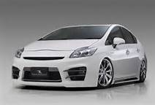
Sales per minute
PRIUS：sale（2010）
http://jp.wsj.com/japanrealtime/2011/01/12/%E3%83%88%E3%83%A8%E3%82%BF%E3%80%8C%E3%83%97%E3%83%AA%E3%82%A6%E3%82%B9%E3%80%8D%E3%80%81%E5%B9%B4%E9%96%93%E8%B2%A9%E5%A3%B2%E5%8F%B0%E6%95%B0%E3%81%A7%E3%80%8C%E3%82%AB%E3%83%AD%E3%83%BC%E3%83%A9/
Total(one year) | 315,669
 | 365
Per day | 864.8466
 | 24
Per hour | 36.03527
 | 60
Per minute | 0.600588
Presence、Radical、Ideal、Unity、Sophisticate
Notes:
かつて日立製作所が発売していた同名の家庭用パソコン「プリウス」（こちらはP以外のアルファベットを小文字にして、"Prius"と表記する）も全く同じ意味でネーミングされたもので、こちらは1年早い1996年に発売された。
まったくの偶然ではあるが、派生車種プリウスαのOEM「メビウス（MEBIUS）」もかつてシャープのパソコンの名称として存在していた。こちらも日立製作所のPriusと同様M以外を小文字にして"Mebius"と表記する。

Slide 10
Sales per minute
PRIUS：sale（2011）
http://www.jada.or.jp/contents/data/ranking.html#
Total(one year) | 317,675
 | 365
Per day | 870.3425
 | 24
Per hour | 36.26427
 | 60
Per minute | 0.604404
Presence、Radical、Ideal、Unity、Sophisticate
Notes:
かつて日立製作所が発売していた同名の家庭用パソコン「プリウス」（こちらはP以外のアルファベットを小文字にして、"Prius"と表記する）も全く同じ意味でネーミングされたもので、こちらは1年早い1996年に発売された。
まったくの偶然ではあるが、派生車種プリウスαのOEM「メビウス（MEBIUS）」もかつてシャープのパソコンの名称として存在していた。こちらも日立製作所のPriusと同様M以外を小文字にして"Mebius"と表記する。

Slide 11
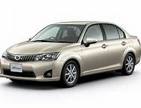
Sales per minute
Corolla：Sales（1990）
http://www.asahi.com/business/update/0106/NGY201101060018.html
Year | 300,008
 | 365
Per day | 821.9397
 | 24
Per hour | 34.24749
 | 60
Per minute | 0.570791
Notes:
2011年、8位の80,459台
Corolla：花の冠

Slide 12
Suicides per minute
Suicide（2010）
http://www.asahi.com/business/update/0106/NGY201101060018.html
One year | 31,690
 | 365
Per day | 86.82192
 | 24
Per hour | 3.61758
 | 60
Per minute | 0.060293

Slide 13
Suicides per minute
Suicide（2003）
http://www.asahi.com/business/update/0106/NGY201101060018.html
 | 2010 | 2003
One year | 31,690 | 34,427
 | 365 | 365
Per day | 86.82192 | 94.32055
 | 24 | 24
Per hour | 3.61758 | 3.930023
 | 60 | 60
Per minute | 0.060293 | 0.0655

Slide 14
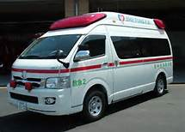
Emergency telephone calls per minute
110 call（2010 in Japan）
Total (one year) | 8,491,285
 | 365
Per day | 23,263.79
 | 24
Per hour | 969.3248
 | 60
Per minute | 16.15541
Notes:
Emergency telephone number

Slide 15
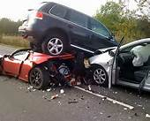
Traffic accident fatalities per minute
Traffic accident fatalities in Japan
http://www.garbagenews.net/archives/1642551.html
 | 1992 | 2010
Total (one year) | 11,451 | 4,863
 | 365 | 365
Per day | 31.3726 | 13.32329
 | 24 | 24
Per hour | 1.307192 | 0.555137
 | 60 | 60
Per minute | 0.021787 | 0.009252

Slide 16
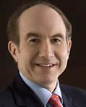
An Annual income（2010）
Viacom（Philippe Dauman）84.50 million dollars
http://ameblo.jp/ousetsuin/entry-10858242456.html
An Annual income | 84500000
 | 365
Per day | 231506.8
 | 24
Per hour | 9646.119
 | 60
Per minute | 160.7686

Slide 17
Our personal reason: Self- actualization
An Annual income（2010）: Viacom（Philippe Dauman）84.50 million dollars
 | 100 Yen/USD | 142.63 Yen/USD
An Annual income | 8,450,000,000 | 12,052,235,000
 | 365 | 366
Per day | 23,150,685 | 32,929,604
 | 24 | 25
Per hour | 964,612 | 1,317,184
 | 60 | 61
Per minute | 16,077 | 21,593
Notes:
http://ameblo.jp/ousetsuin/entry-10858242456.html

Slide 18
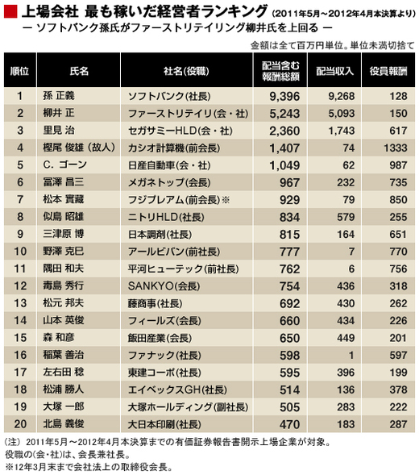
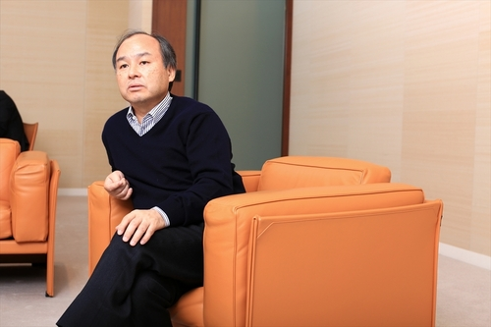
9,396,000,000Yen；17,876Yen/min
Notes:
http://ecodb.net/ranking/imf_ngdpd.html

Slide 19
GDP Ranking （2021＆2022）
No. | Countries | Dollars(2022) | No. | Countries | Dollars(2021)
1 | United States | $20.89 trillion | 1 | United States | $22996.1 billion
2 | China | $14.72 trillion | 2 | China | $17731.8 billion
3 | Japan | $5.06 trillion | 3 | Japan | $4937.42 billion
4 | Germany | $3.85 trillion | 4 | Germany | $4223.12 billion
5 | United Kingdom | $2.67 trillion | 5 | United Kingdom | $3186.86 billion
6 | India | $2.66 trillion | 6 | India | $3173.4 billion
7 | France | $2.63 trillion | 7 | France | $2937.47 billion
8 | Italy | $1.89 trillion | 8 | Russia | $2562.95 billion
9 | Canada | $1.64 trillion | 9 | Italy | $2099.88 billion
10 | South Korea | $1.63 trillion | 10 | Canada | $1990.76 billion
Notes:
https://www.bestdataanalytics.com/gdp/world-gdp-ranking-by-country-in-2021/#:~:text=According%20to%20the%20latest%20statistics%20released%20by%20the,economy%20of%20%243186.86%20billion%2C%20ranked%20fifth%20in%20GDP.
https://globalpeoservices.com/top-15-countries-by-gdp-in-2022/#:~:text=Top%2015%20Countries%20by%20GDP%20in%202022%201,7.%20France%20...%208%208.%20Italy%20...%20%E3%81%9D%E3%81%AE%E4%BB%96%E3%81%AE%E3%82%A2%E3%82%A4%E3%83%86%E3%83%A0

Slide 20
Millionaires （2022）
No. | Name | Source | Net Worth Sep 2022 | Net Worth Mar 2021 | Change 2021-2022
1 | Elon Musk | Tesla, SpaceX | $266B | $151B | $115B
2 | Bernard Arnault & family | LVMH | $160B | $150B | $10B
3 | Gautam Adani & family | Infrastructure, Commodities | $151B | $51B | $100B
4 | Jeff Bezos | Amazon | $150B | $177B | -$27B
5 | Bill Gates | Microsoft | $107B | $124B | -$17B
6 | Larry Ellison | Oracle | $104B | $93B | $11B
7 | Warren Buffett | Berkshire Hathaway | $97B | $96B | $1B
8 | Mukesh Ambani | Diversified | $95B | $85B | $10B
9 | Larry Page | Google | $90B | $92B | -$2B
10 | Sergey Brin | Google | $86B | $89B | -$3B
Notes:
https://www.visualcapitalist.com/richest-people-in-the-world-2022/

Slide 21
Millionaires （2021）
No. | Name | Source | Net Worth Nov 2021 | Net Worth Mar 2020 | Change 2020-2021
1 | Elon Musk | Tesla, SpaceX | $301B | $25B | $276B
2 | Jeff Bezos | Amazon | $202B | $113B | $89B
3 | Bernard Arnault & family | LVMH | $197B | $76B | $121B
4 | Bill Gates | Microsoft | $139B | $98B | $41B
5 | Larry Ellison | Oracle | $130B | $59B | $71B
6 | Larry Page | Google | $127B | $51B | $76B
7 | Sergey Brin | Google | $122B | $49B | $73B
8 | Mark Zuckerberg | Meta (Facebook) | $121B | $55B | $66B
9 | Steve Ballmer | Microsoft | $106B | $69B | $37B
10 | Warren Buffett | Berkshire Hathaway | $105B | $68B | $37B
Notes:
https://www.visualcapitalist.com/richest-people-in-the-world-2021/

Slide 22
IMF^{[1][13]} |  | World Bank^{[14]} |  | United Nations^{[15]}
Estimate | Year | Estimate | Year | Estimate | Year
Iraq | Asia | 267.893 | 2023 | 264.182 | 2022 | 204.004 | 2021
Portugal | Europe | 267.721 | 2023 | 251.945 | 2022 | 253.663 | 2021
New Zealand | Oceania | 251.969 | 2023 | 247.234 | 2022 | 250.451 | 2021
Kazakhstan | Asia | 245.695 | 2023 | 220.623 | 2022 | 193.018 | 2021
Greece | Europe | 239.300 | 2023 | 219.066 | 2022 | 214.874 | 2021
Qatar | Asia | 219.570 | 2023 | 237.296 | 2022 | 179.571 | 2021
Algeria | Africa | 206.007 | 2023 | 191.913 | 2022 | 163.473 | 2021
Hungary | Europe | 188.505 | 2023 | 178.789 | 2022 | 181.848 | 2021
Notes:
https://en.wikipedia.org/wiki/List_of_countries_by_GDP_(nominal)

Slide 23
GDP Ranking （2015）
 | Countries | Billion dollars |  | Area
1 | USA | 17,348.08 | － | North America
2 | China | 10,356.51 | － | Asia
3 | Japan | 4,602.37 | － | Asia
4 | Germany | 3,874.44 | － | Europe
5 | U.K | 2,950.04 | +1 | Europe
6 | France | 2,833.69 | -1 | Europe
7 | Brazil | 2,346.58 | － | Central and South America
8 | Italia | 2,147.74 | － | Europe
9 | India | 2,051.23 | +1 | Asia
Notes:
http://ecodb.net/ranking/imf_ngdpd.html

Slide 24
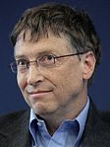
Millionaires （2015）
世界順位 | 名前 | 名前(読み) | 関連 | 国籍 | 年齢 | 資産 (10億$)
1 | Bill Gates | ビル・ゲイツ | マイクロソフト | アメリカ | 59 | 79.2
2 | Carlos Slim Helu | カルロス・スリム | テレフォノス・デ・メヒコ | メキシコ | 75 | 77.1
3 | Warren Buffett | ウォーレン・バフェット | バークシャー・ハサウェイ | アメリカ | 84 | 72.7
4 | Amancio Ortega | アマンシオ・オルテガ | ザラ | スペイン | 78 | 64.5
5 | Larry Ellison | ラリー・エリソン | オラクル | アメリカ | 70 | 54.3
6 | Charles Koch | チャールズ・コーク | コーク・インダストリーズ | アメリカ | 79 | 42.9
6 | David Koch | デイヴィッド・コーク | コーク・インダストリーズ | アメリカ | 74 | 42.9
8 | Christy Walton | クリスティ・ウォルトン | ウォルマート | アメリカ | 60 | 41.7
9 | Jim Walton | ジム・ウォルトン | ウォルマート | アメリカ | 67 | 40.6
http://ja.wikipedia.org/wiki/%E4%B8%96%E7%95%8C%E9%95%B7%E8%80%85%E7%95%AA%E4%BB%98
Notes:
http://memorva.jp/ranking/forbes/forbes_world_billionaires_2015_world.php
通信、情報、アパレル、投資、情報、製造行、不動産・金融、化粧品、化粧品
7.3兆円
宇部市 620億円（117倍）

Slide 25
The World’s Billionaires
Rank | Country | Number
1 | The United States of American | 442
2 | China | 122
3 | Russian Federation | 110
4 | Germany | 58
5 | India | 55
6 | Brazil | 46
7 | Turkey | 43
8 | Hong Kong | 39
9 | Great British | 37
10 | Canada | 29
11 | Taiwan | 26
12 | Indonesia | 25
13 | Korea | 24
13 | France | 24
15 | Italia | 23
16 | Australia | 22
16 | Japan | 22
18 | Spain | 20
19 | Israel | 17
20 | Mexico | 15
http://ja.wikipedia.org/wiki/%E4%B8%96%E7%95%8C%E9%95%B7%E8%80%85%E7%95%AA%E4%BB%98
Notes:
http://ja.wikipedia.org/wiki/%E4%B8%96%E7%95%8C%E9%95%B7%E8%80%85%E7%95%AA%E4%BB%98

Slide 26
64 | Sultanate of Oman | 72.68 | the middle east
65 | Ecuador | 66.47 | South & Central American
66 | Republic of Azerbaijan | 64.82 | European
67 | Sudan | 64.00 | the African
68 | Republic of Croatia | 62.43 | European
69 | The Grand Duchy of Luxembourg | 59.58 | European
70 | Sri Lanka | 59.15 | Asian
71 | Dominican Republic | 55.75 | South & Central American
72 | Republic of Belarus | 55.14 | European
73 | Bulgaria | 53.55 | European
74 | The Union of Myanmar | 51.44 | Asian

Slide 27
170 | Antigua and Barbuda | 1.12 | South and Central American
171 | Repiblik Sesel | 1.02 | the African
172 | The Gambia | 0.98 | the African
173 | Republic of Guinea-Bissau | 0.97 | the African
174 | Solomon Islands | 0.87 | Oceania
175 | Grenada | 0.82 | South and Central American
176 | Vanuatu | 0.76 | Oceania
177 | Saint and Christopher and Nevis | 0.72 | South and Central American
178 | Saint Vincent and the Grenadines | 0.69 | South and Central American
179 | Mālō Sa'oloto Tuto'atasi o Samoa | 0.63 | Oceania
180 | Union of Comoros | 0.61 | the African
181 | Commonwealth of Dominica | 0.48 | South and Central American
182 | Tonga | 0.44 | Oceania
183 | São Tomé and Principe | 0.25 | the African
184 | Kiribati | 0.17 | Oceania
185 | Tuvalu | 0.04 | Oceania
Notes:
38国家のGDP合計（72.21）

Slide 28
64位 | オマーン | 72.68 | 国 | 中東
65位 | エクアドル | 66.47 | 国 | 中南米
66位 | アゼルバイジャン | 64.82 | 国 | ヨーロッパ
67位 | スーダン | 64.00 | 国 | アフリカ
68位 | クロアチア | 62.43 | 国 | ヨーロッパ
69位 | ルクセンブルク | 59.58 | 国 | ヨーロッパ
70位 | スリランカ | 59.15 | 国 | アジア
71位 | ドミニカ共和国 | 55.75 | 国 | 中南米
72位 | ベラルーシ | 55.14 | 国 | ヨーロッパ
73位 | ブルガリア | 53.55 | 国 | ヨーロッパ
74位 | ミャンマー | 51.44 | 国 | アジア

Slide 29
Tips
Wealth of the richest 1% of the population vs. the total wealth of the rest 99%.
The wealth of the richest 8 person vs. the total wealth of 3.6 billion poorest person.
Wealth of the richest 1% of the population is bigger than the total wealth of the rest 99%.
The wealth of the richest 8 person equals to the total wealth of 3.6 billion poorest person.
Notes:
ビル・ゲイツ（マイクロソフト＝2016年資産は、８兆4,800億円！）
マーク・ザッカーバーグ（フェイスブック＝５兆400億円）
ジェフ・ベゾス（アマゾン＝５兆1,100億円）
いずれも、世界的企業の創業者。残り５人は誰なのでしょうか？
アマンシオ・オルテガ（ザラ＝７兆5,700億円）
ウォーレン・バフェット（バークシャー・ハサウェイ＝６兆800億円）
カルロス・スリム（テレフォノス・デ・メヒコ＝５兆6,500億円）
ラリー・エリソン（オラクル＝４兆9,300億円）
マイケル・ブルームバーグ（ブルームバーグ＝４兆5,200億円）

Slide 30
Tips
On average, an individual from the top 10% will earn $122,100, but an individual from the bottom half will earn just $3,920.
The poorest half of the global population owns just 2% of the global total, while the richest 10% own 76% of all wealth.
More than 31 times!
Notes:
ビル・ゲイツ（マイクロソフト＝2016年資産は、８兆4,800億円！）
マーク・ザッカーバーグ（フェイスブック＝５兆400億円）
ジェフ・ベゾス（アマゾン＝５兆1,100億円）
いずれも、世界的企業の創業者。残り５人は誰なのでしょうか？
アマンシオ・オルテガ（ザラ＝７兆5,700億円）
ウォーレン・バフェット（バークシャー・ハサウェイ＝６兆800億円）
カルロス・スリム（テレフォノス・デ・メヒコ＝５兆6,500億円）
ラリー・エリソン（オラクル＝４兆9,300億円）
マイケル・ブルームバーグ（ブルームバーグ＝４兆5,200億円）

Slide 31
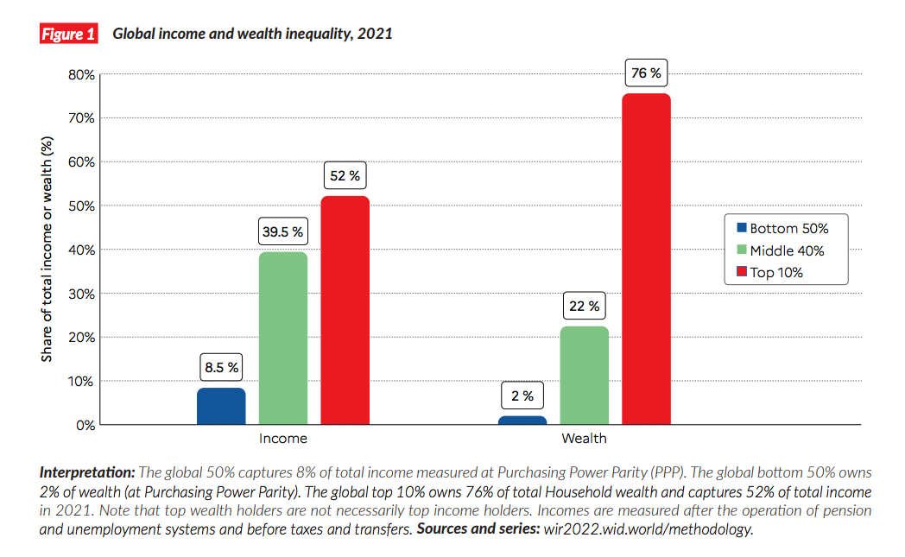
Tips
On average, an individual from the top 10% will earn $122,100, but an individual from the bottom half will earn just $3,920.
The poorest half of the global population owns just 2% of the global total, while the richest 10% own 76% of all wealth.
More than 31 times!
Notes:
https://www.weforum.org/agenda/2021/12/global-income-inequality-gap-report-rich-poor/

Slide 32
A Framework of Companies
1) Human-resources
2) Raw materials；Equipment etc.
3) Financial-resources
4) Information
5) Time
Organization
Transformation
Process
Goods and Services
inputs
outputs

Slide 33
Profit, Efficiency, and Productivity
Productivity

Slide 34
2. Case Studies
Rental fee for copy machine : 100,000 Japanese Yen
The cost of each page : 15 Japanese Yen (including paper, electricity fee etc.)
Two divisions A and B in your company use this copy machine together. The volume of Division A: 3,000 pcs
The volume of Division B: 2,000 pcs
Calculate the amount of payment of division A and B

Slide 35
Cost per each page
The average pages: 5,000 pcs
Cost of each month for 5,000 pcs
Then, cost of each page

Slide 36
Total cost
100,000
piece

Slide 37
Total cost
100,000
piece

Slide 38
Answer
Payment of Department A:105,000
Payment of Department B: 75,000
$$y_{A}=\frac{3,000}{5,000}×175,000=105,000 (Yen)$$
$$y_{B}=\frac{2,000}{5,000}×175,000=75,000 (Yen)$$

Slide 39
Answer
Payment of Division A:105,000
Payment of Division B: 70,000
Other way for the payment?

Slide 40
Answer
Other way for the payment? (What is the best choice if you are the member of Department A?)

Slide 41
Another answer
Rent fee could be shared by two departments equally because it is a fixed cost.
Payment of Department A
Payment of department B
$$y_{A}=\frac{100,000}{2}+15×3000=95,000 (Yen)$$
$$y_{B}=\frac{100,000}{2}+15×2,000=80,000 (Yen)$$

Slide 42
Benefit or loss?
The copy machine has some trouble things in company X. Company X has to copy 1,000 pages. They will pay 30 Japanese yen for each page.
You will gain profit, or you will lose if Company X use your copy machine and pay 30 Japanese Yen for each page?

Slide 43
Answer
You may refuse because the total cost of each page is 35 Japanese Yen, larger than 30 Japanese Yen?
Or you will gain profit?
The variable cost is only 15 Japanese Yen, less than 30 Japanese Yen.
Total profit is 15,000 Japanese Yen.

Slide 44
To think about……
What is the new things you learn from the case?

Slide 45
3. Other Basic Concepts in Corporate Management
1)Innovation
the introduction of new goods and services
2)Quality
the excellence of your goods

Slide 46
3)Speed
Fast and timely execution, response, and delivery of results
4)Cost competitiveness
Keeping costs low in order to achieve profits and be able to offer prices that are attractive to customers

Slide 47
Three useful skills
1)Technical skills
The ability to perform a specialized involving a particular method or process
2)Conceptual and decision skills
Skills pertaining to the ability and resolve problems for the benefit of the organization and its members

Slide 48
3)Interpersonal and communication skills
People skills： the ability to lead motivated, and communicate effectively with others
Emotional intelligence： the skills of understanding yourself, managing yourself, and dealing effectively with others

Slide 49
Three layers in Corporation
 | Frontline Managers | Middle-level Managers | Top-level Mangers
Changing roles | from operational implementers to aggressive entrepreneurs | from administrative controllers to supportive coaches | from resource allocators to institutional leaders
Key activities | creating and pursuing new growth opportunities for the business | developing individuals and supporting their activities | establishing high performance standards
 | attracting and developing resources | linking dispersed knowledge and skills across units | institutionalizing a set of norms and values to support cooperation and trust
 | managing continuous performance improvement within the unit | managing the tension between short-term performance and long-term ambition | creating an overarching corporate purpose an ambition

Slide 50
Develop your career
1)Be both a Specialist and Generalist
2)Be self reliant
3)Be connected
4)Be active to manage your relation with your organization
5)Be survive and thrive

Slide 51
Thank you for your attention!

