Slide 1
The MOT and Venture Business
５ Guiding Principles
The Pursuit of Peace
The Creation of New Forms of Knowledge
The Nurturing of Well-Rounded Human Beings
Collaboration with the Local, Regional, and International Community
Continuous Self-Development
Intensive Course of
Prof. Takao Ito,
Doctor of Economics, PH.D. of Engineering,
Graduate School of Advanced Science and Engineering, Hiroshima University
E-Mail: itotakao@Hiroshima-u.ac.jp

Slide 2
Lecture Schedule
MOT and Venture Business (An Intensive Course)
08:50-16:20, Saturday and Sunday
No. | Date |  | Lecture
1 | 2022/11/12 | Sat | Outlines and Introduction | 08:50-10:20
2 | 2022/11/12 | Sat | The evolution of Management | 10:30-12:00
3 | 2022/11/12 | Sat | Key Issues in Corporate Management | 13:10-14:40
4 | 2022/11/12 | Sat | Break-Even Point Analysis | 14:50-16:20
5 | 2022/11/13 | Sun | Cost Benefit Analysis and Ethics | 08:50-10:20
6 | 2022/11/13 | Sun | Stock Control | 10:30-12:00
7 | 2022/11/13 | Sun | Case Studies and Group Discussion | 13:10-14:40
8 | 2022/11/13 | Sun | Kaizen and Quality Control | 14:50-16:20
9 | 2022/11/26 | Sat | Motivation (self Learning) | 08:50-10:20
10 | 2022/11/26 | Sat | Organization Structure | 10:30-12:00
11 | 2022/11/26 | Sat | Decision-making and Strategy | 13:10-14:40
12 | 2022/11/26 | Sat | Leadership | 14:50-16:20
13 | 2022/11/27 | Sun | Business Plan | 08:50-10:20
14 | 2022/11/27 | Sun | Entrepreneur and Venture Business | 10:30-12:00
15 | 2022/11/27 | Sun | Presentation and/or Final Examination | 13:10-14:40
16 | 2022/11/27 | Sun | Review and Free Discussion | 14:50-16:20

Slide 3
Schedule
MOT and Venture Business (An Intensive Course)
08:50-16:20, Saturday and Sunday
No. | Date |  | Lecture
1 | 2023/10/21 | Sat | Outlines and Introduction | 08:50-10:20
2 | 2023/10/21 | Sat | The evolution of Management | 10:30-12:00
3 | 2023/10/21 | Sat | Key Issues in Corporate Management | 13:10-14:40
4 | 2023/10/21 | Sat | Break-Even Point Analysis | 14:50-16:20
5 | 2023/10/22 | Sun | Cost Benefit Analysis and Ethics | 08:50-10:20
6 | 2023/10/22 | Sun | Stock Control | 10:30-12:00
7 | 2023/10/22 | Sun | Case Studies and Group Discussion | 13:10-14:40
8 | 2023/10/22 | Sun | Kaizen and Quality Control | 14:50-16:20
9 | 2023/11/11 | Sat | Motivation (self Learning) | 08:50-10:20
10 | 2023/11/11 | Sat | Organization Structure | 10:30-12:00
11 | 2023/11/11 | Sat | Decision-making and Strategy | 13:10-14:40
12 | 2023/11/11 | Sat | Leadership | 14:50-16:20
13 | 2023/11/12 | Sun | Business Plan | 08:50-10:20
14 | 2023/11/12 | Sun | Entrepreneur and Venture Business | 10:30-12:00
15 | 2023/11/12 | Sun | Presentation and/or Final Examination | 13:10-14:40
16 | 2023/11/12 | Sun | Review and Free Discussion | 14:50-16:20

Slide 4
Topic 13 Business Plan： Marketing and forecasting

Slide 5
Agenda
Key Planning Elements of Business Plan
Other Issues of Business Plan
Marketing
Forecasting and Complex Systems Theory
Uncertainty and Illusions
Prospect Theory

Slide 6
１．Key Planning Elements of Business Plan
the finance
the idea
the People
the Opportunity
the Competition
the Context
the risk and reward

Slide 7
The People
The people should be energetic and have skills and expertise directly relevant to the venture
More important even than the idea
Arthur Rock（a legendary venture capitalist who helped start Intel, Teledyne and Apple）： I invest in people, not ideas. If you can find good people, if they’re wrong with the product, they’ll make a switch.
Notes:
I invest in people, not ideas. If you can find good people, if they’re wrong with the product, they’ll make a switch.

Slide 8
Opportunity
The opportunity should provide a competitive advantage that can be defended.
Customers are the focus here: who is the customer? How does the customer make decisions? How will the product be priced? How will the venture reach all customer segments? How much does it cost to acquire and support a customer, and to produce and deliver the product? How easy or difficult is it to retain a customer?

Slide 9
The competition
It is essential to fully consider competition.
The plan must identify current competitors and their strengths and weaknesses, predict how they will respond to the new venture potential competitors, and consider how to collaborate with actual or potential competitors.
Andrew Busey： created ichat which became the leading provider of software for chatroom. American Online and Microsoft started competing directly with him. Busey responded by collaboration with IBM; the Lotus division bundled ichat’s software with its Internet-ready version of Notes.

Slide 10
Context
It should be favorable one from regulatory and economic perspectives. Such factors as tax policies, rules about raising capital, interest rates, inflation, and exchange rates will affect the viability of the new venture.
It can make it easier to get backing and to succeed.
Your plan should make clear that you know that the context inevitably will change, how the changes will affect the business, and how you will deal with the exchanges.

Slide 11
Risk and reward
The risk should understood and addressed as fully as possible.
The future is always uncertain, and the elements described in you plan will change over time.
Although you cannot predict the future, you must contemplate head-on the possibilities of key people leaving, interest rates changing, a key customer leaving, or a powerful competitor responding ferociously.
Describe what you will do to prevent, avoid, or cope with such possibilities.

Slide 12
Discussions
You should speak out to the end of the process: how to get money out of the business eventually.
Will you go public? Will you sell or liquidate? What are the various possibilities for investors to realize ultimate gains?

Slide 13
２．Other Issues of Business Plan
Selling the plan
Nonfinancial resources

Slide 14
Selling the plan
Your goal is to get investors to support the plan.
Passive investors will give them money and let them do what they want.
Professional venture capitalists do not, as they demand more control and more of the returns. But when a business goes wrong- and chances are, it will – nonprofessional investors are less helpful. Sophisticated investors have seen sinking ships before and know how to help.

Slide 15
Nonfinancial resources
Legitimacy
Networks
Top management team
Advisory boards
Partners
Notes:
諮問機関：

Slide 16
Legitimacy
Liability of newness
A business is legitimate if its goals and methods are consistent with societal value.
When the market confers legitimacy, it helps overcome the “liabilities of newness”.
Legitimacy helps a firm acquire other resources such as top managers, good employees, financial resources, and government support.
Notes:
諮問機関：

Slide 17
Networks
The entrepreneur is aided greatly by having a strong network of people.
Social capital- being part of a social network, and having a good reputation- helps entrepreneurs gain access to useful information, gain trust and cooperation from others, recruit employees, form successful business alliance, receive finding from venture capitalists, and become more successful.
Notes:
諮問機関：

Slide 18
Top management teams
The board of directors improves the company image, develops long-term plans for expansion, supports day-todays activities, and develops a network of information sources.
Michael Dell：founder of Dell Computer at age 19; he hired managers who were far more experienced than he and prominent and powerful board members.
Notes:
諮問機関：

Slide 19
Advisory boards
Anita Brattina thought after two or three years of running her own marketing firm she would have lots of cash, no debt, and time to enjoy her independence.
Eight years later, she still worked 50 to 60 hours a week and was not making much money.
So she got an advisory. Board member taught her to do cash-flow analysis, suggested some strategic changes, and encouraged her to cultivate relationship with a banker, an accountant, and am attorney. In addition, the helped her interview with salespeople, develop a long-term marketing strategy, and reorganize operations.
They also vetoed a number of her ideas.
Sales went up, after one year of listening to the board and implementing its idea.
Notes:
諮問機関：

Slide 20
Partners
Often two people go into business together as partners.
Partners can help one another access capital, spread the workload, share the risk, and share expertise.
Mark talked three of his friends into joining him in starting his own telecommunication company because he did not want to try it alone. While he wanted to put money into growing the business, his three partners wanted the company to pay for their cars and meeting s in the Bahamas. The company collapsed.
“I never thought a business relationship could over-power friendship, but this one did. Where money’s involves, people change.”
Notes:
諮問機関：

Slide 21
３．Marketing
Marketing is a "social and managerial process by which individuals and groups obtain what they need and want through creating and exchanging products and values with others."

Slide 22
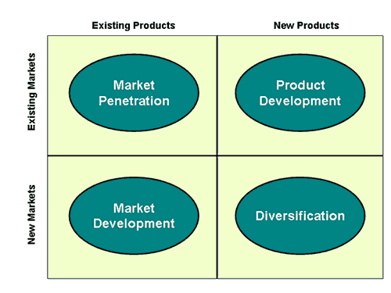
Ansoff’s matrix

Slide 23
4P in Marketing
Product | → | Solution
Promotion | → | Information
Price | → | Value
Placement | → | Access

Slide 24
Reviewing Marketing Concepts
DIRECT MARKETING
ADVERTISING
TELEMARKETING
PUBLIC RELATIONS
BRAND RECOGNITION
CUSTOMER FEEDBACK
DEMAND AND SUPPLY GAP
COMPETITION EATING INTO YOUR MARKET SHARE
NEW MARKET ENTRY BARRIERS

Slide 25
Reviewing Marketing Concepts
You see a gorgeous girl at a party. You go up to her and say: "I am very rich. Marry me!"
You're at a party with a bunch of friends and see a gorgeous girl. One of your friends goes up to her and pointing at you says: "He's very rich. Marry him."
You see a gorgeous girl at a party. You go up to her and get her telephone number. The next day, you call and say: "Hi, I'm very rich. Marry me."
DIRECT MARKETING
ADVERTISING
TELEMARKETING

Slide 26
Reviewing Marketing Concepts
You're at a party and see gorgeous girl. You get up and straighten your tie, you walk up to her and pour her a drink, you open the door (of the car) for her, pick up her bag after she drops it, offer her ride and then say : "By the way, I'm rich. Will you marry me?"
You're at a party and see gorgeous girl. She walks up to you and says: "You are very rich! Can you marry me?"
PUBLIC RELATIONS
BRAND RECOGNITION

Slide 27
Reviewing Marketing Concepts
You see a gorgeous girl at a party. You go up to her and say: "I am very rich. Marry me!" She gives you a nice hard slap on your face.
You see a gorgeous girl at a party. You go up to her and say: "I am very rich. Marry me!" And she introduces you to her husband.
CUSTOMER FEEDBACK
DEMAND AND SUPPLY GAP

Slide 28
Reviewing Marketing Concepts
You see a gorgeous girl at a party. You go up to her and before you say anything, another person comes and tells her: "I'm rich. Will you marry me?" and she goes with him
You see a gorgeous girl at a party. You go up to her and before you say: "I'm rich, Marry me!" your wife arrives.
COMPETITION EATING INTO YOUR MARKET SHARE
NEW MARKET ENTRY BARRIERS

Slide 29
４．Forecasting and Complex Systems Theory
Chaos Theory
Automaton language
Percolation model
Fractal dimension
Notes:
ネットワーク的な観点は決して新しいものではない。

Slide 30
Chaos: a state of utter confusion or disorder; a total lack of organization or order.
Automaton: a mechanical figure or contrivance constructed to act as if by its own motive power; robot.
Notes:
ネットワーク的な観点は決して新しいものではない。

Slide 31
Percolation: the act or state of causing (a liquid) to pass through a porous body; filter.
Fractal: a geometrical or physical structure having an irregular or fragmented shape at all scales of measurement between a greatest and smallest scale such that certain mathematical or physical properties of the structure, as the perimeter of a curve or the flow rate in a porous medium, behave as if the dimensions of the structure (fractal dimensions) are greater than the spatial dimensions.
Notes:
ネットワーク的な観点は決して新しいものではない。

Slide 32
Fractal dimension: It is a ratio providing a statistical index of complexity comparing how detail in a pattern (strictly speaking, a fractal pattern) changes with the scale at which it is measured.
Notes:
ネットワーク的な観点は決して新しいものではない。

Slide 33
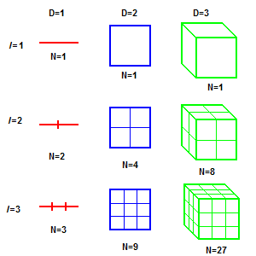
Application of Complex Systems Theory:
Basic Concept of Dimension
For instance, measuring a line using first one measuring stick then another 1/3 its size, will give for the second stick a total length 3 times as many sticks long as with the first.
This holds in 2 dimensions, as well. If one measures the area of a square then measures again with a box of side length 1/3 the size of the original, one will find 9 times as many squares as with the first measure.
Such familiar scaling relationships can be defined mathematically by the general scaling rule in Equation 1, where the variable N stands for the number of new sticks, \epsilon for the scaling factor, and D for the fractal dimension:
Fig. 1 Dimension
Notes:
ネットワーク的な観点は決して新しいものではない。

Slide 34
Such familiar scaling relationships can be defined mathematically by the general scaling rule in the following Equation, where the variable N stands for the number of new sticks, epsilon for the scaling factor, and D for the fractal dimension:
Notes:
The symbol above denotes proportionality.

Slide 35
Application of complex systems theory
Basic concept: Dimension
$$D_{1}=−\frac{\log{N}}{\log{ε}}=−\frac{\log{3}}{\log{\frac{1}{3}}}=1$$
$$D_{2}=−\frac{\log{N}}{\log{ε}}=−\frac{\log{9}}{\log{\frac{1}{3}}}=2$$
$$D_{3}=−\frac{\log{N}}{\log{ε}}=−\frac{\log{27}}{\log{\frac{1}{3}}}=3$$
Fig. 1 Dimension
Notes:
ネットワーク的な観点は決して新しいものではない。

Slide 36
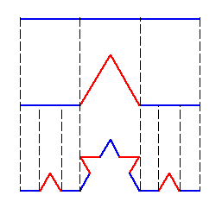
Fractal Dimension
Fig. 2 Koch curve=snowflake
Fig. 3 Sierpinski triangle
D=1.262
D=1.585
Notes:
D=lim(logN(e)/log(1/e))=lim(log3/log2=1.585)

Slide 37
Fractal Dimension=1/Hurst Index
 | H<0.5 | H=0.5 | H>0.5
Hurst index | Short-term memory | Random | Long-term memory

Slide 38
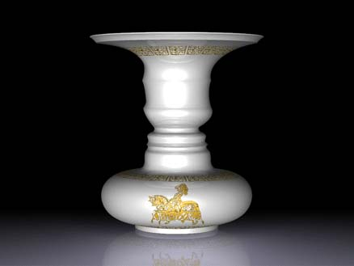
5. Uncertainty and Illusions
Vase and Two Persons

Slide 39
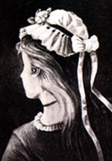
My Wife and My Mother–in-law

Slide 41
6. Prospect Theory
A theory that people value gains and losses differently and, as such, will base decisions on perceived gains rather than perceived losses. Thus, if a person were given two equal choices, one expressed in terms of possible gains and the other in possible losses, people would choose the former.

Slide 42
Example
Expectation value is same 90
A case: E(x)=0.9*100=90
B case: E(x)=0.1*900=90

Slide 43
Thank you for your attention!

