Slide 1


The MOT and Venture Business
５ Guiding Principles
The Pursuit of Peace
The Creation of New Forms of Knowledge
The Nurturing of Well-Rounded Human Beings
Collaboration with the Local, Regional, and International Community
Continuous Self-Development
Intensive Course of
Prof. Takao Ito,
Doctor of Economics, PH.D. of Engineering,
Graduate School of Advanced Science and Engineering, Hiroshima University
E-Mail: itotakao@Hiroshima-u.ac.jp

Slide 2
Schedule
MOT and Venture Business (An Intensive Course)
08:50-16:20, Saturday and Sunday
No. | Date |  | Lecture
1 | 2023/10/21 | Sat | Outlines and Introduction | 08:50-10:20
2 | 2023/10/21 | Sat | The evolution of Management | 10:30-12:00
3 | 2023/10/21 | Sat | Key Issues in Corporate Management | 13:10-14:40
4 | 2023/10/21 | Sat | Break-Even Point Analysis | 14:50-16:20
5 | 2023/10/22 | Sun | Cost Benefit Analysis and Ethics | 08:50-10:20
6 | 2023/10/22 | Sun | Stock Control | 10:30-12:00
7 | 2023/10/22 | Sun | Case Studies and Group Discussion | 13:10-14:40
8 | 2023/10/22 | Sun | Kaizen and Quality Control | 14:50-16:20
9 | 2023/11/11 | Sat | Motivation (self Learning) | 08:50-10:20
10 | 2023/11/11 | Sat | Organization Structure | 10:30-12:00
11 | 2023/11/11 | Sat | Decision-making and Strategy | 13:10-14:40
12 | 2023/11/11 | Sat | Leadership | 14:50-16:20
13 | 2023/11/12 | Sun | Business Plan | 08:50-10:20
14 | 2023/11/12 | Sun | Entrepreneur and Venture Business | 10:30-12:00
15 | 2023/11/12 | Sun | Presentation and/or Final Examination | 13:10-14:40
16 | 2023/11/12 | Sun | Review and Free Discussion | 14:50-16:20

Slide 3
Topic 14 Entrepreneur and Venture Business

Slide 4
Agenda
Characteristics of Entrepreneurs
Entrepreneurship
Why is entrepreneurship required in modern society?
Myth of Entrepreneurship
Entrepreneur and Intraentrepreneur
Entrepreneurial Q & A
The Valley of Death
Determining Your Entrepreneurial Quotient?

Slide 5
1．Characteristics of Entrepreneurs
Internal locus of control
Tolerance for ambiguity
Entrepreneurial personality
High energy level
Awareness of passing time
Need to achieve
Self-confidence

Slide 6
2. Characteristics of Entrepreneurs
Internal locus of control
Tolerance for ambiguity
Entrepreneurial Personality
High energy level
Awareness of passing time
Need to achieve
Self-confidence
Seacat: Self-confidence, Energetic, Achievement, Control, Awareness, Tolerance
Notes:
Seacat: self-confidence, (high) energetic, achieve, control, awareness, tolerance

Slide 7
Reasons for starting a Business

Slide 8
Sources of new-business ideas

Slide 9
Ｓｔｅｐs of new business
Resource maturity
Takeoff
success
survival
existence

Slide 10
2. Entrepreneurship
Entrepreneurship: The pursuit of lucrative opportunities by enterprising individuals.
Small business: A business having fewer than 100 employees, independently owned and operated, not dominant in its field, and not characterized by many innovative practices.
Entrepreneurial venture: A new business having growth and high profitability as primary objectives.

Slide 11
3. Why is entrepreneurship required in modern society?
3-1 Reasons for developing venture business
① Economic environment change: maturing economies, shift away from manufacturing to an information and service.
② Technological environment change: Development of IT and ICT technology.
③ Social environment change: declining birthrate and aging population, value shift, diversification of values.
④ Political environment change: deregulation, venture support policy of Government.

Slide 12
3. Why is entrepreneurship required in modern society?
3-2 Meaning of venture business
① Drive force of economic development
Microsoft: Sales Revenue, 211.9Billion (2023)
② Increase in employment
Microsoft: Employees, 221,000 (2023); Sansan1,212employees
③ Solve social issues
Handyman (Benriya), Traffic system, Environment issues, SDGs
④ Provide chance for self-realization
Notes:
Sansan1,212employees
Handyman()

Slide 13
GDP Ranking （2021＆2022）
No. | Countries | Dollars(2022) | No. | Countries | Dollars(2021)
1 | United States | $20.89 trillion | 1 | United States | $22996.1 billion
2 | China | $14.72 trillion | 2 | China | $17731.8 billion
3 | Japan | $5.06 trillion | 3 | Japan | $4937.42 billion
4 | Germany | $3.85 trillion | 4 | Germany | $4223.12 billion
5 | United Kingdom | $2.67 trillion | 5 | United Kingdom | $3186.86 billion
6 | India | $2.66 trillion | 6 | India | $3173.4 billion
7 | France | $2.63 trillion | 7 | France | $2937.47 billion
8 | Italy | $1.89 trillion | 8 | Russia | $2562.95 billion
9 | Canada | $1.64 trillion | 9 | Italy | $2099.88 billion
10 | South Korea | $1.63 trillion | 10 | Canada | $1990.76 billion
Notes:
https://www.bestdataanalytics.com/gdp/world-gdp-ranking-by-country-in-2021/#:~:text=According%20to%20the%20latest%20statistics%20released%20by%20the,economy%20of%20%243186.86%20billion%2C%20ranked%20fifth%20in%20GDP.
https://globalpeoservices.com/top-15-countries-by-gdp-in-2022/#:~:text=Top%2015%20Countries%20by%20GDP%20in%202022%201,7.%20France%20...%208%208.%20Italy%20...%20%E3%81%9D%E3%81%AE%E4%BB%96%E3%81%AE%E3%82%A2%E3%82%A4%E3%83%86%E3%83%A0

Slide 14
Millionaires （2022）
No. | Name | Source | Net Worth Sep 2022 | Net Worth Mar 2021 | Change 2021-2022
1 | Elon Musk | Tesla, SpaceX | $266B | $151B | $115B
2 | Bernard Arnault & family | LVMH | $160B | $150B | $10B
3 | Gautam Adani & family | Infrastructure, Commodities | $151B | $51B | $100B
4 | Jeff Bezos | Amazon | $150B | $177B | -$27B
5 | Bill Gates | Microsoft | $107B | $124B | -$17B
6 | Larry Ellison | Oracle | $104B | $93B | $11B
7 | Warren Buffett | Berkshire Hathaway | $97B | $96B | $1B
8 | Mukesh Ambani | Diversified | $95B | $85B | $10B
9 | Larry Page | Google | $90B | $92B | -$2B
10 | Sergey Brin | Google | $86B | $89B | -$3B
Notes:
Https://www.visualcapitalist.com/richest-people-in-the-world-2022/
Bernard Arnault & family French
Gautam Adani & family Indian
Warren Buffett American
Mukesh Ambani Indian

Slide 15
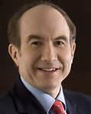
Our personal reason: Self- actualization
An Annual income（2010）: Viacom（Philippe Dauman）84.50 million dollars
 | 100 Yen/USD | 142.63 Yen/USD
An Annual income | 8,450,000,000 | 12,052,235,000
 | 365 | 366
Per day | 23,150,685 | 32,929,604
 | 24 | 25
Per hour | 964,612 | 1,317,184
 | 60 | 61
Per minute | 16,077 | 21,593
Notes:
http://ameblo.jp/ousetsuin/entry-10858242456.html

Slide 16
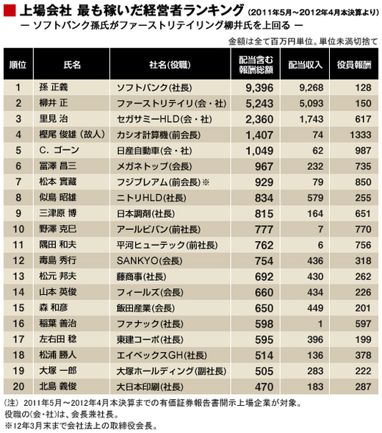
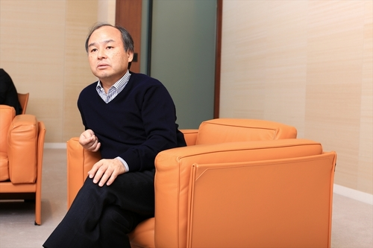
An Annual income | 9,396,000,000
 | 365
Per day | 25,742,466
 | 24
Per hour | 1,072,603
 | 60
Per minute | 17,877
Notes:
http://ecodb.net/ranking/imf_ngdpd.html

Slide 17
4. Myth of Entrepreneurship
Myth 1: Anyone can start a business.
Reality: The easiest part is starting up. What is hardest is surviving, sustaining, and building a venture so its founders can realize a harvest.
Myth 2: Entrepreneurship are gamblers.
Reality: Successful entrepreneurs take very careful, calculated risks. They do not deliberately seek to take more risk or to take unnecessary risk, nor do they shy away from unavoidable risk.

Slide 18
4. Myth of Entrepreneurship
Myth 3: Entrepreneurs want the whole show to themselves.
Reality: It is extremely difficult to grow a higher potential venture by working single-handedly. Higher potential entrepreneurs build a team, an organization, and a company.
Myth 4: Entrepreneurs are their own bosses and completely independent.
Reality: Entrepreneurs are far from independent. They have to serve many masters and constituencies, including partners, investors, customers, suppliers, creditors, employees, families, and social and community obligations.

Slide 19
4. Myth of Entrepreneurship
Myth 5: Entrepreneurs work longer and harder than managers in big company.
Reality: There is no such evidence. Some work mode, some less.
Myth 6: Entrepreneurs experience a great deal of stress and pay a high price.
Reality: No doubt about it: Being an entrepreneur is stressful and demanding. But entrepreneurs find their jobs very satisfying. They are healthier, and are much less likely to retire than those who work for other.

Slide 20
4. Myth of Entrepreneurship
Myth 7: Entrepreneurs are motivated solely by the quest for the almighty dollar.
Reality: Entrepreneurs seeking high potential ventures are more driven by building enterprises and realizing long term capital gains than by instant gratification through high salaries and perks. Feeling in control of their own destinies, and realizing their vision and dreams, are also powerful motivators. Money is viewed as a tool and a way of keeping score.

Slide 21
4. Myth of Entrepreneurship
Myth 8: Entrepreneurs seek power and control over others.
Reality: Successful entrepreneurs are driven by the quest for responsibility, achievement, and results, rather than for power for its own sake. By virtue of their accomplishments, they may be powerful and influential, but these are more the by-products of the entrepreneurial process than a driving force behind it.

Slide 22
4. Myth of Entrepreneurship
Myth 9: If an entrepreneur is talented, success will happen in a year or two.
Reality: An old maxim among venture capitalists says it all: The lemons ripen in two and a half years, but the pearls take seven or eight. Rarely is a new business established solidly in less than three or four years.

Slide 23
4. Myth of Entrepreneurship
Myth 10: Any entrepreneur with a good idea can raise venture capital.
Reality: The ventures of entrepreneurs with good idea who seek out venture capital, only 1 to 3 out of 100 are funded.
Myth 11: If an entrepreneur has enough start-up capital, he or she can’t miss.
Reality: Too much money at the outset often leads to lack of discipline and impulsive spending that usually result in serious problems and failure.

Slide 24
4. Myth of Entrepreneurship
Myth 12: Entrepreneurs are lone wolves and cannot work with others.
Reality: The most successful entrepreneur are leaders who build great teams and effective relationships working with peers, directors, investors, key suppliers, and the like.
Myth 13: Unless you attained 600+ on your SATs or HMATS you’ll never be a successful entrepreneur.
Reality: Entrepreneurial IQ is a unique combination of creativity, motivation,
integrity, leadership, team building, analytical ability to deal with ambiguity and adversity.

Slide 25
5. Entrepreneur and Intraentrepreneur
Entrepreneur: An individual who establishes a new organization without the benefit of corporate sponsorship.
Intraentrepreneurs: New venture creators working inside big companies.

Slide 26
Mega-Entrepreneurs Who started in Their 20s.
Entrepreneurial Company | Founder(s)
Microsoft | Bill gates and Paul Allen
Netscape | Marc Andressen
dell Computers | Michael Dell
Gateway 2000 | Ted Waitt
Mccaw Cellilar | Craig McCaw
Apple Computers | Steve Jobs and Steve Woznaik
Digital Equipment Corporation | Ken and Stan Olsen
Federal Express | Fred Smith
Genentech | Robert Swanson
Polaroid | Edward Land
Nike | Phil Knight
Lotus Development Corporation | Mitch Kapor
Ipix.com | Kevin McCurdy

Slide 27
6. Entrepreneur and Innovation
Creativity and innovation | High | Inventor | Entrepreneur
 | Low | Promoter | Manager, administrator
 |  | Low | High
 |  | General management skills, business know-how, and networks

Slide 28
Entrepreneurial Strategy Matrix
Innovation (Creating a unique and different product/service) | High | High innovation Low risk | High innovation High risk
 | Low | Low innovation Low risk | Low innovation High risk
 |  | Low | High
 |  | Risk (Probability of major loss)

Slide 29
7. Entrepreneurial Q & A
Question: What was the hardest lesson you’ve learnt?
Answer:
(Tom Stemberg) Take every competitor serious.
(Judy Wicks) Put every agreement in writing.
Question: is Entrepreneurship getting more difficult?
Answer: (Judy Wicks, White Dog Enterprises) It’s harder to compete with corporations on price, but consumers increasingly appreciate the high quality, creativity, and authenticity entrepreneurs can offer.

Slide 30
Entrepreneurial Q & A
Question: What is the one piece of advice you would give to someone starting out?
Answer:
(Andra Rush, Rush Trucking) Don’t let anyone steal your dream.
(Tom Stemberg, Staplers) Do all your planning with the customer firmly in mind.
(Rhonda Kallman, New Century Brewing) Choose a business you love. You may have to live with it forever.
(James Goodnight, SAS) Avoid the mistakes of the dot-bomb era. Those folks mistook an exit strategy for a business plan. Go into it with the idea of running a business for the long term.

Slide 31
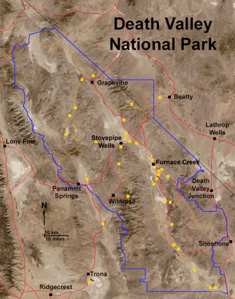
7. The Valley of Death

Slide 32
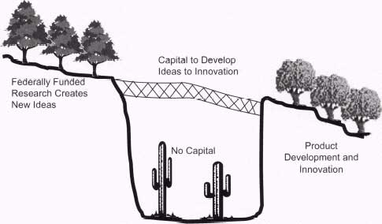

Slide 33
Ｔhe early-stage capital gap, often called the Valley of Death, between federally funded basic research and venture capital funded later-stage product development.

Slide 34
The term “Valley of Death” has come to describe the period of transition when a developing technology is deemed promising, but too new to validate its commercial potential and thereby attract the capital necessary for its continued development.

Slide 35
Only 0.03% of VC funding goes into the seed stage due to the very high risk of failure.
Between 1986 and 2008, VC biotech investors averaged net returns of 20.7%, although suffering a loss in 2008.

Slide 36
Solutions to The Valley of Death
To cross this Valley of Death, the United States has developed a range of programs, including awards for innovation. Two of these award programs are the Advanced Technology Program (ATP) and the Small Business Innovation Research Program (SBIR, a two-phase program that provides small awards to encourage innovation from small companies (i.e., fewer than 500 employees).

Slide 37
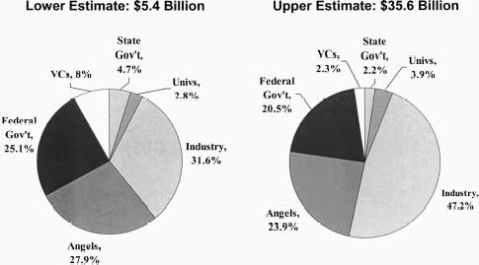
Estimated distribution of funding sources for early-stage technology development.

Slide 38
8. Determining Your Entrepreneurial Quotient?
Will you move to USA if you were born in 18th century?
Were you an honor student?
Did you enjoy group functions in school-clubs, team sports, even double dates?
As a youngster, did you prefer to be alone frequently?
As a child, did you have a paper route, a lemonade stand, or some other small enterprise?
Were you a stubborn child?
Were you a cautious youngster, the last in the neighborhood to try diving off the highboard?
Do you worry about what others think of you?
Are you in a rut, tired of the same routine day in and day out?
Would you be willing to dip deeply into your “nest egg” –and possibly lose all you invested – to go it alone?
If your new business should fail, would you get to work immediately on another?
Are you an optimist?

Slide 39
8. Measure your entrepreneurial quotient
Are you a first-generation American? (Will you move to USA if you were born in 18th century?)
Were you an honor student?
Did you enjoy group functions in school-clubs, team sports, even double dates?
As a youngster, did you prefer to be alone frequently?
As a child, did you have a paper route, a lemonade stand, or some other small enterprise?
Were you a stubborn child?
Were you a cautious youngster, the last in the neighborhood to try diving off the highboard?
Do you worry about what others think of you?
Are you in a rut, tired of the same routine day in and day out?
Would you be willing to dip deeply into your “nest egg” –and possibly lose all you invested – to go it alone?
If your new business should fail, would you get to work immediately on another?
Are you an optimist?
Notes:
１．Are you a first-generation American?

Slide 40
Are you a first-generation American? (Will you move to USA if you were born in 18th century?)
+
・Challenge difficulties and unexperienced issues.
・Anyone can start a business: The easiest part is starting up. What is hardest is surviving, sustaining, and building a venture so its founders can realize a harvest.
High energy level
Notes:
１．Are you a first-generation American?

Slide 41
2. Were you an honor student?
- - - -
Unless you attained 600+ on your SATs or HMATS you’ll never be a successful entrepreneur: Entrepreneurial IQ is a unique combination of creativity, motivation, integrity, leadership, team building, analytical ability to deal with ambiguity and adversity. Tolerance for ambiguity.

Slide 42
3. Did you enjoy group functions in school-clubs, team sports, even double dates?
-
Not member of a team; Need to achieve.

Slide 43
4. As a youngster, did you prefer to be alone frequently?
+
Keep your own philosophy.
Internal locus of control

Slide 44
5. As a child, did you have a paper route, a lemonade stand, or some other small enterprise?
++
Practice is important.
Even if an entrepreneur is talented, success will never happen in a year or two.
Entrepreneurs are motivated solely by the quest for the almighty dollar.

Slide 45
6. Were you a stubborn child?
+
Unique idea, and self-confidence

Slide 46
2. Some questions on your entrepreneurial quotient
Will you move to USA if you were born in 18th century?
Were you an honor student?
Did you enjoy group functions in school-clubs, team sports, even double dates?
As a youngster, did you prefer to be alone frequently?
As a child, did you have a paper route, a lemonade stand, or some other small enterprise?
Were you a stubborn child?
+Challenge difficulties and unexperienced issues; high energy level!
- - - - Entrepreneurial IQ is a unique combination of creativity, motivation, integrity, leadership, team building, analytical ability to deal with ambiguity and adversity. Tolerance for ambiguity!
- Not member of a team; Need to achieve!
+ Keep your own philosophy; Internal locus of control!
++ Practice is important.
+ Unique idea, Self-confidence!
Notes:
１．Are you a first-generation American?

Slide 47
2. Some questions on your entrepreneurial quotient
7. Were you a cautious youngster, the last in the neighborhood to try diving off the highboard?
8. Do you worry about what others think of you?
9.Are you in a rut, tired of the same routine day in and day out?
10. Would you be willing to dip deeply into your “nest egg” –and possibly lose all you invested – to go it alone?
11. If your new business should fail, would you get to work immediately on another?
12.
Are you an optimist?
---- Entrepreneurship are not gamblers;
++++Sometimes yes!!! But need to calculate carefully!!!
- Go your own way is not the best! Entrepreneurs are their own bosses and completely independent. Self-confidence!
++ Easy to loss interests of the daily life; more important is to find interests in new world. Need to achieve!
++ Risk taking with careful calculation!!
++++ Do not worry about fail. You will learn from your mistakes. Awareness of passing time.
++ Tolerance for ambiguity, Vision is important.

Slide 48
Answer
Yes = 1, No = minus 1.
Yes = minus 4, No = 4.
Yes = minus 1, No = 1.
Yes = 1, No = minus 1.
Yes = 2, No = minus 2.
Yes = 1, No = minus 1.
Yes = minus 4, No = 4. If you were a particularly daring child, add another 4 points.
Yes = minus 1, No = 1.
Yes = 2, No = minus 2.
Yes = 2, No = minus 2.
Yes = 4, No = minus 4.
Yes = 2, No = minus 2.
Notes:
Management Fifth Edition, Richard L. Daft； 191-192

Slide 49
Answer
More than 20 points: you have a strong entrepreneurial quotient
From 0 to 19 points: it suggests that you have entrepreneurial possibilities
From -10 to 0 points: your chance of successfully starting an entrepreneurial business is marginal
Less than -11 points: it suggest that you are not the entrepreneurial type
Go back over each question, thinking about changes you might make to become more or less entrepreneurial, depending on your career interests.
Source: Peter Lohr, should you be in business for yourself? Readers digest, July 1989, 49-52; modified by Takao Ito

Slide 50
Thank you for your attention!

