Slide 1
The MOT and Venture Business
５ Guiding Principles
The Pursuit of Peace
The Creation of New Forms of Knowledge
The Nurturing of Well-Rounded Human Beings
Collaboration with the Local, Regional, and International Community
Continuous Self-Development
Intensive Course of
Prof. Takao Ito,
Doctor of Economics, PH.D. of Engineering,
Graduate School of Advanced Science and Engineering, Hiroshima University
E-Mail: itotakao@Hiroshima-u.ac.jp

Slide 2
Schedule
MOT and Venture Business (An Intensive Course)
08:50-16:20, Saturday and Sunday
No. | Date |  | Lecture
1 | 2023/10/21 | Sat | Outlines and Introduction | 08:50-10:20
2 | 2023/10/21 | Sat | The evolution of Management | 10:30-12:00
3 | 2023/10/21 | Sat | Key Issues in Corporate Management | 13:10-14:40
4 | 2023/10/21 | Sat | Break-Even Point Analysis | 14:50-16:20
5 | 2023/10/22 | Sun | Cost Benefit Analysis and Ethics | 08:50-10:20
6 | 2023/10/22 | Sun | Stock Control | 10:30-12:00
7 | 2023/10/22 | Sun | Case Studies and Group Discussion | 13:10-14:40
8 | 2023/10/22 | Sun | Kaizen and Quality Control | 14:50-16:20
9 | 2023/11/11 | Sat | Motivation (self Learning) | 08:50-10:20
10 | 2023/11/11 | Sat | Organization Structure | 10:30-12:00
11 | 2023/11/11 | Sat | Decision-making and Strategy | 13:10-14:40
12 | 2023/11/11 | Sat | Leadership | 14:50-16:20
13 | 2023/11/12 | Sun | Business Plan | 08:50-10:20
14 | 2023/11/12 | Sun | Entrepreneur and Venture Business | 10:30-12:00
15 | 2023/11/12 | Sun | Presentation and/or Final Examination | 13:10-14:40
16 | 2023/11/12 | Sun | Review and Free Discussion | 14:50-16:20

Slide 3
Topic 6 Stock Control

Slide 4
Agenda
Stock Control and Inventory
Tow Systems in Stock Control
Economic Order Quantity (EOQ)

Slide 5
１．Stock Control and Inventory
Inventory Control is the supervision of supply, storage and accessibility of items in order to ensure an adequate supply without excessive oversupply.
Stock control is defined as "the activity of checking a shop’s stock".
Notes:
Inventory Control is the supervision of supply, storage and accessibility of items in order to ensure an adequate supply without excessive oversupply. Stock control is defined as "the activity of checking a shop’s stock".[

Slide 6
Deciding how much stock to keep depends on the size and nature of your business, and the type of stock involved. If you are short of space you may be able to buy stock in bulk and then pay a fee to your supplier to store it, calling it off as and when needed.
Notes:
Inventory Control is the supervision of supply, storage and accessibility of items in order to ensure an adequate supply without excessive oversupply. Stock control is defined as "the activity of checking a shop’s stock".[

Slide 7
Keeping little or no stock and negotiating with suppliers to deliver stock as you need it.
Advantages | Disadvantages
Efficient and flexible - you only have what you need, when you need it | Meeting stock needs can become complicated and expensive
Lower storage costs | You might run out of stock if there's a hitch in the system
You can keep up to date and develop new products without wasting stock | You are dependent on the efficiency of your suppliers

Slide 8
Keeping little or no stock and negotiating with suppliers to deliver stock as you need it.
opportunity cost： The cost of an alternative that must be forgone in order to pursue a certain action. Put another way, the benefits you could have received by taking an alternative action.
Notes:
機会損失ともいう。財をある目的に用いたために放棄された他の利用方法から得られるであろう利得のうち最大のもの。

Slide 9
Keeping lots of stock
Advantages | Disadvantages
Can meet sudden changes in demand | Costs of storage – rent and insurance
Less chance of loss of production time because of stock outs | Money tied up in stocks not being used elsewhere in the business
Can take advantage of bulk buying economies of scale | Large stocks subject to deterioration and theft

Slide 10
2．Tow Systems in Stock Control
Fixed order quantity system
Periodic ordering system

Slide 11
Stock Control
the demand=D occurs at a constant rate and that there is no variability in demand.
the lead time=L is constant.
the holding cost=H is known and fixed
stockout cost=S
unit price=C

Slide 12
2-1 Fixed order quantity system
the system assumes that all the variables occur at a constant rate and their values are known with certainty.
Although these assumptions are not realistic the model is highly robust and provides excellent results despite these assumptions.

Slide 13
Fixed order quantity system
Stock
Certain Level
Time
0

Slide 14
2-2 Fixed Periodic ordering system
It is an inventory control method where orders are periodically placed, but the order quantity is different every time, and is also called Fixed Period Deficit Ordering System.

Slide 15
Fixed Periodic ordering system
An order is periodically placed.
The order quantity is different every time.
Even relatively large fluctuations in demand can be handled properly.
Even seasonal variation can be handled modestly.
The inventory volume can be reduced compared with ordering point system.
* A-group items are usually best for this method.
* Longer lead time is acceptable.
* Longer time for paperwork is needed.
Every order quantity in their method is obtained by the following formula.

Slide 16
Periodic ordering system
Stock
0
March 1st
April 1st
May 1st
June 1st
July 1st

Slide 17
How many to order?
Total demand in the lead time：LD

Slide 18
Case 1: the demand occurs at a constant rate its values is known with certainty
Total demand per month D＝600 pcs
Lead time L＝10 days
Stock
0
June 1st
June 10th

Slide 19
Case 1: the demand occurs at a constant rate its values is known with certainty
Total demand per month D＝600 pcs
Lead time L＝10 days
Stock
0
June 1st
June 10th

Slide 20
Case 2: orders are periodically placed, but the order quantity is different every time
Demand per month=
Lead time=L
Initial stock =

Slide 21
The central limit theorem states that under certain (fairly common) conditions, the demand will have an approximately normal distribution.
Lead time=L
Order quantity

Slide 22
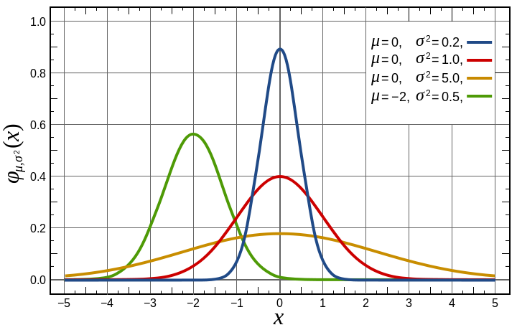
Normal distribution

Slide 23
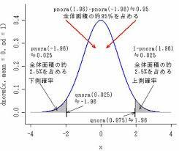
Z | 0 | 0.01 | 0.02 | 0.03 | 0.04 | 0.05 | 0.06 | 0.07 | 0.08 | 0.09
0.0 | .0000 | .0040 | .0080 | .0120 | .0160 | .0199 | .0239 | .0279 | .0319 | .0359
0.1 | .0398 | .0438 | .0478 | .0517 | .0557 | .0596 | .0636 | .0675 | .0714 | .0753
0.2 | .0793 | .0832 | .0871 | .0910 | .0948 | .0987 | .1026 | .1064 | .1103 | .1141
0.3 | .1179 | .1217 | .1255 | .1293 | .1331 | .1368 | .1406 | .1443 | .1480 | .1517
0.4 | .1554 | .1591 | .1628 | .1664 | .1700 | .1736 | .1772 | .1808 | .1844 | .1879
0.5 | .1915 | .1950 | .1985 | .2019 | .2054 | .2088 | .2123 | .2157 | .2190 | .2224
0.6 | .2257 | .2291 | .2324 | .2357 | .2389 | .2422 | .2454 | .2486 | .2517 | .2549
0.7 | .2580 | .2611 | .2642 | .2673 | .2704 | .2734 | .2764 | .2794 | .2823 | .2852
0.8 | .2881 | .2910 | .2939 | .2967 | .2995 | .3023 | .3051 | .3078 | .3106 | .3133
0.9 | .3159 | .3186 | .3212 | .3238 | .3264 | .3289 | .3315 | .3340 | .3365 | .3389
1.0 | .3413 | .3438 | .3461 | .3485 | .3508 | .3531 | .3554 | .3577 | .3599 | .3621
1.1 | .3643 | .3665 | .3686 | .3708 | .3729 | .3749 | .3770 | .3790 | .3810 | .3830
1.2 | .3849 | .3869 | .3888 | .3907 | .3925 | .3944 | .3962 | .3980 | .3997 | .4015
1.3 | .4032 | .4049 | .4066 | .4082 | .4099 | .4115 | .4131 | .4147 | .4162 | .4177
1.4 | .4192 | .4207 | .4222 | .4236 | .4251 | .4265 | .4279 | .4292 | .4306 | .4319
1.5 | .4332 | .4345 | .4357 | .4370 | .4382 | .4394 | .4406 | .4418 | .4429 | .4441
1.6 | .4452 | .4463 | .4474 | .4484 | .4495 | .4505 | .4515 | .4525 | .4535 | .4545
1.7 | .4554 | .4564 | .4573 | .4582 | .4591 | .4599 | .4608 | .4616 | .4625 | .4633
1.8 | .4641 | .4649 | .4656 | .4664 | .4671 | .4678 | .4686 | .4693 | .4699 | .4706
1.9 | .4713 | .4719 | .4726 | .4732 | .4738 | .4744 | .4750 | .4756 | .4761 | .4767
2.0 | .4772 | .4778 | .4783 | .4788 | .4793 | .4798 | .4803 | .4808 | .4812 | .4817
2.1 | .4821 | .4826 | .4830 | .4834 | .4838 | .4842 | .4846 | .4850 | .4854 | .4857
2.2 | .4861 | .4864 | .4868 | .4871 | .4875 | .4878 | .4881 | .4884 | .4887 | .4890
2.3 | .4893 | .4896 | .4898 | .4901 | .4904 | .4906 | .4909 | .4911 | .4913 | .4916
2.4 | .4918 | .4920 | .4922 | .4925 | .4927 | .4929 | .4931 | .4932 | .4934 | .4936
2.5 | .4938 | .4940 | .4941 | .4943 | .4945 | .4946 | .4948 | .4949 | .4951 | .4952
2.6 | .4953 | .4955 | .4956 | .4957 | .4959 | .4960 | .4961 | .4962 | .4963 | .4964
2.7 | .4965 | .4966 | .4967 | .4968 | .4969 | .4970 | .4971 | .4972 | .4973 | .4974
2.8 | .4974 | .4975 | .4976 | .4977 | .4977 | .4978 | .4979 | .4979 | .4980 | .4981
2.9 | .4981 | .4982 | .4982 | .4983 | .4984 | .4984 | .4985 | .4985 | .4986 | .4986
3.0 | .4987 | .4987 | .4987 | .4988 | .4988 | .4989 | .4989 | .4989 | .4990 | .4990
3.1 | .4990 | .4991 | .4991 | .4991 | .4992 | .4992 | .4992 | .4992 | .4993 | .4993
3.2 | .4993 | .4993 | .4994 | .4994 | .4994 | .4994 | .4994 | .4995 | .4995 | .4995
3.3 | .4995 | .4995 | .4995 | .4996 | .4996 | .4996 | .4996 | .4996 | .4996 | .4997
3.4 | .4997 | .4997 | .4997 | .4997 | .4997 | .4997 | .4997 | .4997 | .4997 | .4998
3.5 | .4998 | .4998 | .4998 | .4998 | .4998 | .4998 | .4998 | .4998 | .4998 | .4998
3.6 | .4998 | .4998 | .4999 | .4999 | .4999 | .4999 | .4999 | .4999 | .4999 | .4999
3.7 | .4999 | .4999 | .4999 | .4999 | .49991 | .49992 | .49992 | .49992 | .49992 | .49992
3.8 | .49993 | .49993 | .49993 | .49994 | .49994 | .49994 | .49994 | .49995 | .49995 | .49995
3.9 | .49995 | .49995 | .49996 | .49996 | .49996 | .49996 | .49996 | .49996 | .49997 | .49997
4.0 | .49997 | .49997 | .49997 | .49997 | .49997 | .49997 | .49997 | .49997 | .49997 | .49997
4.1 | .49998 | .49998 | .49998 | .49998 | .49998 | .49998 | .49998 | .49998 | .49998 | .49998
4.2 | .49999 | .49999 | .49999 | .49999 | .49999 | .49999 | .49999 | .49999 | .49999 | .49999
4.3 | .49999 | .49999 | .49999 | .49999 | .49999 | .49999 | .49999 | .49999 | .49999 | .49999
4.4 | .49999 | .49999 | .49999 | .49999 | .49999 | .49999 | .49999 | .49999 | .49999 | .49999
4.5 | .49997 | .49997 | .49997 | .49997 | .49997 | .49997 | .49997 | .49997 | .49997 | .49997
4.6 | .49998 | .49998 | .49998 | .49998 | .49998 | .49998 | .49998 | .49998 | .49998 | .49998
4.7 | .49999 | .49999 | .49999 | .49999 | .49999 | .49999 | .49999 | .49999 | .49999 | .49999
4.8 | .49999 | .49999 | .49999 | .49999 | .49999 | .49999 | .49999 | .49999 | .49999 | .49999
4.9 | .499995 | .499995 | .499995 | .499995 | .499995 | .499995 | .499995 | .499995 | .499995 | .499995
5.0 | .499997
$$\int_{Z_{α}}^{∞}{f\left(x\right)dx}=0.025$$
$$\int_{0}^{z_{α}}{f\left(x\right)dx}=0.475$$
$$z_{α}=1.96$$

Slide 24
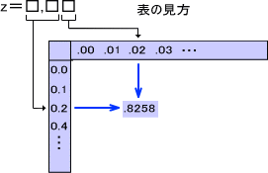
 | 標準正規分布表
 | .00 | .01 | .02 | .03 | .04 | .05 | .06 | .07 | .08 | .09
0.0 | 1.0000 | .9920 | .9840 | .9760 | .9680 | .9602 | .9522 | .9442 | .9362 | .9282
0.1 | .9204 | .9124 | .9044 | .8966 | .8886 | .8808 | .8728 | .8650 | .8572 | .8494
0.2 | .8414 | .8336 | .8258 | .8180 | .8104 | .8026 | .7948 | .7872 | .7794 | .7718
0.3 | .7642 | .7566 | .7490 | .7414 | .7338 | .7264 | .7188 | .7114 | .7040 | .6966
0.4 | .6892 | .6818 | .6744 | .6672 | .6600 | .6528 | .6456 | .6384 | .6312 | .6242
0.5 | .6170 | .6100 | .6030 | .5962 | .5892 | .5824 | .5754 | .5686 | .5620 | .5552
0.6 | .5486 | .5418 | .5352 | .5286 | .5222 | .5156 | .5092 | .5028 | .4964 | .4902
0.7 | .4840 | .4776 | .4716 | .4654 | .4592 | .4532 | .4472 | .4412 | .4354 | .4296
0.8 | .4238 | .4180 | .4122 | .4066 | .4010 | .3954 | .3898 | .3842 | .3788 | .3734
0.9 | .3682 | .3628 | .3576 | .3524 | .3472 | .3422 | .3370 | .3320 | .3270 | .3222
1.0 | .3174 | .3124 | .3078 | .3030 | .2984 | .2938 | .2892 | .2846 | .2802 | .2758
1.1 | .2714 | .2670 | .2628 | .2584 | .2542 | .2502 | .2460 | .2420 | .2380 | .2340
1.2 | .2302 | .2262 | .2224 | .2186 | .2150 | .2112 | .2076 | .2040 | .2006 | .1970
1.3 | .1936 | .1902 | .1868 | .1836 | .1802 | .1770 | .1738 | .1706 | .1676 | .1646
1.4 | .1616 | .1586 | .1556 | .1528 | .1498 | .1470 | .1442 | .1416 | .1388 | .1362
1.5 | .1336 | .1310 | .1286 | .1260 | .1236 | .1212 | .1188 | .1164 | .1142 | .1118
1.6 | .1096 | .1074 | .1052 | .1030 | .1010 | .0990 | .0970 | .0950 | .0930 | .0910
1.7 | .0892 | .0872 | .0854 | .0836 | .0818 | .0802 | .0784 | .0768 | .0750 | .0734
1.8 | .0718 | .0702 | .0688 | .0672 | .0658 | .0644 | .0628 | .0614 | .0602 | .0588
1.9 | .0574 | .0562 | .0548 | .0536 | .0524 | .0512 | .0500 | .0488 | .0478 | .0466
2.0 | .04550 | .04444 | .04338 | .04236 | .04134 | .04036 | .03940 | .03846 | .03752 | .03662
2.1 | .03572 | .03486 | .03400 | .03318 | .03236 | .03156 | .03078 | .03000 | .02926 | .02852
2.2 | .02780 | .02710 | .02642 | .02574 | .02510 | .02444 | .02382 | .02320 | .02260 | .02202
2.3 | .02144 | .02088 | .02034 | .01980 | .01928 | .01878 | .01828 | .01778 | .01732 | .01684
2.4 | .01640 | .01596 | .01552 | .01510 | .01468 | .01428 | .01390 | .01352 | .01314 | .01278
2.5 | .01242 | .01208 | .01174 | .01140 | .01108 | .01078 | .01046 | .01016 | .00988 | .00960
2.6 | .00932 | .00906 | .00880 | .00854 | .00830 | .00804 | .00782 | .00758 | .00736 | .00714
2.7 | .00694 | .00672 | .00652 | .00634 | .00614 | .00596 | .00578 | .00560 | .00544 | .00528
2.8 | .00510 | .00496 | .00480 | .00466 | .00452 | .00438 | .00424 | .00410 | .00398 | .00386
2.9 | .00374 | .00362 | .00350 | .00338 | .00328 | .00318 | .00308 | .00298 | .00288 | .00278
3.0 | .00270 | .00262 | .00252 | .00244 | .00236 | .00228 | .00222 | .00214 | .00206 | .00200
3.1 | .00194 | .00188 | .00180 | .00174 | .00168 | .00164 | .00158 | .00152 | .00148 | .00142
3.2 | .00138 | .00132 | .00128 | .00124 | .00120 | .00116 | .00112 | .00108 | .0104 | .00100
3.3 | .00096 | .00094 | .00090 | .00086 | .00084 | .00080 | .00078 | .00076 | .00072 | .00070
3.4 | .00068 | .00064 | .00062 | .00060 | .00058 | .00056 | .00054 | .00052 | .00050 | .00048

Slide 26
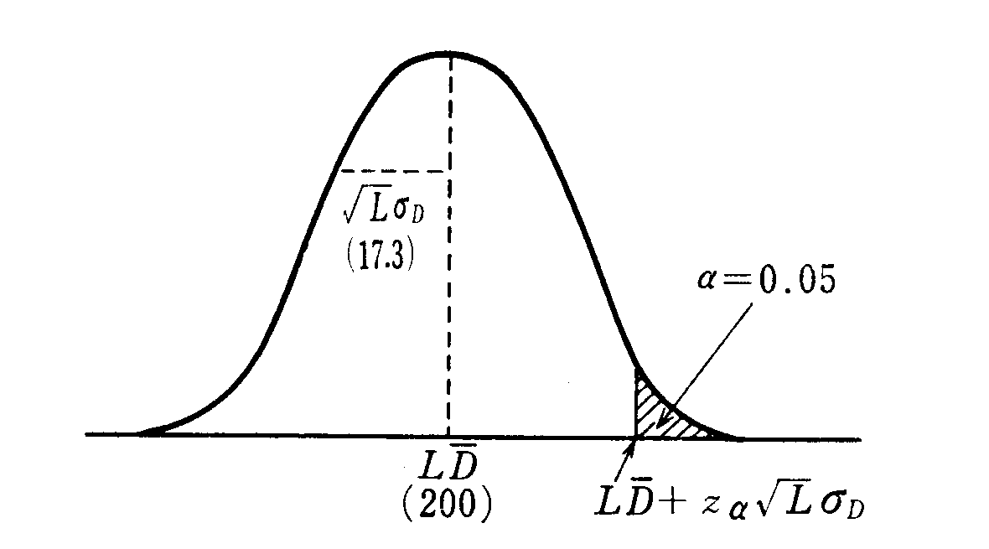
Order quantity

Slide 27
3．Economic Order Quantity (EOQ)
The value of the average stockholding = (Q/2 x item cost/value) where Q is the order quantity. The holding cost/unit (C_{h}) is derived from the average inventory value) multiplied by the cost of carrying the item over the period (one year) expressed as a % of the item cost/value.

Slide 28
Optimizing Economic Order Quantity (EOQ)
C_{h} is the holding cost per unit. It is also called carrying costs. Q is the order quantity

Slide 29
Order cost (C_{o}) is derived from the number of orders placed (D/Q - demand p.a. divided by order quantity) multiplied by the cost of placing an order.
C_{o}……ordering cost
D…… demand per year
Q …… order quantity

Slide 30
Total cost=Holding cost + Order cost
Notes:
differential calculus

Slide 31
Case 3
As an example, in a company where order cost is estimated at $10 and with a holding cost of 25% of item value if annual demand is 1000 units at a supply price of $36. Calculate the EOQ.

Slide 32
Answer
the EOQ is 48 units

Slide 33
Exercise：EOQ
In a company where the total demand each year is 7,200 pcs, and ordering cost is estimated at 2,000 Japanese Yen. The EOQ is 400 pcs. Calculate the holding cost per unit each year.

Slide 34
Exercise：EOQ
In a company where the total demand each year is 7,200 pcs, and ordering cost is estimated at 2,000 Japanese Yen. The EOQ is 400 pcs. Calculate the holding cost per unit each year.
Less C_{H} more EOQ

Slide 35
Thank you for your attention!

