Slide 1
Ion Acceleration via Spherical Coulomb Explosion
Myles Allen Zosa
Institute of Laser Engineering, Osaka University

Slide 2
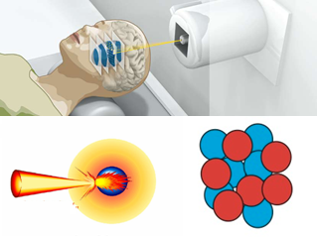
Laser Driven Ion Acceleration
Neutron Generation
  ~ 2 MeV Protons
Cancer Therapy
  > 100 MeV Protons
Ion Driven Fast Ignition
Isotope Generation

Slide 3
Laser Driven Ion Acceleration
Coulomb Explosion (CE)
Target Normal Sheath Acceleration (TNSA)
Radiation Pressure Acceleration (RPA)
Hole Boring Acceleration (HBA)

Slide 4
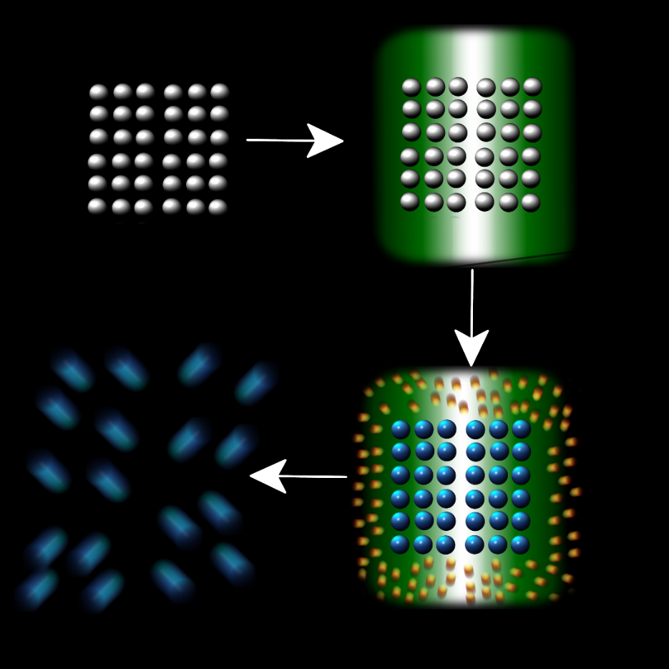
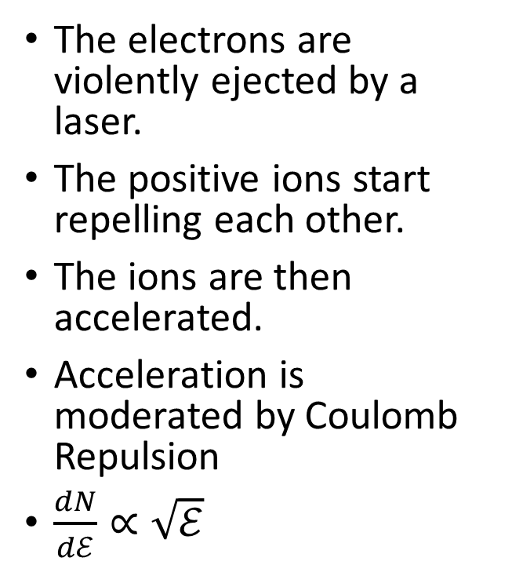
What is Coulomb Explosion?
The electrons are violently ejected by a laser.
The positive ions start repelling each other.
The ions are then accelerated.
Acceleration is moderated by Coulomb Repulsion
$\frac{dN}{dℰ}∝\sqrt{ℰ}$

Slide 5
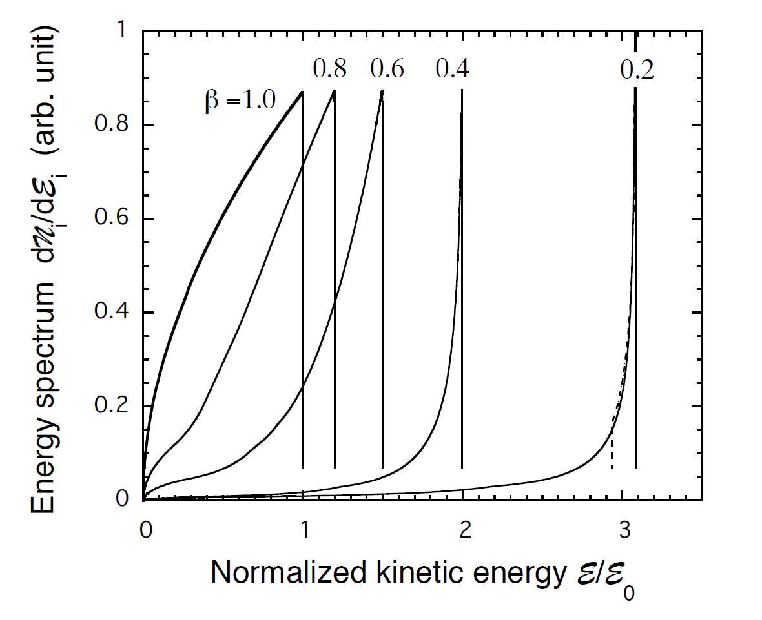
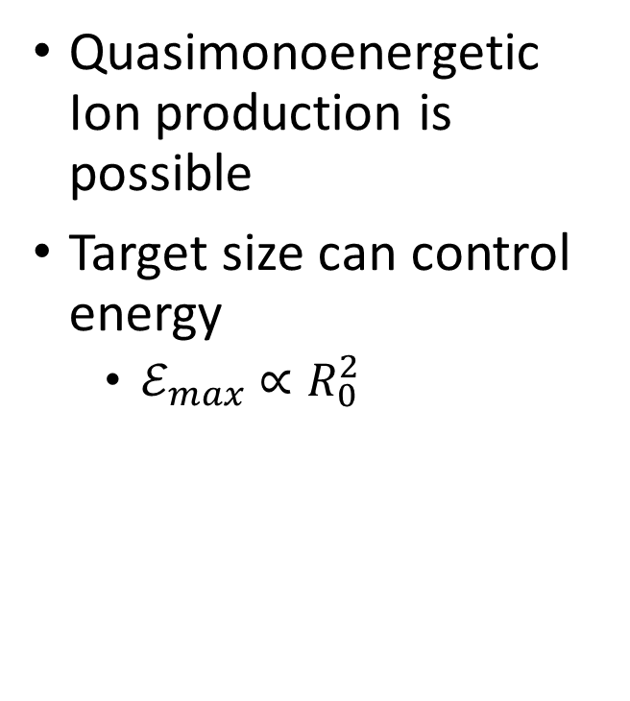
Why Coulomb Explosion?
Quasimonoenergetic Ion production is possible
Target size can control energy
  $ℰ_{max}∝R_{0}^{2}$
M. Murakami, K. Mima, PoP, 2009

Slide 6
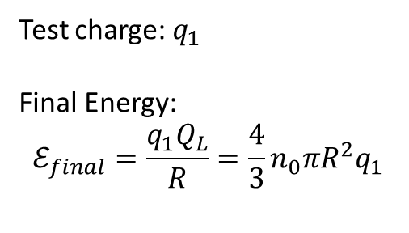
Coulomb Explosion: Similar Ions
Test charge: $q_{1}$
Final Energy:
$$ℰ_{final}=\frac{q_{1}Q_{L}}{R}=\frac{4}{3}n_{0}πR^{2}q_{1}$$
1
Q_{L}
R

Slide 7
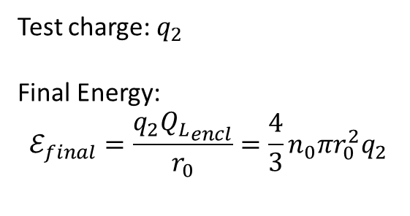
Coulomb Explosion: Similar Ions
Test charge: $q_{2}$
Final Energy:
$$ℰ_{final}=\frac{q_{2}{Q_{L}}_{encl}}{r_{0}}=\frac{4}{3}n_{0}πr_{0}^{2}q_{2}$$
Inner Ions Cannot overtake the outer ions
  Outer Ions have more initial enclosed charge
Only the enclosed region contributes to the final energy
Q
2
Q_{L}
r₀

Slide 8
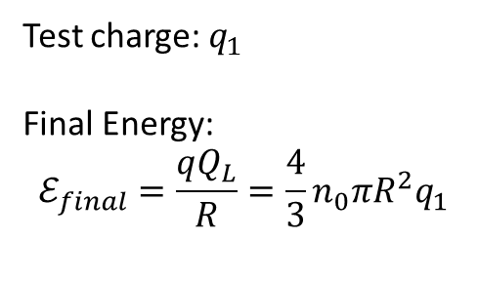
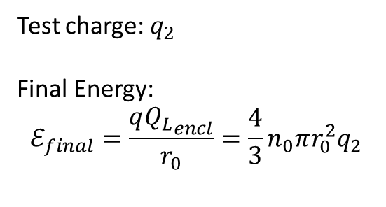
Coulomb Explosion: Similar Ions
Test charge: $q_{1}$
Final Energy:
$$ℰ_{final}=\frac{qQ_{L}}{R}=\frac{4}{3}n_{0}πR^{2}q_{1}$$
Test charge: $q_{2}$
Final Energy:
$$ℰ_{final}=\frac{q{Q_{L}}_{encl}}{r_{0}}=\frac{4}{3}n_{0}πr_{0}^{2}q_{2}$$
1
Q
2
Q_{L}
r₀
Inner Ions Have Lower Energy than Outer Ions!
Add More Energy to Inner Ions!
Not Monoenergetic!

Slide 9
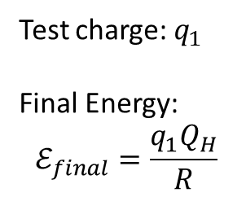
Coulomb Explosion: Heavy Ions
Test charge: $q_{1}$
Final Energy:
$$ℰ_{final}=\frac{q_{1}Q_{H}}{R}$$
1
Q_{H}
R

Slide 10
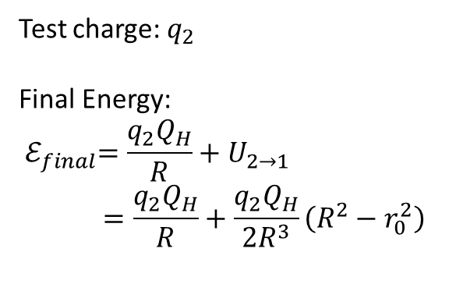
Coulomb Explosion: Heavy Ions
Test charge: $q_{2}$
Final Energy:
$${ ℰ}_{final}=\frac{q_{2}Q_{H}}{R}+U_{2→1}$$
$$=\frac{q_{2}Q_{H}}{R}+\frac{q_{2}Q_{H}}{2R^{3}}\left(R^{2}−r_{0}^{2}\right)$$
1
Q
Assume heavy ions are static!
2
Q_{H}
r₀

Slide 11
Coulomb Explosion: Heavy Ions
Test charge: $q_{1}$
Final Energy:
$$ℰ_{final}=\frac{q_{1}Q_{H}}{R}$$
Test charge: $q_{2}$
Final Energy:
$${ ℰ}_{final}=\frac{q_{2}Q_{H}}{R}+U_{2→1}$$
$$=\frac{q_{2}Q_{H}}{R}+\frac{q_{2}Q_{H}}{2R^{3}}\left(R^{2}−r_{0}^{2}\right)$$
1
Q
2
Q_{H}
r₀
Inner Ions final energy
GREATER THAN
Outer Inner Final Energy
Adding heavy ions will improve the energy spectrum

Slide 12
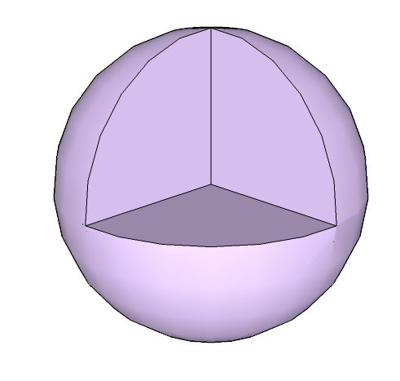
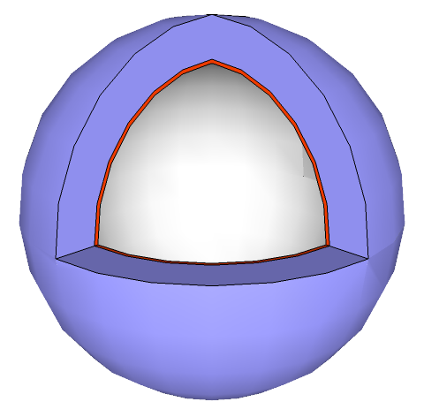
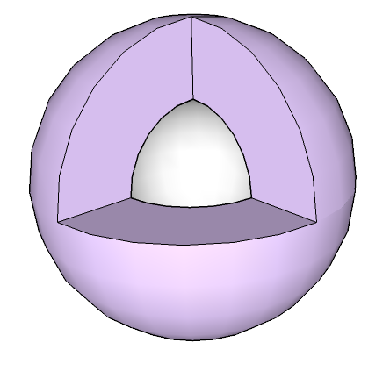
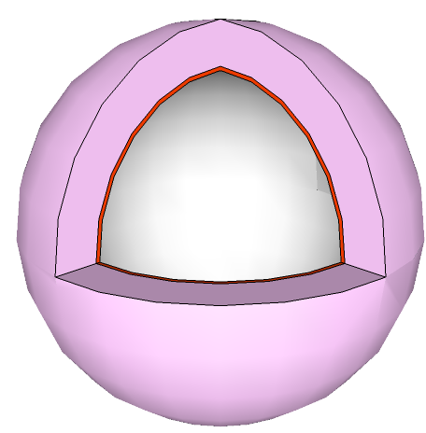
Types of Spherical Targets for Optimization
Target 1
Target 2
Target 3
Target 4

Slide 13
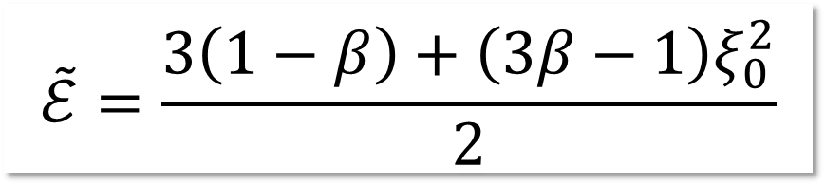
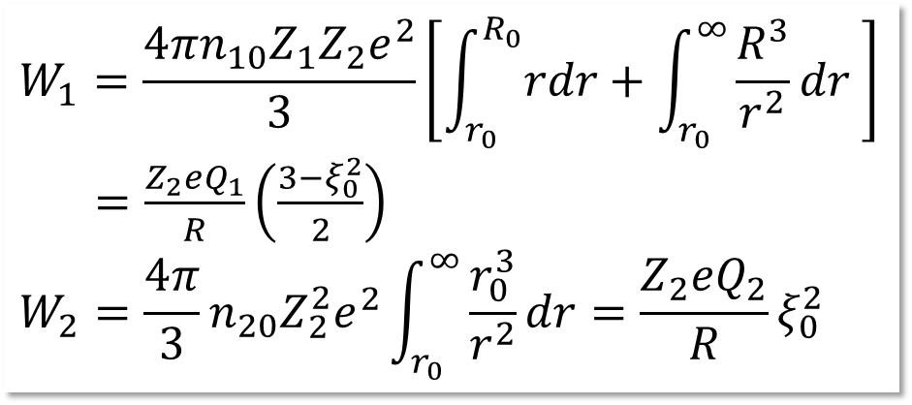
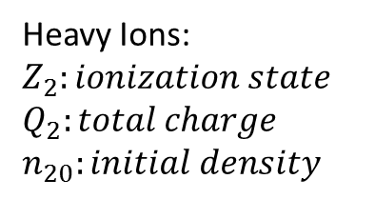
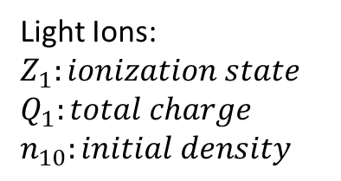
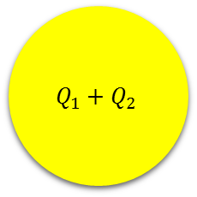
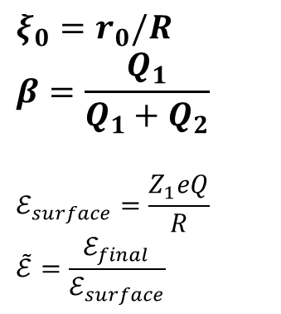
Target 1: Uniform Solid Target
$$Q_{1}+Q_{2}$$
Energy Profile of Light Ions
Energy Contributions from light ions (1)
and heavy ions (2):
Light Ions:
$$Z_{1}:ionization state$$
$$Q_{1}:total charge$$
$$n_{10}:initial density$$
$$ξ_{0}=r_{0}/R$$
$$β=\frac{Q_{1}}{Q_{1}+Q_{2}}$$
$$ℰ_{surface}=\frac{Z_{1}eQ}{R}$$
$$\tilde{ℰ}=\frac{ℰ_{final}}{ℰ_{surface}}$$
Heavy Ions:
$$Z_{2}:ionization state$$
$$Q_{2}:total charge$$
$$n_{20}:initial density$$

Slide 14
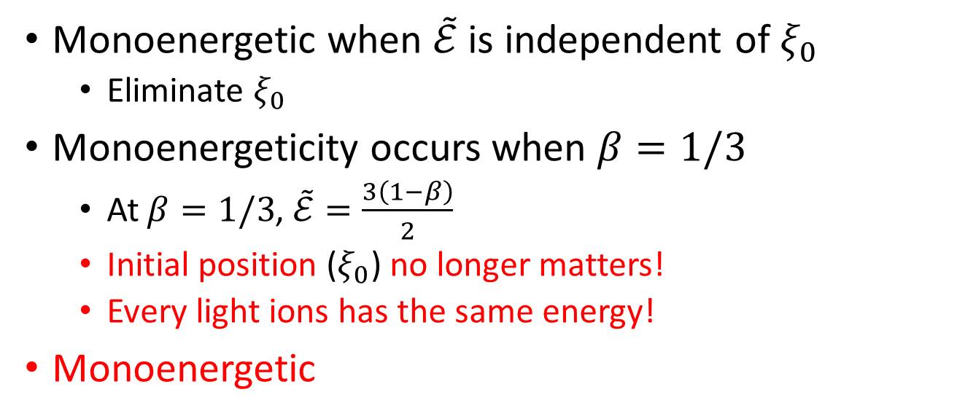
Target 1: Quasimonoenergeticity
Monoenergetic when $\tilde{ℰ}$ is independent of $ξ_{0}$
  Eliminate $ξ_{0}$
Monoenergeticity occurs when $β=1/3$
  At $β=1/3$, $\tilde{ℰ}=\frac{3\left(1−β\right)}{2}$
  Initial position ($ξ_{0}$) no longer matters!
  Every light ions has the same energy!
Monoenergetic

Slide 15
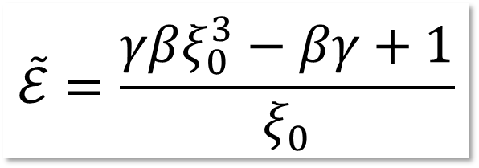
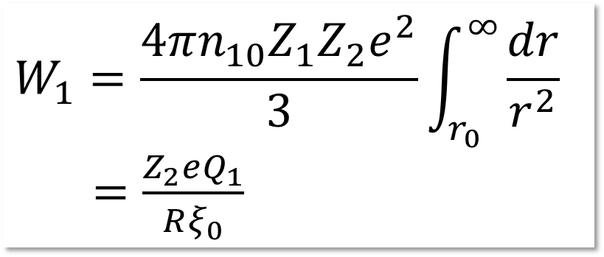
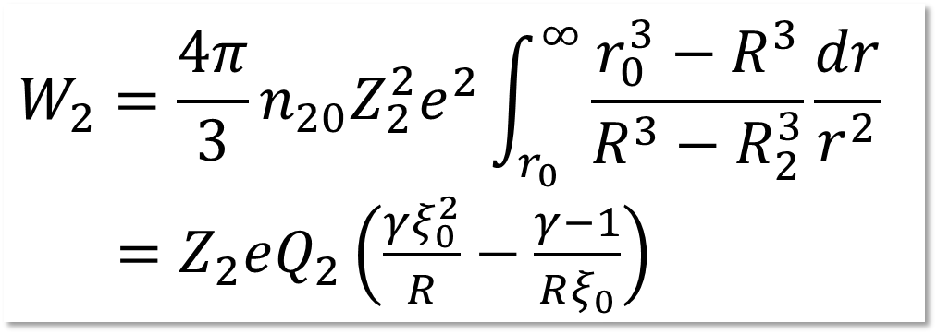
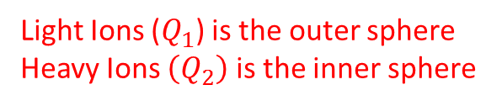





Target 2: Segregated Hollow Target
$$Q_{2}$$
$$Q_{1}$$
Energy Profile of Light Ions
$$R_{i}$$
$$R$$
$$γ=\frac{1}{1−{\tilde{R}}^{3}}$$
$$\tilde{R}=R_{i}/R$$
Light Ions ($Q_{1}$) is the outer sphere
Heavy Ions $\left(Q_{2}\right)$ is the inner sphere
New parameters:
Energy Contributions from light ions (1) and heavy ions (2):

Slide 16
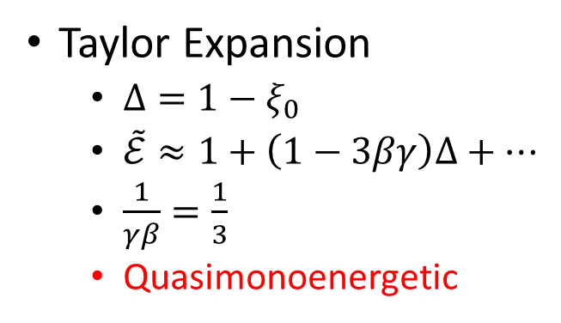
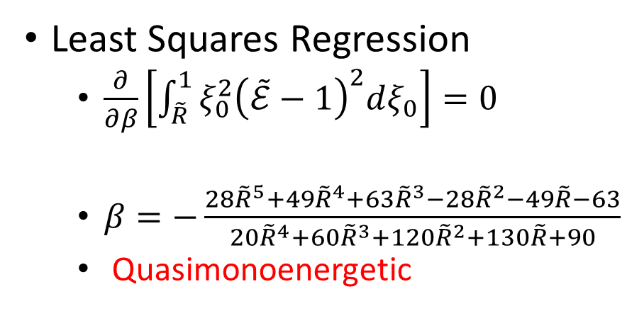

Target 2: Monoenergeticity
Cannot Eliminate $ξ_{0}$
Taylor Expansion
  $Δ=1−ξ_{0}$
  $\tilde{ℰ}≈1+\left(1−3βγ\right)Δ+…$
  $\frac{1}{γβ}=\frac{1}{3}$
  Quasimonoenergetic
Least Squares Regression
  $\frac{∂}{∂β}\left[\int_{\tilde{R}}^{1}{ξ_{0}^{2}{\left(\tilde{ℰ}−1\right)}^{2}dξ_{0}}\right]=0$
  $β=−\frac{28{\tilde{R}}^{5}+49{\tilde{R}}^{4}+63{\tilde{R}}^{3}−28{\tilde{R}}^{2}−49\tilde{R}−63}{20{\tilde{R}}^{4}+60{\tilde{R}}^{3}+120{\tilde{R}}^{2}+130\tilde{R}+90}$
  Quasimonoenergetic

Slide 17
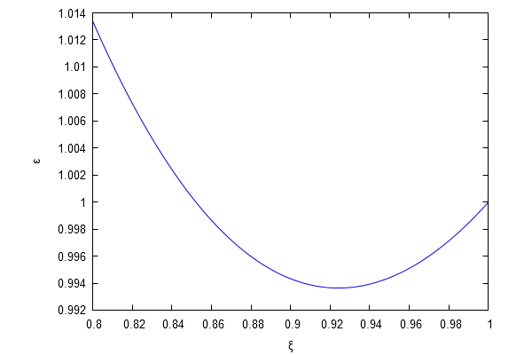
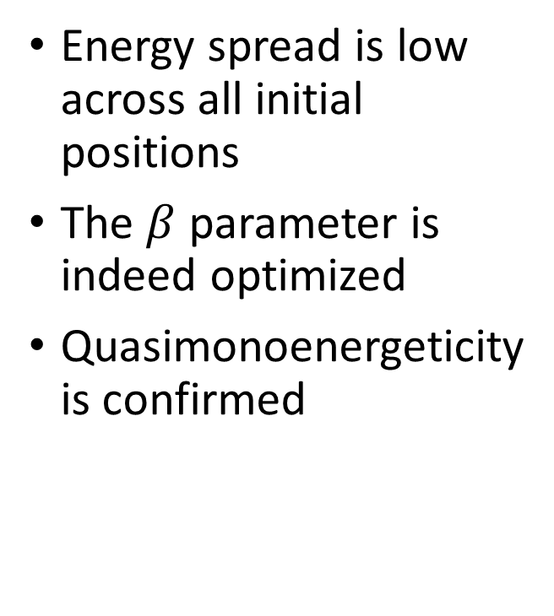

Target 2: Energy Profile ($ξ_{0})$ dependence
Energy spread is low across all initial positions
The $β$ parameter is indeed optimized
Quasimonoenergeticity is confirmed

Slide 18
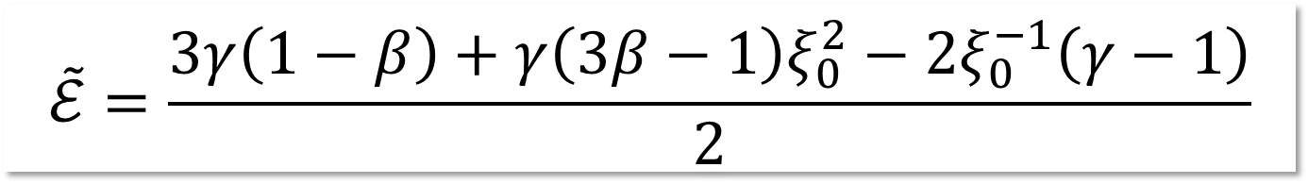
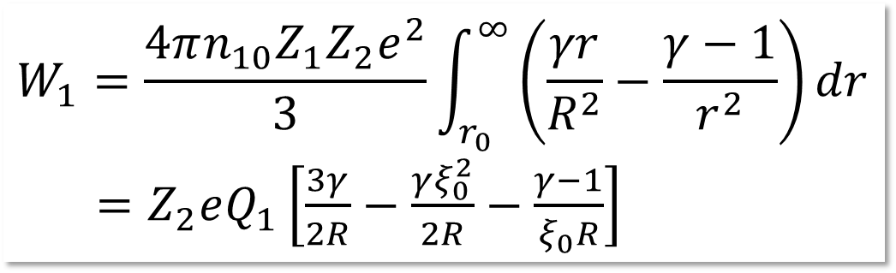
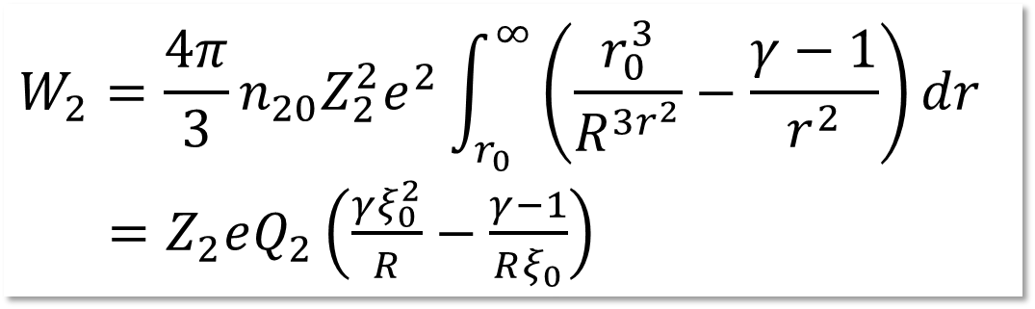



Target 3: Uniform Hollow Target
$${Q_{1}+Q}_{2}$$
Energy Profile of Light Ions
$$R_{i}$$
$$R$$
Light Ions ($Q_{1}$) and Heavy Ions $\left(Q_{2}\right)$ are uniformly mixed
Energy Contributions from light ions (1) and heavy ions (2):

Slide 19
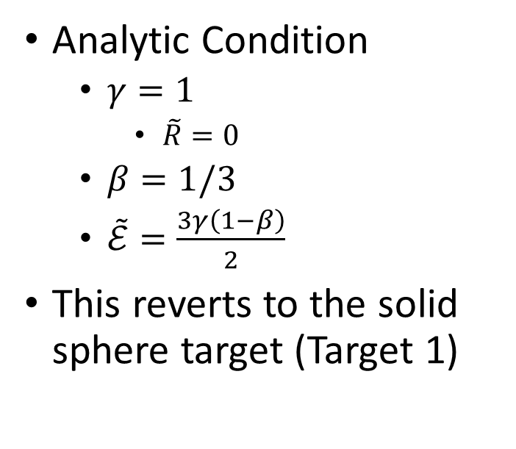
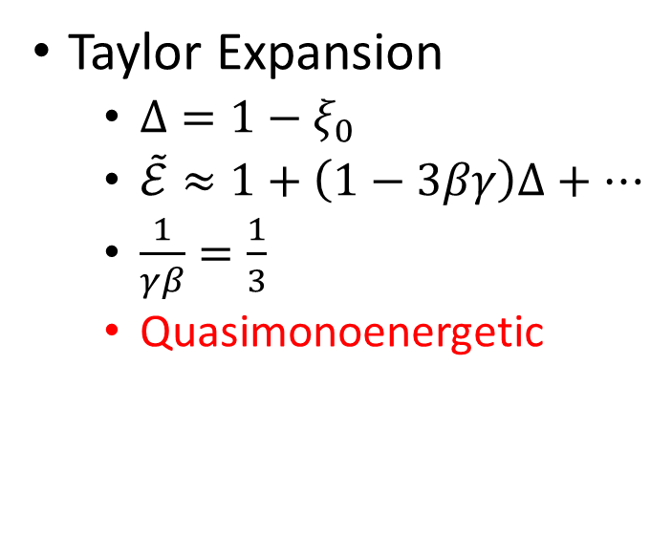
Target 3: Monoenergeticity
Taylor Expansion
  $Δ=1−ξ_{0}$
  $\tilde{ℰ}≈1+\left(1−3βγ\right)Δ+…$
  $\frac{1}{γβ}=\frac{1}{3}$
  Quasimonoenergetic
Analytic Condition
  $γ=1$
    $\tilde{R}=0$
  $β=1/3$
  $\tilde{ℰ}=\frac{3γ\left(1−β\right)}{2}$
This reverts to the solid sphere target (Target 1)

Slide 20
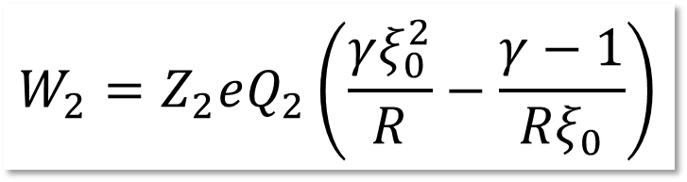
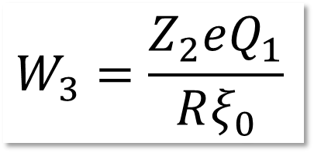
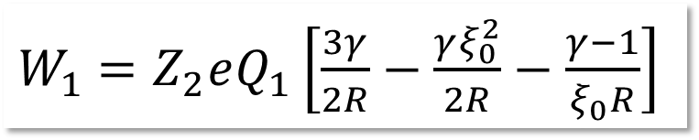
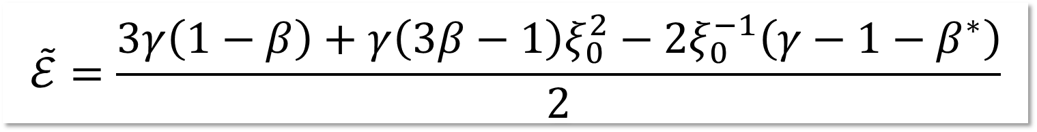


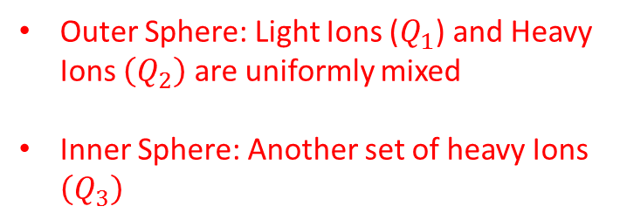


Target 4: Hybrid Target
$$Q_{3}$$
$${Q_{1}+Q}_{2}$$
Outer Sphere: Light Ions ($Q_{1}$) and Heavy Ions $\left(Q_{2}\right)$ are uniformly mixed
Inner Sphere: Another set of heavy Ions $\left(Q_{3}\right)$
$$R_{i}$$
$$R$$
New parameter: $β^{∗}=\frac{Q_{3}}{Q_{1}+Q_{2}}$
Energy Contributions from light ions (1) and heavy ions (2):
Energy Profile of Light Ions

Slide 21

Target 4: Monoenergeticity
$\tilde{ℰ}$ can be optimized analytically
$β^{∗}=γ−1,$ $β=1/3$
  $\tilde{ℰ}=\frac{3γ\left(1−β\right)}{2}$
Monoenergetic

Slide 22
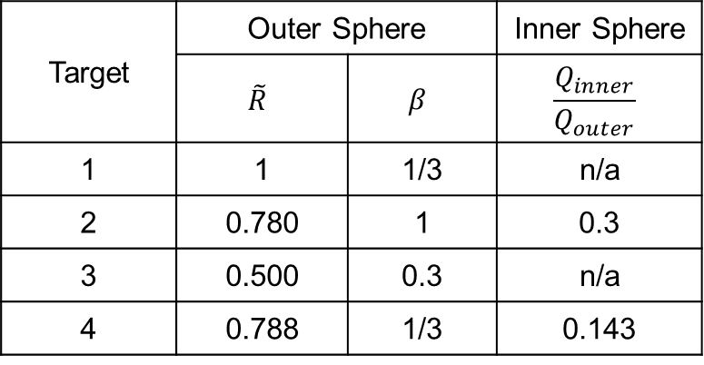
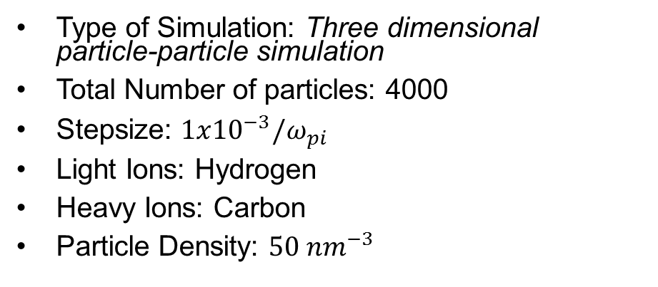
MD Simulation Parameters
Type of Simulation: Three dimensional particle-particle simulation
Total Number of particles: 4000
Stepsize: $1x{10}^{−3}/ω_{pi}$
Light Ions: Hydrogen
Heavy Ions: Carbon
Particle Density: $50 nm^{−3}$
Target | Outer Sphere |  | Inner Sphere
 | $$\tilde{R}$$ | $$β$$ | $$\frac{Q_{inner}}{Q_{outer}}$$
1 | 1 | 1/3 | n/a
2 | 0.780 | 1 | 0.3
3 | 0.500 | 0.3 | n/a
4 | 0.788 | 1/3 | 0.143

Slide 23
Energy Spectrum
All targets are have quasimonoenergetic spectrums
  Comparable quasimonoenergeticity
No low energy protons for targets 2 and 4

Slide 24
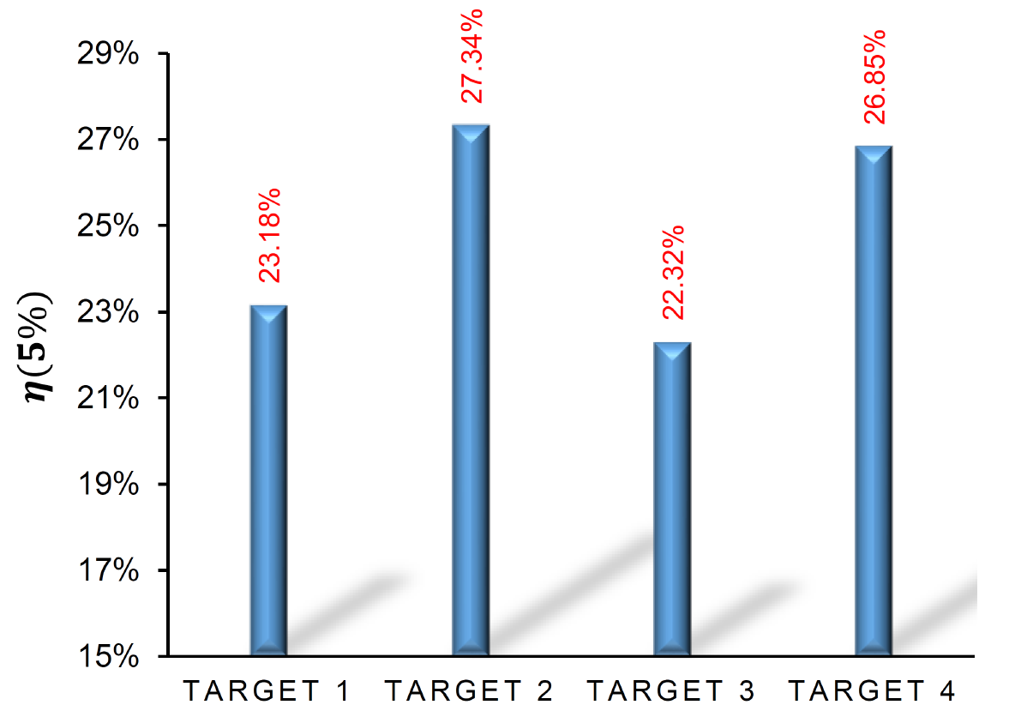
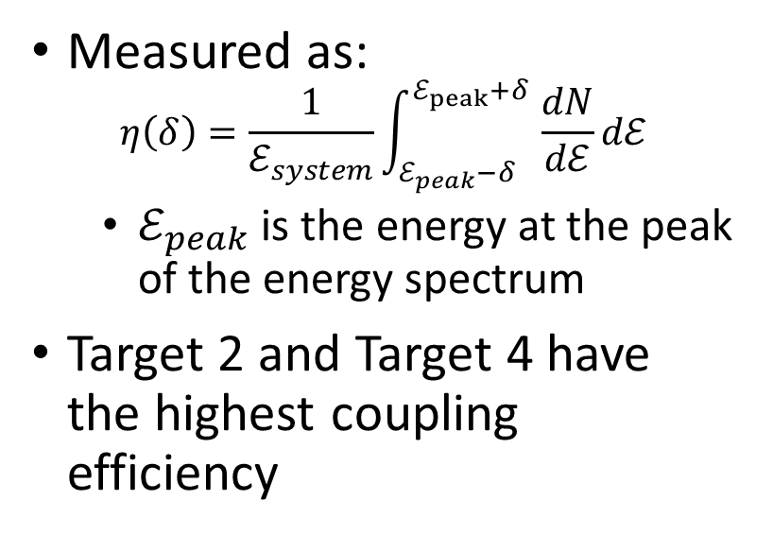
Coupling Efficiency
Measured as:
$$η\left(δ\right)=\frac{1}{ℰ_{system}}\int_{ℰ_{peak}−δ}^{ℰ_{peak}+δ }{\frac{dN}{dℰ}}dℰ$$
  $ℰ_{peak}$ is the energy at the peak of the energy spectrum
Target 2 and Target 4 have the highest coupling efficiency

Slide 25
Optimal Targets
Target 2:
Segregated Hollow Sphere
Target 4:
Hybrid Target
Both have a thin inner heavy ion Layer!

Slide 26
Conclusion and Outlook
All targets produce quasimonoenergetic protons
The thin layer of heavy ions is essential for high coupling efficiency
Proton Energies >100 MeV maybe difficult
  2 MeV protons possible
2 MeV protons can be used for neutron generation

Slide 27
Thank you for your attention!

