Slide 1

QCD thermodynamics from shifted boundary conditions
Takashi Umeda
Lattice QCD at finite temperature and density,
KEK, Ibaraki, Japan, 20-22 January 2014

Slide 2
Contents of this talk
Introduction
  finite T with Wilson quarks
Fixed scale approach
  quenched results
  Nf=2+1 QCD results
Shifted boundary conditions
  EOS
  Tc
  Beta-functions (entropy density)
Summary

Slide 3
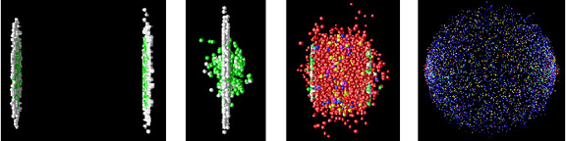
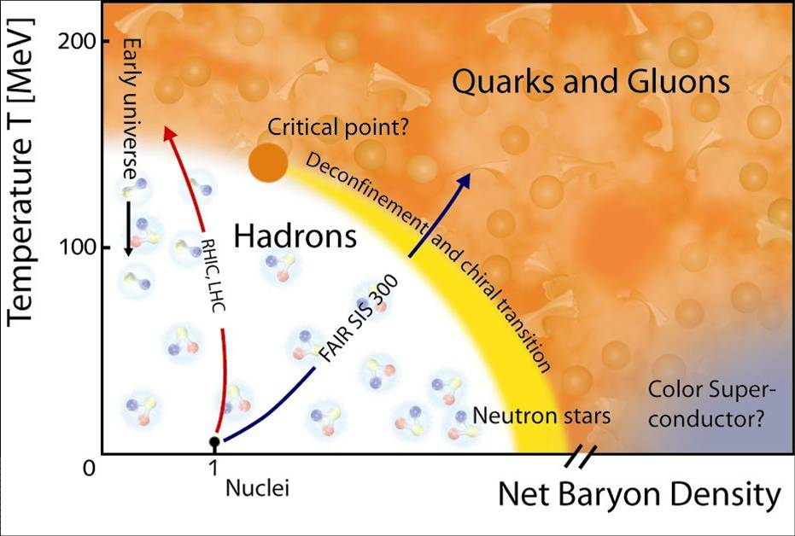
Quark Gluon Plasma in Lattice QCD
from the Phenix group web-site
Observables in Lattice QCD
  Phase diagram in (T, μ, m_{ud}, m_{s})
  Critical temperature
  Equation of state ( ε/T⁴, p/T⁴,...)
  Hadronic excitations
  Transport coefficients
  Finite chemical potential
  etc...
http://www.gsi.de/fair/experiments/

Slide 4
QCD Thermodynamics with Wilson quarks
Most (T, μ≠0) studies at m_{phys} are done with Staggered-type quarks
  4th-root trick to remove unphysical “tastes”
  → non-locality “Validity is not guaranteed”
It is important to cross-check with
theoretically sound lattice quarks like Wilson-type quarks
WHOT-QCD collaboration is investigating
QCD at finite T & μ using Wilson-type quarks
Review on WHOT-QCD studies :
S. Ejiri, K. Kanaya, T. Umeda for WHOT-QCD Collaboration,
Prog. Theor. Exp. Phys. (2012) 01A104 [ arXiv: 1205.5347 (hep-lat) ]

Slide 5
Recent studies on QCD Thermodynamics
Non-Staggered quark studies at T>0
Domain-Wall quarks
hotQCD Collaboration, Phys. Rev. D86 (2012) 094503.
TWQCD Collaboration, arXiv:1311.6220 (Lat2013).
Overlap quarks
S. Borsanyi et al. (Wuppertal), Phys. Lett. B713 (2012) 342.
JLQCD Collaboration, Phys. Rev. D87 (2013) 114514 .
twisted mass quarks
tmfT Collaboration, arXiv:1311.1631(Lat2013).
Wilson quarks
S. Borsanyi et al. (Wuppertal), JHEP08 (2012) 126.
WHOT-QCD Collaboration, Phys. Rev. D85 (2012) 094508.
Fixed scale approach is adopted to study T>0

Slide 6
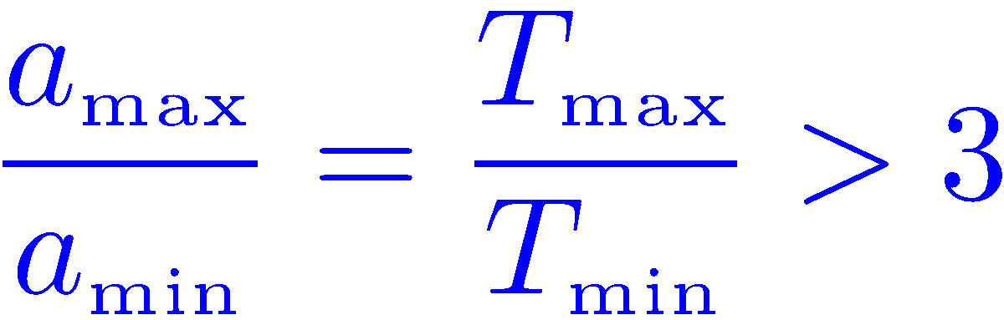
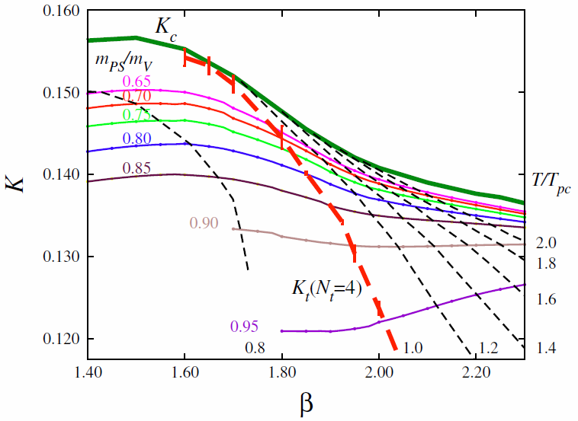
Fixed scale approach to study QCD thermodynamics
Conventional fixed Nt approach
a : lattice spacing
N_{t} : lattice size
in t-direction
Temperature T=1/(N_{t}a) is varied by a at fixed N_{t}
Coupling constants are different at each T
To study Equation of States
- T=0 subtractions at each T
- beta-functions at each T wide range of a
- Line of Constant Physics ( for full QCD )
These are done in T=0 simulations
- larger space-time volume
- smaller eigenvalue in Dirac op.
→ larger part of the simulation cost

Slide 7
Fixed scale approach to study QCD thermodynamics
Fixed scale approach
a : lattice spacing
N_{t} : lattice size
in t-direction
Temperature T=1/(N_{t}a) is varied by N_{t} at fixed a
Coupling constants are common at each T
To study Equation of States
- T=0 subtractions are common
- beta-functions are common
- Line of Constant Physics is automatically satisfied
Cost for T=0 simulations can be largely reduced
However possible temperatures are restricted by integer N_{t}
△ critical temperature T_{c}
○ EOS

Slide 8
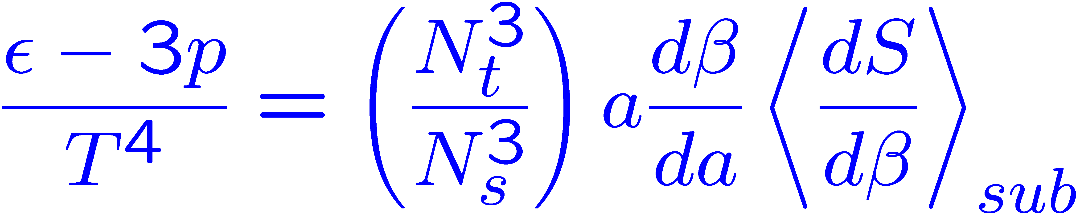
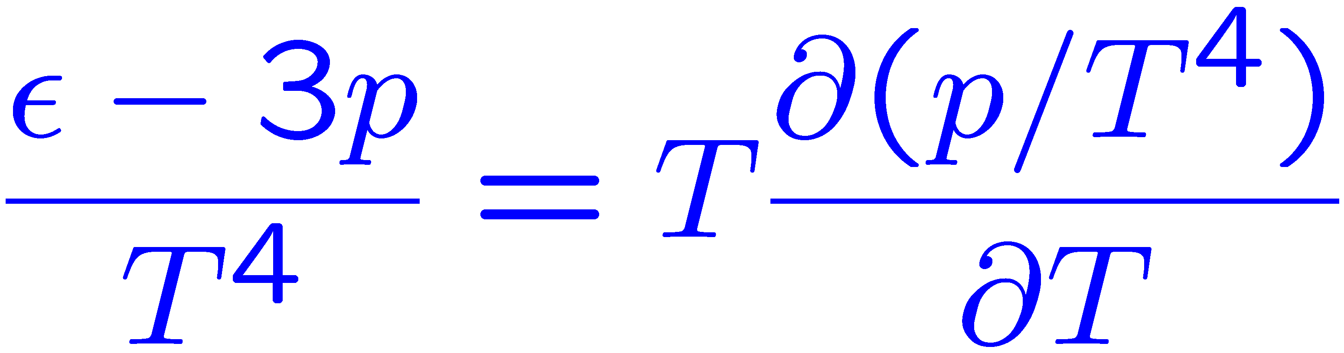
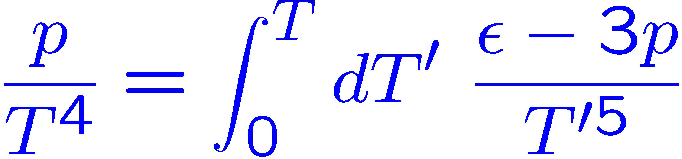
T-integration method to calculate the EOS
We propose the T-integration method
to calculate the EOS at fixed scales
T.Umeda et al. (WHOT-QCD), Phys. Rev. D79 (2009) 051501
Our method is based on the trace anomaly (interaction measure),
and the thermodynamic relation.

Slide 9
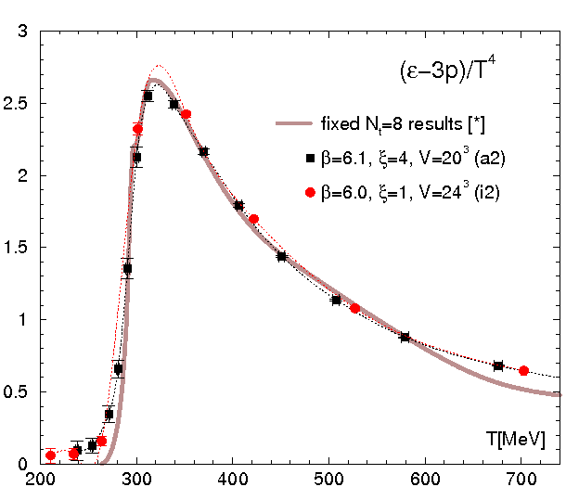
Test in quenched QCD
T. Umeda et al. (WHOT-QCD)
Phys. Rev. D79 (2009) 051501.
Our results are roughly
consistent with previous results.
at higher T
lattice cutoff effects
( aT~0.3 or higher )
at lower T
finite volume effects
V > (2fm)³ is ncessarry T<T_{c}
Anisotropic lattice is
a reasonable choice
[*] G. Boyd et al., NPB469, 419 (1996)

Slide 10
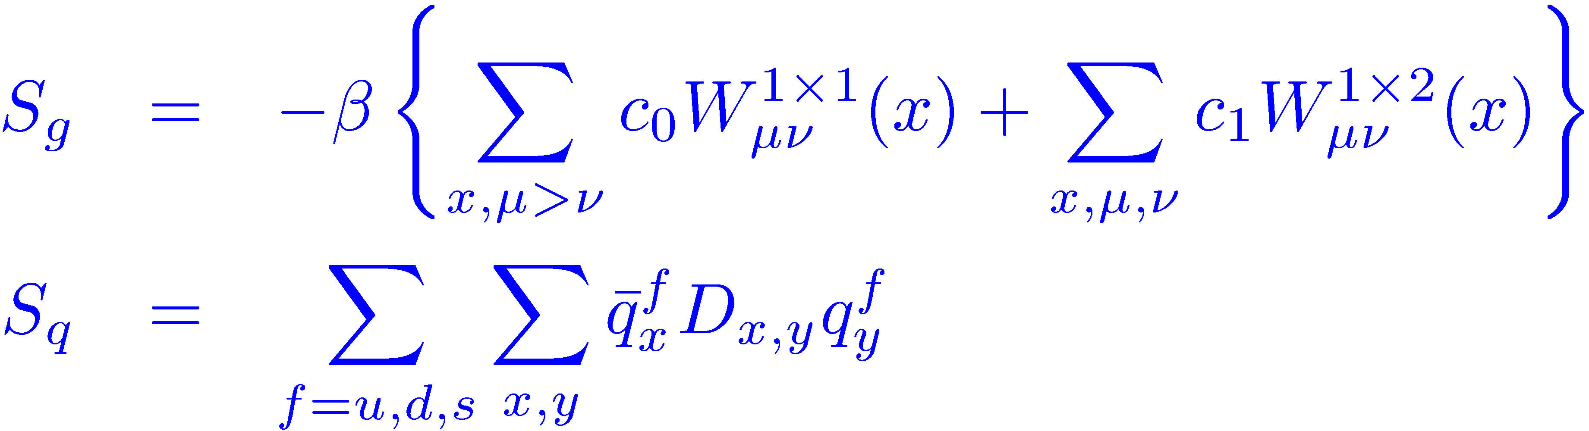
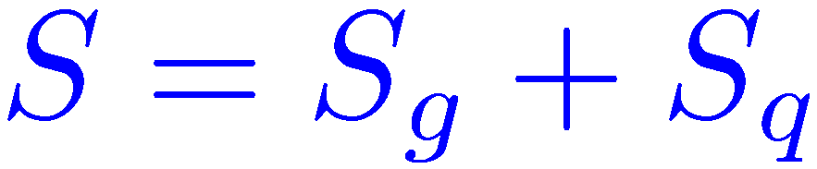
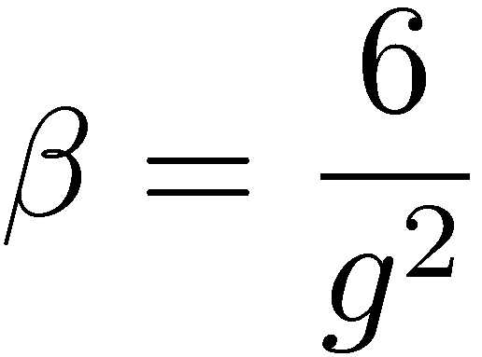
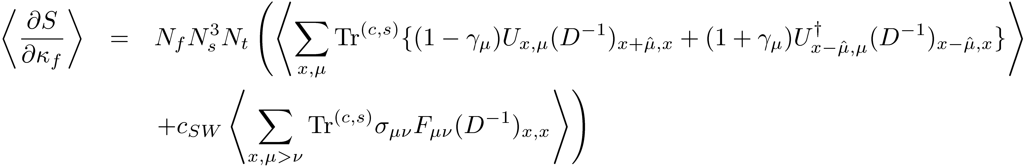
EOS for N_{f}=2+1 improved Wilson quarks
Noise method ( #noise = 1 for each color & spin indices )

Slide 11
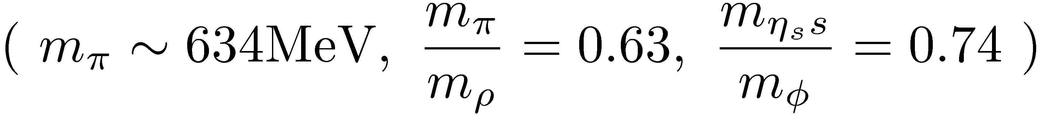
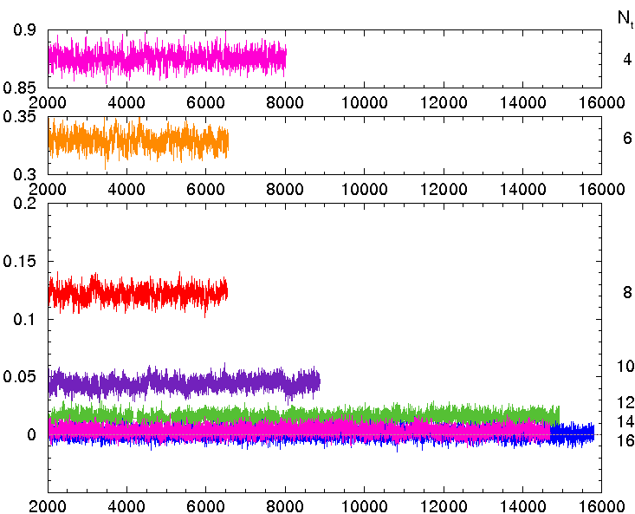
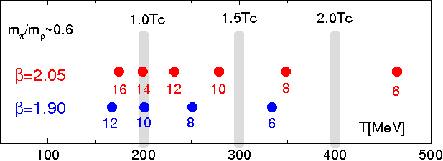
T=0 & T>0 configurations for N_{f}=2+1 QCD
T=0 simulation: on 28³ x 56
- RG-improved glue + NP-improved Wilson quarks
- V~(2 fm)³ , a≃0.07 fm,
- configurations available on the ILDG/JLDG
CP-PACS/JLQCD Phys. Rev. D78 (2008) 011502
T>0 simulations: on 32³ x N_{t} (N_{t}=4, 6, ..., 14, 16) lattices
  RHMC algorithm, same coupling parameters as T=0 simulation

Slide 12
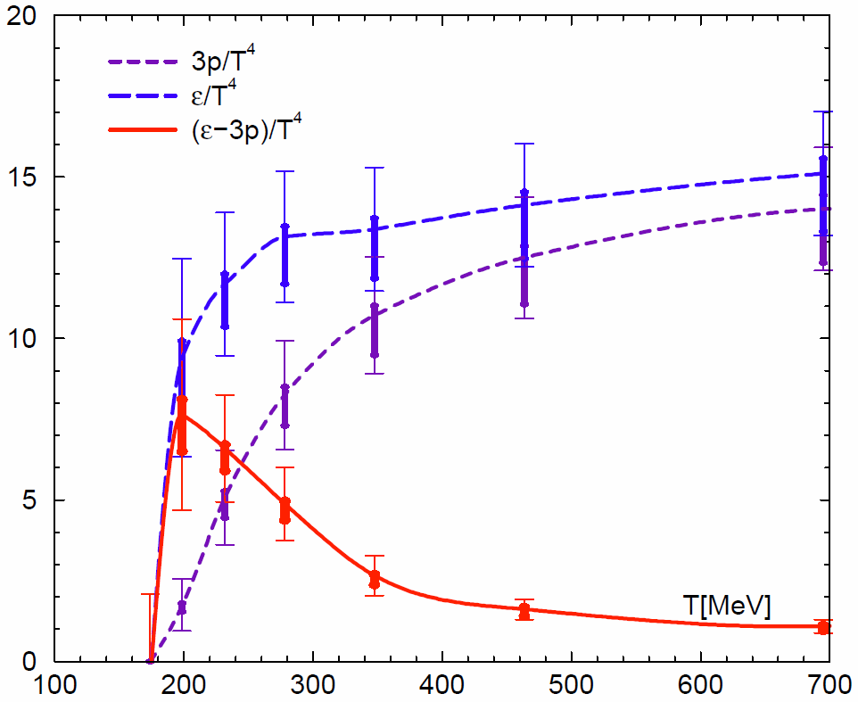
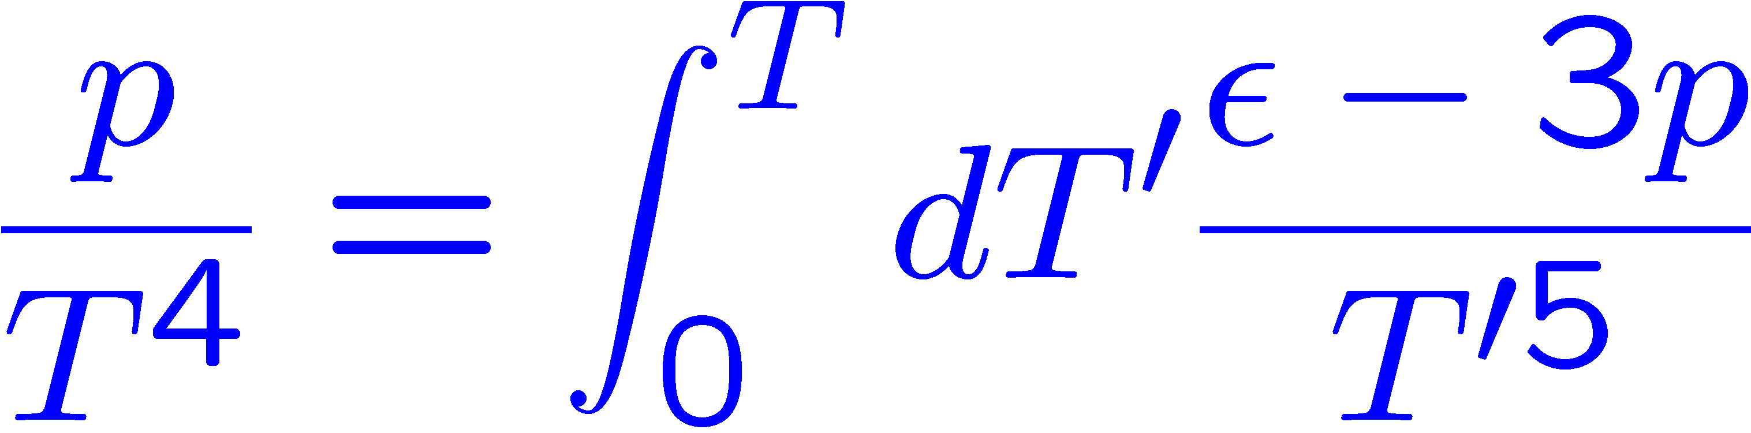
Equation of State in N_{f}=2+1 QCD
T. Umeda et al. (WHOT-QCD)
Phys. Rev. D85 (2012) 094508
SB limit
T-integration
is performed by Akima Spline
interpolation.
A systematic error
for beta-functions
numerical error propagates
until higher temperatures

Slide 13
Summary on Fixed scale approach
Fixed scale approach for EOS
  EOS (p, e, s, ...) by T-integral method
  Cost for T=0 simulations can be largely reduced
  possible temperatures are restricted by integer N_{t}
  beta-functions are still a burden
Some groups adopted the approach
  - tmfT Collaboration, arXiv:1311.1631(Lat2013).
  - S. Borsanyi et al. (Wuppertal), JHEP08 (2012) 126.
Physical point simulation with Wilson quarks is on going

Slide 14
Contents of this talk
Introduction
  finite T with Wilson quarks
Fixed scale approach
  quenched results
  Nf=2+1 QCD results
Shifted boundary conditions
  EOS
  Tc
  Beta-functions (entropy density)
Summary

Slide 15
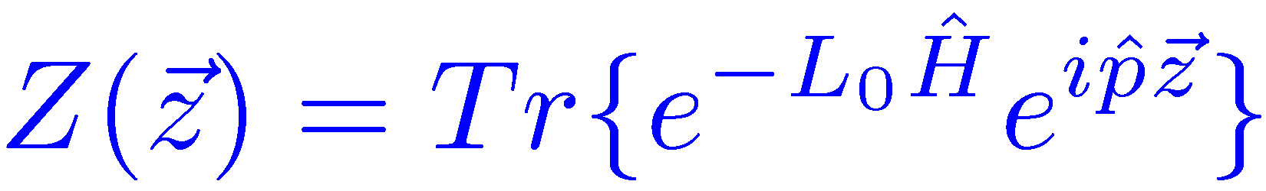
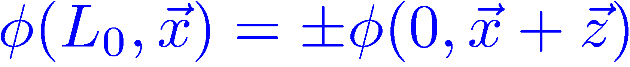
Shifted boundary conditions
L. Giusti and H. B. Meyer, Phys. Rev. Lett. 106 (2011) 131601.
Thermal momentum distribution from path integrals
with shifted boundary conditions
New method to calculate thermodynamic potentials
(entropy density, specific heat, etc. )
The method is based on the partition function
which can be expressed by Path-integral with shifted boundary condition
L. Giusti and H. B. Meyer, JHEP 11 (2011) 087
L. Giusti and H. B. Meyer, JHEP 01 (2013) 140

Slide 16
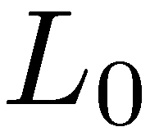
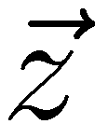
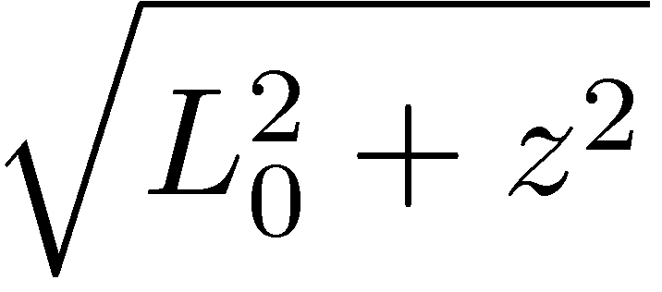
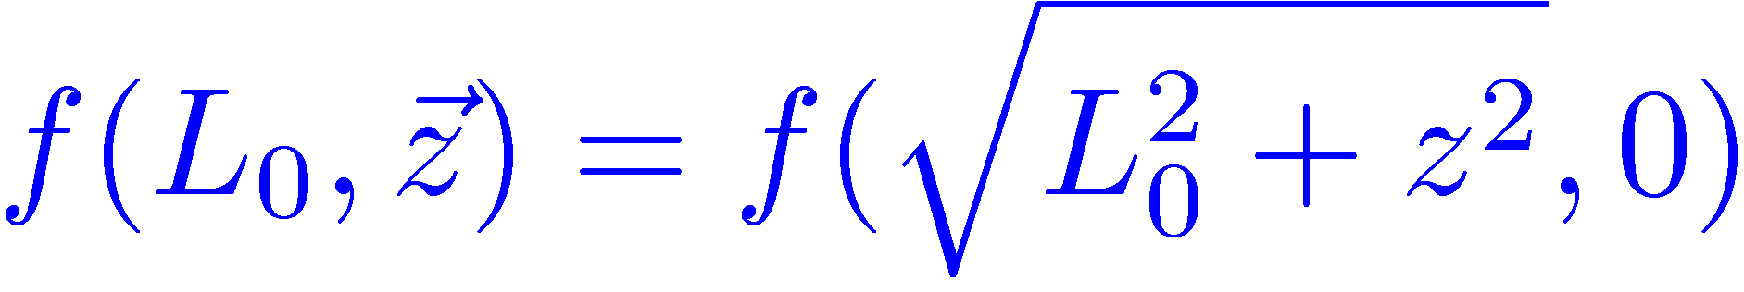
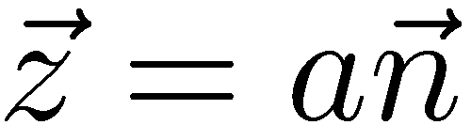


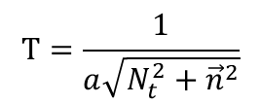


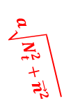
Shifted boundary conditions
Due to the Lorentz invariance of the theory
the free-energy depends on and the boundary shift
only through the combination
$$t=aN_{t}=L_{0}$$
$$a\sqrt{N_{t}^{2}+{\vec{n}}^{2}}$$
time
$$a\vec{n}$$
$$T=\frac{1}{a\sqrt{N_{t}^{2}+{\vec{n}}^{2}}}$$
space
$$t=0$$
$$a\vec{n}$$

Slide 17
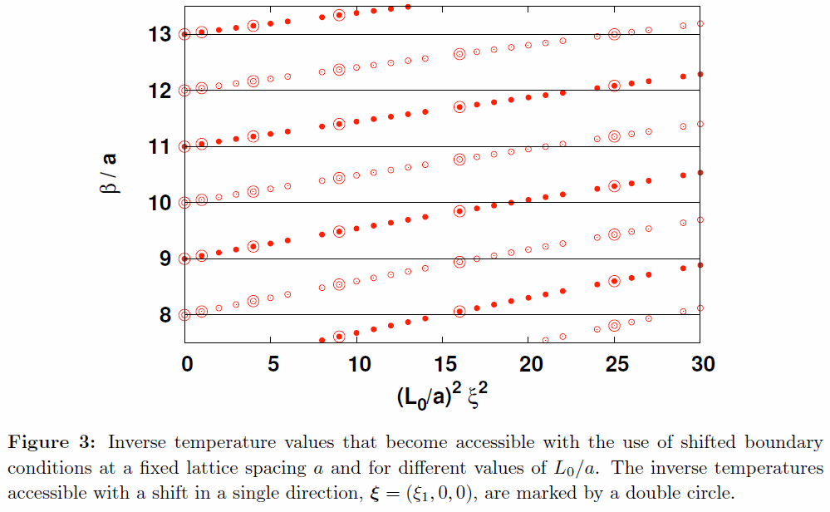
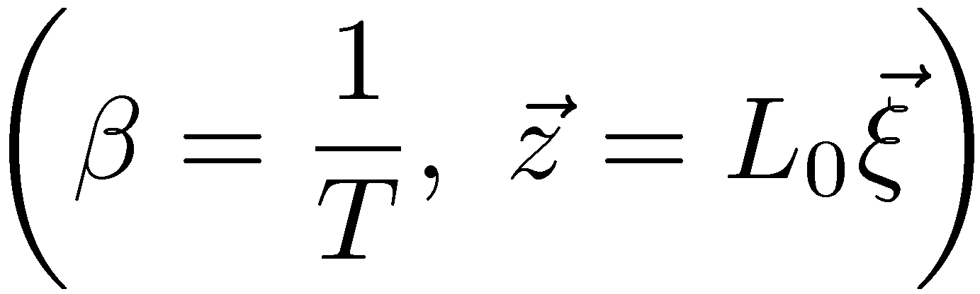
Shifted boundary conditions
By using the shifted boundary
various T’s are realized with the same lattice spacing
T resolution is largely improved
while keeping advantages of the fixed scale approach
L. Giusti et al. (2013)

Slide 18
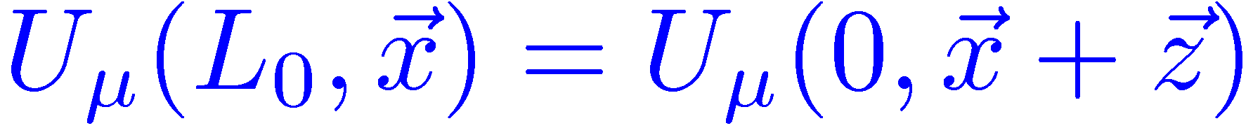
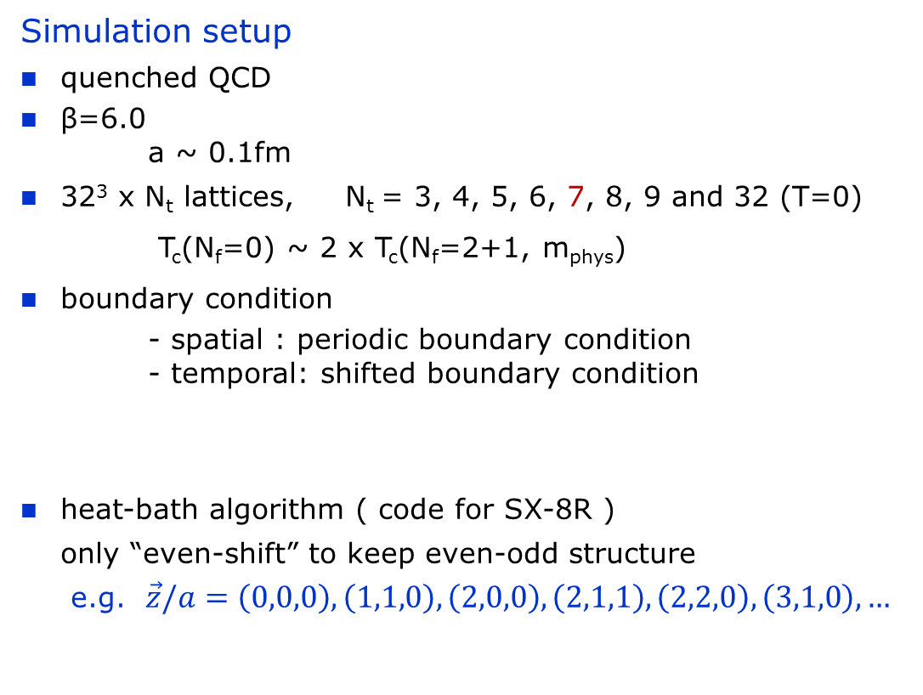
Test in quenched QCD
Simulation setup
quenched QCD
β=6.0
a ~ 0.1fm
32³ x N_{t} lattices, N_{t} = 3, 4, 5, 6, 7, 8, 9 and 32 (T=0)
T_{c}(N_{f}=0) ~ 2 x T_{c}(N_{f}=2+1, m_{phys})
boundary condition
- spatial : periodic boundary condition
- temporal: shifted boundary condition
heat-bath algorithm ( code for SX-8R )
only “even-shift” to keep even-odd structure
e.g. $\vec{z}/a=\left(0,0,0\right), \left(1,1,0\right), \left(2,0,0\right), \left(2,1,1\right), \left(2,2,0\right), \left(3,1,0\right), …$

Slide 19
Test in quenched QCD
Choice of boundary shifts

Slide 20
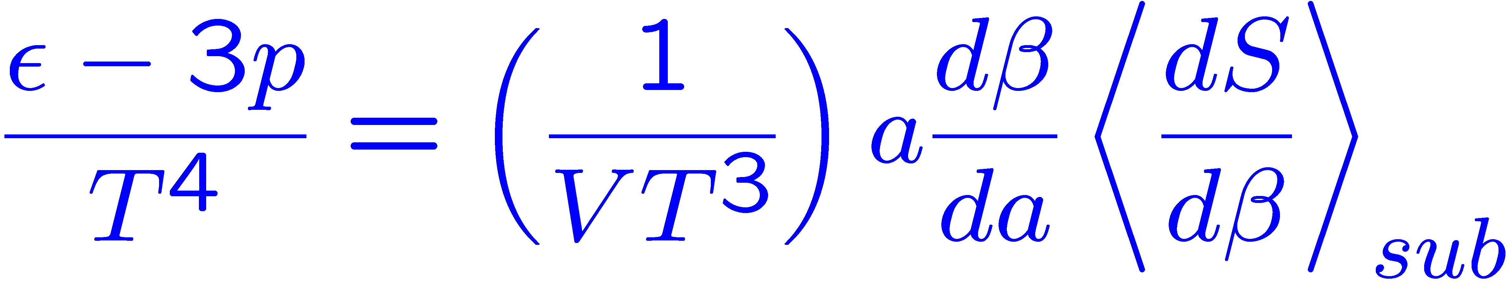
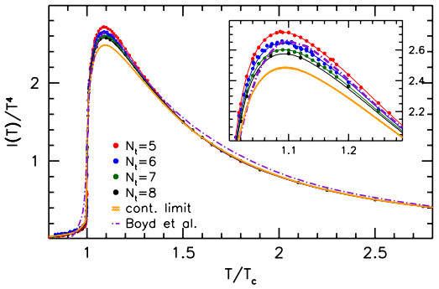
Trace anomaly ( e-3p )/T⁴
Reference data
S. Borsanyi et al., JHEP 07 (2012) 056
Precision SU(3) lattice thermodynamics
for a large temperature range
N_{s}/N_{t} = 8 near T_{c}
small N_{t} dependence at T>1.3Tc
peak height at Nt=6 is about
7% higher than continuum value
assuming T_{c}=293MeV
The continuum values referred as “continuum”

Slide 21
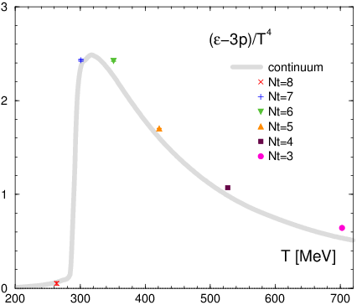
Trace anomaly ( e-3p )/T⁴
w/o shifted boundary
beta-function: Boyd et al. (1998)

Slide 22
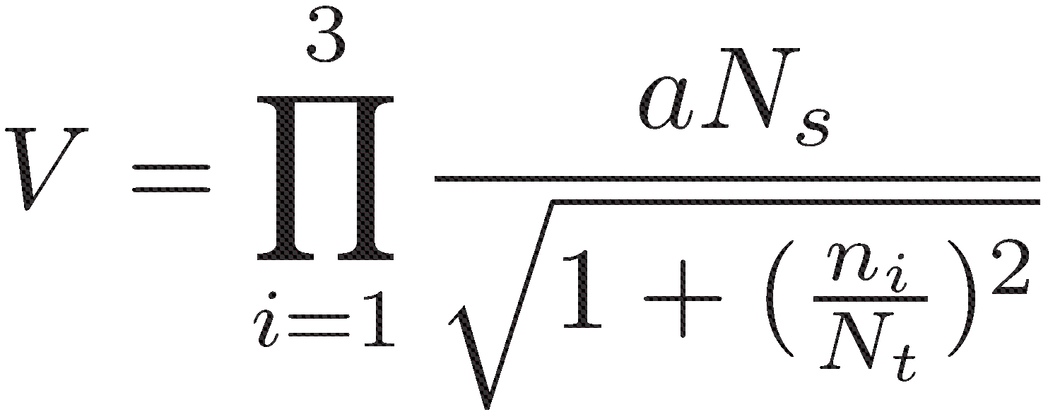
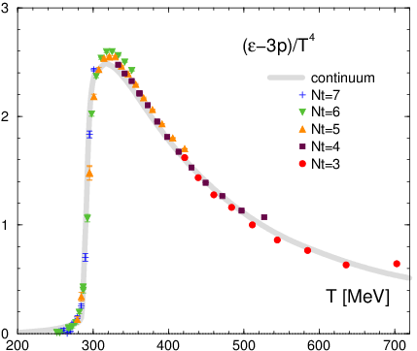
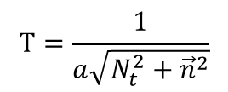
Trace anomaly ( e-3p )/T⁴
$$T=\frac{1}{a\sqrt{N_{t}^{2}+{\vec{n}}^{2}}}$$
w/o shifted boundary
w/ shifted boundary
beta-function: Boyd et al. (1998)

Slide 23
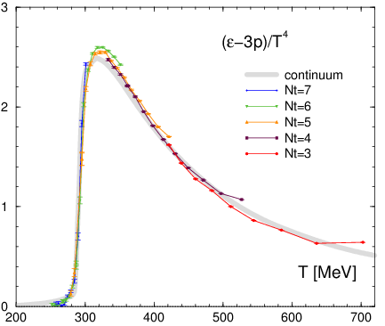
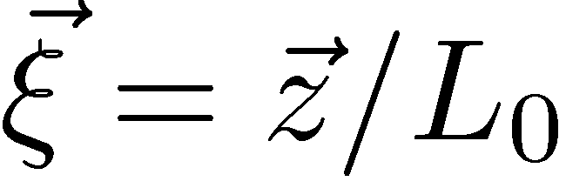
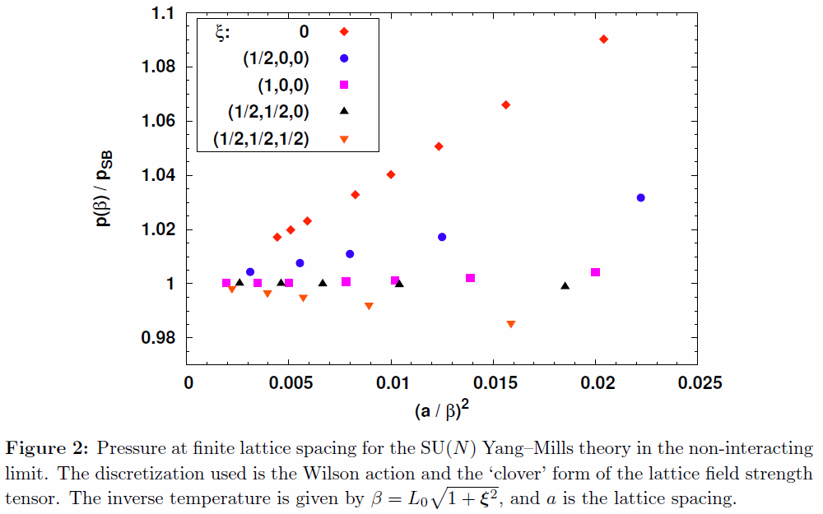
Lattice artifacts from shifted boundaries
L. Giusti et al. (2011)
Lattice artifacts are suppressed at larger shifts
Non-interacting limit with fermions should be checked
Notes:
When such suppression will be held in case of full QCD, Larger shift simulations are good way to investigate the QCD EOS.

Slide 24
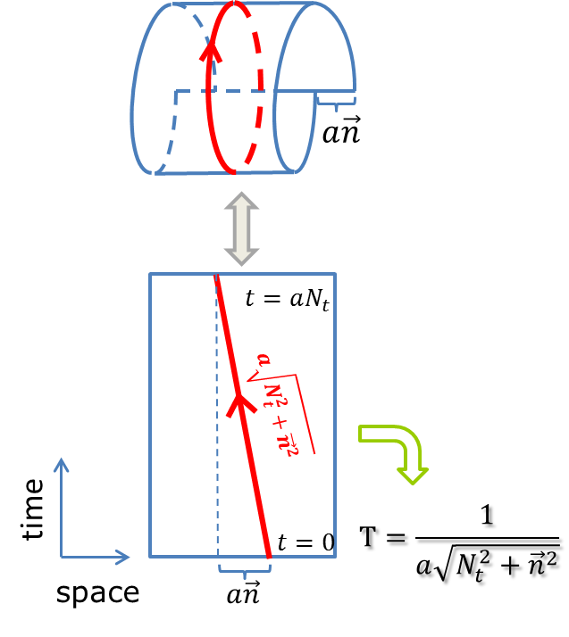
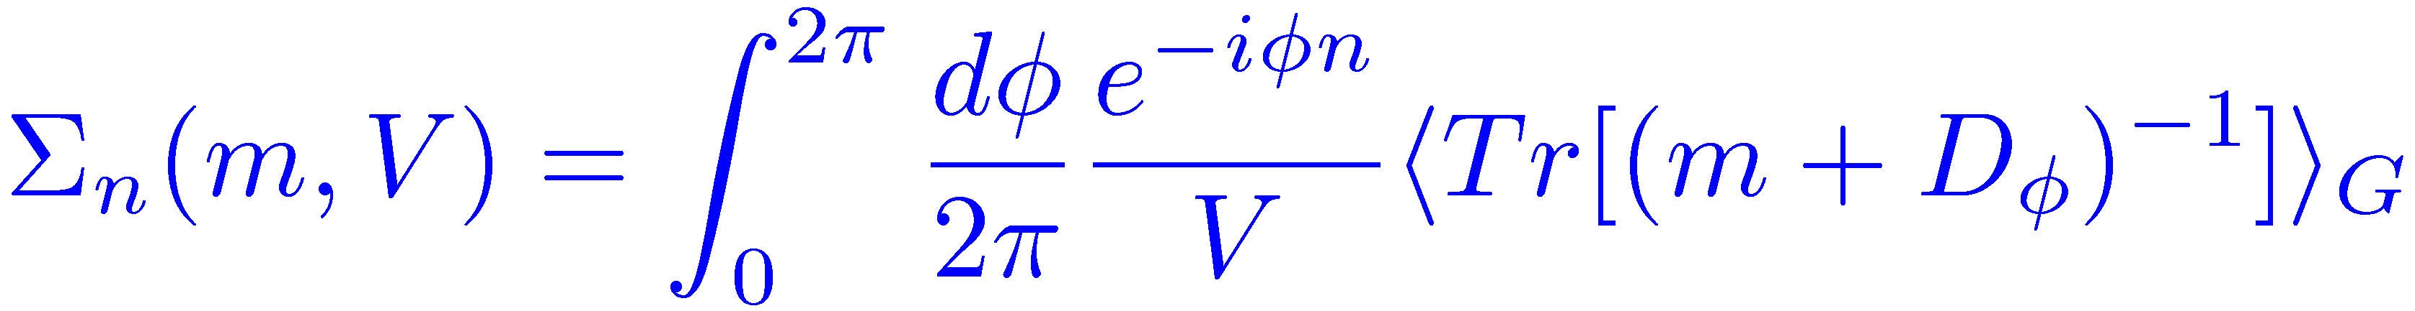
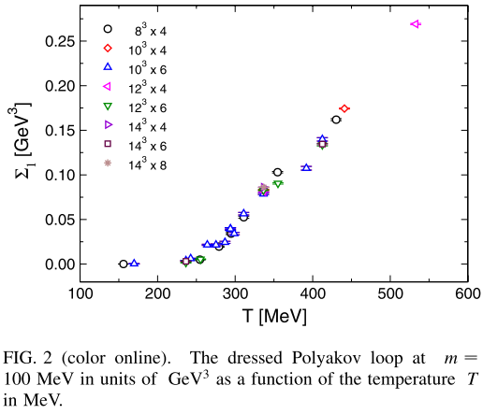
Critical temperature T_{c}
Polyakov loop is difficult to be defined
because of misalignment of
time and compact directions
Dressed Polyakov loop
E. Bilgici et al.,
Phys. Rev. D77 (2008) 094007
Polyakov loop defined with light quarks
Notes:
I think there may be a simple idea to extract the Polyakov loop from simulation with the shifted boundary conditions.
In any case, in full QCD calculation, we have to measure the chiral condensate to discuss the pseud-critical temperature.

Slide 25
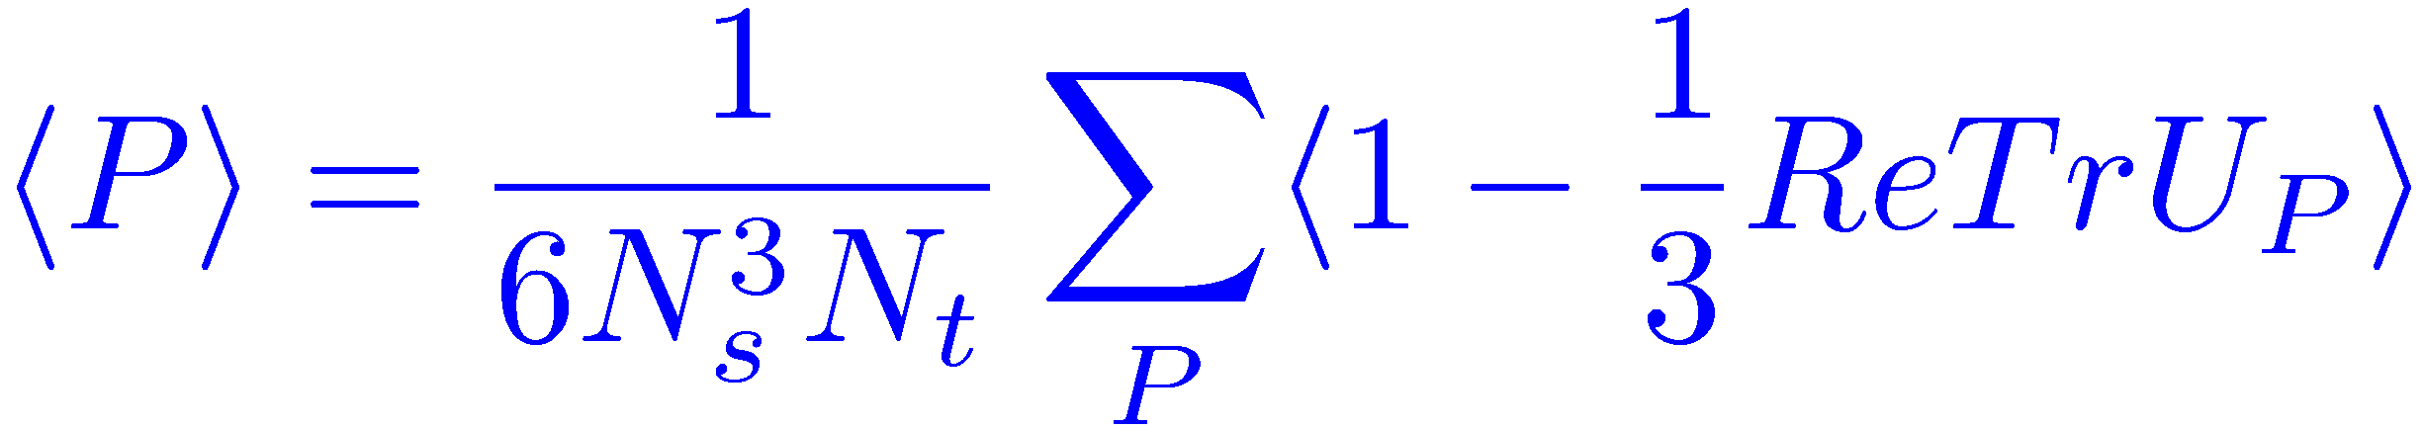
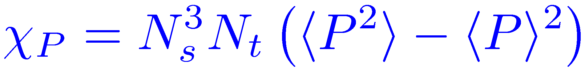
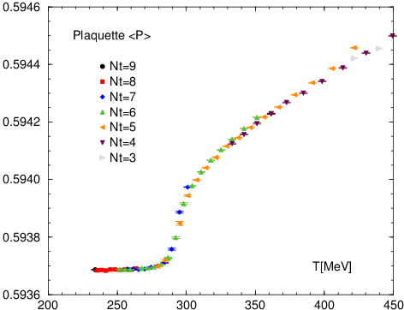
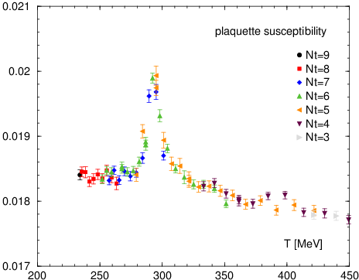
Critical temperature Tc
Plaquette value
Plaquette susceptibility
Plaq. suscep. has a peak
around T = 293 MeV

Slide 26
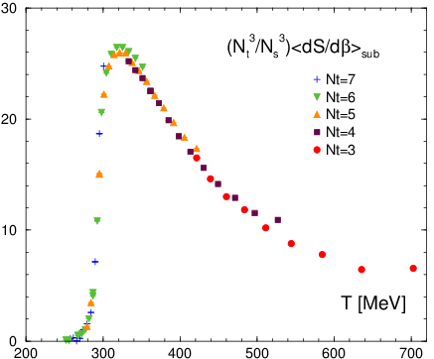
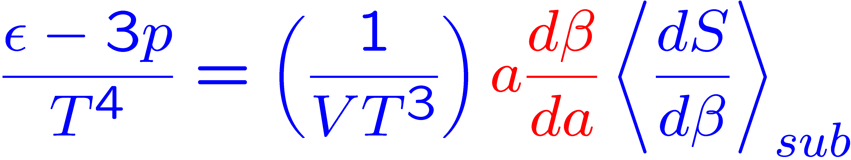
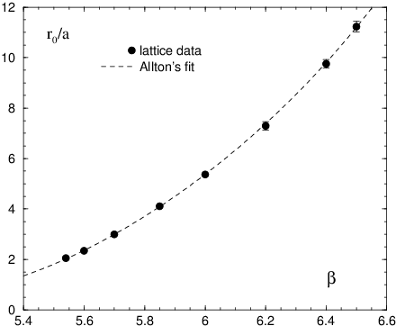
Beta-functions ( in case of quenched QCD )
In the fixed scale approach
beta-func at the simulation point
is required
However, T=0 simulations near the point
are necessary to calculate the beta-function
We are looking for
new methods to calculate beta-function
- Reweighting method
- Shifted boundary condition

Slide 27
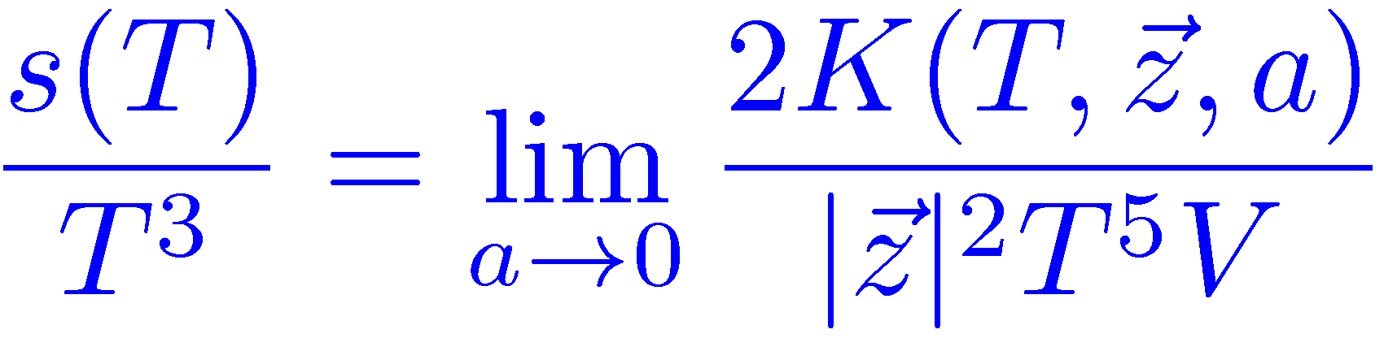




Entropy density from shifted boundaries
Entropy density s/T³
from the cumulant of the momentum distribution
L. Giusti and H. B. Meyer, Phys. Rev. Lett. 106 (2011) 131601
: partition function
with shifted boundary
where ,
n_{z} being kept fixed when a→0
L. Giusti et al. (2011)

Slide 28




Entropy density from shifted boundaries
Entropy density at a temperature (T₀)
by the new method with shifted b.c.
Entropy density w/o beta-function
by the T-integral method
Beta-func is determined by
matching of entropy densities at T₀
Notes:
When we adopt the new method, the previous method including our T-integral method are not necessary in principle.
Now it is a matter of numerical cost. At present the new method may need larger cost than our method.

Slide 29




L. Giusti and H. B. Meyer (2011)
momentum distribution
Temporal extent
Hamiltonian
projector onto states
with total momentum p
The generating function K(z) of the cumulants of the mom. dist. is defined
the cumulants are given by

Slide 30



L. Giusti and H. B. Meyer (2011)
The generating func. K(p) can be written
with the partition function
Z(z) can be expressed as a path integral
with the field satisfying the shifted b.c.
By the Ward Identities, the cumulant is related to the entropy density “s”
The specific heat and speed of sound can be also obtained in the method.

Slide 31




How to calculate k_{{0,0,2}}
Evaluation of Z(z)/Z with reweighting method

Slide 32
Summary & outlook
We presented our study of the QCD Thermodynamics
by using Fixed scale approach
and Shifted boundary conditions
Fixed scale approach
- Cost for T=0 simulations can be largely reduced
- first result in N_{f}=2+1 QCD with Wilson-type quarks
Shifted boundary conditions are promising tool
to improve the fixed scale approach
- fine resolution in Temperature
- suppression of lattice artifacts at larger shifts
- Tc determination could be possible
- New method to estimate beta-functions
Test in full QCD → Nf=2+1 QCD at the physical point

Slide 33
Thank you for your attention !

Slide 34




L. Giusti and H. B. Meyer (2011) jhep1111, p10
Notes:
Ward Identities (2.6) with O=T_0k
(5.1), (5.2) → (5.3) at V=∞ → (5.5)
(5.6) and (4.8)

