Slide 1
偏移境界条件を用いた有限温度格子QCDの研究
Takashi Umeda (Hiroshima Univ.)
JPS meeting, Tokai Univ., Kanagawa, 28 March 2014

Slide 2
Fixed scale approach to study QCD thermodynamics
Fixed scale approach
a : lattice spacing
N_{t} : lattice size
in t-direction
Temperature T=1/(N_{t}a) is varied by N_{t} at fixed a
Coupling constants are common at each T
To study Equation of States
- T=0 subtractions are common
- beta-functions are common
- Line of Constant Physics is automatically satisfied
Cost for T=0 simulations can be largely reduced
However possible temperatures are restricted by integer N_{t}
△ critical temperature T_{c}
○ EOS

Slide 3
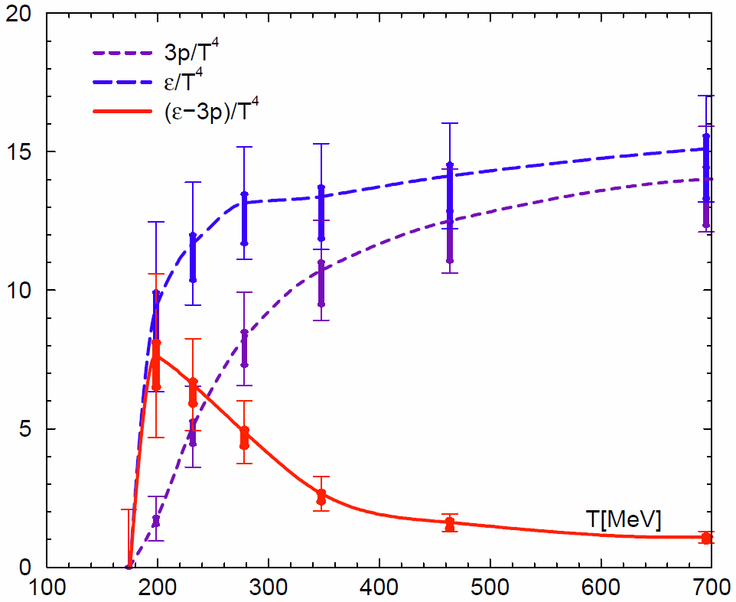
Equation of State in N_{f}=2+1 QCD
Fixed scale approach for EOS
EOS by T-integral method
Small cost for T=0 simulation
restricted T’s by integer N_{t}
beta-functions
Some groups adopted the approach
- tmfT, arXiv:1311.1631
- Wuppertal, JHEP08(2012)126.
Physical point simulation with Wilson quarks is on going
SB limit
T. Umeda et al. (WHOT-QCD)
Phys. Rev. D85 (2012) 094508

Slide 4
Shifted boundary conditions
L. Giusti and H. B. Meyer, Phys. Rev. Lett. 106 (2011) 131601.
Thermal momentum distribution from path integrals
with shifted boundary conditions
New method to calculate thermodynamic potentials
(entropy density, specific heat, etc. )
The method is based on the partition function
which can be expressed by Path-integral with shifted boundary condition
L. Giusti and H. B. Meyer, JHEP 11 (2011) 087
L. Giusti and H. B. Meyer, JHEP 01 (2013) 140

Slide 5
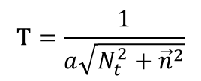
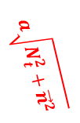
Shifted boundary conditions
$$t=aN_{t}=L_{0}$$
$$a\sqrt{N_{t}^{2}+{\vec{n}}^{2}}$$
time
$$a\vec{n}$$
$$T=\frac{1}{a\sqrt{N_{t}^{2}+{\vec{n}}^{2}}}$$
space
$$t=0$$
$$a\vec{n}$$
By using the shifted boundary
various T’s are realized with the same lattice spacing
T resolution is largely improved
while keeping advantages of the fixed scale approach

Slide 6
Test in quenched QCD
Simulation setup
quenched QCD
β=6.0
a ~ 0.1fm
32³ x N_{t} lattices, N_{t} = 3, 4, 5, 6, 7, 8, 9 and 32 (T=0)
T_{c}(N_{f}=0) ~ 2 x T_{c}(N_{f}=2+1, m_{phys})
boundary condition
- spatial : periodic boundary condition
- temporal: shifted boundary condition
heat-bath algorithm ( code for SX-8R )
only “even-shift” to keep even-odd structure
e.g. $\vec{z}/a=\left(0,0,0\right), \left(1,1,0\right), \left(2,0,0\right), \left(2,1,1\right), \left(2,2,0\right), \left(3,1,0\right), …$

Slide 7
Test in quenched QCD
Choice of boundary shifts

Slide 8
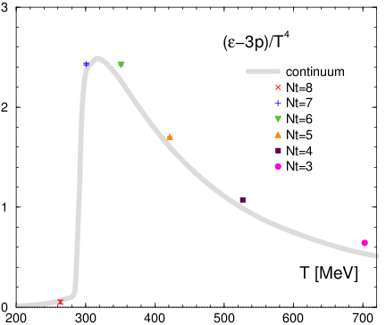
Trace anomaly ( e-3p )/T⁴
w/o shifted boundary
beta-function: Boyd et al. (1998)

Slide 9
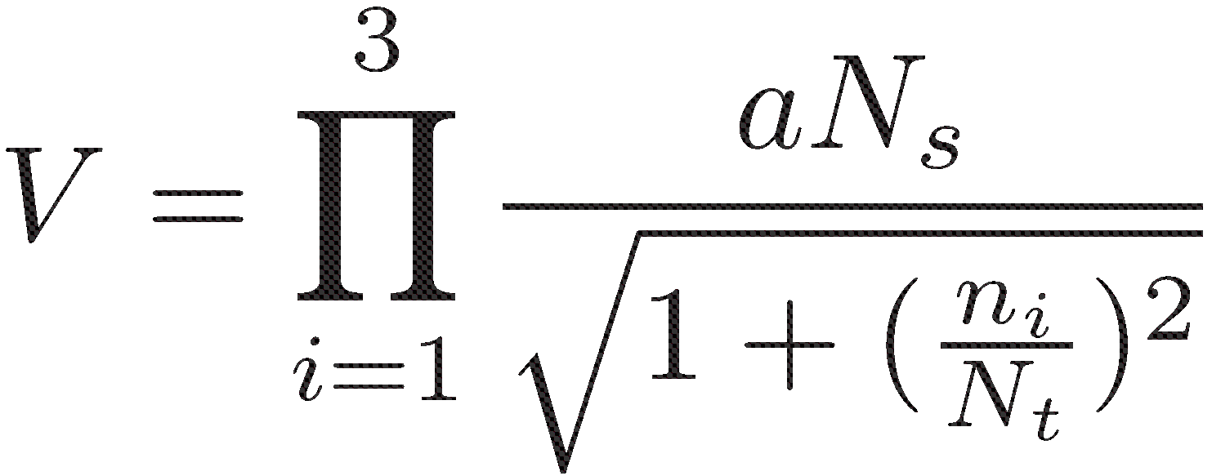
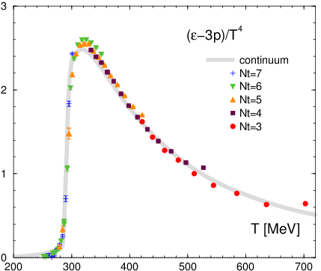
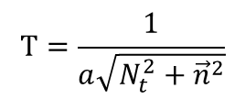
Trace anomaly ( e-3p )/T⁴
$$T=\frac{1}{a\sqrt{N_{t}^{2}+{\vec{n}}^{2}}}$$
w/o shifted boundary
w/ shifted boundary
beta-function: Boyd et al. (1998)

Slide 10
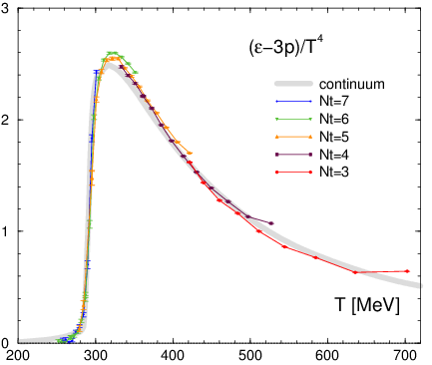
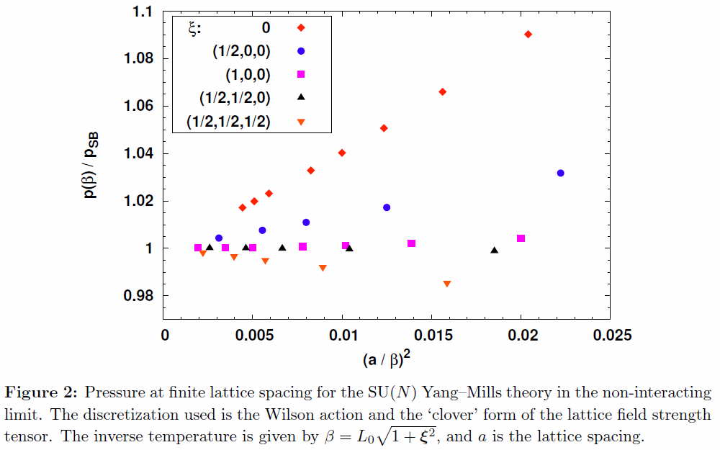
Lattice artifacts from shifted boundaries
L. Giusti et al. (2011)
Lattice artifacts are suppressed at larger shifts
Non-interacting limit with fermions should be checked
Notes:
When such suppression will be held in case of full QCD, Larger shift simulations are good way to investigate the QCD EOS.

Slide 11
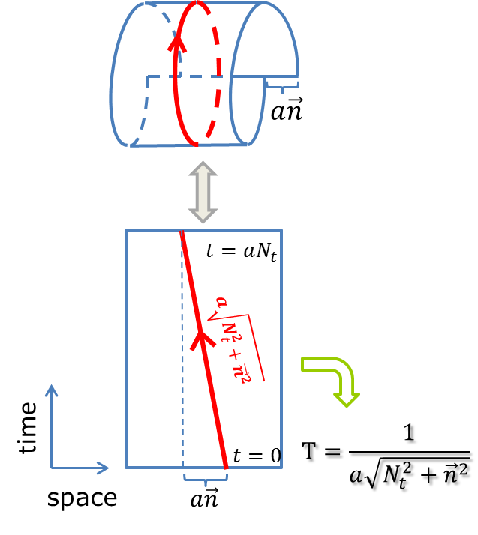
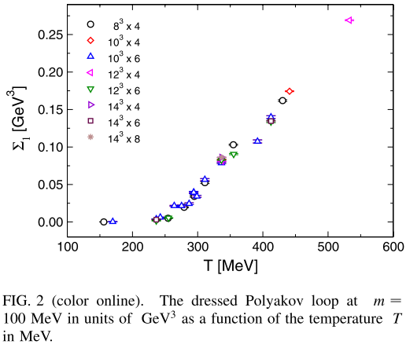
Critical temperature T_{c}
Polyakov loop is difficult to be defined
because of misalignment of
time and compact directions
Dressed Polyakov loop
E. Bilgici et al.,
Phys. Rev. D77 (2008) 094007
Polyakov loop defined with light quarks
Notes:
I think there may be a simple idea to extract the Polyakov loop from simulation with the shifted boundary conditions.
In any case, in full QCD calculation, we have to measure the chiral condensate to discuss the pseud-critical temperature.

Slide 12
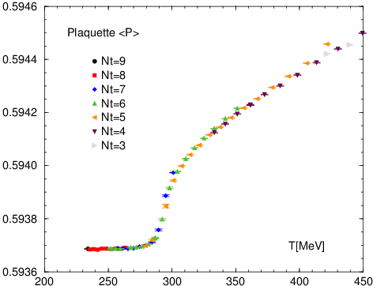
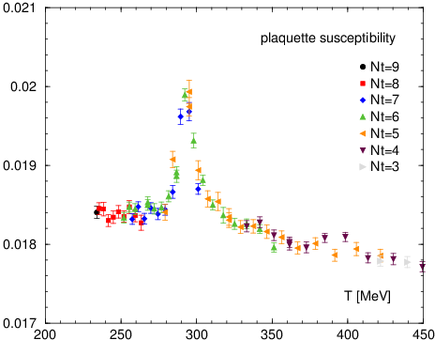
Critical temperature Tc
Plaquette value
Plaquette susceptibility
Plaq. suscep. has a peak
around T = 293 MeV

Slide 13
Summary & outlook
We presented our study of the QCD Thermodynamics
by using Fixed scale approach
and Shifted boundary conditions
Fixed scale approach
- Cost for T=0 simulations can be largely reduced
- first result in N_{f}=2+1 QCD with Wilson-type quarks
Shifted boundary conditions are promising tool
to improve the fixed scale approach
- fine resolution in Temperature
- suppression of lattice artifacts at larger shifts
- Tc determination could be possible
- New method to estimate beta-functions
Test in full QCD → Nf=2+1 QCD at the physical point

Slide 14
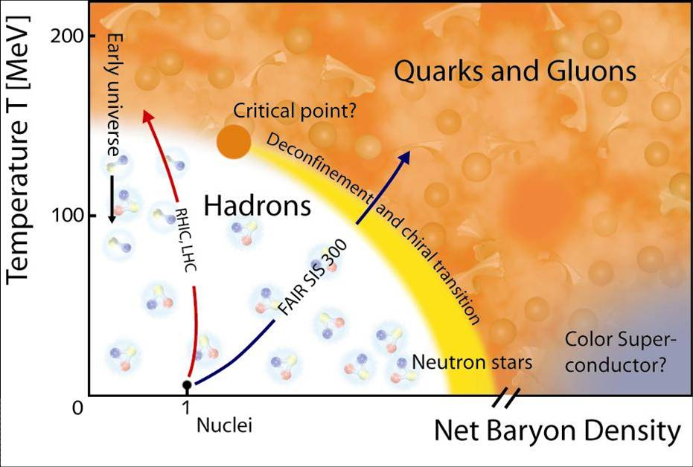
Quark Gluon Plasma in Lattice QCD
from the Phenix group web-site
Observables in Lattice QCD
Phase diagram in (T, μ, m_{ud}, m_{s})
Critical temperature
Equation of state ( ε/T⁴, p/T⁴,...)
Hadronic excitations
Transport coefficients
Finite chemical potential
etc...
http://www.gsi.de/fair/experiments/

