Slide 1
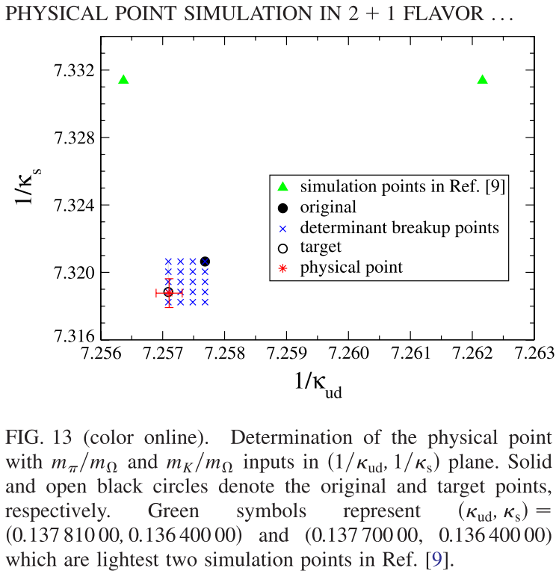
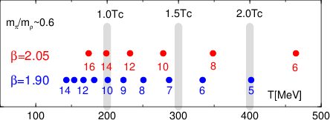
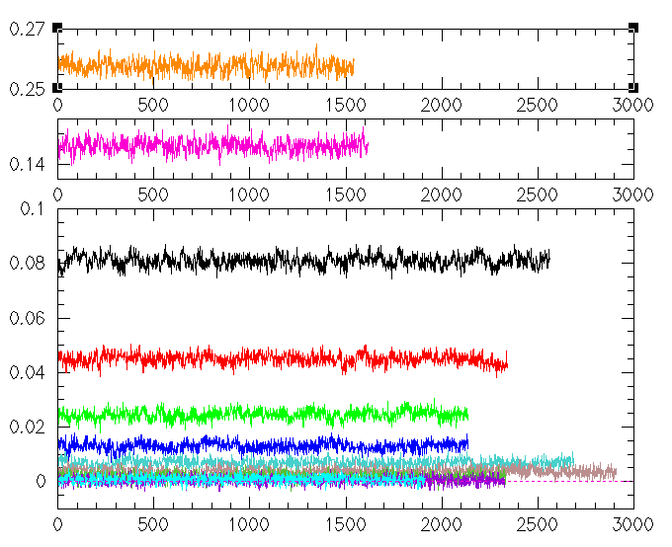
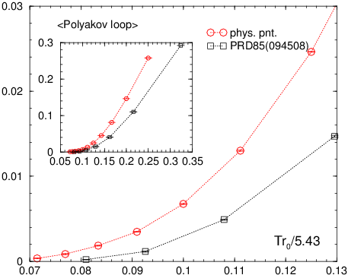
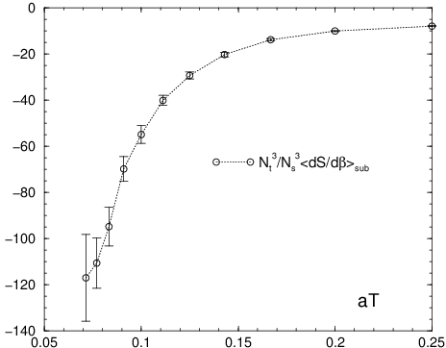
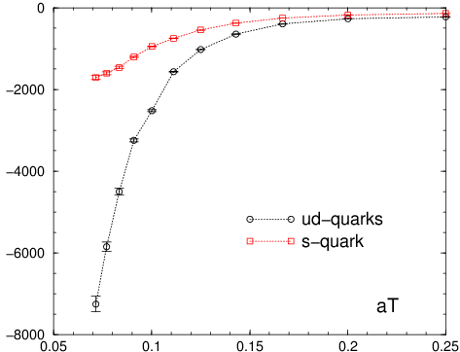
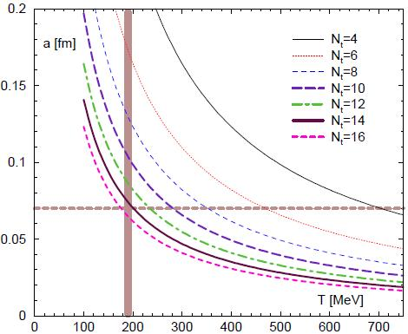
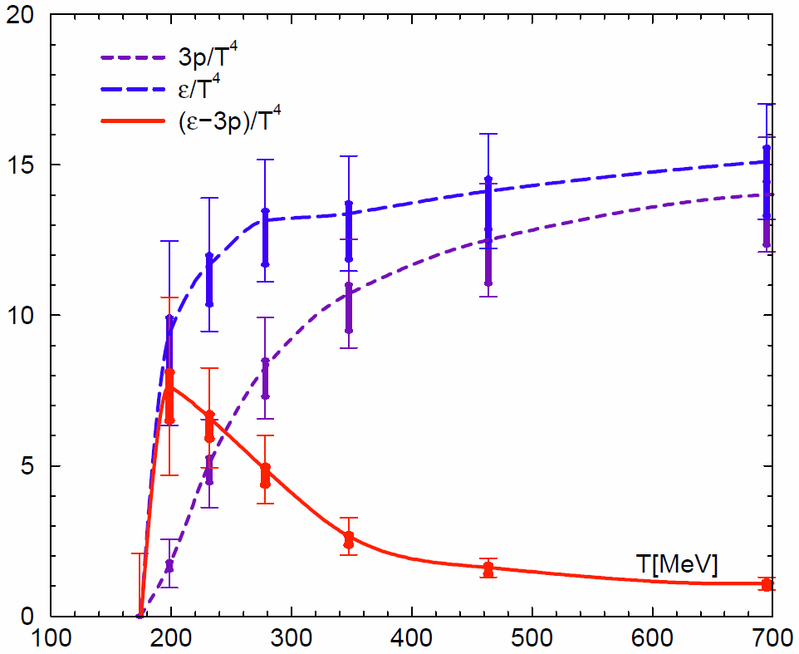





Towards the QCD equation of state at the physical point using Wilson fermion
37
WHOT-QCD Collaboration:
T. Umeda (Hiroshima Univ.), S. Ejiri (Niigata Univ.), R. Iwami (Niigata Univ.), K. Kanaya (Univ. of Tsukuba)
Abstract:
We study the $N_{f}$=2+1 QCD at nonzero temperatures using nonperturbatively improved Wilson quarks of the physical masses by the fixed scale approach. We perform physical point simulations at finite temperatures with the coupling parameters which were adopted by the PACS-CS collaboration in their studies using the reweighting technique. Zero temperature values are obtained on the PACS-CS configurations which are open to the public on the ILDG. Finite temperature configurations are generated with the RHMC algorithm. The lattice sizes are ${32}^{3}×N_{t}$, where $N_{t}=14, 13,⋯, 5, 4$ corresponding to $T≃$140 – 500 MeV. We present results of some basic observables at these temperatures and the status of our calculation of the equation of state.
3. Physical point simulation
3-1. Zero-temperature
Phys. Rev. D81, 074503 (2010), PACS-CS
Iwasaki gauge + improved Wilson
β=1.90, c_{sw}=1.715, 32³ x 64 lattice
Reweighting to physical point
original hopping param.
target hopping param.
MD time = 2000 (#conf = 80)
Configs. are open to the public on ILDG
1. Motivation
QCD Thermodynamics with Wilson quarks
$$\left(κ_{ud}, κ_{s}\right)=(0.137785, 0.136600)$$
It is important to check the results of staggered quarks, whose continuum
limit is not guaranteed to be universal to QCD, using theoretically sound
lattice quarks like Wilson-type quarks.
$$\left(κ_{ud}, κ_{s}\right)=(0.13779625, 0.13663375)$$
3-2. Finite-temperatures
WHOT-QCD collab. studies finite T & μ QCD using Wilson-type quarks
We generated only T>0 configs by Bridge++ code on BlueGene/Q (KEK)
RHMC algorithm, threefold-mass-preconditioning
Lattice size : 32³ x N_{t}, (N_{t}=14, 13, …, 5,4 )
The same coupling parameters as T=0 PACS-CS
at the target hopping param.
2. Strategy to study the QCD equation of states
$$\left(κ_{ud}, κ_{s}\right)=(0.13779625, 0.13663375)$$
2-1. formulation of (2+1)-flavor QCD
Iwasaki improved gauge
+ Nonperturbatively improved Wilson quark action
Temperatures for previous & present works
$$S_{g}=−β\left\{\sum_{x,μ>ν}{c_{0}W_{μν}^{1×1}\left(x\right)}+\sum_{x,μ,ν}{c_{1}W_{μν}^{1×2}\left(x\right)}\right\}$$
$$β=\frac{6}{g^{2}}$$
Phys. Rev. D85 094508
$$S=S_{g}+S_{q}$$
$$S_{q}=\sum_{f=u,d,s}{\sum_{x,y}{{\overline{q}}_{x}^{f}D_{x,y}q_{y}^{f}}}$$
This study
$$D_{x,y}=δ_{x,y}−κ_{f}\sum_{μ}{\left\{\left(1−γ_{μ}\right)U_{x,μ}δ_{x+\hat{μ},y}+\left(1+γ_{μ}\right)U_{x−\hat{μ},μ}^{†}δ_{x−\hat{μ},y}\right\}}−δ_{x,y}c_{SW}κ_{f}\sum_{μ>ν}{σ_{μν}F_{μν}}$$
Time history of Polyakov loop
T dependence of Polyakov loop
( heavier mass vs physical point )
Trace anomaly
Nt=4
Nt=5
Nt=6
Nt=7
Nt=8
Nt=9-14
$$\frac{ε−3p}{T^{4}}=\frac{N_{t}^{3}}{N_{s}^{3}}\left(a\frac{∂β}{∂a}{\left\langle \frac{∂S}{∂β}\right\rangle }_{sub}+a\frac{∂κ_{ud}}{∂a}{\left\langle \frac{∂S}{∂κ_{ud}}\right\rangle }_{sub}+a\frac{∂κ_{s}}{∂a}{\left\langle \frac{∂S}{∂κ_{s}}\right\rangle }_{sub}\right)$$
$$\left\langle \frac{∂S}{∂β}\right\rangle =N_{s}^{3}N_{t}\left(−\left\langle \sum_{x,μ>ν}{c_{0}W_{μν}^{1×1}\left(x\right)}+\sum_{x,μ,ν}{c_{1}W_{μν}^{1×2}\left(x\right)}\right\rangle +N_{f}\frac{a∂c_{SW}}{∂β}κ_{f}\left\langle \sum_{x,μ>ν}{{\text{Tr}}^{\left(c,s\right)}σ_{μν}F_{μν}{\left(D^{−1}\right)}_{x,x}}\right\rangle \right)$$
$$\left\langle \frac{∂S}{∂κ_{f}}\right\rangle =N_{f}N_{s}^{3}N_{t}\left(\left\langle \sum_{x,μ}{{\text{Tr}}^{\left(c,s\right)}\left\{\left(1−γ_{μ}\right)U_{x,μ}{\left(D^{−1}\right)}_{x+\hat{μ},x}+\left(1+γ_{μ}\right)U_{x−\hat{μ},x}^{†}{\left(D^{−1}\right)}_{x−\hat{μ},x}\right\}}\right\rangle +c_{SW}\left\langle \sum_{x,μ>ν}{{\text{Tr}}^{\left(c,s\right)}σ_{μν}F_{μν}{\left(D^{−1}\right)}_{x,x}}\right\rangle \right)$$
2-2. Fixed scale approach
$$c_{SW}\left(β\right)=1+0.113g^{2}+0.0209g^{4}+0.0049g^{6}$$
Phys. Rev. D73, 034501, CP-PACS/JLQCD
Finite temperature configs 1500-3000 MD traj. at each T
Polyakov loop starts to increase from the lower T at the physical point
Temperature $T=\frac{1}{N_{t}a}$ is varied by $N_{t}$ at fixed $a$
3-2. Observables for the EOS
T-dependence of the observables in the trace anomaly (see Sec. 2-1)
a : lattice spacing
N_{t} : lattice size in temporal direction
lattice spacing at fixed N_{t}
Phys. Rev. D79, 051501 (2009), WHOT-QCD
Advantages
- Line of Constant Physics
- Common T=0 subtraction
(spectrum study at T=0 )
- Lattice spacing at lower T
- Finite volume effects
Disadvantages
- T resolution due to integer N_{t}
- UV cutoff eff. at high T’s
$$\frac{N_{t}^{3}}{N_{s}^{3}}{\left\langle \frac{∂S}{∂κ_{f}}\right\rangle }_{sub}$$
$$\frac{N_{t}^{3}}{N_{s}^{3}}{\left\langle \frac{∂S}{∂β}\right\rangle }_{sub}$$
fixed
scale
2-3. T-integration method at the fixed scale
3-3. Beta-function at the physical point
Beta-functions are necessary to calculate the EOS
We are planning to calculate the beta-function using the following methods
$$\frac{p}{T^{4}}=\int_{T_{0}}^{T}{dT′\frac{ε−3p}{T^{′5}}}$$
with T₀ chosen such that p(T₀)≈0
Direct fit method using PACS-CS spectrum data
Phys. Rev. D85, 094508 (2012), WHOT-QCD
Single-point reweighting using PACS-CS reweighting data
Multi-point reweighting
R. Iwami et al. (in preparation)
Phys. Rev. D85, 094508 (2012), WHOT-QCD
(2+1)-flavor QCD Equation of state
using Wilson quarks
heavier ud-quarks ( m_{π}/m_{ρ} ≈ 0.63 )
T=0 data from CP-PACS/JLQCD
We have generated only T>0 configs.
A systematic error for beta-functions
4. Summary
1) Physical point simulations are carried out at T>0.
2) Pseudo-critical temperature decreases as quark masses decreases.
3) Observables for the EOS are measured at the physical point.
4) Beta-functions are needed to obtain the EOS.

