Slide 1
Guide to Living in Saijô with Dietary Restrictions
A project by:
Kai Wang, Rong Xichao, Wei Shang, Alexandre Bouche, Philipp Freitag
1

Slide 2
Contents
p.3 Introduction
p.4 Dietary Restrictions
p.5 Ingredient Lists
p.8 Restaurants
2

Slide 3
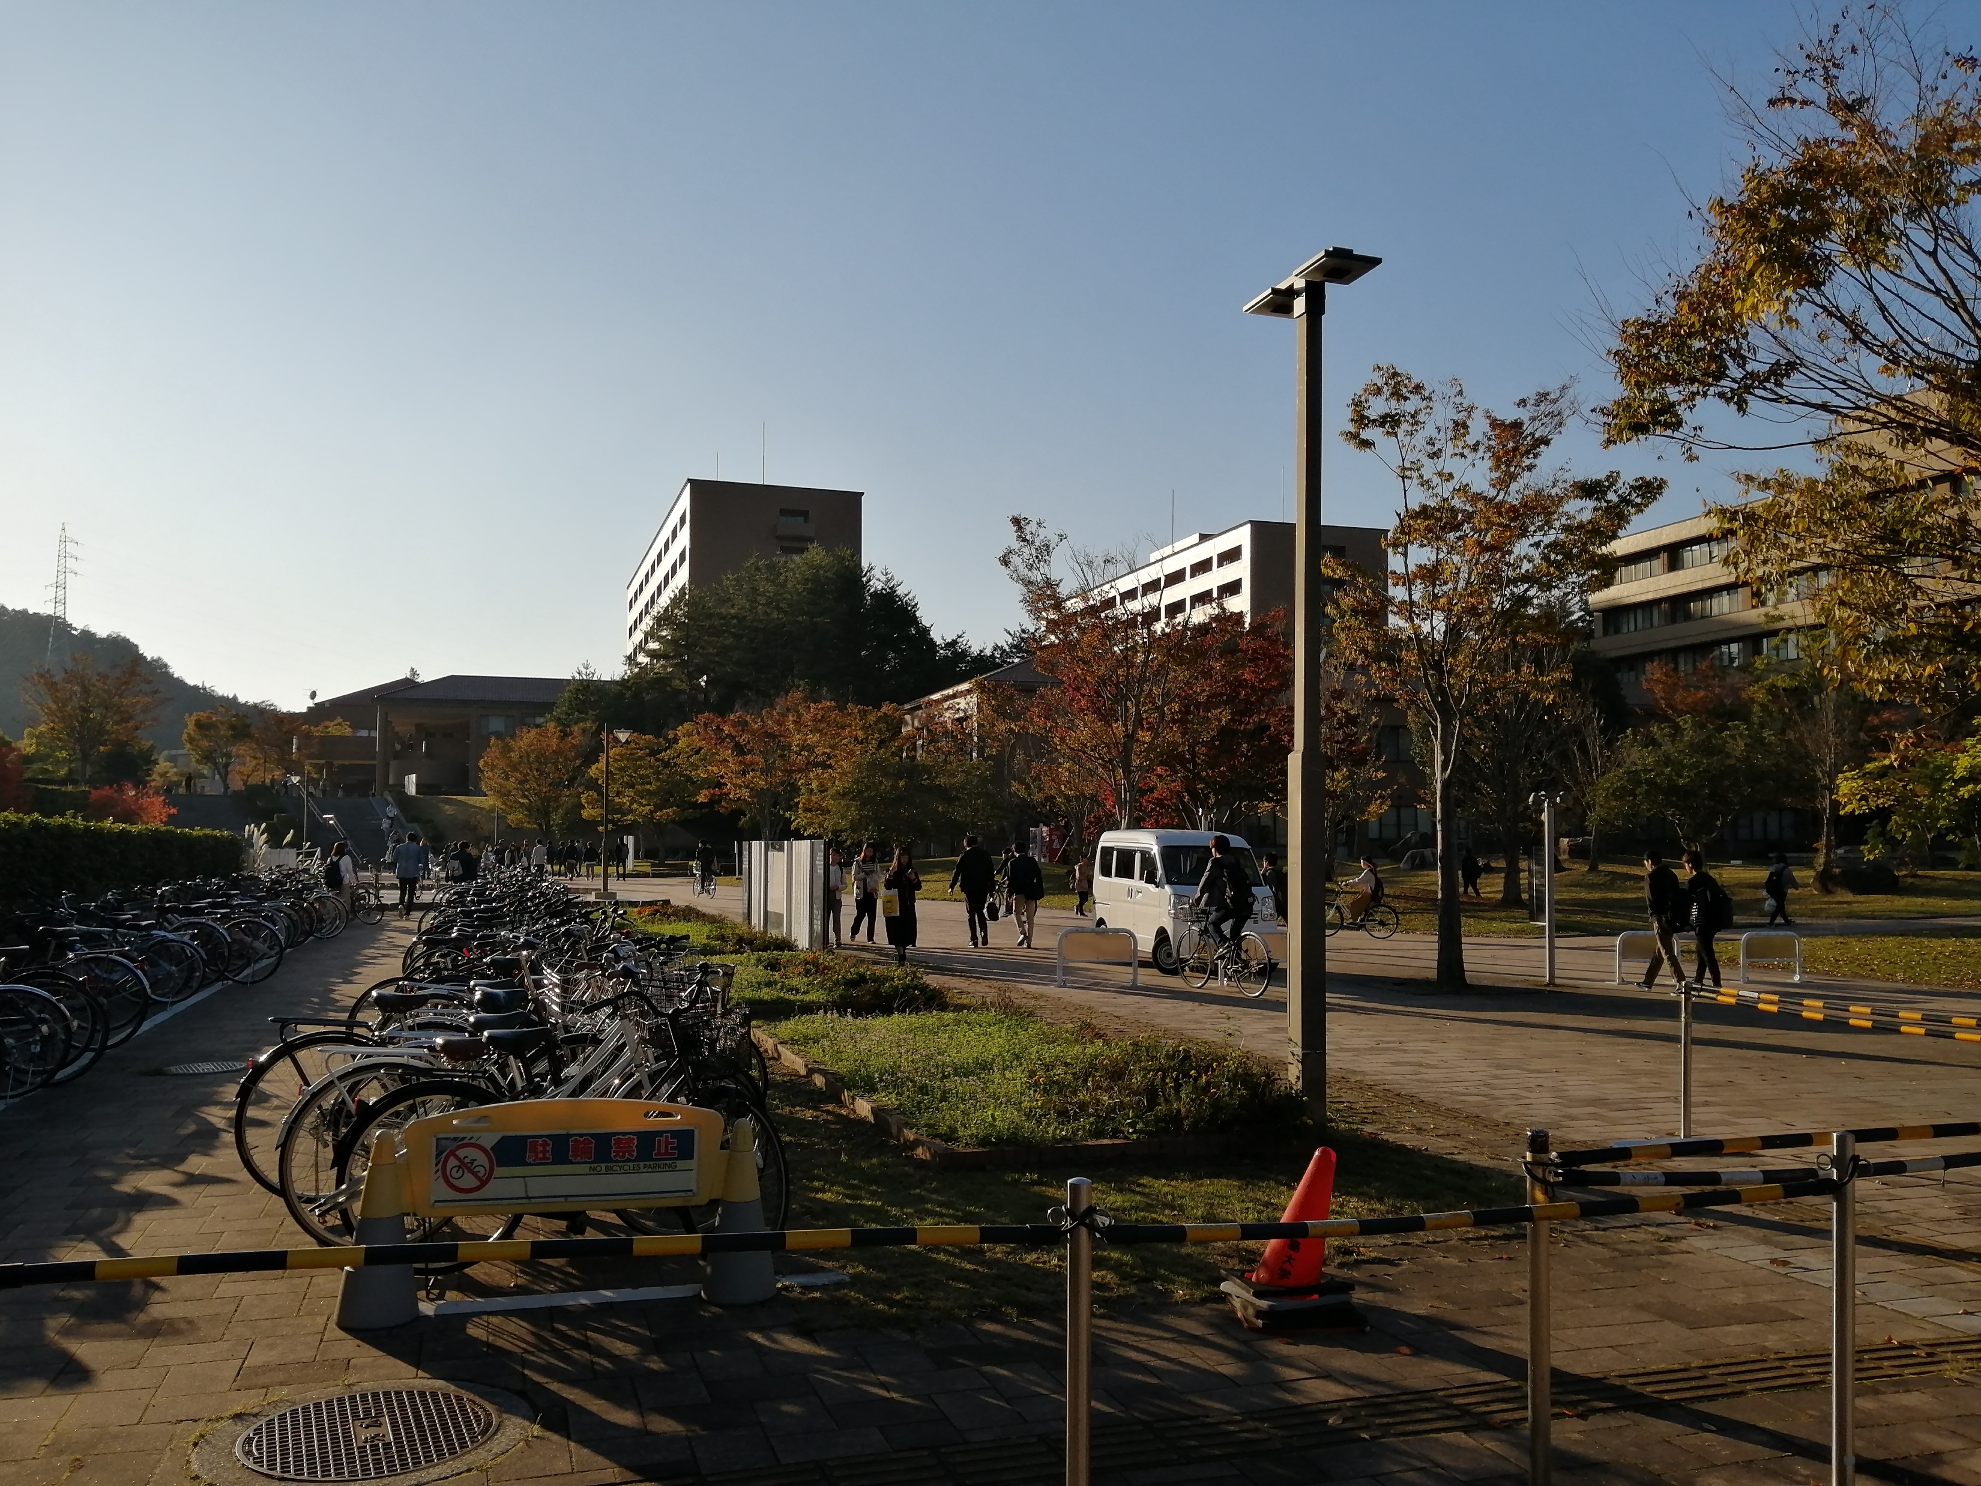
Introduction
This guide is designed to help students with dietary restrictions of any kind in adjusting to life in Saijo. It provides some of the necessary information people suffering from allergies or celiac disease and people who don’t eat certain products for religious or ethical reasons will need.
Disclaimer: Some of the information in this guide might be incorrect or outdated.
3

Slide 4
Dietary Restrictions
Celiac Disease:
People suffering from celiac disease can’t eat products that contain gluten. 1% of the population of the western world and about 0.5% of Japan’s population suffers from celiac disease. In Japan, many products contain wheat (komugi 小麦). Since some of the basic ingredients like soy sauce (shouyu 醬油) contain wheat, it is very hard to avoid foods containing gluten. It is therefore recommended to only eat in restaurants, which have allergen menus and therefore declare where wheat is used and where not (see restaurant list) and buy wheat-free soy sauce (komugi wo tsukawanai shouyu 小麦を使わない醬油) to use for your own cooking and to bring with you when going to restaurants.
Religious or Ethical Restrictions:
Allergen menus and ingredient lists (see p. 5) also declare which meat or animal products a product or dish contains. Cooking by yourself or going to restaurant chains is therefore usually no problem. People not eating certain or all meats or animal products might find it difficult though to eat in smaller restaurants, where contents of foods might not be guaranteed.
Allergies:
Depending on the allergy some things are easier and some things harder to avoid. It is recommended to always ask for an allergy menu when at a restaurant and if there is non to tell the restaurant workers what you can’t eat. Furthermore you should eat anything new very carefully if you’re an allergic.
4

Slide 5
Ingredient Lists
Allergens which have to be declared:
7 ingredients which have to be displayed | えび(shrimp)、かに(crab)、小麦(wheat)、そば(buckwheat)、卵(egg)、乳(milk)、落花生(peanuts)
20 ingredients which are recommended to be displayed (there is a chance, that a product contains these ingredients even if not declared | あわび(abalone)、いか(squid)、いくら(salmon roe)、オレンジ(orange)、カシューナッツ(cashew nuts)、キウイフルーツ(kiwi)、 牛肉(beef)、くるみ(walnut)、ごま(sesame)、さけ(salmon)、さば(mackerel)、大豆(soy beans)、鶏肉(chicken)、バナナ(banana)、豚肉(pork)、まつたけ(matsutake)、もも(peach)、やまいも(japanese yam)、りんご(apple)、ゼラチン(gelatin)
5

Slide 6
Ingredient Lists
Allergens and types of meat included are usually mentioned at the end of the ingredient list
乳成分(nyuuseibun) : dairy products
大豆(daizu) :
soy beans
卵(tamago) : eggs
豚肉(butaniku) : pork
6

Slide 7
Ingredient Lists
Spanish ham
As an allergic, you might not be able to eat products that you eat in your country. If you have allergies, always check for allergens
Japanese bacon
7

Slide 8
Restaurants
The following list presents some information about the restaurants you might go to during your stay in Saijo
Symbols used in the Restaurant List＊
1 or more gluten free option available (full meal)
V
1 or more vegan option available (full meal)
A
Allergen list available
＊Information in the Restaurant list
might be incorrect or outdated
8

Slide 9
Restaurants
Restaurant Name | Type of Restaurant | Distance to Dorms | Available Food
Okonomiyaki Q お好み焼きQ | Okonomiyaki | 400m On the road to YouMe Town
Tandoor Shitami タンドール下見店 | Indian Restaurant | 500m Around YouMe Town
Pasta Amare パスタアマーレ | Italian Restaurant | 550m Around YouMe Town
University * Cafeteria 大学食堂 | Cafeteria | Multiple at the University
Sushiro スシロー | Conveyor Belt Sushi | 2.7km At Fuji Grande
Sukiya すき家 | 24h Japanese fast food chain | 1.3km Closest: Around YouMe Town
Matsuya 松屋 | 24h Japanese fast food chain | 3.3km Closest: Jike
V
A
A
A
A
*the university cafeteria sometimes has a gluten-free meal, so it is worth checking
9

Slide 10
Restaurants
Restaurant Name | Type of Restaurant | Distance to Dorms | Available Food
Yakiniku Ichiraku 焼肉一楽 | Barbecue chain (Yakiniku) | Closest.1.2km | The Tare (sauce) contains gluten
Yoshinoya 吉野家 | 24h Japanese fast food chain | Closest 5.7km
McDonalds | American fast food chain | At Youme Town
Shabu-yo しゃぶ葉 | Japanese hot pot | 2.7km At Fuji Grande
Onyasai 温野菜 | Japanese hot pot | 3.8km Near Uniqlo
Gaba 我馬 | Ramen ラーメン | 2.5km Saijo main street
Bamiyan バーミヤン | Chinese food chain | 2.８km Saijo main street
A
A
A
V
A
V
A
A
V
10

Slide 11
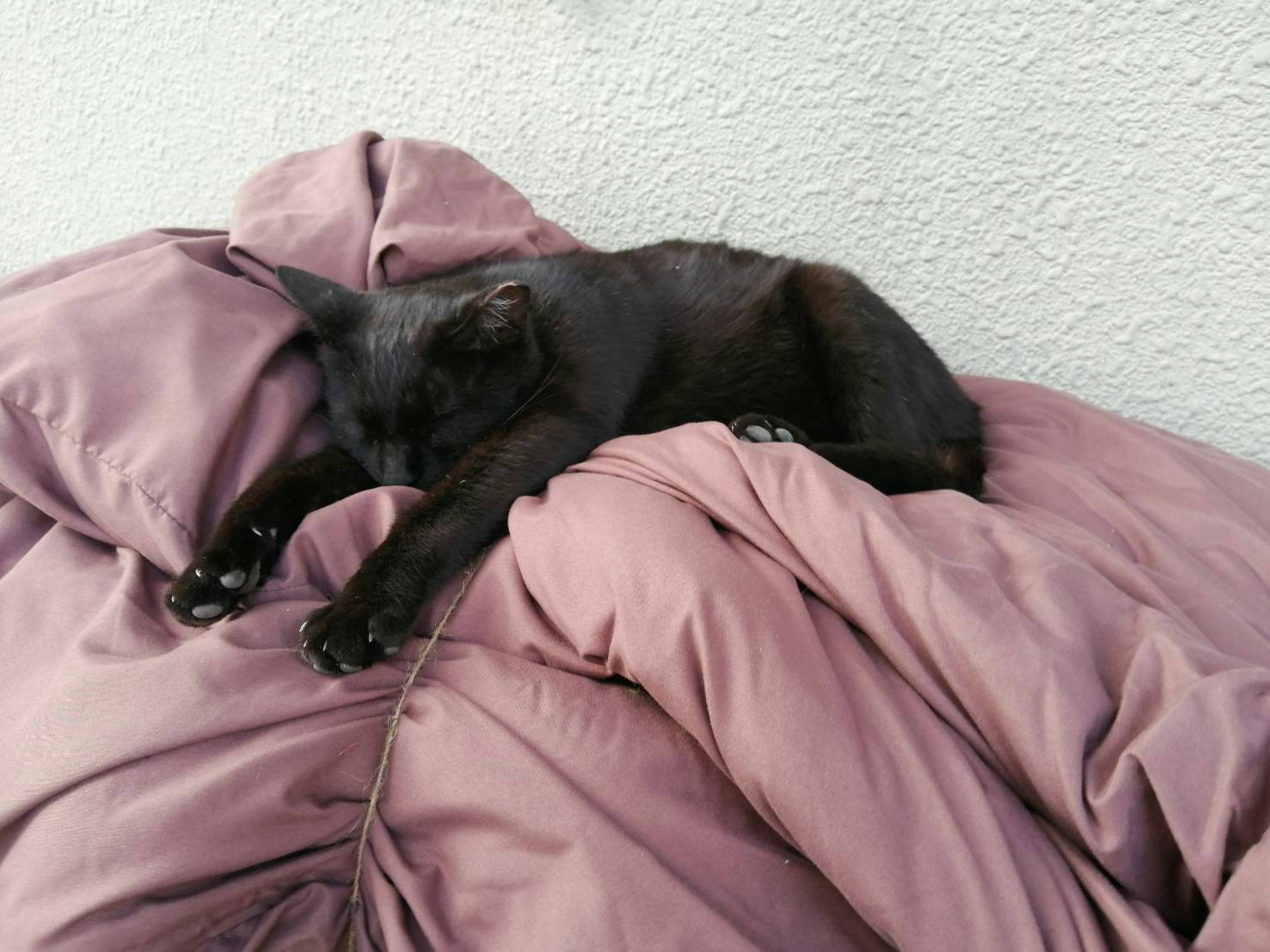
Restaurants
Contains: 「ザ・キャット」
Do not eat if allergic to cuteness
スセ・レ・テトン
11

