Slide 1

Next Stages of PHENIX for
Enhanced Physics with
Jets, Quarkonia, and Photons
SHIGAKI, Kenta （志垣 賢太）
(Hiroshima University )
for the PHENIX Collaboration
Asian Triangle Heavy Ion Conference 2014
August 8, 2014, Osaka University

Slide 2
Presentation Outline
improved insight into quark-gluon plasma
  prominently via jet and heavy flavor (mostly) at LHC
feedback to next stage: sPHENIX at RHIC
detector design and physics prospects
  calorimeters and inner detectors
  jet, heavy flavor, photon, and more
status/schedule/plan/future
  activities in Japan
summary and concluding remarks

Slide 3
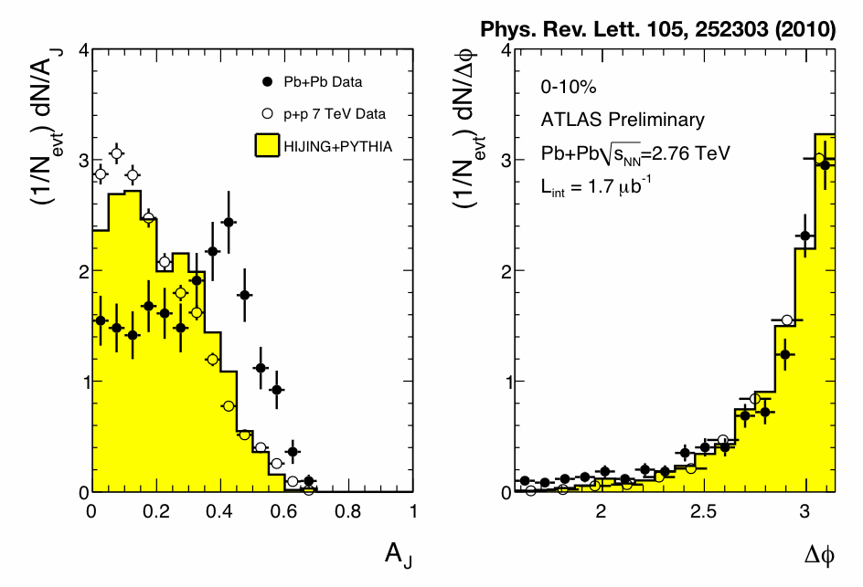
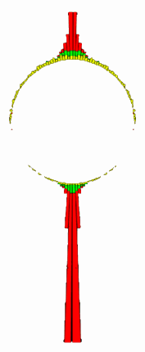
Insight into Quark-Gluon Plasma
via high p_{T} probes, e.g. jets, γ–jet correlation
recent highlights include:
  energy loss/redistribution of hard scattered parton
  γ–jet correlation: parton initial energy tagging
initial parton energy tagging
γ – jet
jet – jet
energy asymmetry
relative angle
π⁰ (hadron) – jet
energy redistribution
path length dependent bias due to energy loss

Slide 4
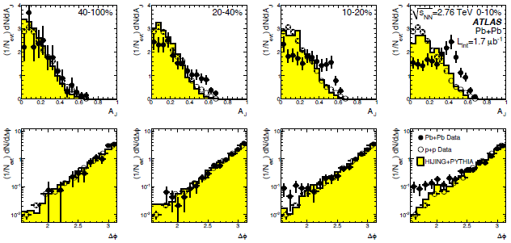
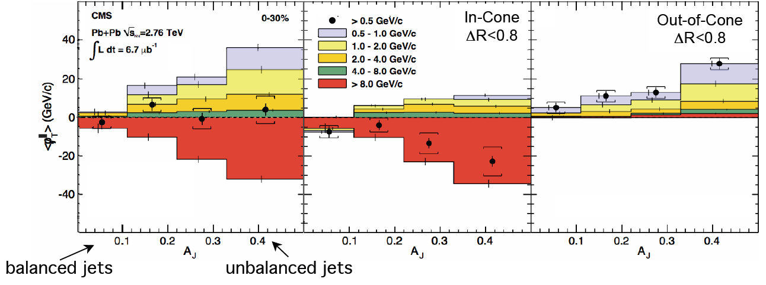
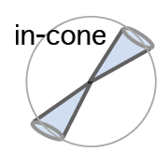
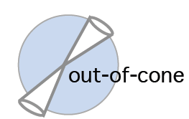

New Era of Jet Physics at LHC
asymmetric di-jets and even mono-jets
lost jet energy distributed very widely
  ΔR > 0.8 ~ π/4
  enhancement at low p_{T}
ATLAS
ΔR>0.8
CMS

Slide 5
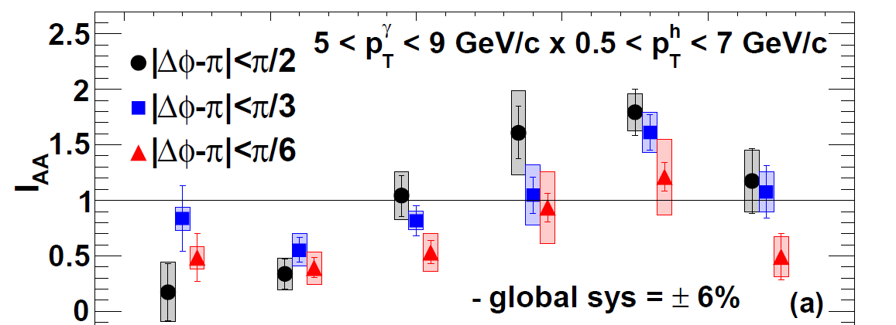

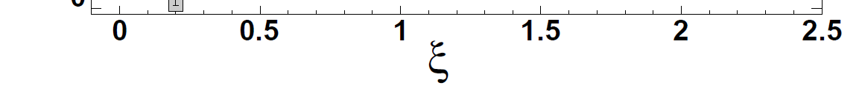
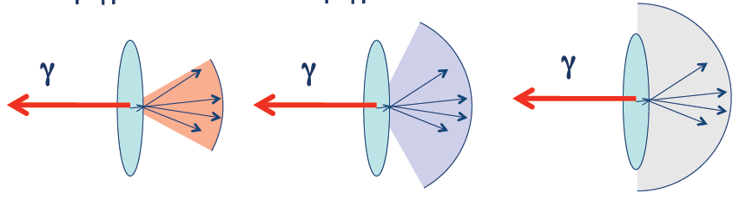
  γ–Jet Correlation: the Ultimate
thermal-like redistribution of energy suggested
  narrow cone → high z_{T} suppression
  wide cone → low z_{T} enhancement
PHENIX
yield in Au+Au
yield in p+p
I_{AA} =
ξ = ln(1/z_{T})
z_{T} = p_{T}^{hadron}/p_{T}^{photon}
high z_{T}
low z_{T}
|Δφ-π| < π/6 |Δφ-π| < π/3 |Δφ-π| < π/2

Slide 6
Parton Differential: Mass Hierarchy?
charm and beauty mesons with compatible <p_{T}>
  open charm (average of D⁰, D⁺, D^{∗+}), ALICE
  non-prompt J/Ψ (← B), CMS
cf. heavy flavor tagged jet

Slide 7
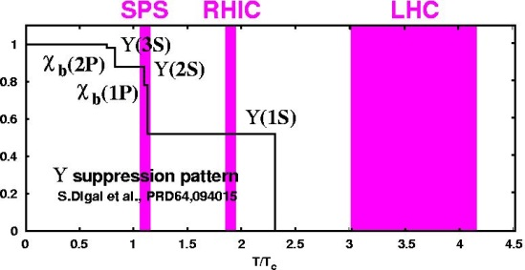
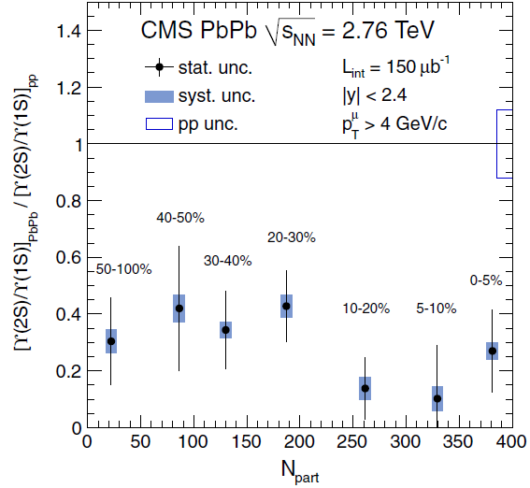
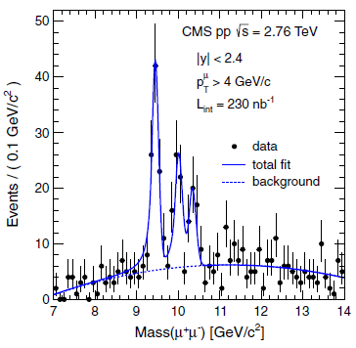
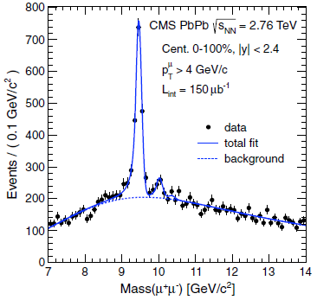
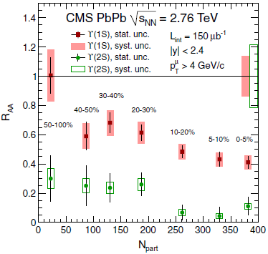
Quarkonia – Sequentially Melting?
Υ(2S) more suppressed than Υ(1S)
  Υ(3S) even more suppressed
no signature of sequential melting
(feed down uncorrected)
CMS, PRL 109, 222301 (2012)

Slide 8
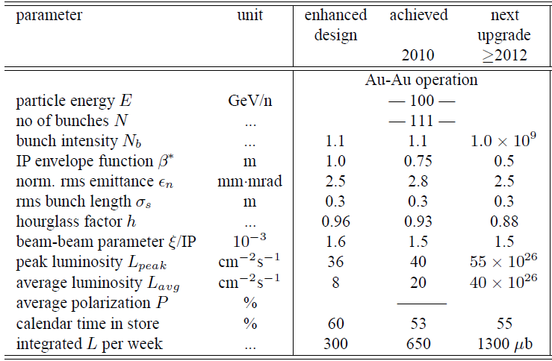
Hard/Heavy Probes Very Prominent
original sales points at higher energies
  demonstrated very powerful at ALICE/ATLAS/CMS
RHIC luminosity upgrade to give new opportunities
more flexibility with EBIS and beam cooling
W.Fischer, IPAC’10

Slide 9
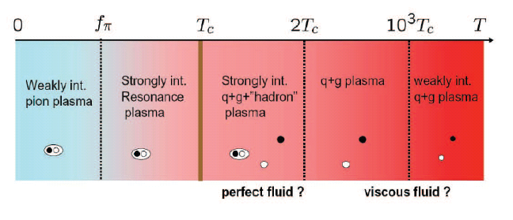
RHIC/LHC from Heavy Ion Viewpoint
highest energy ≠ optimum physics condition
RHIC： dedicated to heavy ion (and spin) programs
  wide collision energy range
    ~10 < √s_{NN} < 200 GeV
    phase boundary; transition regime
  variety of collision systems including asymmetric
    Au+Au, U+U, Cu+Cu, Cu+Au, ³He+Au, d+Au, （p+Au,） p+p
  high luminosity
    average 50×10²⁶ cm⁻²s⁻¹ （2014, Au+Au 200 GeV）
    cf. LHC peak 5×10²⁶ cm⁻²s⁻¹ （2011, Pb+Pb 2.76 TeV）
  good time allocation for heavy ion program
    ave. 10.3 weeks (+ ave. 6.5 weeks of p+p) /year (runs 1–14)

Slide 10
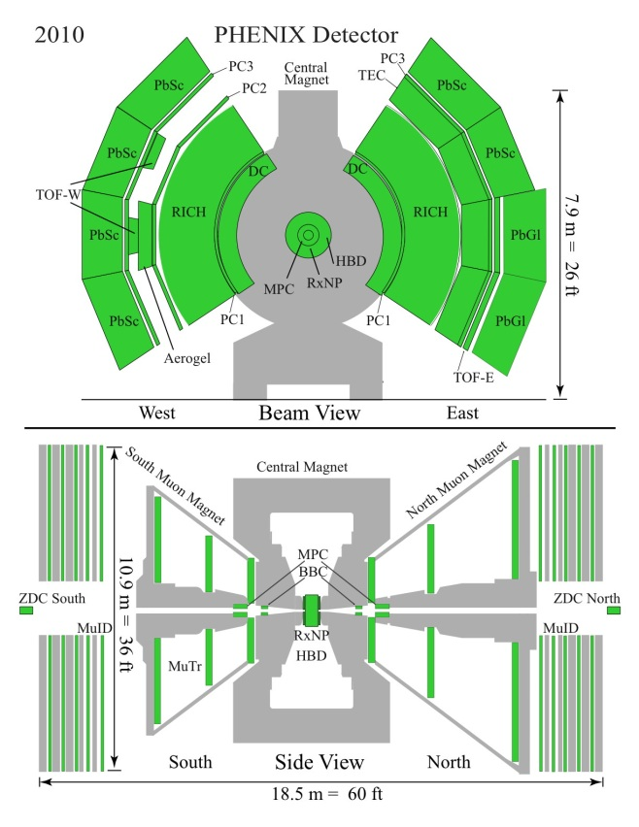
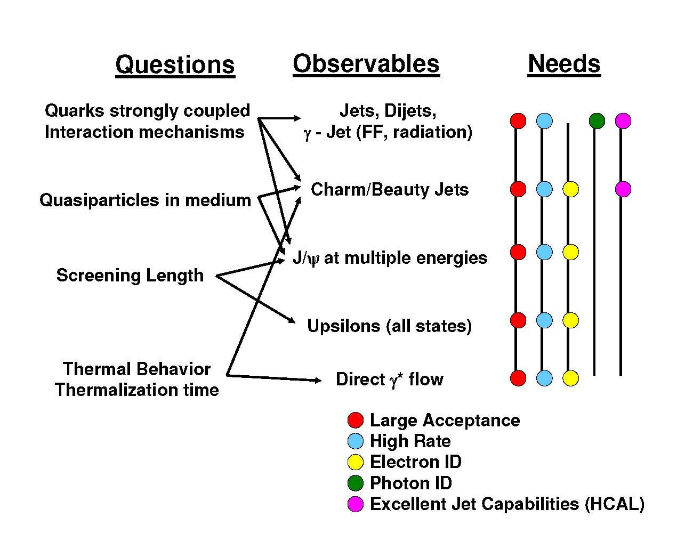
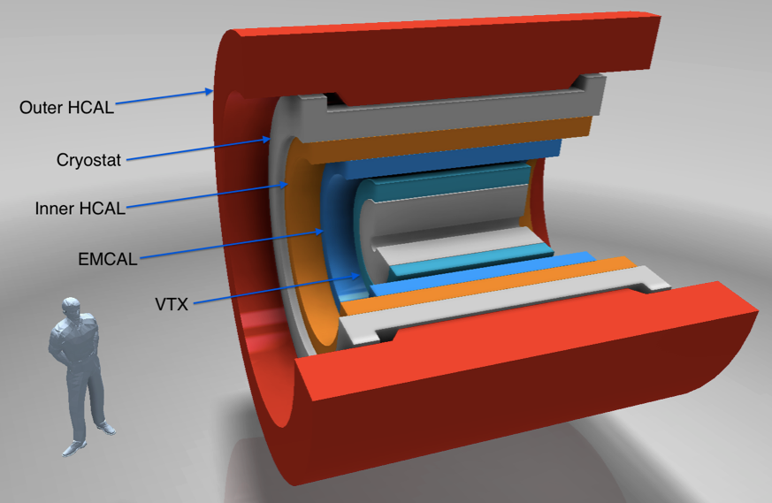
sPHENIX: Feedback to RHIC from LHC
PHENIX
  fast, selective, precise
  focus on mid/low p_{T}
  limited acceptance
sPHENIX
  fast, (selective,) precise
  focus on high/mid p_{T}
  large acceptance

Slide 11
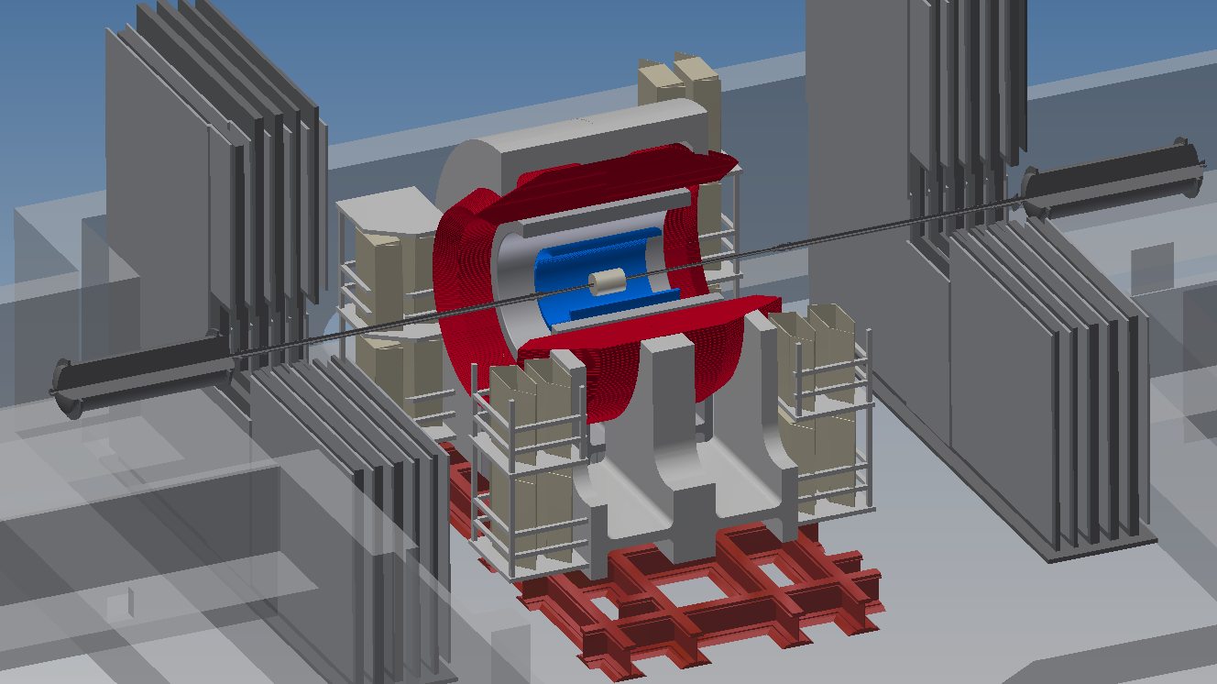
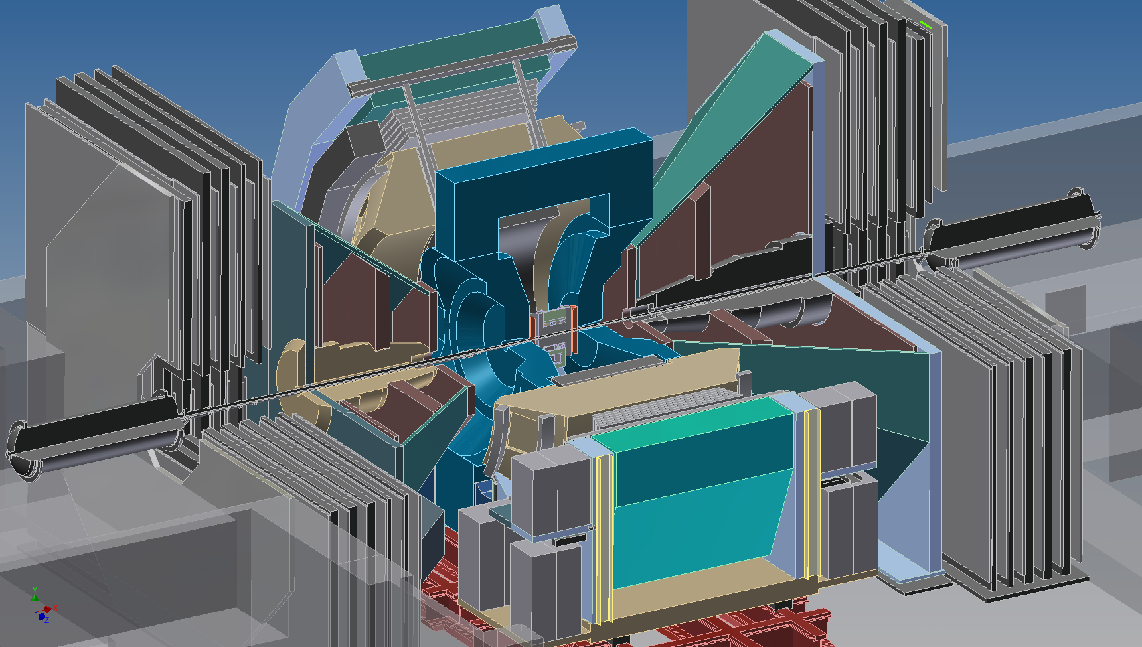
sPHENIX at a Glance
hermetic and uniform coverage at |η| < 1.1
  electromagnetic and hadronic calorimeters
    outer hadronic calorimeter as flux return
  vertex and extended silicon trackers
  high rate (~10 kHz) data acquisition
former BaBar 1.5 T solenoid transferred from SLAC
aiming at (partial) start in 2019
  first sPHENIX beam tests at FNAL in 2014/02–03

Slide 12
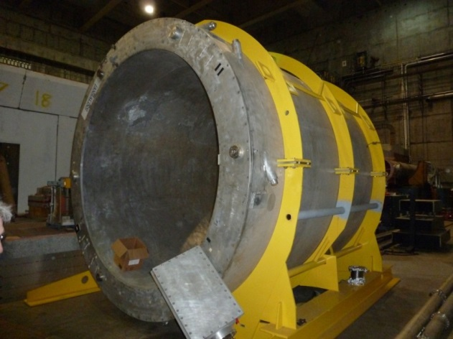
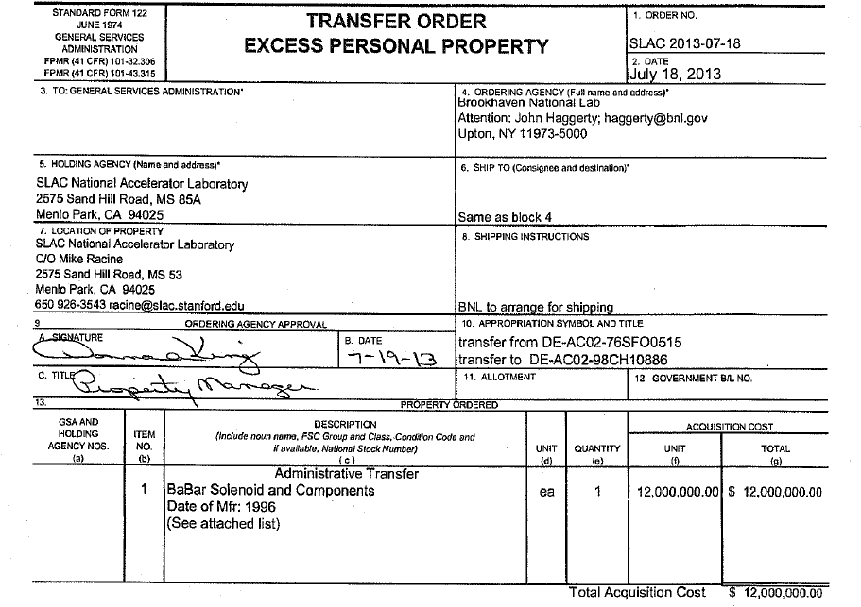
BaBar Super-Conducting Solenoid
1.5 T, cryostat 140–173 cm radially, 385 cm long
ownership officially transferred to BNL
shipping under preparation

Slide 13
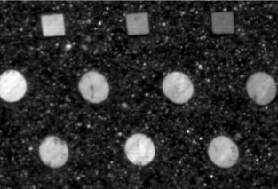
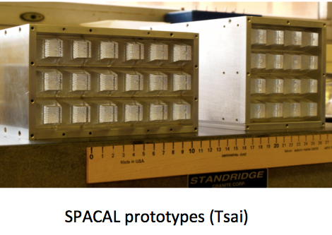
Electro-Magnetic Calorimeter
scintillation fiber in tungsten epoxy (“spacal”)
design parameters
  ~ 18 radiation length (~ 1 interaction length)
  energy resolution ~ 12%/E (GeV)
  cell size ~ Moliere radius = 2.3 cm
  ~ 25 k channels
prototype built and tested at FNAL

Slide 14
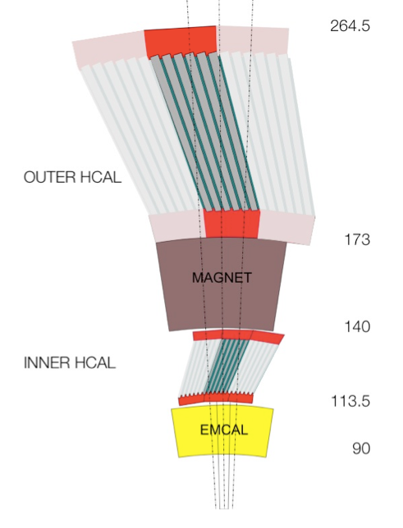
Hadronic Calorimeter
tilted plate scheme
  straight track to cross 4 scintillators
design parameters
  ~ 1 (inner) and ~ 4 (outer) interaction lengths
    additional ~ 1 in electro-magnetic calorimeter
  energy leakage ~ few % for hadrons > 50 GeV
    comparable to other contributions to resolution
  energy resolution ~ 100%/E (GeV)
  tower size ~ 0.1 x 0.1
  outer absorber as magnet flux return
prototype built and tested at FNAL

Slide 15
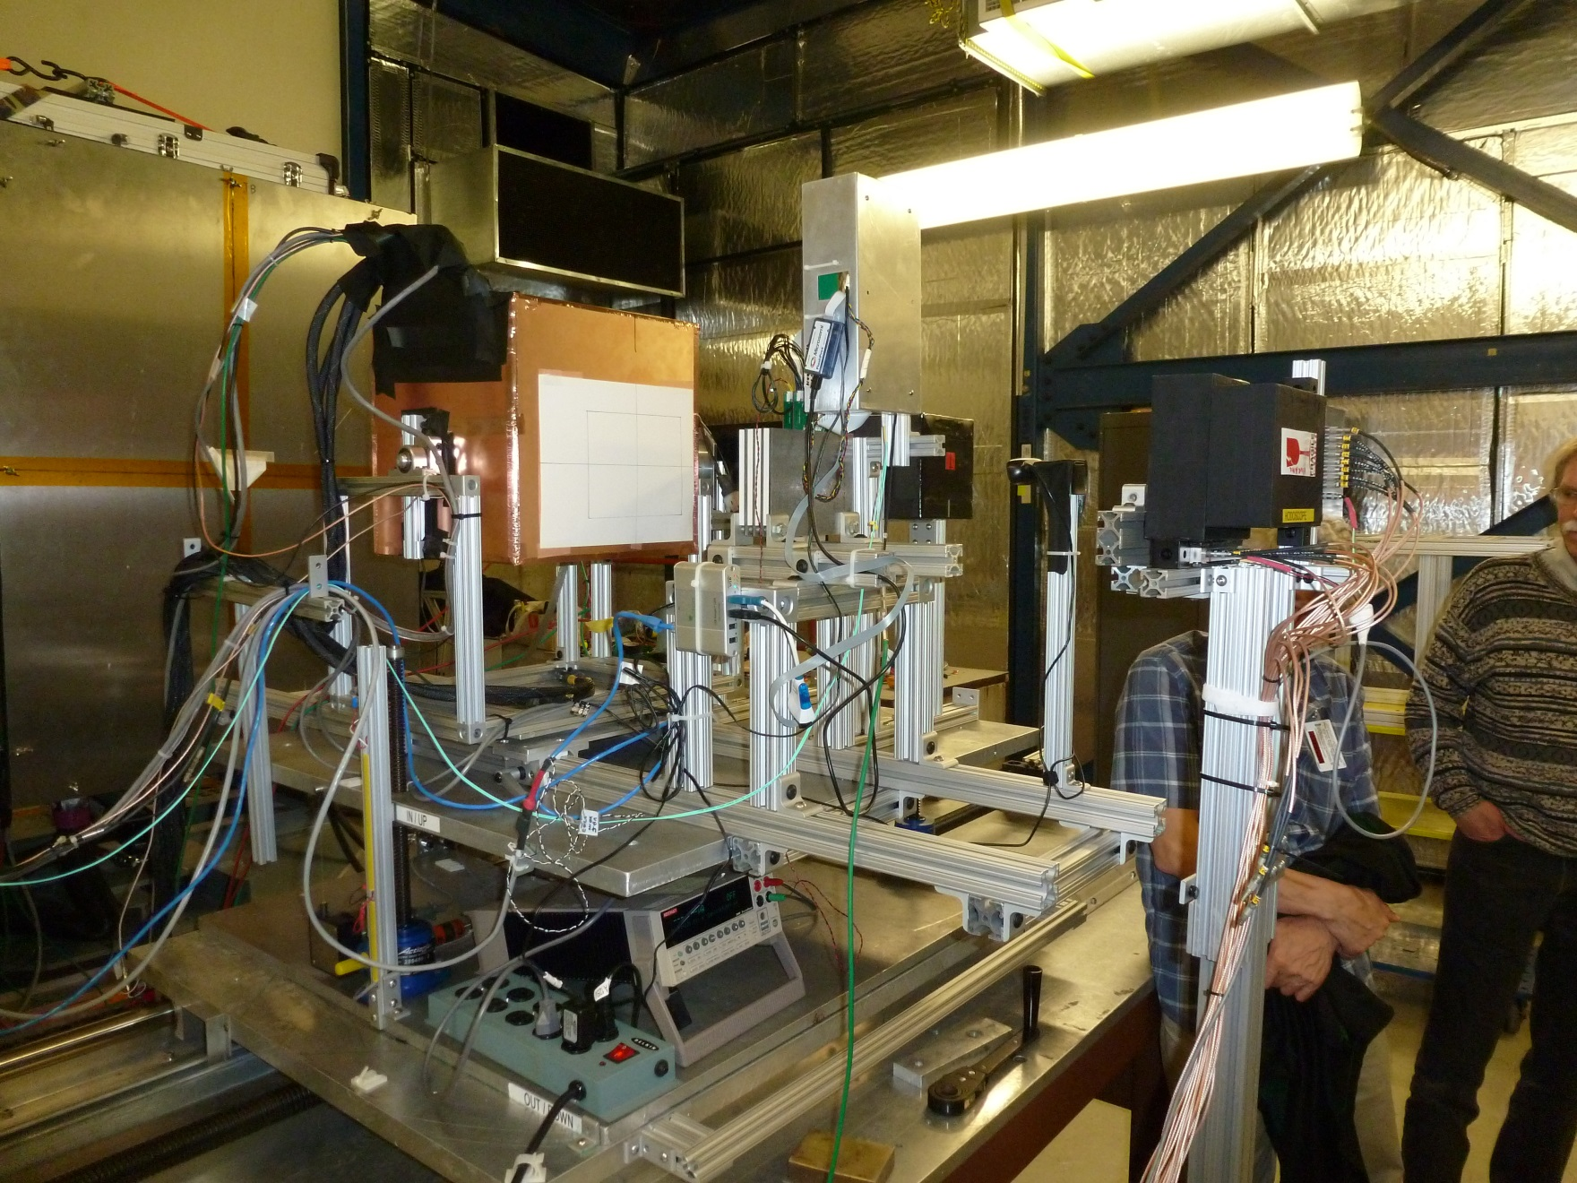
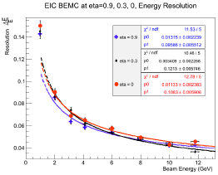
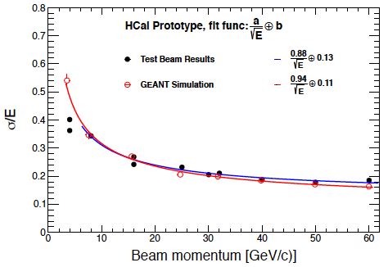
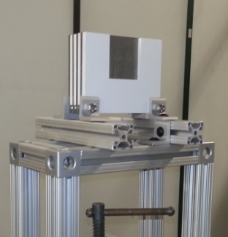
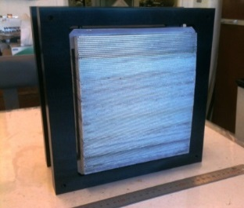
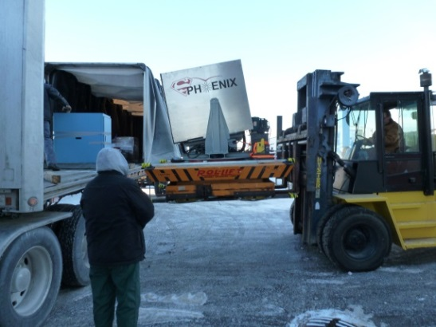
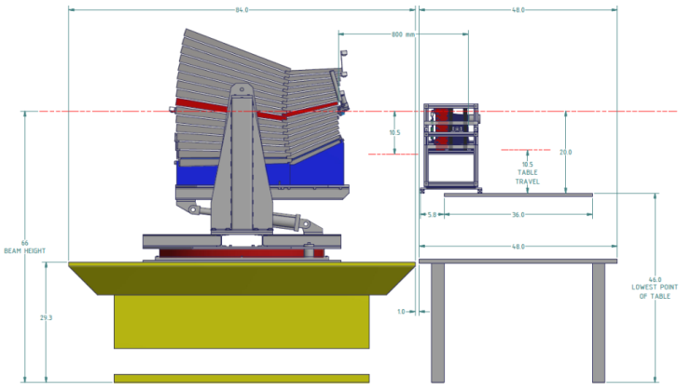
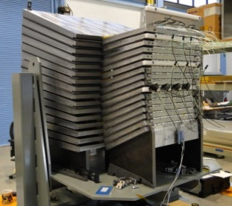
  First Beam Tests at FNAL
T1018/T1044/T1054 in 2014/02–03
EMCal: “spacal” option preferred
HCal: good resolution for jet measurements
pre-shower: first prototype successfully read out

Slide 16
Not Only Jet: Enhanced Programs
physics with e± / h± / γ / π⁰ identification
  QCD debye screening via e⁺e⁻ from quarkonia
  parton energy loss tagged via direct γ–jet correlation
  parton behavior via identified single particles
  ...
inner tracking and high performance PID
  extended silicon trackers
  reconfigured electromagnetic and hadronic calorimeters
  more options, e.g. pre-shower detector
originally not in MIE for US DOE funding
now incorporated as “day-1 upgrade”

Slide 17
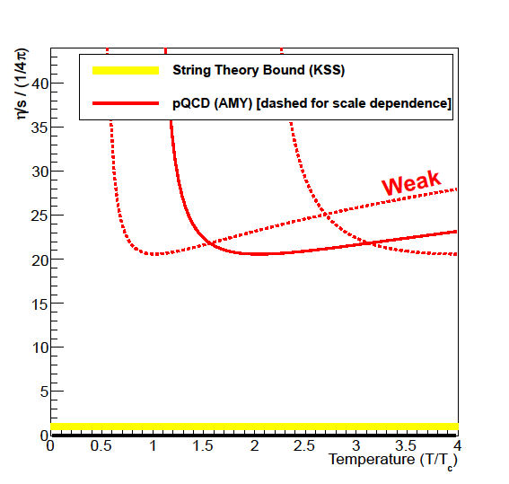
QCD Phase Diagram Also in Scope
strongly coupled perfect fluid discovered at RHIC
  weakly coupled regime at higher temperature?
    η/s 1–2 orders larger with expected weak QCD coupling
    theory not well constrained
RHIC to probe quark-gluon plasma at 1–2 Tc
  transition from strong to weak regime?
RHIC

Slide 18
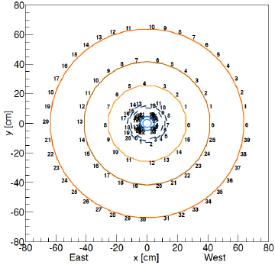
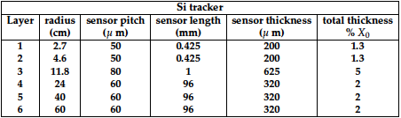
Extended Silicon Trackers
design under discussion, e.g.
  3 inner layers reconfigured from existing VTX
  3 outer layers at ~24, 40, and 60 cm radii
    total ~ 10 m², ~ 1.3 M channels
a key criterion: momentum (pair mass) resolution

Slide 19
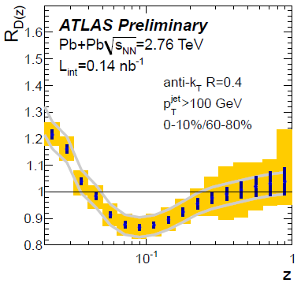
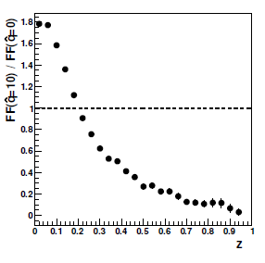
Calorimetry → Jet Modification
longitudinal and transverse jet modifications
→ energy loss and fragmentation
  comparison between RHIC and LHC
    model prediction of stronger effects at RHIC
  measurement in wide p_{T} range
Q-PYTHIA, RHIC
G.-Y.Qin and B.Muller,
PRL106, 162302 (2011)

Slide 20
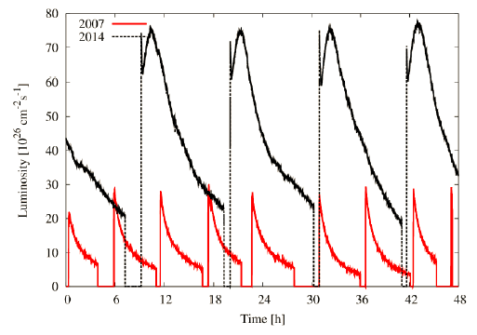
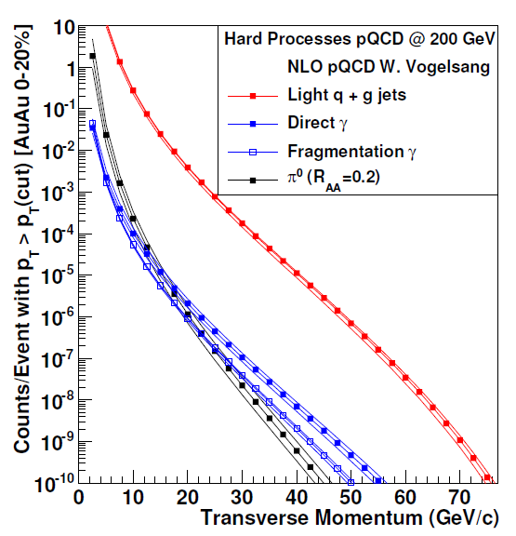
Jet, Jet–Jet, γ–Jet
high rate/statistics for differential measurements
  note: run 11 performance assumed
    RHIC performance further improved in run 14
direct photon dominating (S/B > 3) at > 20 GeV/c
 | Au+Au (central 20%) | p+p | d+Au
>20GeV | 10⁷ jets 10⁴ photons | 10⁶ jets 10³ photons | 10⁷ jets 10⁴ photons
>30GeV | 10⁶ jets 10³ photons | 10⁵ jets 10² photons | 10⁶ jets 10³ photons
>40GeV | 10⁵ jets | 10⁴ jets | 10⁵ jets
>50GeV | 10⁴ jets | 10³ jets | 10⁴ jets

Slide 21
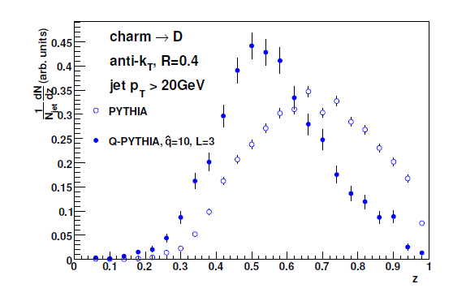
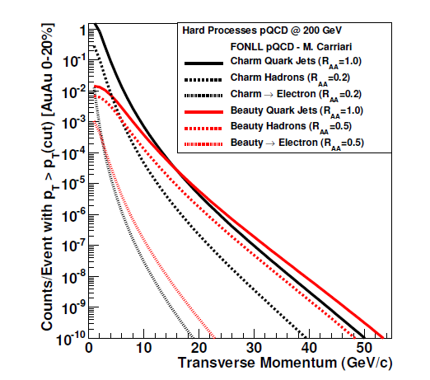
Tracking → Heavy Flavor Tagged Jet
charm/beauty hadron and tagged jet
→ energy loss and fragmentation of heavy flavor
  additional key exam to models
10⁶ / year
beauty jet
10⁴ / year
10² / year

Slide 22
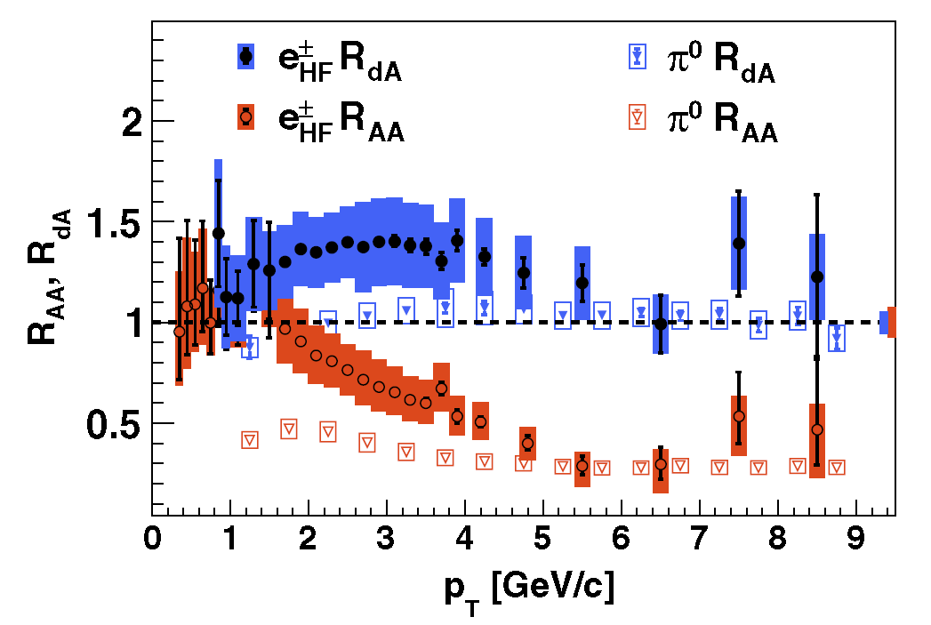
Electron ID → Open Heavy Flavor
light (u, d, s), charm, and beauty quarks
  vertex + tracking + electron ID
→ mass hierarchy question
PHENIX, PRL109, 242301 (2012)

Slide 23
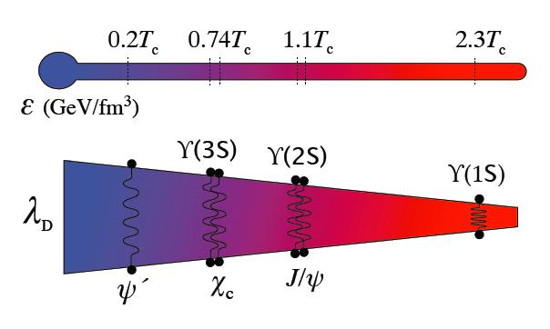
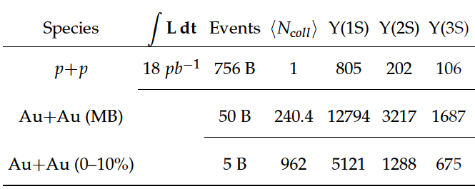
Electron ID → QCD Debye Screening
precise Υ measurement separating excited states
→ binding energy (average radius) dependence
→ function of temperature (color Debye length) ?
  comparison between RHIC and LHC
Υ(1s)
Υ(2s)
Υ(3s)

Slide 24
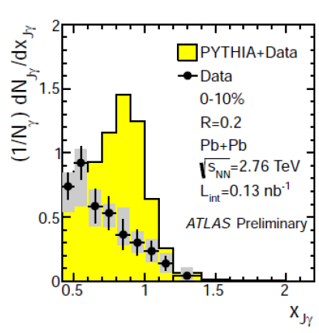
Single γ ID → Direct γ–Jet Correlation
rejection of double γ from hadron decay
→ direct γ tagged jet: ultimate jet measurement
→ direct γ : QCD reference process
  wide p_{T} range maximally from ~10 GeV/c to ~40 GeV/c
    with optional pre-shower detector
jet energy / photon energy

Slide 25
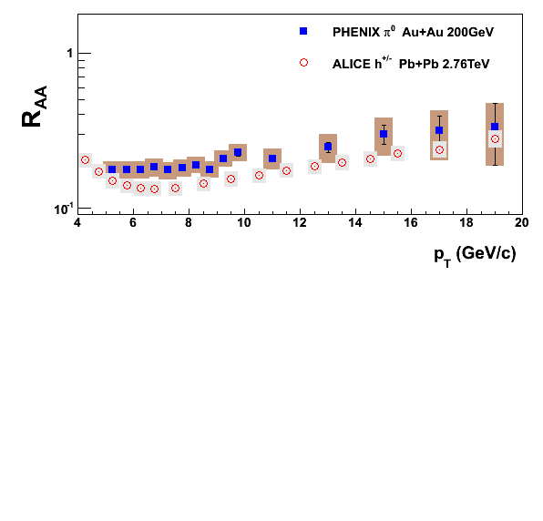
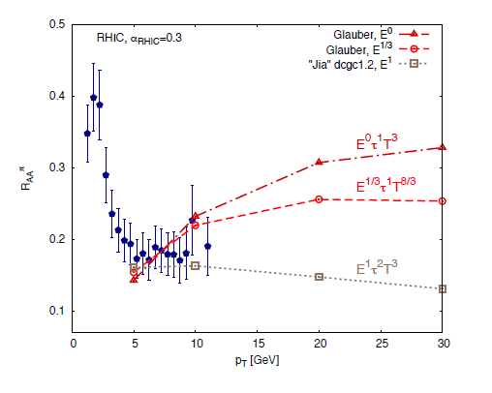
Double γ ID → High p_{T} Neutral Mesons
very high p_{T} π⁰ suppression
  present RHIC data up to 20 GeV/c → ~ 40 GeV/c
    with optional pre-shower detector
→ constraints on energy loss models
→ check if different behavior at RHIC and LHC

Slide 26
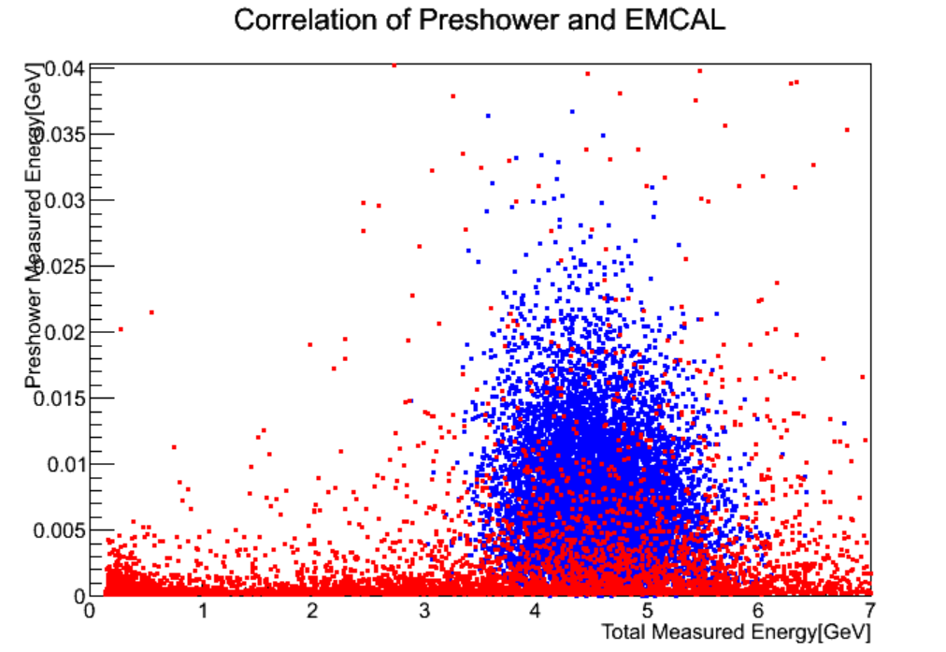


Optional Pre-Shower Detector
additional e± / h± identification
γ / π⁰ identification from ~ 10 to ~ 40 GeV/c
design/simulation activities in Japan
  Kazuya Nagashima (Hiroshima U.), 8/07 afternoon
  GEANT4 based design/performance studies
multi-variable cut
e⁻ （5 GeV/c）
π⁺ （5 GeV/c）
photon pair from π⁰

Slide 27
sPHENIX Status/Schedule/Plan
physics case reviewed by US-DOE in 2014/07
“critical decisions” 0/1 expected in 2015
(partial) start in 2019
preliminary physics run plan in 2021–2022
  ~20 weeks 200 GeV Au+Au
  ~10 weeks 200 GeV p+Au
  ~10 weeks 200 GeV p+p
> 50 B minimum-bias Au+Au to record
  assuming current RHIC/PHENIX performance
  full range of differential measurements

Slide 28
Key Project at BNL in Next Decade
Years | Beam Species and Energies | Science Goals | New Systems Commissioned
2014 | 15 GeV Au+Au 200 GeV Au+Au | Heavy flavor flow, energy loss, thermalization, etc. Quarkonium studies QCD critical point search | Electron lenses 56 MHz SRF STAR HFT STAR MTD
2015-16 | p+p at 200 GeV p+Au, d+Au, ³He+Au at 200 GeV High statistics Au+Au | Extract η/s(T) + constrain initial quantum fluctuations More heavy flavor studies Sphaleron tests Transverse spin physics | PHENIX MPC-EX Coherent e-cooling test
2017 | No Run |  | Low energy e-cooling upgrade
2018-19 | 5-20 GeV Au+Au (BES-2) | Search for QCD critical point and onset of deconfinement | STAR ITPC upgrade Partial commissioning of sPHENIX (in 2019)
2020 | No Run |  | Complete sPHENIX installation STAR forward upgrades
2021-22 | Long 200 GeV Au+Au with upgraded detectors p+p, p/d+Au at 200 GeV | Jet, di-jet, γ-jet probes of parton transport and energy loss mechanism Color screening for different quarkonia | sPHENIX
2023-24 | No Runs |  | Transition to eRHIC
present RHIC/PHENIX

Slide 29


Path to Electron Ion Collider Detector
eRHIC anticipated in 2025
  100 GeV/A heavy ion, 250 GeV polarized proton
  15 (20) GeV polarized electron
  > 10³³ cm⁻²s⁻¹
letter of intent arXiv:1402.1209

Slide 30
Summary and Concluding Remarks
sPHENIX: strategy feedback from LHC to RHIC
  RHIC: optimum facility to explore heavy ion physics
  keeping basic PHENIX strategies: fast, (selective,) precise
  plus: higher transverse momentum, larger acceptance
nicely on track toward runs in 2019/2021–2022
strong physics cases with high p_{T} electron/photon
  via tracking and high performance particle identification
activities in Japan, especially on inner detectors
  silicon trackers (RIKEN)
  optional pre-shower detector for e±/h±/γ/π⁰ identification
  from physics to detector design/R&D/prototyping

