Slide 1

Past/Present/Future of
ALICE and (s)PHENIX and More for Heavy Ion Program at J-PARC
Kenta Shigaki (Hiroshima University )
Heavy Ion at J-PARC Workshop
March 17, 2014
J-PARC, JAEA Tokai

Slide 2
Presentation Outline
PAST experiences at (+ before) PHENIX/ALICE
  and physics at J-PARC-HI
PRESENT topics at PHENIX/ALICE
  and stimulus to J-PARC-HI
FUTURE plans at PHENIX/ALICE
  and impacts on J-PARC-HI
summary and concluding remarks

Slide 3
Historical Trend of High Energy A+A
from Bevalac/SIS/AGS/SPS to RHIC/LHC
  from high density to high energy density regime
recent major facilities
  BNL-AGS (11 A GeV ¹⁹⁷Au + fixed target)
    ²⁸Si since 1986, ¹⁹⁷Au since 1991; programs terminated
  CERN-SPS (200 A GeV ²⁰⁸Pb + fixed target)
    ³²S since 1986, ²⁰⁸Pb since 1994; programs terminated
  BNL-RHIC (100 + 100 A GeV ¹⁹⁷Au + ¹⁹⁷Au)
    since 2000; in operation
  CERN-LHC (2.8 + 2.8 A TeV ²⁰⁸Pb + ²⁰⁸Pb)
    since 2009; in operation
why going back to lower energy

Slide 4
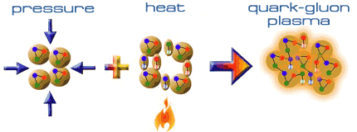
Expeditions on QCD Phase Diagram
toward deconfined partonic phase
discovery at RHIC after ~ 25 years of search
now in new stage to look into:
  properties of deconfined partonic matter
  structures of QCD phase diagram
  scenario of early universe evolution
  …
Early Universe
Deconfined Partonic Phase
(Quark-Gluon Plasma)
Tri-Critical point
Energy Density (Temperature)
Critical Temperature ~ 170 MeV
High Energy A+A Collisions
Hadron gas
Color Super-Conductivity?
Color-Flavor Locking?
Nucleus
Neutron Star
Baryon Density

Slide 5

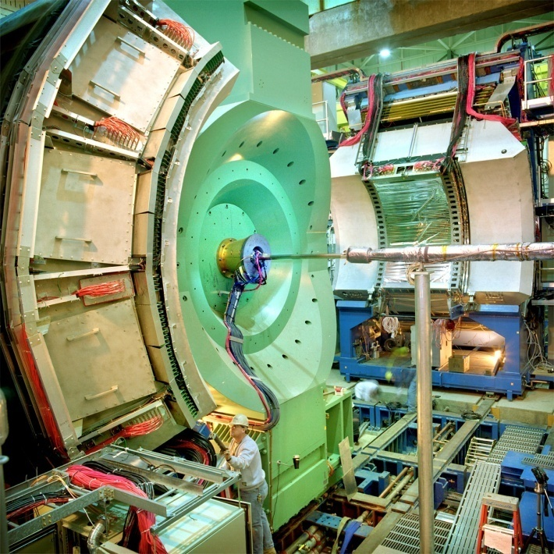




Relativistic Heavy Ion Collider at BNL
2 independent super-conducting synchrotrons
up to 100 A GeV Au and/or 250 GeV (polarized) p
  Au+Au/Cu+Cu/U+U/d+Au/p+p (/p+Au/³He+Au/…)
4 (presently 2) complimentary experiments

Slide 6
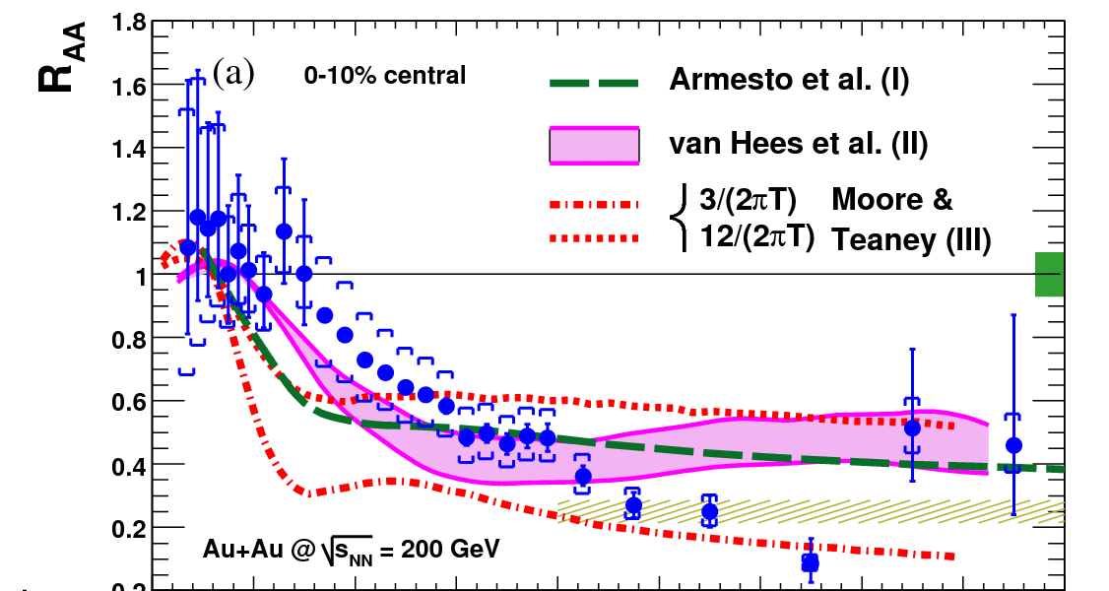
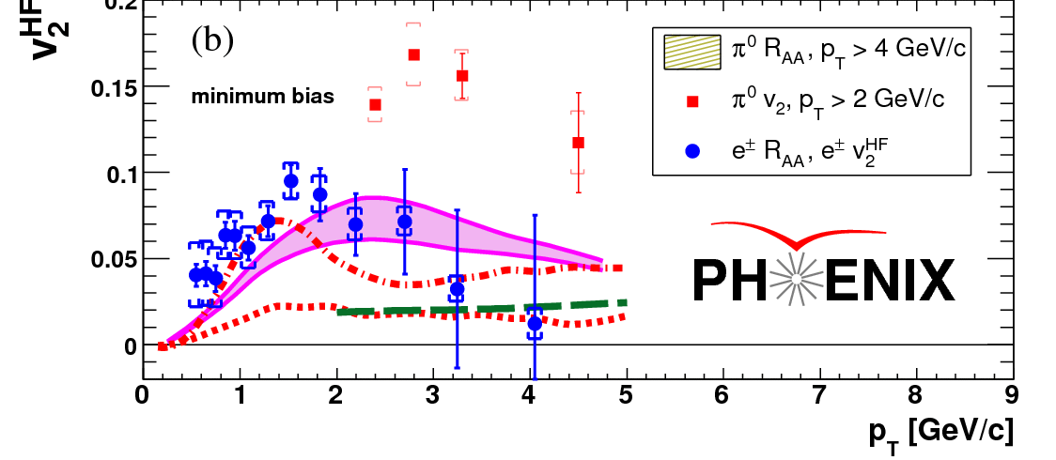
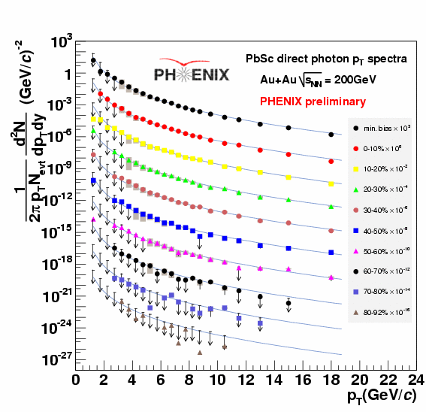
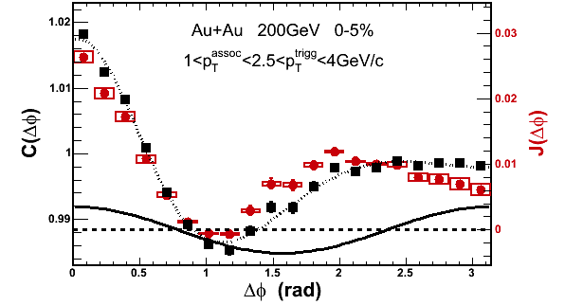
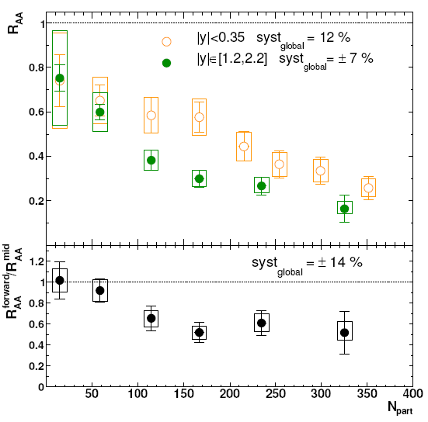
RHIC Outcomes: New State of Matter
partonic: quarks’ degrees of freedom, screening
  constituent quark number scaling of collective motion
  J/Ψ suppression
dense: energy loss of (even heavy) quarks
  jet quenching (high p_{T} suppression)
  jet modification
strongly coupled: perfect fluidity
  hydro-dynamical collective motion
hot: thermally radiative
  thermal (virtual) photons
The matter is dense
The matter is strongly coupled
The matter may melt and/or regenerate J/ψ’s
The matter modifies jets
The matter is hot

Slide 7
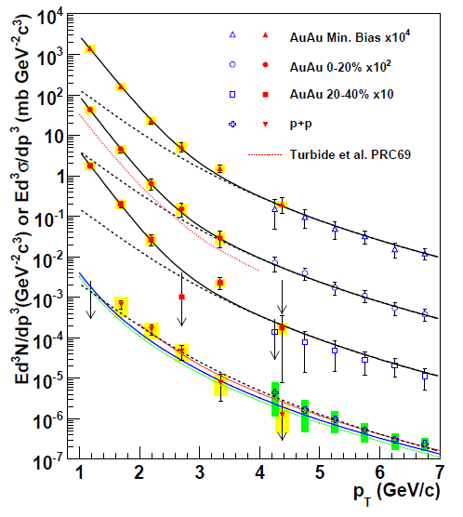
Photons (γ and γ*) as Thermometer
real and virtual photon methods consisitent
Au+Au: “thermal” excess
  ~ exponential with slope 221 ± 19 ± 19 MeV
cf. p+p data
  consistent with pQCD down to low p_{T}
PHENIX (A. Adare et al.), PRL 104, 132301 (2010)
NLO pQCD (W. Vogelsang)

Slide 8
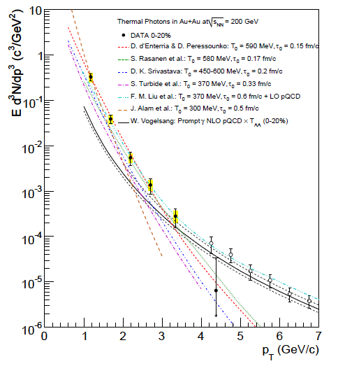
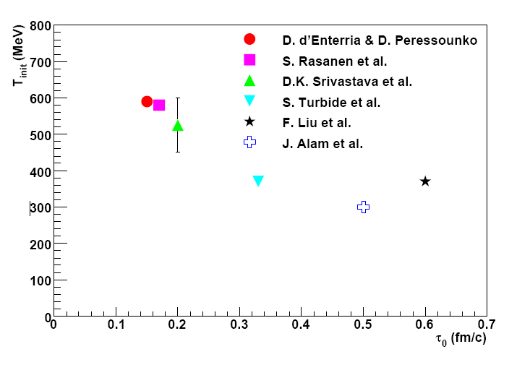

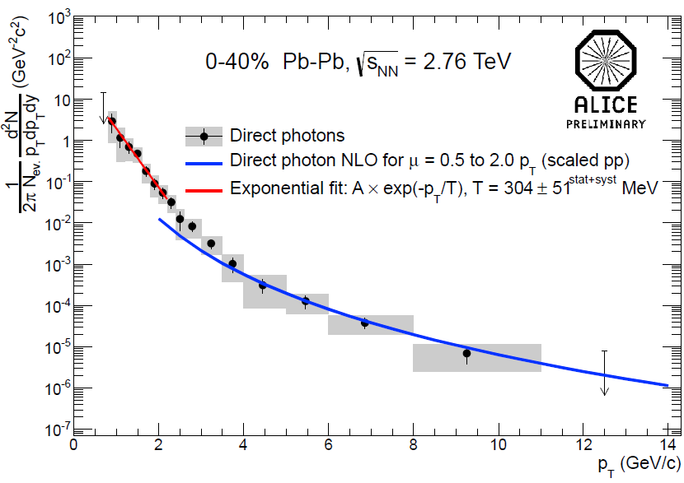
Initial Temperature Evaluation
initial temperature > data slope ~ 220 MeV
300–600 MeV (model dependence within factor 2)
  hydro-dynamic description
    w/ τ₀ = 0.15–0.6 fm/c
slope ~ 304 ± 51 MeV at LHC-ALICE
cf. phase transition predicted at ~ 170 MeV
slope
PHENIX (A. Adare et al.),
PRC 81, 034911 (2010)
transition temperature
ALICE (M. Wilde et al.),
Nucl.Phys. A904-905, 573c (2013)

Slide 9
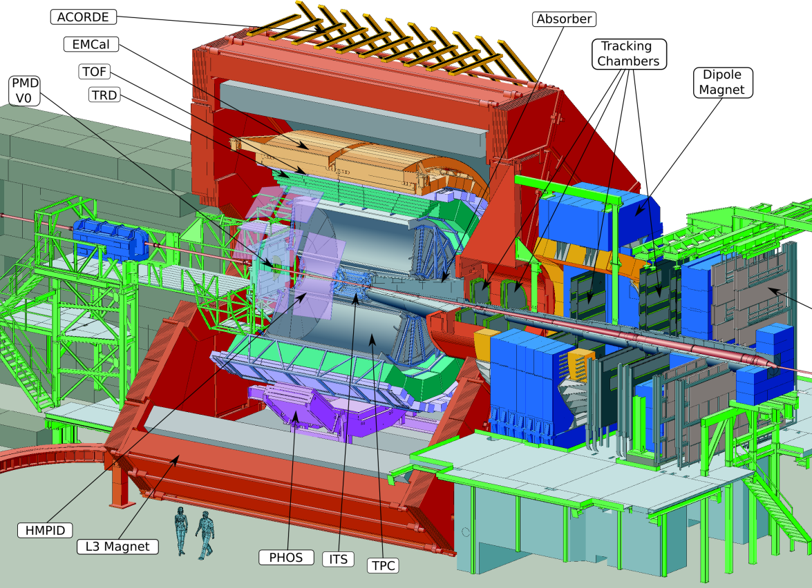
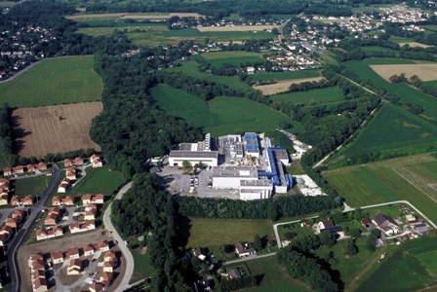

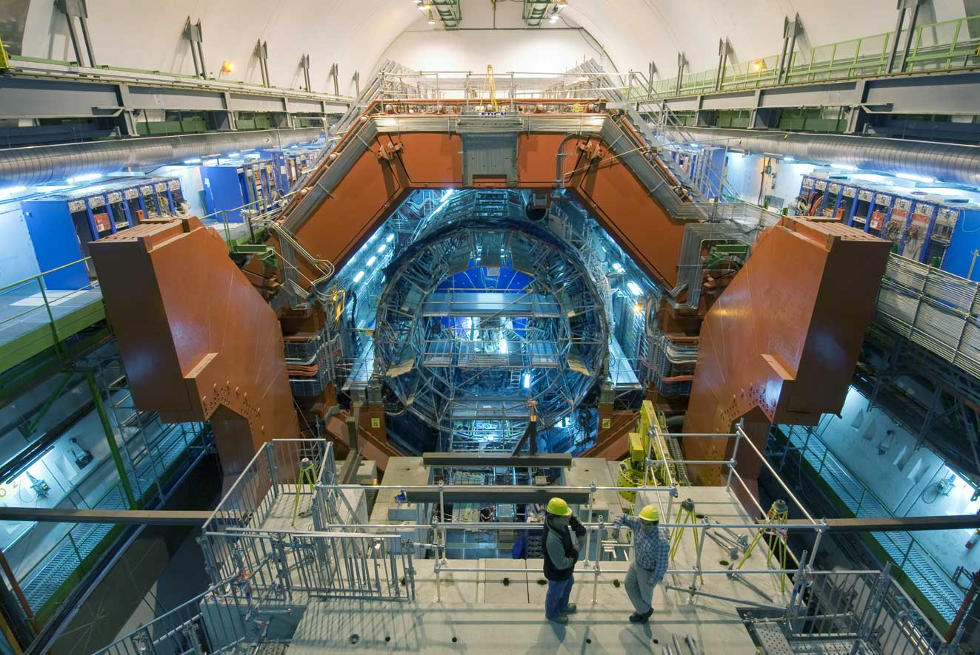
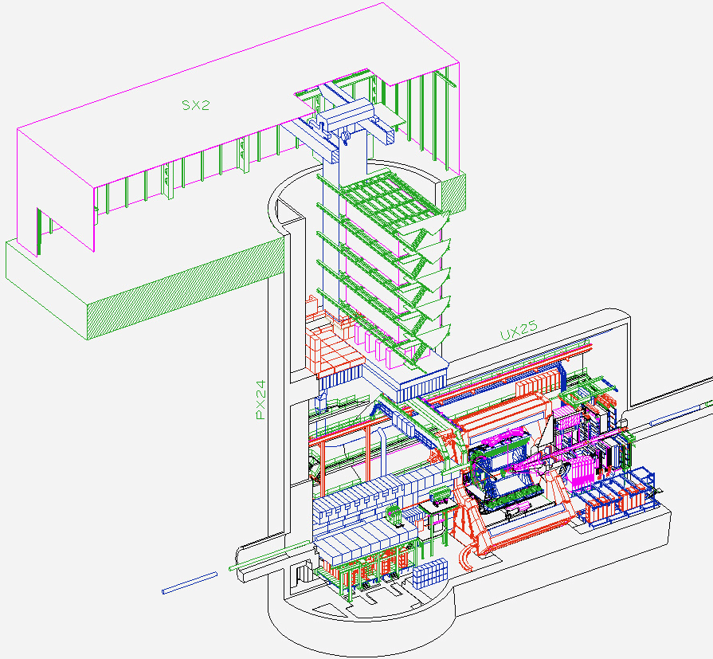
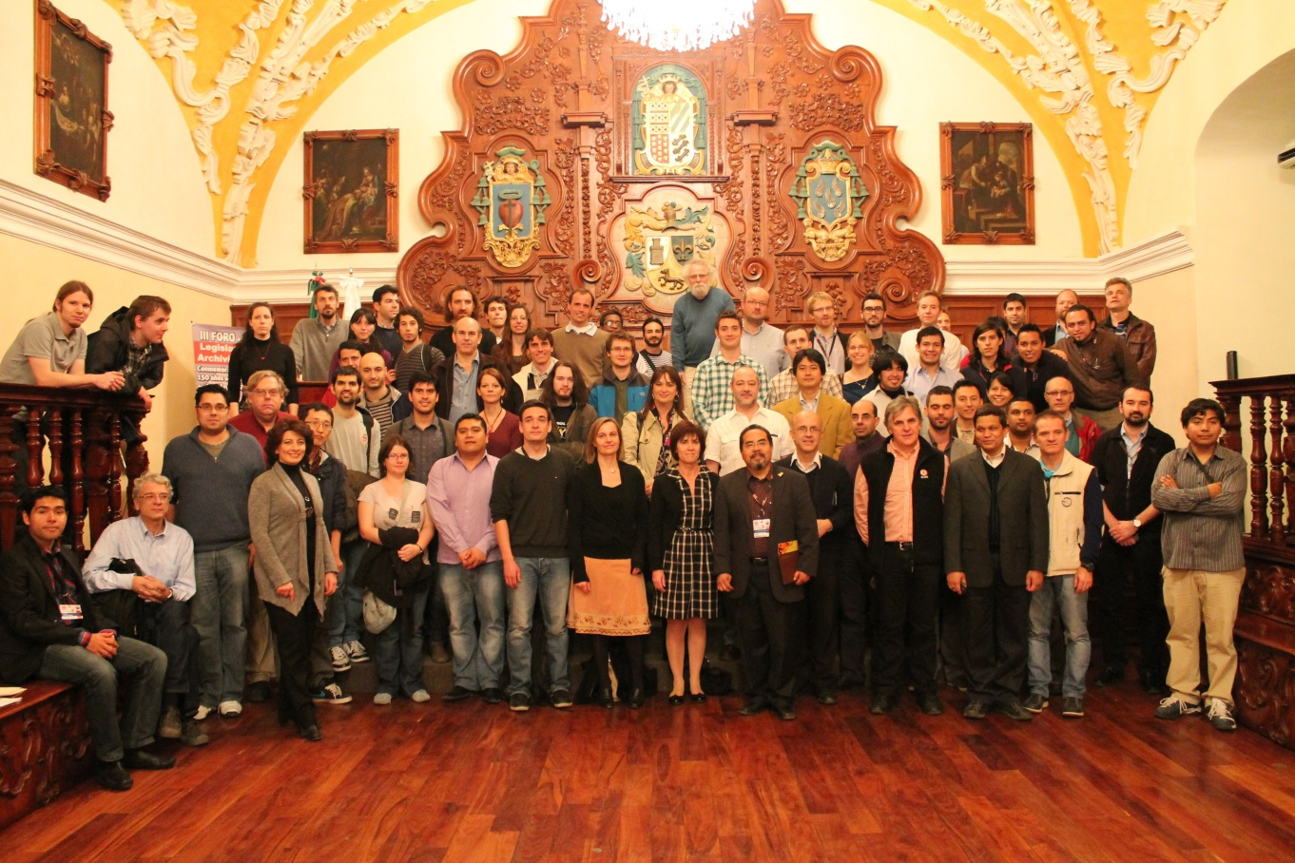

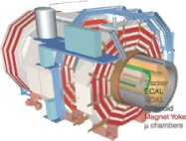

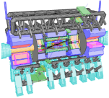


A Large Ion Collider Experiment
the nucleus-nucleus collision experiment at LHC
36 countries; 131 institutes; ~1,200 members
    as of November, 2013
CMS
LHCb
ALICE
ATLAS, LHCf

Slide 10

Highest Energy (So Far) Pb+Pb
2.76 TeV Pb+Pb in 2010 and 2011
  14 times higher √s_{NN} than at RHIC
~ 5.1 TeV in 2015; design energy at 5.5 TeV

Slide 11
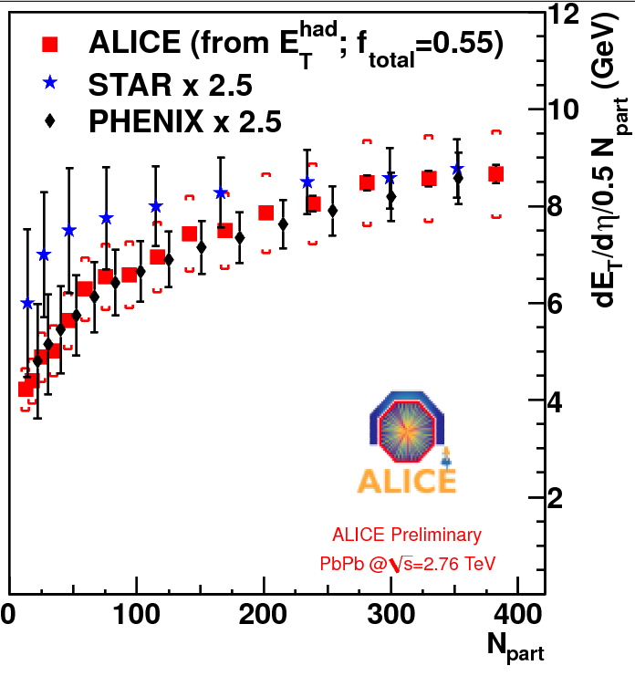
Highest Initial Energy Density
~ 2.5 × transverse energy density than at RHIC
from Bjorken formula:
ετ₀ ~ 16 GeV/fm²c ~ 3 × at RHIC
  lower limit for ε ; likely higher with shorter time scale

Slide 12
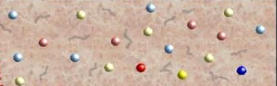
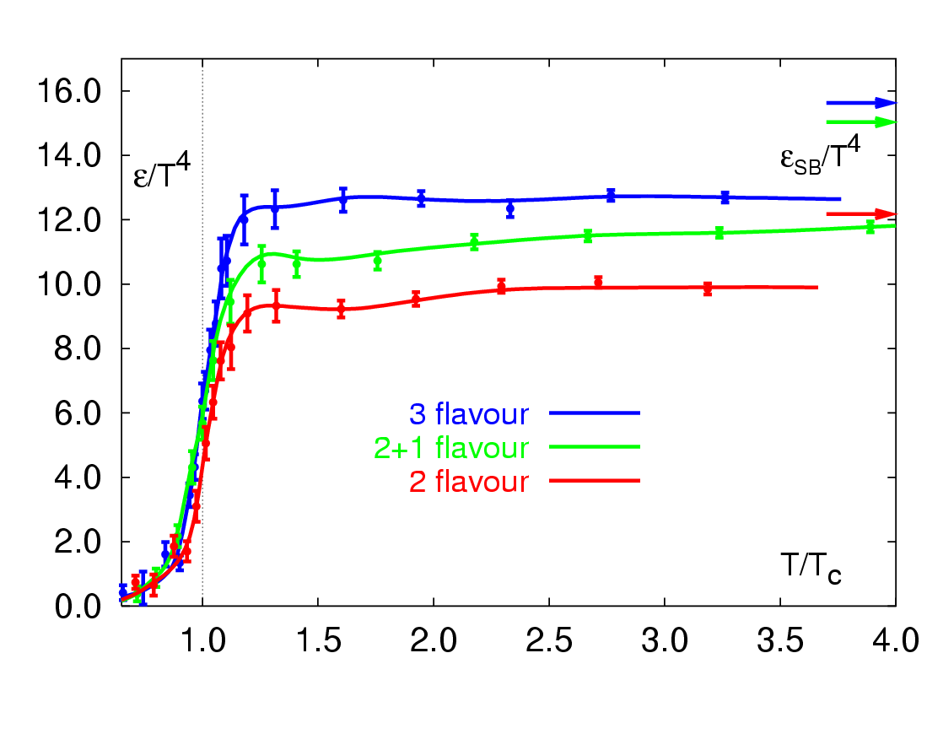
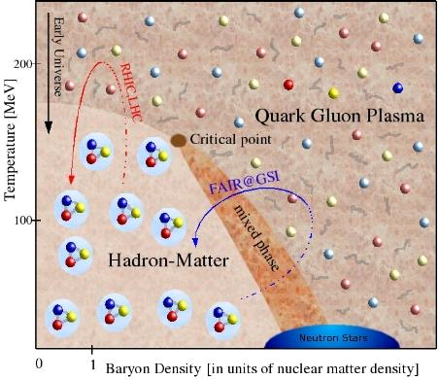
Adventure beyond Boundary
RHIC → LHC
RHIC
“free gas” ?
“perfect fluid”
RHIC → LHC
RHIC

Slide 13
Prominent Probes at Higher Energies
high transverse momentum phenomena, e.g. jets
heavy flavors (charm and beauty)
demonstrated very powerful at ALICE/ATLAS/CMS

Slide 14
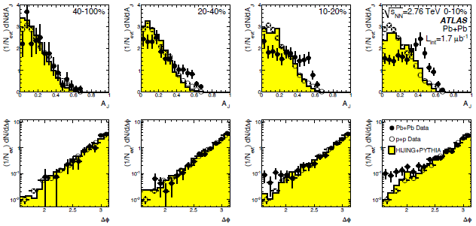
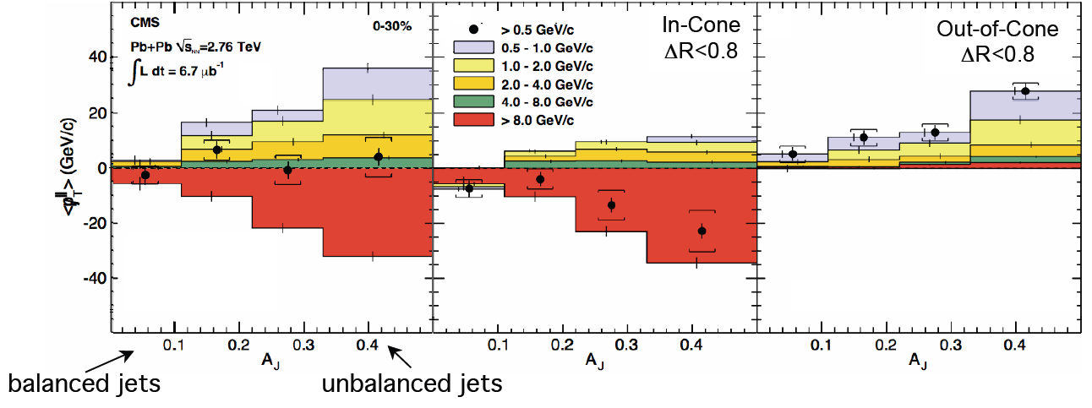
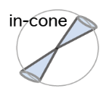


Jet Modification at LHC
asymmetric di-jets and even mono-jets (!)
lost jet energy distributed very widely
  ΔR > 0.8 ~ π/4
  enhancement at low p_{T}
high p_{T} hadron
ATLAS
hadrons (jet)
quenched jet
quark
ΔR>0.8
(anti-)quark
CMS
hadrons (jet)
high p_{T} hadron

Slide 15
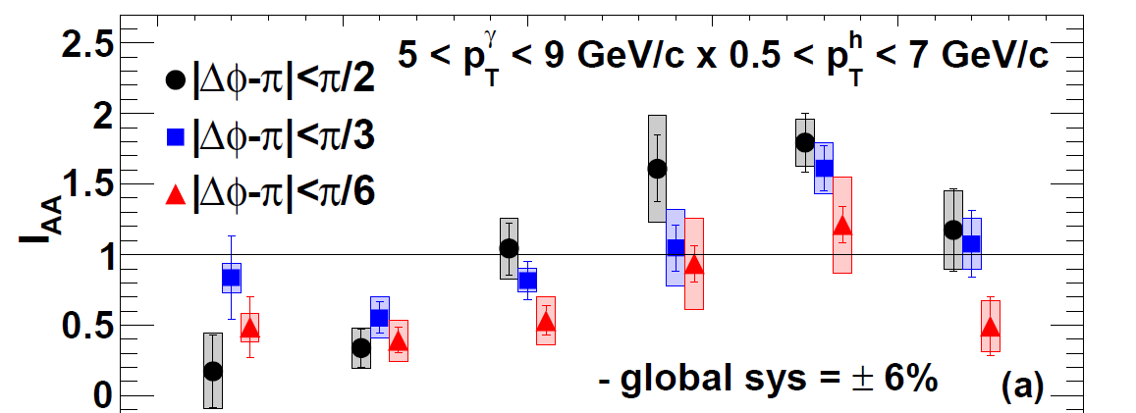

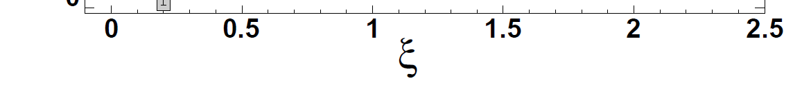
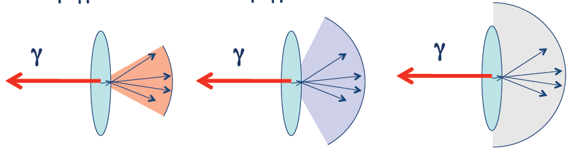
Jet Energy Loss and Redistribution
narrow cone → high z_{T} suppression
  no corresponding enhancement at low z_{T}
wide cone → low z_{T} enhancement
PHENIX
yield in Au+Au
yield in p+p
I_{AA} =
ξ = ln(1/z_{T})
z_{T} = p_{T}^{hadron}/p_{T}^{photon}
high z_{T}
low z_{T}
|Δφ-π| < π/6 |Δφ-π| < π/3 |Δφ-π| < π/2

Slide 16
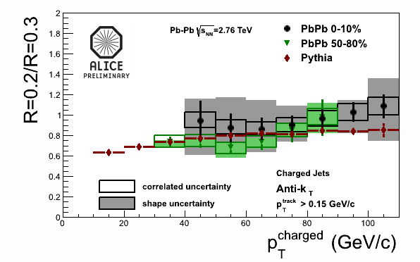
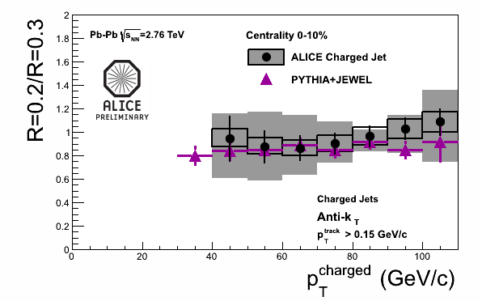
Survived Jets Un-Modified ?
shape after energy loss consistent with in vacuum
  energy ratio in different cone radii σ(R=0.2)/σ(R=0.3)
  both for peripheral and central collisions
no sign of jet broadening
good agreement with a model with energy loss

Slide 17
PID’ed Singles for Flavor Differential
RHIC and LHC heavy flavor results consistent
  charm+beauty mesons’ semi-leptonic decay electrons
next step: charm/beauty separation
  key: vertex detctors
PHENIX, ALICE

Slide 18
Possible Mass Hierarchy
charm and beauty mesons with compatible <p_{T}>
  open charm (average of D⁰, D⁺, D^{∗+}), ALICE
  non-prompt J/Ψ (← B), CMS
indication of weaker suppression of beauty

Slide 19
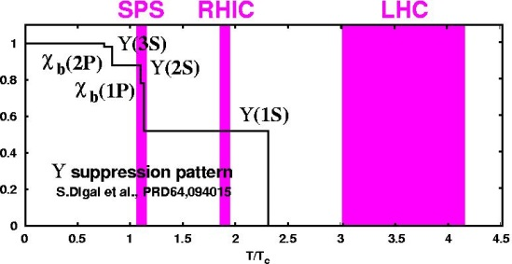
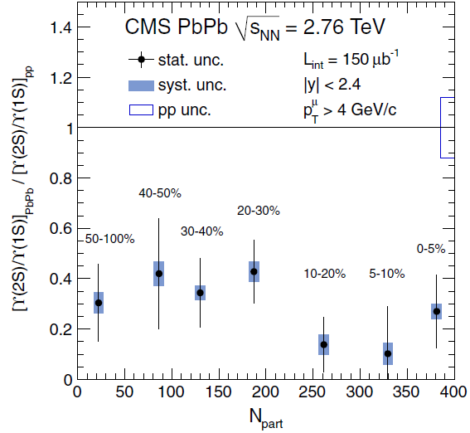
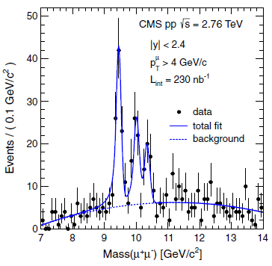
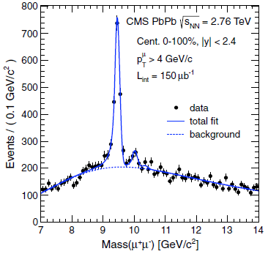
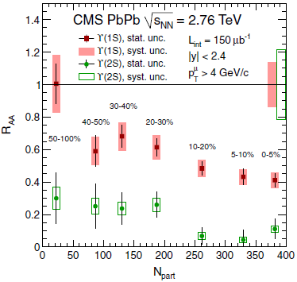
Quarkonia – Sequentially Melting?
Υ(2S) more suppressed than Υ(1S)
  Υ(3S) even more suppressed
no signature of sequential melting
(feed down uncorrected)
CMS, PRL 109, 222301 (2012)

Slide 20
Time to Look Back and Think
RHIC beam energy scan
  phase 1 (2010–2011)
    7.7, 11.5, 19.6, 27, 39 GeV
  phase 2 (2018–2019)
    same energy region
    luminosity upgrade with electron cooling
  ref. N. Xu on STAR and RHIC BES
remember? once upon a time, we had fixed targets

Slide 21
Heavy Ion Programs at SPS
hadron production at √s_{NN} up to ~ 20 GeV
  NA34
  NA35/49/61
  NA36
  NA44
    S. Nagamiya, K. Shigaki, M. Kaneta et al.
  NA52
  WA85/94/97, NA57
lepton/photon production at √s_{NN} up to ~ 20 GeV
  NA38/50/51/60 (di-muon)
  NA45 (di-electron)
  WA80/93/98 (photon)

Slide 22
Heavy Ion Programs at AGS
hadron production at √s_{NN} up to ~ 5 GeV
  E802/859/866/917
    S. Nagamiya, H. Hamagaki, K. Shigaki, H. Sako, et al.
  E810/891
  E814/877
    P. Braun-Munzinger, N. Xu, et al.
no lepton/photon experiment in this energy regime
question: new feasibility in 21st century at J-PARC

Slide 23
Breakthrough at J-PARC?
no thanks for left over at AGS/SPS/RHIC-BES
rare probes, especially (di-)leptons
J-PARC aiming at × 50 proton intensity of AGS
key #1: heavy ion beam intensity at J-PARC
key #2: high intensity capable detector
  ref. T. Sakaguchi on lepton/photon measurement

Slide 24
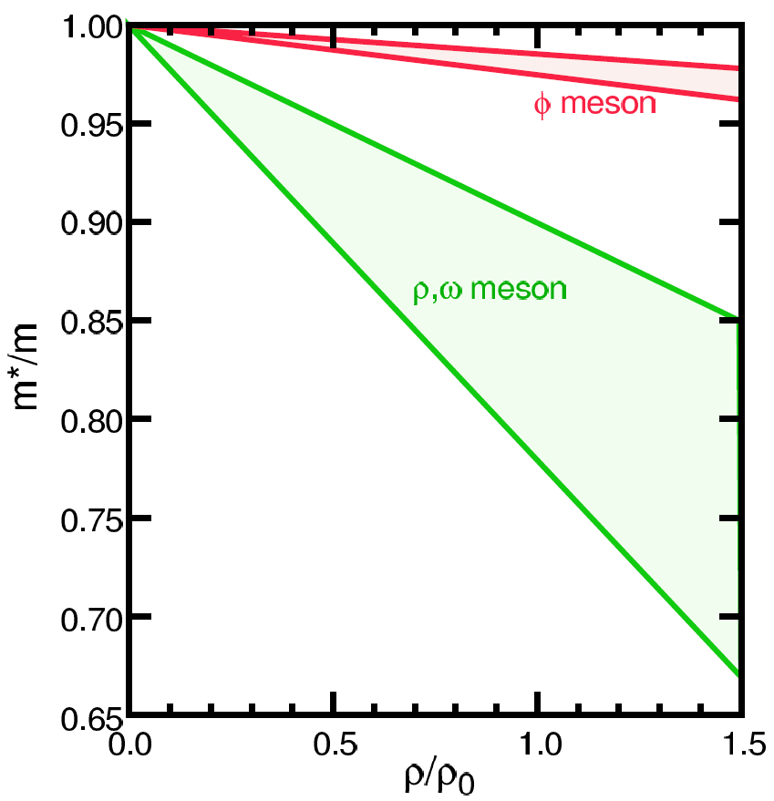
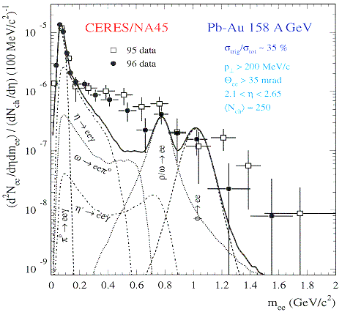
Interesting Though Unexplored
phenomena with restored symmetry
in case of chiral symmetry:
  diminishing effective (light) quark masses
  probably lower hadron masses
typically, light vector meson mass modification
  ref. K. Ozawa on J-PARC primary beam physics
  leptonic decay channels with short life time
    e.g. φ (ss) → e⁺e⁻ (0.03 %)
looking into “parallel world”
T.Hatsuda, H.Shiomi and H.Kuwabara
Prog. Theor. Phys. 95 (1996) 1009

Slide 25
Uniqueness of QCD Phase Transition
only possible boundary to experimentally cross
  to prove (or disprove) paradigm of universe evolution
  not just to catch residue
K. Homma, 2008/09

Slide 26
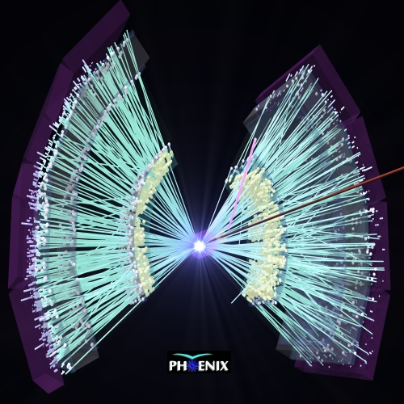
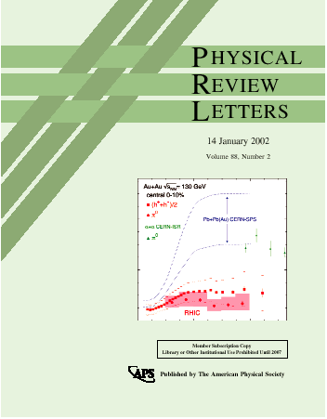
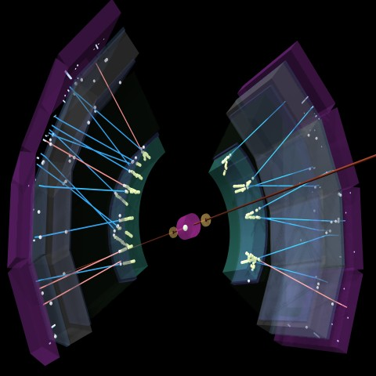
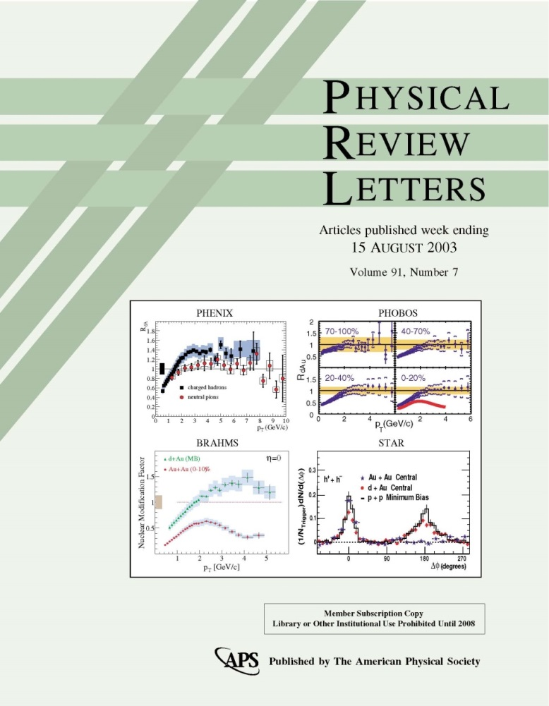
p(d)+A Gathering New Attention
originally as reference to bridge p+p and A+A
  initial state nuclear effects
  final state cold nuclear matter effects
“suppression of hadrons with large p_{T}”
Au+Au at √s_{NN} = 130 GeV
PRL 88 (January, 2002)
“lack of suppression”
d+Au at √s_{NN} = 200 GeV
PRL 91 (August, 2003)
Au+Au at √s_{NN} = 200 GeV
d+Au at √s_{NN} = 200 GeV

Slide 27
Something More Complicated (?)
original thought: cold nuclear matter, i.e.
  not partonic
  not dense
  not strongly coupled
  not hot
indications of strongly coupled partonic matter??

Slide 28
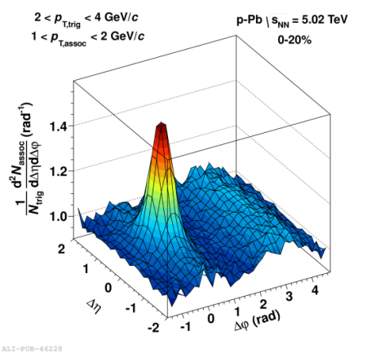
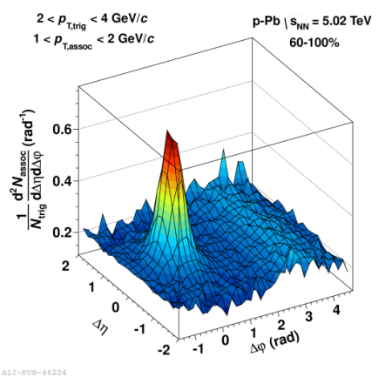
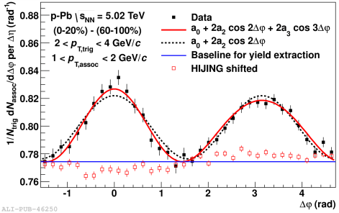
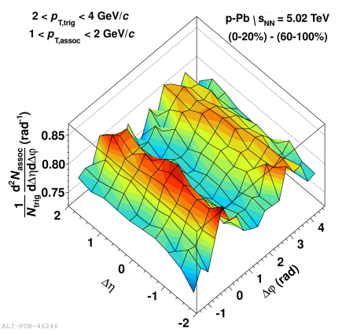
New Discovery in p+p and p+A
“ridge” in p+p and “double ridge” in p+Pb
  long range angular correlations in near and away sides
explained by collective flow from initial fluctuation
  strongly coupled matter already in p+p and p+A?
− =
high multiplicity p+Pb low multiplicity p+Pb long range correlation

Slide 29
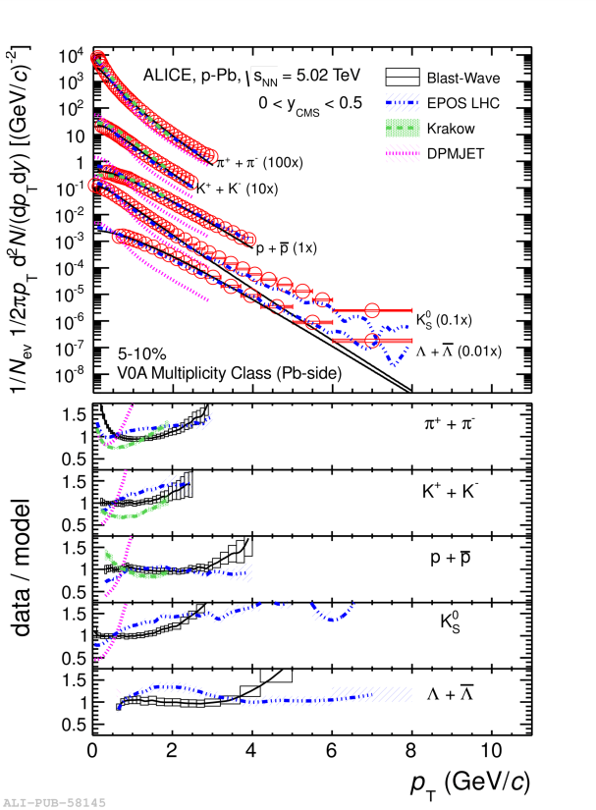
Hydro-like Behaviors in p+Pb
harder particle spectra at higher multiplicity
increasing effect with particle mass
better described by models
with hydrodymanics
    Blast-Wave: PRC 48,2462 (1993)
    EPOS LHC: arXiv:1306.0121 [hep-ph]
    Krakow: PRC 85,014911 (2012)
    DPMJET: arXiv:hep-ph/0012252

Slide 30
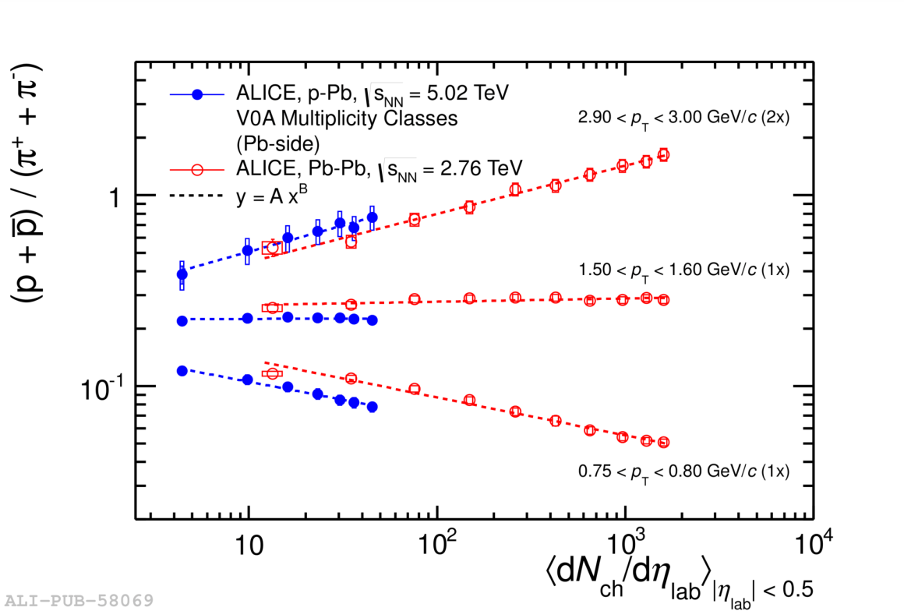
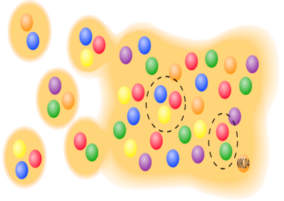
Quark Fluid in p+Pb?
baryon enhancement in intermediate p_{T}
  understood via quark recombination in A+A
similar evolution with multiplicity

Slide 31
p(d)+A Seemingly in Mystery
long range longitudinal correlations
hydro-dynamical behaviors?
quark recombination??
→ reanalysis of d+Au at RHIC giving similar results
→ first p+Au at RHIC planned in 2015
high intensity p+A at J-PARC of instant interest

Slide 32
ALICE and (s)PHENIX in Next Decade
ALICE upgrade for higher luminosity
  × 2–3 high speeding at long shutdown 1 (2013–2014)
    readout electronics
  × 100 high speeding at long shutdown 2 (2018–2019)
    TPC readout replacement with GEM
    new inner trackers
sPHENIX to feedback knowledge at LHC to RHIC
  high transverse momentum and heavy flavor probes
  hermetic design

Slide 33
CERN Long Term Plan
Run 2
LS 2
Run 3
LS 3
Run 4
LS 4
Run 5
LS 5
Physics
Shutdown
Beam commissioning
Technical stop

Slide 34
ALICE (-Japan) Upgrade Plan
long shutdown 1 (2013–2014)
  high resolution EM cal. high speeding (Hiroshima)
    thermal photon
  di-jet calorimeter (Tsukuba)
    photon–jet correlation
long shutdown 2 (2018–2019)
  TPC upgrade (Tokyo)
    non-triggerable low transverse momentum phenomena
  inner tracker upgrade
  forward calorimeter (Tsukuba, Tokyo)
    small x physics
  muon forward tracker

Slide 35
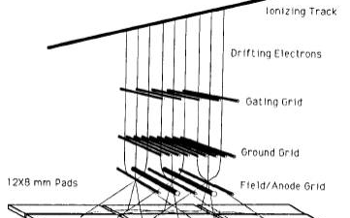
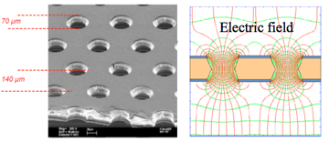
TPC Upgrade with GEM Readout
present: MWPC with gating grid
  effective dead time ~ 280 μsec; rate < 3.5 kHz
plan: GEM with continuous sampling at 10 MHz

Slide 36




Small x Physics with Forward Cal.
new regime at LHC
  possible transition from pQCD to CGC
Si-W calorimeter at 2.5 < η < 4.5 or 3.3 < η < 5.3
photon pair from
π⁰ at 200 GeV/c

Slide 37


sPHENIX: Feedback to RHIC from LHC
PHENIX
  fast, selective, precise
  mid to low trans. mom.
  limited acceptance
sPHENIX
  fast, selective, precise
  high to mid trans. mom.
  large acceptance
detectors by US-Japan
2013 revision
with BaBar solenoid

Slide 38







  Aiming at (Partial) Start in 2019
former BaBar solenoid transferred from SLAC
first test beam at FNAL in 2014/02

Slide 39




Not Only Jet: “Day-1 Upgrade”
physics with e± / h± / γ / π⁰ identification
  QCD debye screening via e⁺e⁻ from quarkonia
  photon–jet correlation via direct γ
  parton behavior via π⁰
high performance PID
  pre-shower detector (Hiroshima, Tsukuba)
multi-variable cut
e⁻ （5 GeV/c）
π⁺ （5 GeV/c）
Geant4
photon pair from π⁰

Slide 40
Major Project in Next Decade
Years | Beam Species and Energies | Science Goals | New Systems Commissioned
2014 | 15 GeV Au+Au 200 GeV Au+Au | Heavy flavor flow, energy loss, thermalization, etc. Quarkonium studies QCD critical point search | Electron lenses 56 MHz SRF STAR HFT STAR MTD
2015-16 | p+p at 200 GeV p+Au, d+Au, ³He+Au at 200 GeV High statistics Au+Au | Extract η/s(T) + constrain initial quantum fluctuations More heavy flavor studies Sphaleron tests Transverse spin physics | PHENIX MPC-EX Coherent e-cooling test
2017 | No Run |  | Low energy e-cooling upgrade
2018-19 | 5-20 GeV Au+Au (BES-2) | Search for QCD critical point and onset of deconfinement | STAR ITPC upgrade Partial commissioning of sPHENIX (in 2019)
2020 | No Run |  | Complete sPHENIX installation STAR forward upgrades
2021-22 | Long 200 GeV Au+Au with upgraded detectors p+p, p/d+Au at 200 GeV | Jet, di-jet, γ-jet probes of parton transport and energy loss mechanism Color screening for different quarkonia | sPHENIX
2023-24 | No Runs |  | Transition to eRHIC
present RHIC/PHENIX

Slide 41
Summary and Concluding Remarks
high energy A+A physics in new stage
J-PARC-HI physics complimentary with RHIC/LHC
improved knowledge/technique since AGS/SPS
parallel with ALICE upgrade and sPHENIX
high intensity heavy ion beam
high intensity capable rare probe experiment(s)
unexplored territory: chiral symmetry restoration
interesting to start with p+A

