Slide 1

A Truly Experimental Study of Very Early Universe: the New Stage of
High Energy Nucleus-Nucleus Collision
Experiments
Kenta Shigaki (Hiroshima University )
KMI Colloquium
February 26, 2014
Kobayashi-Maskawa Institute, Nagoya University

Slide 2
Presentation Outline
unique features of high energy A+A physics
  challenge to reach “the other side” of phase boundary
new stage of high energy A+A experiments
  clearly beyond QCD phase boundary
selection of recent topics
  authentic: knowledge on partonic matter
  new: mysteriously behaving p(d)+A collisions
  brand new: ultra-intense U(1) magnetic field
summary and concluding remarks

Slide 3
Goals of High Energy A+A Collisions
why nucleus-nucleus at GeV/TeV range?
  “snowball + snowball”
“system” of particles under strong QCD field
  non-perturbative QCD under extreme conditions
    cf. “processes” between elementary particles
state of matter at ~ 10⁻⁵ seconds after Big Bang
  quark (de)confinement
    cf. production/interaction of matter at ~ 10⁻¹² seconds
hadronic mass generation at confinement
  spontaneous chiral symmetry breaking/restoration
    cf. particle mass generation via BEH mechanism

Slide 4
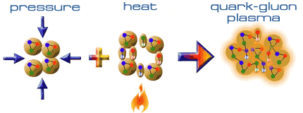
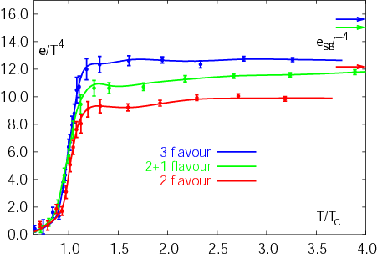
Expeditions on QCD Phase Diagram
toward deconfined partonic phase
lattice Quantum Chromo-Dynamics predictions
  critical temperature ~ 170 MeV
  critical energy density ~ 1 GeV/fm³
lost phase within experimental reach
Early Universe
Deconfined Partonic Phase
(Quark-Gluon Plasma)
Tri-Critical point
Energy Density (Temperature)
Critical Temperature ~ 170 MeV
High Energy A+A Collisions
Hadron gas
Color Super-Conductivity?
F. Karsch,
Lect. Notes Phys. 583 (2002) 209
Color-Flavor Locking?
Nucleus
Neutron Star
Baryon Density

Slide 5
Uniqueness of QCD Phase Transition
only possible boundary to experimentally cross
  to prove (or disprove) paradigm of universe evolution
  not just to catch residue
K. Homma, 2008/09

Slide 6
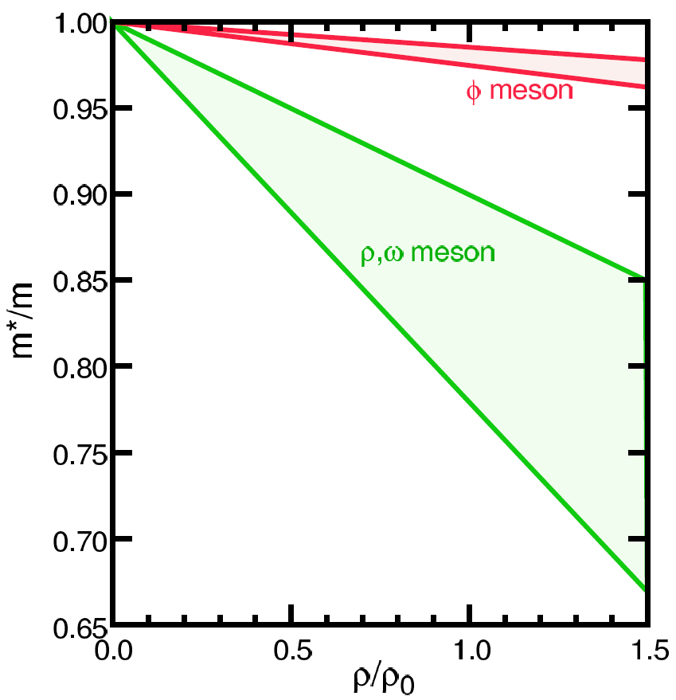
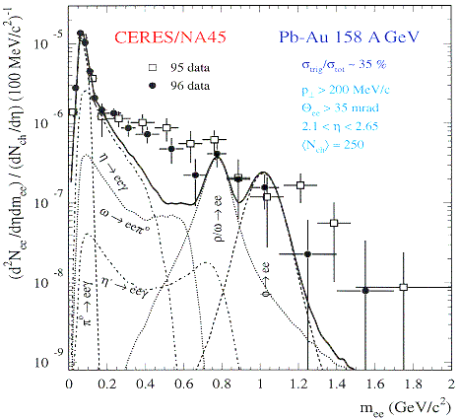
Looking into “Parallel World”
phenomena with restored symmetry
in case of chiral symmetry:
  diminishing effective (light) quark masses
  probably lower hadron masses
e.g. light vector meson mass modification
  leptonic decay channels with short life time
    e.g. φ (ss) → e⁺e⁻ (0.03 %)
T.Hatsuda, H.Shiomi and H.Kuwabara
Prog. Theor. Phys. 95 (1996) 1009

Slide 7
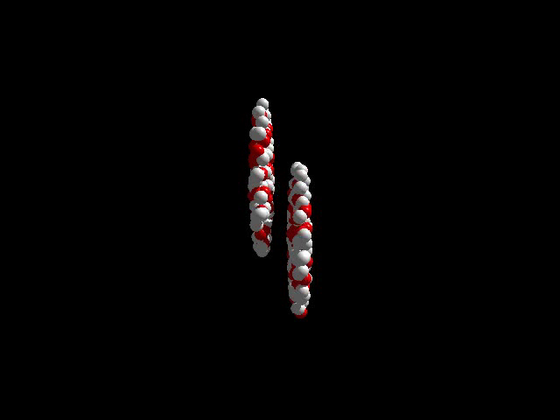
Brief History of A+A Facilities
from Bevalac/SIS/AGS/SPS to RHIC/LHC
  from high density to high energy density regime
recent major facilities
  BNL-AGS (11 A GeV ¹⁹⁷Au + fixed target)
    ²⁸Si since 1986, ¹⁹⁷Au since 1991; programs terminated
  CERN-SPS (200 A GeV ²⁰⁸Pb + fixed target)
    ³²S since 1986, ²⁰⁸Pb since 1994; programs terminated
  BNL-RHIC (100 + 100 A GeV ¹⁹⁷Au + ¹⁹⁷Au)
    since 2000; in operation
  CERN-LHC (2.8 + 2.8 A TeV ²⁰⁸Pb + ²⁰⁸Pb)
    since 2009; in operation

Slide 8

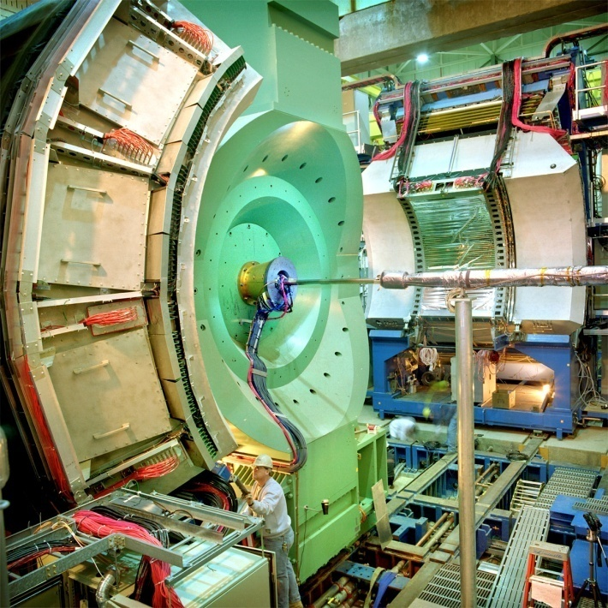




Relativistic Heavy Ion Collider at BNL
2 independent super-conducting synchrotrons
up to 100 A GeV Au and/or 250 GeV (polarized) p
  Au+Au/Cu+Cu/U+U/d+Au/p+p (/p+Au/³He+Au/…)
4 (presently 2) complimentary experiments

Slide 9
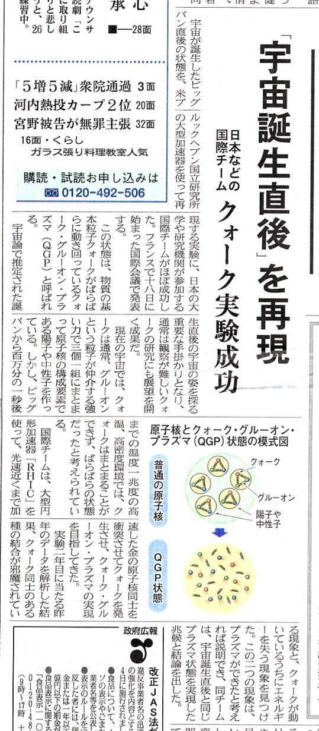
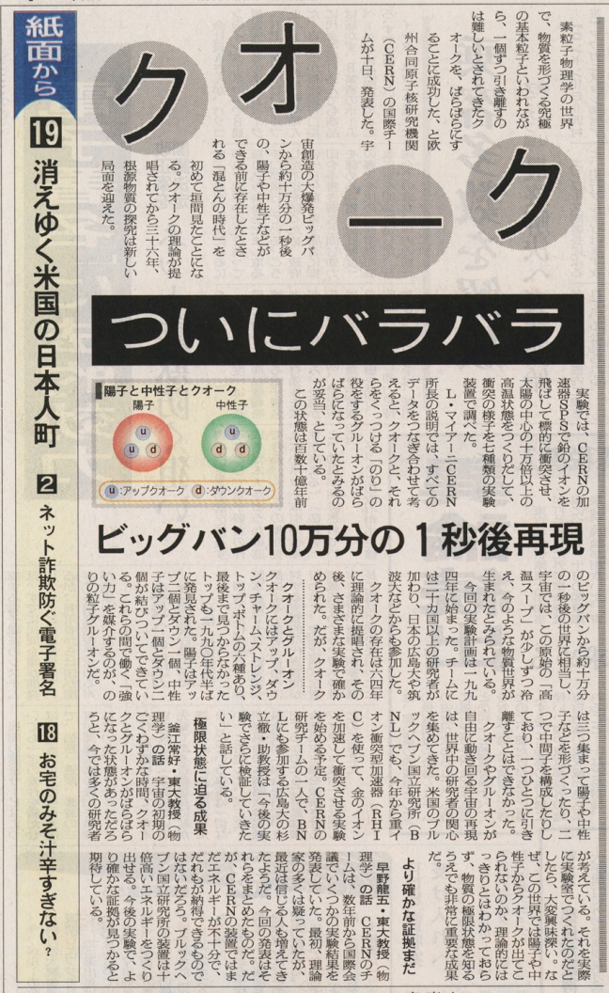
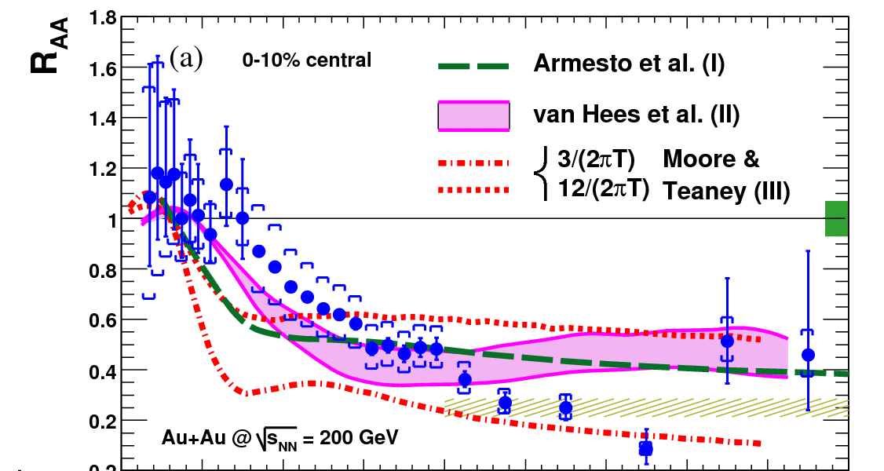
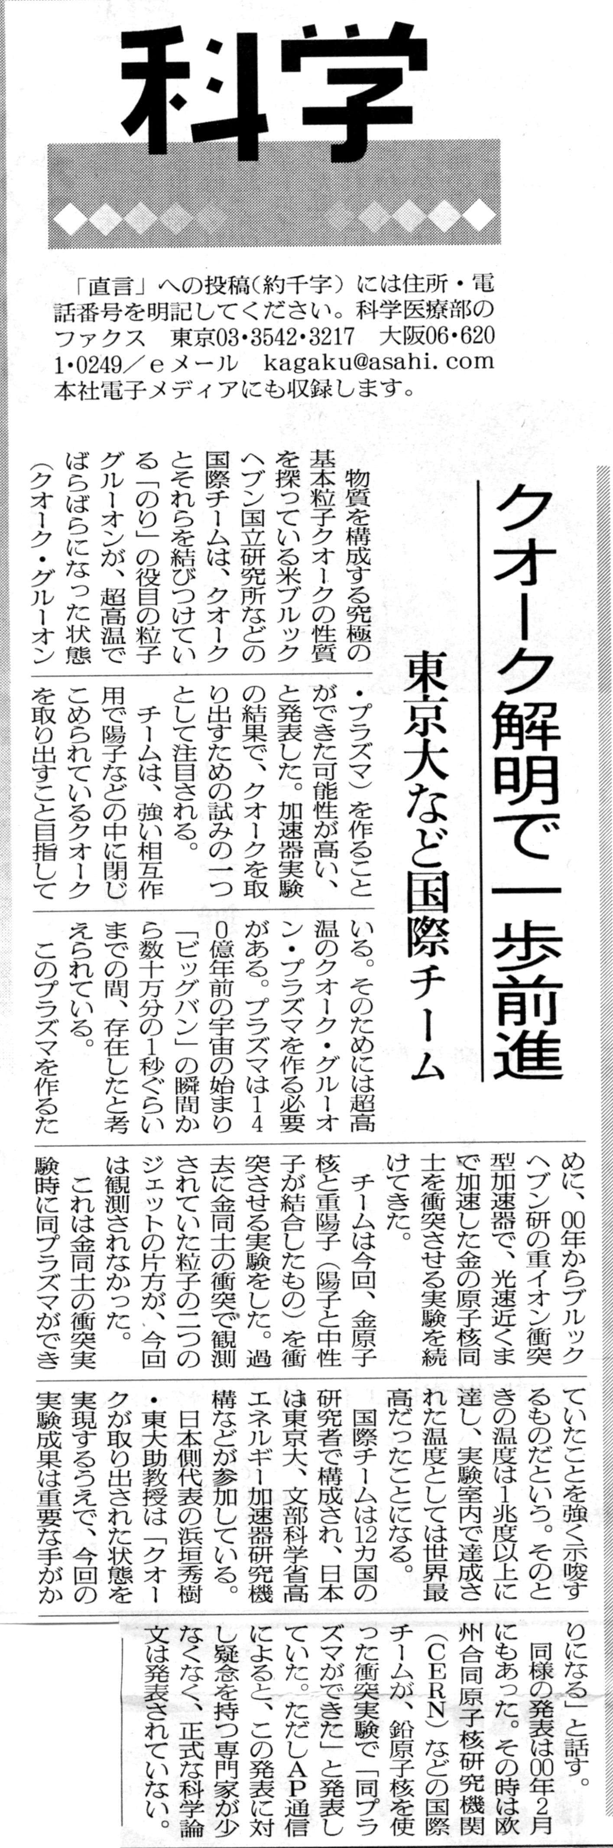
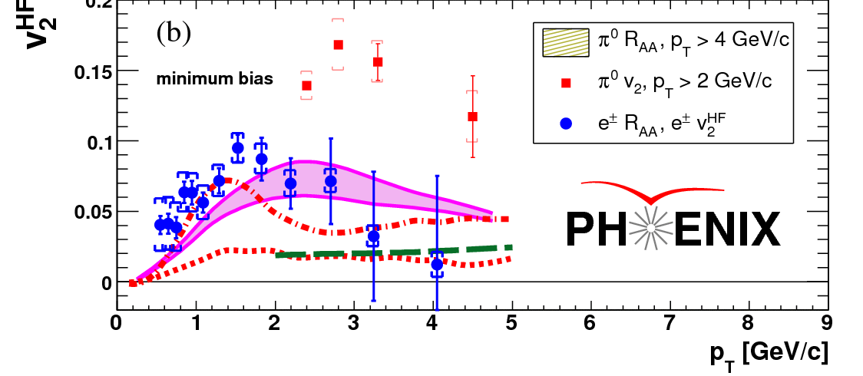
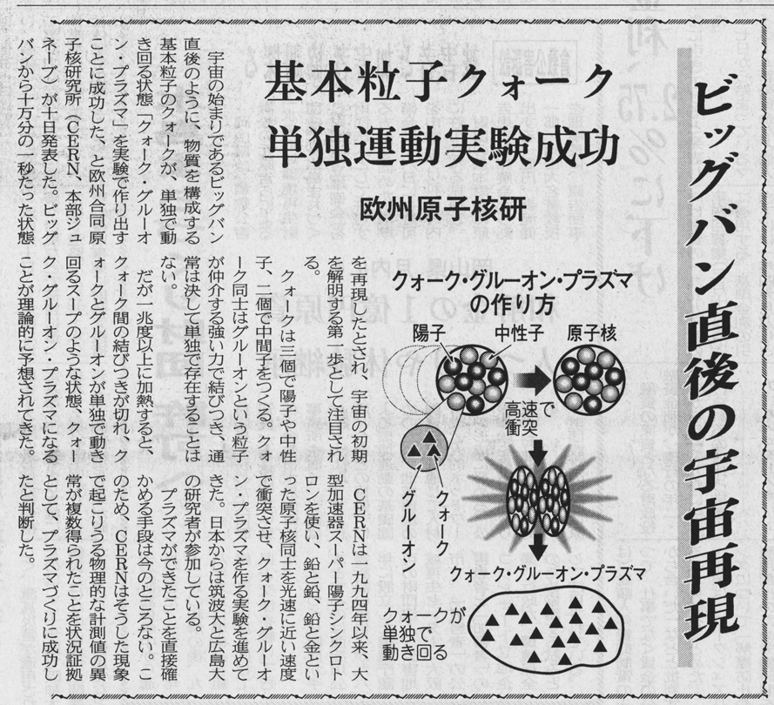
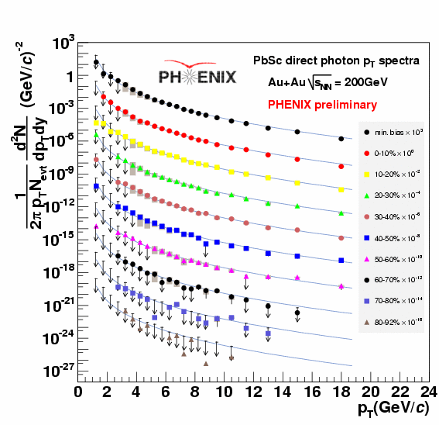
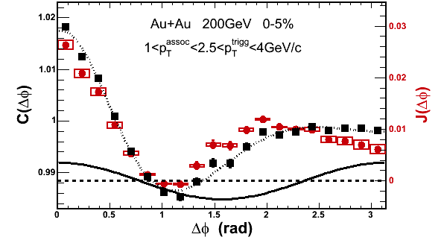
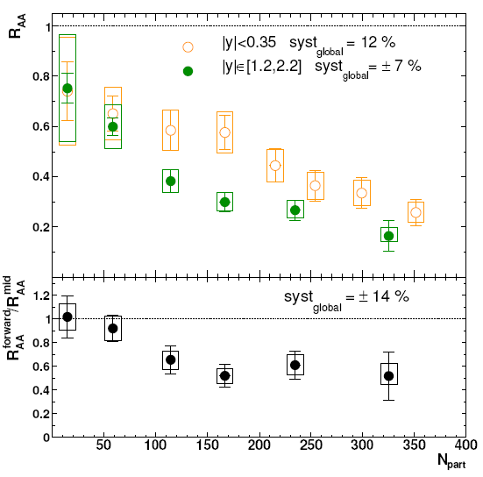
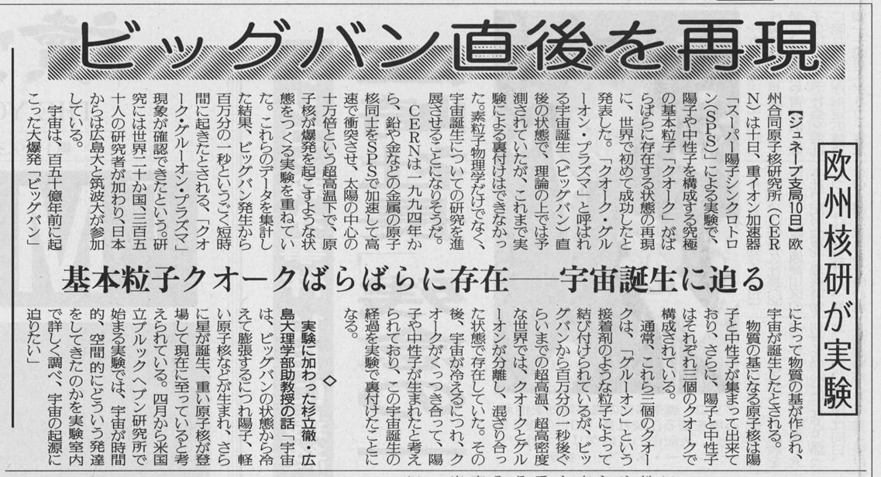
RHIC Outcomes: New State of Matter
partonic: quarks’ degrees of freedom, screening
  constituent quark number scaling of collective motion
  J/Ψ suppression
dense: energy loss of (even heavy) quarks
  jet quenching (high p_{T} suppression)
  jet modification
strongly coupled: perfect fluidity
  hydro-dynamical collective motion
hot: thermally radiative
  thermal (virtual) photons
The matter is dense
The matter is strongly coupled
The matter may melt and/or regenerate J/ψ’s
The matter modifies jets
The matter is hot

Slide 10
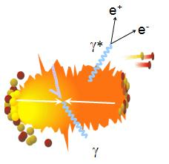
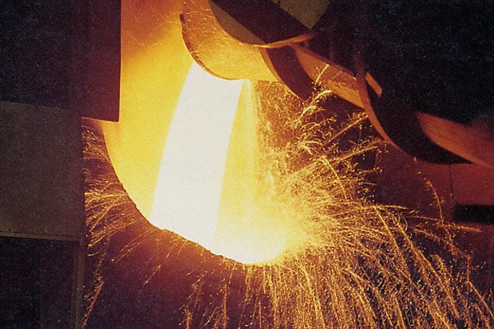
Photons as Thermometer
thermal radiation if in equilibrium
emission spectrum ↔ temperature
real and virtual thermal photons

Slide 11

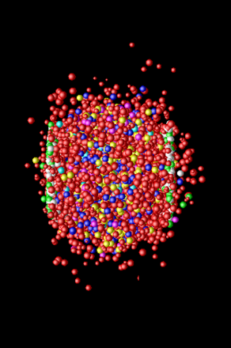
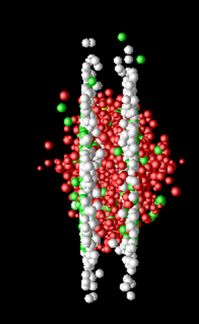
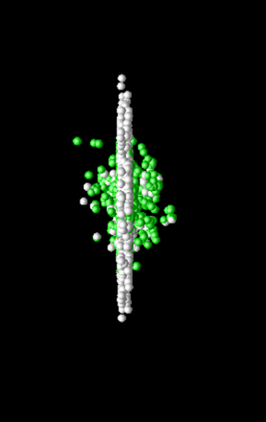
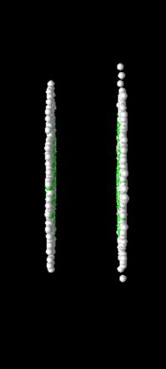
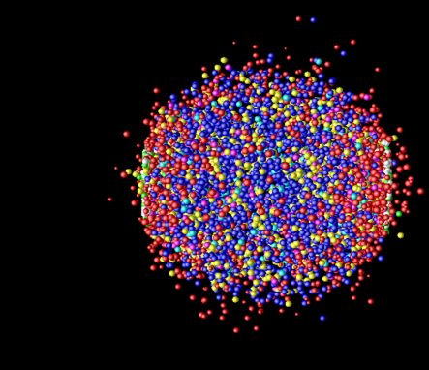
Photon Production Everywhere
Hadronization
(Freeze-out) +
Expansion
Mixed phase
Thermalization
QGP phase
Pre-equilibrium
Compton/Annihillation
Fragmentation
Prompt Photon
Jet-Photon Conversion
Jet-Bremsstrahlung (QGP)
Jet+Medium
Thermal Photon (QGP)
Thermal Photon (HG)
Thermal Photon
Time Evolution

Slide 12
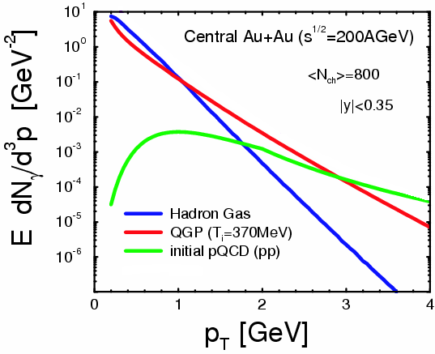
Where to Catch Thermal Photons
π
π
g
q
high p_{T} : pQCD photons
low p_{T} : photons from hadronic gas
intermediate p_{T} : QGP thermal photons dominant (!)
also other sources
plus hadron decay photons everywhere
hadron decay
photons
ρ
γ
q
γ
S.Turbide et al., PRC 69 014903

Slide 13
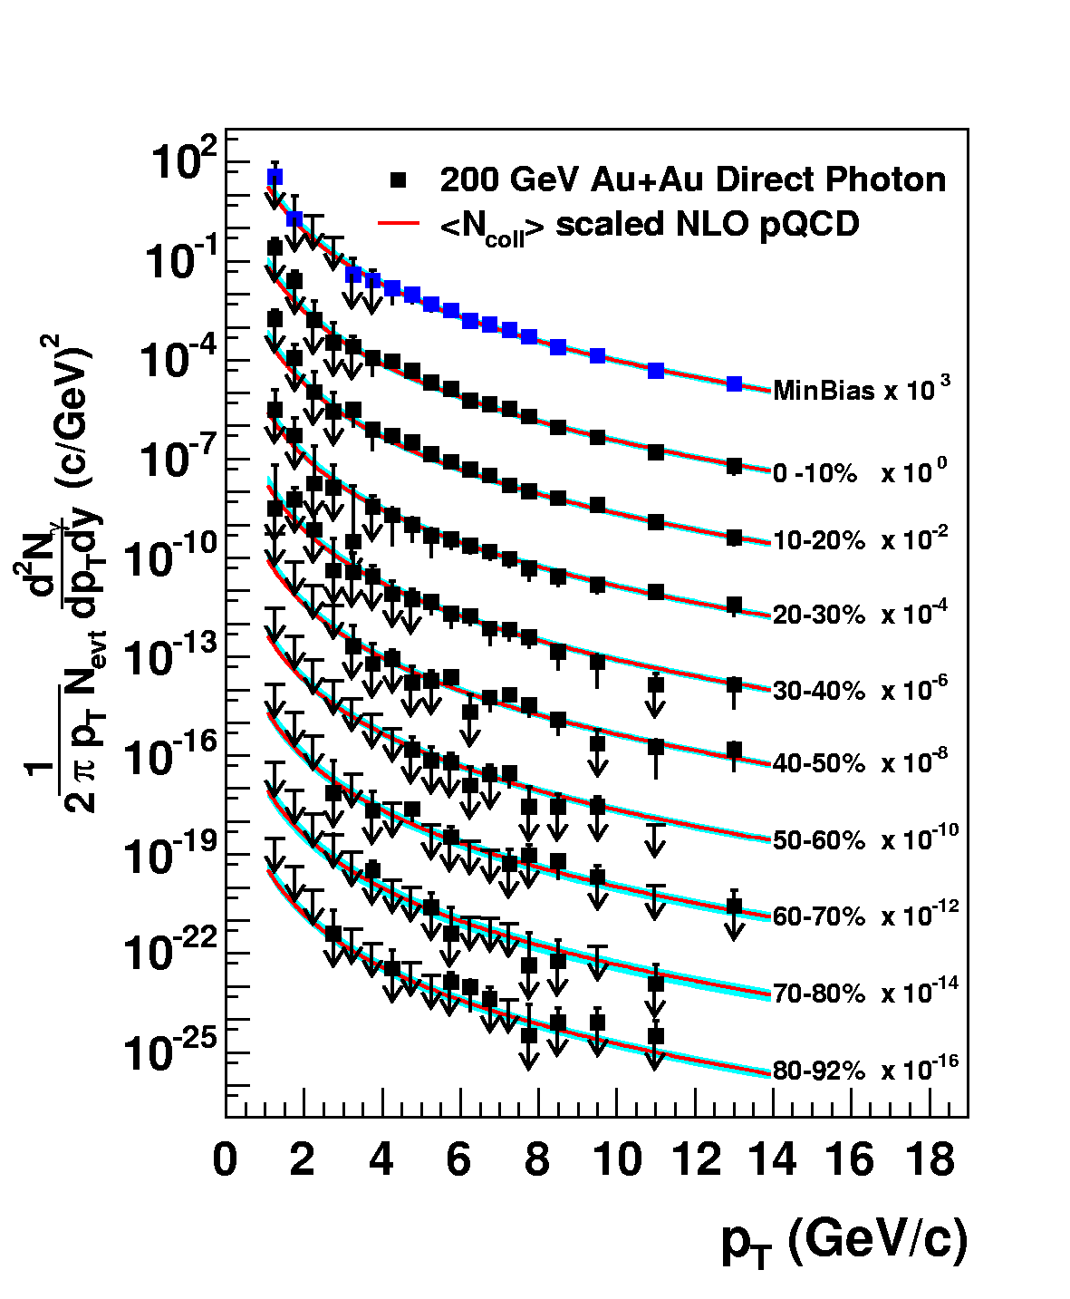
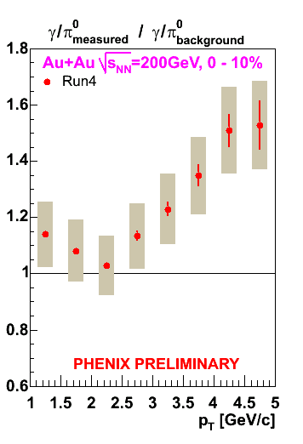
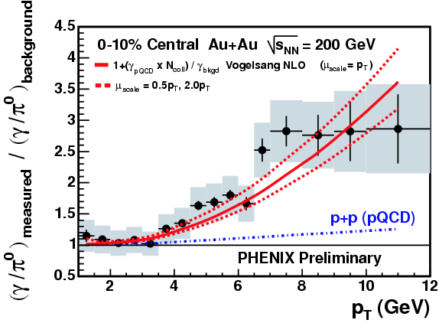
Naïve Way: Direct Real Photons
measured as “excess” above hadron decay photon
  Au+Au result consistent with pQCD×binary scaling
challenging at lower p_{T} due to smaller S/B ratio
PRL 94, 232301 (2005)

Slide 14
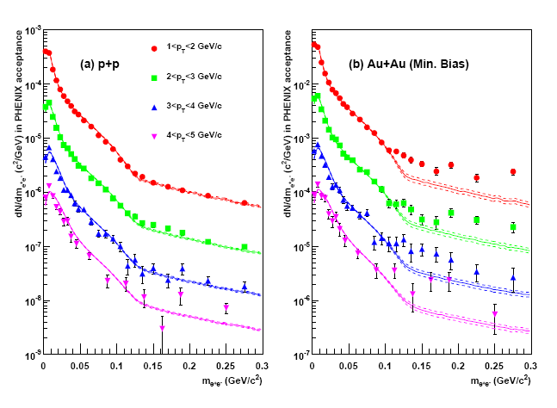
Alternative: “Almost Real” Photons
low mass electron-positron pairs
p+p: hadronic decay + pQCD photon at high p_{T}
Au+Au: enhancement above ~ 135 MeV
  no π₀ decay virtual photon above π₀ mass
PHENIX (A. Adare et al.),
PRL 104, 132301 (2010)

Slide 15
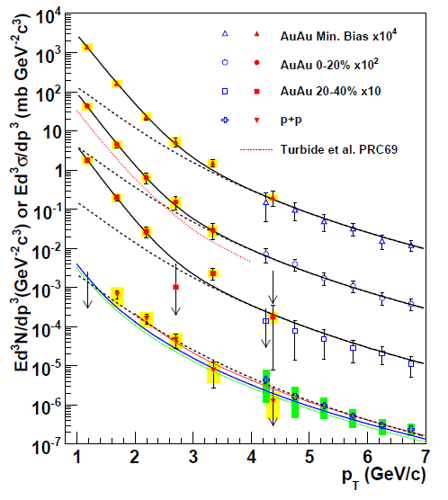
Direct Photon Spectra via γ and γ*
real and virtual photon methods consisitent
Au+Au: “thermal” excess
  ~ exponential with slope 221 ± 19 ± 19 MeV
cf. p+p data
  consistent with pQCD down to low p_{T}
PHENIX (A. Adare et al.), PRL 104, 132301 (2010)
NLO pQCD (W. Vogelsang)

Slide 16
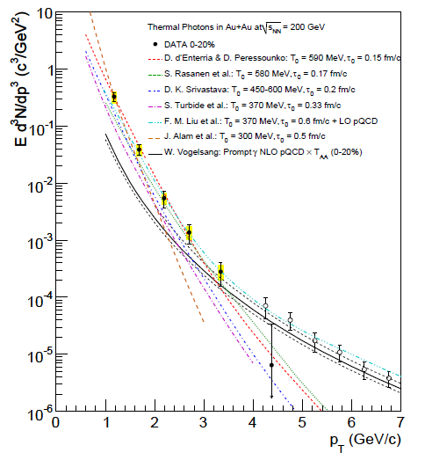
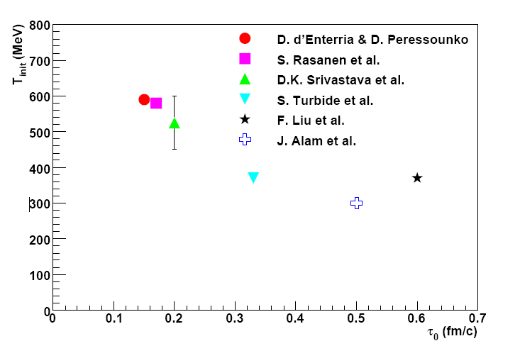

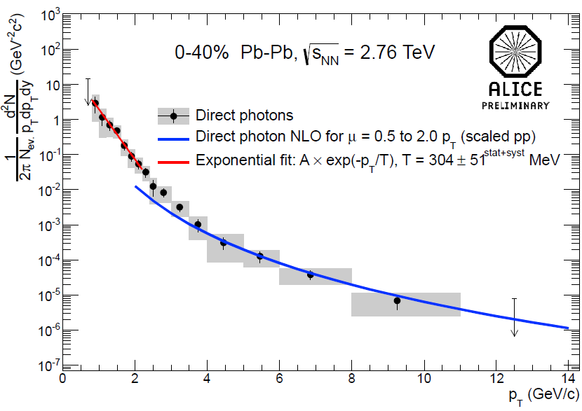
Initial Temperature Evaluation
initial temperature > data slope ~ 220 MeV
300–600 MeV (model dependence within factor 2)
  hydro-dynamic description
    w/ τ₀ = 0.15–0.6 fm/c
slope ~ 304 ± 51 MeV at LHC-ALICE
cf. phase transition predicted at ~ 170 MeV
slope
PHENIX (A. Adare et al.),
PRC 81, 034911 (2010)
transition temperature
ALICE (M. Wilde et al.),
Nucl.Phys. A904-905, 573c (2013)

Slide 17
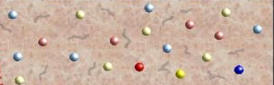
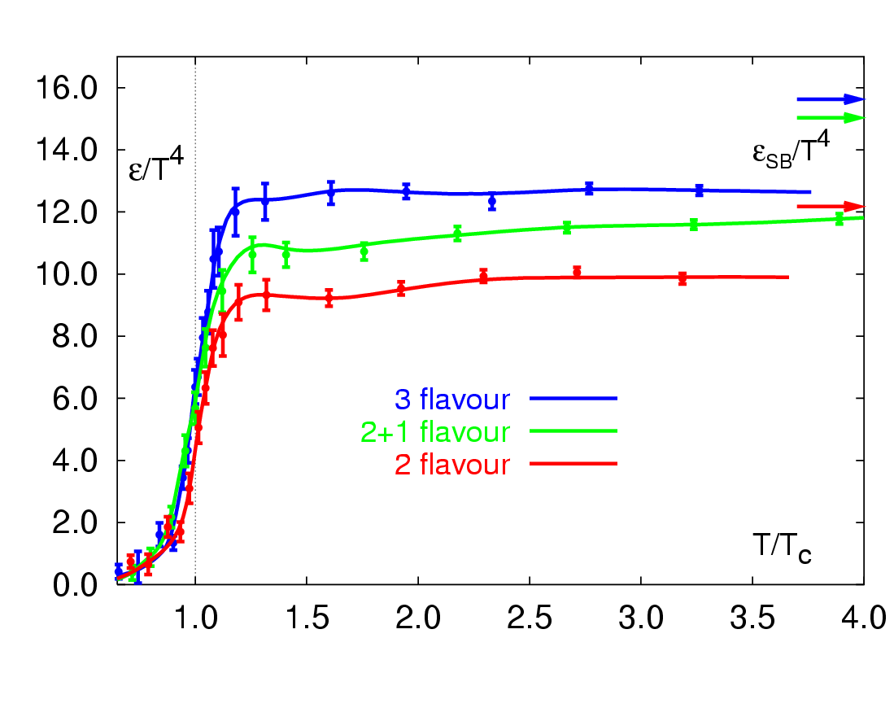
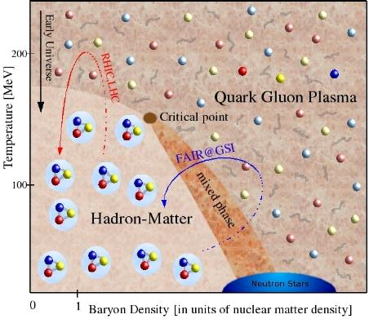
Across the Boundary and Beyond
RHIC → LHC
RHIC
“free gas” ?
“perfect fluid”
RHIC → LHC
RHIC

Slide 18
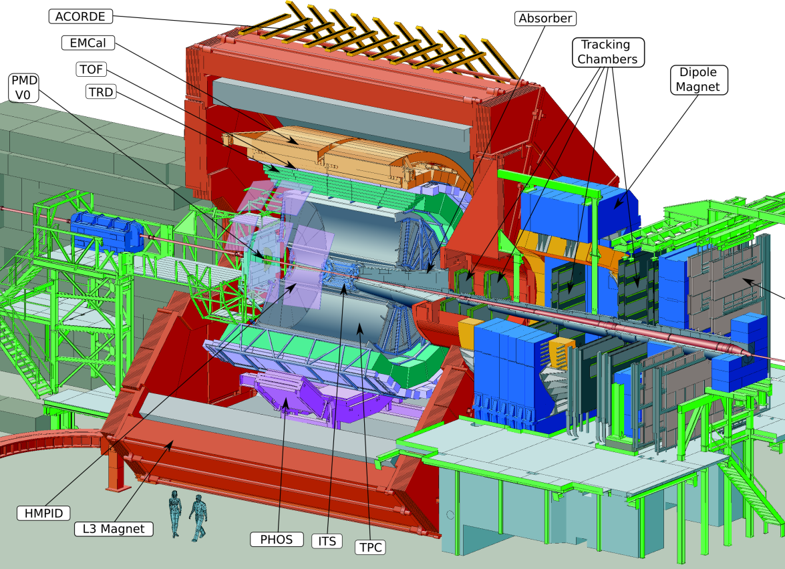
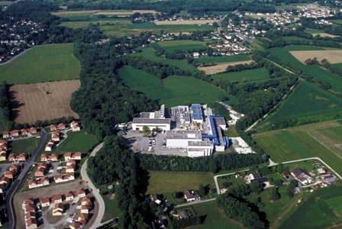

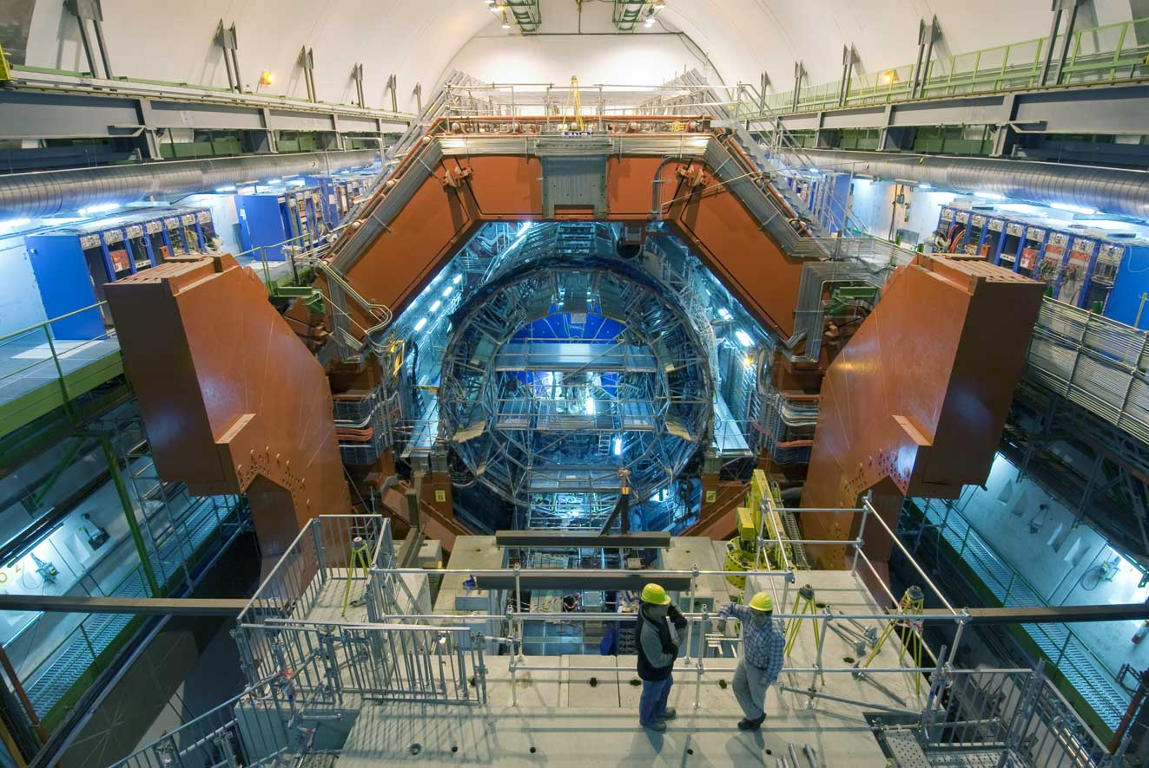
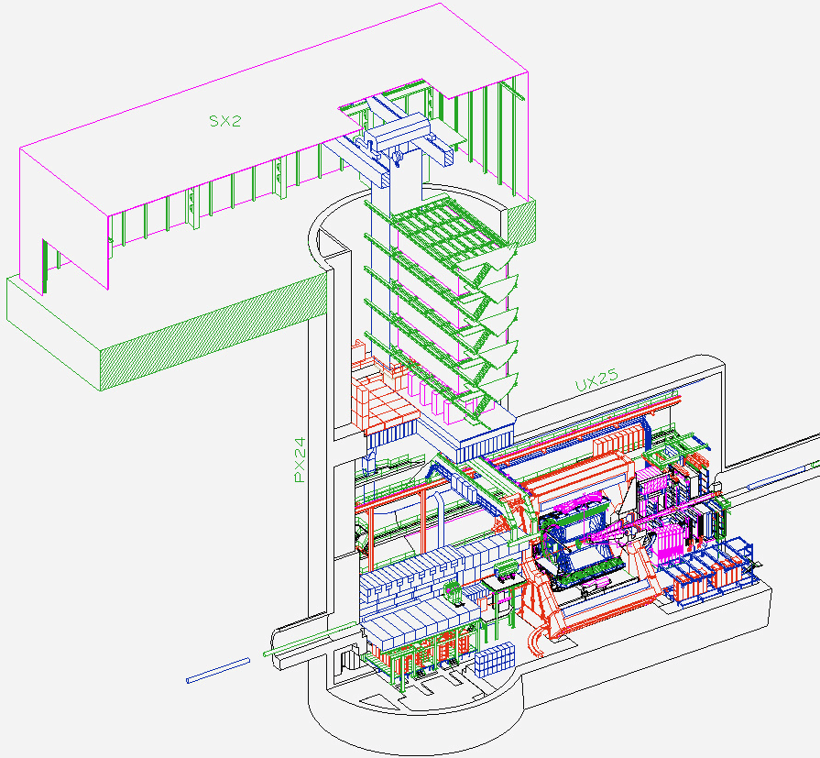
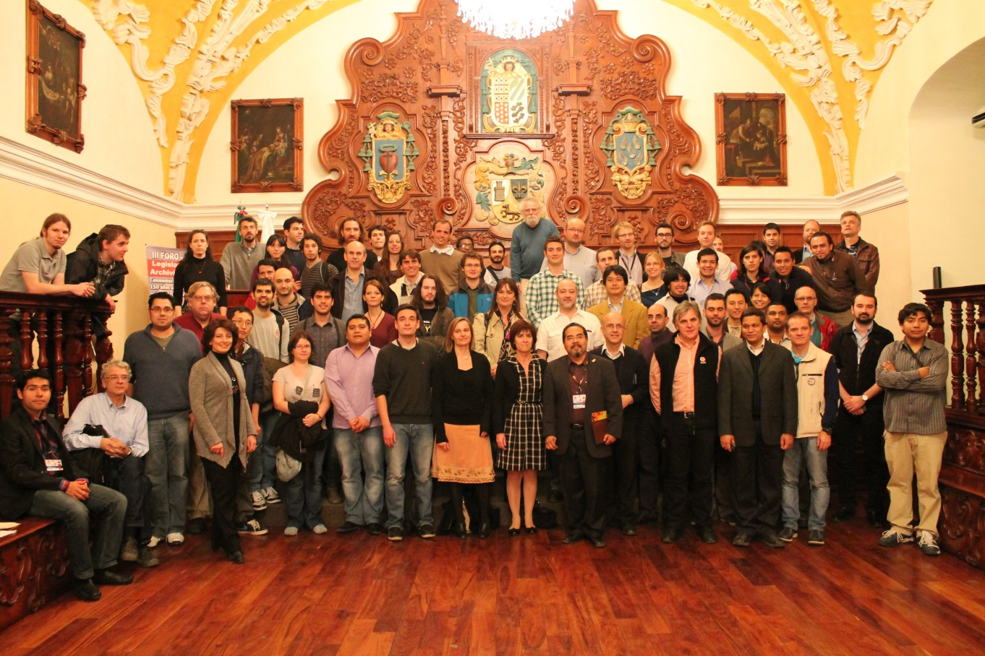
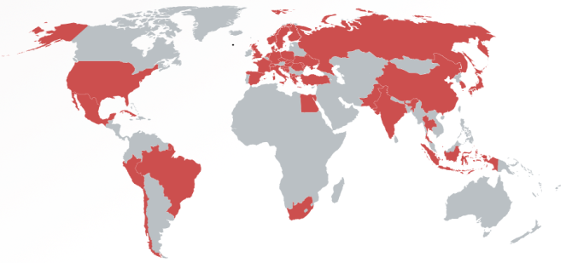
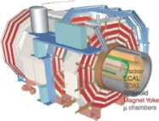

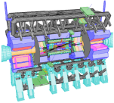


A Large Ion Collider Experiment
the nucleus-nucleus collision experiment at LHC
36 countries; 131 institutes; ~1,200 members
    as of November, 2013
CMS
LHCb
ALICE
ATLAS, LHCf

Slide 19
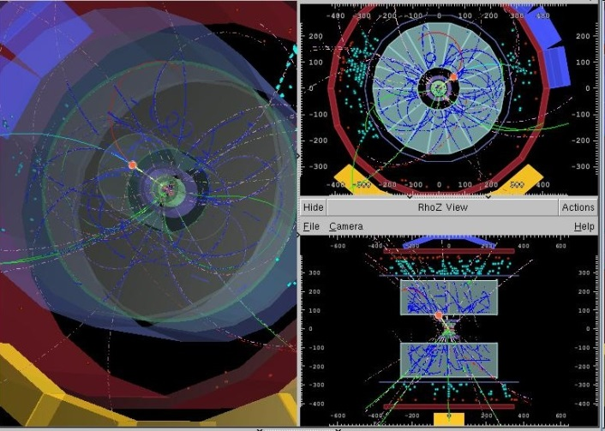
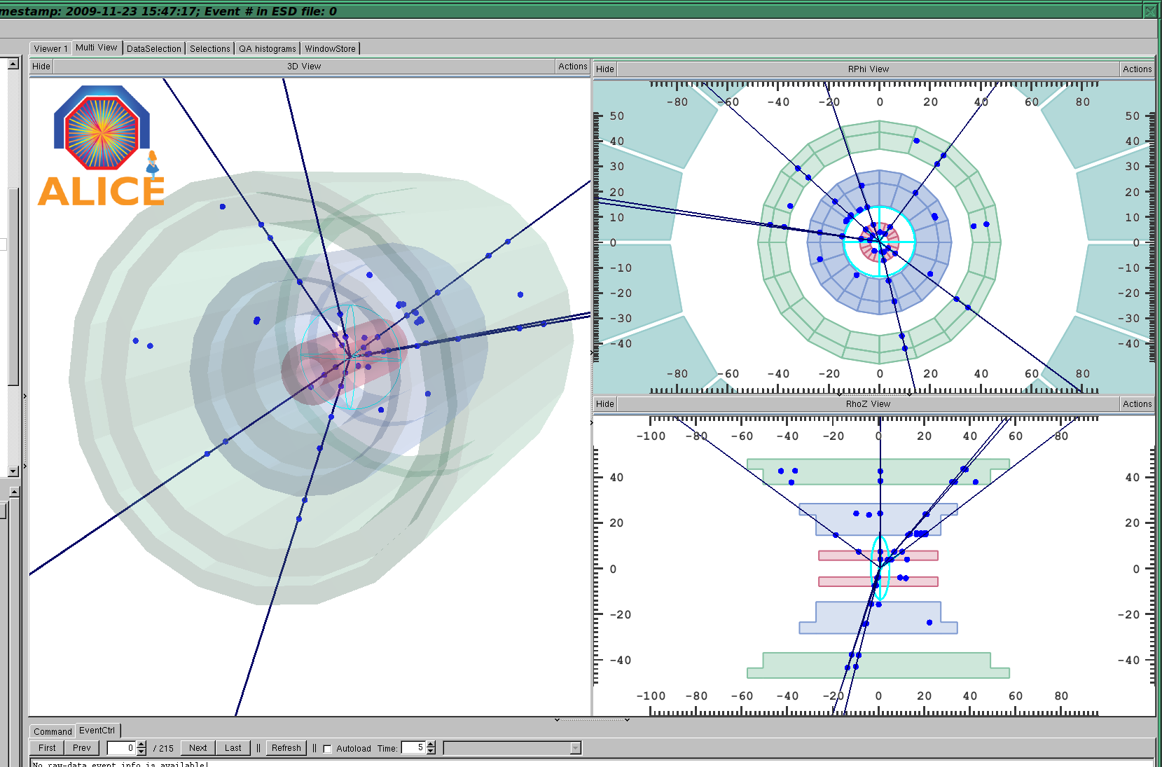
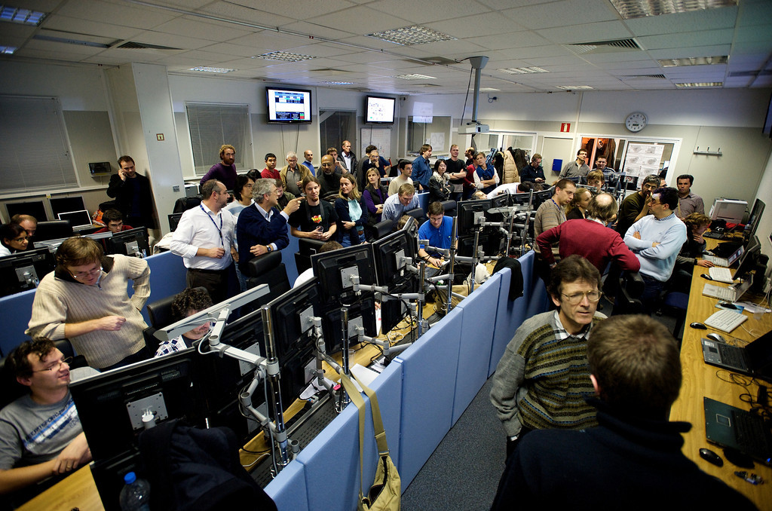
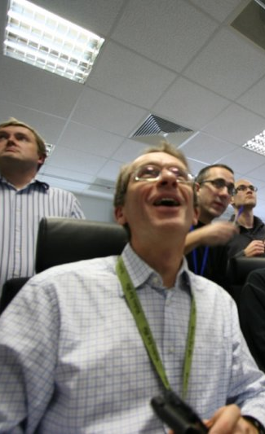
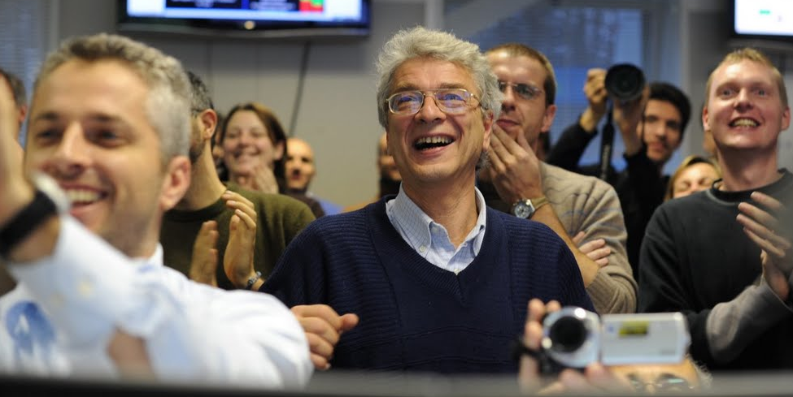
First Collisions, 23.11.2009
~ 16:35
~ 16:42
~ 16:41

Slide 20
First LHC Physics Paper, 28.11.2009
charged particle density measurement
dN_{ch}/dη in p+p at 900 GeV
  3.10 ± 0.13 ± 0.22 (inel.)
  3.51 ± 0.15 ± 0.25 (NSD)
ALICE Collaboration
Eur.Phys.J.C65:111-125, 2010
National Geographic News (04.12.2009)
‘….a machine called ALICE....
found that a (!) proton-proton collision
recorded on November 23
created the precise ratio
of matter and antimatter particles
predicted from theory..’

Slide 21
Almost Zero Baryo-Chemical Potential
anti-proton/proton ratio in mid-rapidity region
  0.957 ± 0.006 (stat) ± 0.014 (sys) at 900 GeV
  0.990 ± 0.006 (stat) ± 0.014 (sys) at 7 TeV
ALICE (K. Aamodt et al.),
PRL 105, 072002 (2010)

Slide 22

Highest Energy (So Far) Pb+Pb
2.76 TeV Pb+Pb in 2010 and 2011
  14 times higher √s_{NN} than at RHIC
~ 5.1 TeV in 2015; design energy at 5.5 TeV

Slide 23
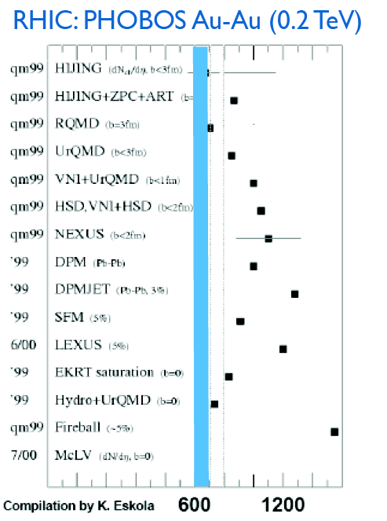
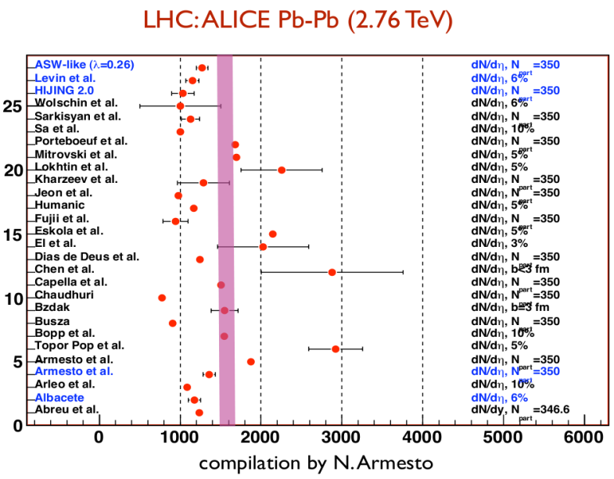

Abundant Particle Production
dN_{ch}/dη = 1,580 ± 80 (sys) in 2.76 TeV Pb+Pb
  high side of predictions
  faster growth with √s_{(NN)} than in p+p
    i.e. √s_{NN} dependent nuclear amplification
ALICE (K. Aamodt et al.),
PRL 106, 032301 (2011)
back at RHIC

Slide 24

Highest Initial Energy Density
~ 2.5×transverse energy density than at RHIC
from Bjorken formula:
ετ₀ ~ 16 GeV/fm²c ~ 3×at RHIC
  lower limit for ε ; likely higher with shorter time scale

Slide 25




Hotter, Larger, Longer-Lived Fireball
Bose Einstein (aka HBT) particle interferometry
  space-time evolution of co-moving volume
    lifetime also accessible via Fourier transformation (E, p) → (τ, x)
  particle multiplicity dependences consistent with models
~ 2×larger, 20–30% longer-lived than at RHIC
  ~ 300 fm³, ~ 10 fm/c
p+p 7 TeV
Enhancement
radius ~ 1/width
ALICE (K. Aamodt et al.),
PLB 696, 328 (2011)
Pb+Pb 2.76 TeV
Pair Momentum Difference

Slide 26
Prominent Probes at Higher Energies
high transverse momentum phenomena, e.g. jets
heavy flavors (charm and beauty)
demonstrated very powerful at ALICE/ATLAS/CMS

Slide 27





Jet Modification at LHC
asymmetric di-jets and even mono-jets (!)
lost jet energy distributed very widely
  ΔR > 0.8 ~ π/4
  enhancement at low p_{T}
high p_{T} hadron
ATLAS
hadrons (jet)
quenched jet
quark
ΔR>0.8
(anti-)quark
CMS
hadrons (jet)
high p_{T} hadron

Slide 28




Jet Energy Loss and Redistribution
narrow cone → high z_{T} suppression
  no corresponding enhancement at low z_{T}
wide cone → low z_{T} enhancement
PHENIX
yield in Au+Au
yield in p+p
I_{AA} =
ξ = ln(1/z_{T})
z_{T} = p_{T}^{hadron}/p_{T}^{photon}
high z_{T}
low z_{T}
|Δφ-π| < π/6 |Δφ-π| < π/3 |Δφ-π| < π/2

Slide 29


Survived Jets Un-Modified ?
shape after energy loss consistent with in vacuum
  energy ratio in different cone radii σ(R=0.2)/σ(R=0.3)
  both for peripheral and central collisions
no sign of jet broadening
good agreement with a model with energy loss

Slide 30
PID’ed Singles for Flavor Differential
RHIC and LHC heavy flavor results consistent
  charm+beauty mesons’ semi-leptonic decay electrons
next step: charm/beauty separation
  key: vertex detctors
PHENIX, ALICE

Slide 31
Possible Mass Hierarchy
charm and beauty mesons with compatible <p_{T}>
  open charm (average of D⁰, D⁺, D^{∗+}), ALICE
  non-prompt J/Ψ (← B), CMS
indication of weaker suppression of beauty

Slide 32





Quarkonia – Sequentially Melting?
Υ(2S) more suppressed than Υ(1S)
  Υ(3S) even more suppressed
no signature of sequential melting
(feed down uncorrected)
CMS, PRL 109, 222301 (2012)

Slide 33


p(d)+A: Reference or Unexpected
originally as reference to bridge p+p and A+A
  initial state nuclear effects
  final state cold nuclear matter effects
Au+Au at √s_{NN} = 200 GeV
d+Au at √s_{NN} = 200 GeV

Slide 34


RHIC First Year (2000) Outcome
binary collision scaling
based on extrapolated
UA1 p+p data
--
Au+Au at √s_{NN} = 130 GeV
PHENIX PRL 88, 022301 (2002)
high p_{T} yield suppressed due to quark energy loss

Slide 35

Another PRL Cover with d+Au
“lack of suppression”
  indicating final state fireball effect in Au+Au
PHENIX
BRAHMS
PHOBOS
STAR
PRL 91 (August, 2003)

Slide 36
Something More Complicated (?)
original thought: cold nuclear matter, i.e.
  not partonic
  not dense
  not strongly coupled
  not hot
indications of strongly coupled partonic matter??

Slide 37




New Discovery in p+p and p+A
“ridge” in p+p and “double ridge” in p+Pb
  long range angular correlations in near and away sides
explained by collective flow from initial fluctuation
  strongly coupled matter already in p+p and p+A?
− =
high multiplicity p+Pb low multiplicity p+Pb long range correlation

Slide 38

Hydro-like Behaviors in p+Pb
harder particle spectra at higher multiplicity
increasing effect with particle mass
better described by models
with hydrodymanics
    Blast-Wave: PRC 48,2462 (1993)
    EPOS LHC: arXiv:1306.0121 [hep-ph]
    Krakow: PRC 85,014911 (2012)
    DPMJET: arXiv:hep-ph/0012252

Slide 39



Quark Fluid in p+Pb?
baryon enhancement in intermediate p_{T}
  understood via quark recombination in A+A
similar evolution with multiplicity

Slide 40
p(d)+A Seemingly in Mystery
long range longitudinal correlations
hydro-dynamical behaviors?
quark recombination??
→ reanalysis of d+Au at RHIC giving similar results
→ first p+Au at RHIC planned in 2015
stay tuned for p(d)+A (if not for this whole field)

Slide 41

Brand New Topic: Ultra-Intense Field
intense U(1) magnetic field
  naturally expected with moving charged sources (nuclei)
  ~ 10¹⁵ T at LHC, ~ 10¹⁴ T at RHIC
    cf. magnetar surface ~ 10¹¹ T
  could be long-lived in “perfect fluid”
possible non-linear QED behaviors
  above electron critical magnetic field em_{e}² = 4×10⁹ T
other interesting physics also under discussion
  chiral magnetic effects
  quark synchrotron radiation
  …
Magnetic Field

Slide 42
Note: Critical Magnetic Field
electron critical electric/magnetic field
  energy at Compton radius scale ≈ rest mass
  eE_{c}h/m_{e}c = m_{e}c² ; E_{c} = m_{e}²c³/eh ~ 10¹⁷ V/m
  eB_{c}h/m_{e}c = m_{e}c ; B_{c} = m_{e}²c²/eh ~ 10⁹ T
if electric: Schwinger mechanism
  e⁺e⁻ pair creation
  (probably) meaningless to consider E > E_{c} situation
if magnetic: non-linear QED effects
  e.g. γ → γ γ, γ → e⁺e⁻, birefringence, …

Slide 43




Field Intensity and Time Evolution
common approach: cascade models
  spectator contribution dominant
    10¹⁴ – 10¹⁵ T at LHC
    short life time < 1 fm/c due to Lorentz contraction
    though still above em_{e}² after several fm/c
possible longer-lived field in “perfect fluid”
  participant contribution
  “static field” approximation
    10¹³ – 10¹⁴ T at LHC
Pb+Pb 5.5 TeV
Pb+Pb 2.76 TeV
Au+Au 200 GeV
baryon stopping power in account
10¹⁴ T
JAM; Au+Au 200 GeV
(A.Tsuji)
10¹³ T
URQMD; Au+Au 200 GeV

Slide 44

Experimental Probes of Intense Field
must originate from initial stages
  field life time ~ 0.1 fm/c
must be electro-magnetic
ideal probe: direct γ/γ∗ from pQCD processes
good reference: γ/γ∗ from later stages
  e.g. π⁰ decay γ/γ∗ (Dalitz di-electron)
0 fm/c
~ 4 fm/c
~ 10 fm/c
B > B_{c}
electro-magnetic probes
hadronic probes

Slide 45


γ∗ (Low Mass e⁺e⁻) “Polarization”
anisotropic decay w.r.t. magnetic field
feasibility study based on QED calculations
  vacuum polarization tensors under magnetic field
    summation for infinite Landau levels
    photon momentum up to ~ GeV
    ref. K.-I. Ishikawa, K. Shigaki et al.,
    Int. J. Mod. Phys. A28, 1350100 (2013)
anisotropy ~ o(10⁻¹)
e⁻
γ*
γ*
?
e⁺

Slide 46

Work in Progress
mass regions (not) expecting polarization
  e.g. low mass dominated by π⁰ Dalitz decay
analysis ongoing, e.g. background understaning
high statistics high p_{T} data set demended
Pb-Pb √S_{NN} = 2.76 TeV
ALICE work in progress 22/03/2013
EP resolution not corrected
0 < M_{ee} < 30 MeV/c²
120 < M_{ee} < 300 MeV/c²
300 < M_{ee} < 500 MeV/c²

Slide 47
Summary and Concluding Remarks
unique to look into “parallel world”
  early universe phase transition experimentally reverted
    min. 300 MeV reached; beyond boundary ~ 170 MeV
deconfined quarks/gluons finally on präparat
  steadily revealing partonic phase properties
  chiral symmetry restoration yet to be attacked
ever emerging new (and brand new) topics
  e.g. mysteries in p(d)+A, ultra-intense U(1) magnetic field
next generation also in preparation/discussion
  ALICE upgrade, “super” PHENIX, J-PARC/HI

