Slide 1

Physics at
High Energy Nucleus-Nucleus Colliders:
Prospect and Relevance to
Hadron Physics
Kenta Shigaki (Hiroshima University )
Hadron Physics Symposium
April 17, 2014
Nagoya University

Slide 2
Presentation Outline
physics at high energy A+A colliders
  discovery of deconfined partonic matter
  looking into “parallel world”: other side of boundary
recent insight and next steps
emerging topics
  new: mysteriously behaving p(d)+A collisions
  brand new: ultra-intense U(1) magnetic field
summary and concluding remarks

Slide 3
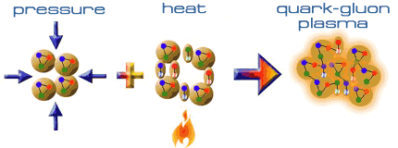
~ 25 Years of “QGP” Hunting
long expeditions on QCD phase diagram
  from Bevalac/SIS/AGS/SPS to RHIC/LHC
  from high density regime to high temperature regime
deconfined partonic matter discovered at RHIC
now providing new stage to look into:
  properties of deconfined partonic matter
  structures of QCD phase diagram
  scenario of early universe evolution
  hadrons as quark composites
  …
Early Universe
Deconfined Partonic Phase
(Quark-Gluon Plasma)
Tri-Critical point
Energy Density (Temperature)
Critical Temperature ~ 170 MeV
High Energy A+A Collisions
Hadron gas
Color Super-Conductivity?
Color-Flavor Locking?
Nucleus
Neutron Star
Baryon Density

Slide 4

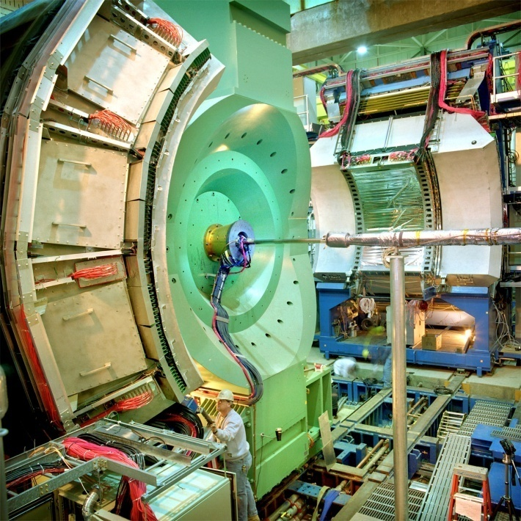




Relativistic Heavy Ion Collider at BNL
2 independent super-conducting synchrotrons
up to 100 A GeV Au and/or 250 GeV (polarized) p
  Au+Au/Cu+Cu/U+U/d+Au/p+p (/p+Au/³He+Au/…)
4 (presently 2) complementary experiments

Slide 5
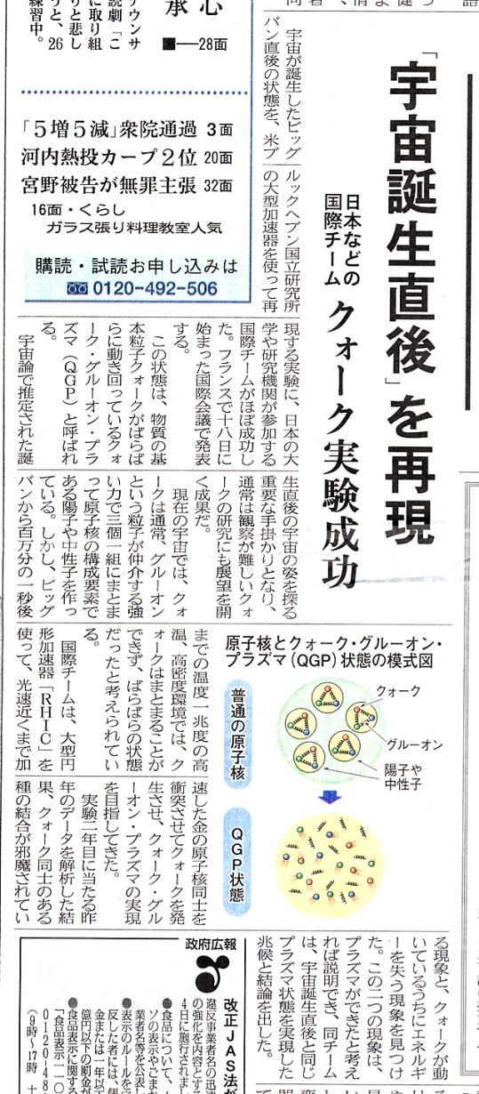
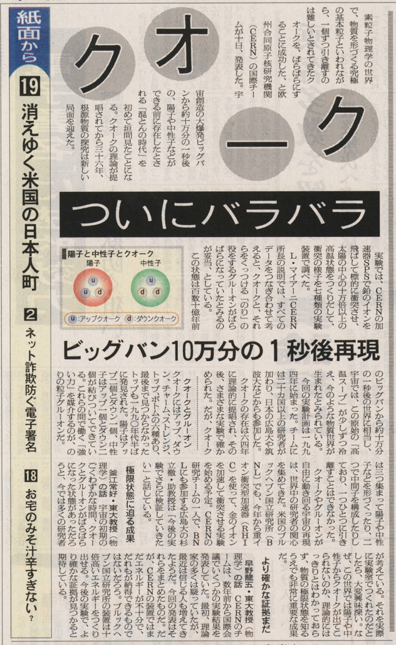
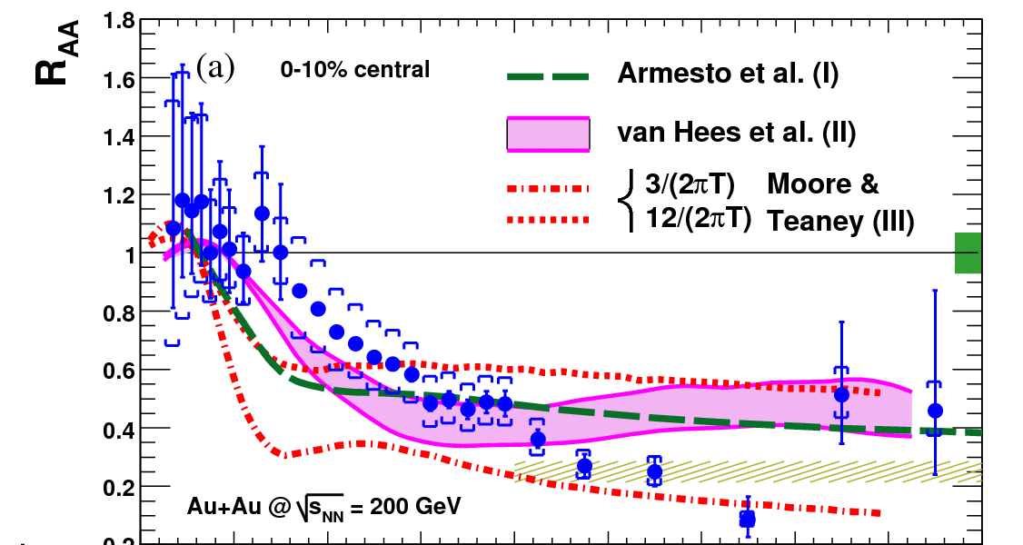
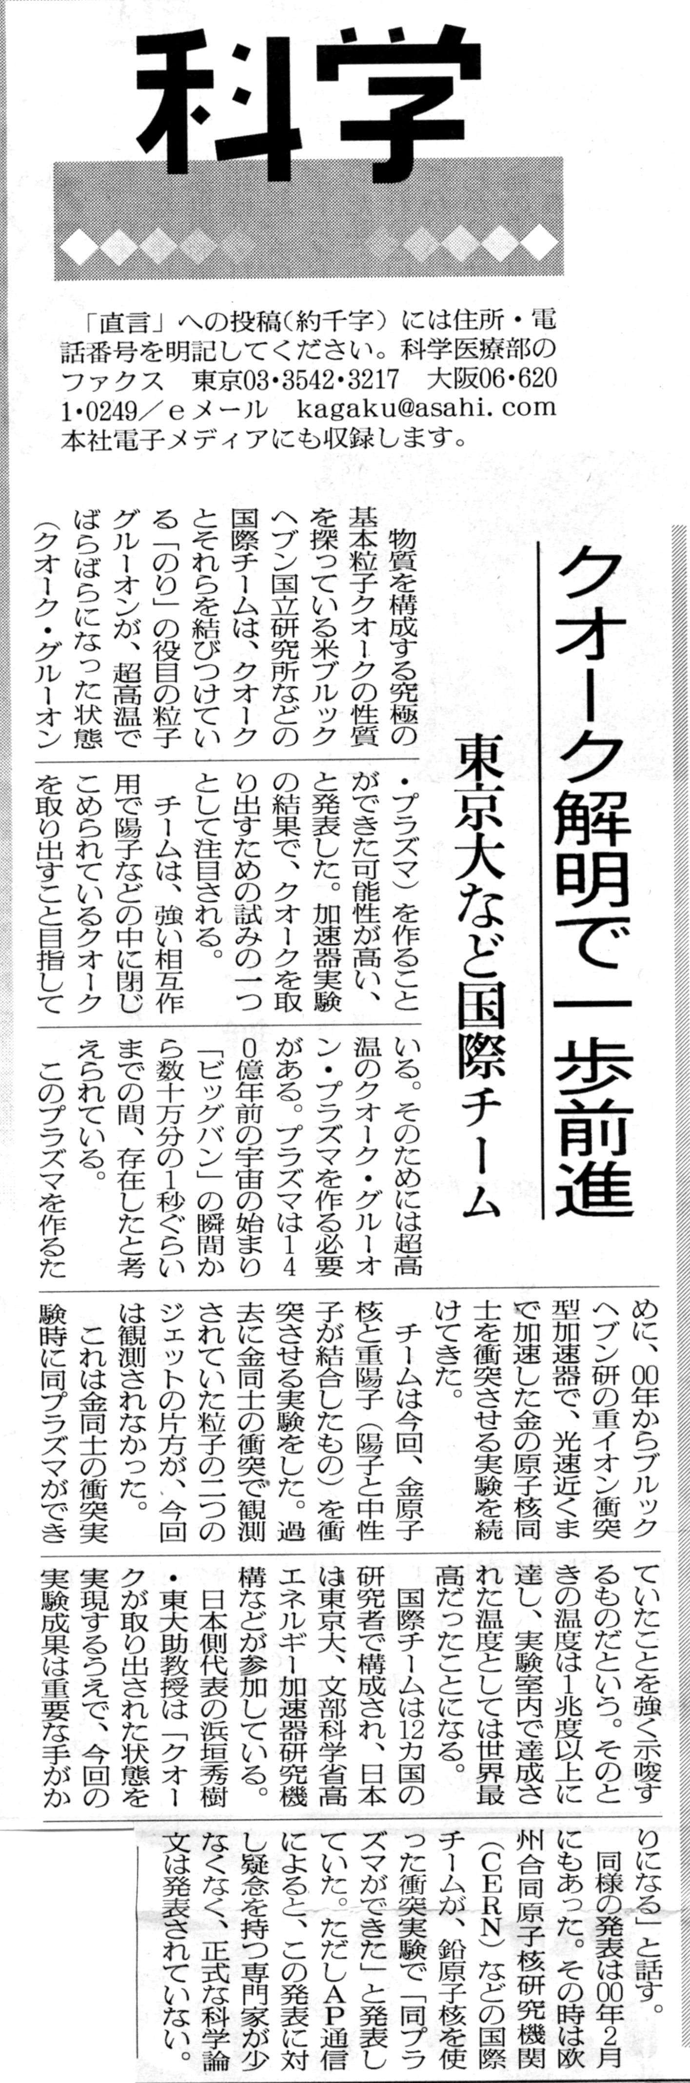
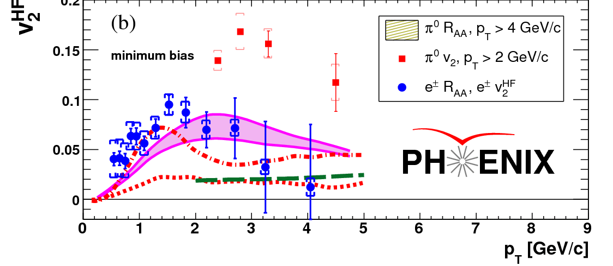
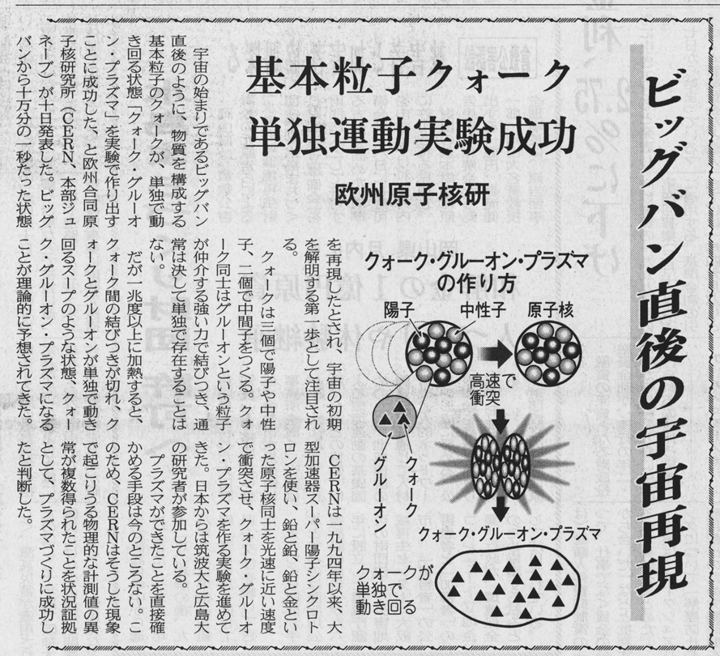
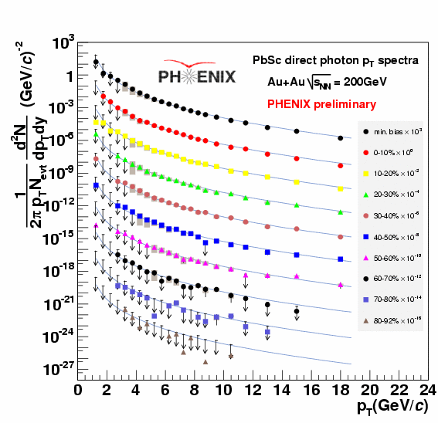
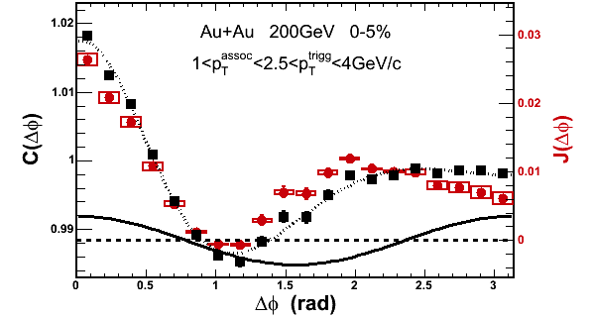
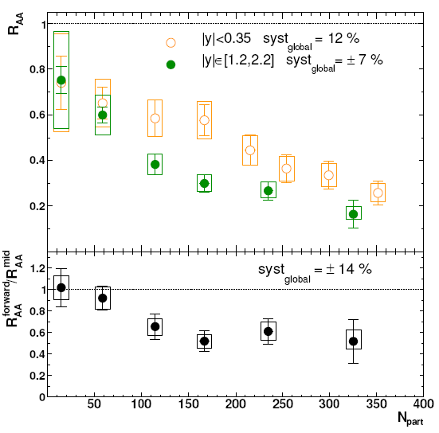
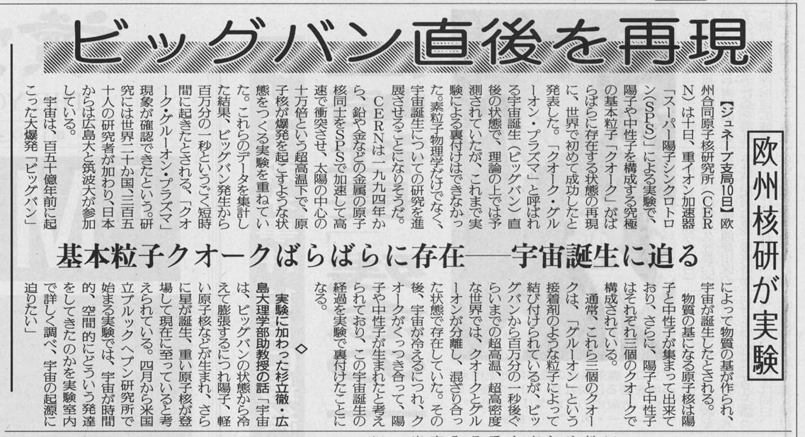
RHIC Outcomes: New State of Matter
partonic: quarks’ degrees of freedom, screening
  constituent quark number scaling of collective motion
  J/Ψ suppression
dense: energy loss of (even heavy) quarks
  jet quenching (high p_{T} suppression)
  jet modification
strongly coupled: perfect fluidity
  hydro-dynamical collective motion
hot: thermally radiative
  thermal (virtual) photons
The matter is dense
The matter is strongly coupled
The matter may melt and/or regenerate J/ψ’s
The matter modifies jets
The matter is hot

Slide 6
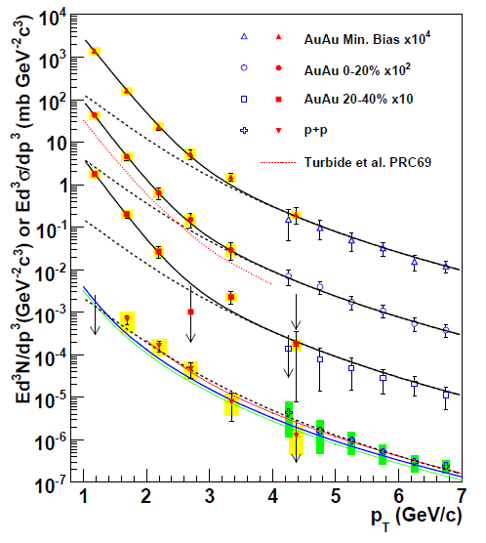
Photons (γ and γ*) as Thermometer
real and virtual photon methods consisitent
Au+Au: “thermal” excess
  ~ exponential with slope 221 ± 19 ± 19 MeV
cf. p+p data
  consistent with pQCD down to low p_{T}
PHENIX (A. Adare et al.), PRL 104, 132301 (2010)
NLO pQCD (W. Vogelsang)

Slide 7
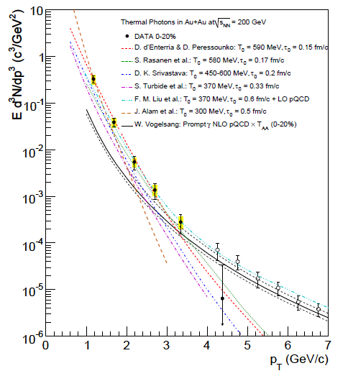
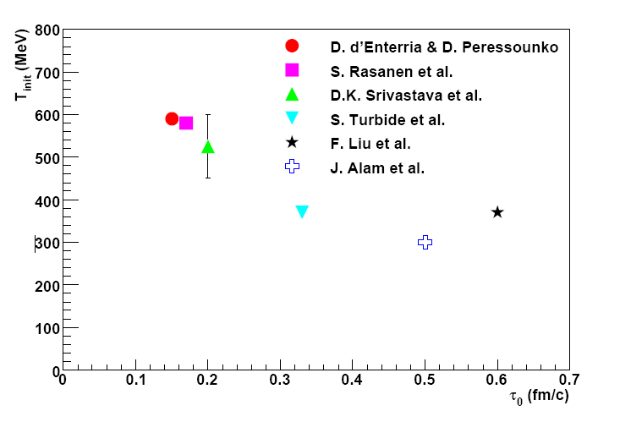

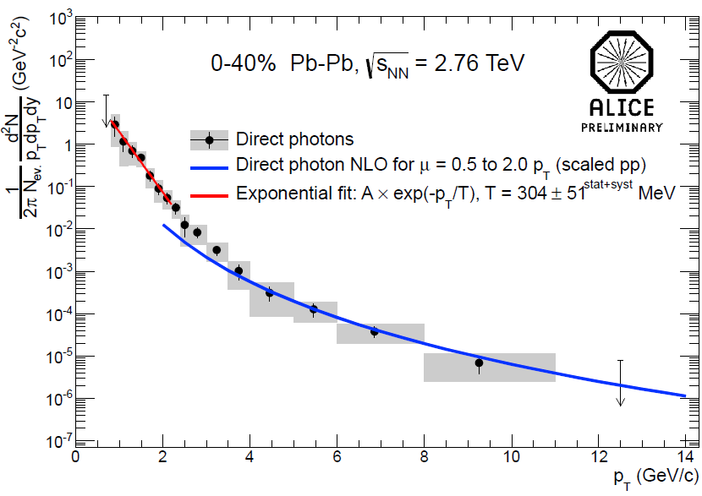
Initial Temperature Evaluation
initial temperature > data slope ~ 220 MeV
300–600 MeV (model dependence within factor 2)
  hydro-dynamic description
    w/ τ₀ = 0.15–0.6 fm/c
slope ~ 304 ± 51 MeV at LHC-ALICE
cf. phase transition predicted at ~ 170 MeV
slope
PHENIX (A. Adare et al.),
PRC 81, 034911 (2010)
transition temperature
ALICE (M. Wilde et al.),
Nucl.Phys. A904-905, 573c (2013)

Slide 8
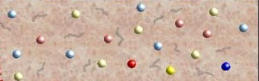
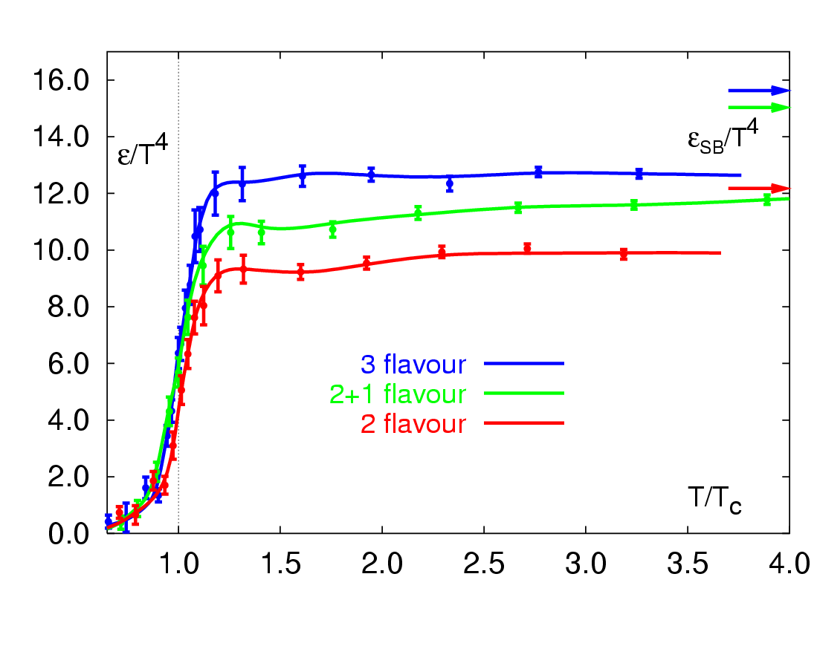
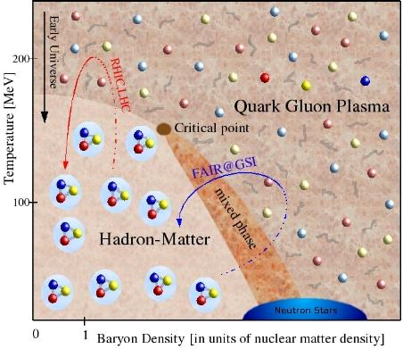
Boundary Crossed at RHIC
RHIC
RHIC
F. Karsch,
Lect. Notes Phys. 583 (2002) 209

Slide 9
Uniqueness of QCD Phase Transition
only possible boundary to experimentally cross
  to prove (or disprove) paradigm of universe evolution
  not just to catch residue
K. Homma, 2008/09

Slide 10
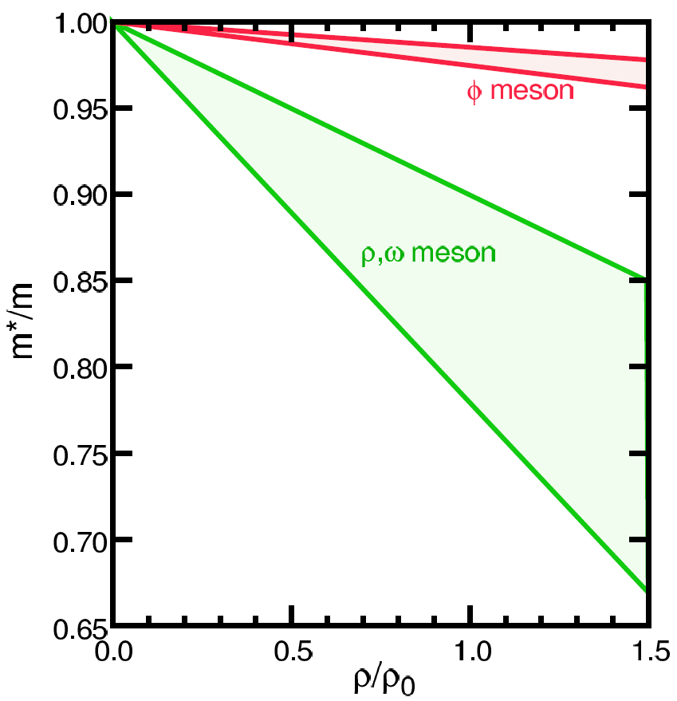
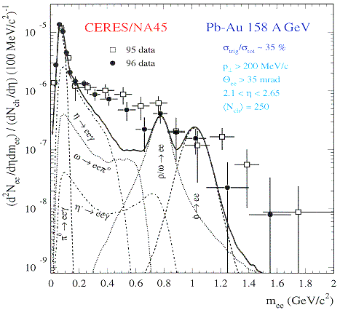
Looking into “Parallel World”
phenomena with restored symmetry
in case of QCD phase transition: chiral symmetry
  diminishing effective (light) quark masses
  probably lower hadron masses
typically, light vector meson mass modification
  leptonic decay channels with short life time
    e.g. φ (ss) → e⁺e⁻ (0.03 %)
  ref. H. Enyo on J-PARC E16 experiment
T.Hatsuda, H.Shiomi and H.Kuwabara
Prog. Theor. Phys. 95 (1996) 1009

Slide 11
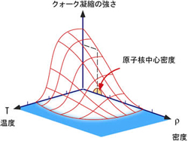
Relevance and Complementarity
different regimes of chiral symmetry restoration
high density
  neutron/quark star
  low/intermediate energy A+A
  normal nucleus
  high energy A+A
  early universe
high temperature
synergy with lower energy experiments
  e.g. φ/ω in nuclear matter at J-PARC

Slide 12
Further Adventure beyond Boundary
RHIC → LHC
RHIC
“free gas” ?
“perfect fluid”
RHIC → LHC
RHIC
F. Karsch,
Lect. Notes Phys. 583 (2002) 209

Slide 13
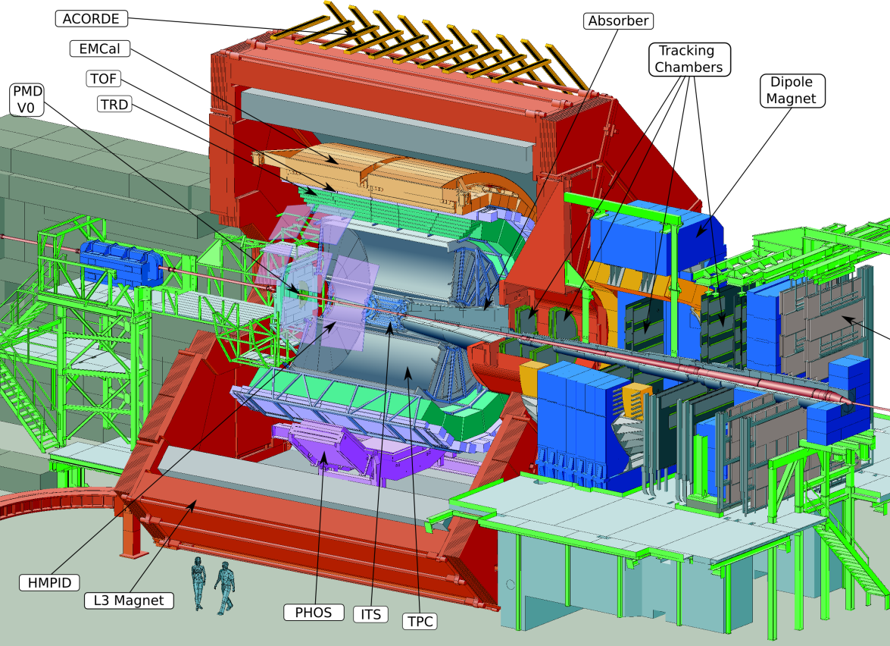
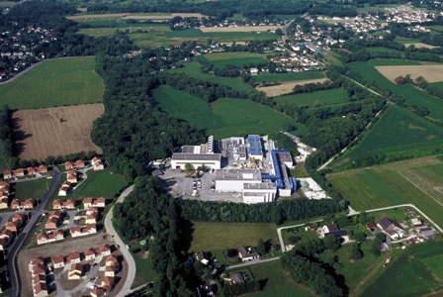

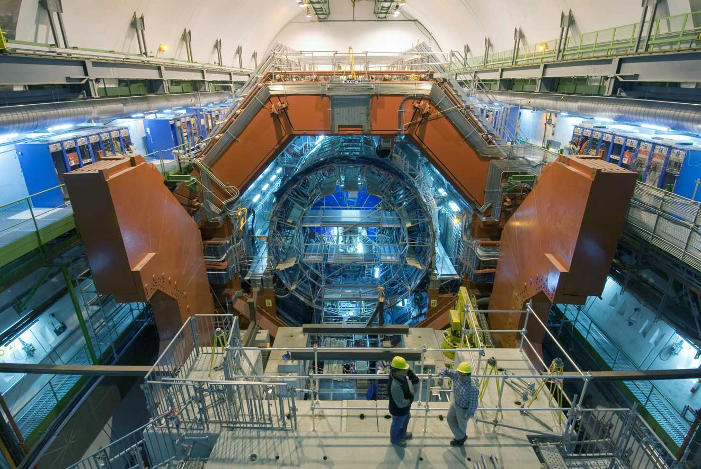
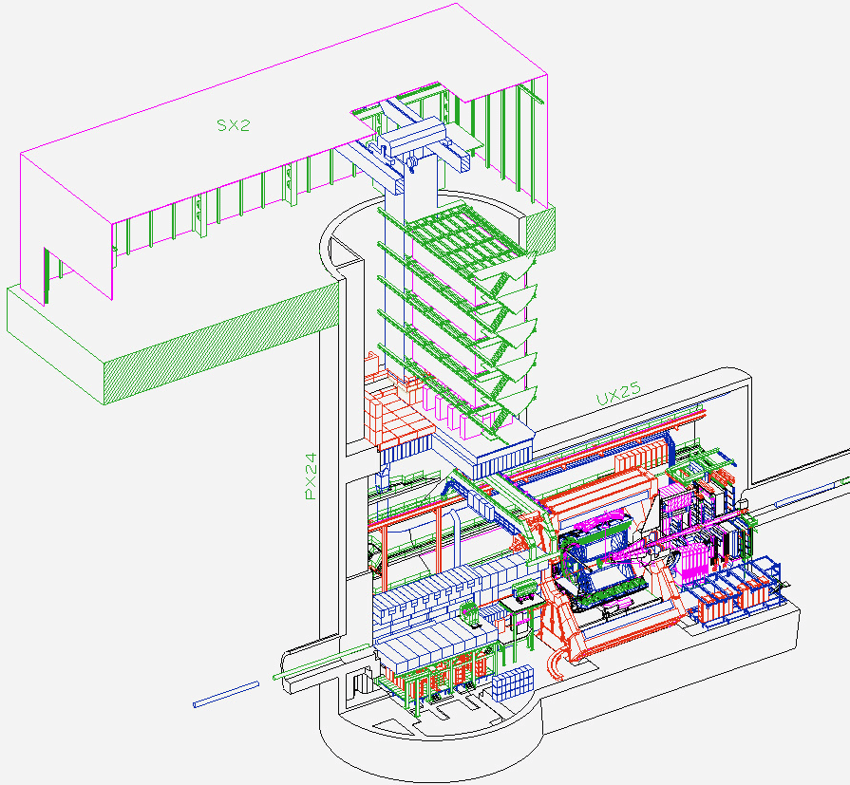
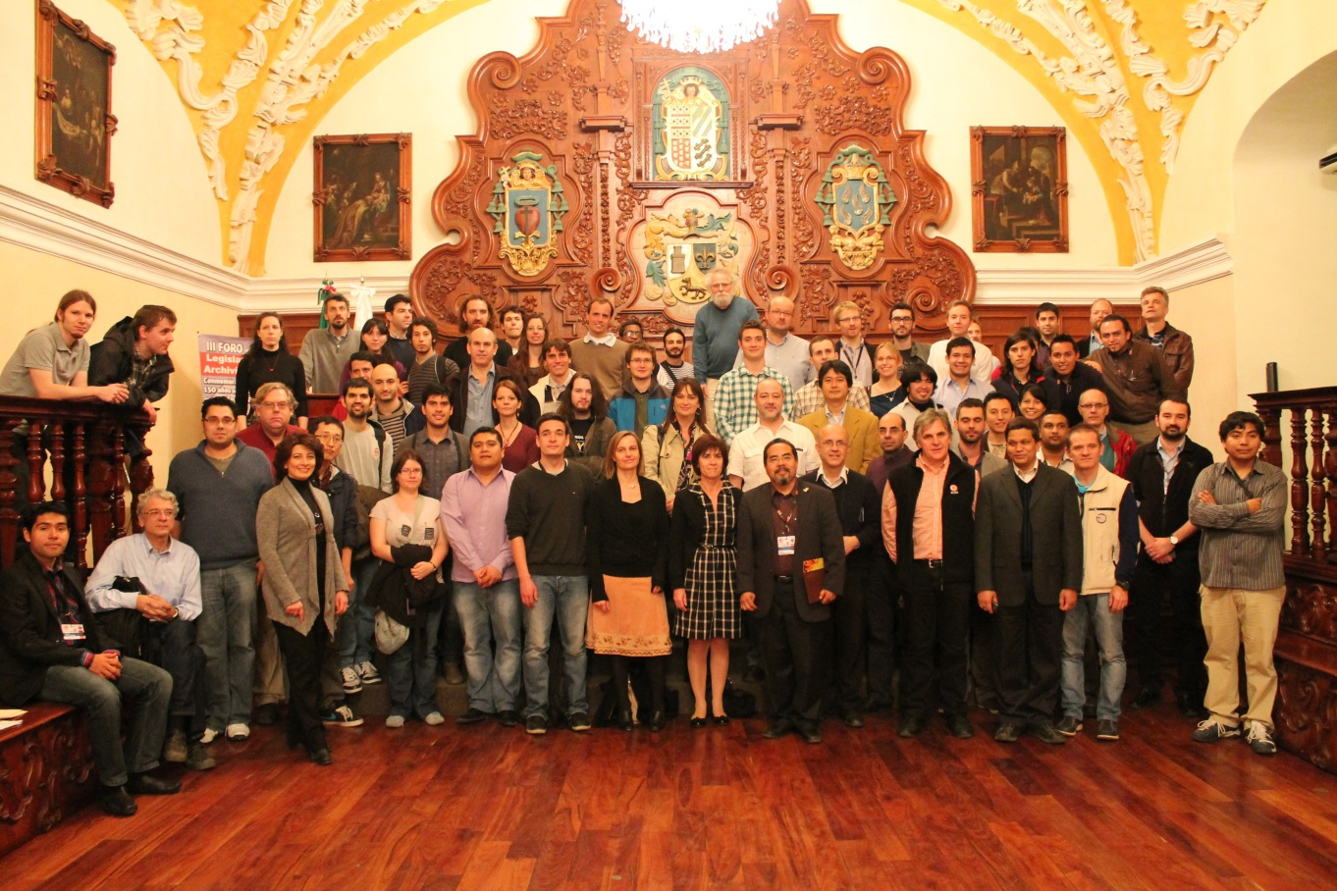
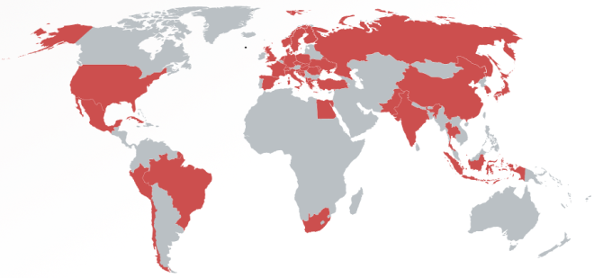
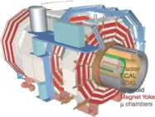

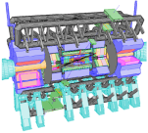


A Large Ion Collider Experiment
the nucleus-nucleus collision experiment at LHC
36 countries; 131 institutes; ~1,200 members
    as of November, 2013
CMS
LHCb
ALICE
ATLAS, LHCf

Slide 14

Highest Energy A+A Collision
2.76 TeV Pb+Pb in 2010 and 2011
  14 times higher √s_{NN} than at RHIC
~ 5.1 TeV in 2015; design energy at 5.5 TeV

Slide 15
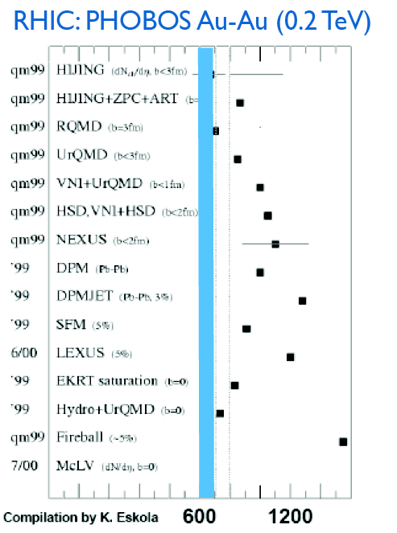
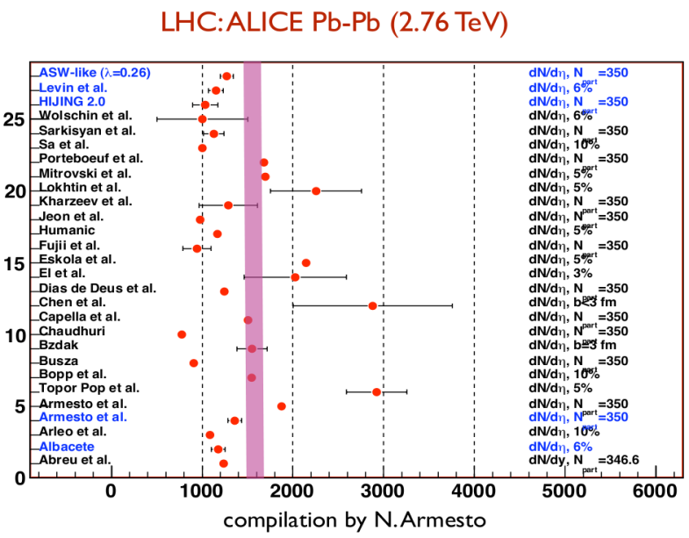
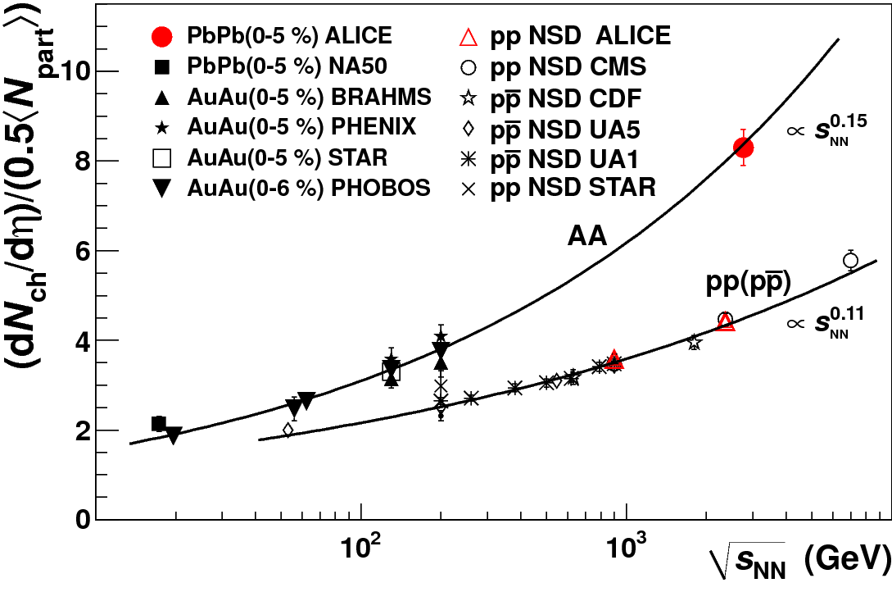
Abundant Particle Production
dN_{ch}/dη = 1,580 ± 80 (sys) in 2.76 TeV Pb+Pb
  high side of predictions
  faster growth with √s_{(NN)} than in p+p
    i.e. √s_{NN} dependent nuclear amplification
ALICE (K. Aamodt et al.),
PRL 106, 032301 (2011)
back at RHIC

Slide 16
Prominent Probes at Higher Energies
high transverse momentum phenomena, e.g. jets
heavy flavors (charm and beauty)
demonstrated very powerful at ALICE/ATLAS/CMS

Slide 17
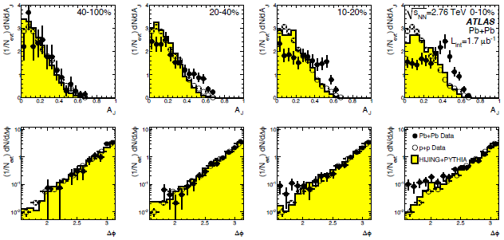
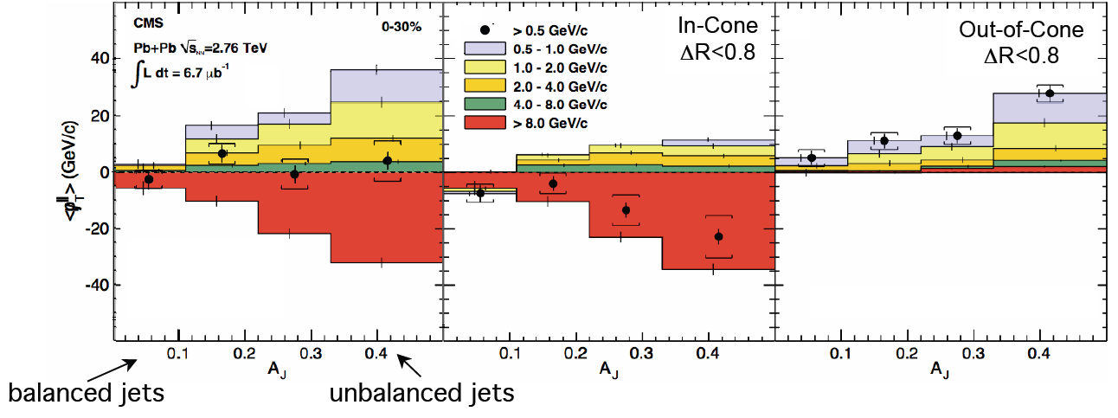
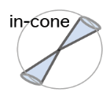


Jet Modification at LHC
asymmetric di-jets and even mono-jets (!)
lost jet energy distributed very widely
  ΔR > 0.8 ~ π/4
  enhancement at low p_{T}
high p_{T} hadron
ATLAS
hadrons (jet)
quenched jet
quark
ΔR>0.8
(anti-)quark
CMS
hadrons (jet)
high p_{T} hadron

Slide 18
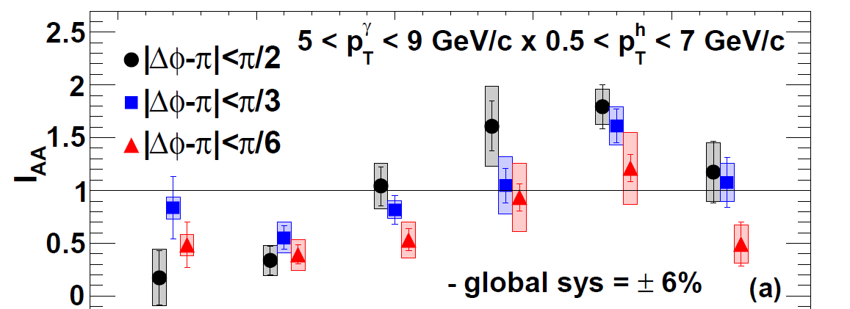


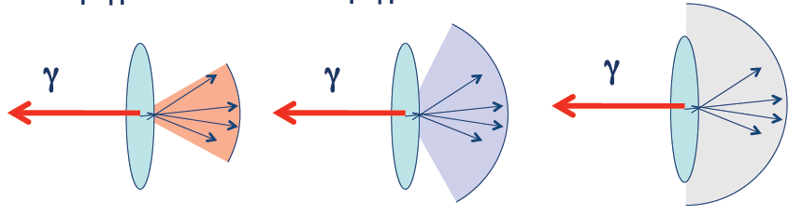
Jet Energy Loss and Redistribution
thermal-like redistribution suggested
  narrow cone → high z_{T} suppression
  wide cone → low z_{T} enhancement
PHENIX
yield in Au+Au
yield in p+p
I_{AA} =
ξ = ln(1/z_{T})
z_{T} = p_{T}^{hadron}/p_{T}^{photon}
high z_{T}
low z_{T}
|Δφ-π| < π/6 |Δφ-π| < π/3 |Δφ-π| < π/2

Slide 19
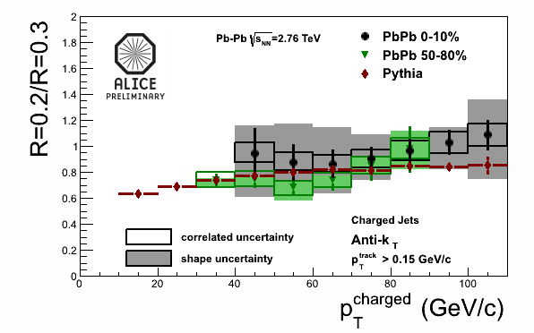
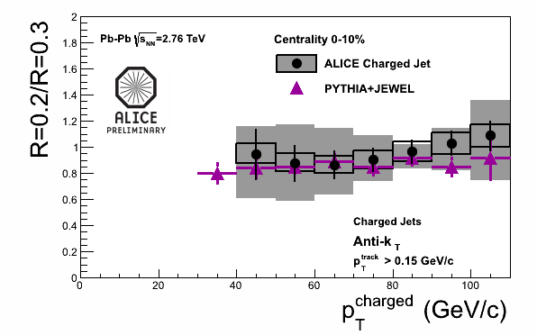
Survived Jets Un- (or Little-) Modified
shape after energy loss consistent with in vacuum
  energy ratio in different cone radii σ(R=0.2)/σ(R=0.3)
  both for peripheral and central collisions
no sign of jet broadening
good agreement with a model with energy loss

Slide 20
More Differential: Mass Hierarchy?
charm and beauty mesons with compatible <p_{T}>
  open charm (average of D⁰, D⁺, D^{∗+}), ALICE
  non-prompt J/Ψ (← B), CMS
possible indication of weaker beauty suppression

Slide 21
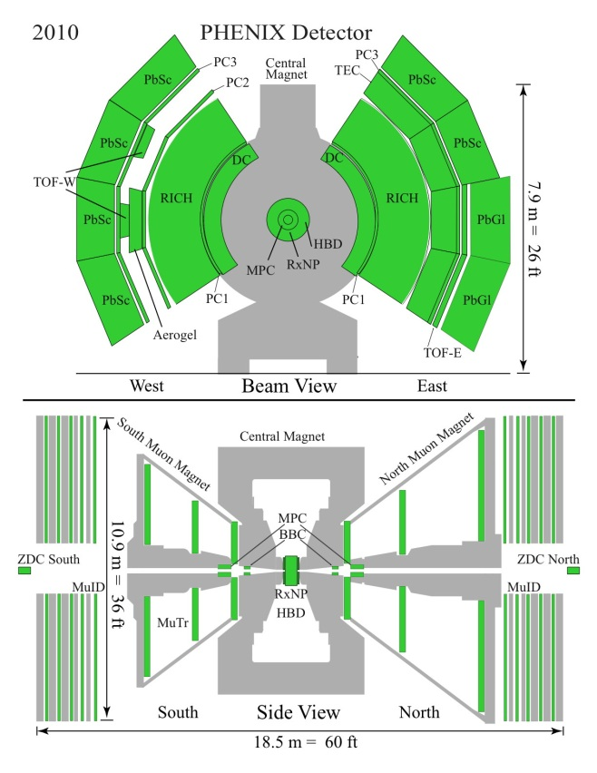
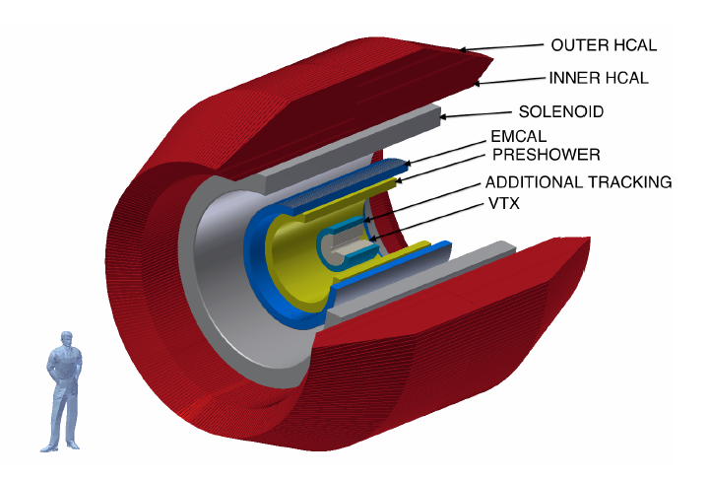
sPHENIX: Feedback to RHIC from LHC
PHENIX
  fast, selective, precise
  mid to low trans. mom.
  limited acceptance
“super” PHENIX
  fast, selective, precise
  high to mid trans. mom.
  large acceptance
detectors by US-Japan
2013 revision
with BaBar solenoid

Slide 22
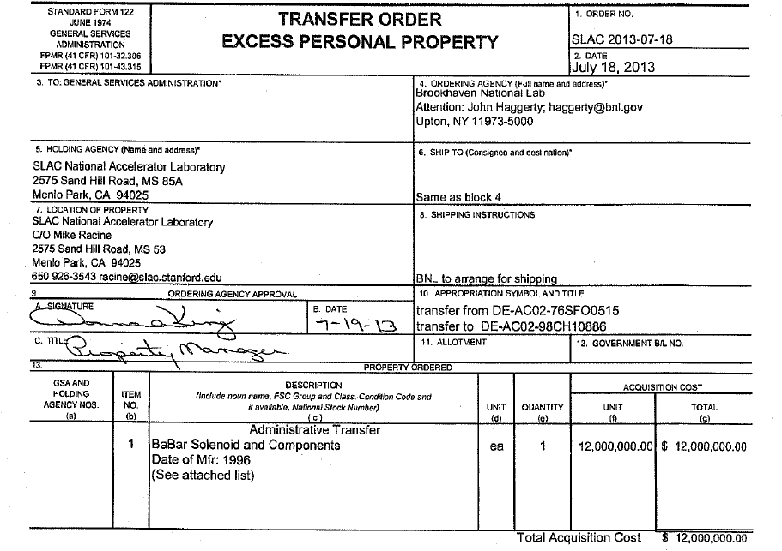
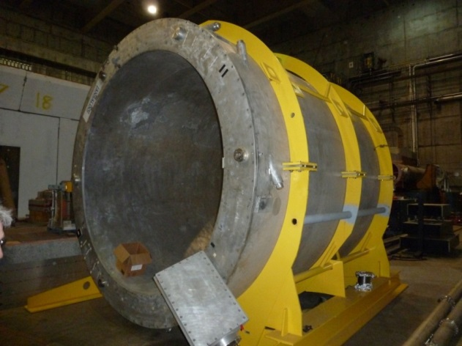
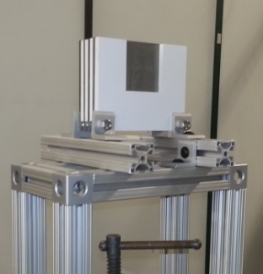
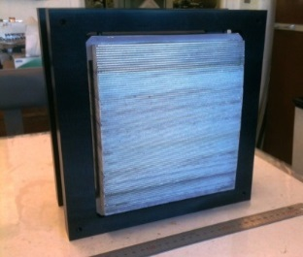
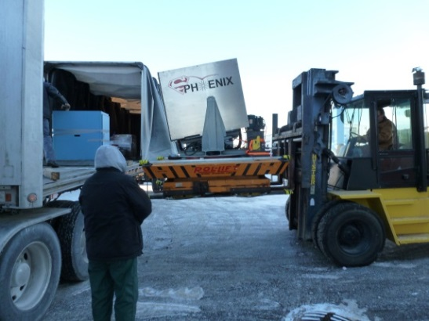
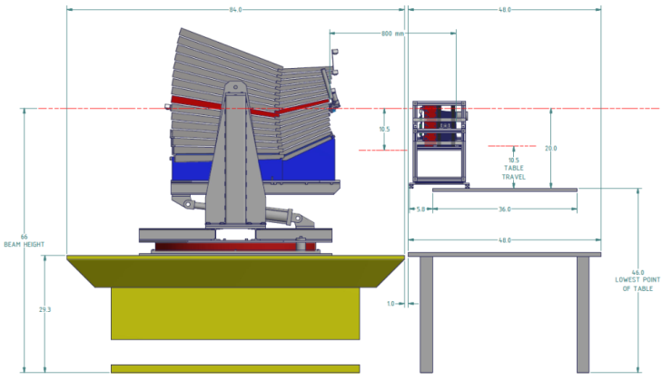
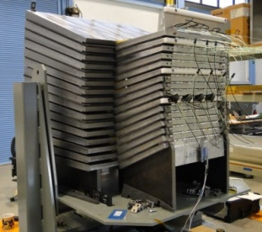
  Aiming at (Partial) Start in 2019
former BaBar solenoid transferred from SLAC
first sPHENIX test beam at FNAL in 2014/02

Slide 23
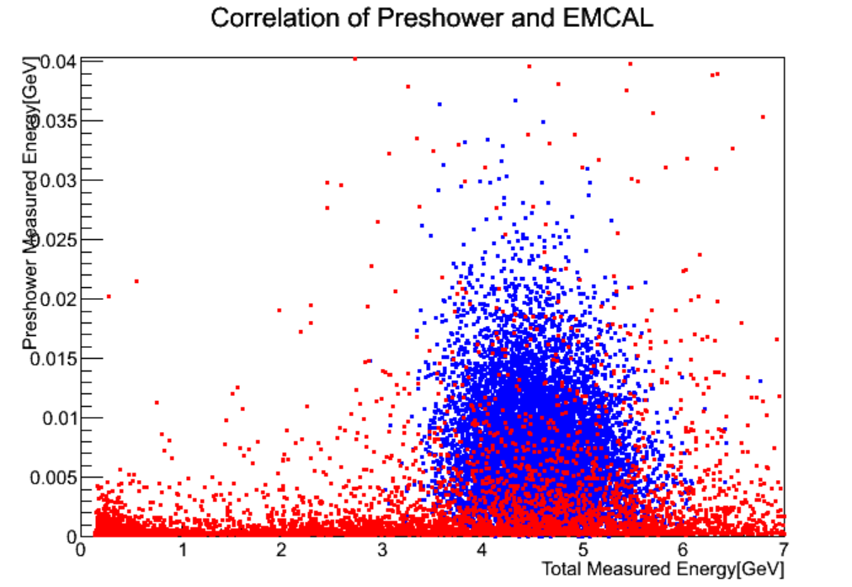



Not Only Jet: “Day-1 Upgrade”
physics with e± / h± / γ / π⁰ identification
  QCD debye screening via e⁺e⁻ from quarkonia
  photon–jet correlation via direct γ
  parton behavior via π⁰
high performance PID
  pre-shower detector (Hiroshima, Tsukuba, RIKEN)
multi-variable cut
e⁻ （5 GeV/c）
π⁺ （5 GeV/c）
Geant4
photon pair from π⁰

Slide 24
Key Project at BNL in Next Decade
Years | Beam Species and Energies | Science Goals | New Systems Commissioned
2014 | 15 GeV Au+Au 200 GeV Au+Au | Heavy flavor flow, energy loss, thermalization, etc. Quarkonium studies QCD critical point search | Electron lenses 56 MHz SRF STAR HFT STAR MTD
2015-16 | p+p at 200 GeV p+Au, d+Au, ³He+Au at 200 GeV High statistics Au+Au | Extract η/s(T) + constrain initial quantum fluctuations More heavy flavor studies Sphaleron tests Transverse spin physics | PHENIX MPC-EX Coherent e-cooling test
2017 | No Run |  | Low energy e-cooling upgrade
2018-19 | 5-20 GeV Au+Au (BES-2) | Search for QCD critical point and onset of deconfinement | STAR ITPC upgrade Partial commissioning of sPHENIX (in 2019)
2020 | No Run |  | Complete sPHENIX installation STAR forward upgrades
2021-22 | Long 200 GeV Au+Au with upgraded detectors p+p, p/d+Au at 200 GeV | Jet, di-jet, γ-jet probes of parton transport and energy loss mechanism Color screening for different quarkonia | sPHENIX
2023-24 | No Runs |  | Transition to eRHIC
present RHIC/PHENIX
  ref. Y. Akiba on (s and) ePHENIX

Slide 25
ALICE (-Japan) in Next Decade
  ref. poster by T. Gunji on ALICE upgrade plans
first: jet and heavy flavor
  × 2–3 high speeding in 2013–2014 shutdown
    upgrade: high resolution EM calorimeter (Hiroshima)
    new: di-jet calorimeter (Tsukuba)
next: low transverse momentum phenomena
  × 100 high speeding in 2018–2019 shutdown
    upgrade: TPC (Tokyo), inner tracker
also: forward physics
  additional detectors in 2018–2019 shutdown
    new: calorimeter (Tsukuba, Tokyo), muon tracker

Slide 26




p(d)+A Gathering New Attention
originally as reference to bridge p+p and A+A
  initial state nuclear effects, e.g. modified PDF
  final state cold nuclear matter effects
“suppression of hadrons with large p_{T}”
Au+Au at √s_{NN} = 130 GeV
PRL 88 (January, 2002)
“lack of suppression”
d+Au at √s_{NN} = 200 GeV
PRL 91 (August, 2003)
Au+Au at √s_{NN} = 200 GeV
d+Au at √s_{NN} = 200 GeV

Slide 27
Something More Complicated (?)
original thought: cold nuclear matter, i.e.
  not partonic
  not dense
  not strongly coupled
  not hot
indications of strongly coupled partonic matter??

Slide 28




Discovery in p+p and p+A at LHC
“ridge” in p+p and “double ridge” in p+Pb
  long range angular correlations in near and away sides
explained by collective flow from initial fluctuation
  strongly coupled matter already in p+p and p+A?
− =
high multiplicity p+Pb low multiplicity p+Pb long range correlation

Slide 29

Hydro-like Behaviors in p+Pb
harder particle spectra at higher multiplicity
increasing effect with particle mass
better described by models
with hydrodymanics
    Blast-Wave: PRC 48,2462 (1993)
    EPOS LHC: arXiv:1306.0121 [hep-ph]
    Krakow: PRC 85,014911 (2012)
    DPMJET: arXiv:hep-ph/0012252

Slide 30



Quark Fluid in p+Pb?
baryon enhancement in intermediate p_{T}
  understood via quark recombination in A+A
similar evolution with multiplicity

Slide 31

Another Relevance/Complementarity
different mechanisms of hadron production
quark recombination/coalescence
  near zero strangeness chemical potential at RHIC/LHC
quark pair production (color string fragmentation)
synergy with e⁺+e⁻/p+p experiments
  ref. K. Miyabayashi on e⁺+e⁻ collider experiments
B. Z. Kopeliovich et al.,
Int. J. Mod. Phys. E18, 1629 (2009)

Slide 32

Brand New Topic: Ultra-Intense Field
intense U(1) magnetic field
  naturally expected with moving charged sources
  ~ 10¹⁵ T at LHC, ~ 10¹⁴ T at RHIC
    cf. magnetar surface ~ 10¹¹ T
possible non-linear QED behaviors
  above electron critical magnetic field em_{e}² = 4×10⁹ T
  e.g. γ → γ γ, γ → e⁺e⁻, birefringence, …
other interesting physics under discussion, e.g.
  chiral magnetic effects
  lower QCD critical temperature
  quark synchrotron radiation
Magnetic Field

Slide 33


γ∗ (Low Mass e⁺e⁻) “Polarization”
anisotropic decay w.r.t. magnetic field
feasibility study based on QED calculations
  vacuum polarization tensors under magnetic field
    summation for infinite Landau levels
    photon momentum up to ~ GeV
    ref. K.-I. Ishikawa, K. Shigaki et al.,
    Int. J. Mod. Phys. A28, 1350100 (2013)
anisotropy ~ o(10⁻¹)
e⁻
γ*
γ*
?
e⁺

Slide 34

Work in Progress (at ALICE/PHENIX)
mass regions (not) expecting polarization
  e.g. low mass not: dominated by π⁰ Dalitz decay
analysis ongoing, e.g. background understanding
high statistics high p_{T} data set to come
Pb-Pb √S_{NN} = 2.76 TeV
ALICE work in progress 22/03/2013
EP resolution not corrected
0 < M_{ee} < 30 MeV/c²
120 < M_{ee} < 300 MeV/c²
300 < M_{ee} < 500 MeV/c²

Slide 35
Summary and Concluding Remarks
deconfined quarks/gluons now on präparat
  unique to look into “parallel world”
    early universe phase transition experimentally reverted
  steadily revealing partonic matter properties
  next generation already in preparation/discussion
    ALICE upgrade, “super” PHENIX, J-PARC-HI
ever emerging new (and brand new) topics
  mysteries in p(d)+A
  ultra-intense U(1) magnetic field
established and unique: relevant to broader physics
  complementary with e⁺+e⁻/p+p/lower energy

