Slide 1


Dilepton Measurement at ALICE
- especially the
Muon Forward Tracker Upgrade -
Kenta Shigaki （Hiroshima University ）
on behalf of the ALICE Collaboration
Workshop on Photons and Dileptons at RHIC and LHC
ECT*, Trento, Italy
2 December, 2015

Slide 2
Presentation Outline
physics focus at LHC/ALICE
dilepton and photon measurements at ALICE
run 1 (2009–2013) dilepton results and status
runs 2 (2015–2018) and 3 (2021–) strategies
dielectrons versus dimuons
Muon Forward Tracker upgrade for run 3
  open heavy flavors and quarkonia
  low mass, low p_{T} physics
summary and concluding remarks

Slide 3
Uniqueness of QCD Phase Transition
only possible boundary to experimentally cross
  lost phase within experimental reach
  to prove (or disprove) paradigm of universe evolution
  not just to catch residue
K. Homma, 2008/09

Slide 4
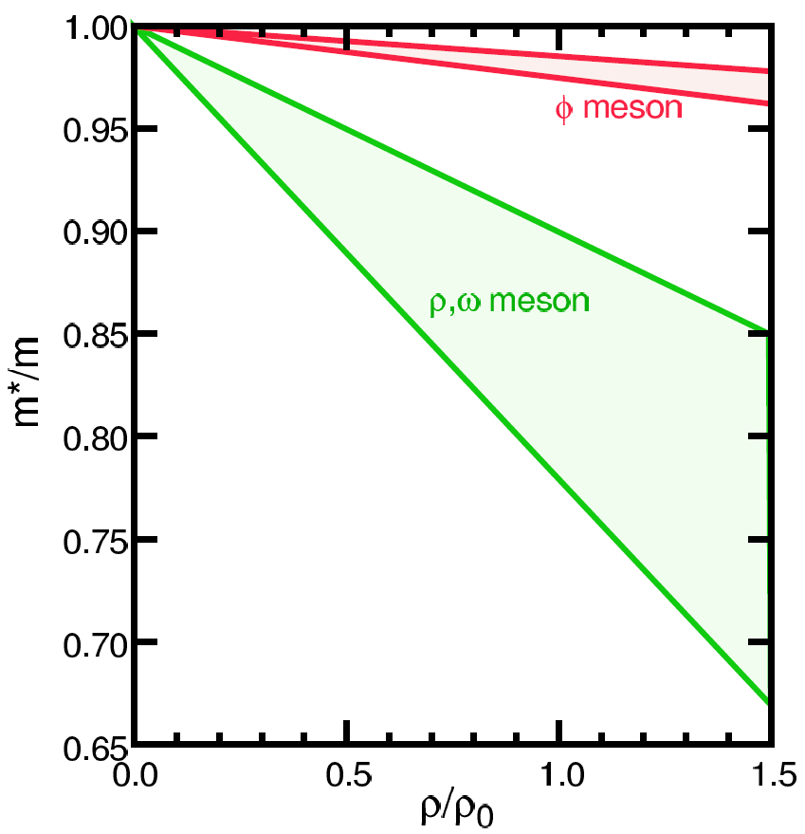
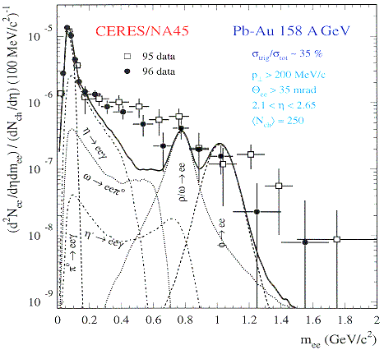
Looking into “Parallel World”
phenomena with restored symmetry
in case of chiral symmetry:
  diminishing effective (light) quark masses
  probably lower hadron masses
e.g. light vector meson mass modification
  leptonic decay channels with short life time
    e.g. φ (ss) → e⁺e⁻ (0.03 %)
T.Hatsuda, H.Shiomi and H.Kuwabara
Prog. Theor. Phys. 95, 1009 (1996)

Slide 5
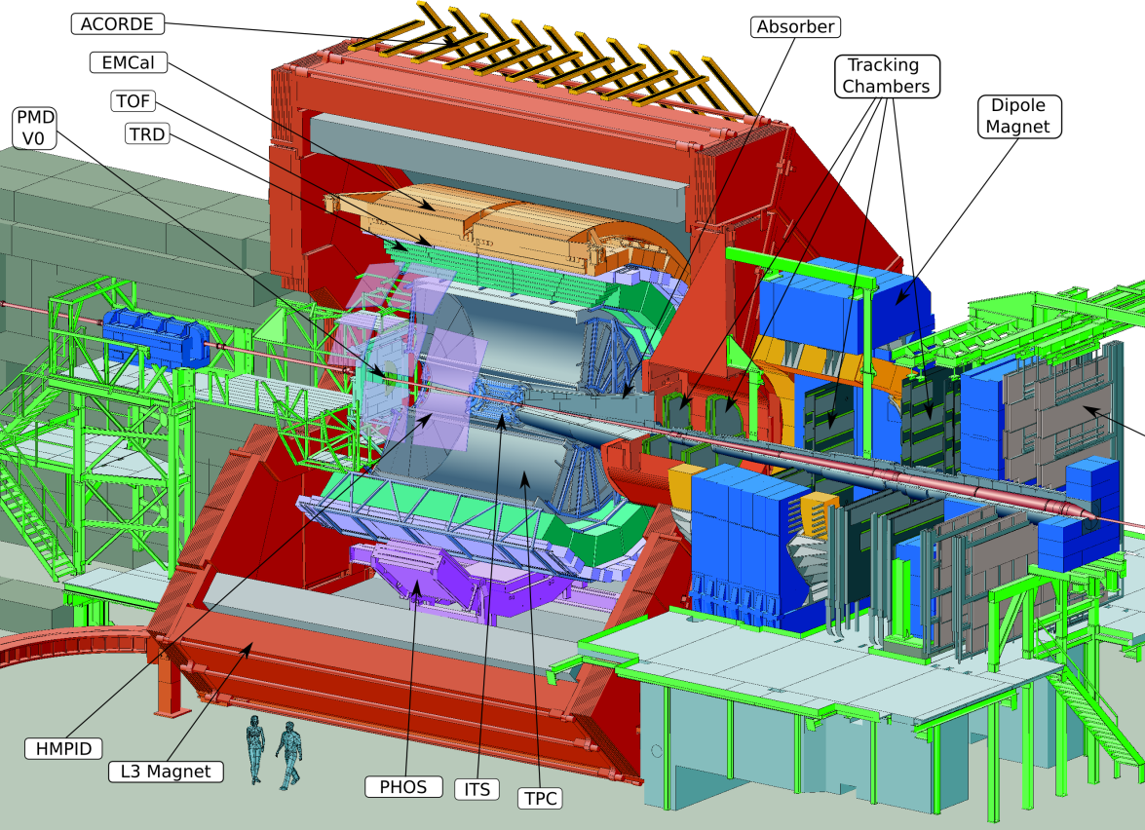
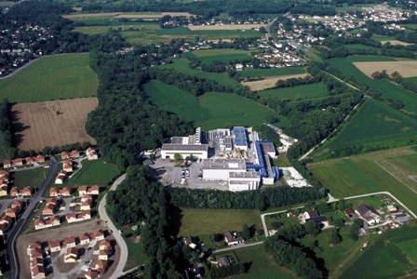

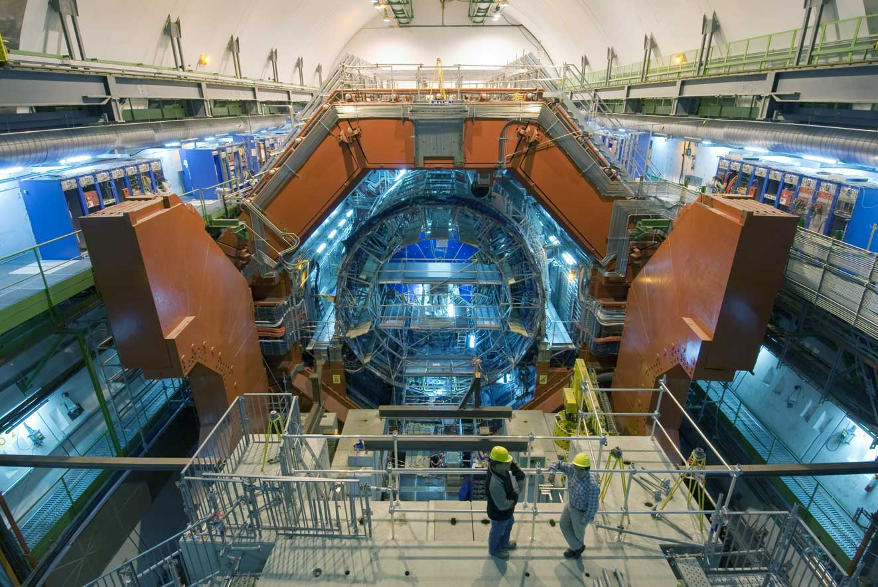
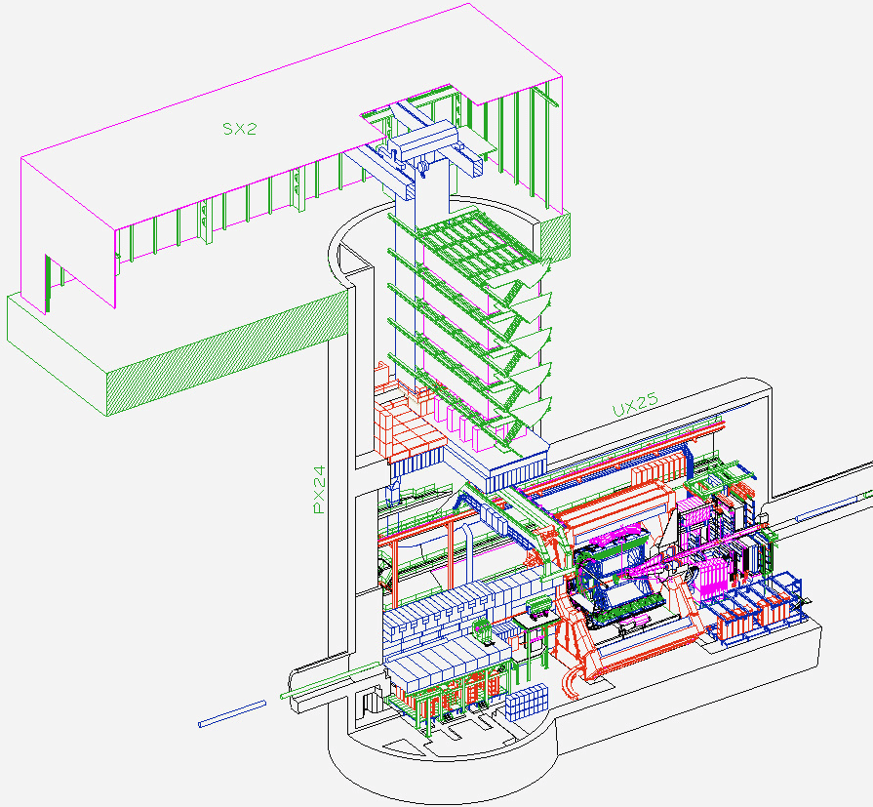
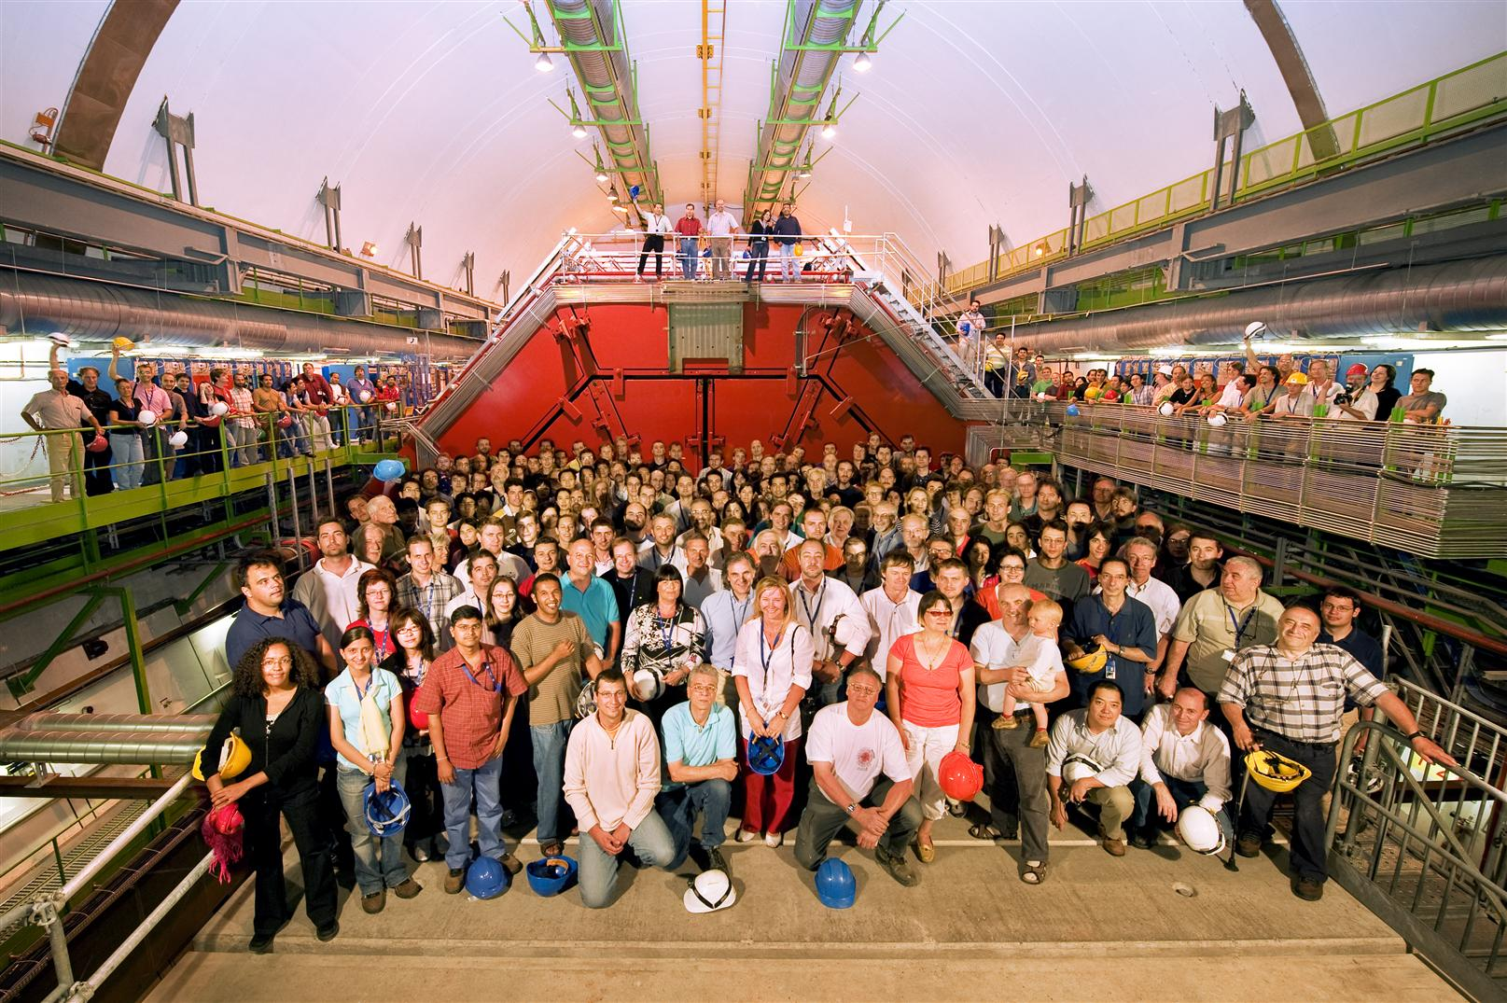
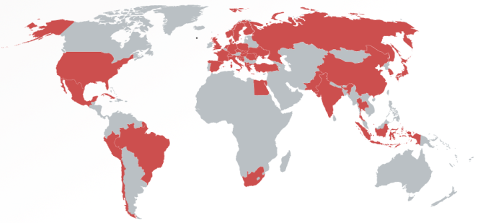
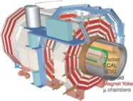
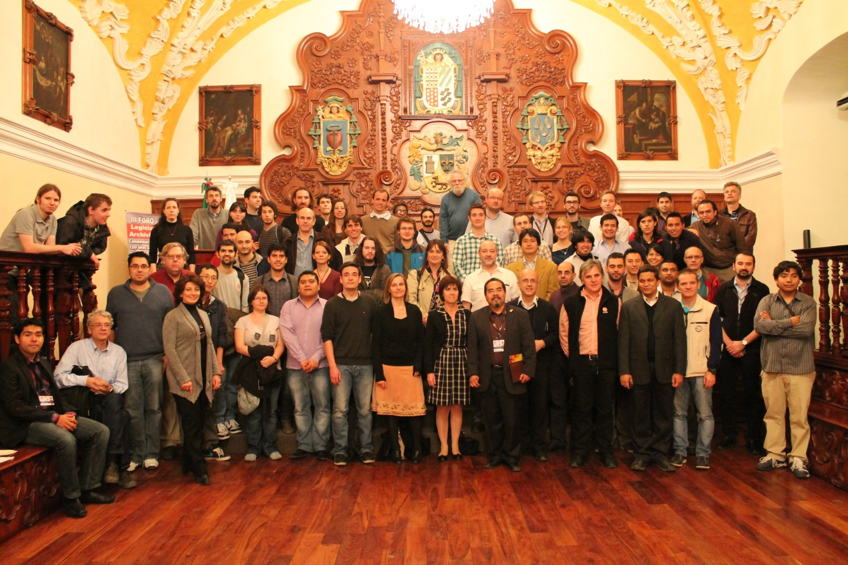
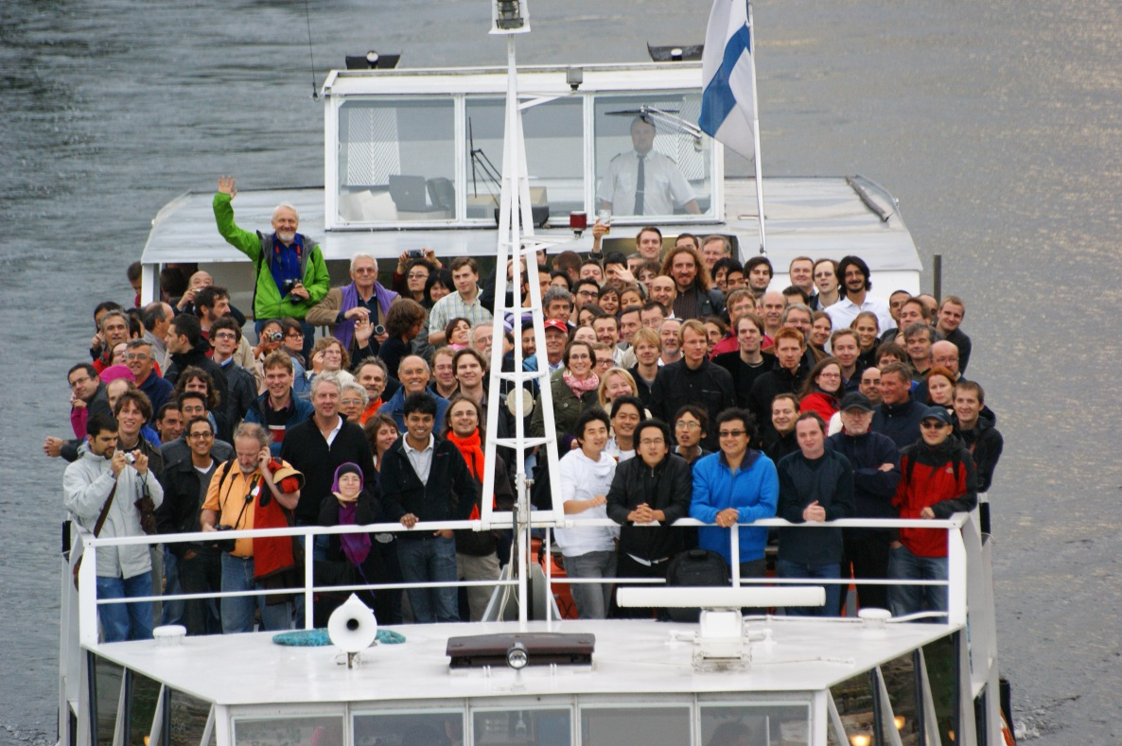

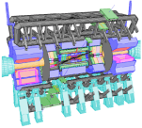


A Large Ion Collider Experiment
the nucleus-nucleus collision experiment at LHC
37 countries; 151 institutes; ~1,550 members
CMS
LHCb
ALICE
ATLAS, LHCf

Slide 6
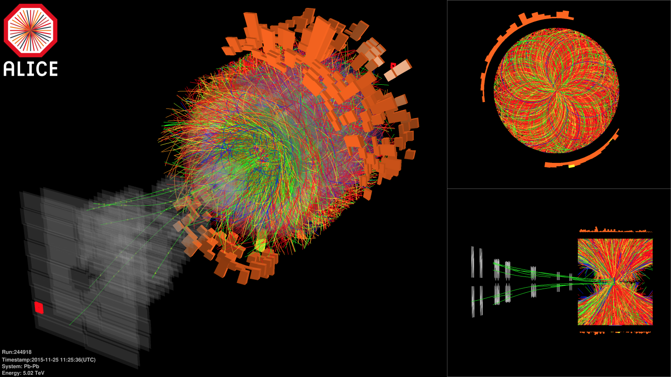

Pb-Pb at Highest Ever Energy
5.02 TeV collisions right now (since 25 November)
  design energy at 5.5 TeV
2.76 TeV in 2010 and 2011
  already 14 times higher √s_{NN} than at RHIC

Slide 7
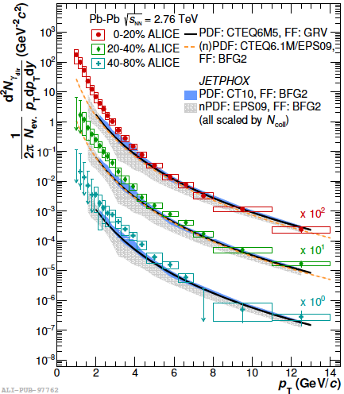
Evaluated Initial Temperatures
initial temperature > averaged photon slope
300–600 MeV at RHIC (slope ~ 220 MeV)
  hydro-dynamic description w/ τ₀ = 0.15–0.6 fm/c
slope at ALICE: 297 ± 12 (stat.) ± 41 (sys.) MeV
cf. phase transition predicted at ~170 MeV
ALICE, submitted to PLB,
arXiv:1509.07324 [nucl-ex] (2015)

Slide 8
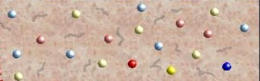
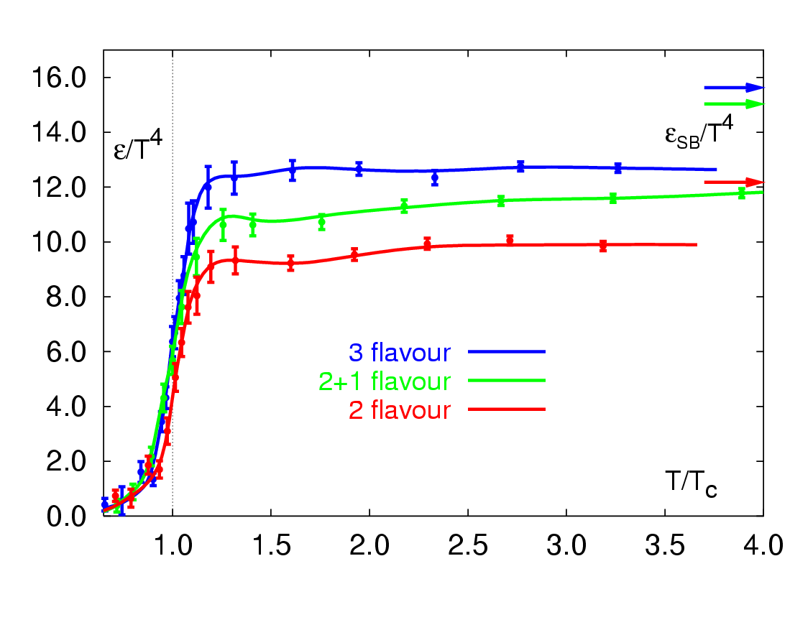
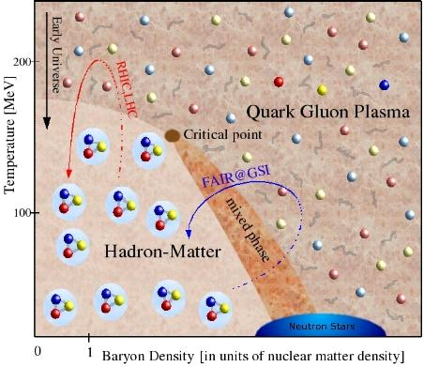
Across the Boundary and Beyond
RHIC → LHC
RHIC
F. Karsch,
Lect. Notes Phys. 583, 209 (2002)
RHIC → LHC
RHIC

Slide 9
Photon Measurement at ALICE
EM calorimeter (+ dijet calorimeter)
  large solid angle; connection with jet
photon spectrometer (PHOS)
  high spatial and energy resolutions
photon conversion (dielectron) in TPC
  high momentum resolution; powerful at low p_{T}
ref. K.Reygers, Tuesday next week

Slide 10
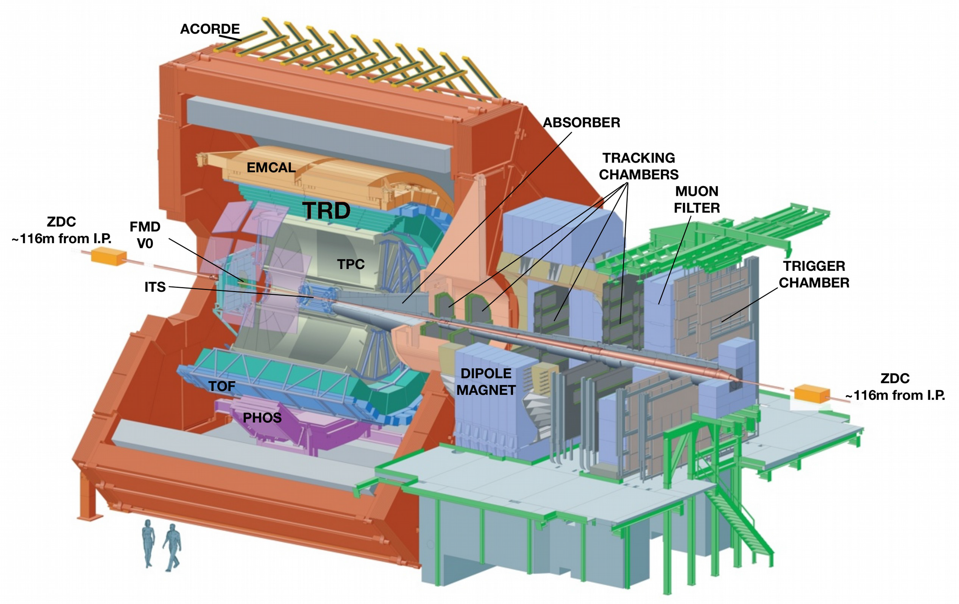
Dielectron Measurement at ALICE
inner tracking system (ITS)
  tracking, vertex, PID via dE/dx
time projection chamber (TPC)
  tracking, PID via dE/dx
time of flight detector (TOF)
  hadron rejection

Slide 11
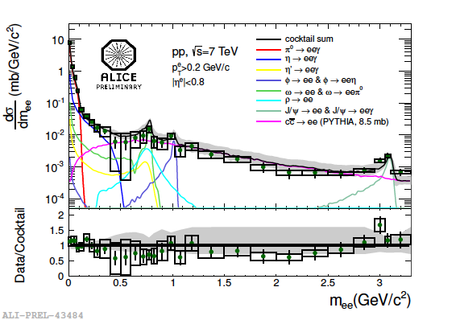
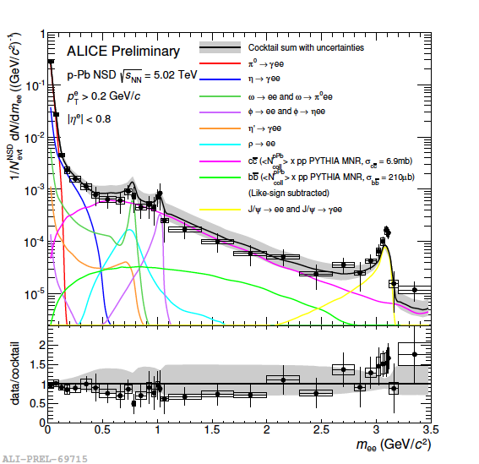
Dielectrons in Run 1 pp, p-Pb
pp at 7 TeV: ~300 M minimum bias events
p-Pb at 5.02 TeV: ~100 M minimum bias events
in agreement with expectations
ref. Alberto Caliva, Thursday this week

Slide 12
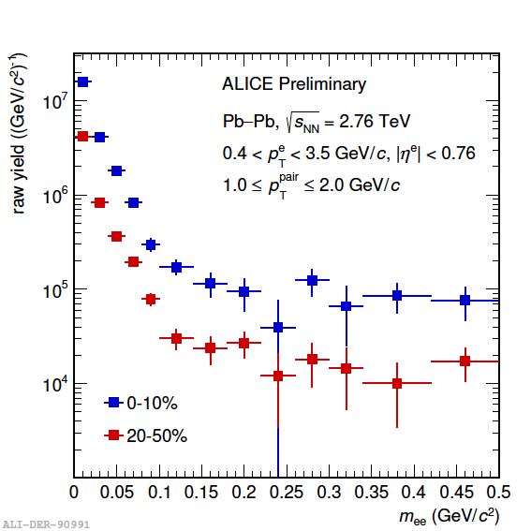
Dielectrons in Run 1 Pb-Pb
at 2.76 TeV: 17 M central, 12 M semi-central
feasibility in very low mass region
  differential in pair p_{T}
  central (0–10%) and semi-central (20–50%)
  challenging S/B ratio
analysis ongoing
ref. Alberto Caliva, Thursday this week

Slide 13
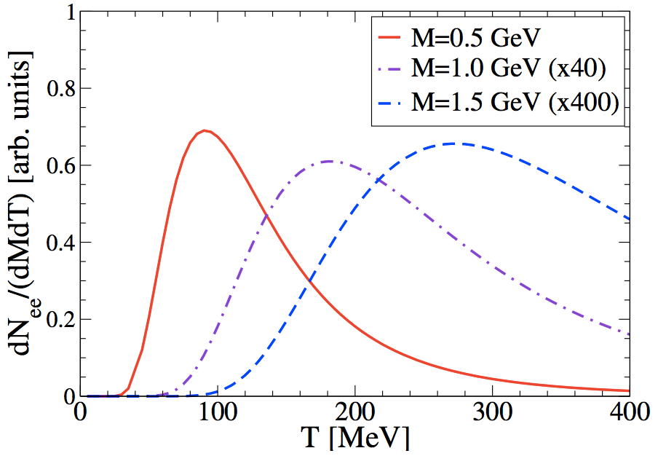
Virtual Photon Thermometers
real photons
  average over collision evolution
  blue shift due to collective effects
virtual photons (→ dileptons)
  invariant mass as extra dimension
  selective in time
  higher significance avoiding π⁰
low mass: extracted in pp, ongoing in p-Pb, Pb-Pb
intermediate mass: future scope
  no blue shift in invariant mass
    R. Rapp,
    Acta Phys. Polon. B42,
    2823 (2011)

Slide 14
Dimuon Measurement at ALICE
−4 < η < −2.5
data collected in run 1:
  Pb-Pb at 2.76 TeV
  p-Pb and “Pb-p” (muon arm on p going side) at 5.02 TeV
  pp at 2.76, 7, 8 TeV

Slide 15
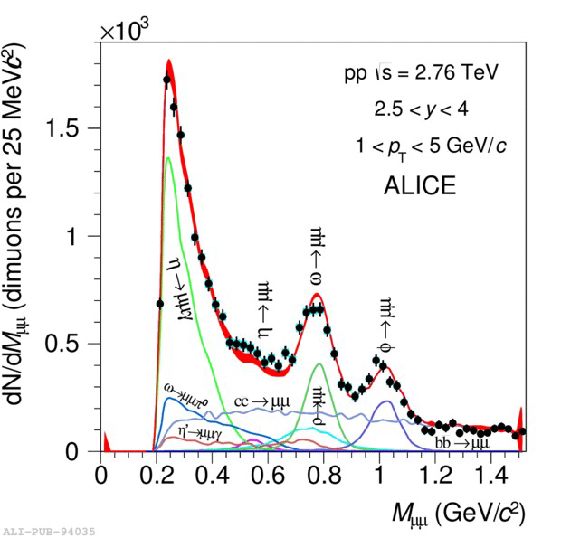
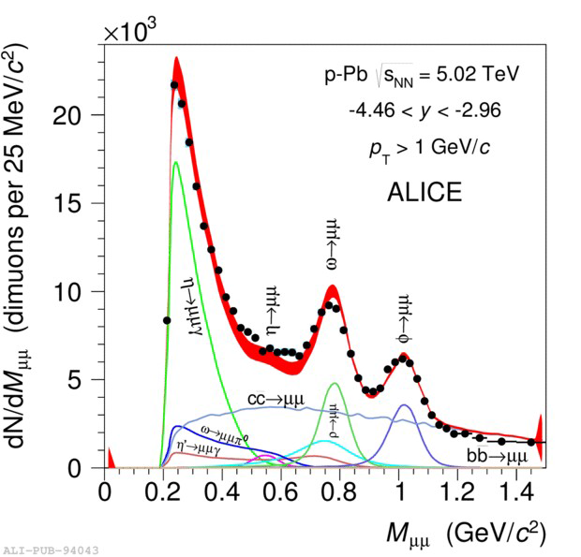
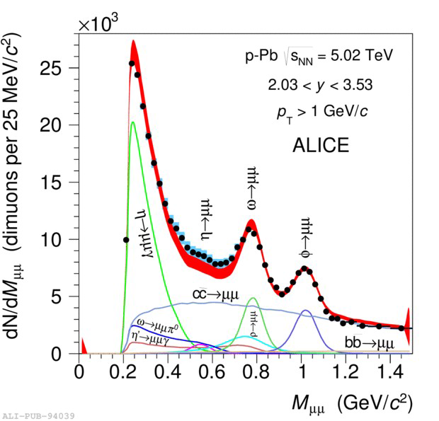
Low Mass Dimuons in Run 1 pp, p-Pb
unlike sign muon pair analysis
  matching between tracking and μ trigger
    trigger threshold p_{Tμ}~ 0.5 GeV/c
  fiducial cuts on η_{μ} and y_{μμ}
combinatorial background via event mixing
arXiv 1506:09206

Slide 16
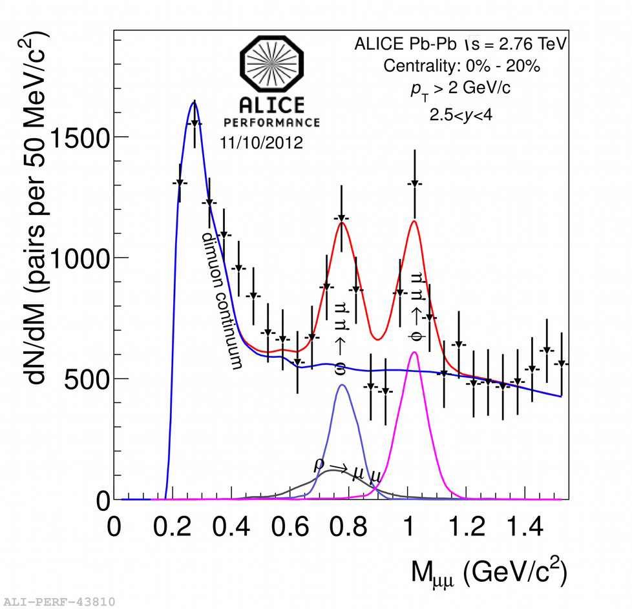
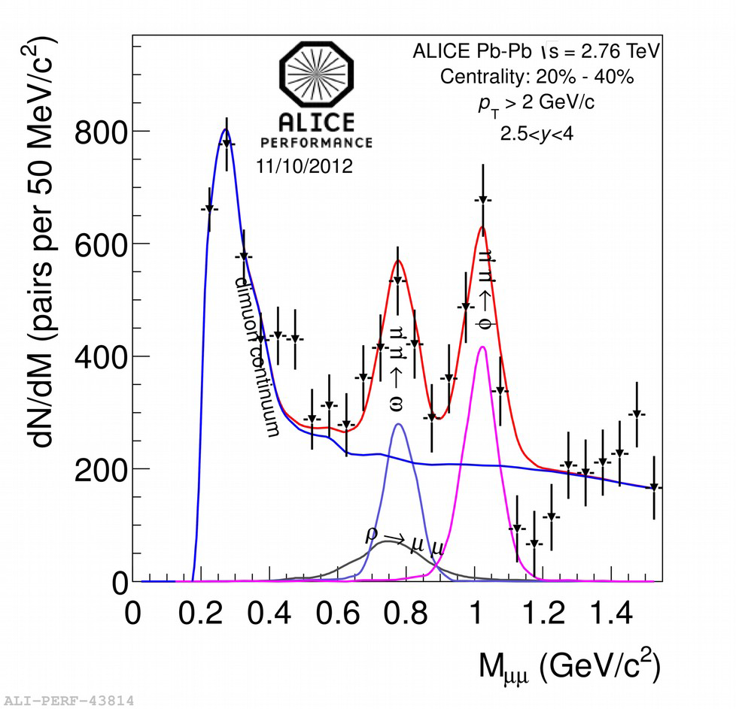
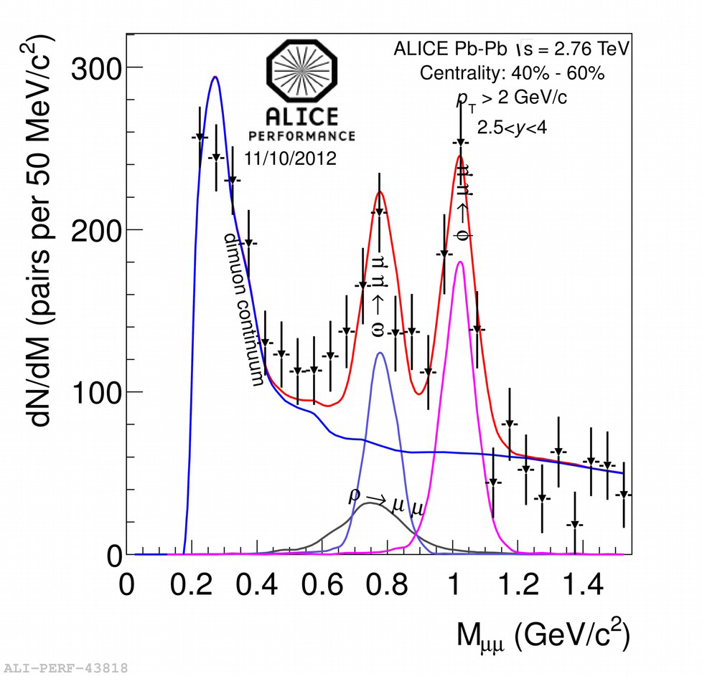
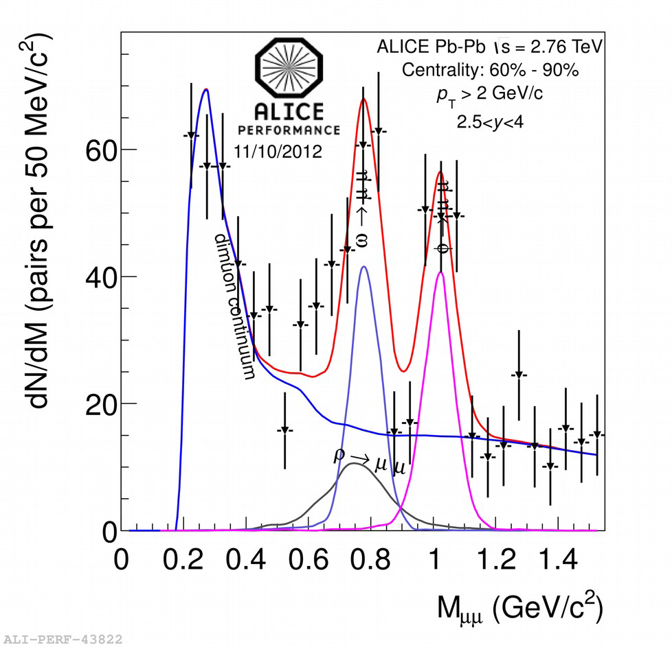
Low Mass Dimuons in Run 1 Pb-Pb
same selections as in pp and p-Pb plus:
  sharp offline cut on p_{Tμ} > 0.85 GeV/c, p_{Tμμ} > 2 GeV/c
empirical continuum background (blue lines)

Slide 17
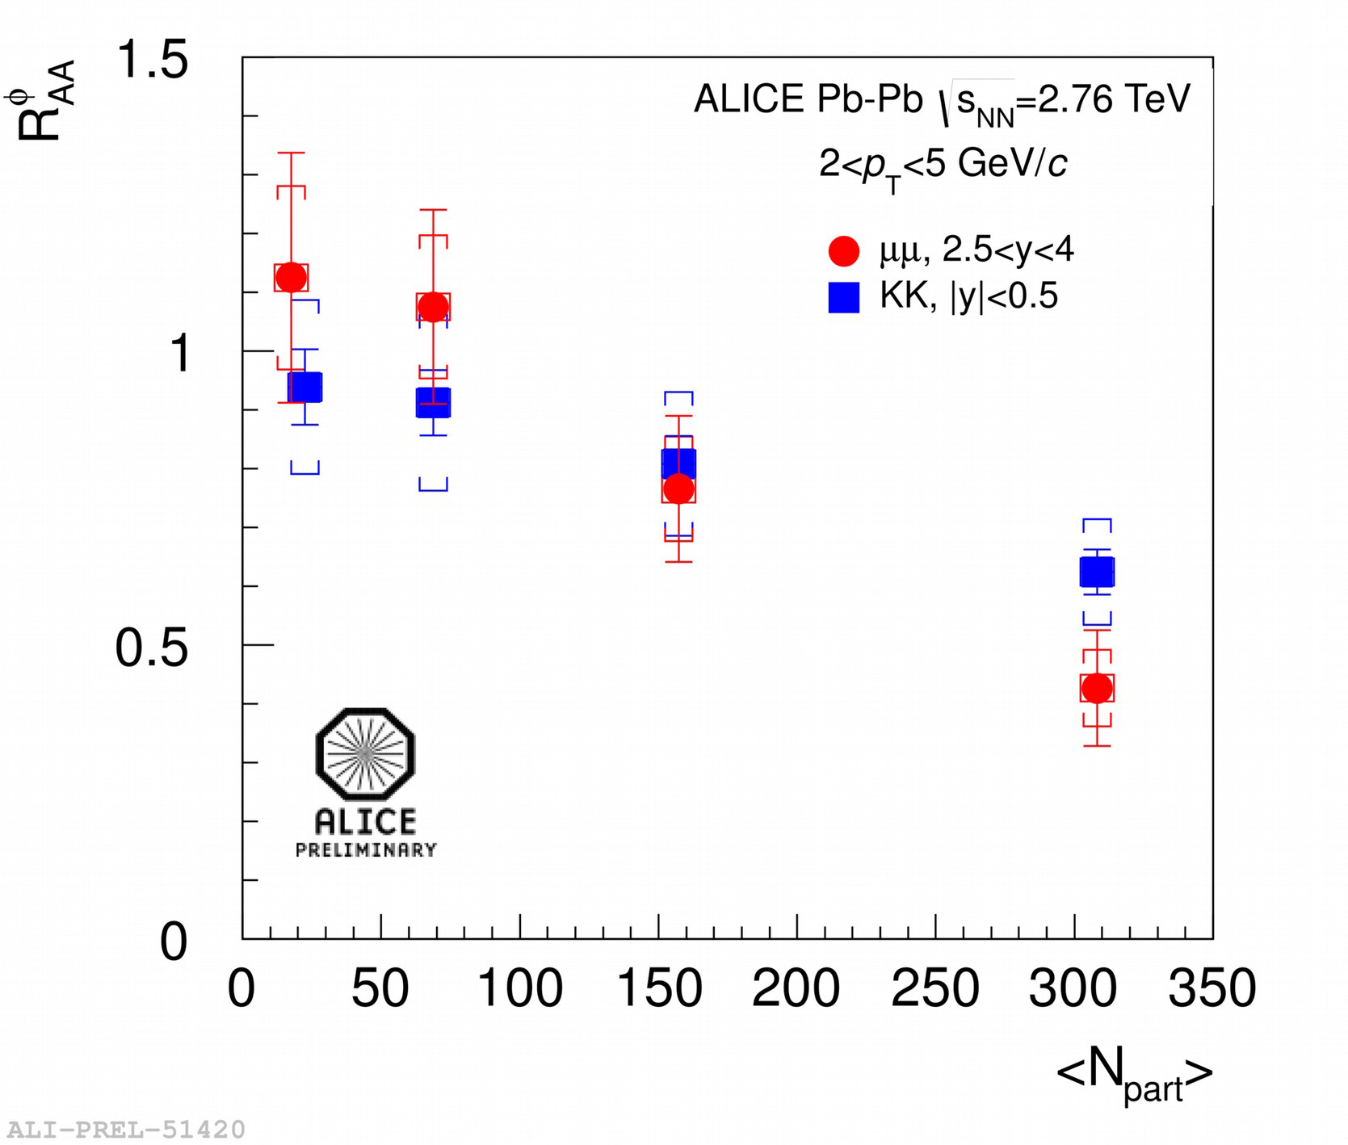
φ R_{AA}: A Run 1 Achievement
comparison with mid-rapidity φ→K⁺K⁻
in agreement point to point
different slopes? different hydrodynamic push?

Slide 18
2015 Pb-Pb Strategy
300 μb⁻¹ in muon arm
  ~4 times run 1 integrated luminosity
150 M MB events (~19 μb⁻¹) in central barrel
  emphasis on peripheral to bridge pp, p-Pb and Pb-Pb
    00–10%: ~0.75 times run 1
    10–50%: ~2.5 times run 1
    50–90%: ~10 times run 1
pp reference at 5.02 TeV
  0.15 pb⁻¹ in muon arm
  80 M MB events in central barrel

Slide 19
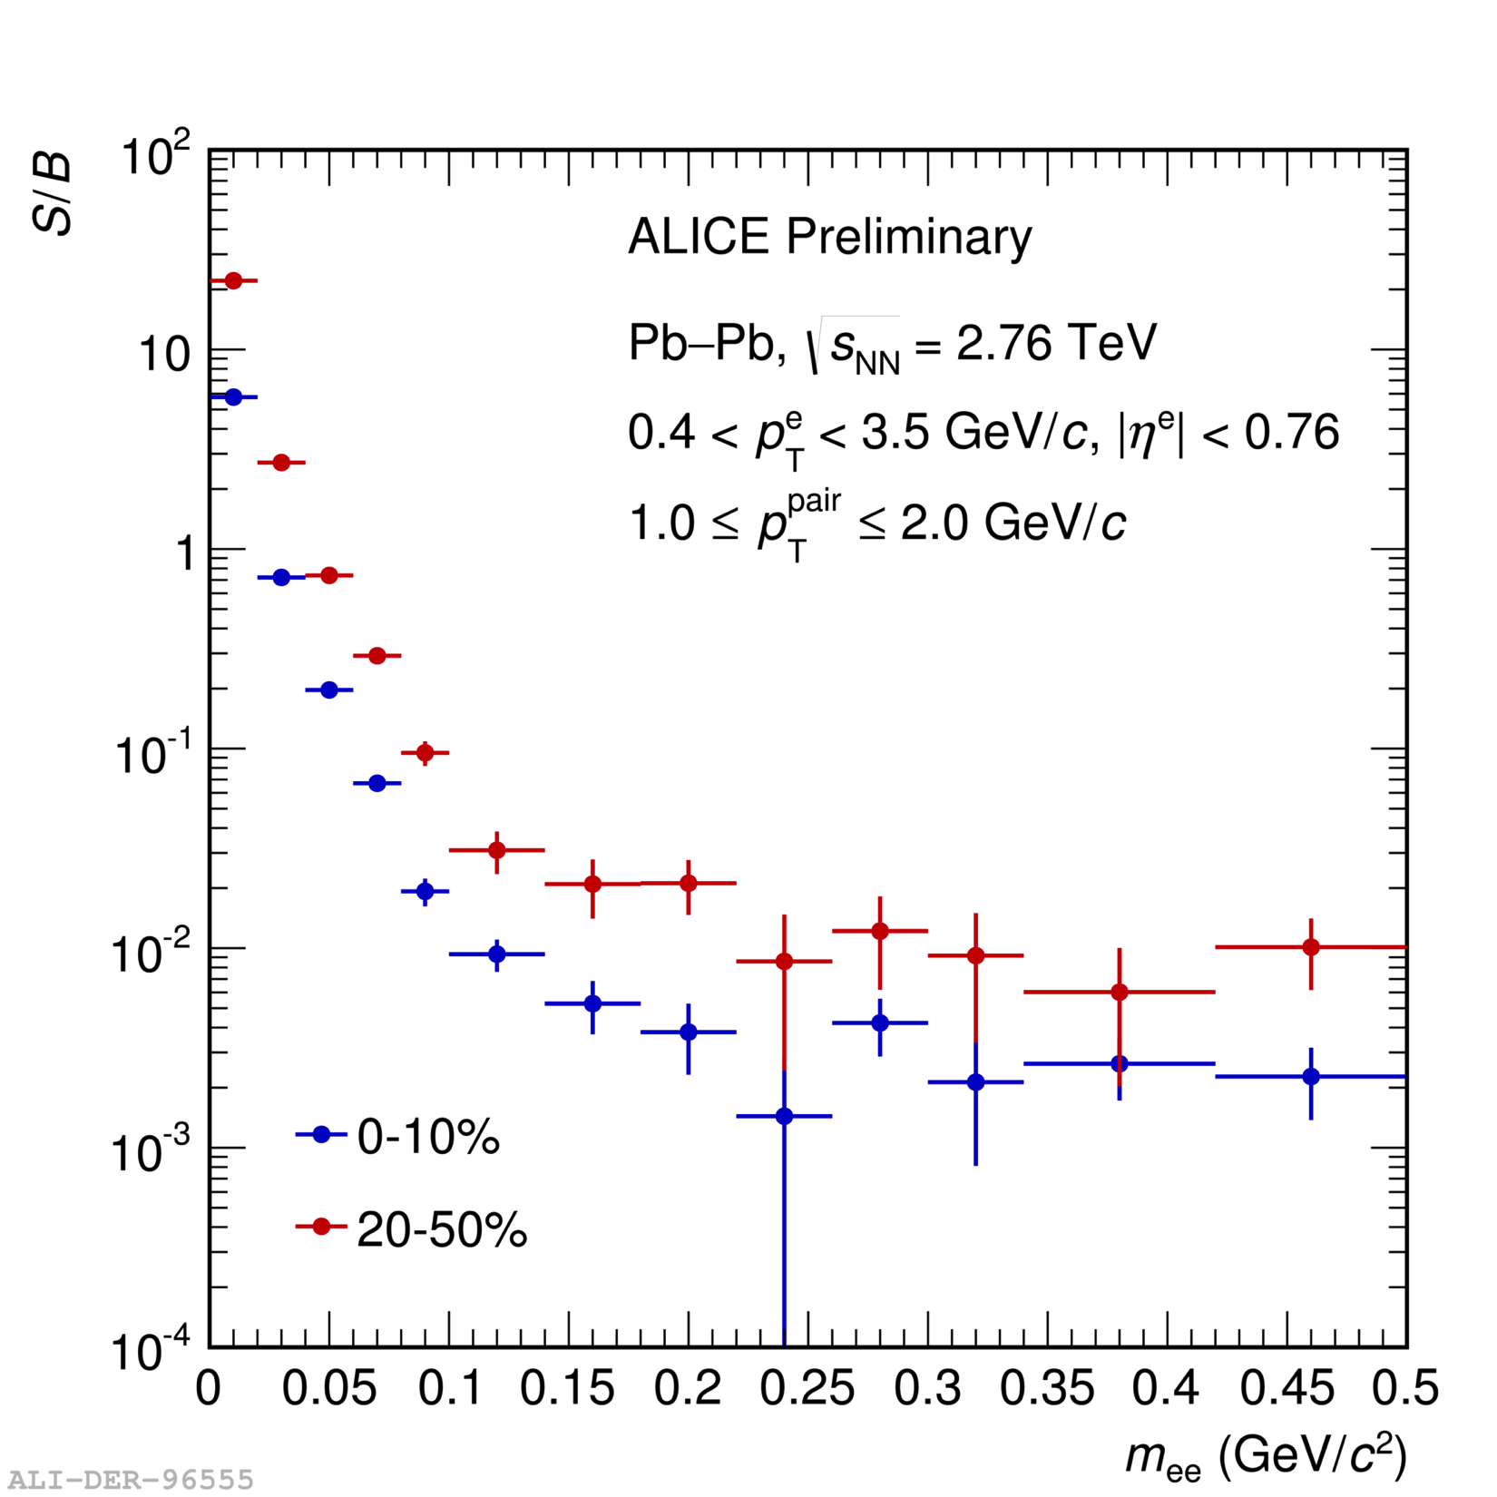
Low Mass Dielectron Goals
continuum up to J/ψ mass in minimum bias
virtual photons in different centralities
  low S/B ratio; ~0.25% in central, ~1% in semi-central
dielectron elliptic flow

Slide 20
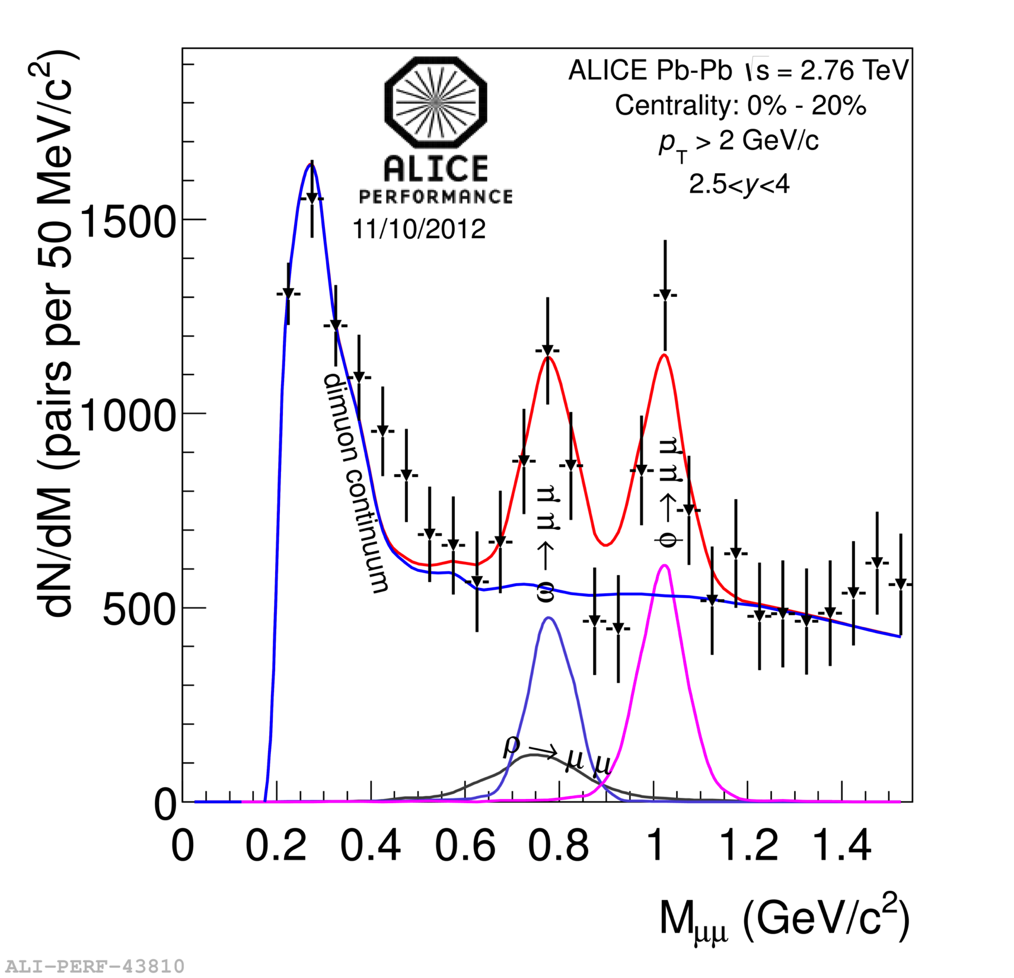
Low Mass Dimuon Goals
φ and ρ+ω R_{AA}
  2 < p_{T} < 6 GeV/c
φ and ρ+ω elliptic flow
  integrated over p_{T}
low and intermediate mass spectrum
  2 < p_{T} < 6 GeV/c
  → hadronic cocktail + open heavy flavor

Slide 21
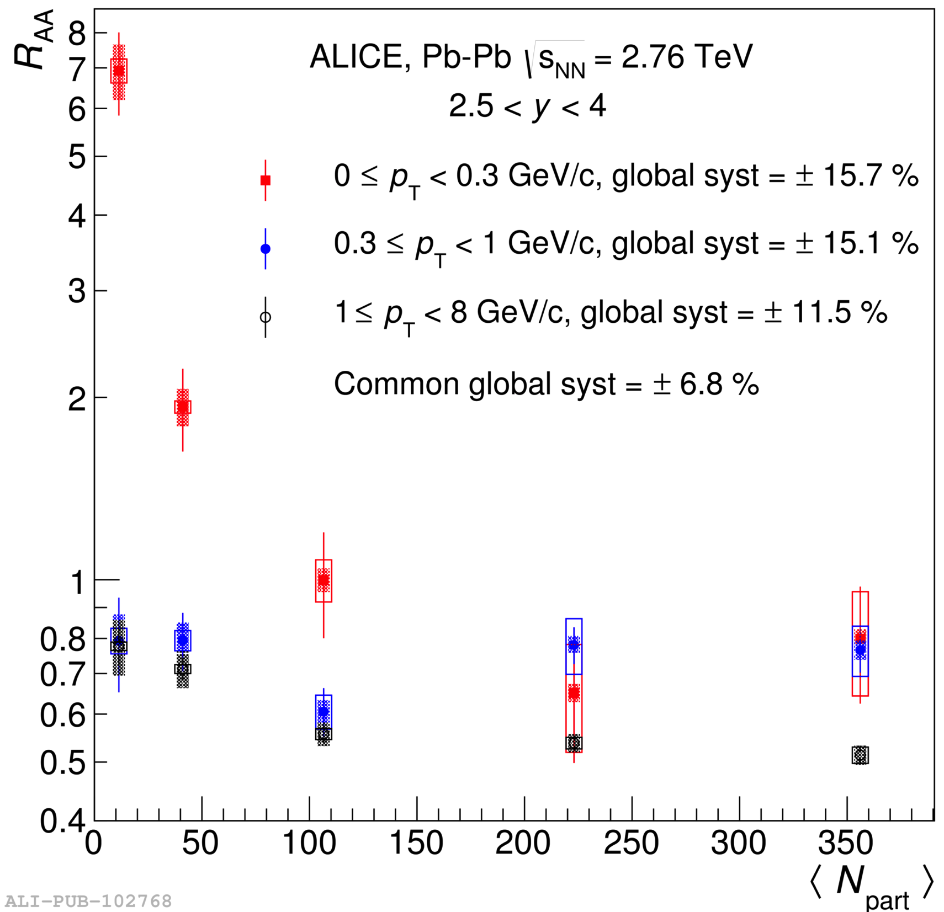
Other Dilepton Goals in Run 2
J/ψ R_{AA} versus centrality, rapidity, p_{T}
J/ψ elliptic flow
J/ψ at very low p_{T}
excited states: ψ’, Υ(1S), Υ(2S)
ALICE, submitted to PRL,
arXiv:1509.08802 [nucl-ex] (2015)

Slide 22
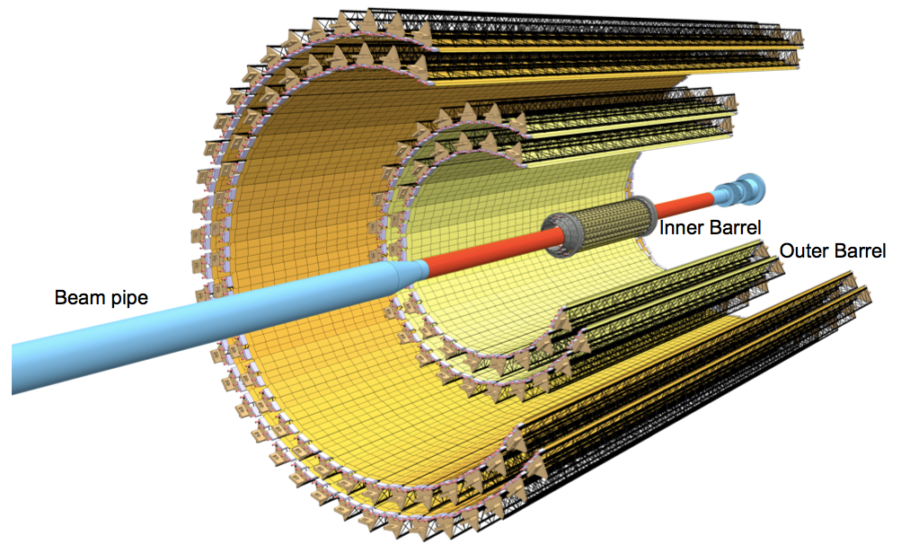
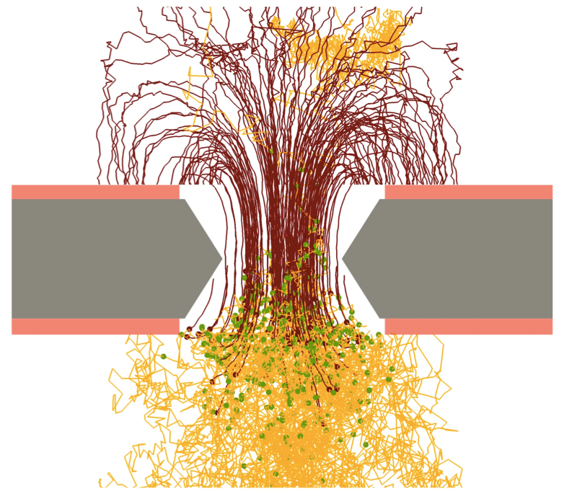
Major Upgrades at Run 3 (2021–)
new ITS
  7 layers of MAPS silicon pixel detectors
  precise measurement of displaced vertices
    to separate heavy flavor decays
new TPC readout chambers
  GEM technology with no gating grid
  ~100 times higher data taking rate (50 kHz in Pb-Pb)
    continuous readout
Muon Forward Tracker (MFT)

Slide 23
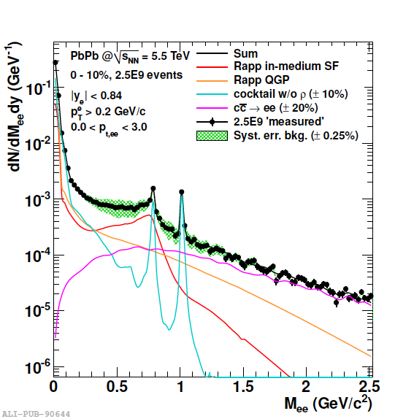
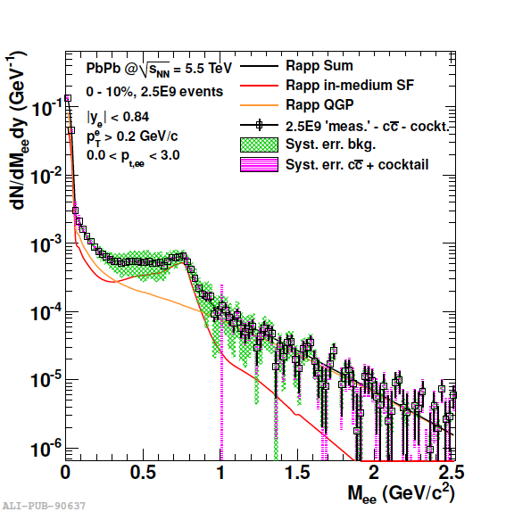
Dielectron Goals and Plans in Run 3
radiation in intermediate (> 1.1 GeV/c²) mass
  precise measurement of early time temperature
    average over early times, no blue shift
expected precision: ±10% stat., ±10–20% sys.
  2.5 G minimum bias events assumed
  subtraction established for known sources
ALICE,
ITS Upgrade TDR,
J. Phys. G 41,
087002 (2014)

Slide 24
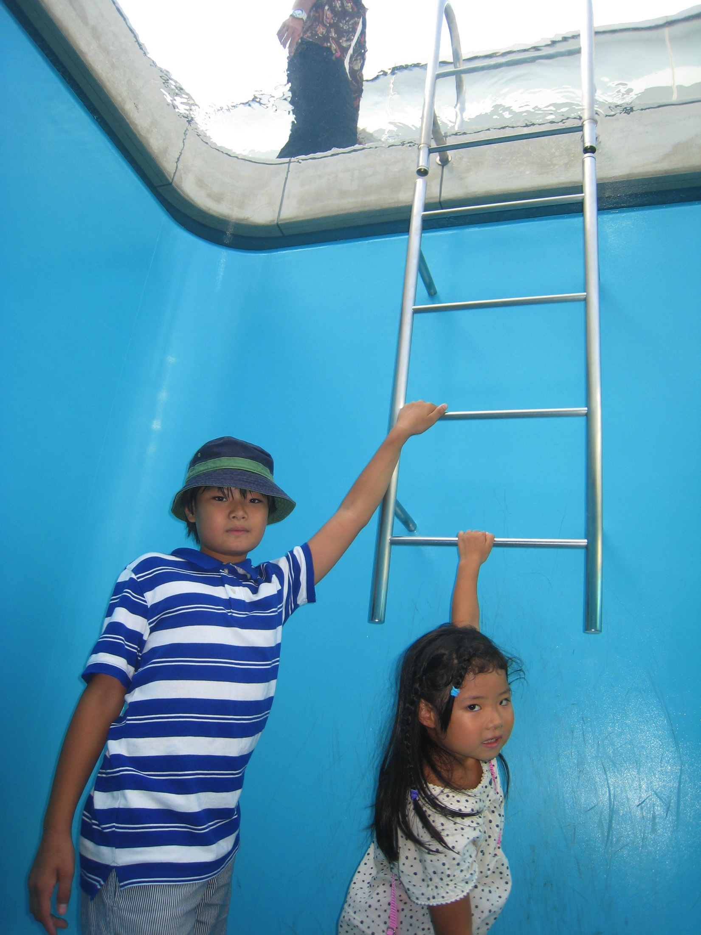
e± and μ±, Typical Brothers/Sisters
basically equivalent
unique in how to treat
; different only in masses
; especially in PID
electron identification
  charged hadron rejection via mass difference
    cherenkov, dE/dx, momentum versus electro-magnetic energy
  then Dalitz decay electrons from π⁰, η, ω, η’, φ, …
muon identification
  charged hadron rejection via penetration
    hadron absorber (1 GeV/c μ requiring 80 cm of iron to stop)
  Dalitz only from η (→ γ μ⁺μ⁻ BR ~ 0.03%) and heavier
  π⁺ → μ⁺ν_{μ}, K⁺ → μ⁺ν_{μ} not from primary vertex
(note: 5 years ago)

Slide 25
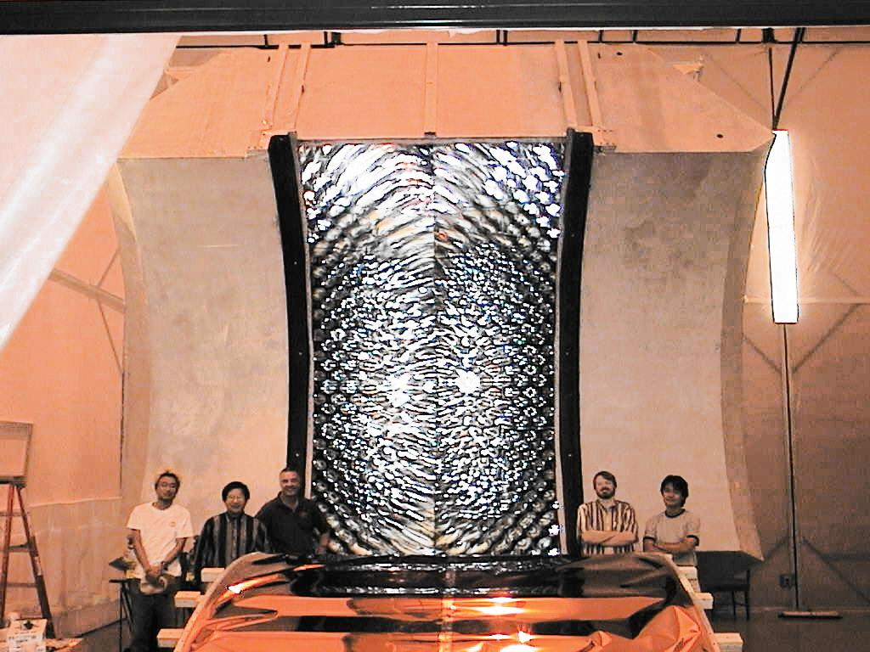
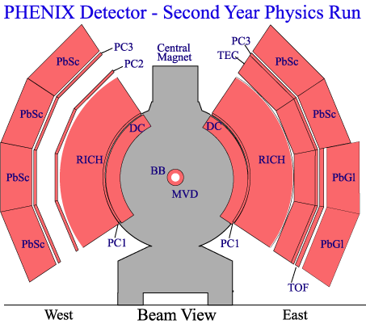
A Typical Electron Measurement
PHENIX at RHIC
precise tracking and electron identification
  challenging background primarily from Dalitz decays
    statistical subtraction
    hadron blind detector
  γ conversion rejection
  correlated background also evaluated
    cross pairs
    jet components
  ref. Y. Watanabe, Monday this week
e⁺
π
e⁻

Slide 26
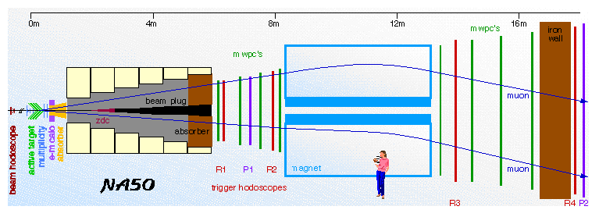
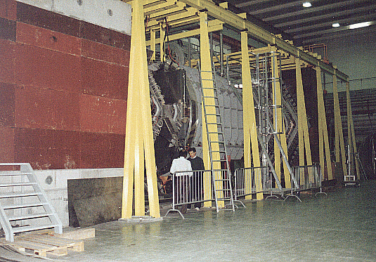
A Typical Muon Measurement
NA38/50/51 at SPS
  ref. H. Specht, Monday this week
μ± spectrometer w/ huge hadron absorber
  primarily for J/ψ physics
fast μ± trigger for high statistics
low resolution: σ_{z} ~ 10 cm, σ_{m} ~ 80 MeV at φ

Slide 27
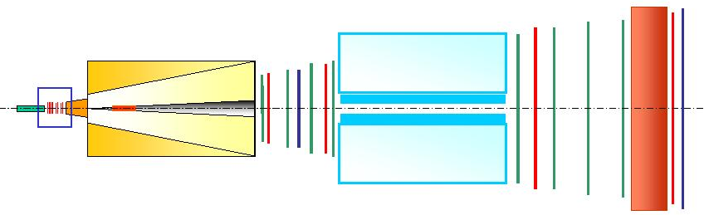
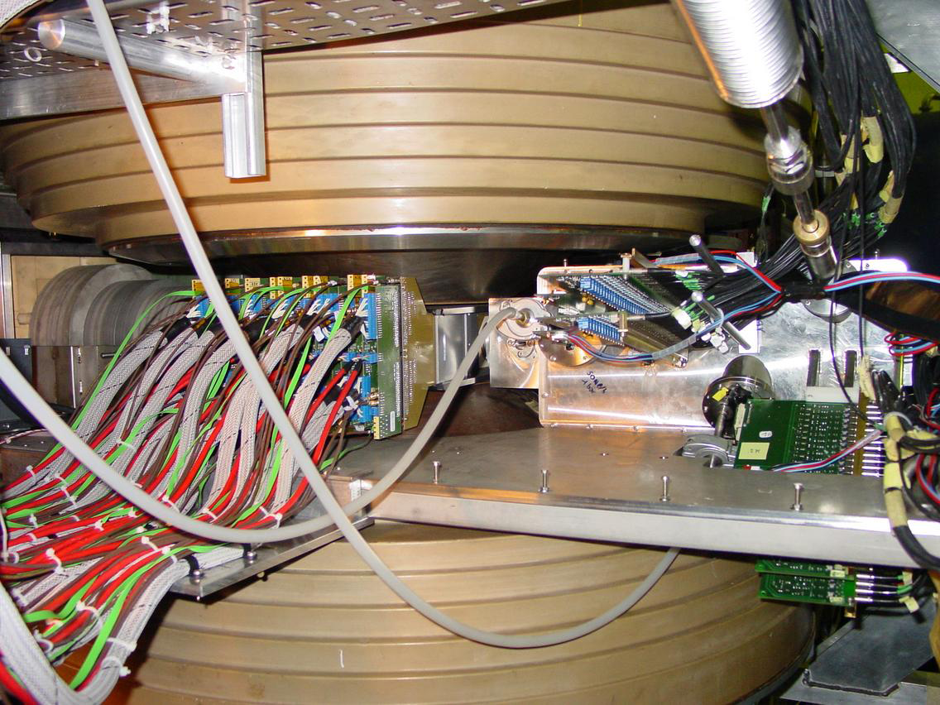
A Historical Muon Upgrade: NA60
radiation hard Si telescope in front of absorber
  high vertex and invariant mass resolutions
~ 1m
Muon Spectrometer
Iron
wall
Hadron absorber
MWPC’s
Toroidal Magnet
Target area
μ
beam
μ
ZDC
Trigger Hodoscopes
Dipole field
2.5 T
TARGET
BOX
MUON
FILTER
BEAM
BEAM
TRACKER
VERTEX
TELESCOPE
IC
not to scale

Slide 28
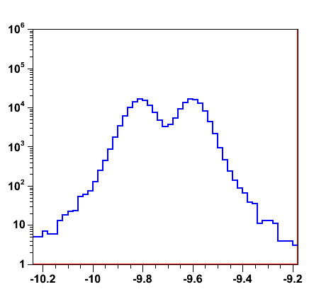
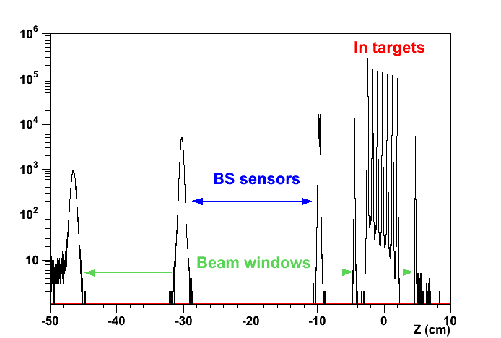
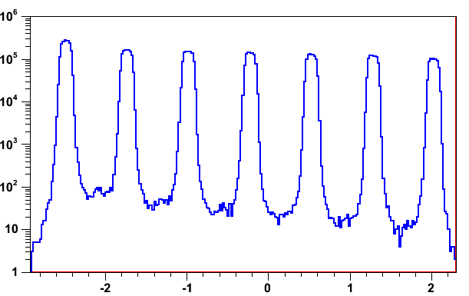
Excellent Vertex Resolution
σ_{z} ~ 200 μm, σ_{x,y} ~ 10–20 μm
  w/ ≥ 4 tracks
Beam Tracker
sensors
windows
indium target images in log scale

Slide 29
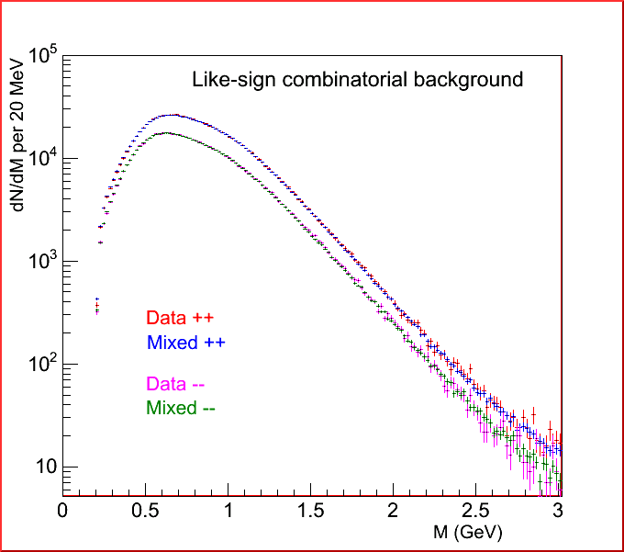
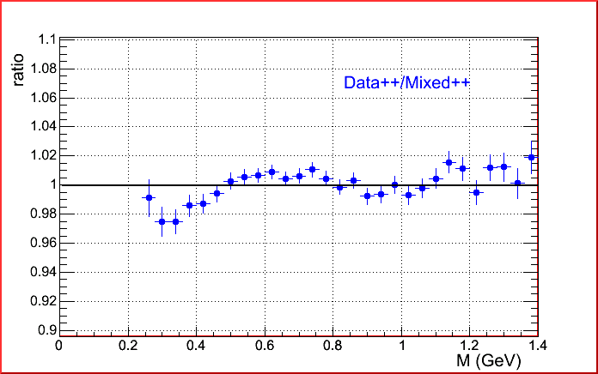
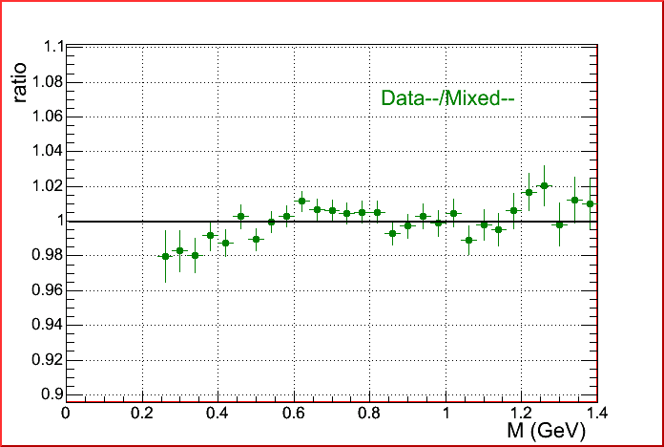
Mixed Event Technique
evaluation of uncorrelated pairs
checked with like sign (++, −−) pairs
  little cross pair contribution at SPS energy
~2% accuracy at NA60 over wide mass range

Slide 30


Excellent Low Mass Spectrum
good statistics and invariant mass resolution
  opening angle with silicon vertex tracker
  momentum with μ± spectrometer
  fake match evaluated with event mixing

Slide 31

ρ Discussions Finally Allowed at SPS
Brown-Rho (dropping mass)
Rapp-Wambach (collision broadening)

Slide 32



Uniqueness of LHC Forward Region
two interesting regimes of quark-gluon droplets
  exploration on QCD phase diagram
virtues at LHC
  not too forward for “central” physics (2.5 < |η| < 3.6)
  forward enough for muon measurement

Slide 33
Forward Upgrade
high precision internal tracking
  in association with existing forward muon spectrometer
“classical” upgrade of muon experiments
  e.g. NA60, PHENIX
  CMS from the beginning
challenges at ALICE:
  only 40 cm left in z
  momentum measurement not possible
    tracks almost parallel to magnetic field
  60 X₀ frontal absorber in front of spectrometer
  high multiplicity

Slide 34


ALICE Muon Spectrometer (Present)
2.5 (9.5∘) < −η < 4.0 (2∘)
  (negative η side in ALICE coordinates)

Slide 35
Muon Forward Tracker (2021–)
eye glasses of muon spectrometer
IP
Absorber
Dipole

Slide 36
Physics Cases at a Glance
open heavy flavor
  D → single muons down to p_{T} = 1 GeV/c
  B → single muons down to p_{T} = 2 GeV/c
  J/ψ down to p_{T} = 0 GeV/c
quarkonia
  prompt/secondary J/ψ, ψ(2S), Υ(1S/2S/3S)
low mass dimuons
  chiral symmetry restoration
    ρ, ω, φ → μ⁺μ⁻ mass line shapes
  direct radiation from QGP
    prompt μ⁺μ⁻ continuum
ALICE, MFT TDR,
CERN-LHCC-2015-001

Slide 37

MFT Layout and Acceptance
−3.6 < η < −2.45
  covering most of muon spectrometer acceptance
912 silicon pixel sensors (0.4 m²)
5 disks (10 detection planes) at z = 46–77 cm

Slide 38

(Tight) MFT Environment

Slide 39


MFT Planes in Half Disk Structure
ladder assembly with active and readout zones
sensors on both sides staggered
  no dead zone, 50% redundancy
front side
back side

Slide 40

Silicon Sensor Technology
CMOS Monolithic Active Pixel Sensor (MAPS)
  active and readout zones on same silicon substrate
  reduced cost compared to hybrid pixel technology
  50 μm thickness → low material budget
  28 × 28 μm² pixels
  15 × 30 mm² sensor size
  ~700 kRad radiation tolerance
Alpide (ALICE pixel detector) readout architecture
  event timing resolution < 4 μs
  power consumption < 50 mW/cm²
Notes:
Chip size: 15mm x 30mm, Pixel pitch ~ 30 μm, Spatial resolution ~ 5 μm, Power density < 100 mW/cm²

Slide 41
Material Budget
< 0.6% X₀ per disk
1st: flexible printed circuit
2nd: water cooling structure
3rd: silicon pixel sensor

Slide 42


Occupancy in Central Pb-Pb
~0.5 cluster/mm²/collision at most
factor ~2 difference from 1st to 5th disk

Slide 43
Data Throughput
estimation including Pb-Pb collisions, QED, noise
  100 kHz collision rate
  4 μs integration time
  10⁻⁵ fake hit rate
  35 bits average hit encoding
max. ~250 Mb/s for inner sensors in 1st disk
  high speed 1.2 Gb/s lines complying with requirements
full data throughput ~57 Gb/s

Slide 44
Track Matching with Spectrometer
high efficiency even in central Pb-Pb
  ~90% at p_{T} > 2 GeV/c
  ~60% at p_{T} = 1 GeV/c
different methods under study
  MFT cluster with spectrometer track (MFT Letter of Intent)
  MFT track with spectrometer track (new)
ALICE, MFT TDR,
CERN-LHCC-2015-001

Slide 45

Low Mass Vector Mesons
significant improvement w/ MFT
  mass resolution by ~4
  LVM signal/background ratio by ~10
ALICE, MFT LOI,
CERN-LHCC-2013-014

Slide 46


Low Mass Continuum
~20% uncertainty w/ MFT, ~70% w/o MFT
  at mµµ ~ 0.5 GeV/c²
  10% hadron/charm subtraction uncertainties assumed
Rapp in-medium ρ+ω
Rapp QGP radiation
syst. err. cocktail (10%)
syst. err. bg (0.25%)
ALICE, MFT LOI, CERN-LHCC-2013-014

Slide 47
ALICE（-Japan） Upgrade Strategies
1st – high p_{T} phenomena (jets), heavy flavors
  ✓ × 2–3 high speeding, new detectors; LS1 2013–2014
    upgrade: TPC readout* (Tokyo), PHOS readout (Hiroshima)
    new: di-jet calorimeter (Tsukuba)
2nd – low/mid p_{T} phenomena
  × 100 high speeding, new detectors; LS2 2019–2020
    upgrade: TPC chamber (Tokyo), new vertex trackers
    new: muon forward tracker (Hiroshima)
3rd – (further) forward physics
  new detectors; LS3 2024 ?
    new: forward calorimeter (Tsukuba)
    * pending

Slide 48






Hiroshima on MFT Project
focus on low mass physics
in charge of detector control system
ladder assembly and testing
  expertise in laser soldering developed in ITS upgrade
    first hybrid integrated circuit assembly test satisfactory
laser soldering machine
laser soldering process
Satoshi Yano (Hiroshima)

Slide 49
Summary and Concluding Remarks
confidence in looking into “parallel world”
  chiral phenomena of most interest
    further and updated theoretical(/experimental) inputs needed
successful dilepton measurements at ALICE run 1
  ref. Alberto Caliva, Thursday this week
run 2 Pb-Pb ongoing for higher statistics
  differential measurements, e.g. φ, ρ+ω, J/ψ elliptic flow
major upgrades in run 3 (2021–)
Muon Forward Tracker
  unique tool also for low mass, low p_{T} physics

