Slide 1

高エネルギー原子核衝突を用いた
極限状態の実験的探究
志垣 賢太 （ ）
東北大学大学院理学研究科 集中講義 兼 セミナー
2015 年 7 月 3 日

Slide 2
Presentation Outline
unique features of high energy A+A physics
  challenge to reach “the other side” of phase boundary
new stage of high energy A+A experiments
  clearly beyond QCD phase boundary
selection of recent topics
  authentic: knowledge on partonic matter
  new: mysteriously behaving p(d)+A collisions
  brand new: ultra-intense U(1) magnetic field
next steps
summary and concluding remarks

Slide 3
Goals of High Energy A+A Collisions
why nucleus-nucleus at GeV/TeV range?
  “snowball + snowball”
“system” of particles under strong QCD field
  non-perturbative QCD under extreme conditions
    cf. “processes” between elementary particles
state of matter at ~ 10⁻⁵ seconds after Big Bang
  quark (de)confinement
    cf. production/interaction of matter at ~ 10⁻¹² seconds
hadronic mass generation at confinement
  spontaneous chiral symmetry breaking/restoration
    cf. particle mass generation via BEH mechanism

Slide 4
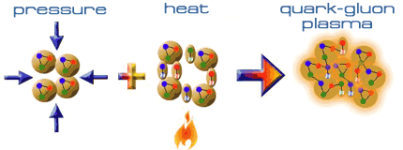
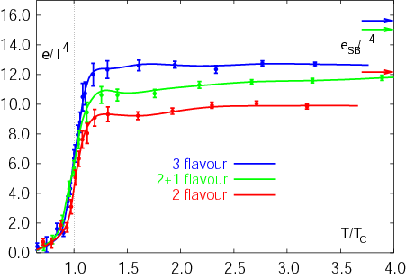
Expeditions on QCD Phase Diagram
toward deconfined partonic phase
lattice Quantum Chromo-Dynamics predictions
  critical temperature ~ 170 MeV
  critical energy density ~ 1 GeV/fm³
lost phase within experimental reach
Early Universe
Deconfined Partonic Phase
(Quark-Gluon Plasma)
Tri-Critical point
Energy Density (Temperature)
Critical Temperature ~ 170 MeV
High Energy A+A Collisions
Hadron gas
Color Super-Conductivity?
F. Karsch,
Lect. Notes Phys. 583 (2002) 209
Color-Flavor Locking?
Nucleus
Neutron Star
Baryon Density

Slide 5
Uniqueness of QCD Phase Transition
only possible boundary to experimentally cross
  to prove (or disprove) paradigm of universe evolution
  not just to catch residue
K. Homma, 2008/09

Slide 6
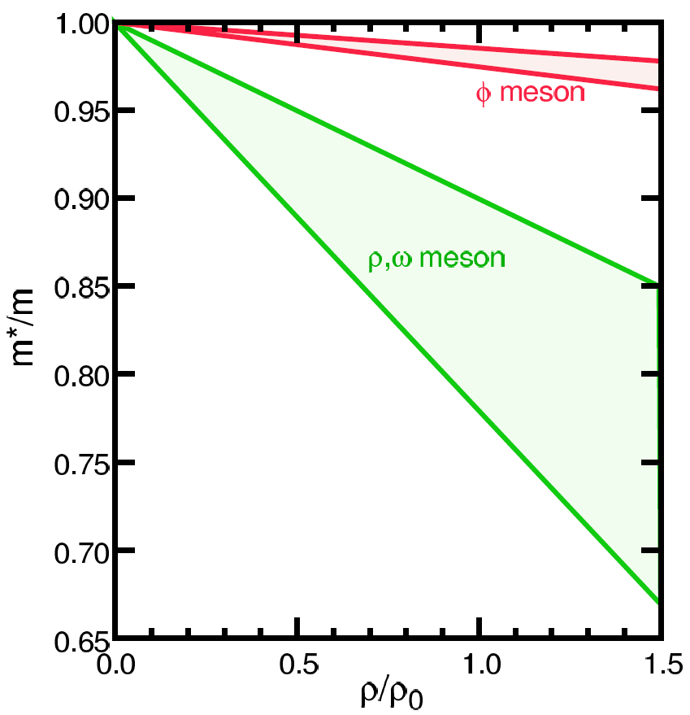
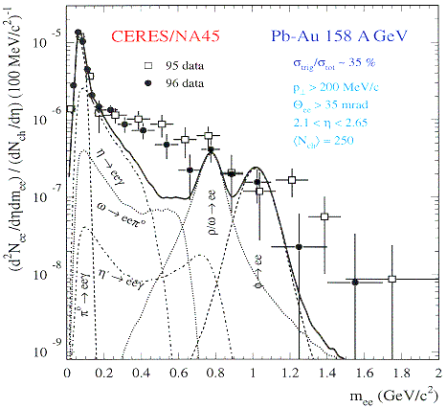
Looking into “Parallel World”
phenomena with restored symmetry
in case of chiral symmetry:
  diminishing effective (light) quark masses
  probably lower hadron masses
e.g. light vector meson mass modification
  leptonic decay channels with short life time
    e.g. φ (ss) → e⁺e⁻ (0.03 %)
T.Hatsuda, H.Shiomi and H.Kuwabara
Prog. Theor. Phys. 95 (1996) 1009

Slide 7
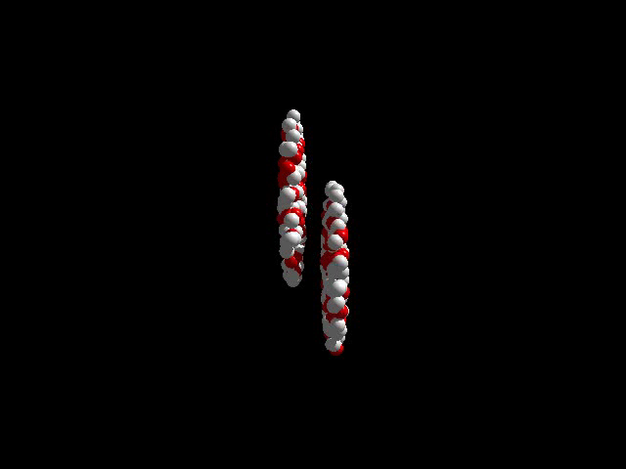
Brief History of A+A Facilities
from Bevalac/SIS/AGS/SPS to RHIC/LHC
  from high density to high energy density regime
recent major facilities
  BNL-AGS (11 A GeV ¹⁹⁷Au + fixed target)
    ²⁸Si since 1986, ¹⁹⁷Au since 1991; programs terminated
  CERN-SPS (158 A GeV ²⁰⁸Pb + fixed target)
    ³²S since 1986, ²⁰⁸Pb since 1994; programs terminated
  BNL-RHIC (100 + 100 A GeV ¹⁹⁷Au + ¹⁹⁷Au)
    since 2000; in operation
  CERN-LHC (2.8 + 2.8 A TeV ²⁰⁸Pb + ²⁰⁸Pb)
    since 2009; in operation

Slide 8

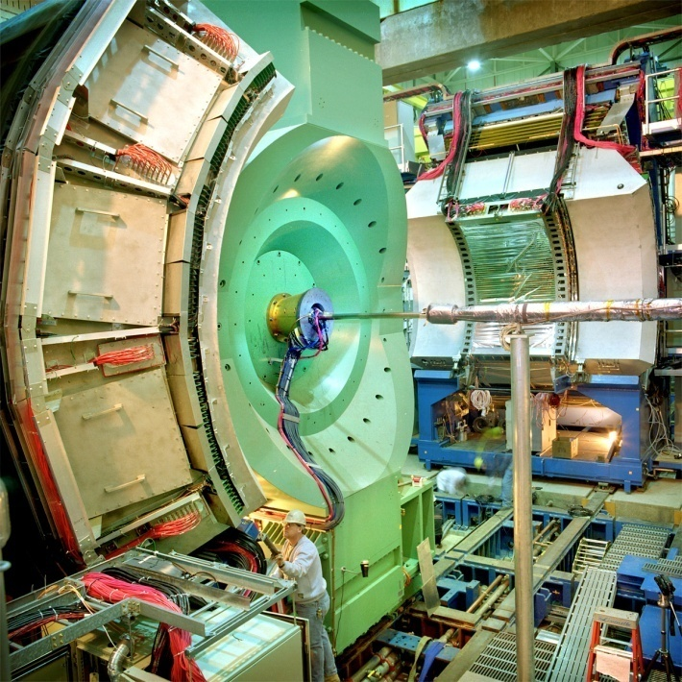




Relativistic Heavy Ion Collider at BNL
2 independent super-conducting synchrotrons
up to 100 A GeV Au and/or 250 GeV (polarized) p
  Au+Au/Cu+Cu/U+U/Cu+Au/p+Au/d+Au/³He+Au/p+p/…
4 (presently 2) complimentary experiments

Slide 9
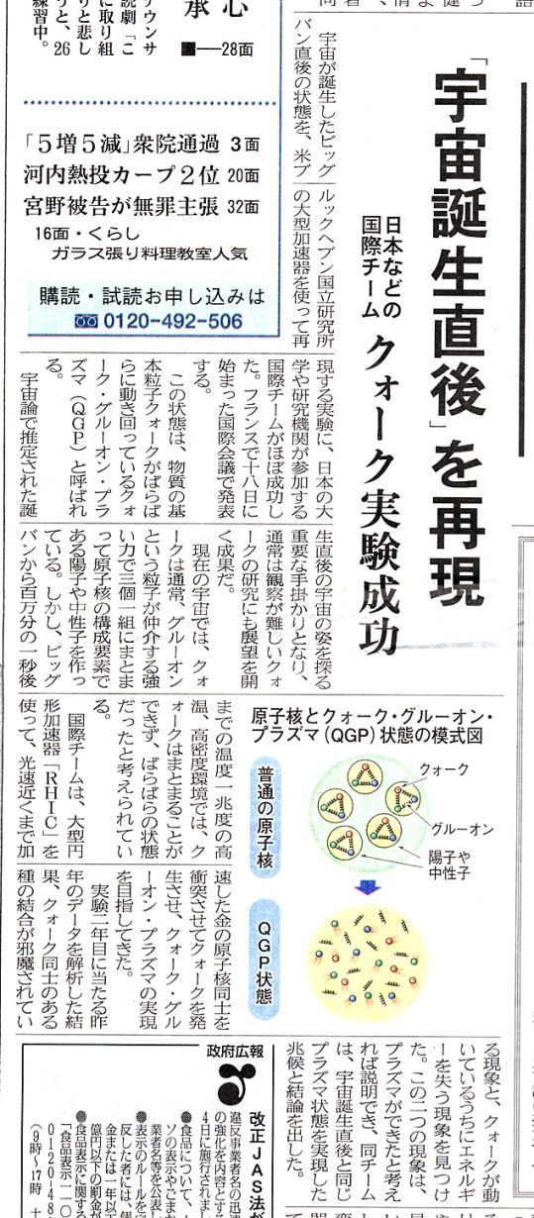
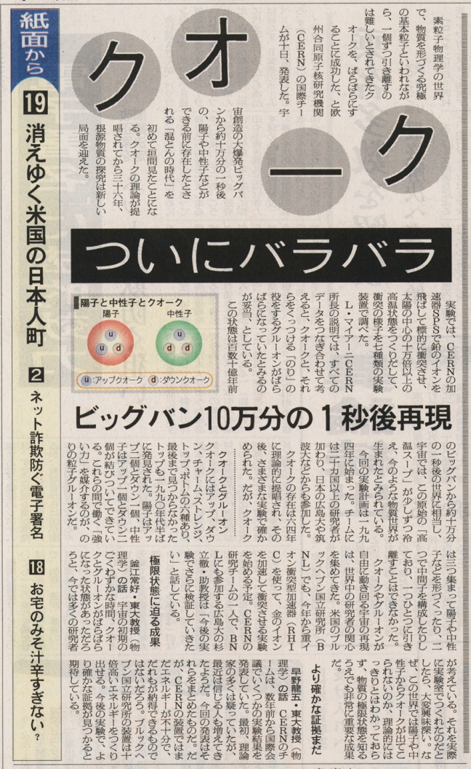
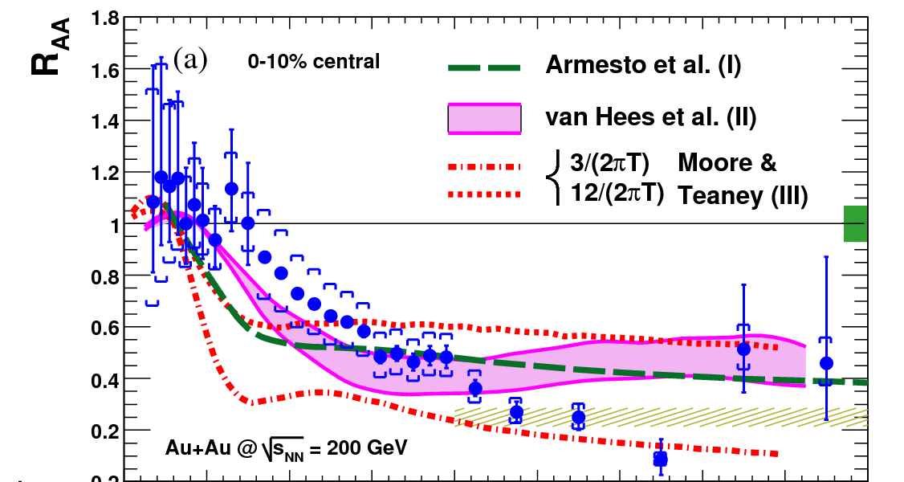
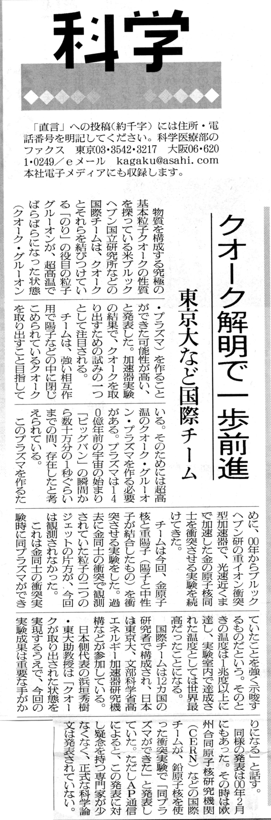
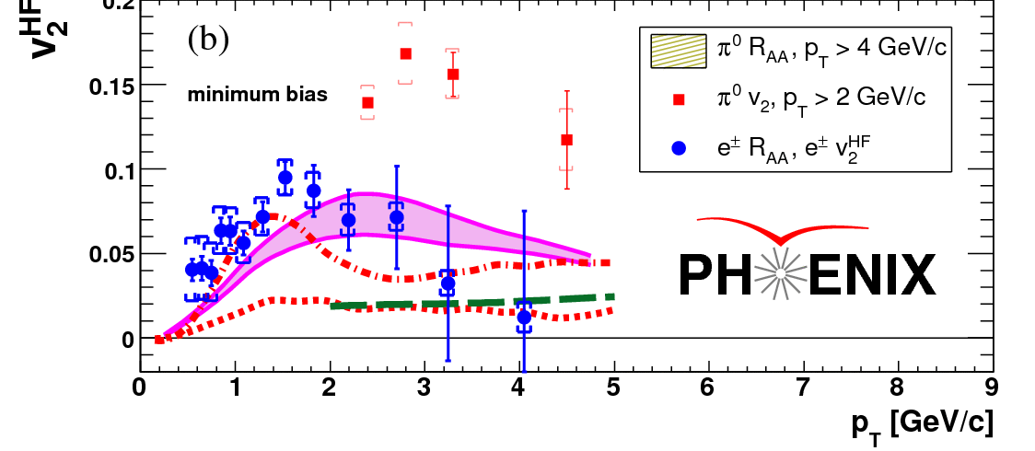
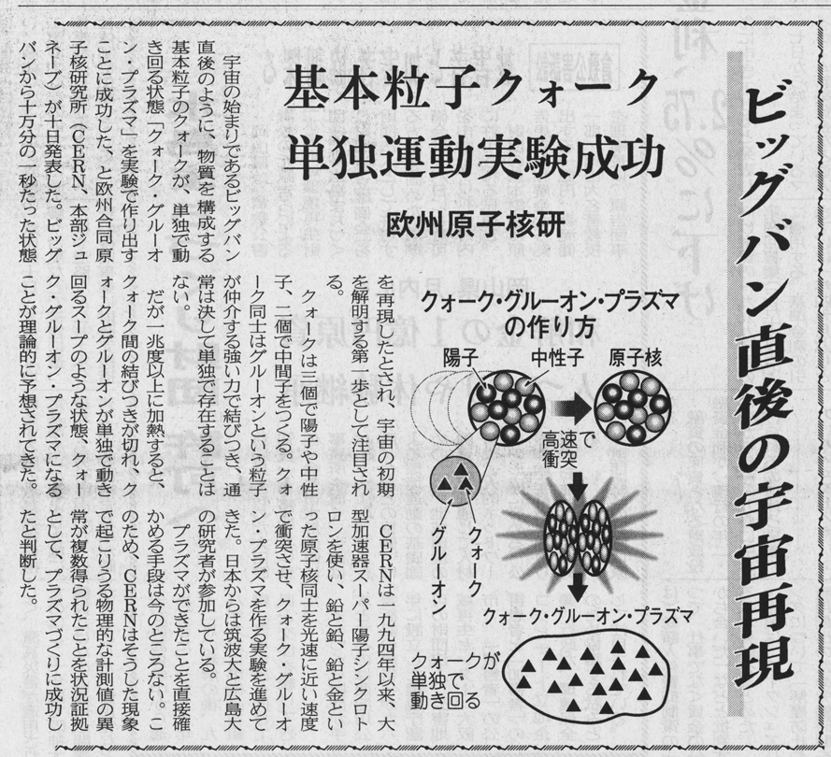
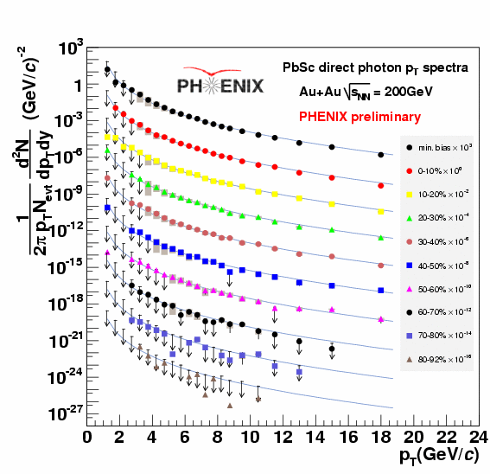
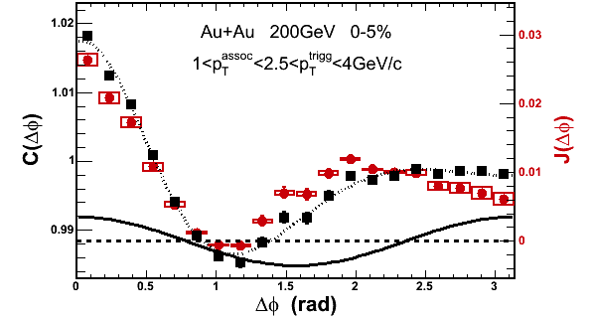
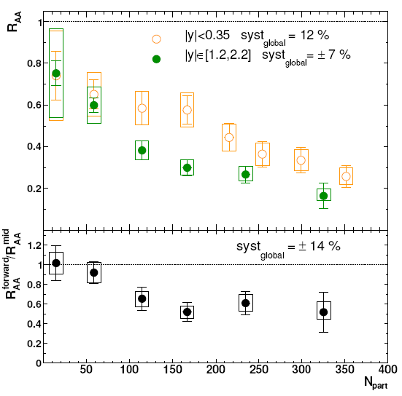
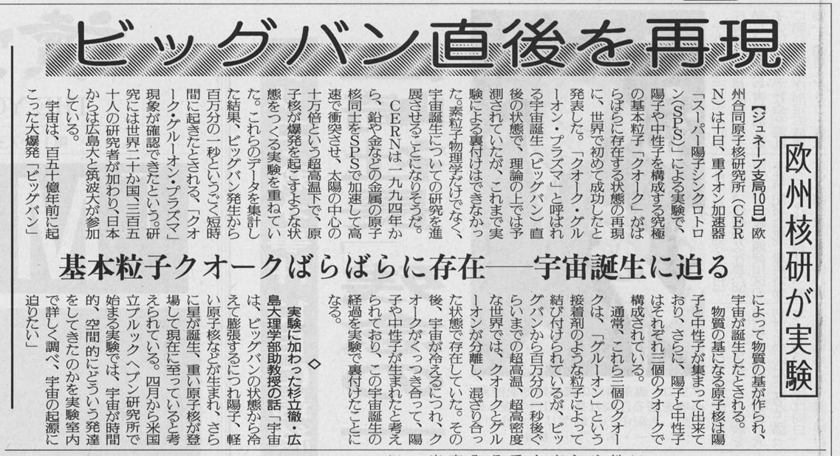
RHIC Outcomes: New State of Matter
partonic: quarks’ degrees of freedom, screening
  constituent quark number scaling of collective motion
  J/Ψ suppression
dense: energy loss of (even heavy) quarks
  jet quenching (high p_{T} suppression)
  jet modification
strongly coupled: perfect fluidity
  hydro-dynamical collective motion
hot: thermally radiative
  thermal (virtual) photons
The matter is dense
The matter is strongly coupled
The matter may melt and/or regenerate J/ψ’s
The matter modifies jets
The matter is hot

Slide 10
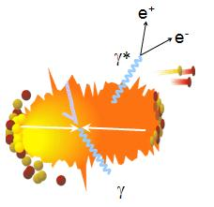
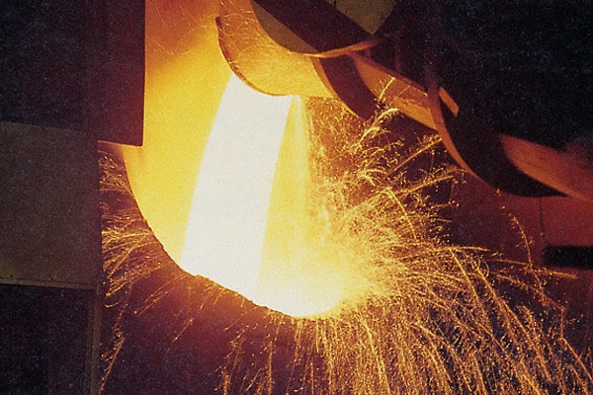
Photons as Thermometer
thermal radiation if in equilibrium
emission spectrum ↔ temperature
real and virtual thermal photons

Slide 11

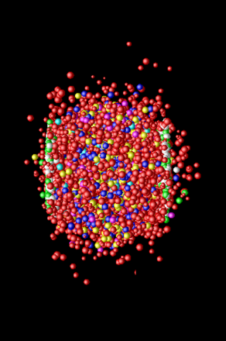
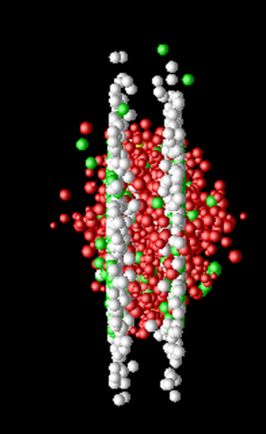
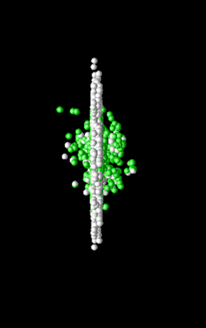
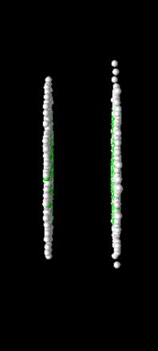
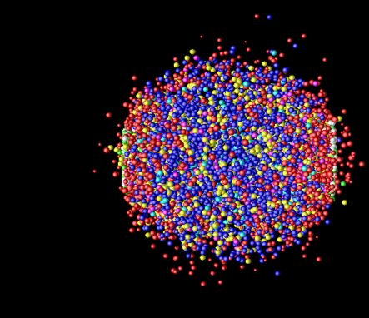
Photon Production Everywhere
Hadronization
(Freeze-out) +
Expansion
Mixed phase
Thermalization
QGP phase
Pre-equilibrium
Compton/Annihillation
Fragmentation
Prompt Photon
Jet-Photon Conversion
Jet-Bremsstrahlung (QGP)
Jet+Medium
Thermal Photon (QGP)
Thermal Photon (HG)
Thermal Photon
Time Evolution

Slide 12
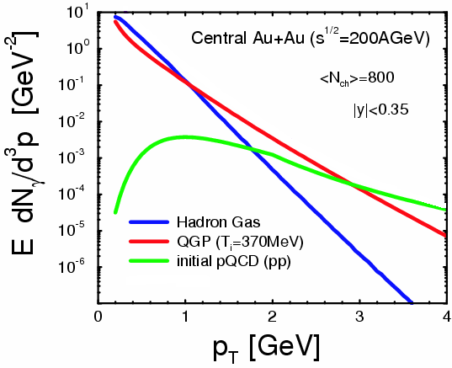
Where to Catch Thermal Photons
π
π
g
q
high p_{T} : pQCD photons
low p_{T} : photons from hadronic gas
intermediate p_{T} : QGP thermal photons dominant (!)
also other sources
plus hadron decay photons everywhere
hadron decay
photons
ρ
γ
q
γ
S.Turbide et al., PRC 69 014903

Slide 13
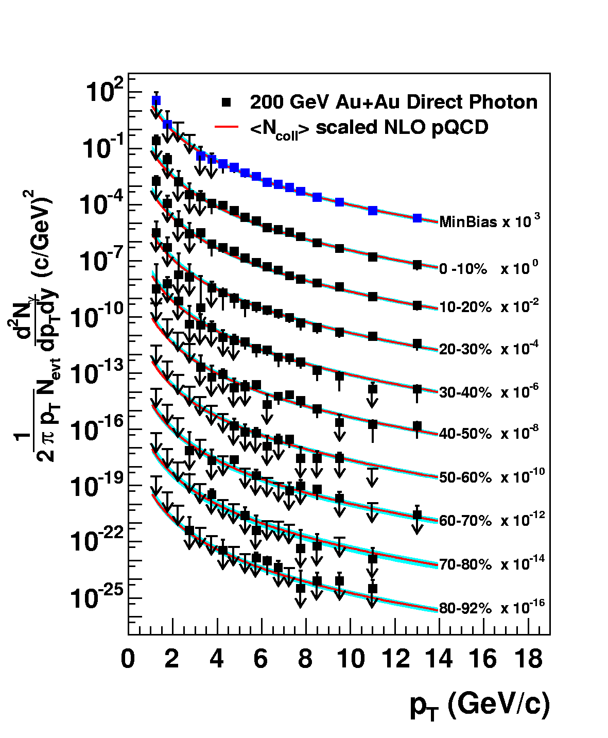
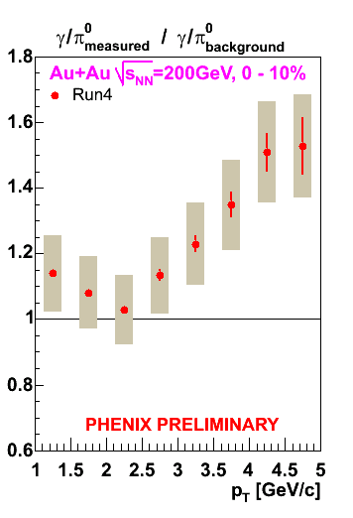
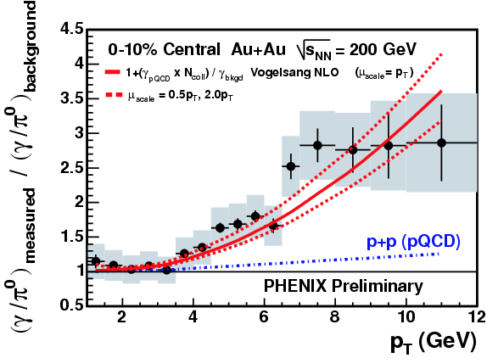
Naïve Way: Direct Real Photons
measured as “excess” above hadron decay photon
  Au+Au result consistent with pQCD×binary scaling
challenging at lower p_{T} due to smaller S/B ratio
PRL 94, 232301 (2005)

Slide 14
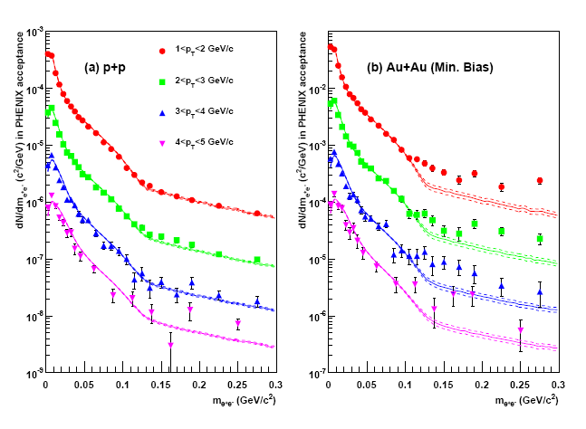
Alternative: “Almost Real” Photons
low mass electron-positron pairs
p+p: hadronic decay + pQCD photon at high p_{T}
Au+Au: enhancement above ~ 135 MeV
  no π₀ decay virtual photon above π₀ mass
PHENIX (A. Adare et al.),
PRL 104, 132301 (2010)

Slide 15
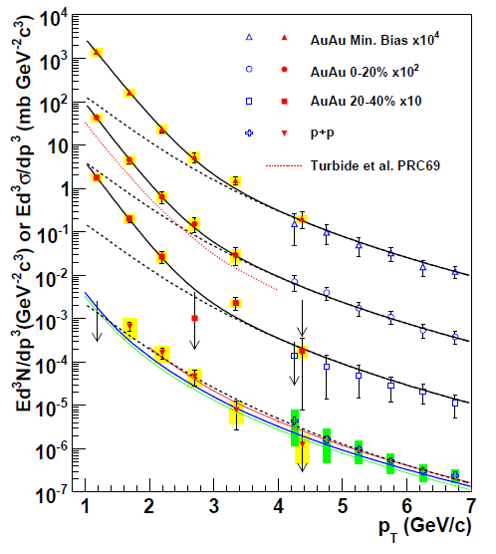
Direct Photon Spectra via γ and γ*
real and virtual photon methods consisitent
Au+Au: “thermal” excess
  ~ exponential with slope 221 ± 19 ± 19 MeV
cf. p+p data
  consistent with pQCD down to low p_{T}
PHENIX (A. Adare et al.), PRL 104, 132301 (2010)
NLO pQCD (W. Vogelsang)

Slide 16
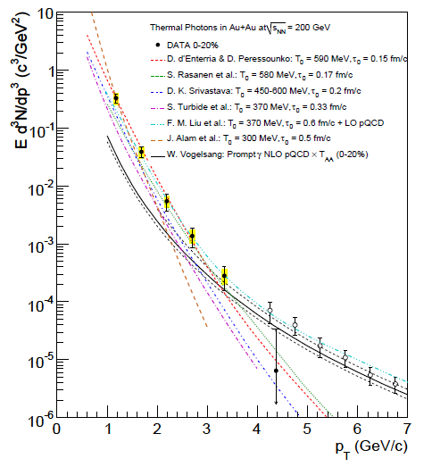
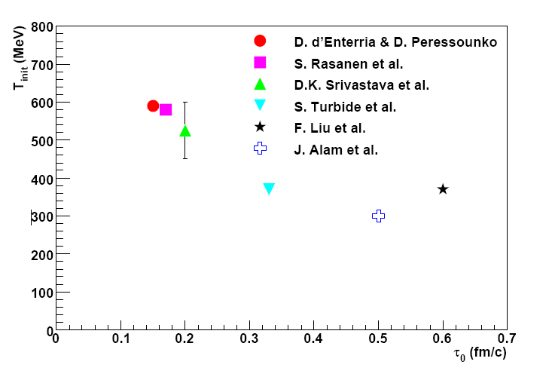

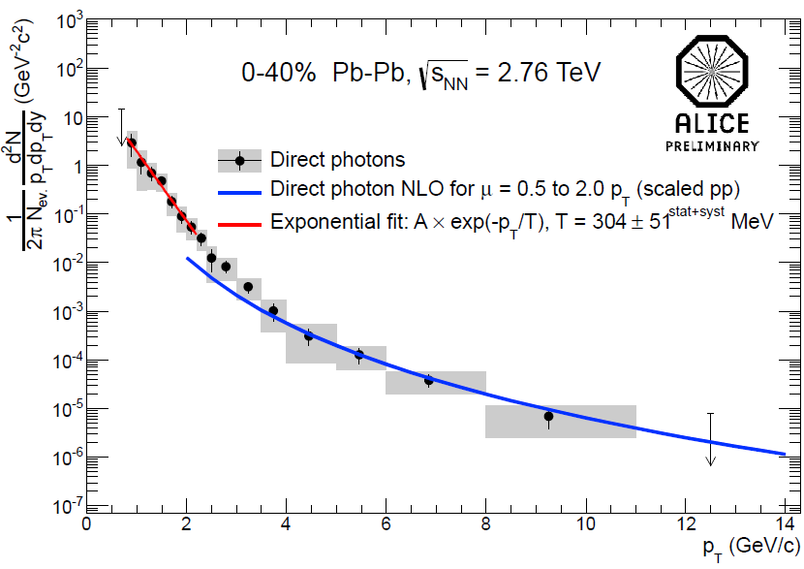
Initial Temperature Evaluation
initial temperature > data slope ~ 220 MeV
300–600 MeV (model dependence within factor 2)
  hydro-dynamic description
    w/ τ₀ = 0.15–0.6 fm/c
slope ~ 304 ± 51 MeV at LHC-ALICE
cf. phase transition predicted at ~ 170 MeV
slope
PHENIX (A. Adare et al.),
PRC 81, 034911 (2010)
transition temperature
ALICE (M. Wilde et al.),
Nucl.Phys. A904-905, 573c (2013)

Slide 17
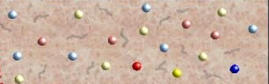
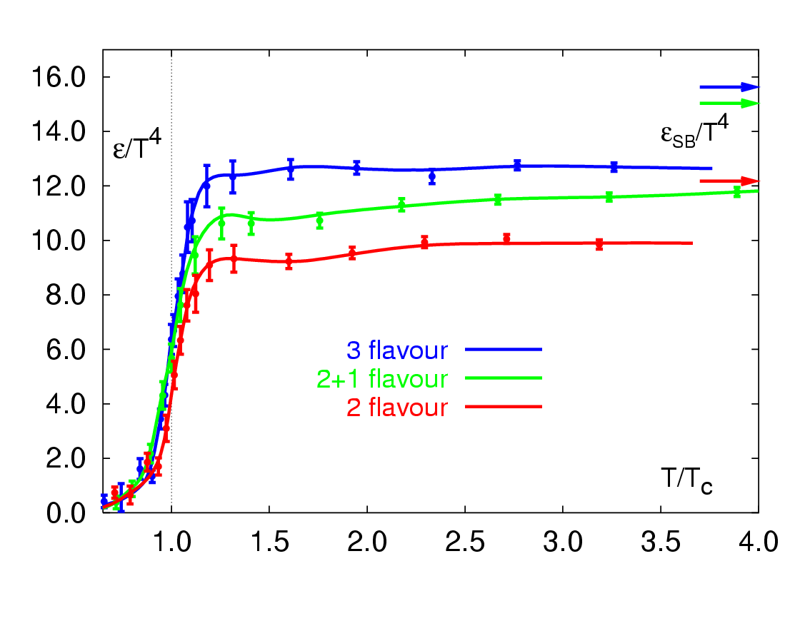
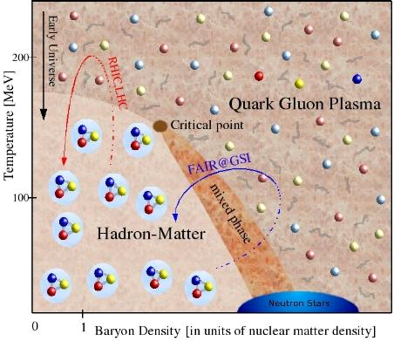
Across the Boundary and Beyond
RHIC → LHC
RHIC
“free gas” ?
“perfect fluid”
RHIC → LHC
RHIC

Slide 18
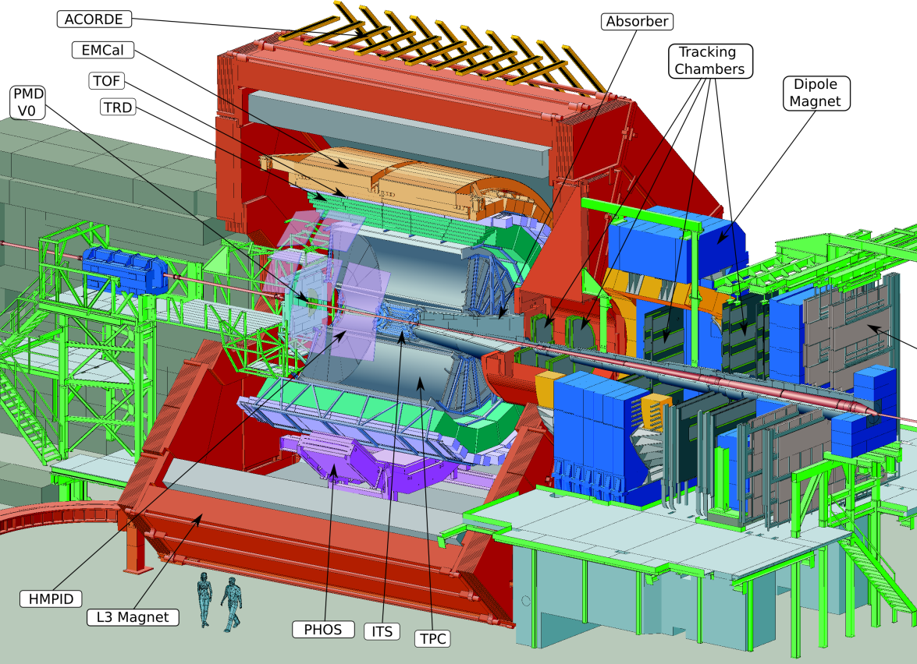
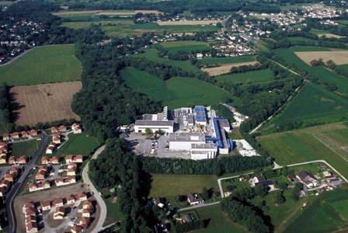

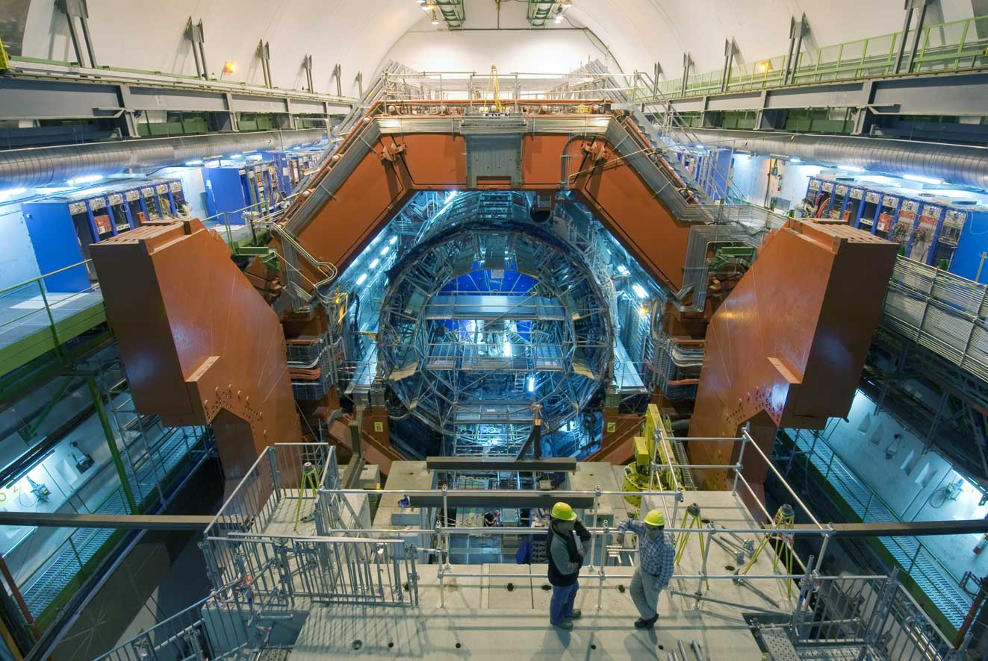
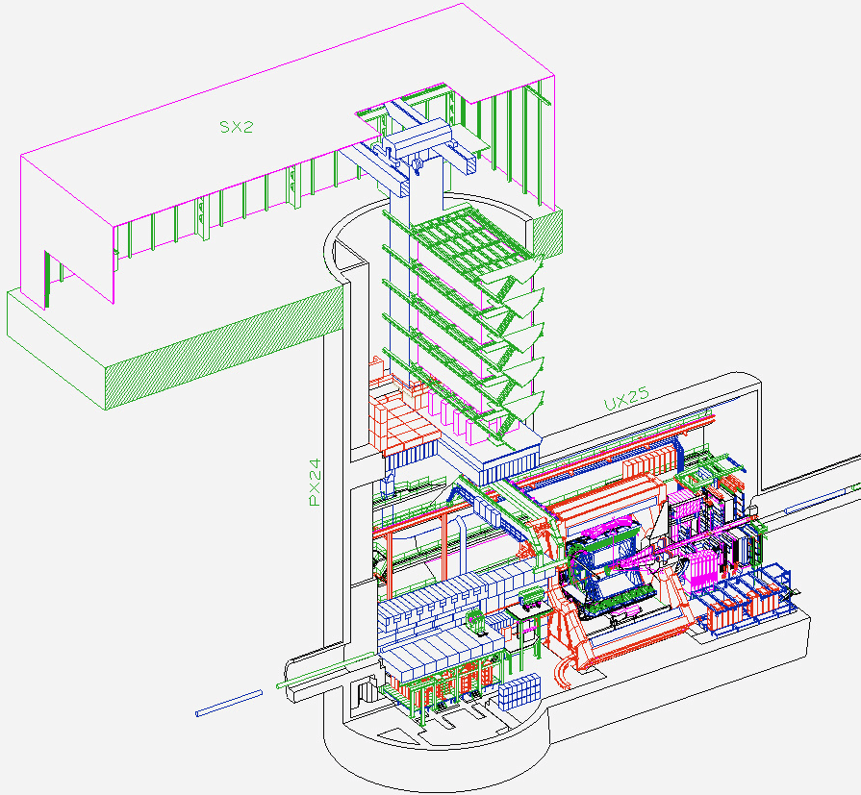
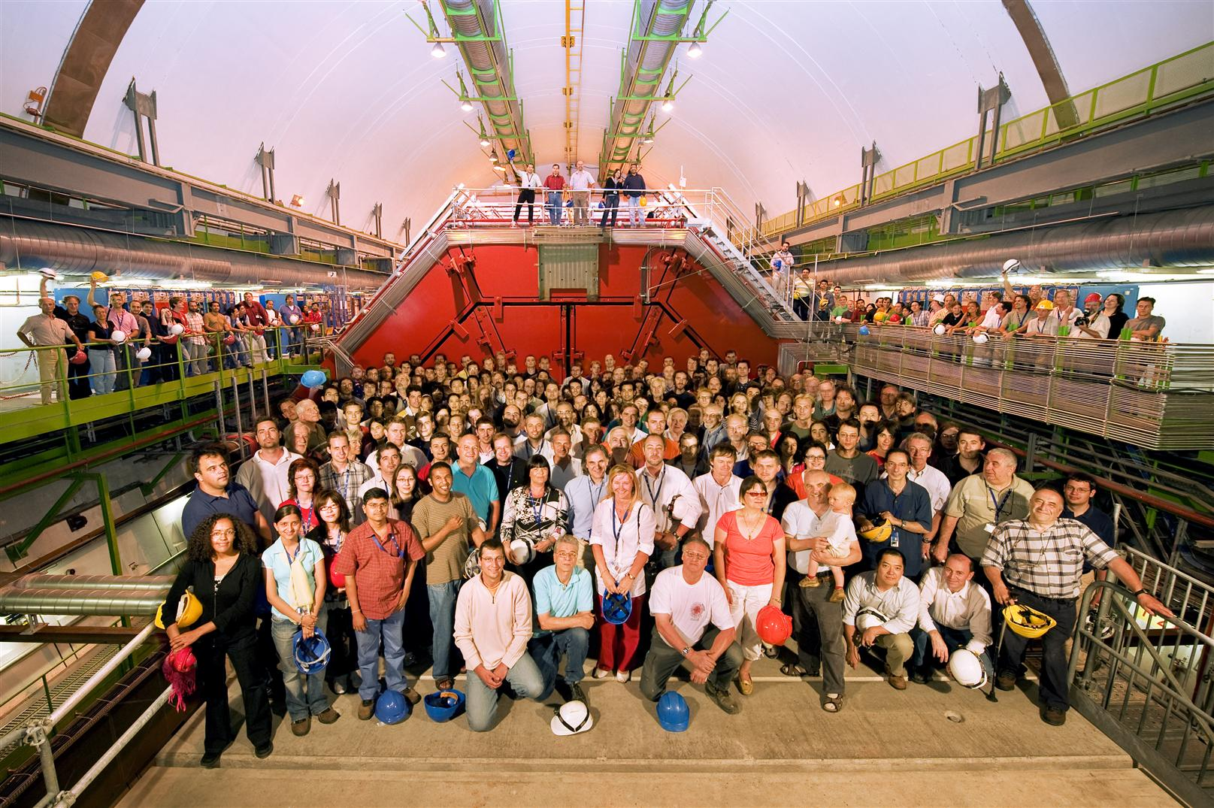
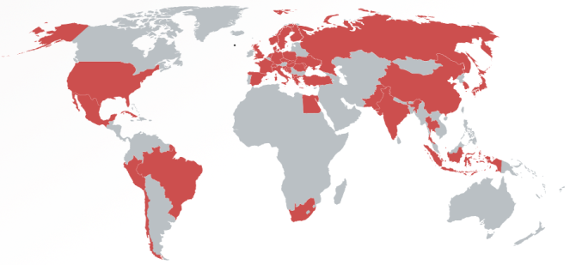
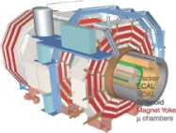
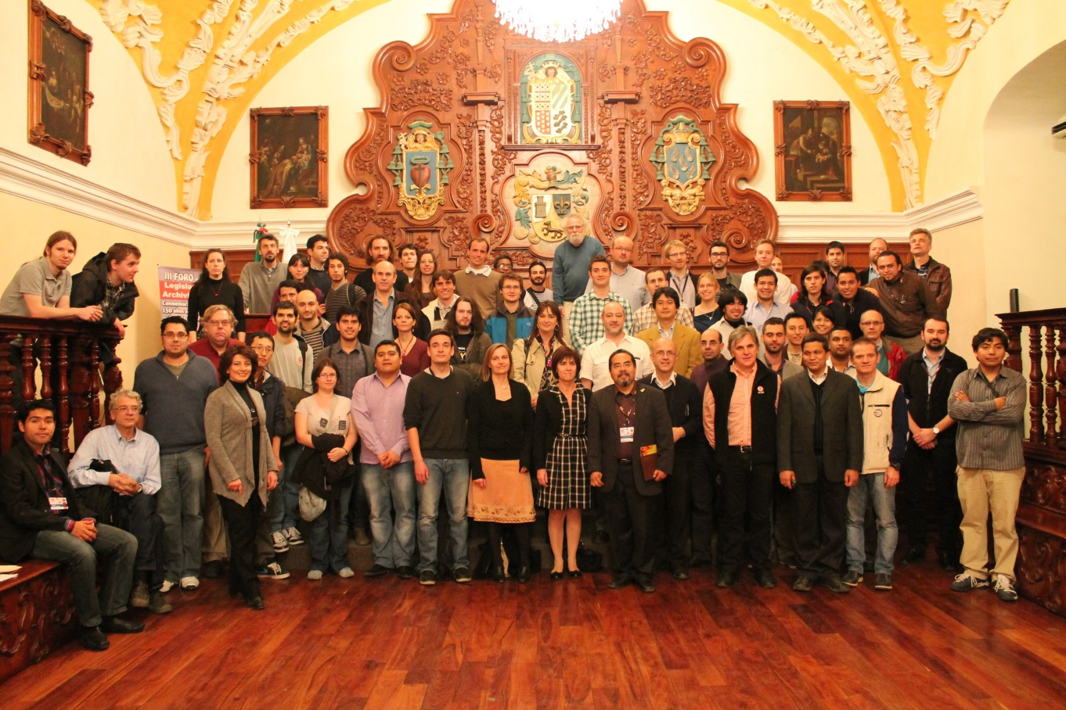
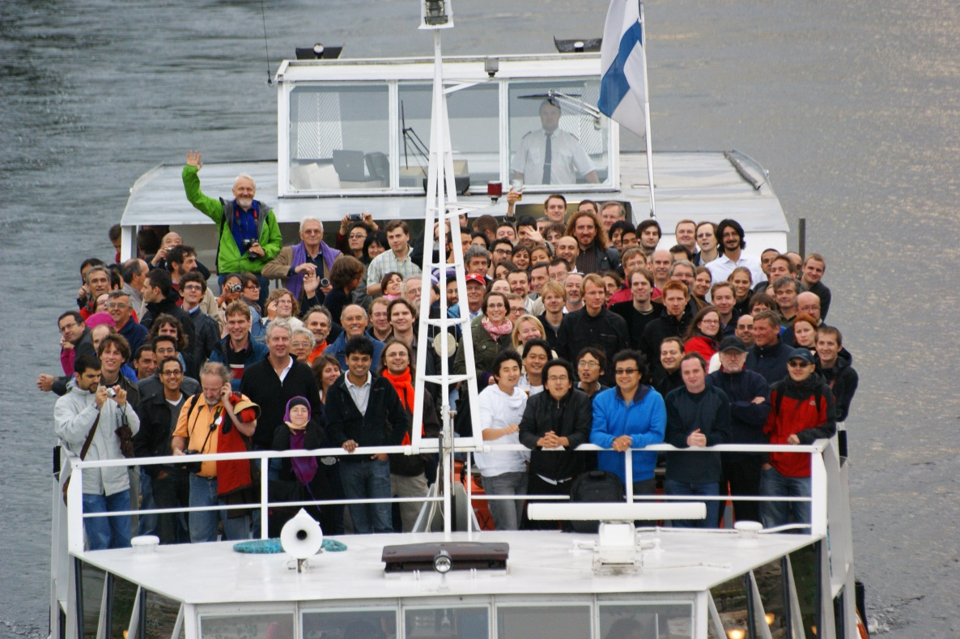


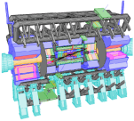


A Large Ion Collider Experiment
the nucleus-nucleus collision experiment at LHC
36 countries; 131 institutes; ~1,200 members
    as of November, 2013
CMS
LHCb
ALICE
ATLAS, LHCf

Slide 19
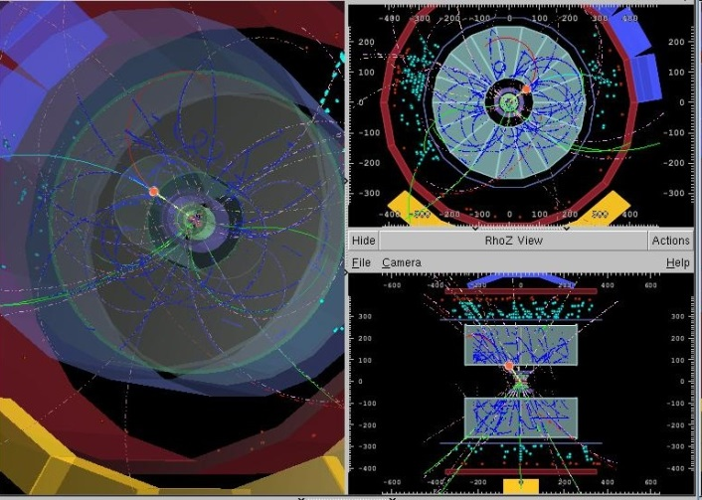
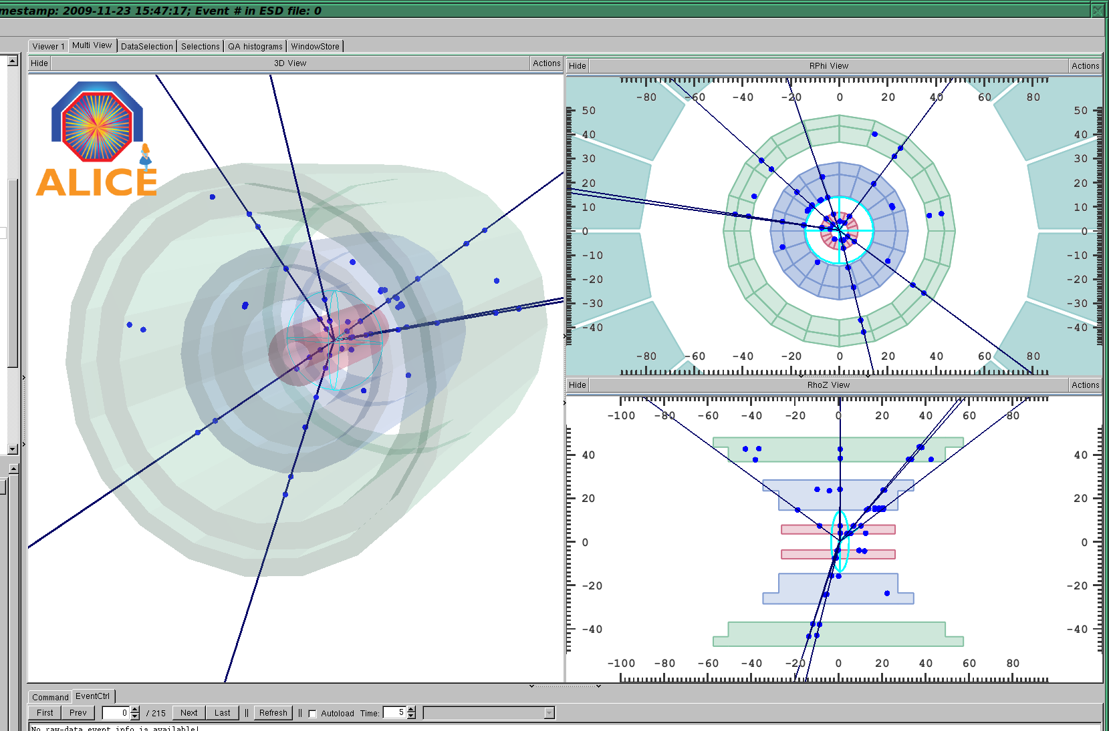
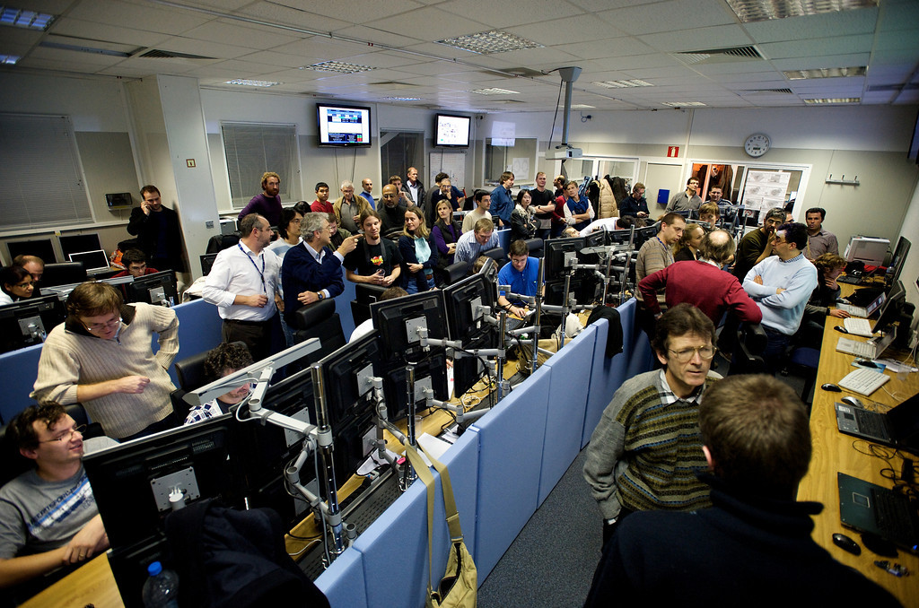
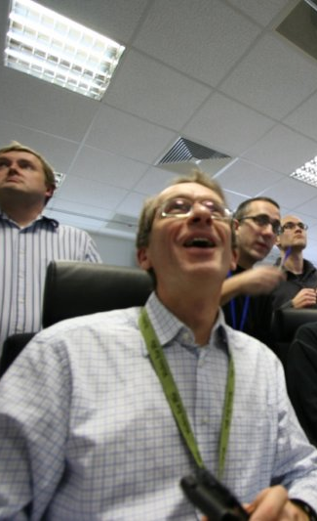
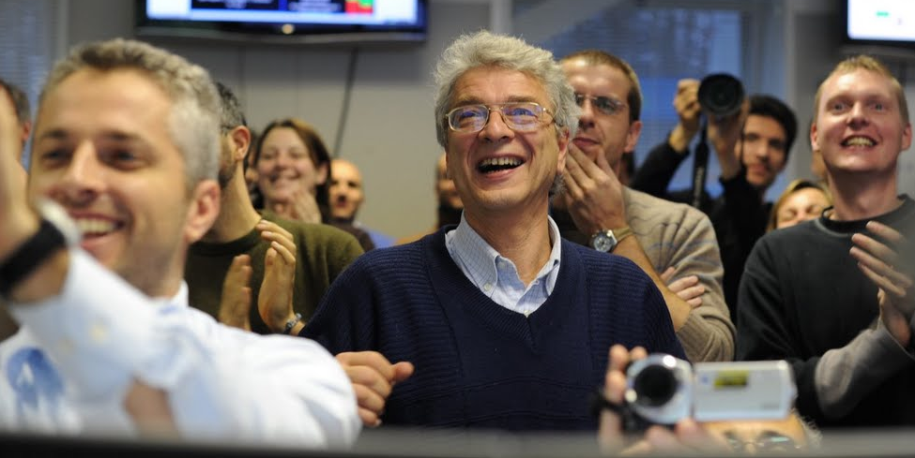
First Collisions, 23.11.2009
~ 16:35
~ 16:42
~ 16:41

Slide 20
First LHC Physics Paper, 28.11.2009
charged particle density measurement
dN_{ch}/dη in p+p at 900 GeV
  3.10 ± 0.13 ± 0.22 (inel.)
  3.51 ± 0.15 ± 0.25 (NSD)
ALICE Collaboration
Eur.Phys.J.C65:111-125, 2010
National Geographic News (04.12.2009)
‘….a machine called ALICE....
found that a (!) proton-proton collision
recorded on November 23
created the precise ratio
of matter and antimatter particles
predicted from theory..’

Slide 21
Almost Zero Baryo-Chemical Potential
anti-proton/proton ratio in mid-rapidity region
  0.957 ± 0.006 (stat) ± 0.014 (sys) at 900 GeV
  0.990 ± 0.006 (stat) ± 0.014 (sys) at 7 TeV
ALICE (K. Aamodt et al.),
PRL 105, 072002 (2010)

Slide 22

Highest Energy (So Far) Pb+Pb
2.76 TeV Pb+Pb in 2010 and 2011
  14 times higher √s_{NN} than at RHIC
~ 5.1 TeV in 2015; design energy at 5.5 TeV

Slide 23



Abundant Particle Production
dN_{ch}/dη = 1,580 ± 80 (sys) in 2.76 TeV Pb+Pb
  high side of predictions
  faster growth with √s_{(NN)} than in p+p
    i.e. √s_{NN} dependent nuclear amplification
ALICE (K. Aamodt et al.),
PRL 106, 032301 (2011)
back at RHIC

Slide 24

Highest Initial Energy Density
~ 2.5×transverse energy density than at RHIC
from Bjorken formula:
ετ₀ ~ 16 GeV/fm²c ~ 3×at RHIC
  lower limit for ε ; likely higher with shorter time scale

Slide 25




Hotter, Larger, Longer-Lived Fireball
Bose Einstein (aka HBT) particle interferometry
  space-time evolution of co-moving volume
    lifetime also accessible via Fourier transformation (E, p) → (τ, x)
  particle multiplicity dependences consistent with models
~ 2×larger, 20–30% longer-lived than at RHIC
  ~ 300 fm³, ~ 10 fm/c
p+p 7 TeV
Enhancement
radius ~ 1/width
ALICE (K. Aamodt et al.),
PLB 696, 328 (2011)
Pb+Pb 2.76 TeV
Pair Momentum Difference

Slide 26
Prominent Probes at Higher Energies
high transverse momentum phenomena, e.g. jets
heavy flavors (charm and beauty)
demonstrated very powerful at ALICE/ATLAS/CMS

Slide 27





Jet Modification at LHC
asymmetric di-jets and even mono-jets (!)
lost jet energy distributed very widely
  ΔR > 0.8 ~ π/4
  enhancement at low p_{T}
high p_{T} hadron
ATLAS
hadrons (jet)
quenched jet
quark
ΔR>0.8
(anti-)quark
CMS
hadrons (jet)
high p_{T} hadron

Slide 28




Jet Energy Loss and Redistribution
narrow cone → high z_{T} suppression
  no corresponding enhancement at low z_{T}
wide cone → low z_{T} enhancement
PHENIX
yield in Au+Au
yield in p+p
I_{AA} =
ξ = ln(1/z_{T})
z_{T} = p_{T}^{hadron}/p_{T}^{photon}
high z_{T}
low z_{T}
|Δφ-π| < π/6 |Δφ-π| < π/3 |Δφ-π| < π/2

Slide 29


Survived Jets Un-Modified?
shape after energy loss consistent with in vacuum
  energy ratio in different cone radii σ(R=0.2)/σ(R=0.3)
  both for peripheral and central collisions
no sign of jet broadening?
good agreement with a model with energy loss

Slide 30
PID’ed Singles for Flavor Differential
RHIC and LHC heavy flavor results consistent
  charm+beauty mesons’ semi-leptonic decay electrons
next step: charm/beauty separation
  key: vertex detectors
PHENIX, ALICE

Slide 31
Possible Mass Hierarchy
charm and beauty mesons with compatible <p_{T}>
  open charm (average of D⁰, D⁺, D^{∗+}), ALICE
  non-prompt J/Ψ (← B), CMS
indication of weaker suppression of beauty

Slide 32


p(d)+A: Reference or Unexpected
originally as reference to bridge p+p and A+A
  initial state nuclear effects
  final state cold nuclear matter effects
Au+Au at √s_{NN} = 200 GeV
d+Au at √s_{NN} = 200 GeV

Slide 33


RHIC First Year (2000) Outcome
binary collision scaling
based on extrapolated
UA1 p+p data
--
Au+Au at √s_{NN} = 130 GeV
PHENIX PRL 88, 022301 (2002)
high p_{T} yield suppressed due to quark energy loss

Slide 34

Another PRL Cover with d+Au
“lack of suppression”
  indicating final state fireball effect in Au+Au
PHENIX
BRAHMS
PHOBOS
STAR
PRL 91 (August, 2003)

Slide 35
Something More Complicated (?)
original thought: cold nuclear matter, i.e.
  not partonic
  not dense
  not strongly coupled
  not hot
indications of strongly coupled partonic matter??

Slide 36




New Discovery in p+p and p+A
“ridge” in p+p and “double ridge” in p+Pb
  long range angular correlations in near and away sides
explained by collective flow from initial fluctuation
  strongly coupled matter already in p+p and p+A?
− =
high multiplicity p+Pb low multiplicity p+Pb long range correlation

Slide 37

Hydro-like Behaviors in p+Pb
harder particle spectra at higher multiplicity
increasing effect with particle mass
better described by models
with hydrodymanics
    Blast-Wave: PRC 48,2462 (1993)
    EPOS LHC: arXiv:1306.0121 [hep-ph]
    Krakow: PRC 85,014911 (2012)
    DPMJET: arXiv:hep-ph/0012252

Slide 38



Quark Fluid in p+Pb?
baryon enhancement in intermediate p_{T}
  understood via quark recombination in A+A
similar evolution with multiplicity

Slide 39
p(d)+A Seemingly in Mystery
long range longitudinal correlations
hydro-dynamical behaviors?
quark recombination??
→ reanalysis of d+Au at RHIC giving similar results
→ first p+Au at RHIC in 2015
stay tuned for p(d)+A (if not for this whole field)

Slide 40

Brand New Topic: Ultra-Intense Field
intense U(1) magnetic field
  naturally expected with moving charged sources (nuclei)
  ~ 10¹⁵ T at LHC, ~ 10¹⁴ T at RHIC
    cf. magnetar surface ~ 10¹¹ T
  could be long-lived in “perfect fluid”
possible non-linear QED behaviors
  above electron critical magnetic field em_{e}² = 4×10⁹ T
other interesting physics also under discussion
  chiral magnetic effects
  quark synchrotron radiation
  …
Magnetic Field

Slide 41
Note: Critical Magnetic Field
electron critical electric/magnetic field
  energy at Compton radius scale ≈ rest mass
  eE_{c}h/m_{e}c = m_{e}c² ; E_{c} = m_{e}²c³/eh ~ 10¹⁷ V/m
  eB_{c}h/m_{e}c = m_{e}c ; B_{c} = m_{e}²c²/eh ~ 10⁹ T
if electric: Schwinger mechanism
  e⁺e⁻ pair creation
  (probably) meaningless to consider E > E_{c} situation
if magnetic: non-linear QED effects
  e.g. γ → γ γ, γ → e⁺e⁻, birefringence, …

Slide 42




Field Intensity and Time Evolution
common approach: cascade models
  spectator contribution dominant
    10¹⁴ – 10¹⁵ T at LHC
    short life time < 1 fm/c due to Lorentz contraction
    though still above em_{e}² after several fm/c
possible longer-lived field in “perfect fluid”
  participant contribution
  “static field” approximation
    10¹³ – 10¹⁴ T at LHC
Pb+Pb 5.5 TeV
Pb+Pb 2.76 TeV
Au+Au 200 GeV
baryon stopping power in account
10¹⁴ T
JAM; Au+Au 200 GeV
(A.Tsuji)
10¹³ T
URQMD; Au+Au 200 GeV

Slide 43

Experimental Probes of Intense Field
must originate from initial stages
  field life time ~ 0.1 fm/c
must be electro-magnetic
ideal probe: direct γ/γ∗ from pQCD processes
good reference: γ/γ∗ from later stages
  e.g. π⁰ decay γ/γ∗ (Dalitz di-electron)
0 fm/c
~ 4 fm/c
~ 10 fm/c
B > B_{c}
electro-magnetic probes
hadronic probes

Slide 44


γ∗ (Low Mass e⁺e⁻) “Polarization”
anisotropic decay w.r.t. magnetic field
feasibility study based on QED calculations
  vacuum polarization tensors under magnetic field
    summation for infinite Landau levels
    photon momentum up to ~ GeV
    ref. K.-I. Ishikawa, K. Shigaki et al.,
    Int. J. Mod. Phys. A28, 1350100 (2013)
anisotropy ~ o(10⁻¹)
e⁻
γ*
γ*
?
e⁺

Slide 45

Work in Progress
mass regions (not) expecting polarization
  e.g. low mass dominated by π⁰ Dalitz decay
analysis ongoing, e.g. background understanding
high statistics high p_{T} data awaited
Pb-Pb √s_{NN} = 2.76 TeV
ALICE work in progress 22/03/2013
EP resolution not corrected
0 < M_{ee} < 30 MeV/c²
120 < M_{ee} < 300 MeV/c²
300 < M_{ee} < 500 MeV/c²

Slide 46
Heavy/Hard Probes at QCD Machine
~ 10×charming and ~ 100×beautiful than at RHIC
  powerful probes with known mass and color charge
    charm/beauty σ_{NN} (mb) shadowing multiplicity
    p+p 14 TeV 11.2/0.5 1.0/1.0 0.16/0.007
    central Pb+Pb 6.6/0.2 0.65/0.85 115/4.6
jets also even more powerful than at RHIC

Slide 47

Closed Heavy Flavors in Pb+Pb
J/Ψ suppression as a signature of deconfinement
  observed at RHIC and SPS
interpretation ambiguous
  sequential melting?
    → further suppression at LHC
  melting and regeneration competing?
    → enhancement at LHC
ϒ another key to resolve mechanism

Slide 48





ϒ Sequentially Melting?
ϒ(2S) more suppressed than ϒ(1S)
  Υ(3S) even more suppressed
no signature of sequential melting
(feed down uncorrected)
CMS, PRL 109, 222301 (2012)

Slide 49
Forward ϒ’s at ALICE
forward ϒ at ALICE ∼ mid-rapidity ϒ at CMS
  for both central and semi-peripheral collisions
ALICE forward upgrade: Muon Forward Tracker

Slide 50


Physics in LHC Forward Regions
two interesting regimes of quark-gluon droplets
  exploration on QCD phase diagram
virtues at LHC
  not too forward for physics
  forward enough for muon measurements

Slide 51


ALICE Muon Spectrometer
2.5 (9.5∘) < η < 4.0 (2∘)

Slide 52
Muon Forward Tracker (2021)
glasses of muon spectrometer
IP
Absorber
Dipole

Slide 53
Physics Cases
open heavy flavor
  D (charm) → single μ, down to p_{T} = 1 GeV/c
  B (beauty) → J/ψ, down to p_{T} = 0 GeV/c
quarkonia
  J/ψ, ψ(2S), ϒ(1S/2S/3S)
  prompt/secondary separation
low mass di-muon
  chiral symmetry restoration
    ρ, ω, φ → μ⁺μ⁻ mass line shapes
  direct radiation from QGP
    prompt μ⁺μ⁻ continuum

Slide 54

Low Mass Physics Enhancement
significant improvement on LVM with MFT
  mass resolution by ~4
  S/B ratio by ~10

Slide 55






Hiroshima Now on MFT
to lead low mass physics
expertise in laser soldering bonding
  between Si sensor chip and flexible printed circuit
  first hybrid integrated circuit assembly test satisfactory
in charge of detector control system
laser soldering machine
laser soldering process
Satoshi Yano (Hiroshima)

Slide 56
ALICE（-J） Upgrade Strategies
1st – high p_{T} phenomena (jet), heavy flavors
  ✓ × 2–3 high speeding, new detectors; LS1 2013–2014
    upgrade: TPC readout (Tokyo), PHOS readout (Hiroshima)
    new: di-jet calorimeter (Tsukuba)
2nd – low/mid p_{T} phenomena
  × 100 high speeding, new detectors; LS2 2019–2020
    upgrade: TPC chamber (Tokyo), vertex trackers
    new: muon forward tracker (Hiroshima)
3rd – (further) forward physics
  new detectors; LS2 2019–2020 or later
    new: forward calorimeter (Tsukuba)

Slide 57
Summary and Concluding Remarks
unique to look into “parallel world”
  early universe phase transition experimentally reverted
    min. 300 MeV reached; beyond boundary ~ 170 MeV
deconfined quarks/gluons finally on präparat
  steadily revealing partonic phase properties
  chiral symmetry restoration yet to be attacked
ever emerging new (and brand new) topics
  e.g. mysteries in p(d)+A, ultra-intense U(1) magnetic field
next generation also in preparation/discussion
  ALICE upgrade (incl. MFT), “super” PHENIX, J-PARC/HI

