Slide 1

Physics of Quark Matter and Research Activities in Japan
Kenta Shigaki （志垣 賢太）
(Hiroshima University )
19 December, 2017
Taiwan National Central University

Slide 2
Presentation Outline
unique features of quark matter physics
  to look into “parallel world” across phase boundary
discovery of quark matter (at BNL RHIC)
  achieved temperature and regime on phase diagram
advanced studies (at CERN LHC)
  properties of fireball and behavior of deconfined quarks
  new topic(s)
    mysteries in p(d)+A and p+p collisions
    ultra-intense U(1) magnetic field
  near future prospects
summary and concluding remarks

Slide 3
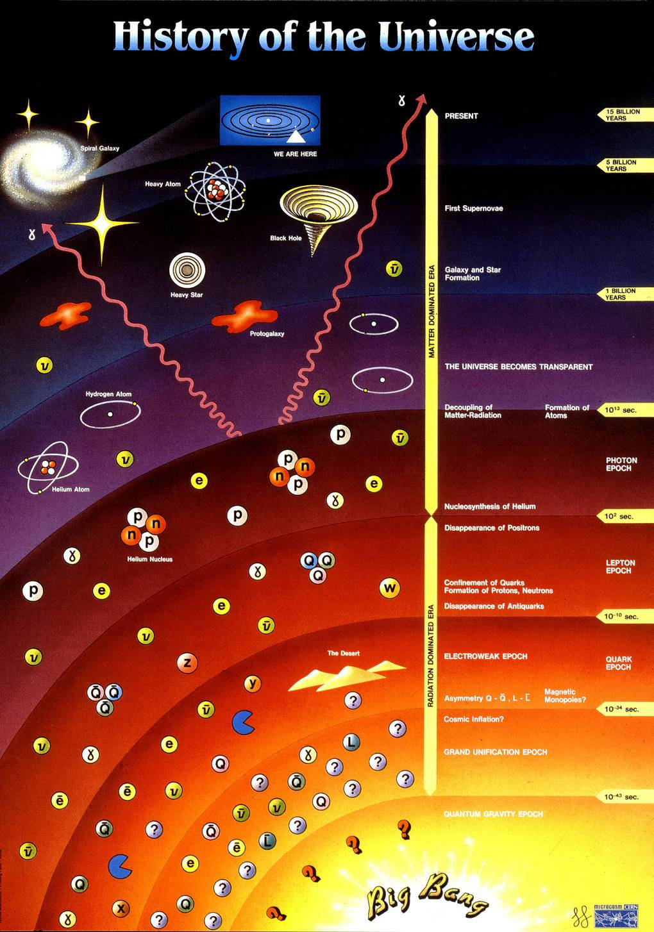
History of Universe and Matter
14 by
this colloquium
1 by
star/galaxy formation
10¹² s
atom formation
10² s
nuclei synthesis
10⁻⁶ s
quark confinement
anti-quark annihilation
quark pair production
0.00 s
Big Bang

Slide 4
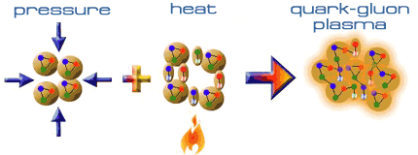
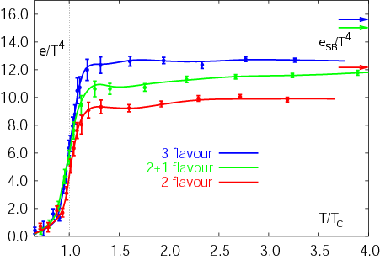
Expeditions on QCD Phase Diagram
toward (or back to) deconfined partonic phase
lattice Quantum Chromo-Dynamics predictions
  critical temperature ~ 170 MeV
  critical energy density ~ 1 GeV/fm³
Early Universe
Deconfined Partonic Phase
(Quark-Gluon Plasma)
Tri-Critical point
Energy Density (Temperature)
Critical Temperature ~ 170 MeV
High Energy A+A Collisions
Hadron gas
Color Super-Conductivity?
Color-Flavor Locking?
F. Karsch,
Lect. Notes Phys. 583 (2002) 209
Nucleus
Neutron Star
Baryon Density

Slide 5
Uniqueness of QCD Phase Transition
only possible boundary to experimentally cross
  to prove (or disprove) paradigm of universe evolution
  lost phase within experimental reach
    not just to catch residue
K. Homma, 2008/09

Slide 6
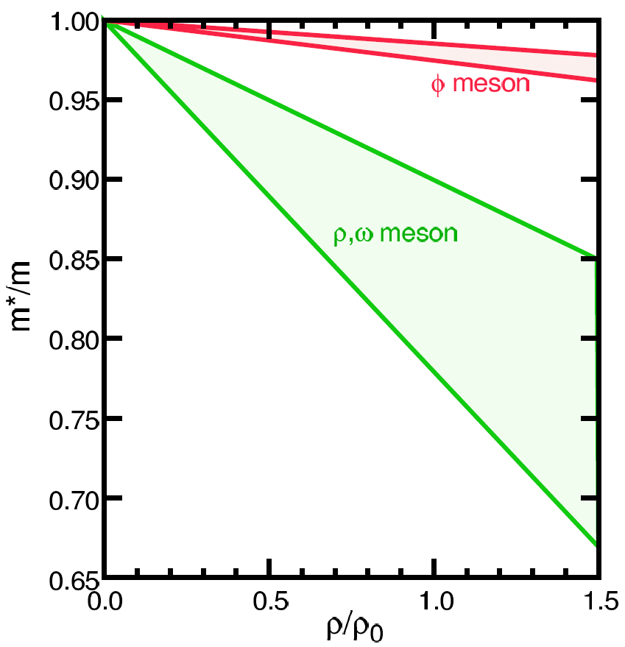
Looking into “Parallel World”
phenomena with restored symmetry
QCD phase transition with chiral symmetry →
  diminishing effective (light) quark masses
  probably lower hadron masses
e.g. light vector meson mass modification
T.Hatsuda, H.Shiomi and H.Kuwabara
Prog. Theor. Phys. 95 (1996) 1009

Slide 7
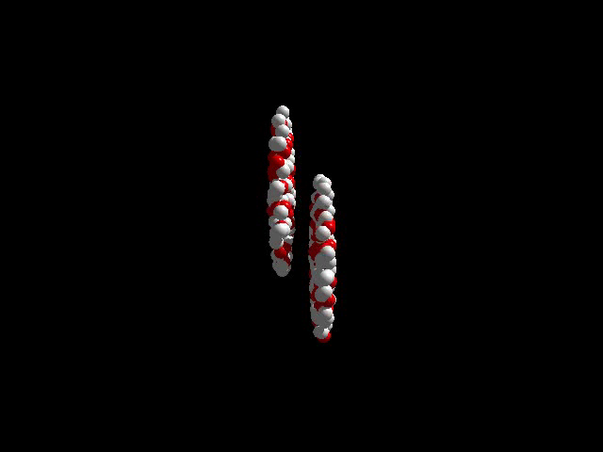
History of Quark Matter Search
1970’s–80’s: first trials
  LBL–BEVALAC （2 A GeV ⁴⁰Ar）
  BNL–AGS （15 A GeV ²⁸Si）
  CERN–SPS （200 A GeV ³²S）
1990’s: onsets of discovery
  BNL–AGS （11 A GeV ¹⁹⁷Au）
  CERN–SPS （158 A GeV ²⁰⁸Pb）
2000’s: deconfined partonic phase!
    thanks to nuclear colliders
  BNL–RHIC （100 + 100 A GeV ¹⁹⁷Au + ¹⁹⁷Au）
  CERN–LHC （2.8 + 2.8 A TeV ²⁰⁸Pb + ²⁰⁸Pb）

Slide 8

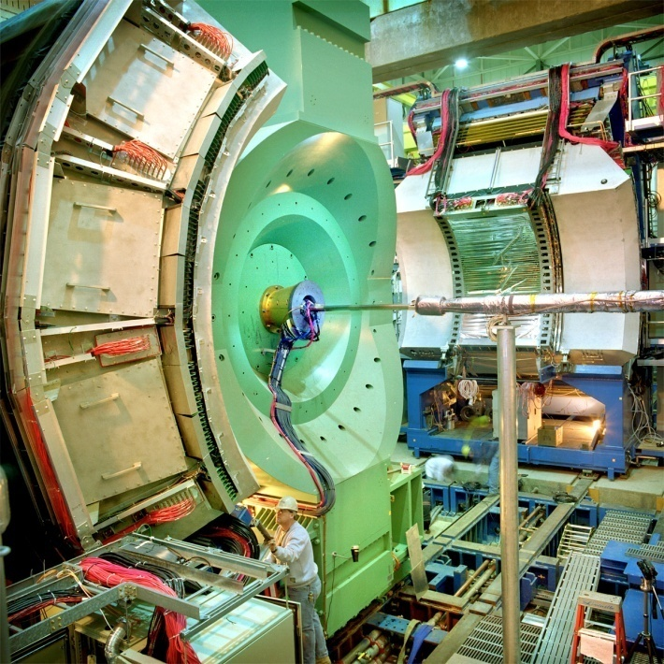




Relativistic Heavy Ion Collider at BNL
2 independent super-conducting synchrotrons
up to 100 A GeV Au and/or 250 GeV (polarized) p
  Au+Au/U+U/Cu+Cu/p+p/p+Au/d+Au/³He+Au/Cu+Au…
4 (presently 1.5) complimentary experiments

Slide 9
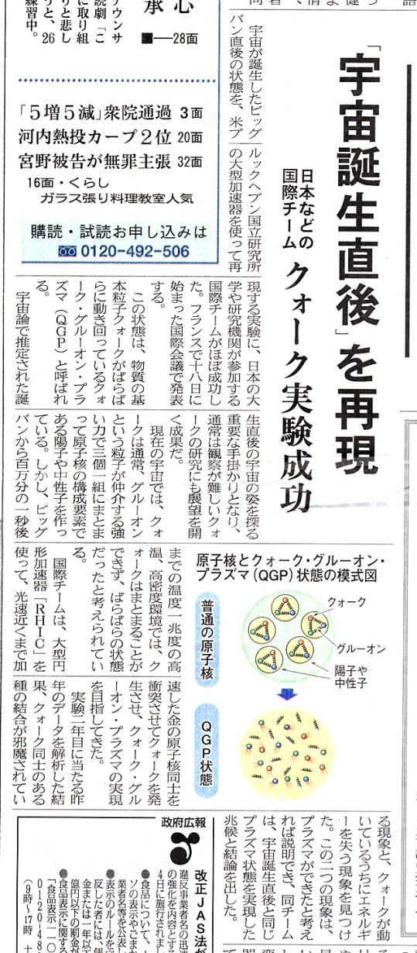
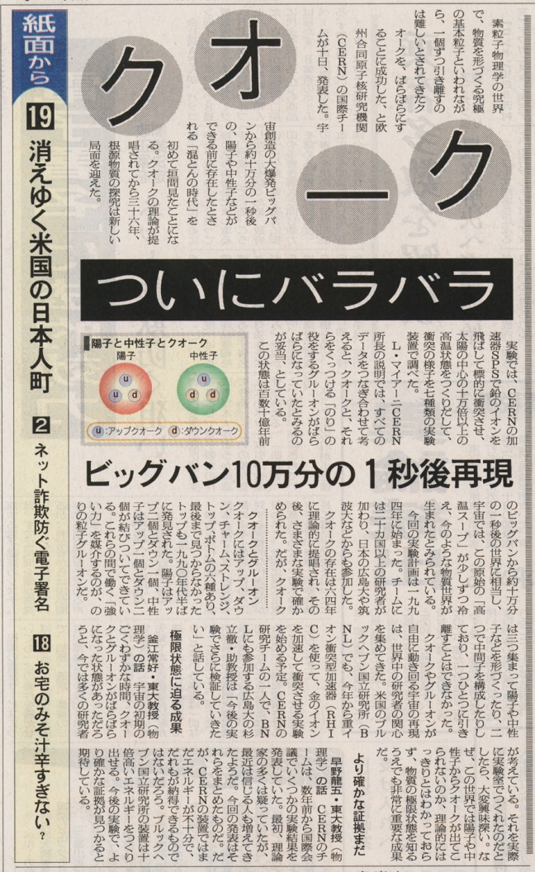
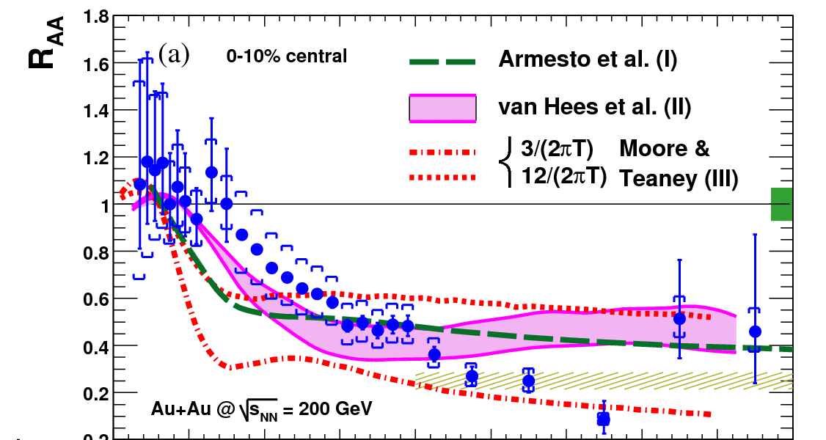
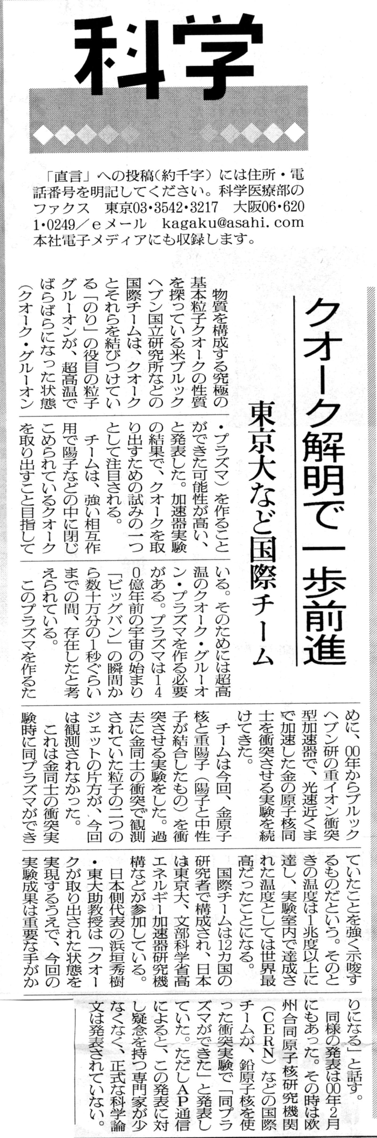
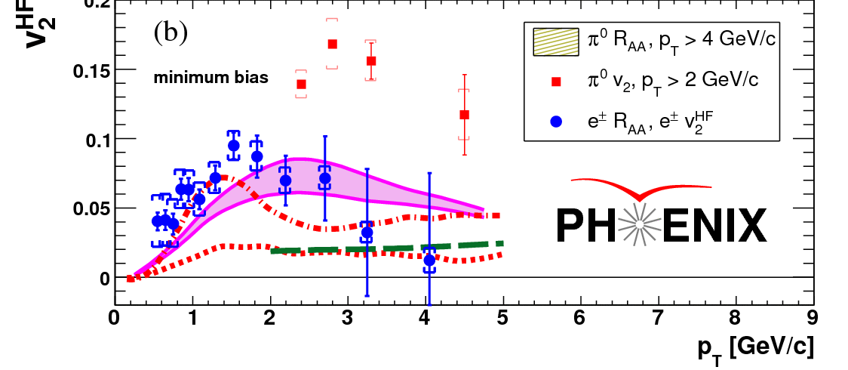
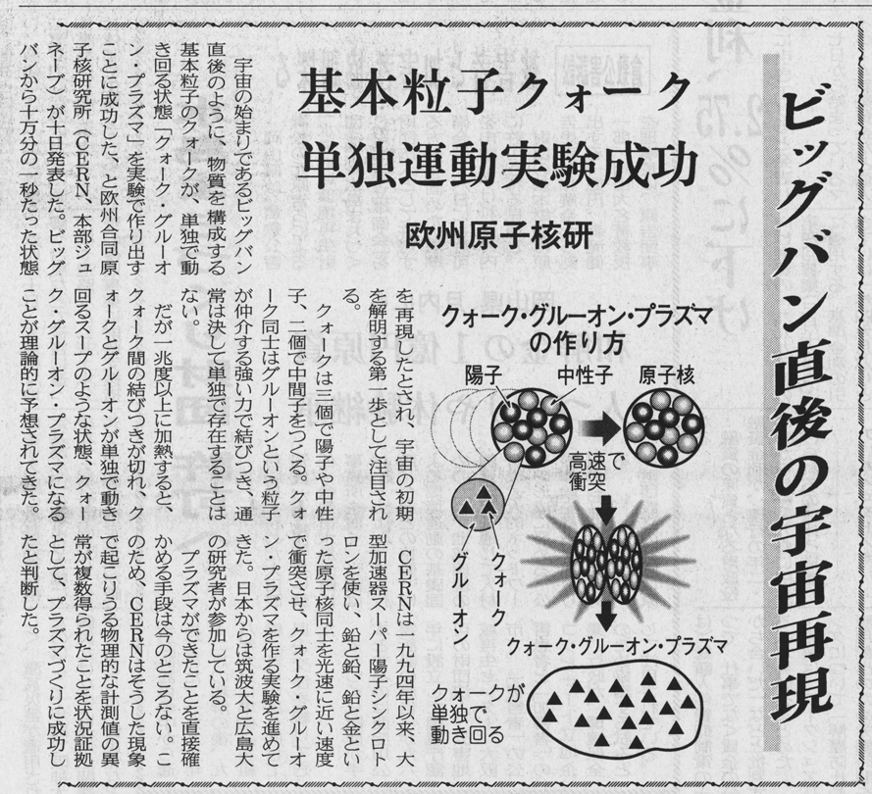
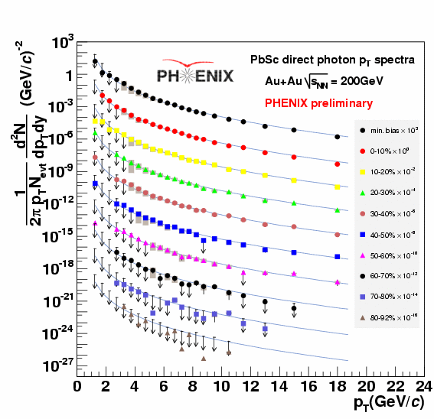
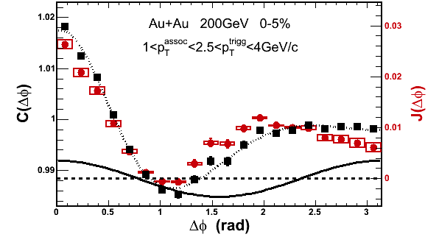
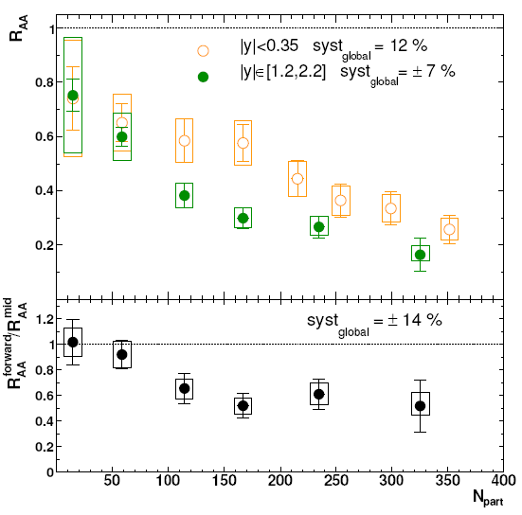
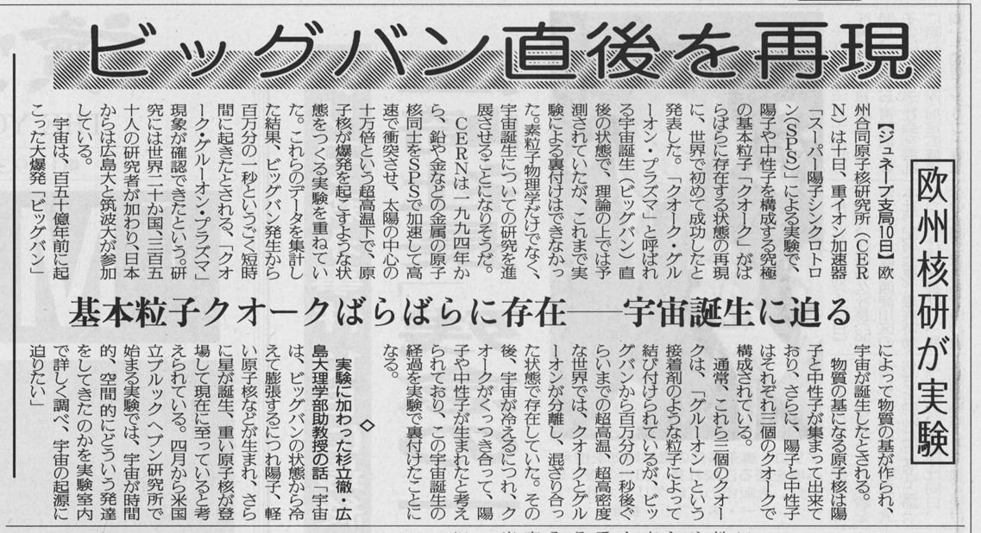
RHIC Outcomes: New State of Matter
partonic: quarks’ degrees of freedom, screening
  constituent quark number scaling of collective motion
  J/Ψ suppression
dense: energy loss of (even heavy) quarks
  jet quenching (high p_{T} suppression)
  jet modification
strongly coupled: perfect fluidity
  hydro-dynamical collective motion
hot: thermally radiative
  thermal (virtual) photons
The matter is dense
The matter is strongly coupled
The matter may melt and/or regenerate J/ψ’s
The matter modifies jets
The matter is hot

Slide 10
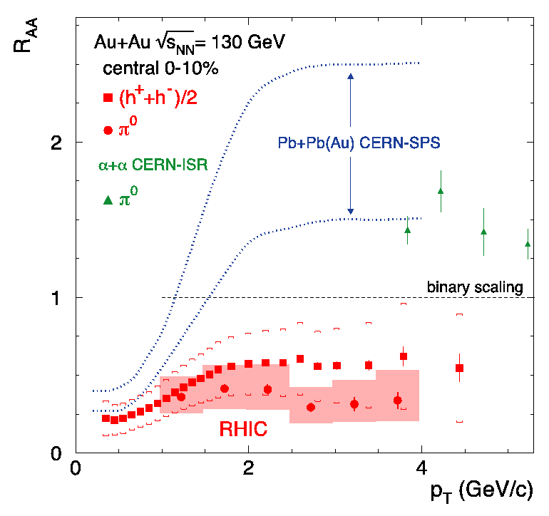
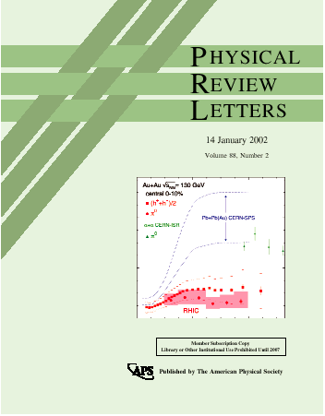
First Evidence of Extremity
binary collision scaling
based on extrapolated
UA1 p+p data
--
Au+Au at √s_{NN} = 130 GeV
PHENIX PRL 88, 022301 (2002)
less high p_{T} particles produced due to “quenching”

Slide 11
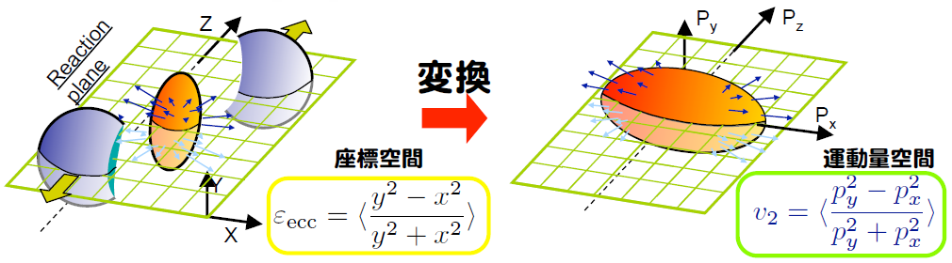
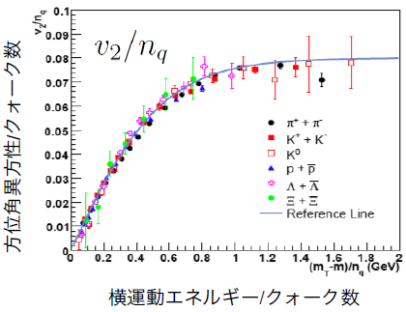
Strongly Coupled Quark Matter
(unexpectedly) large azimuthal anisotropy
  pressure gradient converted to momentum space
  fast thermalization
  strong coupling
constituent quark scaling
  2 for mesons; 3 for baryons
  quark degree of freedom

Slide 12
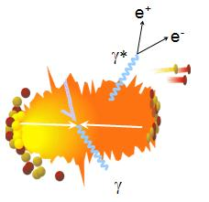
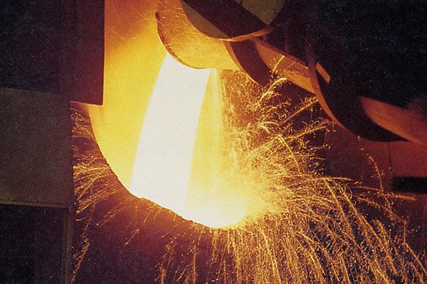
Photons as Wide Scale Thermometer
thermal radiation if in equilibrium
emission spectrum ↔ temperature
real and virtual thermal photons

Slide 13

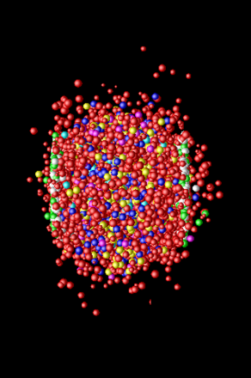
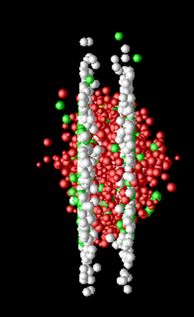
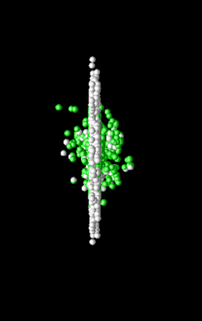
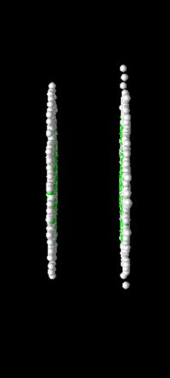
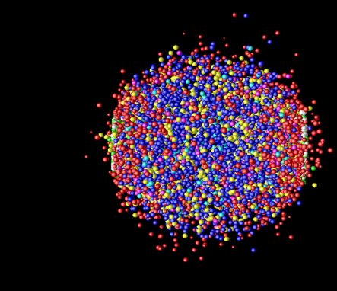
Photon Production Everywhere
Hadronization
(Freeze-out) +
Expansion
Mixed phase
Thermalization
QGP phase
Pre-equilibrium
Compton/Annihillation
Fragmentation
Prompt Photon
Jet-Photon Conversion
Jet-Bremsstrahlung (QGP)
Jet+Medium
Thermal Photon (QGP)
Thermal Photon (HG)
Thermal Photon
Time Evolution

Slide 14
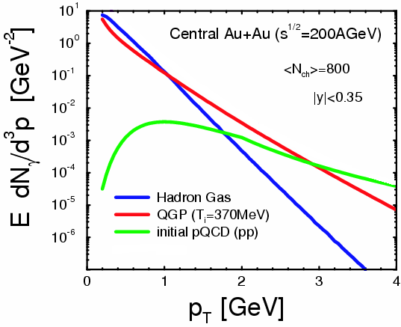
Where to Catch QGP Thermal Photons
π
π
g
q
high p_{T} : pQCD photons
low p_{T} : photons from hadronic gas
intermediate p_{T} : QGP thermal photons dominant (!)
also other sources
plus hadron decay photons everywhere
hadron decay
photons
ρ
γ
q
γ
S.Turbide et al., PRC 69 014903

Slide 15
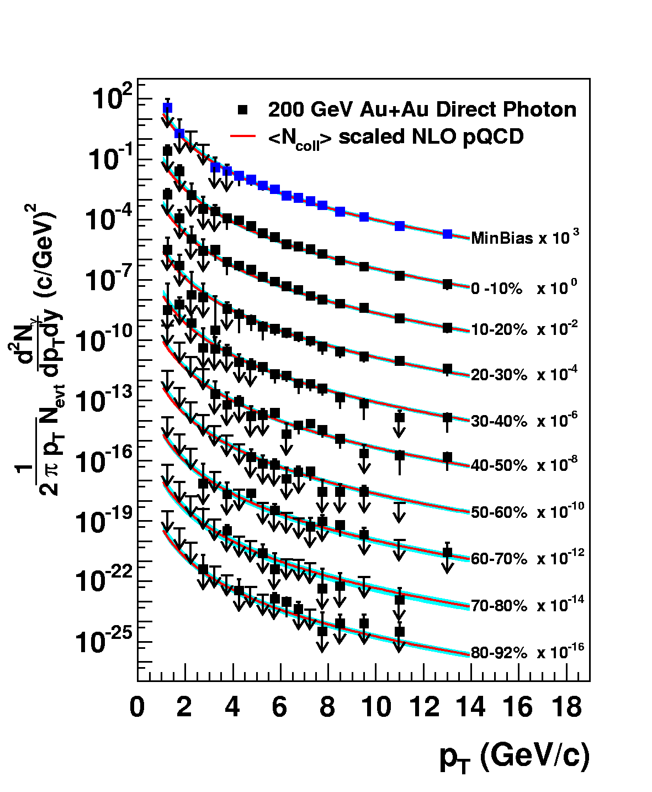
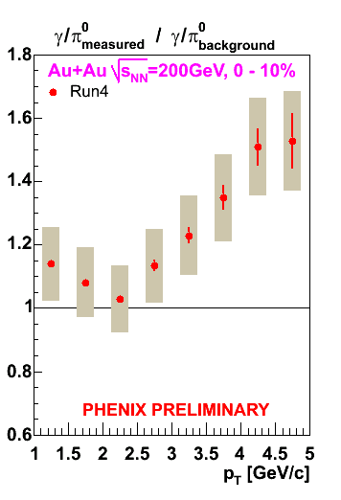
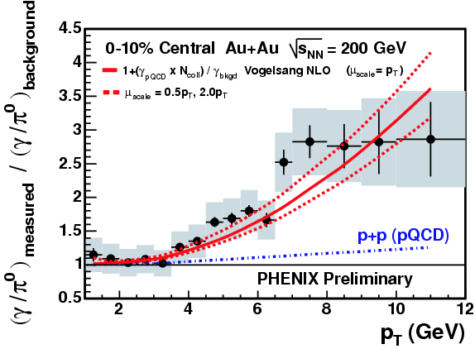
Naïve Way: Direct Real Photons
measured as “excess” above hadron decay photon
  Au+Au result consistent with pQCD×binary scaling
challenging at lower p_{T} due to smaller S/B ratio
PRL 94, 232301 (2005)

Slide 16
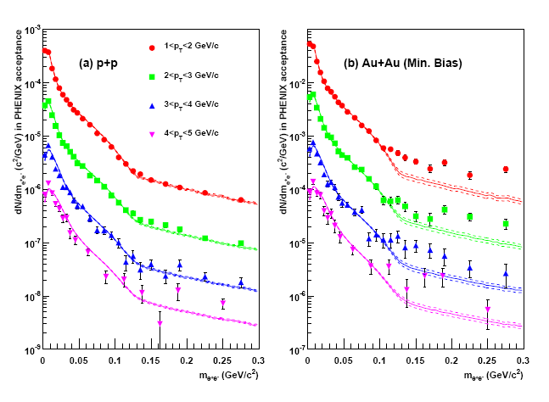
Alternative: “Almost Real” Photons
low mass electron-positron pairs
p+p: hadronic decay + pQCD photon at high p_{T}
Au+Au: enhancement above ~ 135 MeV
  no π⁰ decay virtual photon background above π⁰ mass
PHENIX (A. Adare et al.),
PRL 104, 132301 (2010)

Slide 17
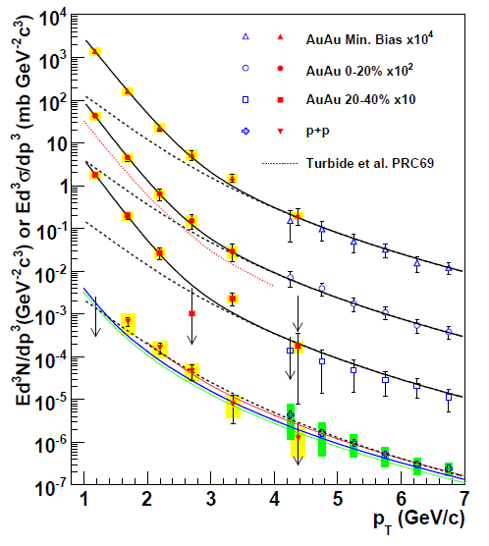
Direct Photon Spectra via γ and γ*
real and virtual photon methods consisitent
Au+Au: “thermal” excess
  ~ exponential with slope 221 ± 19 ± 19 MeV
cf. p+p data
  consistent with pQCD down to low p_{T}
PHENIX (A. Adare et al.), PRL 104, 132301 (2010)
NLO pQCD (W. Vogelsang)

Slide 18
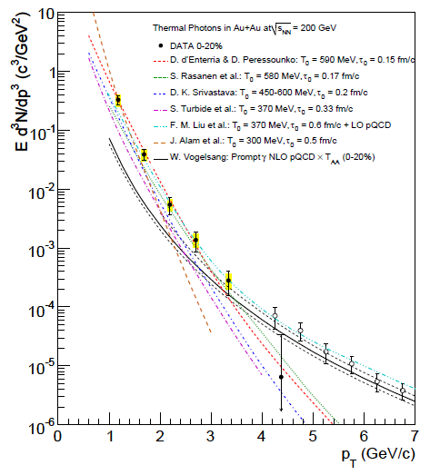
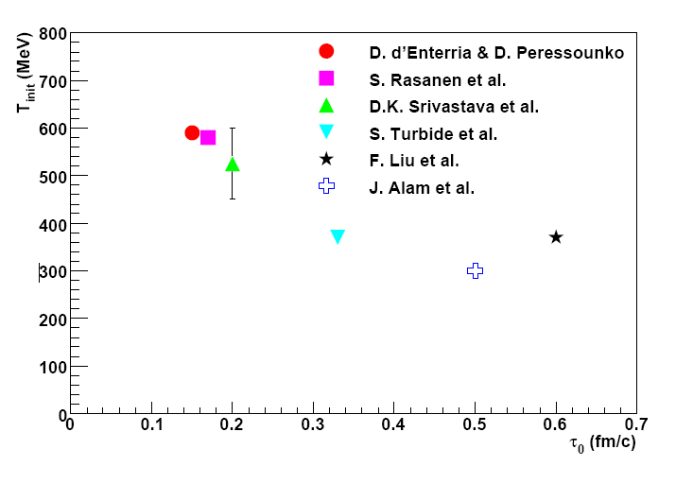

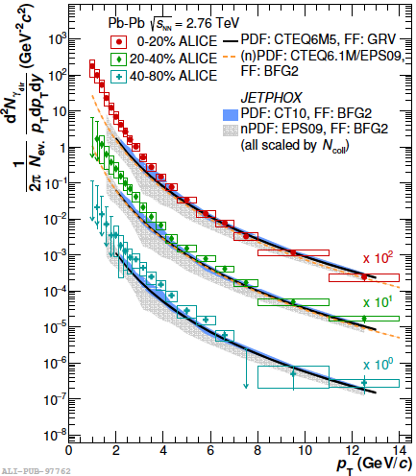
Initial Temperature Evaluation
initial temperature > data slope ~ 220 MeV
300–600 MeV (model dependence within factor 2)
  hydro-dynamic description
    w/ τ₀ = 0.15–0.6 fm/c
slope at 2.76 TeV: 297 ± 12 (stat.) ± 41 (sys.) MeV
cf. phase transition predicted at ~ 170 MeV
slope
PHENIX (A. Adare et al.),
PRC 81, 034911 (2010)
transition temperature
ALICE, PLB 754, 235-248 (2016)

Slide 19
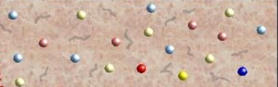
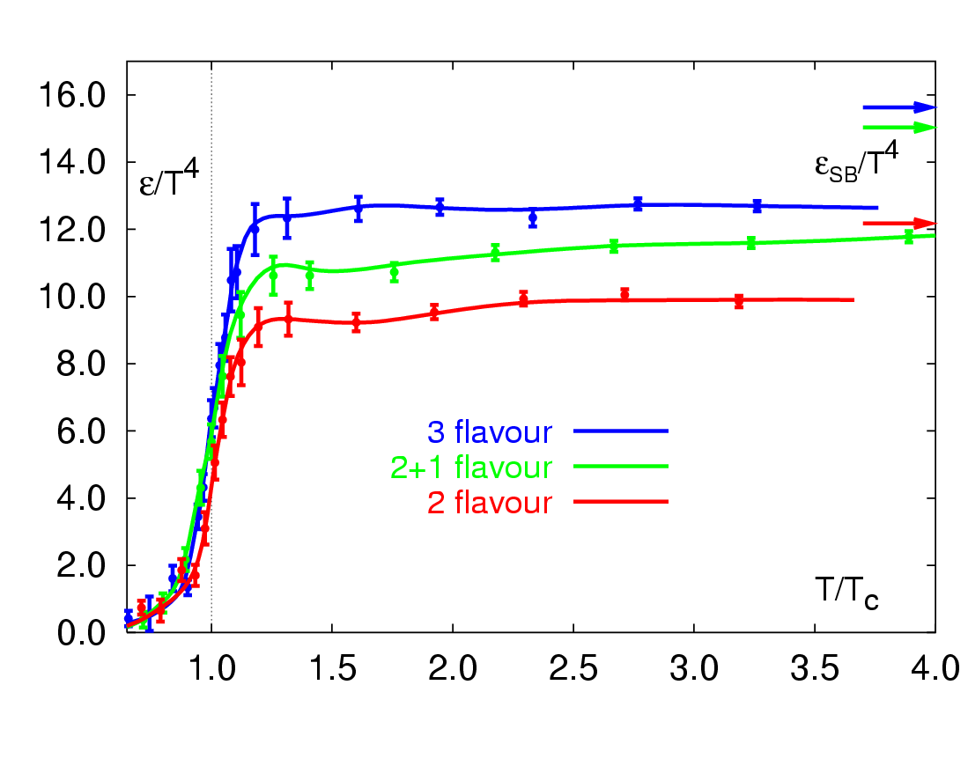
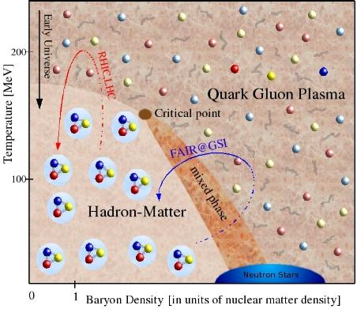
RHIC Outcome: Boundary Crossed
RHIC → LHC
RHIC
“free gas” ?
F. Karsch,
Lect. Notes Phys. 583, 209 (2002)
“perfect fluid”
RHIC → LHC
RHIC

Slide 20
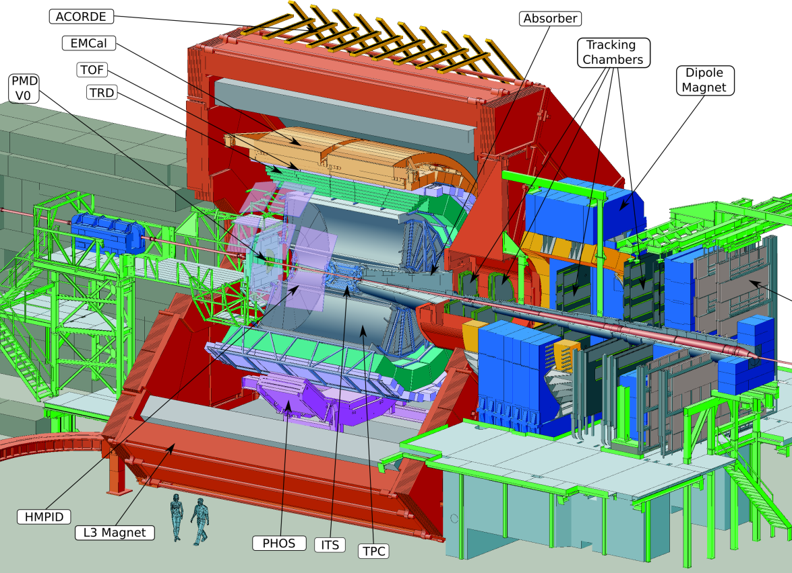
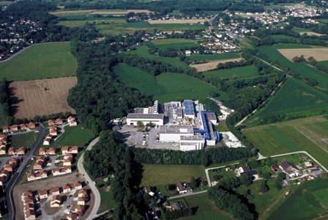

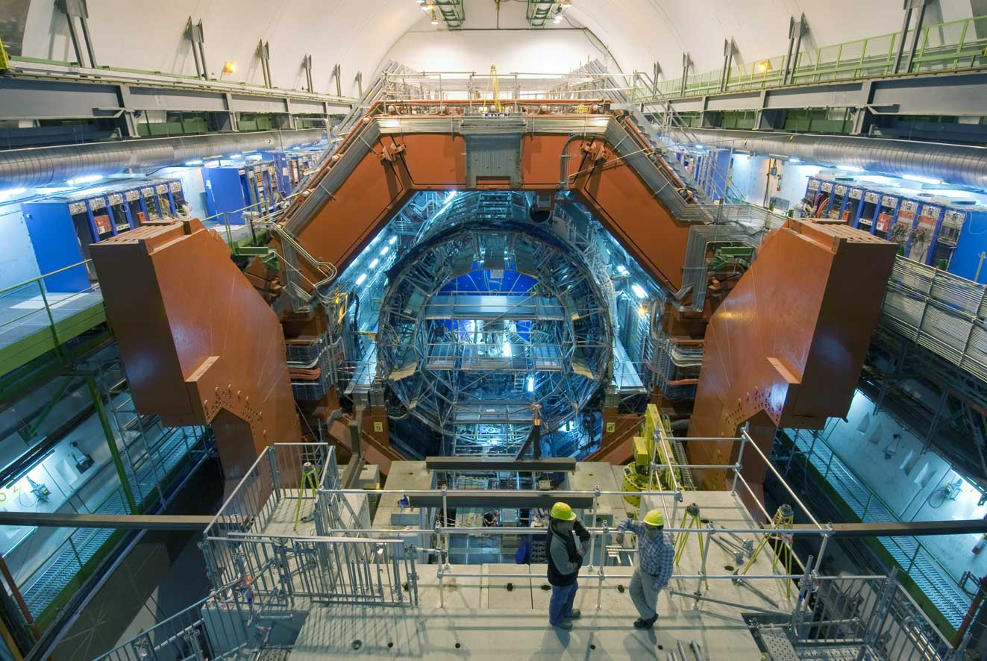
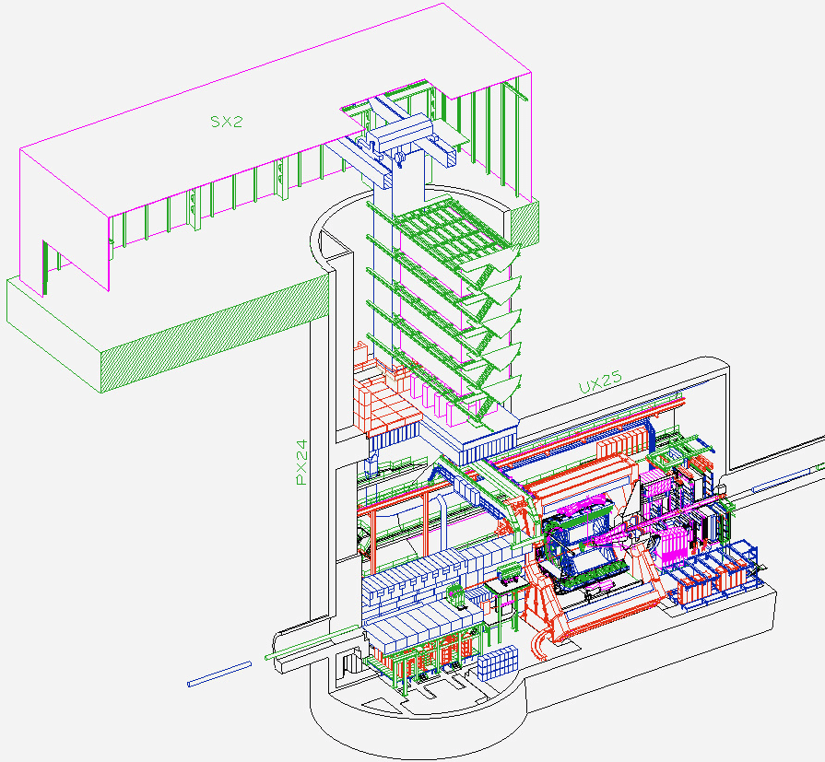
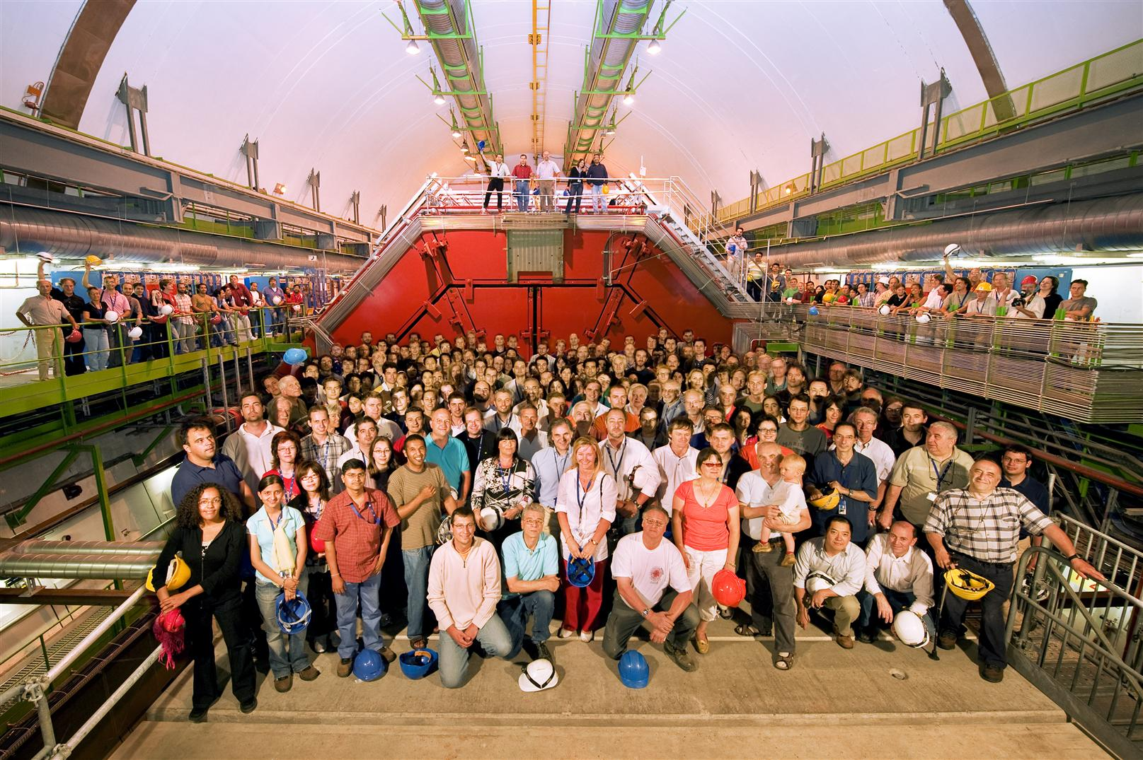
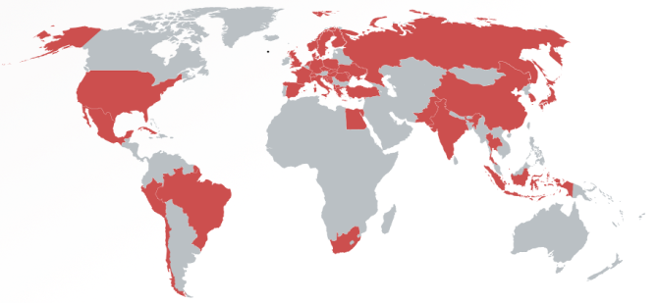
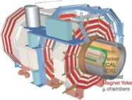
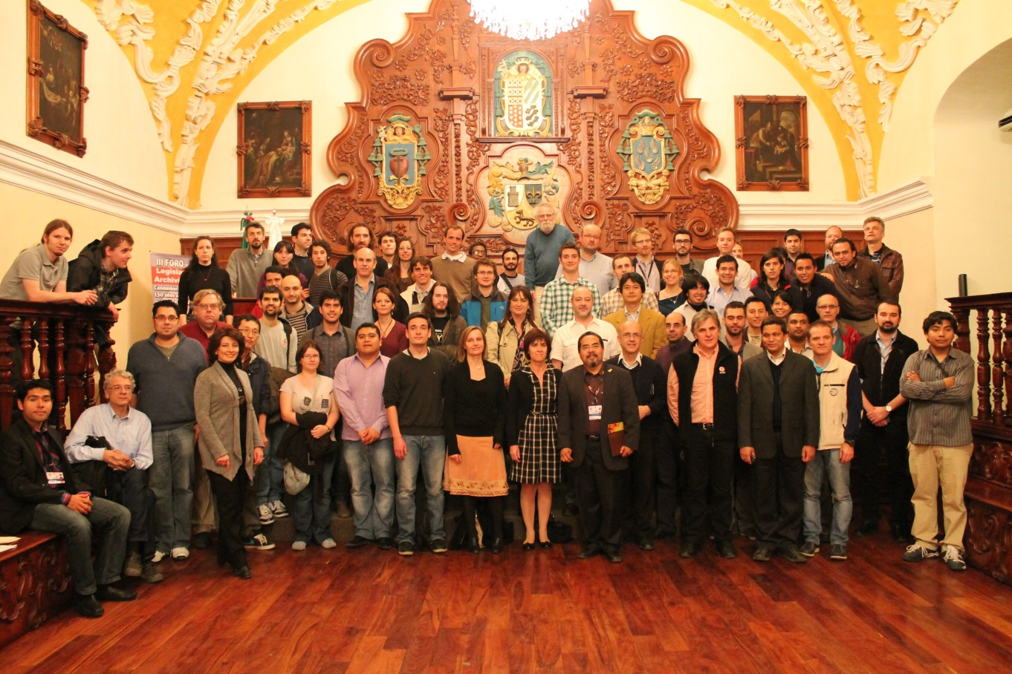
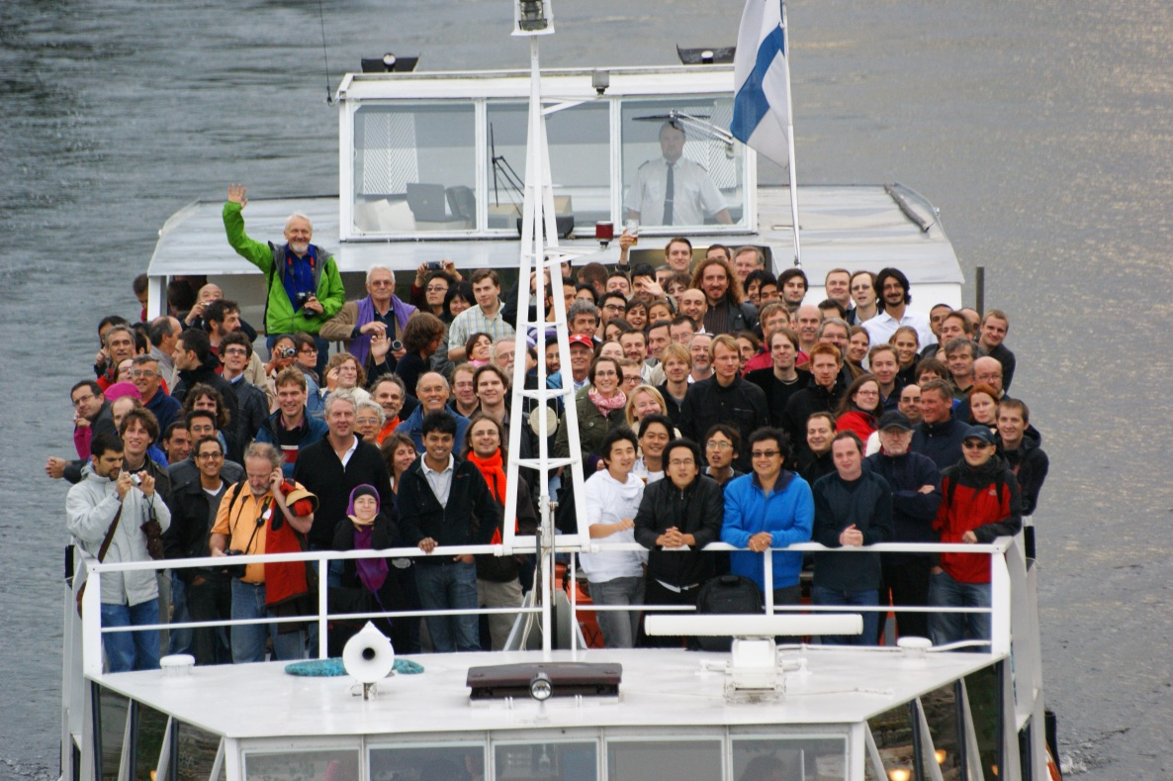


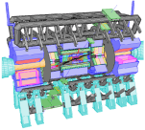


A Large Ion Collider Experiment
the nucleus-nucleus collision experiment at LHC
42 countries; 174 institutes; ~1,800 members
CMS
LHCb
ALICE
ATLAS, LHCf

Slide 21
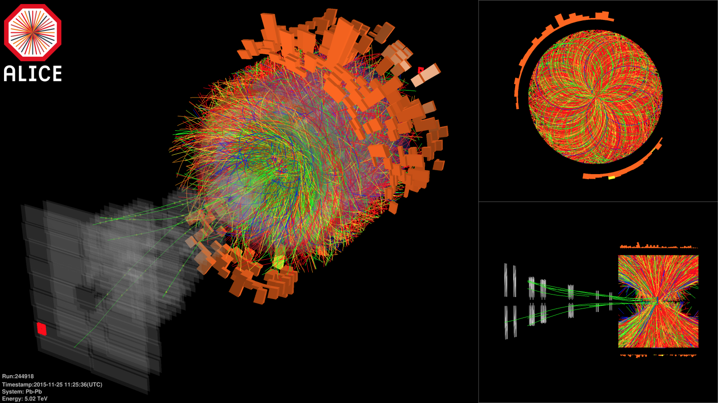

Pb-Pb at Highest Ever Energy
5.02 TeV per nucleon-nucleon pair (√s_{NN}) in 2015
  25 times higher than at RHIC
  design energy at 5.5 TeV
2.76 TeV in 2010 and 2011

Slide 22



Hotter, Larger, Longer-Lived, and Purer
fireball compared to that at RHIC
  energy density × ~3, volume × ~2, life × 1.2–1.3
    ~ 16 GeV/fm³ (thermalization time ~ 1 fm/c)
    ~ 300 fm³, ~ 10 fm/c
net quark (baryon) density ~ 0
  anti-proton/proton at mid-rapidity
    p+p 900 GeV： 0.957 ± 0.006 (stat) ± 0.014 (sys)
    p+p 7 TeV： 0.990 ± 0.006 (stat) ± 0.014 (sys)
ALICE (K. Aamodt et al.),
PRL 105, 072002 (2010)
ALICE (K. Aamodt et al.),
PLB 696, 328 (2011)

Slide 23
Time for More Physics
deconfined quark/gluon phase now on präparat
quark behavior in strong QCD field
  ✓energy loss and redistribution
quarks interaction in strong QCD field
  color Debye screening to melt quarkonia
chiral symmetry restoration
  hadron mass modification

Slide 24

Melting Quarkonia
J/Ψ (cc) suppression as deconfinement signature
  color Debye screening predicted already in 1986
  heavy (charm, beauty) quarks only from initial collisions
  tighter bound states more “heat resistant”
  observed at SPS and RHIC
interpretation ambiguous
  sequential melting?
    → further suppression at LHC
  early melting and late recombination competing?
    → enhancement at LHC
ϒ (bb) another key to resolve mechanism

Slide 25



J/ψ News from ALICE
azimuthal anisotropy (!)
  late charm - anti-charm recombination implied
    along with initial suppression
  no J/ψ unisotropy at RHIC energy (unlike single charm)

Slide 26




Color Debye Screening Thermometer?
ϒ(2S) more suppressed than ϒ(1S)
  ϒ(3S) even more suppressed
sequential melting yet to be established
    (feed down uncorrected)
CMS, PRL 109, 222301 (2012)

Slide 27



J/ψ, ψ’, ϒ News from ALICE
ϒ(1s)： finally melting in central Pb+Pb
ψ’, ϒ(2s)： more suppressed than ground states
  little beauty - anti-beauty recombination (unlike charm)?

Slide 28

Chiral Symmetry Restoration
“observations” in finite density regime
  φ, ω in nuclei via p+A (KEK E325)
    though apparent contradiction to CBELSA/TAPS and CLAS-G7
  π in nuclei via (d, ³He)
no evidence in high temperature regime yet
  challenging dilepton measurements
    e.g. PHENIX with RICH, hadron blind detector, ...

Slide 29



φ, ω, ρ News from ALICE
new low mass μ⁺μ⁻ measurement
to be combined with more traditional e⁺e⁻

Slide 30

Ultra-Intense Magnetic Field
U(1) magnetic field
  naturally expected with moving charged sources (nuclei)
  ~ 10¹⁵ T at LHC, ~ 10¹⁴ T at RHIC
    cf. magnetar surface ~ 10¹¹ T
  could be long-lived in “perfect fluid”
possible non-linear QED behaviors
  above electron critical magnetic field em_{e}² = 4×10⁹ T
  e.g. γ → γ γ, γ → e⁺e⁻, birefringence, …
various interesting physics under discussion
  chiral magnetic effects
  quark synchrotron radiation
Magnetic Field

Slide 31


Chiral Magnetic Effects
if strong P/CP violation + magnetic field
charge separation, observed at RHIC and LHC
B
correlation between particles with different charges
correlation between particles with same charges

Slide 32


γ∗ (Low Mass e⁺e⁻) “Polarization” ?
anisotropic decay w.r.t. magnetic field
feasibility study based on QED calculations
  vacuum polarization tensors under magnetic field
    summation for infinite Landau levels
    photon momentum up to ~ GeV
    ref. K.-I. Ishikawa, K. Shigaki et al.,
    Int. J. Mod. Phys. A28, 1350100 (2013)
anisotropy ~ o(10⁻¹)
e⁻
γ*
γ*
?
e⁺

Slide 33
ALICE（-Japan） Upgrade Strategies
1st – high p_{T} phenomena (jets), heavy flavors
  ✓ × 2–3 high speeding, new detectors; LS1 2013–2014
    upgrade: TPC readout (Tokyo), PHOS readout (Hiroshima)
    new: di-jet calorimeter (Tsukuba)
2nd – low/mid p_{T} phenomena
  × 100 high speeding, new detectors; LS2 2019–2020
    upgrade: TPC chamber (Tokyo), new vertex trackers
    new: muon forward tracker (Hiroshima)
3rd – (further) forward physics
  new detectors; LS3 2024 ?
    new: forward calorimeter (Tsukuba)

Slide 34


Major Upgrades at Run 3 (2021–)
new inner tracking system
  7 layers of MAPS silicon pixel detectors
  precise measurement of displaced vertices
    to separate charm/beauty mesons
new TPC readout chambers
  GEM technology with no gating grid
  ~100 times higher data taking rate (50 kHz in Pb-Pb)
    continuous readout without triggering
Muon Forward Tracker (MFT)

Slide 35



Uniqueness of LHC Forward Region
two interesting regimes of quark-gluon droplets
  exploration on QCD phase diagram
virtues at LHC
  not too forward for “central” physics (2.5 < |η| < 3.6)
  forward enough for muon measurement

Slide 36

Muon Forward Tracker (2021–)
vertex and invariant mass resolutions to improve
IP
Absorber
Dipole

Slide 37

Low Mass Vector Mesons φ, ω, ρ
significant improvement with MFT
  mass resolution by ~4
  signal/background ratio by ~10
ALICE, MFT LOI,
CERN-LHCC-2013-014

Slide 38

LHC Run Schedule
Run 2
Run 3
6.5 TeV proton beam
p-p, p-Pb, Pb-Pb
7.0 TeV proton beam
p-p, p-Pb, Pb-Pb
LHC luminosity upgrade
ALICE upgrade & high speeding

Slide 39
Summary
quark physics via high energy nuclear collisions
unique to look into “parallel world”
  early universe phase transition experimentally reverted
    > 300 MeV reached; beyond boundary ~ 170 MeV
deconfined quarks/gluons finally on präparat
  steadily revealing partonic phase properties
  chiral symmetry restoration yet to be attacked
ever emerging new (i.e. exciting) topics
  e.g. ultra-intense U(1) magnetic field
next steps already in preparation
  ALICE major upgrades (2021–)

Slide 40
Concluding Remarks
quark physics (high energy nuclear physics)
  … and more at Hiroshima University
    high energy astrophysics
    optical and infrared astronomy
    elementary particle theory
    astrophysics and cosmology
wide range of activity and expertise, including:
  particle detector research and development
  high performance computing
NCU - HU interaction/collaboration to grow further
THANK YOU FOR THE INVITATION

