Slide 1


総括に代えて：
原子核素粒子 における カイラル現象 への
実験的アプローチ機会
志垣 賢太 （ ）
広島大学キラル国際研究拠点 （CResCent）
広島大学極限宇宙研究拠点 （Core-U）
合同キラル素粒子論セミナー II
2018 年 4 月 2 日 広島市 神田山荘

Slide 2
Presentation Outline
ultra-relativistic heavy ion collisions
  unique features of quark matter physics
    to look into “parallel world” across phase boundary
chiral symmetry restoration (a la Fukushima-san)
  hadron mass state modification
chiral anomalies (a la Hidaka-san)
  ultra-intense U(1) magnetic field
interesting future framework (a la Yamamoto-san)
  fixed target program at LHC
summary and concluding remarks

Slide 3
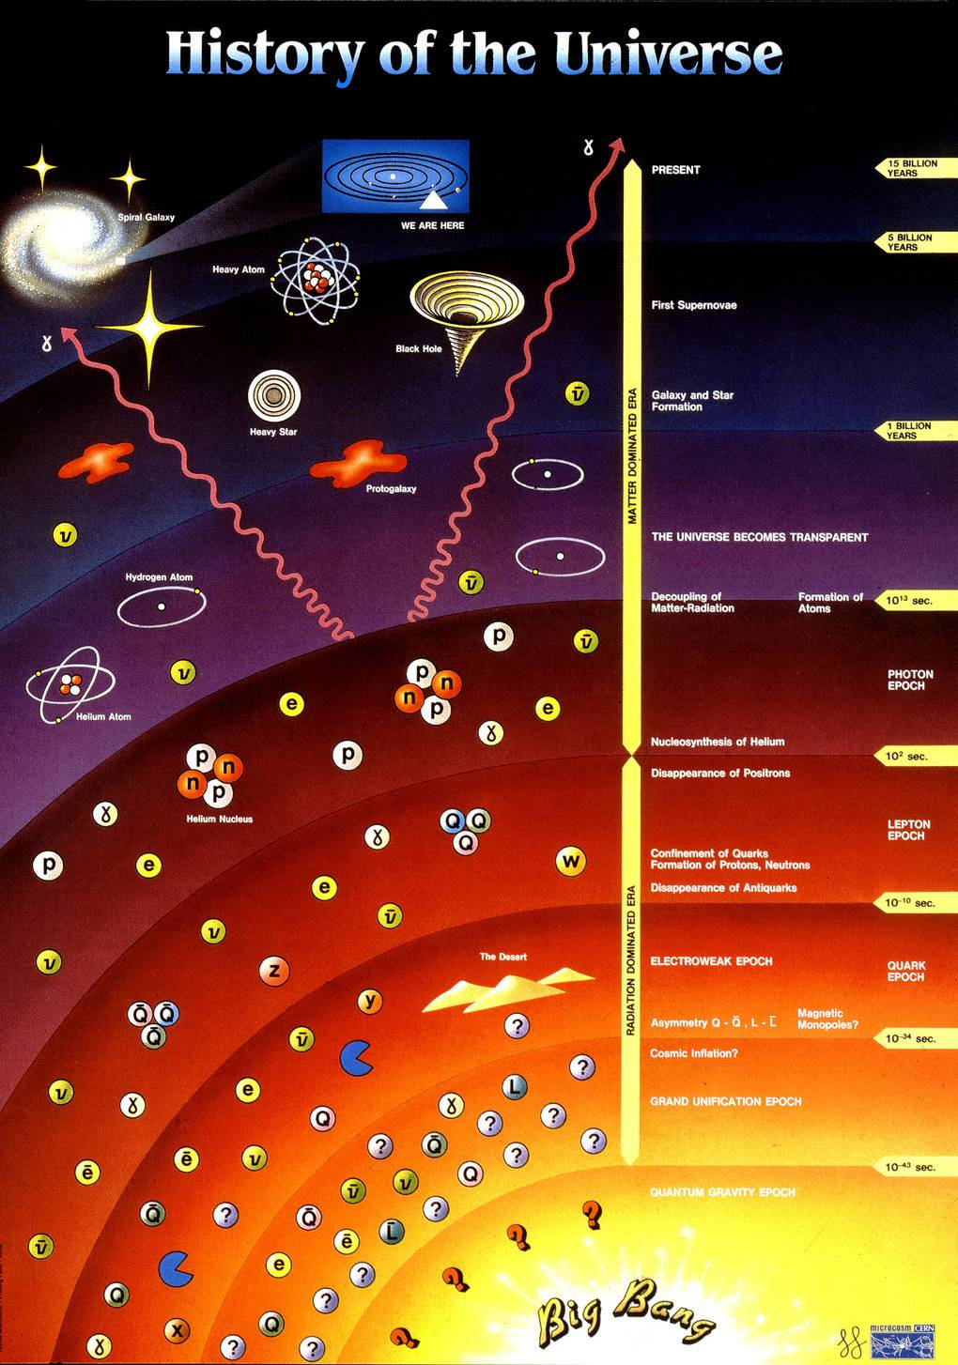
History of Universe and Matter
14 by
this colloquium
1 by
star/galaxy formation
10¹² s
atom formation
10² s
nuclei synthesis
10⁻⁶ s
quark confinement
anti-quark annihilation
quark pair production
0.00 s
Big Bang

Slide 4
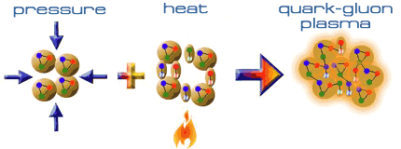
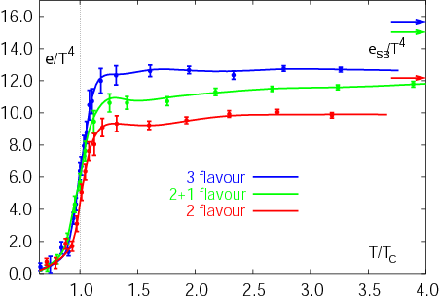
Expeditions on QCD Phase Diagram
toward (or back to) deconfined partonic phase
lattice Quantum Chromo-Dynamics predictions
  critical temperature ~ 170 MeV
  critical energy density ~ 1 GeV/fm³
Early Universe
Deconfined Partonic Phase
(Quark-Gluon Plasma)
Tri-Critical point
Energy Density (Temperature)
Critical Temperature ~ 170 MeV
High Energy A+A Collisions
Hadron gas
Color Super-Conductivity?
Color-Flavor Locking?
F. Karsch,
Lect. Notes Phys. 583 (2002) 209
Nucleus
Neutron Star
Baryon Density

Slide 5
Uniqueness of QCD Phase Transition
only possible boundary to experimentally cross
  to prove (or disprove) paradigm of universe evolution
  lost phase within experimental reach
    not just to catch residue
K. Homma, 2008/09

Slide 6
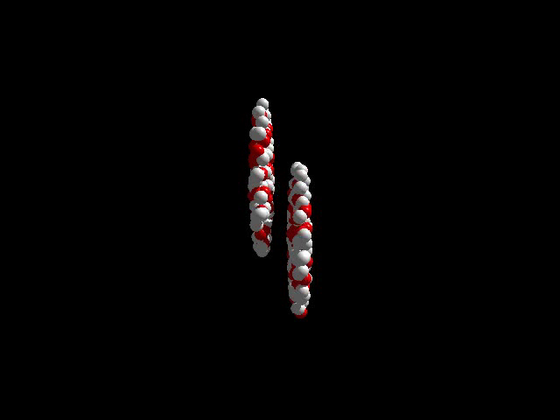
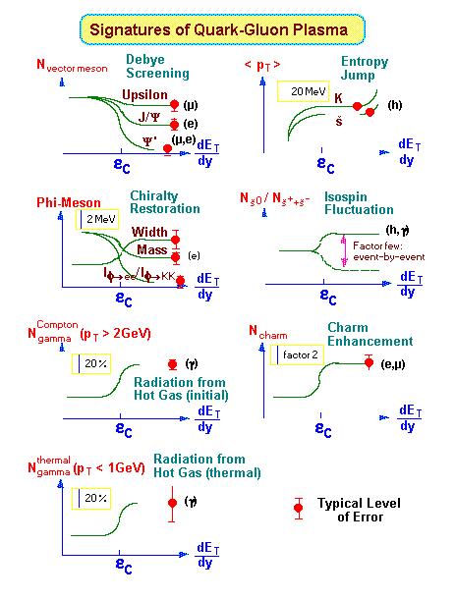
History of Quark Matter Search
1970’s–80’s: first trials
  LBL–BEVALAC （2 A GeV ⁴⁰Ar）
  BNL–AGS （15 A GeV ²⁸Si）
  CERN–SPS （200 A GeV ³²S）
1990’s: onsets of discovery
  BNL–AGS （11 A GeV ¹⁹⁷Au）
  CERN–SPS （158 A GeV ²⁰⁸Pb）
2000’s: deconfined partonic phase!
    thanks to nuclear colliders
  BNL–RHIC （100 + 100 A GeV ¹⁹⁷Au + ¹⁹⁷Au）
  CERN–LHC （2.8 + 2.8 A TeV ²⁰⁸Pb + ²⁰⁸Pb）

Slide 7

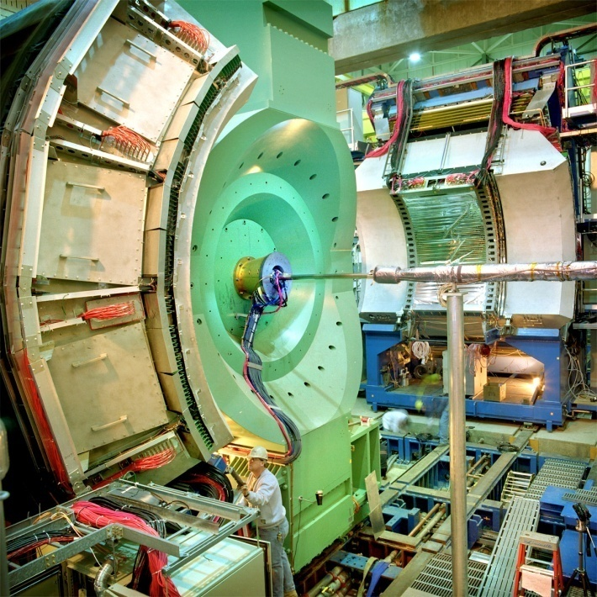




Relativistic Heavy Ion Collider at BNL
2 independent super-conducting synchrotrons
up to 100 A GeV Au and/or 250 GeV (polarized) p
  Au+Au/U+U/Cu+Cu/p+p/p+Au/d+Au/³He+Au/Cu+Au…
4 (presently 1.5) complimentary experiments

Slide 8
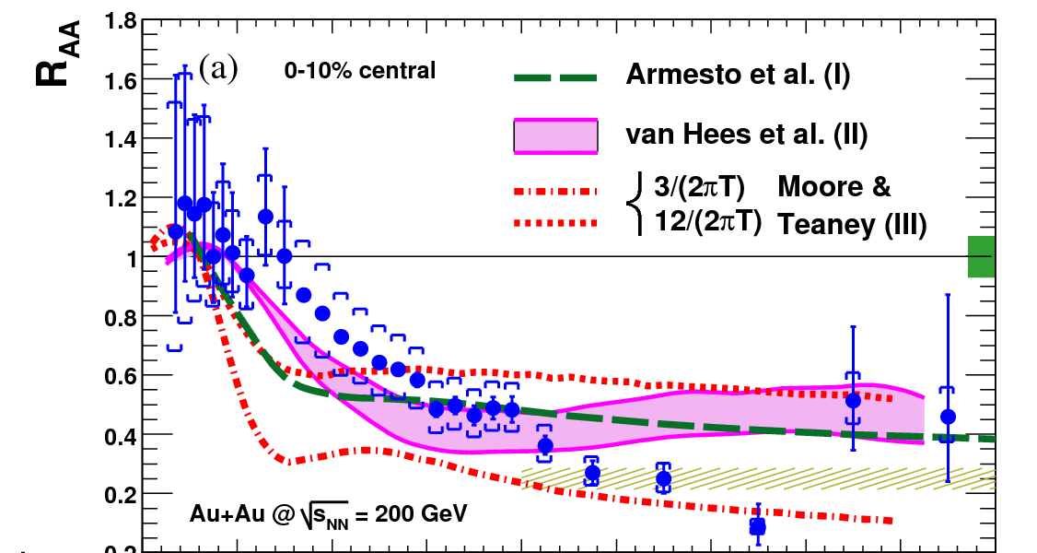
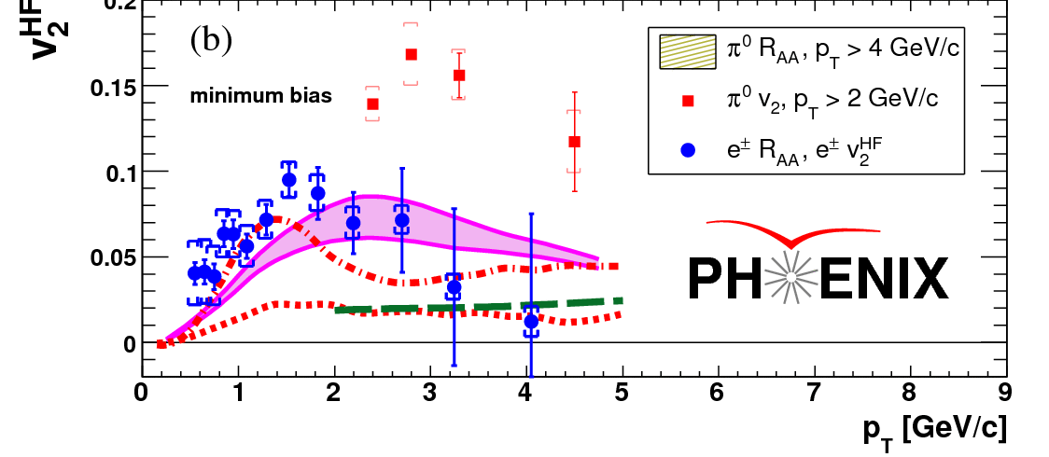
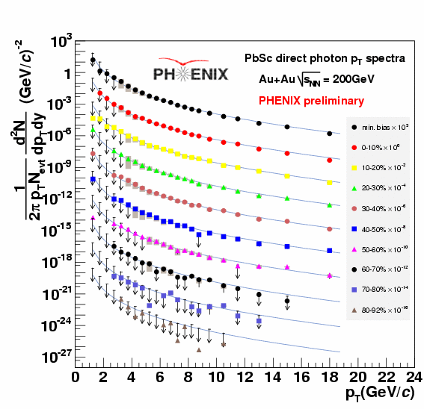
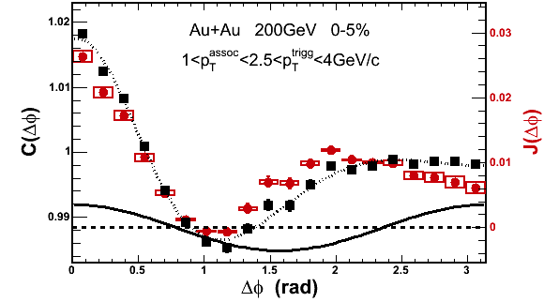
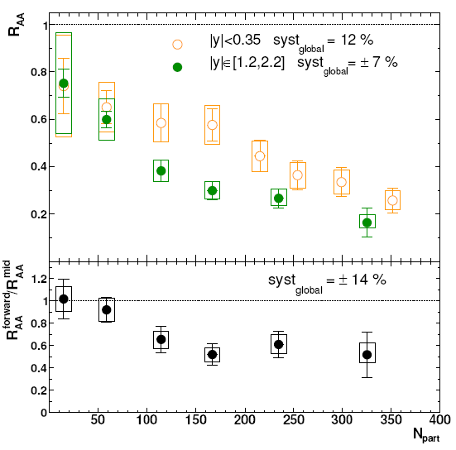
RHIC Outcomes: New State of Matter
partonic: quarks’ degrees of freedom, screening
  constituent quark number scaling of collective motion
  J/Ψ suppression
dense: energy loss of (even heavy) quarks
  jet quenching (high p_{T} suppression)
  jet modification
strongly coupled: perfect fluidity
  hydro-dynamical collective motion
hot: thermally radiative
  thermal (virtual) photons
The matter is dense
The matter is strongly coupled
The matter may melt and/or regenerate J/ψ’s
The matter modifies jets
The matter is hot

Slide 9
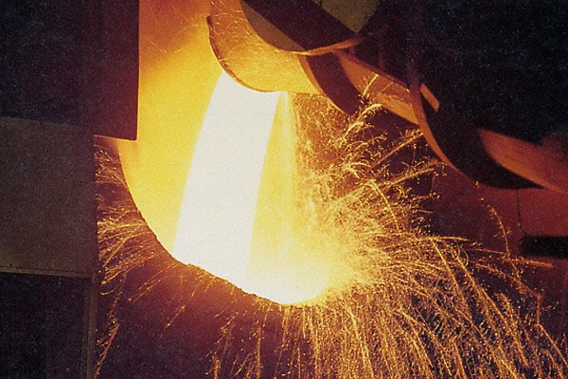
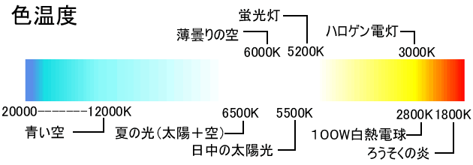
Over 2 Trillion Kelvin (170 MeV)?
thermal radiation if in equilibrium
emission spectrum ↔ temperature

Slide 10
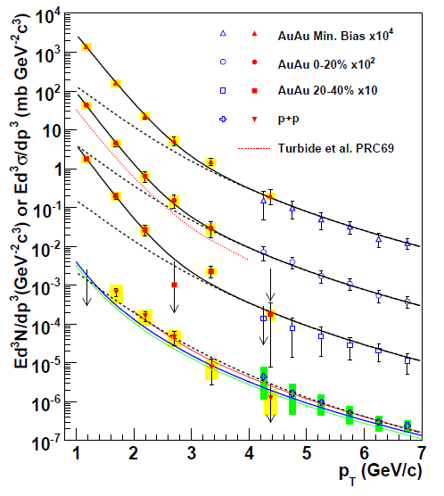

Photon Spectra in Heavy Ion Collisions
Au+Au at √s_{NN} = 200 GeV
  “thermal” excess
  slope ~ 221 ± 19 ± 19 MeV
  initially ~ 300 – 600 MeV
    well above phase boundary
cf. p+p as reference
  consistent with pQCD
PHENIX (A. Adare et al.), PRL 104, 132301 (2010)
NLO pQCD (W. Vogelsang)

Slide 11
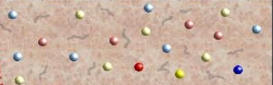
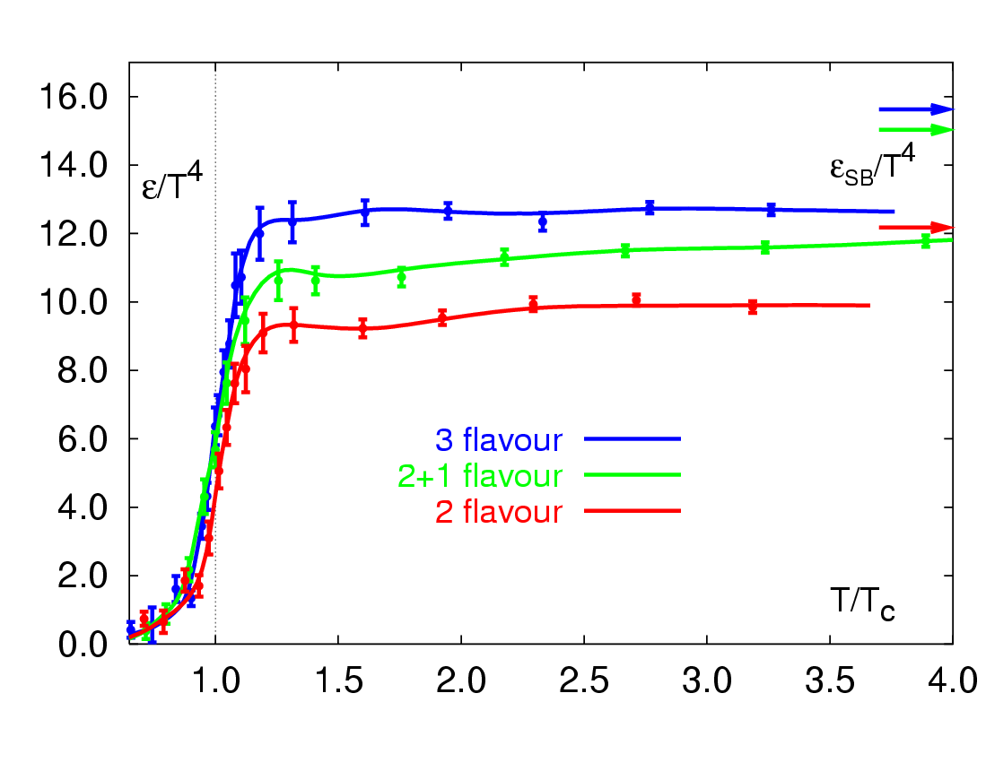
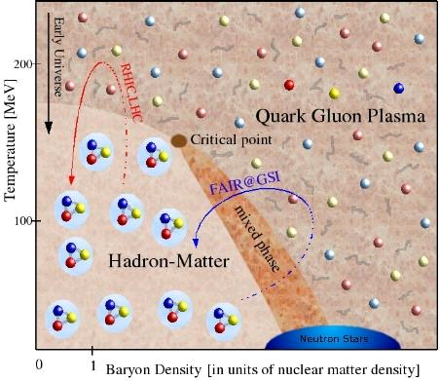
RHIC Outcome: Boundary Crossed
RHIC → LHC
RHIC
“free gas” ?
F. Karsch,
Lect. Notes Phys. 583, 209 (2002)
“perfect fluid”
RHIC → LHC
RHIC

Slide 12
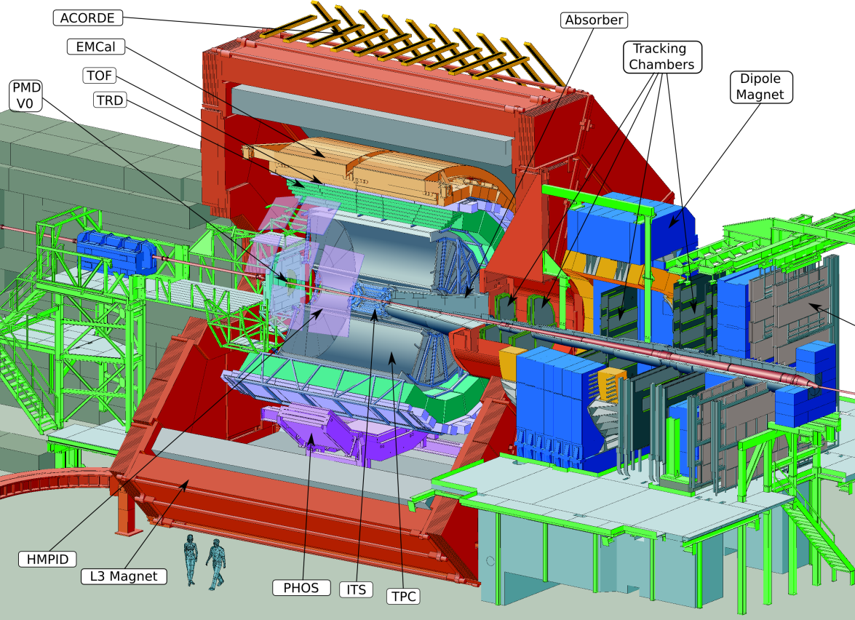
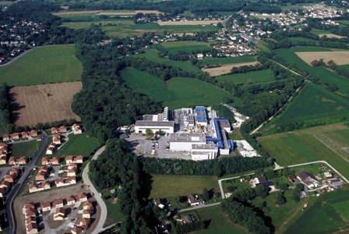

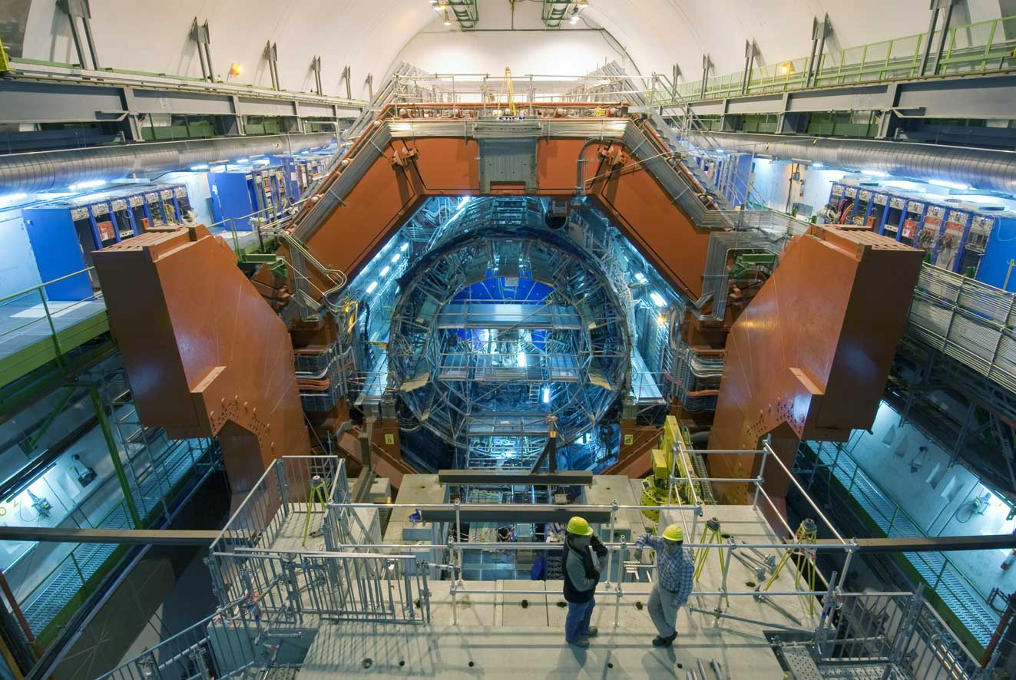
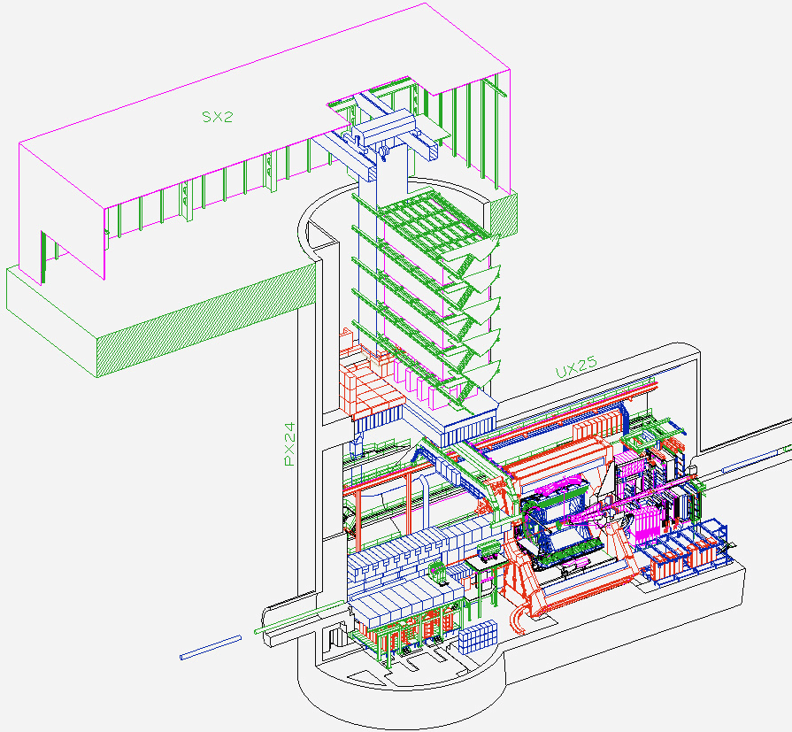
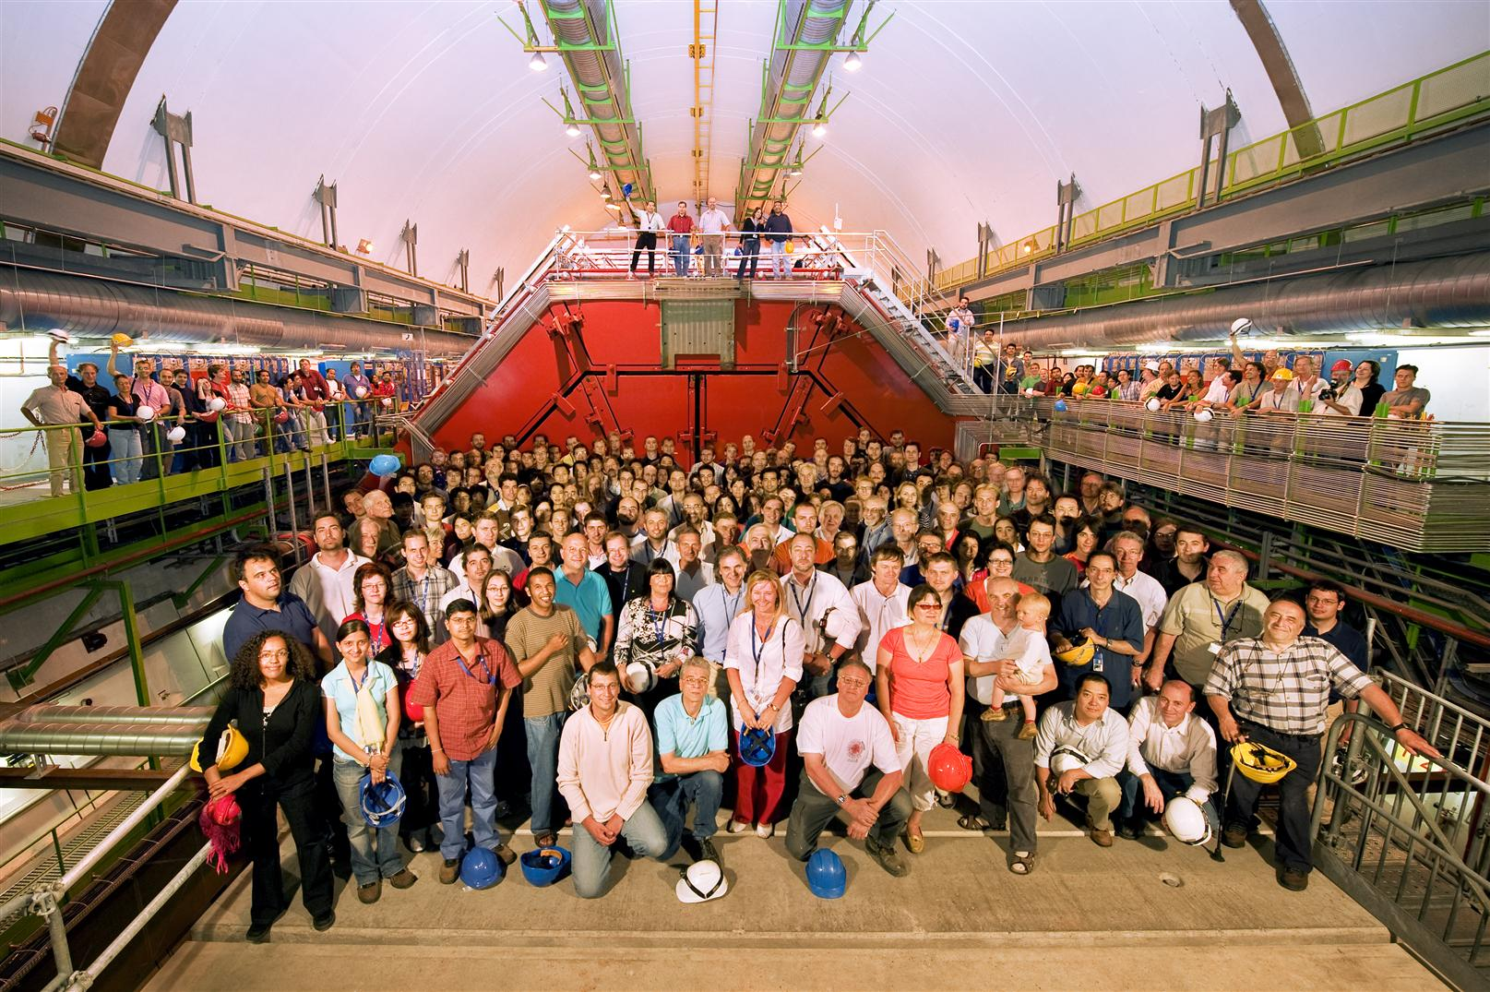
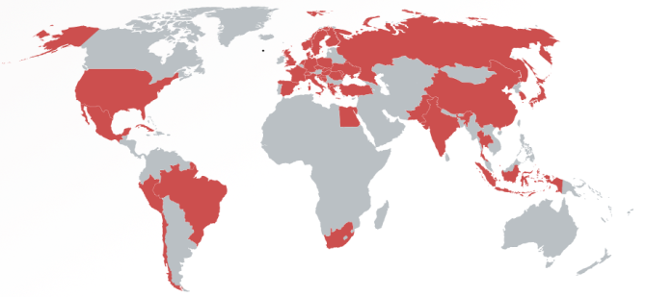
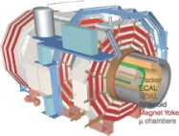
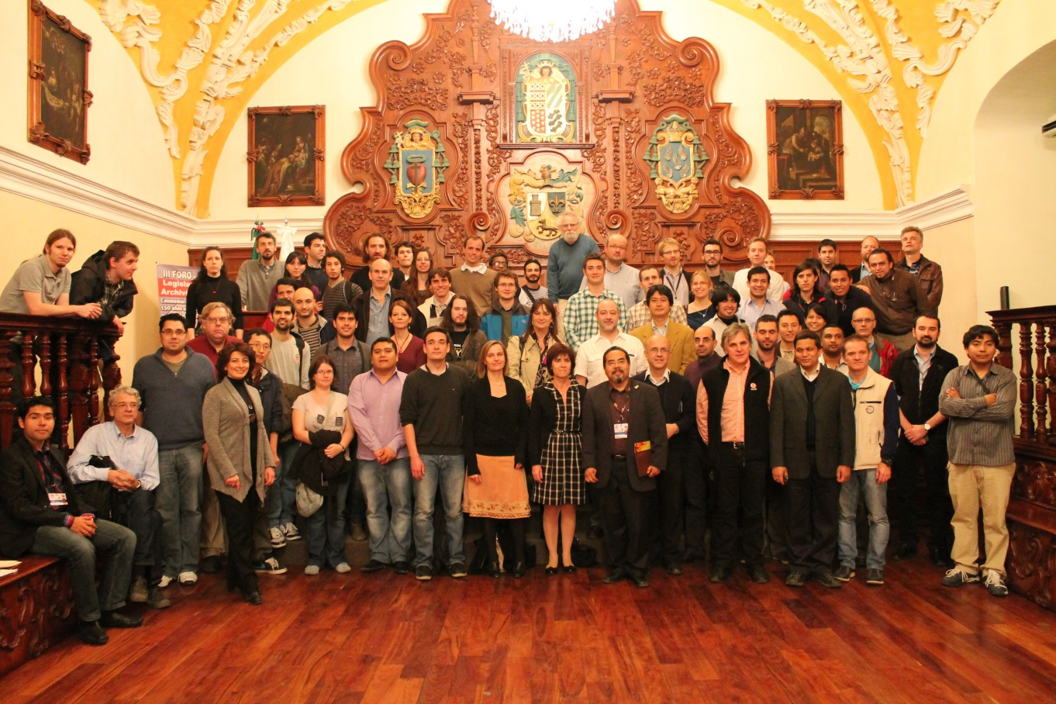
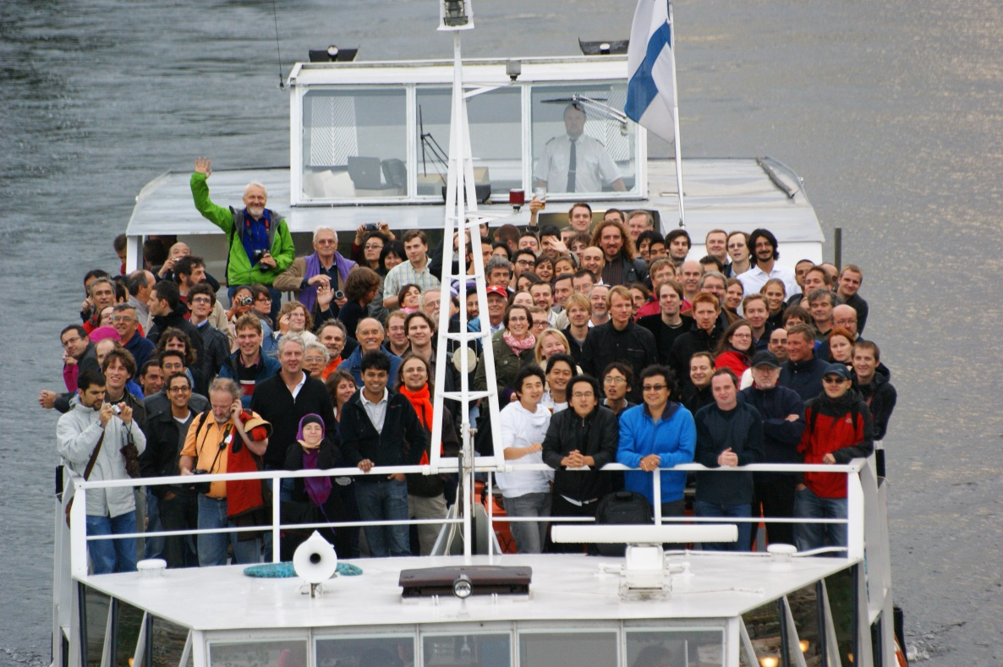


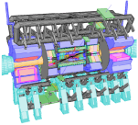


A Large Ion Collider Experiment
the nucleus-nucleus collision experiment at LHC
42 countries; 174 institutes; ~1,800 members
CMS
LHCb
ALICE
ATLAS, LHCf

Slide 13
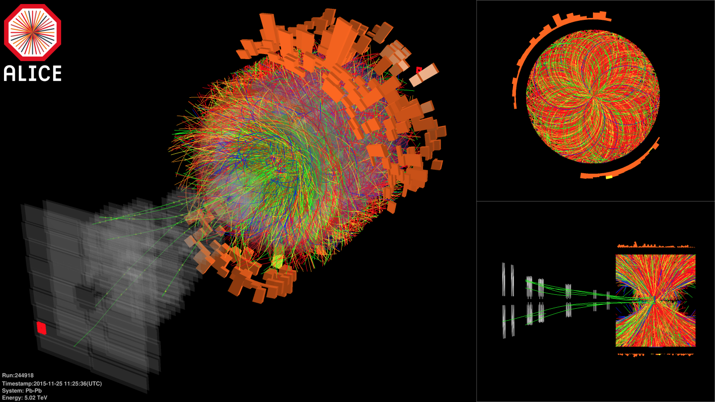

Pb-Pb at Highest Ever Energy
5.02 TeV per nucleon-nucleon pair (√s_{NN}) in 2015
  25 times higher than at RHIC
  design energy at 5.5 TeV
2.76 TeV in 2010 and 2011

Slide 14
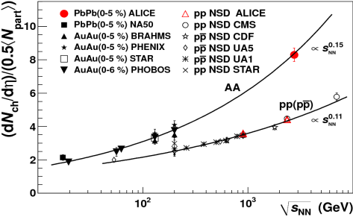
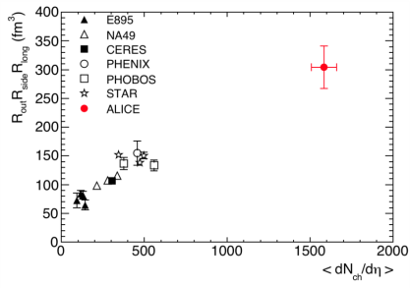
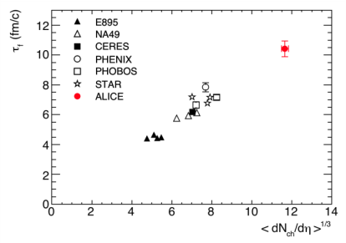
Hotter, Larger, Longer-Lived, and Purer
fireball compared to that at RHIC
  energy density × ~3, volume × ~2, life × 1.2–1.3
    ~ 16 GeV/fm³ (thermalization time ~ 1 fm/c)
    ~ 300 fm³, ~ 10 fm/c
net quark (baryon) density ~ 0
  anti-proton/proton at mid-rapidity
    p+p 900 GeV： 0.957 ± 0.006 (stat) ± 0.014 (sys)
    p+p 7 TeV： 0.990 ± 0.006 (stat) ± 0.014 (sys)
ALICE (K. Aamodt et al.),
PRL 105, 072002 (2010)
ALICE (K. Aamodt et al.),
PLB 696, 328 (2011)

Slide 15
Playground with Extreme Conditions
deconfined quark/gluon phase now in hand
quark behavior in strong QCD field
  energy loss and redistribution
quarks interaction in strong QCD field
  color Debye screening to melt quarkonia
chiral symmetry restoration
  hadron mass modification
more exotics
  physics under ultra-intense magnetic field

Slide 16
Mysteries of Mass
total mass = sum of components’ masses?
astronomical objects
quarks
quark in standard model
universe
quark
proton
matter 5 %
quark mass 1%
quark mass in standard model = 0
dark matter 27 % chiral symmetry breaking BEH mechanism
dark energy 68 %

Slide 17
Uniqueness of Chiral Phase Transition
only possible boundary to experimentally cross
  to prove (or disprove) paradigm of universe evolution
  lost phase within experimental reach
    not just to catch residue
K. Homma, 2008/09

Slide 18
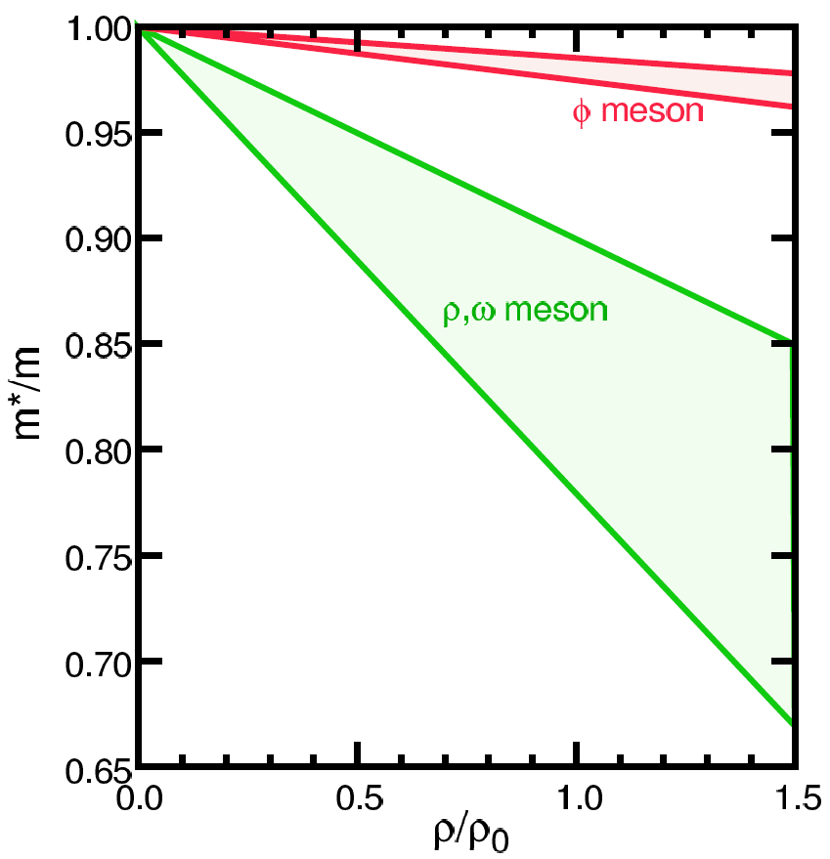
Looking into “Parallel World”
phenomena with restored symmetry
QCD phase transition with chiral symmetry →
  diminishing effective (light) quark masses
  probably lower hadron masses
e.g. light vector meson mass modification
T.Hatsuda, H.Shiomi and H.Kuwabara
Prog. Theor. Phys. 95 (1996) 1009

Slide 19
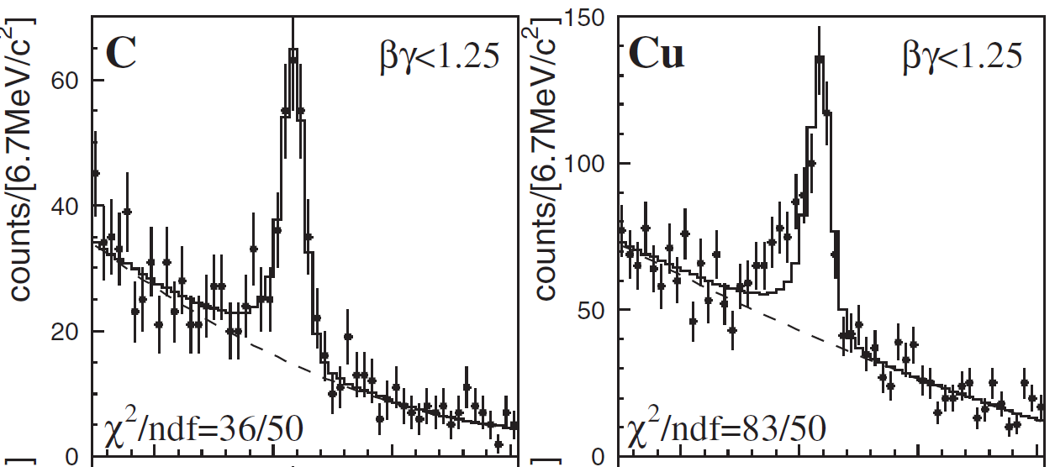
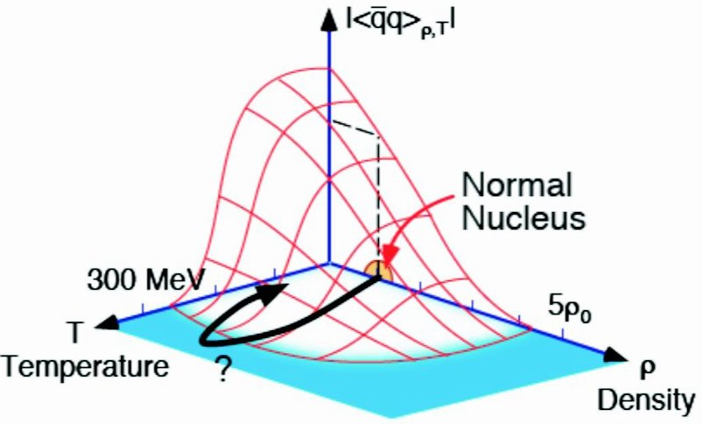
Chiral Symmetry Restoration
“observations” in finite density regime
  φ, ω in nuclei via p+A (KEK E325)
    though apparent contradiction to CB-ELSA/TAPS and CLAS-G7
  π in nuclei via (d, ³He)
no evidence in high temperature regime yet
  challenging dilepton measurements
    e.g. PHENIX with RICH, hadron blind detector, ...

Slide 20
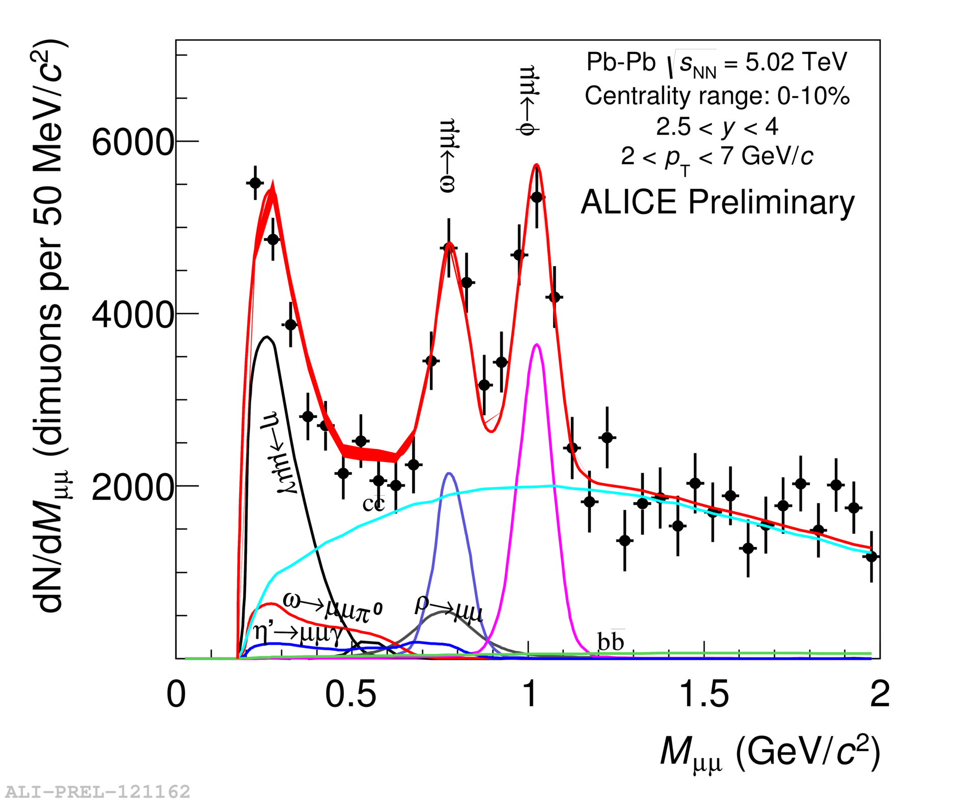
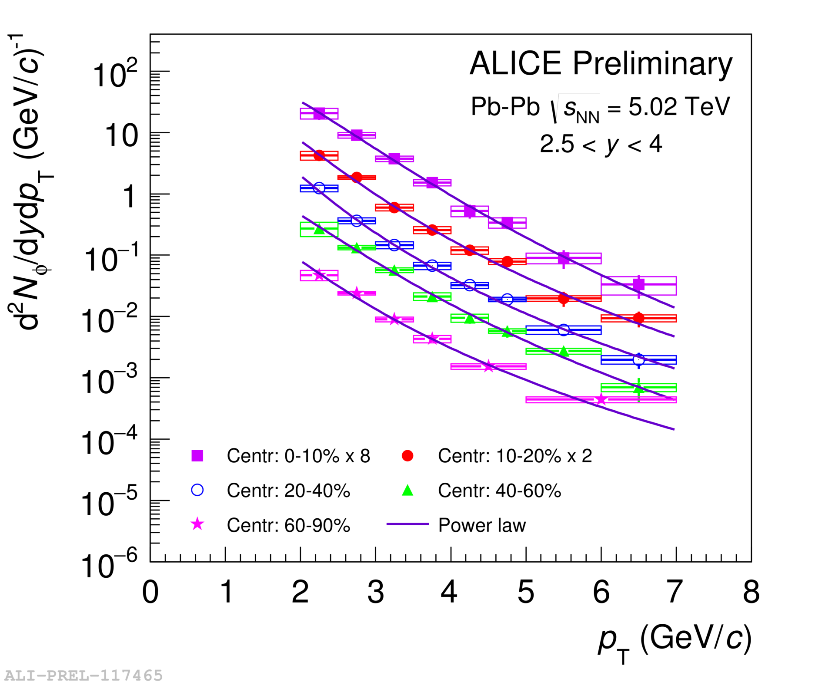
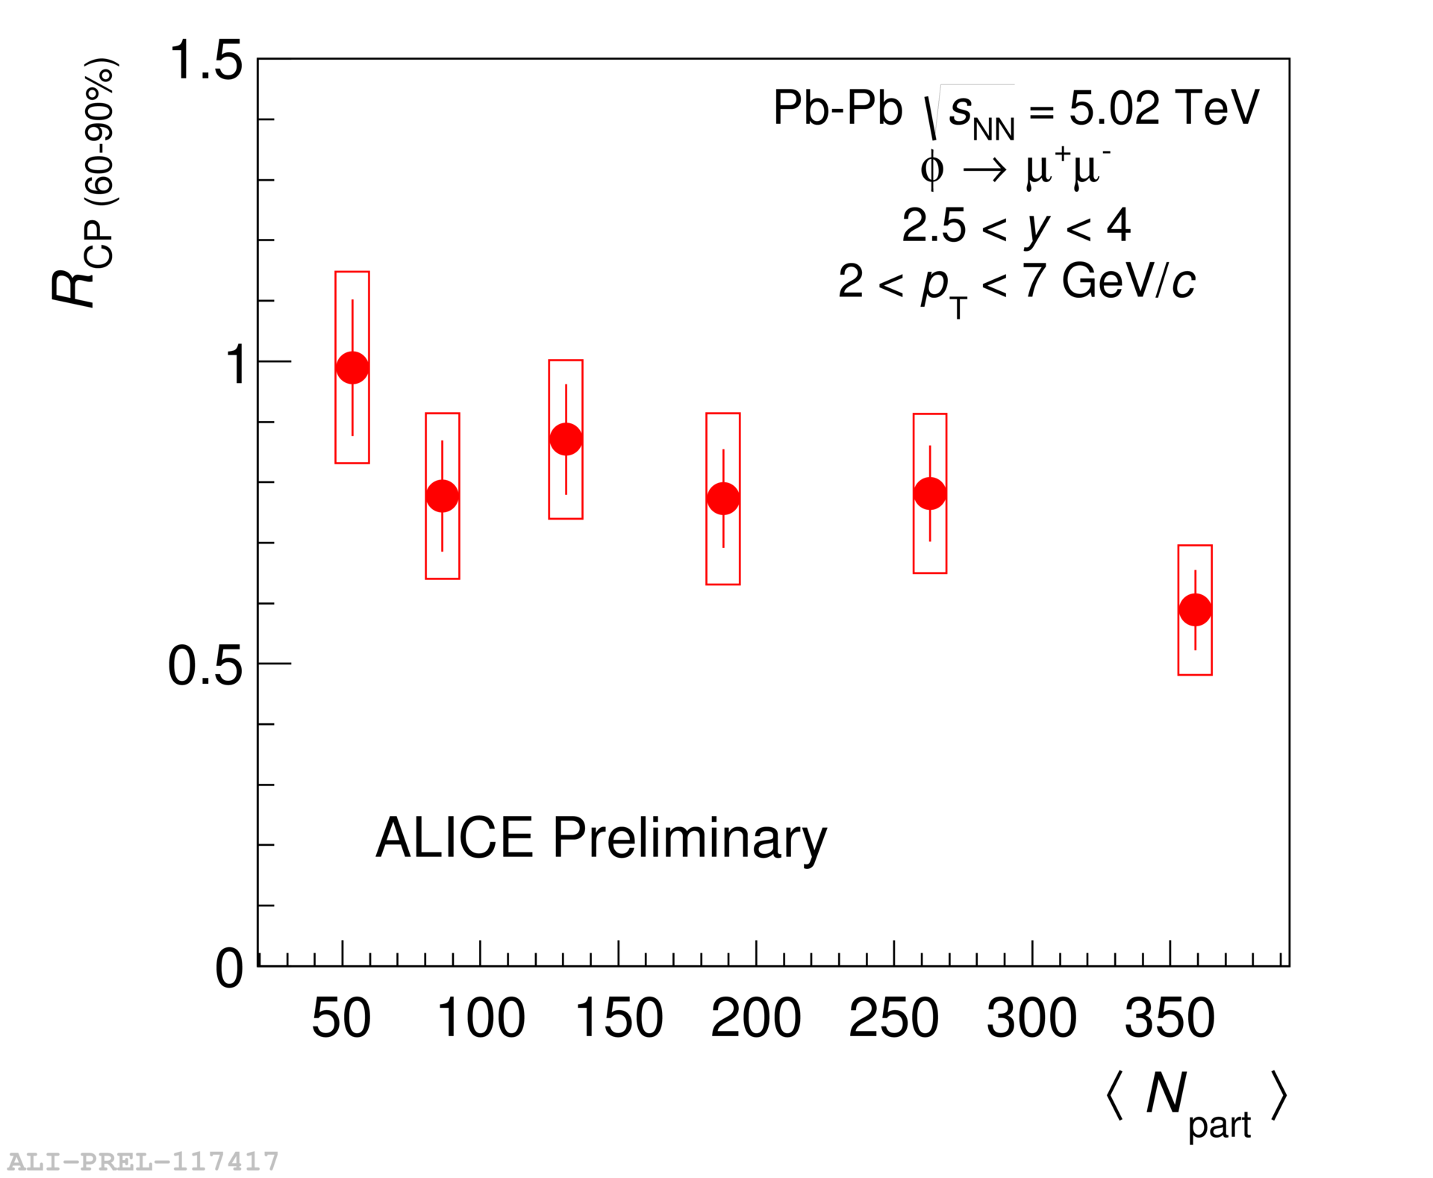
Multiple Probes at ALICE
new low mass (φ, ω, ρ) μ⁺μ⁻ measurement
  to further improve by detector upgrade from 2021
to be combined with more traditional e⁺e⁻

Slide 21
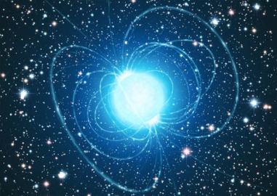
Ultra-Intense Magnetic Field
U(1) magnetic field
  naturally expected with moving charged sources (nuclei)
  ~ 10¹⁵ T at LHC, ~ 10¹⁴ T at RHIC
    cf. magnetar surface ~ 10¹¹ T
  could be long-lived in “perfect fluid”
possible non-linear QED behaviors
  above electron critical magnetic field em_{e}² = 4×10⁹ T
  e.g. γ → γ γ, γ → e⁺e⁻, birefringence, …
various interesting physics under discussion
  chiral magnetic effects
  quark synchrotron radiation
Magnetic Field

Slide 22
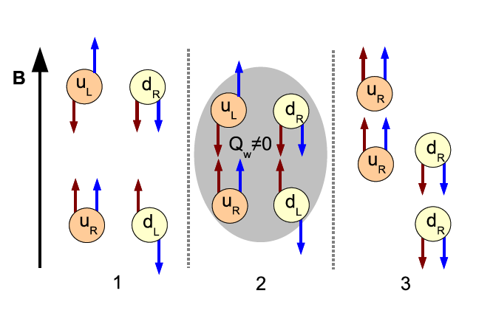
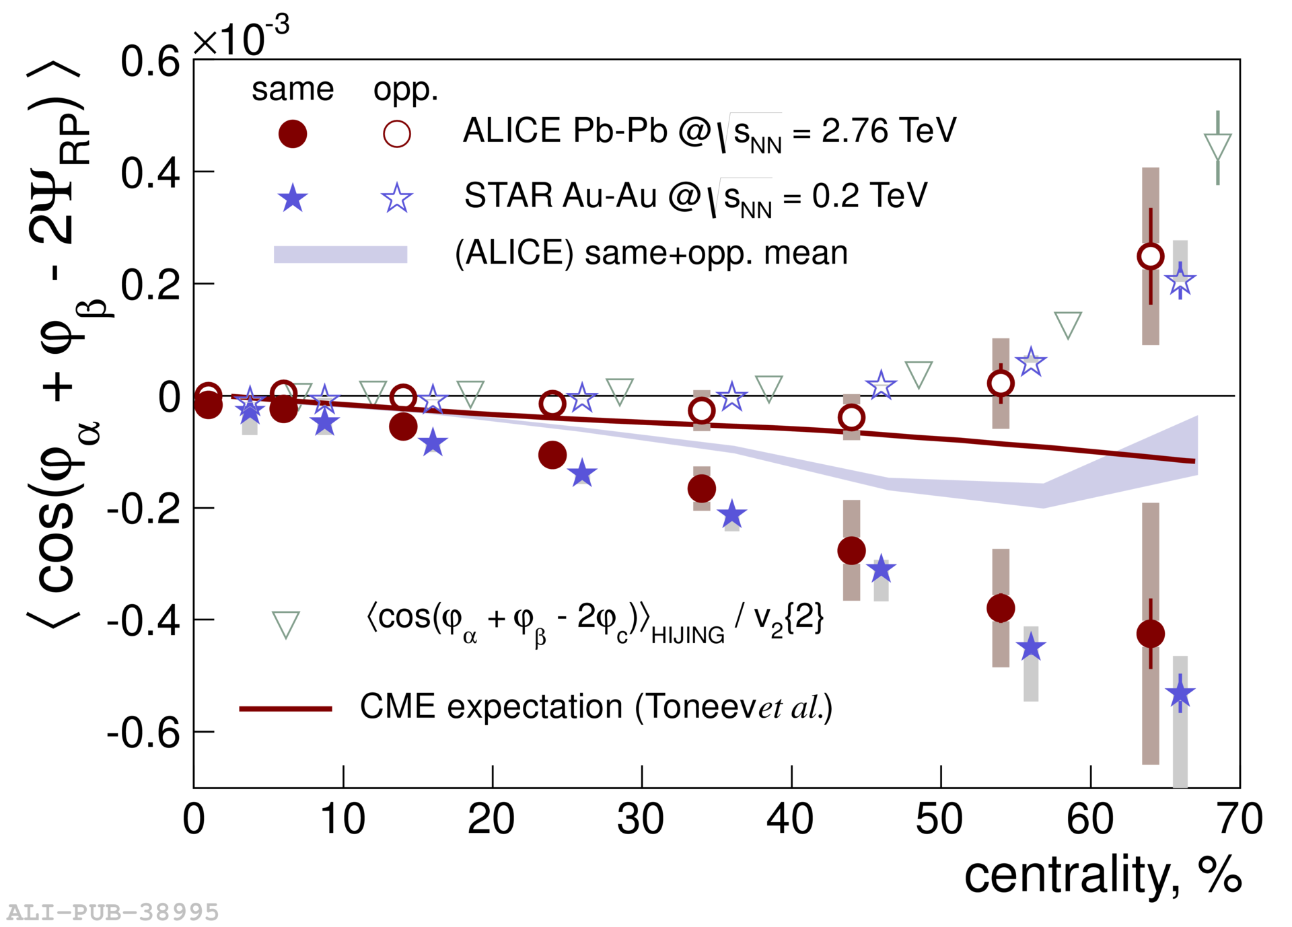
Chiral Magnetic Effects
if strong P/CP violation + magnetic field
charge separation, observed at RHIC and LHC
B
correlation between particles with different charges
correlation between particles with same charges

Slide 23
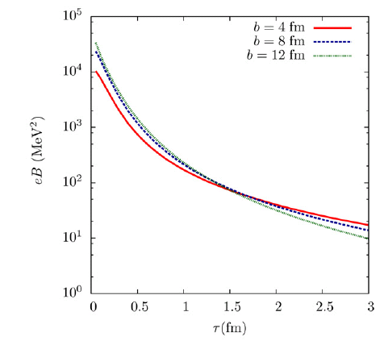
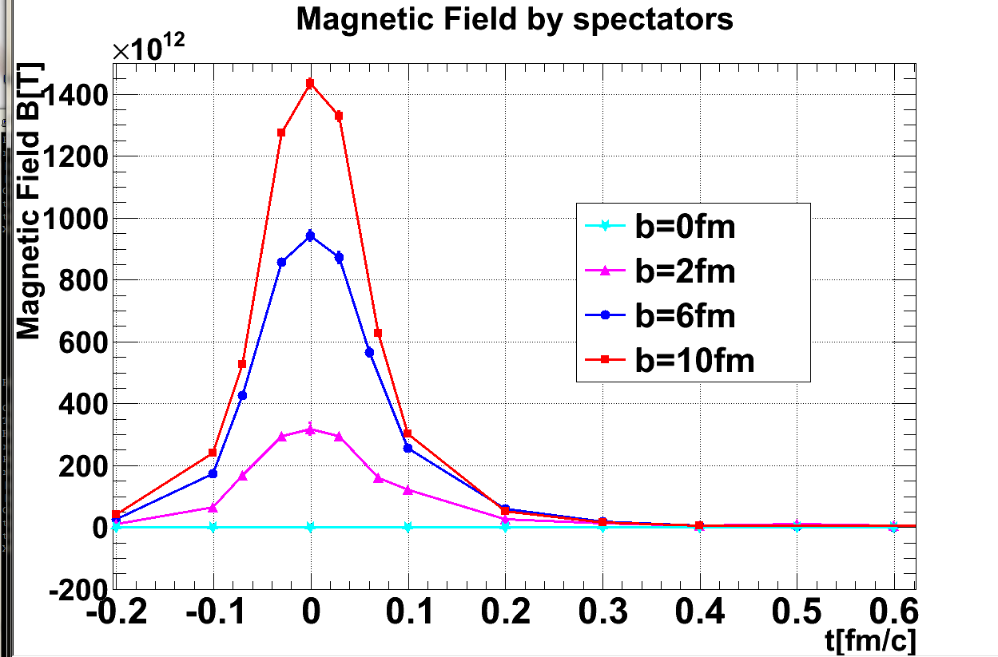
Field Intensity and Time Evolution
common approach: cascade models
  spectator contribution dominant
    10¹⁴ – 10¹⁵ T at LHC
    short life time < 1 fm/c due to Lorentz contraction
    though still above em_{e}² after several fm/c
JAM; Au+Au 200 GeV
(A.Tsuji)
URQMD; Au+Au 200 GeV

Slide 24
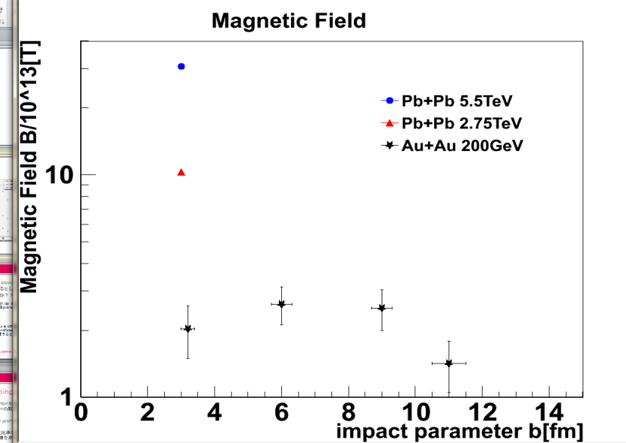
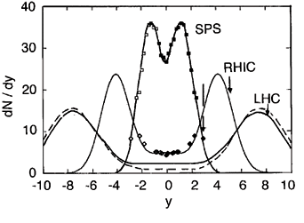
Field Intensity and Time Evolution
common approach: cascade models
  spectator contribution dominant
    10¹⁴ – 10¹⁵ T at LHC
possible longer-lived field in “perfect fluid”
  participant contribution
  “static field” approximation
    10¹³ – 10¹⁴ T at LHC
baryon stopping power
taken into account
Pb+Pb 5.5 TeV
Pb+Pb 2.76 TeV
Au+Au 200 GeV
10¹⁴ T
10¹³ T

Slide 25
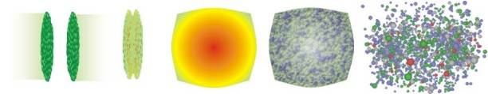
Experimental Probes of Intense Field
must originate from initial stages
  field life time ~ 0.1 fm/c
must be electro-magnetic
ideal probe: direct γ/γ∗ from pQCD processes
good reference: γ/γ∗ from later stages
  e.g. π⁰ decay γ/γ∗ (Dalitz di-electron)
0 fm/c
~ 4 fm/c
~ 10 fm/c
B > B_{c}
electro-magnetic probes
hadronic probes

Slide 26
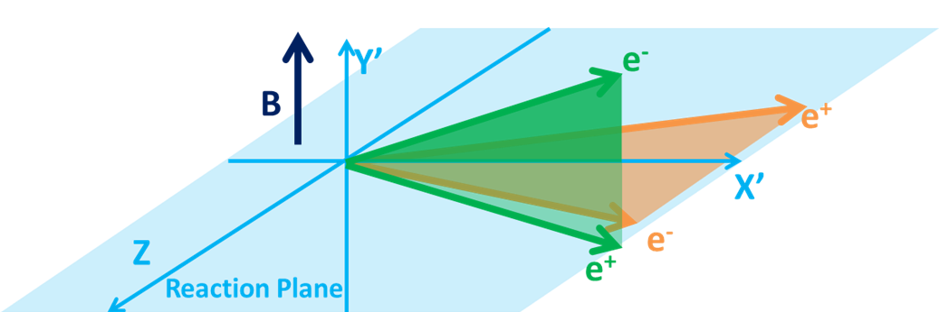
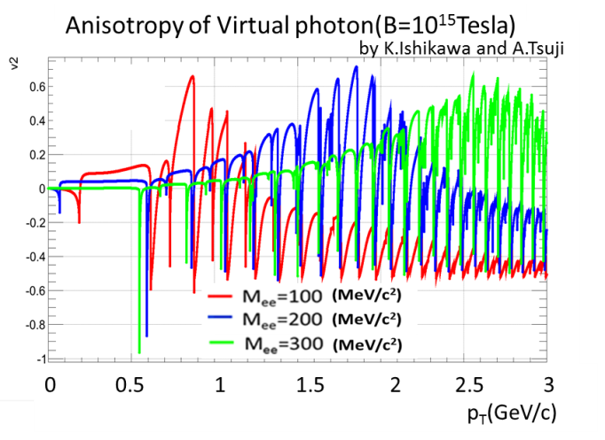
γ∗ (Low Mass l⁺l⁻) “Polarization” ?
anisotropic decay w.r.t. magnetic field
feasibility study based on QED calculations
  vacuum polarization tensors under magnetic field
    summation for infinite Landau levels
    photon momentum up to ~ GeV
    ref. K.-I. Ishikawa, K. Shigaki, et al.,
    Int. J. Mod. Phys. A28, 1350100 (2013)
anisotropy ~ o(10⁻¹)
l⁻
γ*
γ*
?
l⁺

Slide 27
ALICE（-Japan） Upgrade Strategies
1st – high p_{T} phenomena (jets), heavy flavors
  ✓ × 2–3 speeding up, new detectors; LS1 2013–2014
    upgrade: TPC readout (Tokyo), PHOS readout (Hiroshima)
    new: di-jet calorimeter (Tsukuba)
2nd – low/mid p_{T} phenomena
  × 100 speeding up, new detectors; LS2 2019–2020
    upgrade: TPC chamber (Tokyo), new vertex trackers
    new: muon forward tracker (Hiroshima + Nagasaki, Nara)
3rd – (further) forward physics
  new detectors; LS3? 2024?
    new: forward calorimeter (Tsukuba + Hiroshima, Nara)

Slide 28
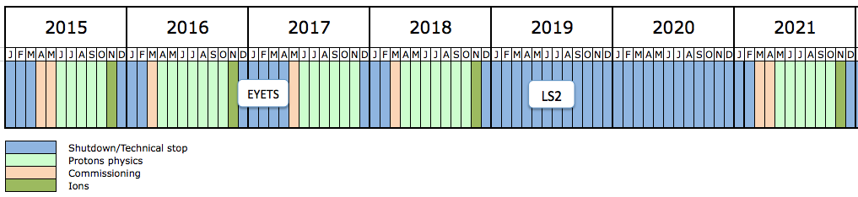
Near-Term LHC Run Schedule
Run 2
Run 3
Long Shutdown 2
6.5 TeV proton beam
p-p, p-Pb, Pb-Pb
7.0 TeV proton beam
p-p, p-Pb, Pb-Pb
LHC luminosity upgrade
ALICE upgrade & speeding up

Slide 29
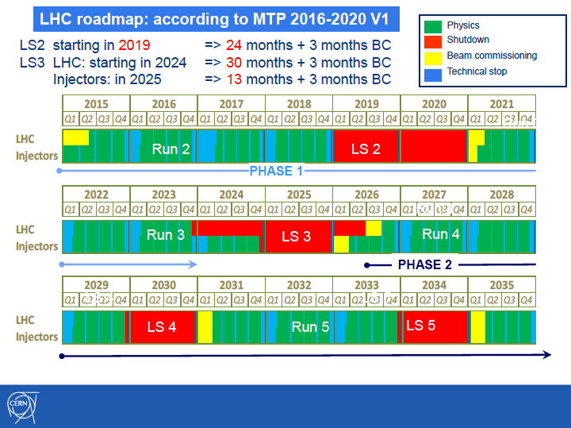
Further Future Opportunity
discussions for run 4 (2026 -) and beyond
fixed target program at LHC
  √s_{NN} ~ 72 GeV with 2.76 A GeV Pb beam
    well above critical √s_{NN} (probably between 10 – 20 GeV)
  much higher rate than colliders
  muon measurement in “central” region
    center-of-mass rapidity shifted by ~ 4.3
    ALICE muon spectrometer covering 2.5 < |η| < 3.6

Slide 30
Summary and Concluding Remarks
deconfined quarks and gluons now in hand
  opposite situation to many other chirality in nature
    chiral symmetry usually broken; restored by heating up
  parity symmetry breaking also possible
chirality/parity/helicity: long standing key issue
  “parallel world” with modified hadron mass
  interplay with ultra-intense magnetic field ~ 10¹⁴ T
experimental approaches with high expectations
  chiral symmetry restoration as remaining challenge
  new topics, e.g. ultra-intense magnetic field
  fixed target program at LHC possibly in future

