Slide 1

実験クォーク物理学の最先端
極限状態への挑戦
志垣 賢太 （ ）
名古屋大学大学院理学研究科物理学教室談話会
2018 年 6 月 27 日

Slide 2
特別講義 （6/26 - 28） 内容
高エネルギー原子核衝突実験の物理学
（1） 対象, 目的, 意義, 歴史, 基礎概念
（2） 高温非閉込クォーク相の発見
  BNL–RHIC 加速器 PHENIX 実験
（3） 最新状況と展望
  CERN–LHC 加速器 ALICE 実験
（教室談話会） 最先端の話題： 極限状態への挑戦
（4） カイラル対称性回復とハドロン質量
（5） 課題, 将来計画, 復習, まとめ

Slide 3
Presentation Outline
physics of relativistic heavy ion collisions
discovery of deconfined partonic phase
  achieved temperature and regime on phase diagram
  unexpectedly also in high-multiplicity small systems!?
physics in extreme conditions
  quark behavior/interaction in strong QCD field
  chiral symmetry restoration
  ultra-intense magnetic field and vorticity
LHC-ALICE upgrade programs
  new approach to solve remaining/emerging mysteries
summary and concluding remarks

Slide 4
Goals of High Energy A+A Collisions
why nucleus-nucleus at GeV/TeV range?
  “snowball + snowball”
“system” of particles under strong QCD field
  non-perturbative QCD under extreme conditions
    cf. “processes” between elementary particles
state of matter at ~ 10⁻⁵ seconds after Big Bang
  quark (de)confinement
    cf. production/interaction of matter at ~ 10⁻¹² seconds
hadronic mass generation at confinement
  spontaneous chiral symmetry breaking/restoration
    cf. particle mass generation via BEH mechanism

Slide 5
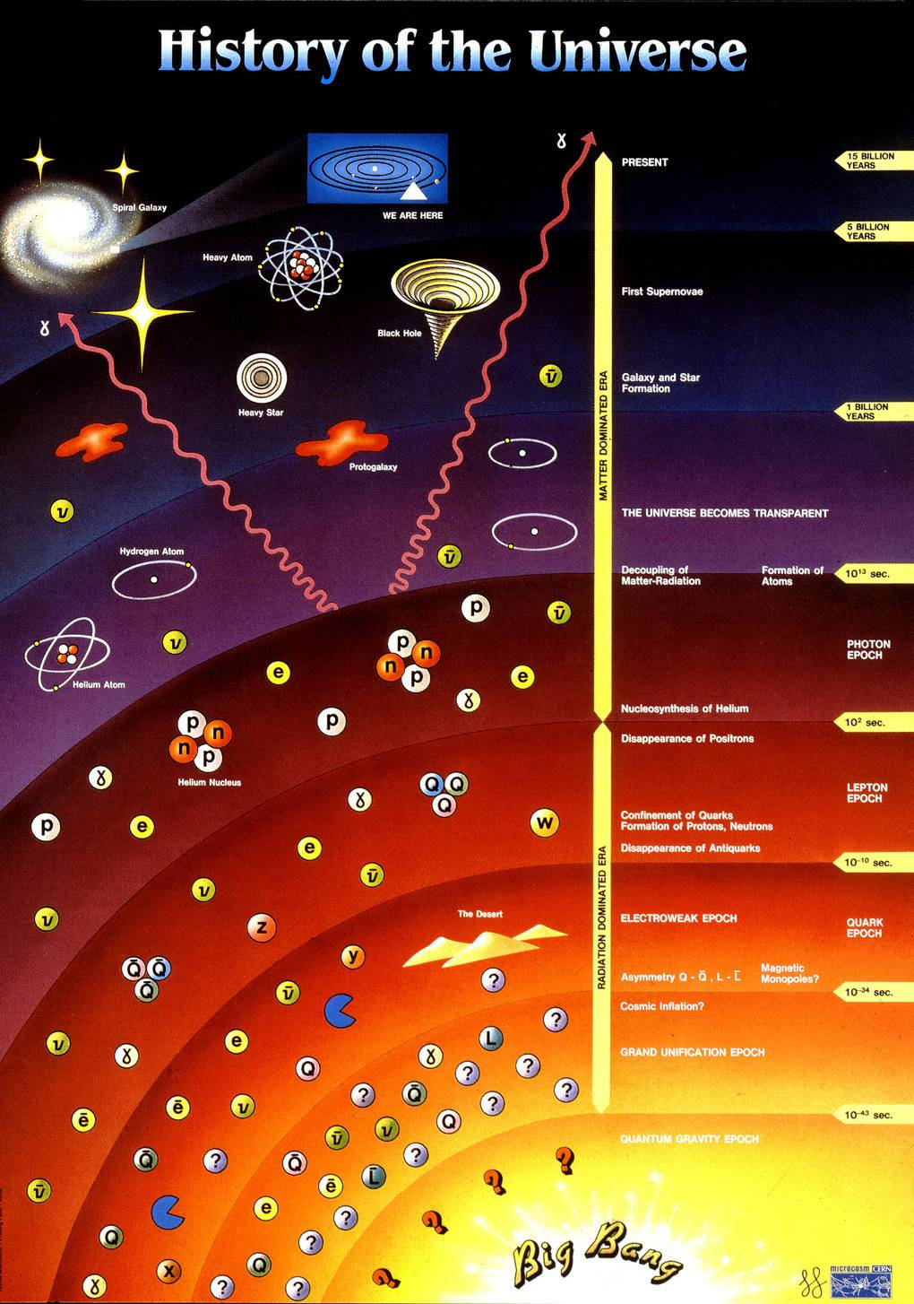
History of Universe and Matter
14 by
this colloquium
1 by
star/galaxy formation
10¹² s
atom formation
10² s
nuclei synthesis
10⁻⁶ s
quark confinement
anti-quark annihilation
quark pair production
0.00 s
Big Bang

Slide 6
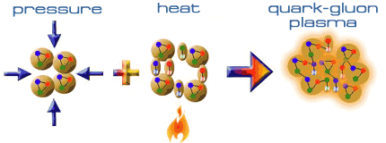
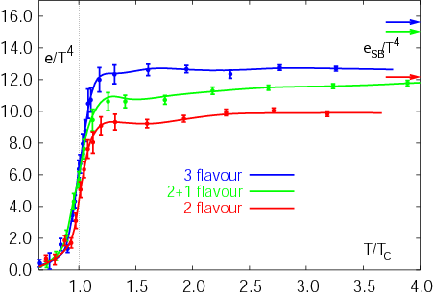
Expeditions on QCD Phase Diagram
toward (or back to) deconfined partonic phase
lattice Quantum Chromo-Dynamics predictions
  critical temperature ~ 170 MeV
  critical energy density ~ 1 GeV/fm³
Early Universe
Deconfined Partonic Phase
(Quark-Gluon Plasma)
Tri-Critical point
Energy Density (Temperature)
Critical Temperature ~ 170 MeV
High Energy A+A Collisions
Hadron gas
Color Super-Conductivity?
Color-Flavor Locking?
F. Karsch,
Lect. Notes Phys. 583 (2002) 209
Nucleus
Neutron Star
Baryon Density

Slide 7
Uniqueness of QCD Phase Transition
only possible boundary to experimentally cross
  to prove (or disprove) paradigm of universe evolution
  lost phase within experimental reach
    not just to catch residue
K. Homma, 2008/09

Slide 8
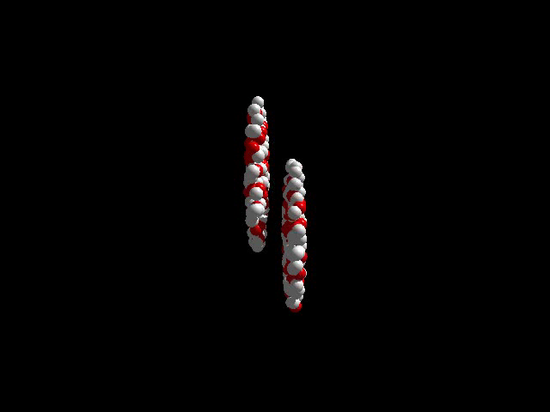
History of Quark Matter Search
1970’s–80’s: first trials
  LBL–BEVALAC （2 A GeV ⁴⁰Ar）
  BNL–AGS （15 A GeV ²⁸Si）
  CERN–SPS （200 A GeV ³²S）
1990’s: onsets of discovery
  BNL–AGS （11 A GeV ¹⁹⁷Au）
  CERN–SPS （158 A GeV ²⁰⁸Pb）
2000’s: deconfined partonic phase!
    thanks to nuclear colliders
  BNL–RHIC （100 + 100 A GeV ¹⁹⁷Au + ¹⁹⁷Au）
  CERN–LHC （2.8 + 2.8 A TeV ²⁰⁸Pb + ²⁰⁸Pb）

Slide 9

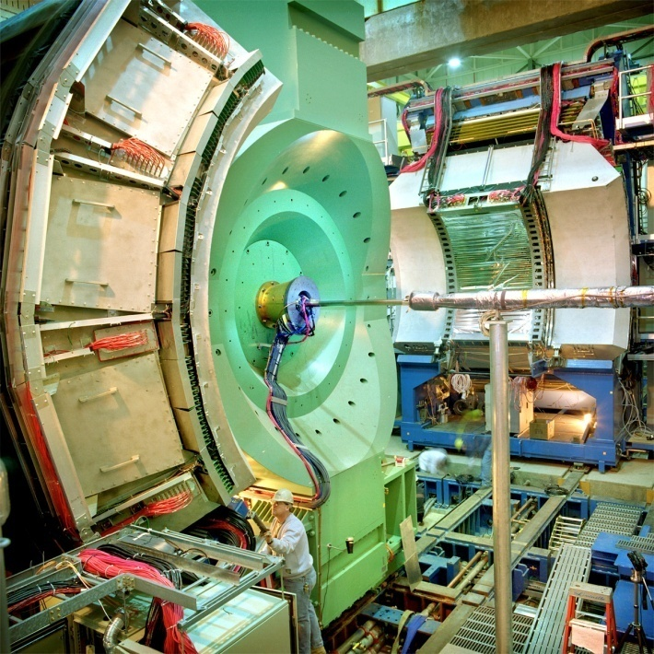




Relativistic Heavy Ion Collider at BNL
2 independent super-conducting synchrotrons
up to 100 A GeV Au and/or 250 GeV (polarized) p
  Au+Au/U+U/Cu+Cu/p+p/p+Au/d+Au/³He+Au/Cu+Au…
4 (presently 1.5) complimentary experiments

Slide 10
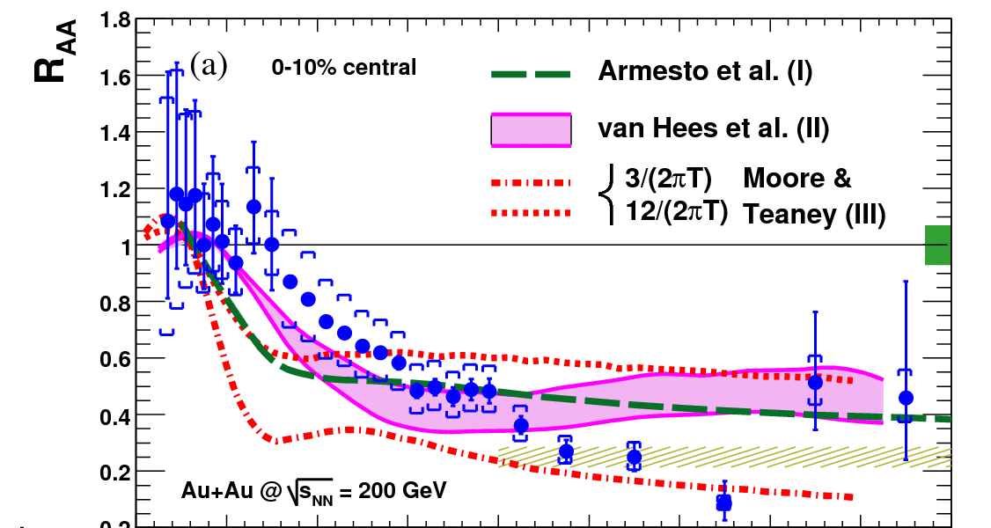
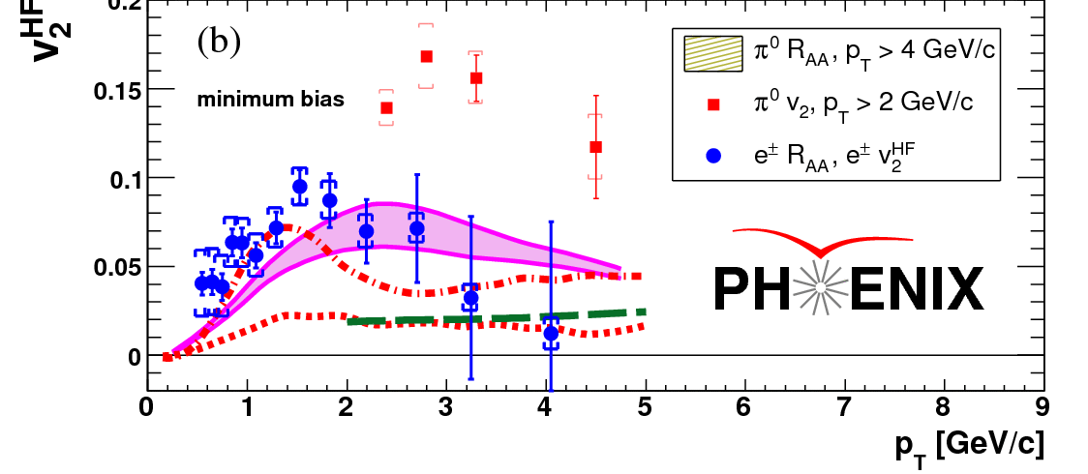
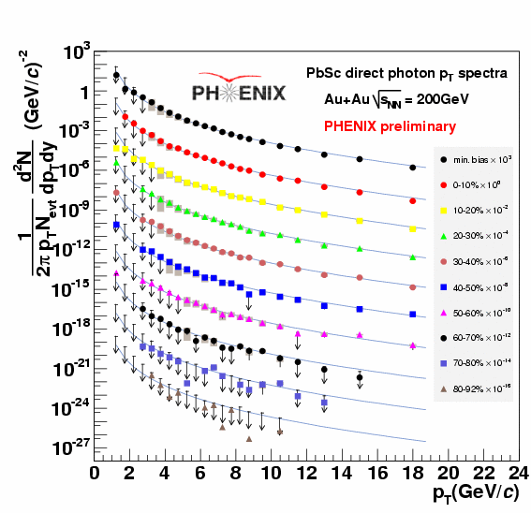
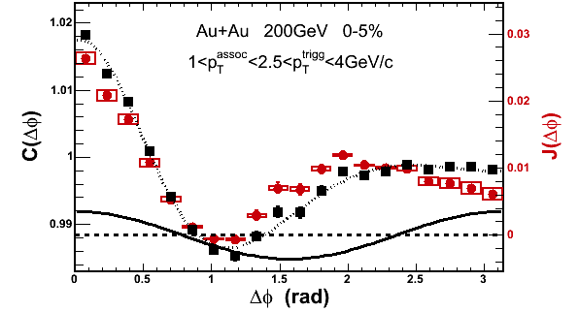
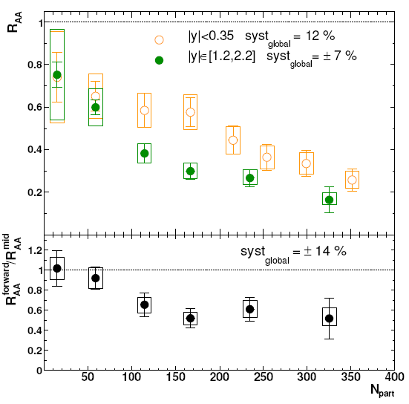
RHIC Outcomes: New State of Matter
partonic: quarks’ degrees of freedom, screening
  constituent quark number scaling of collective motion
  J/Ψ suppression
dense: energy loss of (even heavy) quarks
  jet quenching (high p_{T} suppression)
  jet modification
strongly coupled: perfect fluidity
  hydro-dynamical collective motion
hot: thermally radiative
  thermal (virtual) photons
The matter is dense
The matter is strongly coupled
The matter may melt and/or regenerate J/ψ’s
The matter modifies jets
The matter is hot

Slide 11
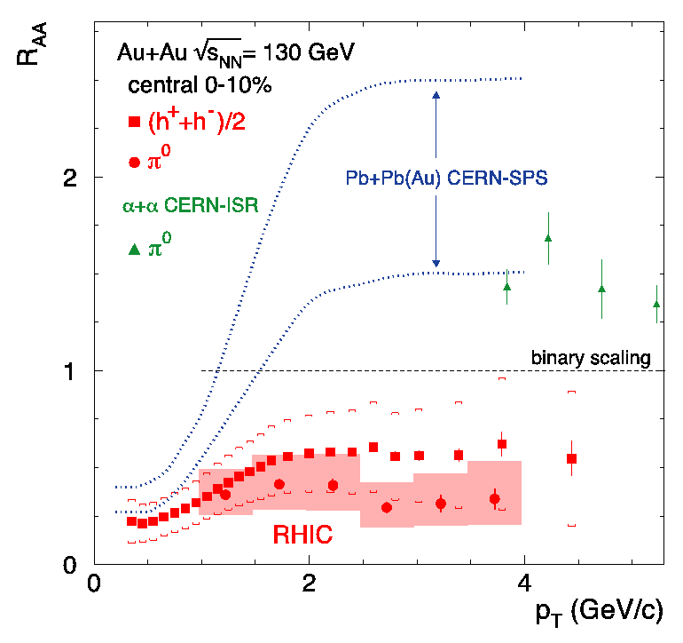
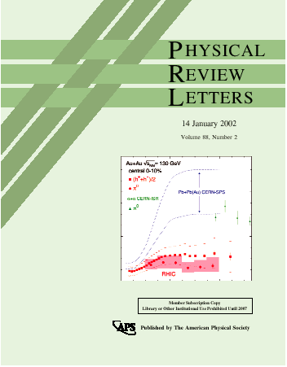
Quark Behavior in Extreme Density
binary collision scaling
based on extrapolated
UA1 p+p data
--
Au+Au at √s_{NN} = 130 GeV
PHENIX PRL 88, 022301 (2002)
less high p_{T} particles produced due to “quenching”

Slide 12
First Signature of Partonic Matter
parton energy loss in deconfined partonic matter
  → high transverse momentum jets suppressed
  → azimuthal back-to-back correlation modified/lost
leading hadron with high p_{T}
hadron jet
(anti-)quark/gluon
(anti-)quark/gluon
hadron jet
leading hadron with high p_{T}

Slide 13
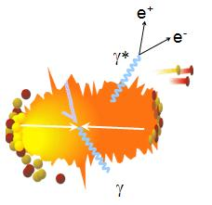
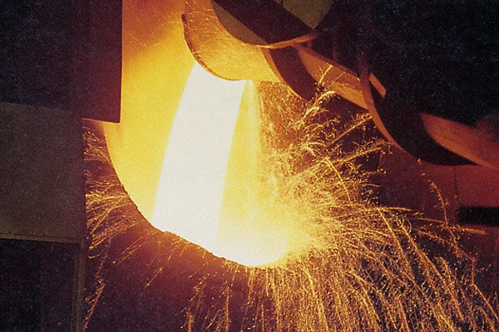
Photons as Wide Scale Thermometer
thermal radiation if in equilibrium
emission spectrum ↔ temperature
real and virtual thermal photons

Slide 14

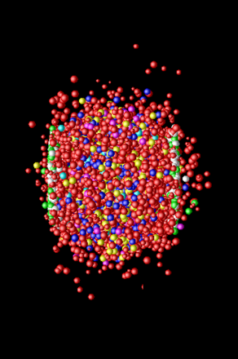
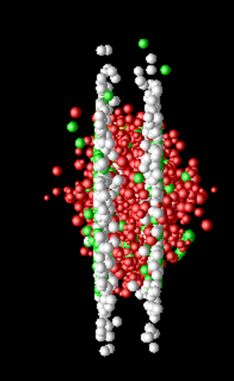
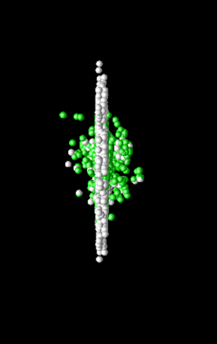
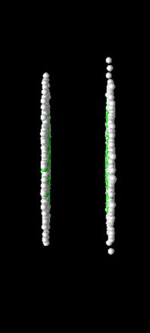
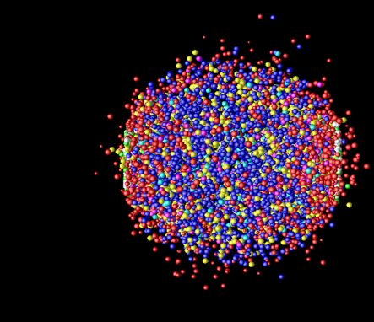
Photon Production Everywhere
Hadronization
(Freeze-out) +
Expansion
Mixed phase
Thermalization
QGP phase
Pre-equilibrium
Compton/Annihillation
Fragmentation
Prompt Photon
Jet-Photon Conversion
Jet-Bremsstrahlung (QGP)
Jet+Medium
Thermal Photon (QGP)
Thermal Photon (HG)
Thermal Photon
Time Evolution

Slide 15
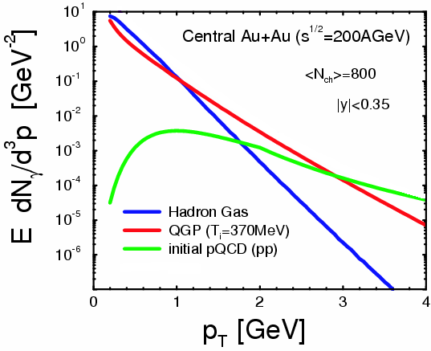
Where to Catch QGP Thermal Photons
π
π
g
q
high p_{T} : pQCD photons
low p_{T} : photons from hadronic gas
intermediate p_{T} : QGP thermal photons dominant (!)
also other sources
plus hadron decay photons everywhere
hadron decay
photons
ρ
γ
q
γ
S.Turbide et al., PRC 69 014903

Slide 16
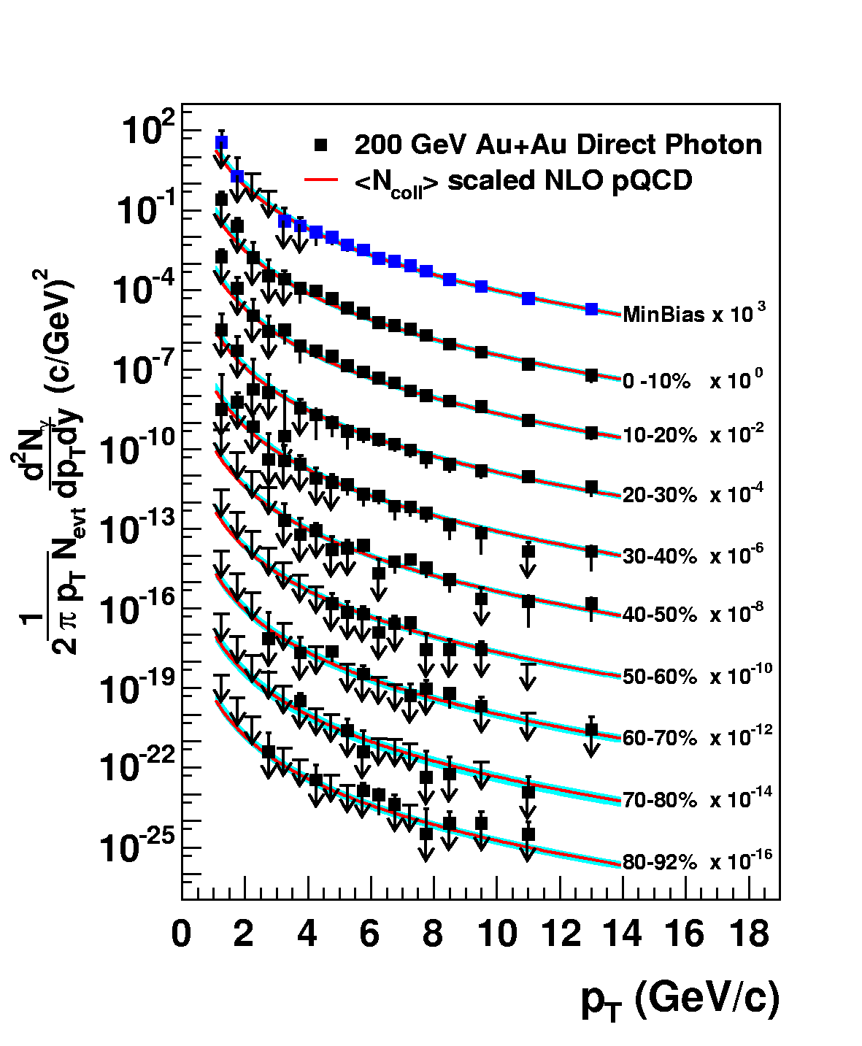
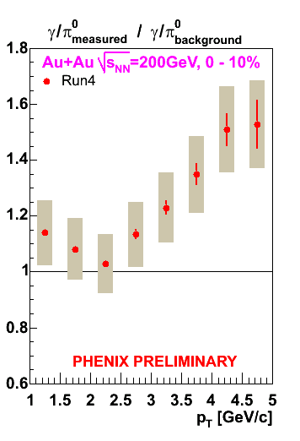
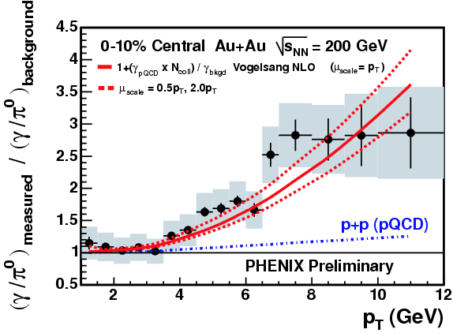
Naïve Way: Direct Real Photons
measured as excess above hadron decay photon
  Au+Au result consistent with pQCD × binary scaling
challenging at lower p_{T} due to smaller S/B ratio
PRL 94, 232301 (2005)

Slide 17
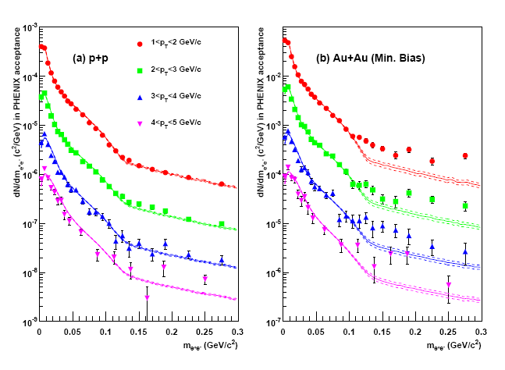
Alternative: “Almost Real” Photons
low mass electron-positron pairs
p+p: hadronic decay + pQCD photon at high p_{T}
Au+Au: enhancement above ~ 135 MeV
  no π⁰ decay virtual photon background above π⁰ mass
PHENIX (A. Adare et al.),
PRL 104, 132301 (2010)

Slide 18
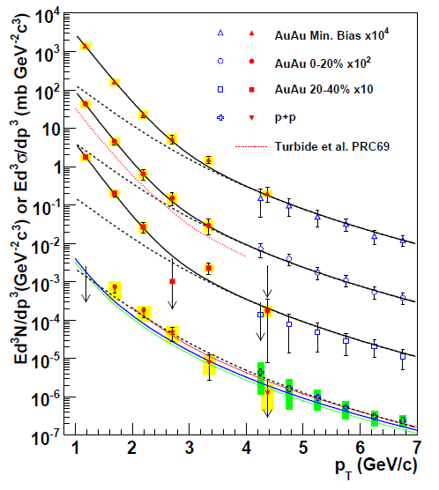
Direct Photon Spectra via γ and γ*
real and virtual photon methods consisitent
Au+Au: “thermal” excess
  ~ exponential with slope 221 ± 19 ± 19 MeV
cf. p+p data
  consistent with pQCD down to low p_{T}
PHENIX (A. Adare et al.), PRL 104, 132301 (2010)
NLO pQCD (W. Vogelsang)

Slide 19
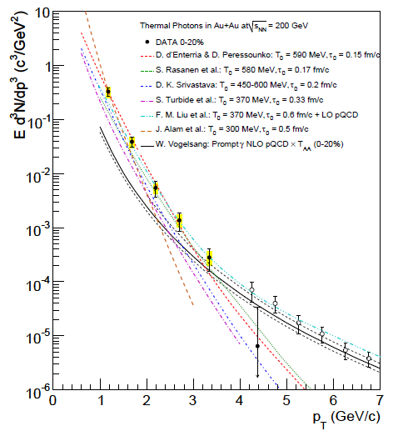
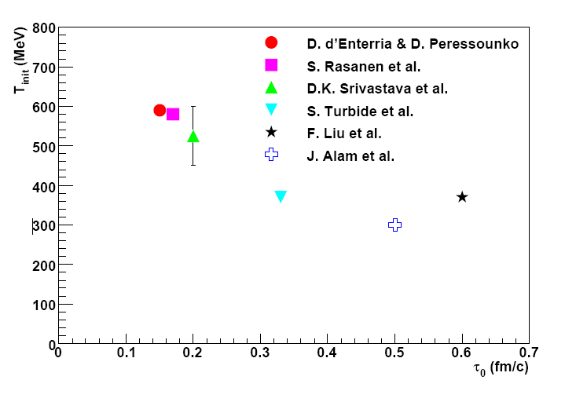

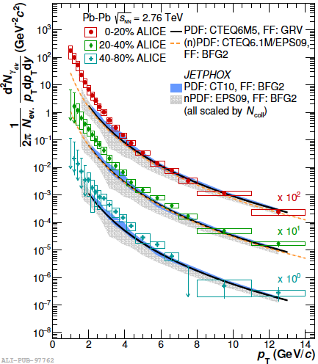
Initial Temperature Evaluation
initial temperature > data slope ~ 220 MeV
300–600 MeV (model dependence within factor 2)
  hydro-dynamic description
    w/ τ₀ = 0.15–0.6 fm/c
slope at 2.76 TeV: 297 ± 12 (stat.) ± 41 (sys.) MeV
cf. phase transition predicted at ~ 170 MeV
slope
PHENIX (A. Adare et al.),
PRC 81, 034911 (2010)
transition temperature
ALICE, PLB 754, 235-248 (2016)

Slide 20
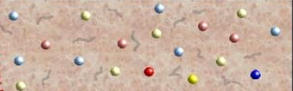
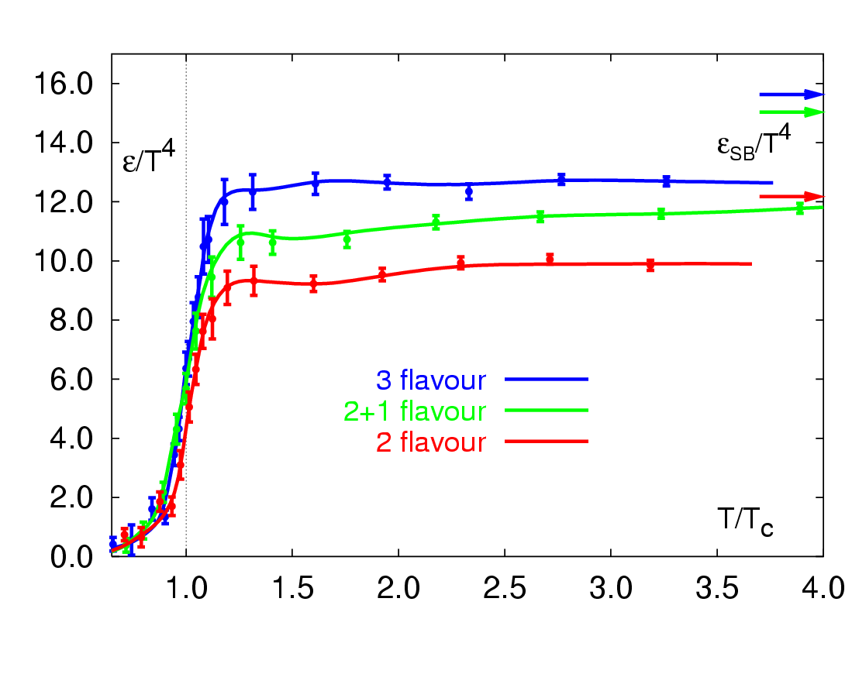
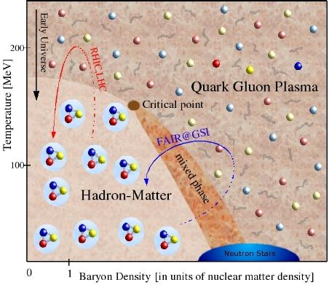
RHIC Outcome: Boundary Crossed
RHIC → LHC
RHIC
“free gas” ?
F. Karsch,
Lect. Notes Phys. 583, 209 (2002)
“perfect fluid”
RHIC → LHC
RHIC

Slide 21
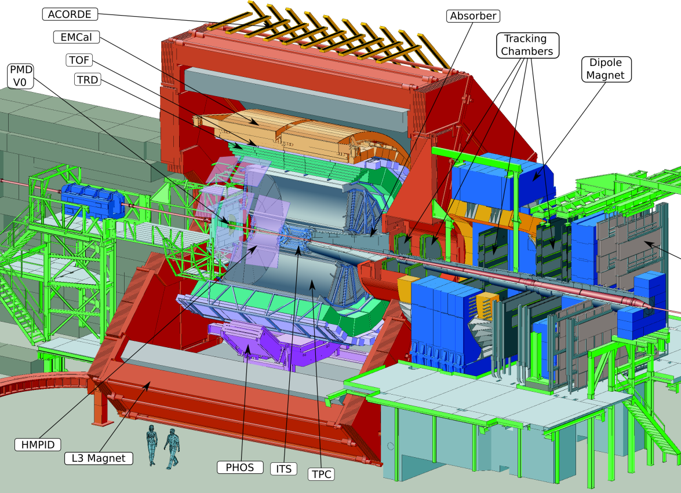
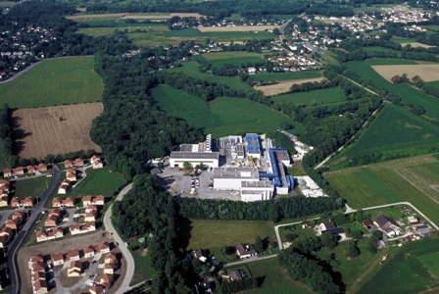

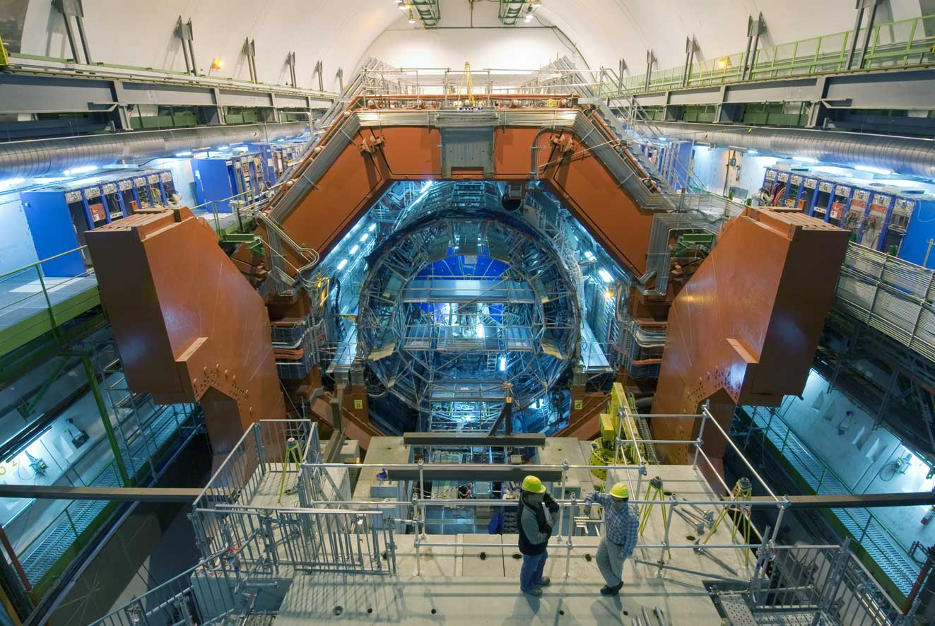
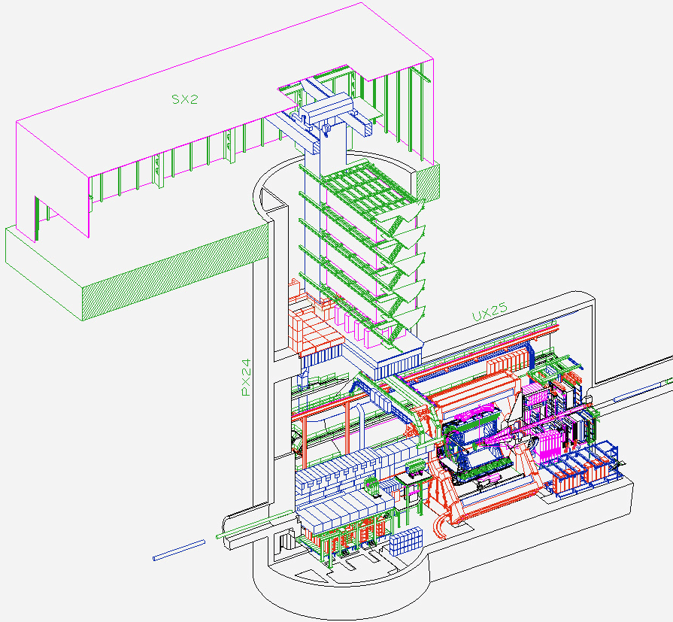
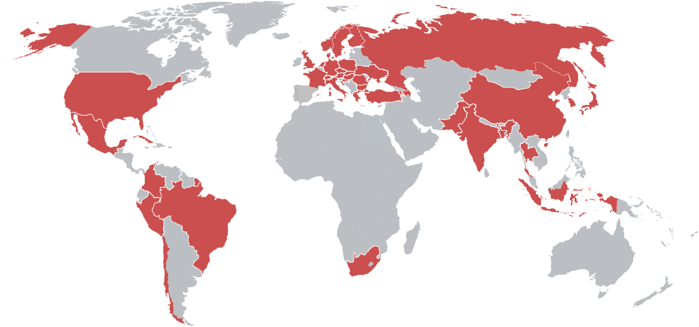
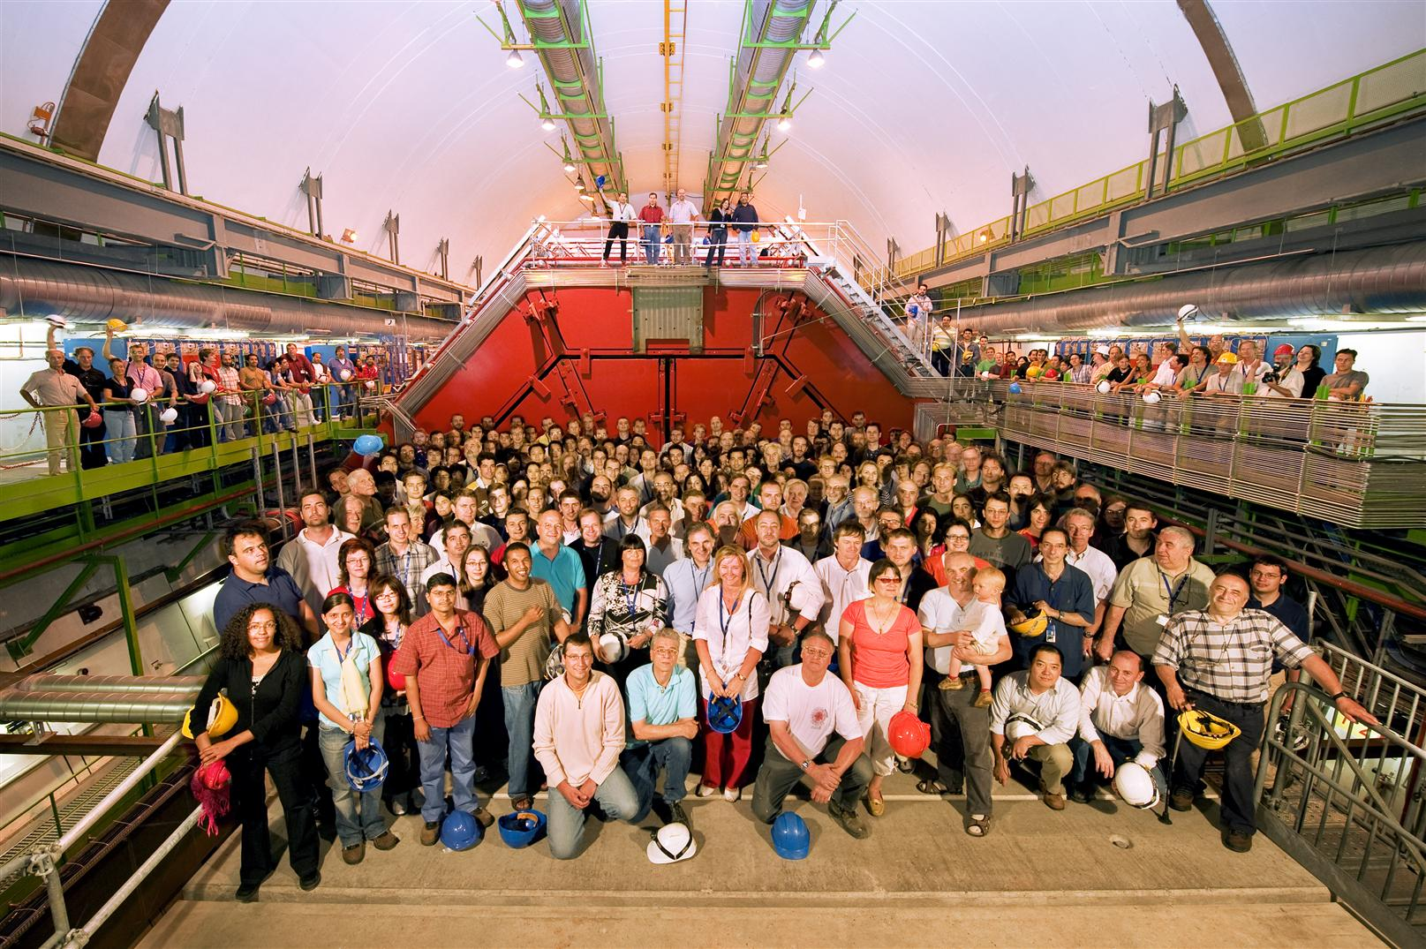
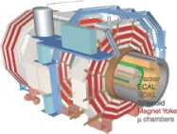
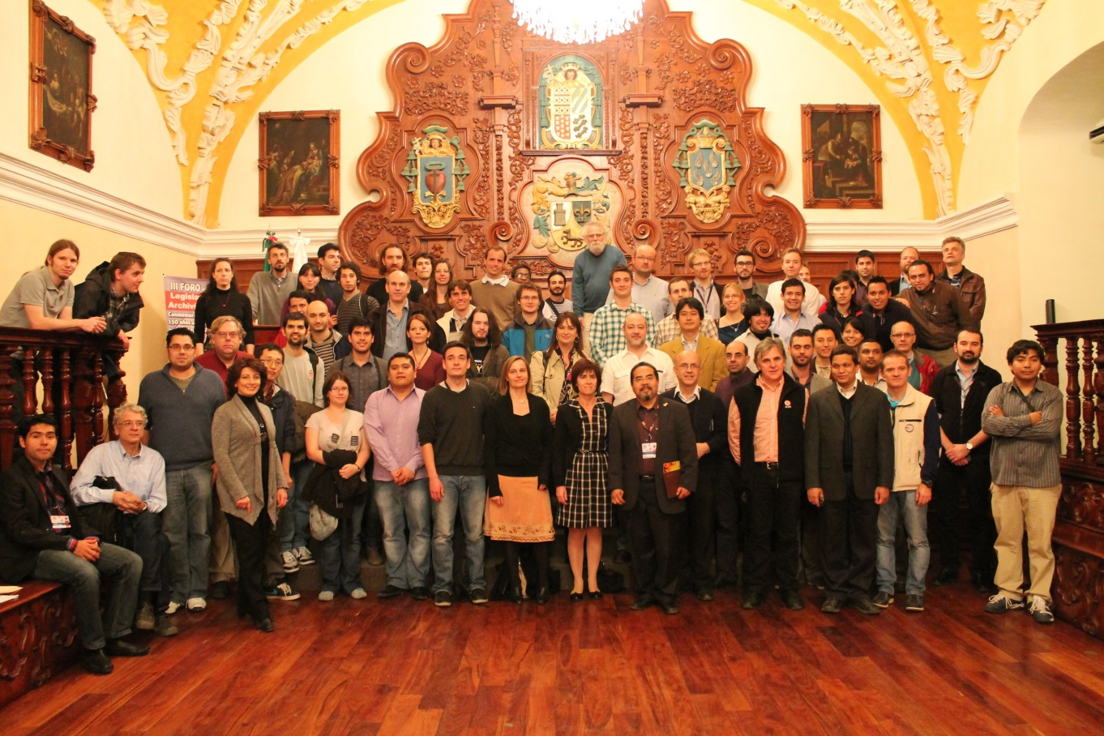
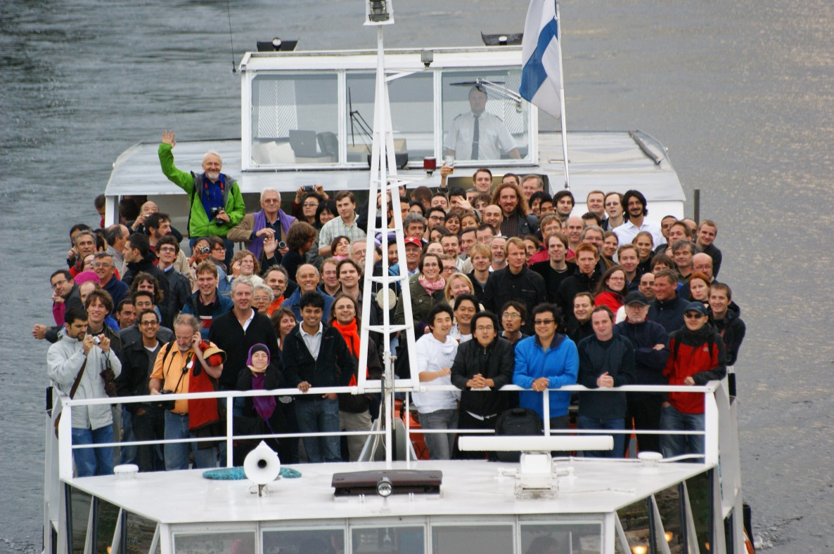


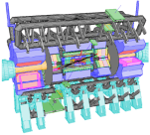


A Large Ion Collider Experiment at LHC
the nucleus-nucleus collision experiment at LHC
41 countries; 178 institutes; ~1,800 members
    as of 2018/01
CMS
LHCb
ALICE
ATLAS, LHCf

Slide 22
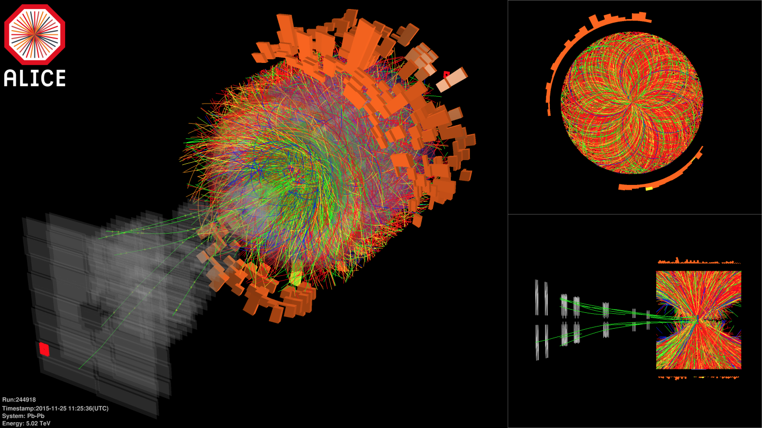

Pb+Pb at Highest Ever Energy
5.02 TeV per nucleon-nucleon pair in 2015, 2018
  25 times higher than at RHIC
  design energy at 5.5 TeV
2.76 TeV in 2010 and 2011

Slide 23
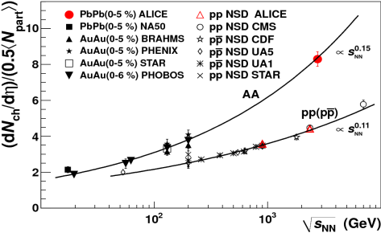
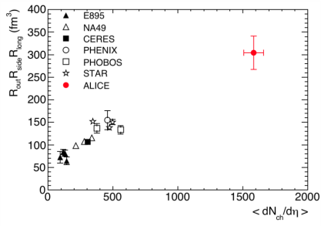
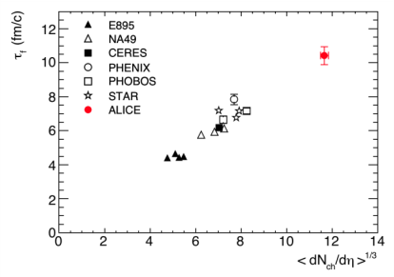
Hotter, Larger, Longer-Lived, and Purer
fireball compared to that at RHIC
  energy density × ~3, volume × ~2, life × 1.2–1.3
    ~ 16 GeV/fm³ (thermalization time ~ 1 fm/c)
    ~ 300 fm³, ~ 10 fm/c
net quark (baryon) density ~ 0
  anti-proton/proton at mid-rapidity
    p+p 900 GeV： 0.957 ± 0.006 (stat) ± 0.014 (sys)
    p+p 7 TeV： 0.990 ± 0.006 (stat) ± 0.014 (sys)
ALICE (K. Aamodt et al.),
PRL 105, 072002 (2010)
ALICE (K. Aamodt et al.),
PLB 696, 328 (2011)

Slide 24
Playground with Extreme Conditions
deconfined quark/gluon phase now in hand
  mechanism and prerequisites of phase transition
quark behavior in strong QCD field
  energy loss and redistribution
quarks interaction in strong QCD field
  color Debye screening to melt quarkonia
chiral symmetry restoration
  hadron mass modification
more exotics
  physics under ultra-intense magnetic field and vorticity

Slide 25
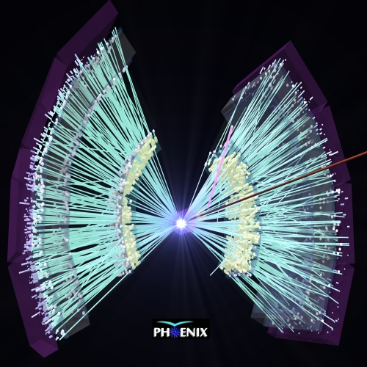
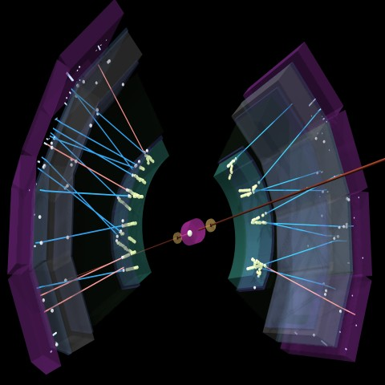
p(d)+A: Reference or Unexpected
originally as reference to bridge p+p and A+A
  initial state nuclear effects
  final state cold nuclear matter effects
Au+Au at √s_{NN} = 200 GeV
d+Au at √s_{NN} = 200 GeV

Slide 26
First PRL Cover with RHIC Year 1 Data
binary collision scaling
based on extrapolated
UA1 p+p data
--
Au+Au at √s_{NN} = 130 GeV
PHENIX PRL 88, 022301 (2002)
high p_{T} yield suppressed due to quark energy loss

Slide 27

Another PRL Cover with d+Au
“lack of suppression”
  indicating final state fireball effect in Au+Au
PHENIX
BRAHMS
PHOBOS
STAR
PRL 91 (August, 2003)

Slide 28
Something More Complicated
original thought: cold nuclear matter, i.e.
  not partonic
  not dense
  not strongly coupled
  not hot
indications of strongly coupled partonic matter??
  note: only in high multiplicity events; still valid reference

Slide 29
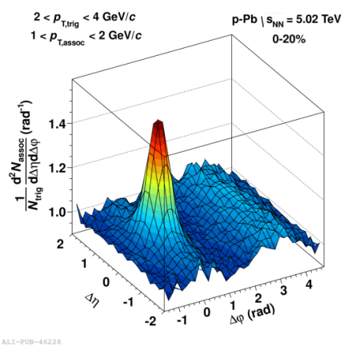
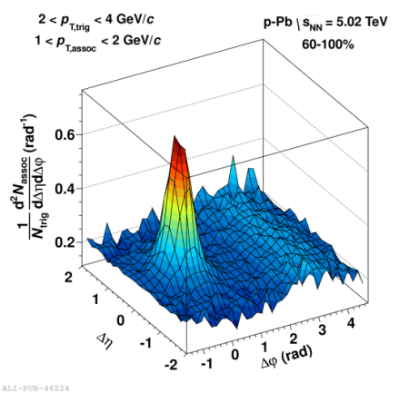
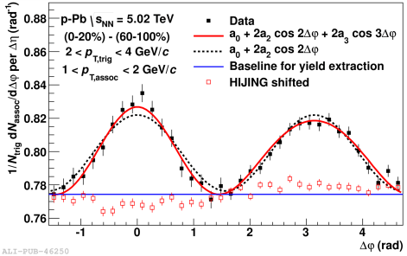

New Discovery in p+p, p+A
“ridge” in p+p and “double ridge” in p+Pb
  long range angular correlations in near and away sides
collective flow due to initial partonic fluctuation
  strongly coupled matter already in p+p and p+A?
− =
high multiplicity p+Pb low multiplicity p+Pb long range correlation

Slide 30

Hydro-like Behaviors in p+p, p+A
harder particle spectra at higher multiplicity
increasing effect with particle mass
better described by models
with hydrodymanics
    Blast-Wave: PRC 48,2462 (1993)
    EPOS LHC: arXiv:1306.0121 [hep-ph]
    Krakow: PRC 85,014911 (2012)
    DPMJET: arXiv:hep-ph/0012252

Slide 31



Quark Fluid in p+p, p+A?
baryon enhancement in intermediate p_{T}
  understood via quark recombination in A+A
similar evolution with multiplicity
even in p+p?

Slide 32

(Multi-)Strangeness Enhancement
another “QGP signature” in high mult. p+p, p+A
ALICE, Nature Physics
13, 535-539 (2017)

Slide 33
Next Steps with High Mult. p+p, p+A
hydro-dynamical behaviors already seen
medium properties, e.g. strange chemical potential
parton energy loss probably hard to observe
  path length ~ medium size
  high statistics high precision measurement?
thermal radiation?
quarkonia suppression?
high luminosity high statistic data essential
  < 1% high multiplicity event selection

Slide 34
Mysteries of Mass
total mass = sum of components’ masses?
astronomical objects
quarks
quark in standard model
universe
quark
proton
matter 5 %
quark mass 1%
quark mass in standard model = 0
dark matter 27 % chiral symmetry breaking BEH mechanism
dark energy 68 %

Slide 35
Uniqueness of Chiral Phase Transition
only possible boundary to experimentally cross
  to prove (or disprove) paradigm of universe evolution
  lost phase within experimental reach
    not just to catch residue
K. Homma, 2008/09

Slide 36

Looking into “Parallel World”
phenomena with restored symmetry
QCD phase transition with chiral symmetry →
  diminishing effective (light) quark masses
  probably lower hadron masses
e.g. light vector meson mass modification
T.Hatsuda, H.Shiomi and H.Kuwabara
Prog. Theor. Phys. 95 (1996) 1009

Slide 37


Chiral Symmetry Restoration
“observations” in finite density regime
  φ, ω in nuclei via p+A (KEK E325)
    though apparent contradiction to CB-ELSA/TAPS and CLAS-G7
  π in nuclei via (d, ³He)
no evidence in high temperature regime yet
  challenging dilepton measurements
    e.g. PHENIX with RICH, hadron blind detector, ...

Slide 38



Dielectrons at ALICE
first results from runs 1, 2
  p+p 7 TeV, 13 TeV published; baseline established
  Pb+Pb 2.76 TeV to be submitted soon
very challenging S/B ratio in Pb+Pb
ALICE, arXiv:1805.044.07 [hep-ex]
submitted to Phys. Lett. B

Slide 39



Multiple Probes at ALICE
new low mass (φ, ω, ρ) μ⁺μ⁻ measurement
  to further improve by detector upgrade from 2021
to be combined with more traditional e⁺e⁻

Slide 40

Ultra-Intense Magnetic Field
U(1) magnetic field
  naturally expected with moving charged sources (nuclei)
  ~ 10¹⁵ T at LHC, ~ 10¹⁴ T at RHIC
    cf. magnetar surface ~ 10¹¹ T
  could be long-lived in “perfect fluid”
possible non-linear QED behaviors
  above electron critical magnetic field em_{e}² = 4×10⁹ T
various interesting physics under discussion
  chiral magnetic effects
  quark synchrotron radiation
  lower QCD critical temperature
Magnetic Field

Slide 41
Critical Magnetic Field
critical electric/magnetic field of electron
  energy within Compton radius ≈ own rest mass
  eE_{c}h/m_{e}c = m_{e}c² ; E_{c} = m_{e}²c³/eh ~ 10¹⁷ V/m
  eB_{c}h/m_{e}c = m_{e}c ; B_{c} = m_{e}²c²/eh ~ 10⁹ T
Schwinger mechanism in case of electric field
  e⁺e⁻ pair production
  no sense to condsider E > E_{c}
non-linear QED effects in case of magnetic field
  e.g. γ → γ γ, γ → e⁺e⁻, bi-refringence, …

Slide 42


Chiral Magnetic Effects
if strong parity violation and magnetic field
charge separation, observed at RHIC and LHC
B
correlation between particles with different charges
correlation between particles with same charges

Slide 43
LPV Domain Size and Observables
assuming perfect alignment and distribution
if 1 domain, [(n₊↑ − n₊↓)/(n₊↑ + n₊↓)]² is always 1
if 2, it is 1 (50%) or 0 (50%), i.e. average at 1/2
if 3, it is 1 (25%) or 0.11 (75%), i.e. average at 1/3
# domains ↔ width of [(n₊↑ − n₊↓)/n₊]² distribution
large N limit ≈ independent N particle production
btw here, [(n₊↑ − n₋↓)/(n₊↑ + n₋↓)]² is always 0
  note this does mean correlation
large N limit ≠ independent N particle production

Slide 44


Field Intensity and Time Evolution
common approach: cascade models
  spectator contribution dominant
    10¹⁴ – 10¹⁵ T at LHC
    short life time < 1 fm/c due to Lorentz contraction
    though still above m_{e}²/e after several fm/c
JAM; Au+Au 200 GeV
(A.Tsuji)
URQMD; Au+Au 200 GeV

Slide 45


Field Possibly Longer Lived
long lived participant contribution in perfect fluid?
  “static field” approximation w/ Glauber model
    finite baryon stopping taken into account
    10¹³ – 10¹⁴ T at LHC
hydro model with local charge nearly available
(A.Tsuji)
Pb+Pb 5.5 TeV
Pb+Pb 2.76 TeV
Au+Au 200 GeV
baryon stopping power
from net baryon distribution
10¹⁴ T
10¹³ T

Slide 46


Vorticity (and/or Magnetic Field)
angular momentum transfer to Λ polarization
  spin - orbit coupling
magnetic field also possible Λ polarization source
  opposite alignment of Λ and Λ
detectable via parity violating Λ decay
T.Niida for STAR, IS’17

Slide 47
Λ Polarization Measurements
successful example of precision improvement
  zero consistent with upper limit at 0.2% in 2007
  √s_{NN} dependent polarization found by 2017

Slide 48

Non-Zero (and Large) Vorticity Found
ω = (9 ± 1) × 10²¹ s⁻¹
  √s_{NN} averaged
  assuming T = 160 MeV
magnetic field?
  implied by Λ and Λ difference
  though still zero consistent
T.Niida for STAR, IS’17

Slide 49
Implications for Magnetic Field Search
magnetic field not yet caught
long-lived medium rotation; very promising source
higher statistics data required at LHC
T.Niida for STAR, IS’17

Slide 50

Experimental Probes of Intense Field
must originate from initial stages
  field life time ~ 0.1 fm/c
must be electro-magnetic
ideal probe: direct γ/γ∗ from pQCD processes
good reference: γ/γ∗ from later stages
  e.g. π⁰ decay γ/γ∗ (Dalitz di-electron)
0 fm/c
~ 4 fm/c
~ 10 fm/c
B > B_{c}
electro-magnetic probes
hadronic probes

Slide 51




Proposal 1. Direct Photon Anisotropy
polarization tensor in magnetic field
  modification factor to
  seemingly v₂ ~ o(10⁻²)
obvious existence of other contributions to v₂
Y.Akamatsu, H.Hamagaki, T.Hatsuda, T.Hirano Phys. Rev. C 85, 054903 (2012)
Au+Au 200 GeV (PHENIX)
20–40% centrality direct γ v₂
k_{T} = 0 (k // B)
(K.Ishikawa and A.Tsuji)

Slide 52


Proposal 2. Direct Photon Polarization
anisotropic decay w.r.t. magnetic field
feasibility study based on QED calculations
  vacuum polarization tensors under magnetic field
    summation for infinite Landau levels
    photon momentum up to ~ GeV
    ref. K.-I. Ishikawa, K. Shigaki, et al.,
    Int. J. Mod. Phys. A28, 1350100 (2013)
anisotropy ~ o(10⁻¹)
l⁻
γ*
γ*
?
l⁺

Slide 53

Proposal 3. Femto-Spectrometer
bending power Bdl ~ 10¹⁴ T×10⁻¹⁵ m
→ bending angle ~ 3×10⁻²/p [rad/(GeV/c)]
detectable as opening angle offset
  e⁺/e⁻ bent in opposite way around magnetic field axis
    reaction axis from directional flow (v₁) in forward/backward
  o(1) degree for o(1) GeV/c particles!

Slide 54

Key Issue: Significance, i.e. Statistics
marginal at best, in 2012–2016
  4 M.Sc. theses in 2013–2016
    T.Hoshino, A.Tsuji, R.Tanizaki, Y.Ueda
  5 B.Sc. theses in 2012–2015
    A.Tsuji, R.Tanizaki, Y.Ueda, A.Nobuhiro, K.Yamakawa
higher statistics data available/coming in
  1 B.Sc. thesis in 2018
    T.Osako
ALICE run 3 (2021–) very promising with ×100 stat.
ALICE 2011
PHENIX 2014

Slide 55
Remarks on Intense Field Search
wide range of interests; not only LPV/CME(/CVE)
field time structure: key for physical significance
  longer-lived participant component in “perfect fluid”?
  hydro-dynamical model with local charge flow wanted
proposals of experimental detection approaches
  seemingly feasible; simulations and real data analysis
    direct photon polarization
    femto-spectrometer
semi-long term visitor on this from China in 2018
high prospects in near-future high statistics data
  both muons and electrons in ALICE run 3 (2021–)

Slide 56

Near-Term LHC Run Schedule
Run 2
Run 3
Long Shutdown 2
6.5 TeV proton beam
p-p, p-Pb, Pb-Pb
7.0 TeV proton beam
p-p, p-Pb, Pb-Pb
LHC luminosity upgrade
ALICE upgrade & speeding up

Slide 57
ALICE（-Japan） Upgrade Strategies
1st – high p_{T} phenomena (jets), heavy flavors
  ✓ × 2–3 speeding up, new detectors; LS1 2013–2014
    upgrade: TPC readout (Tokyo), PHOS readout (Hiroshima)
    new: di-jet calorimeter (Tsukuba)
2nd – low/mid p_{T} phenomena, e.g. c, b ≥ 0 GeV/c
  × 100 speeding up, new detectors; LS2 2019–2020
    upgrade: TPC chamber (Tokyo), new vertex trackers
    new: muon forward tracker (Hiroshima + Nagasaki, Nara)
3rd – t.b.d.: (further) forward physics?
  new detectors; LS3? 2024?
    new: forward calorimeter (Tsukuba + Hiroshima, Nara)

Slide 58



Major Upgrades for Run 3 (2021–)
new inner tracking system
  7 layers of MAPS silicon pixel detectors
  precise measurement of displaced vertices
    to separate charm/beauty mesons
new TPC readout chambers
  GEM technology with no gating grid
  ~100 times higher data taking rate (50 kHz in Pb+Pb)
    continuous readout without triggering
Muon Forward Tracker (MFT)
integrated online/offline data handling (O²)

Slide 59





Muon Forward Tracker (2021–)
vertex and invariant mass resolutions to improve
Tracker
Trigger
𝝻
MFT
𝝻
Frontal
Absorber
Dipole
Dipole
Iron Wall

Slide 60
Muon Forward Tracker Design
2.45 < −η < 3.6
0.4 m² of MAPS silicon pixel sensors
  25 μm x 25 μm, 0.7% X₀ per disk
5 double sided disks at −z = 460–768 mm
Pb+Pb ~50 kHz, p+p ~200 kHz
matching between MFT and muon spectrometer

Slide 61



MFT Structure and Elements
chip (920)/ladder (280)/zone (80)/half plane (20)
/half disk (10) + PS unit (2)/half MFT (2)/MFT (1)

Slide 62







MFT Progresses
R&D review mostly passed by 2017
prototyping components; production starting

Slide 63




MFT Control System by Hiroshima
new architectures in ALICE run 3
  e.g. gigabit transfer slow control adapter (GBT-SCA)
hardware control, finite state machine, interlock

Slide 64



Uniqueness of LHC Forward Region
two interesting regimes of quark-gluon phase
  exploration on QCD phase diagram
virtue only at LHC (and above)
  not too forward for “central” physics (2.5 < |η| < 3.6)
  forward enough for muon measurement

Slide 65
Original Goals Primarily at High Mass
quark behavior in strong QCD field
    current interest: difference between charm and beauty quarks
  charm/beauty meson separation
quarks interaction in strong QCD field
    current interest: sequentially melting of various quarkonia
  feed down (e.g. B → ψ + X) identification

Slide 66

Powerful in Low Mass Region, Too
significant improvement with MFT
  mass resolution by ~4
  signal/background ratio by ~10
ALICE, MFT LOI,
CERN-LHCC-2013-014

Slide 67
Summary and Concluding Remarks
deconfined quarks and gluons now in hand
    steadily revealing partonic phase properties
  mechanism and prerequisites yet to be clarified
uniquely providing extreme conditions
  “Guinness record” temperature > 300 MeV (4×10¹² K)
    early universe phase transition experimentally reverted
  “parallel world” with restored chiral symmetry?
  perfect fluidity (beyond helium and ultra-cold atoms?)
  ultra-intense magnetic field ~ 10¹⁴ T and vorticity
    interplay between chirality, magnetic field, and vorticity
next steps to utilize unique physics conditions
  ALICE upgrades, esp. Muon Forward Tracker (2021–)

