Slide 1

Heavy Ion Collisions and Challenges to Access
Extreme Conditions
Kenta Shigaki
(Hiroshima University )
13 March, 2018
CEA Saclay, France

Slide 2
Presentation Outline
heavy ion collisions to cross QCD phase boundary
discovery of partonic phase (at BNL RHIC)
  achieved temperature and regime on phase diagram
physics in extreme conditions (at CERN LHC)
  quark behavior/interaction in strong QCD field
  chiral symmetry restoration
  ultra-intense magnetic field
ALICE upgrade programs
  next attack to low/mid p_{T} phenomena
summary and concluding remarks

Slide 3
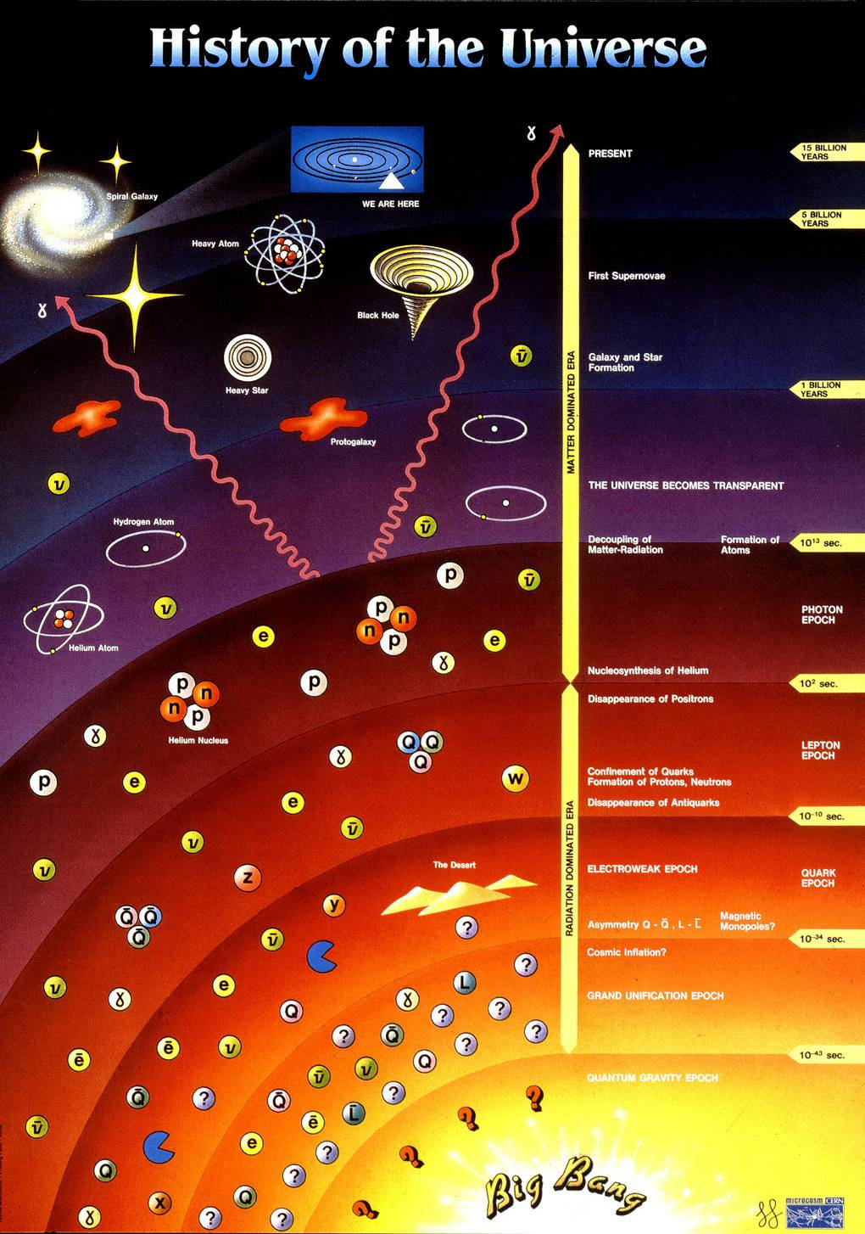
History of Universe and Matter
14 by
this colloquium
1 by
star/galaxy formation
10¹² s
atom formation
10² s
nuclei synthesis
10⁻⁶ s
quark confinement
anti-quark annihilation
quark pair production
0.00 s
Big Bang

Slide 4
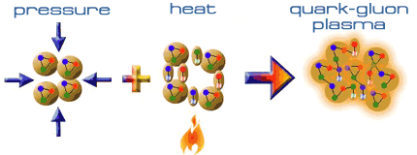
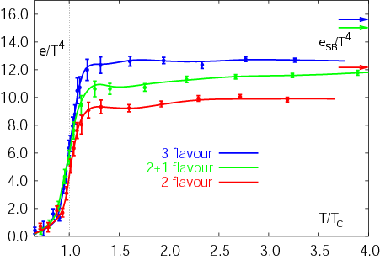
Expeditions on QCD Phase Diagram
toward (or back to) deconfined partonic phase
lattice Quantum Chromo-Dynamics predictions
  critical temperature ~ 170 MeV
  critical energy density ~ 1 GeV/fm³
Early Universe
Deconfined Partonic Phase
(Quark-Gluon Plasma)
Tri-Critical point
Energy Density (Temperature)
Critical Temperature ~ 170 MeV
High Energy A+A Collisions
Hadron gas
Color Super-Conductivity?
Color-Flavor Locking?
F. Karsch,
Lect. Notes Phys. 583 (2002) 209
Nucleus
Neutron Star
Baryon Density

Slide 5
Uniqueness of QCD Phase Transition
only possible boundary to experimentally cross
  to prove (or disprove) paradigm of universe evolution
  lost phase within experimental reach
    not just to catch residue
K. Homma, 2008/09

Slide 6
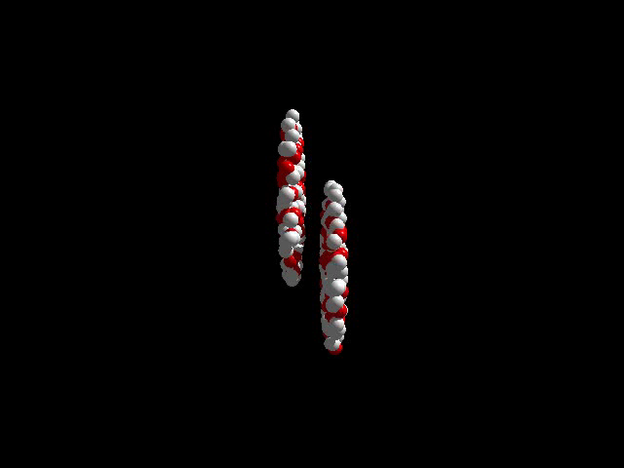
History of Quark Matter Search
1970’s–80’s: first trials
  LBL–BEVALAC （2 A GeV ⁴⁰Ar）
  BNL–AGS （15 A GeV ²⁸Si）
  CERN–SPS （200 A GeV ³²S）
1990’s: onsets of discovery
  BNL–AGS （11 A GeV ¹⁹⁷Au）
  CERN–SPS （158 A GeV ²⁰⁸Pb）
2000’s: deconfined partonic phase!
    thanks to nuclear colliders
  BNL–RHIC （100 + 100 A GeV ¹⁹⁷Au + ¹⁹⁷Au）
  CERN–LHC （2.8 + 2.8 A TeV ²⁰⁸Pb + ²⁰⁸Pb）

Slide 7

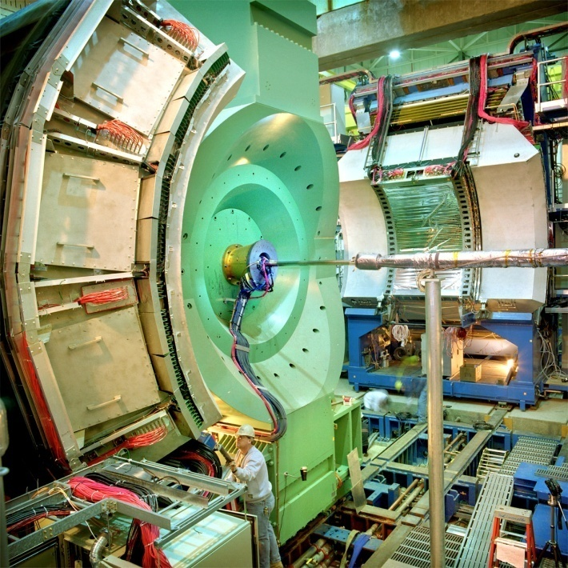




Relativistic Heavy Ion Collider at BNL
2 independent super-conducting synchrotrons
up to 100 A GeV Au and/or 250 GeV (polarized) p
  Au+Au/U+U/Cu+Cu/p+p/p+Au/d+Au/³He+Au/Cu+Au…
4 (presently 1.5) complimentary experiments

Slide 8
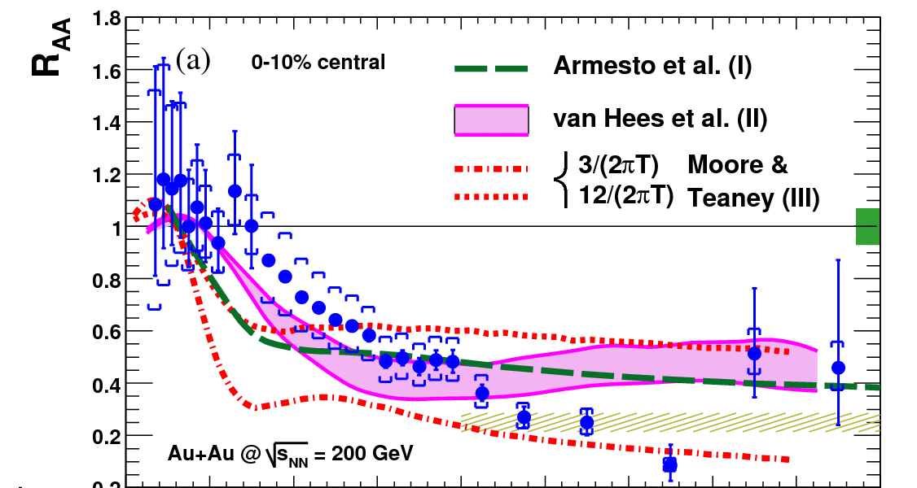
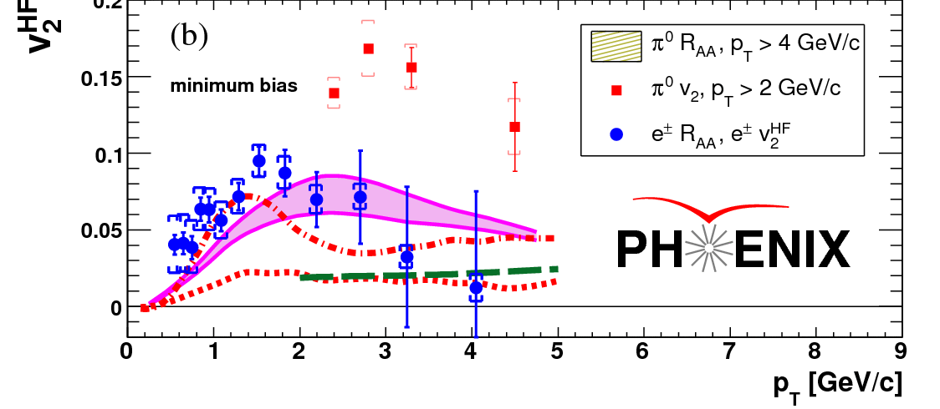
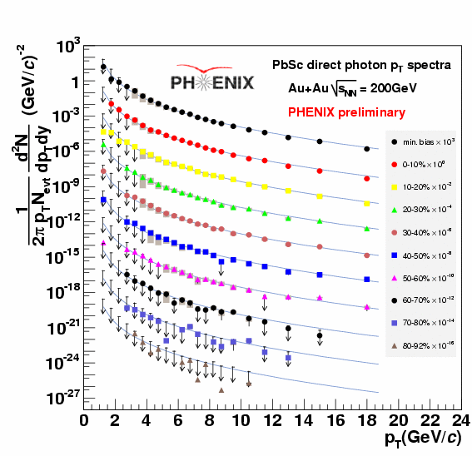
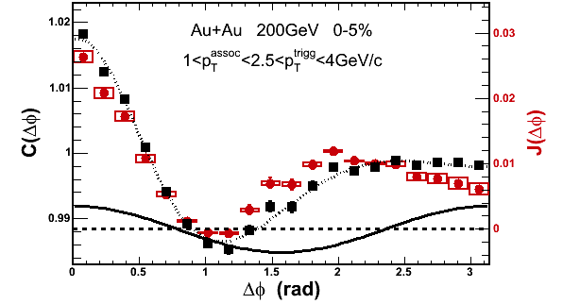
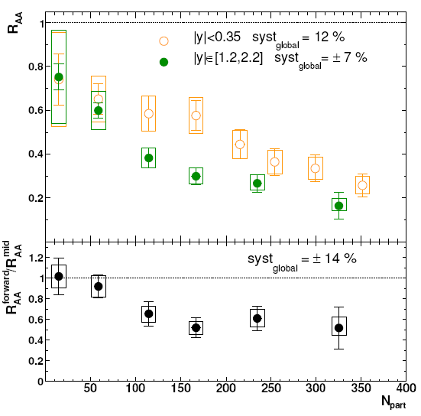
RHIC Outcomes: New State of Matter
partonic: quarks’ degrees of freedom, screening
  constituent quark number scaling of collective motion
  J/Ψ suppression
dense: energy loss of (even heavy) quarks
  jet quenching (high p_{T} suppression)
  jet modification
strongly coupled: perfect fluidity
  hydro-dynamical collective motion
hot: thermally radiative
  thermal (virtual) photons
The matter is dense
The matter is strongly coupled
The matter may melt and/or regenerate J/ψ’s
The matter modifies jets
The matter is hot

Slide 9
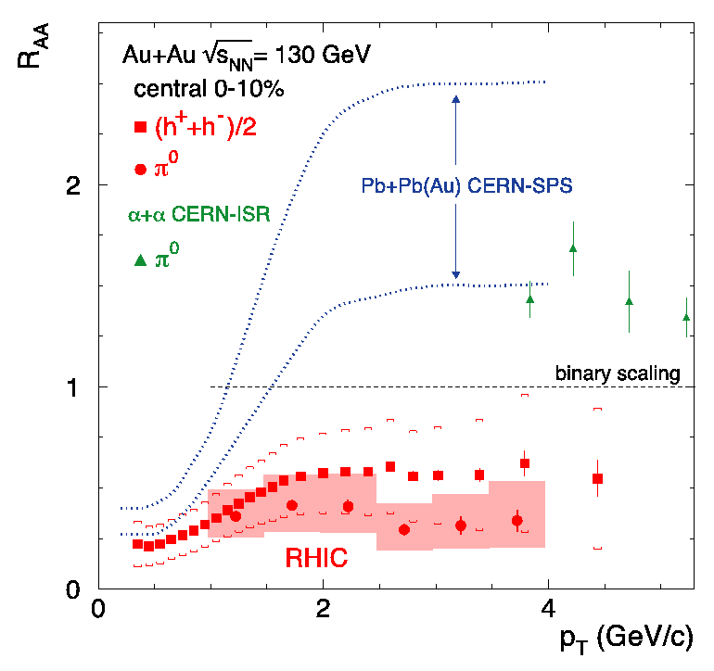
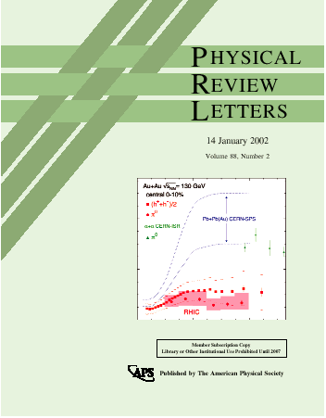
Quark Behavior in Extreme Density
binary collision scaling
based on extrapolated
UA1 p+p data
--
Au+Au at √s_{NN} = 130 GeV
PHENIX PRL 88, 022301 (2002)
less high p_{T} particles produced due to “quenching”

Slide 10
First Signature of Partonic Matter
parton energy loss in deconfined partonic matter
  → high transverse momentum jets suppressed
  → azimuthal back-to-back correlation modified/lost
leading hadron with high p_{T}
hadron jet
(anti-)quark/gluon
(anti-)quark/gluon
hadron jet
leading hadron with high p_{T}

Slide 11
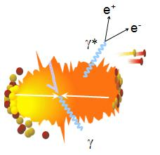
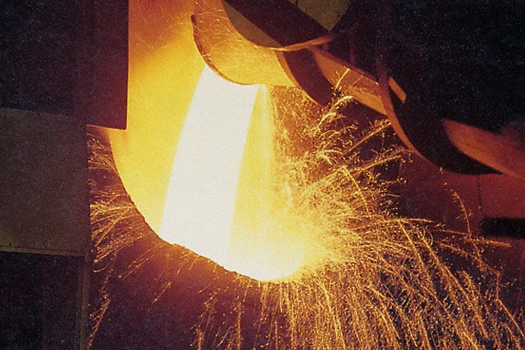
Photons as Wide Scale Thermometer
thermal radiation if in equilibrium
emission spectrum ↔ temperature
real and virtual thermal photons

Slide 12

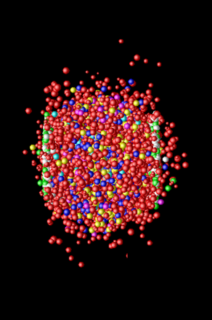
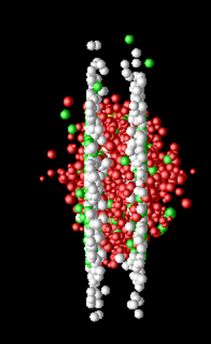
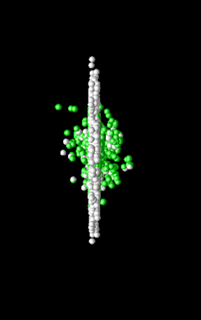
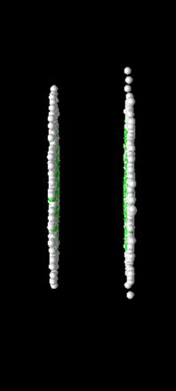
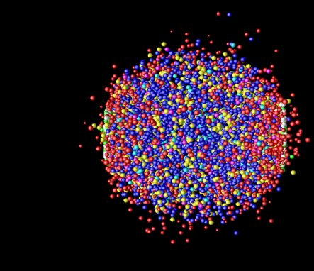
Photon Production Everywhere
Hadronization
(Freeze-out) +
Expansion
Mixed phase
Thermalization
QGP phase
Pre-equilibrium
Compton/Annihillation
Fragmentation
Prompt Photon
Jet-Photon Conversion
Jet-Bremsstrahlung (QGP)
Jet+Medium
Thermal Photon (QGP)
Thermal Photon (HG)
Thermal Photon
Time Evolution

Slide 13
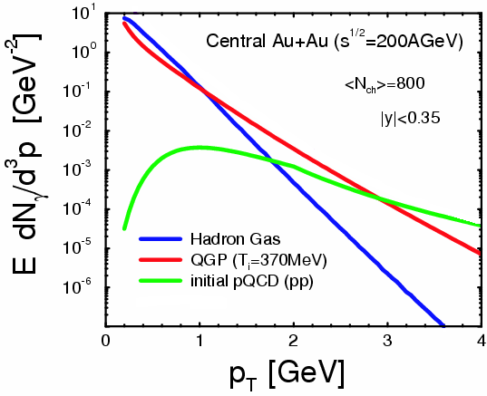
Where to Catch QGP Thermal Photons
π
π
g
q
high p_{T} : pQCD photons
low p_{T} : photons from hadronic gas
intermediate p_{T} : QGP thermal photons dominant (!)
also other sources
plus hadron decay photons everywhere
hadron decay
photons
ρ
γ
q
γ
S.Turbide et al., PRC 69 014903

Slide 14
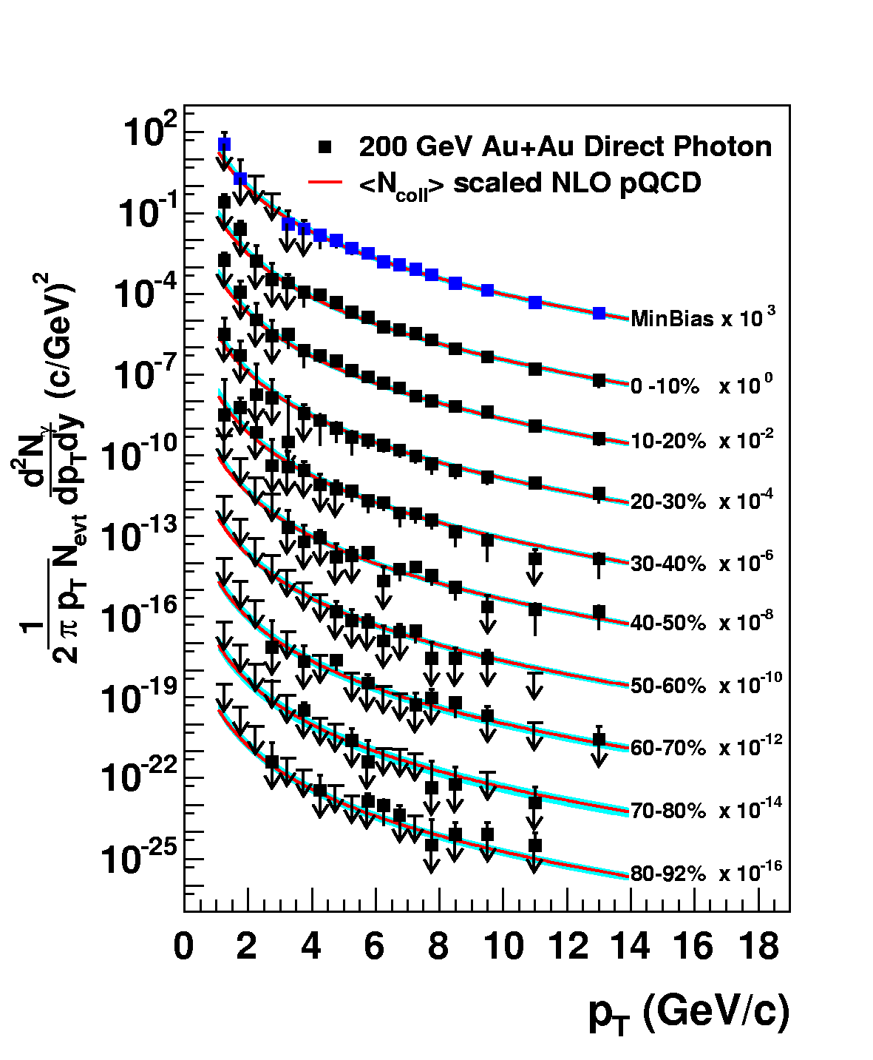
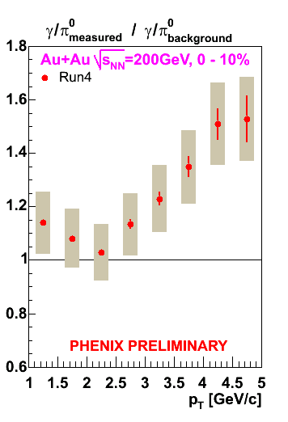
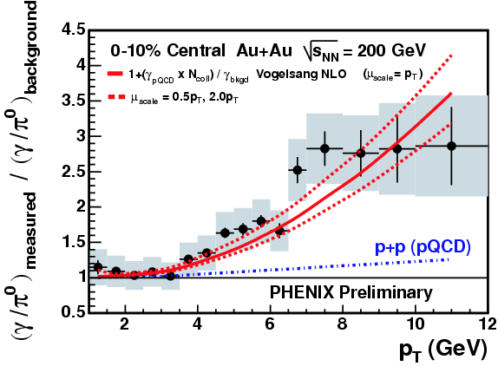
Naïve Way: Direct Real Photons
measured as “excess” above hadron decay photon
  Au+Au result consistent with pQCD×binary scaling
challenging at lower p_{T} due to smaller S/B ratio
PRL 94, 232301 (2005)

Slide 15
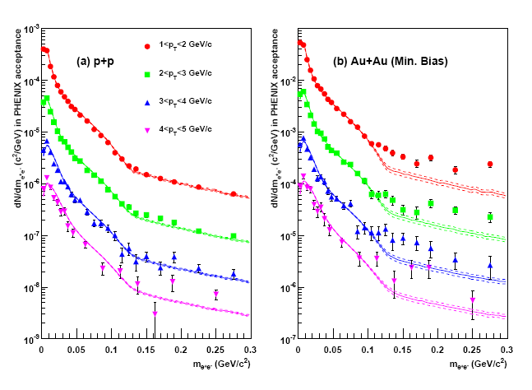
Alternative: “Almost Real” Photons
low mass electron-positron pairs
p+p: hadronic decay + pQCD photon at high p_{T}
Au+Au: enhancement above ~ 135 MeV
  no π⁰ decay virtual photon background above π⁰ mass
PHENIX (A. Adare et al.),
PRL 104, 132301 (2010)

Slide 16
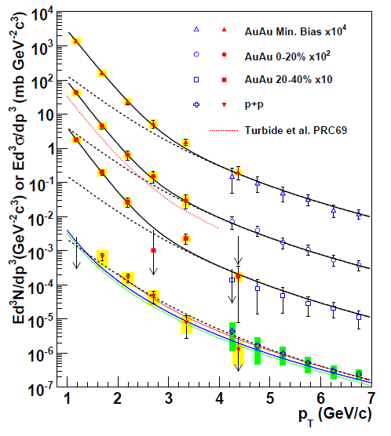
Direct Photon Spectra via γ and γ*
real and virtual photon methods consisitent
Au+Au: “thermal” excess
  ~ exponential with slope 221 ± 19 ± 19 MeV
cf. p+p data
  consistent with pQCD down to low p_{T}
PHENIX (A. Adare et al.), PRL 104, 132301 (2010)
NLO pQCD (W. Vogelsang)

Slide 17
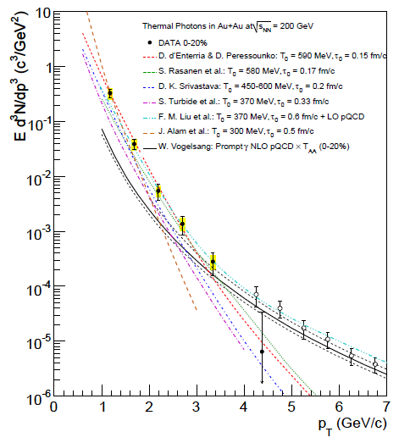
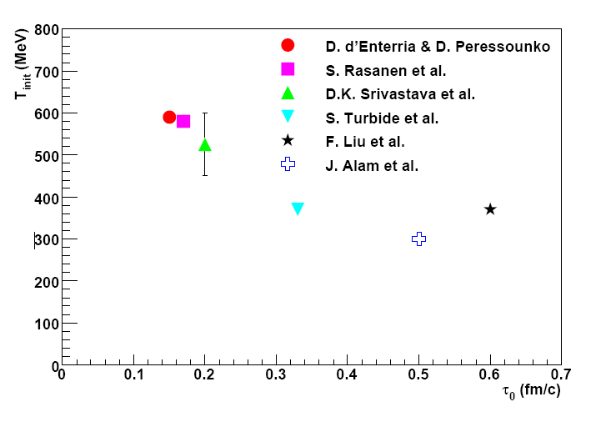

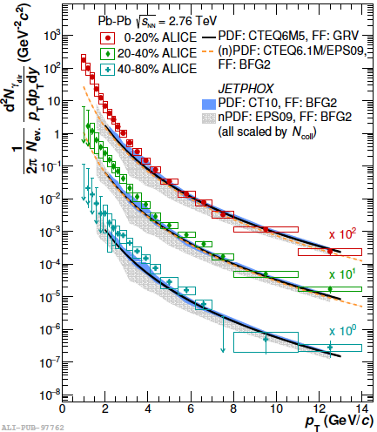
Initial Temperature Evaluation
initial temperature > data slope ~ 220 MeV
300–600 MeV (model dependence within factor 2)
  hydro-dynamic description
    w/ τ₀ = 0.15–0.6 fm/c
slope at 2.76 TeV: 297 ± 12 (stat.) ± 41 (sys.) MeV
cf. phase transition predicted at ~ 170 MeV
slope
PHENIX (A. Adare et al.),
PRC 81, 034911 (2010)
transition temperature
ALICE, PLB 754, 235-248 (2016)

Slide 18
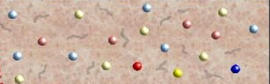
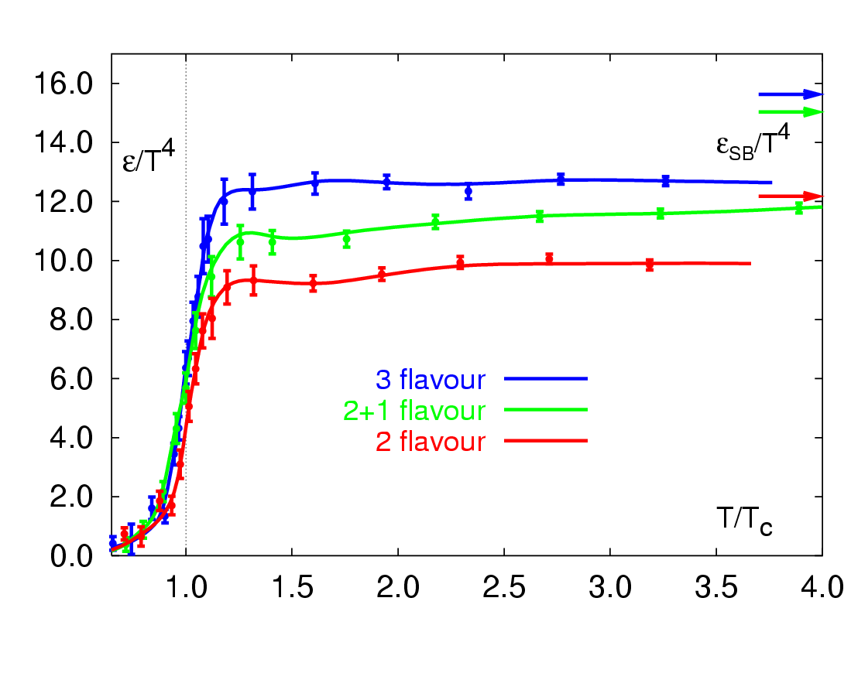
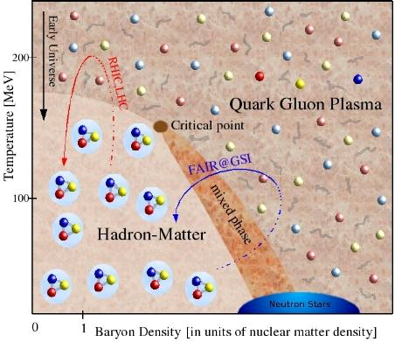
RHIC Outcome: Boundary Crossed
RHIC → LHC
RHIC
“free gas” ?
F. Karsch,
Lect. Notes Phys. 583, 209 (2002)
“perfect fluid”
RHIC → LHC
RHIC

Slide 19
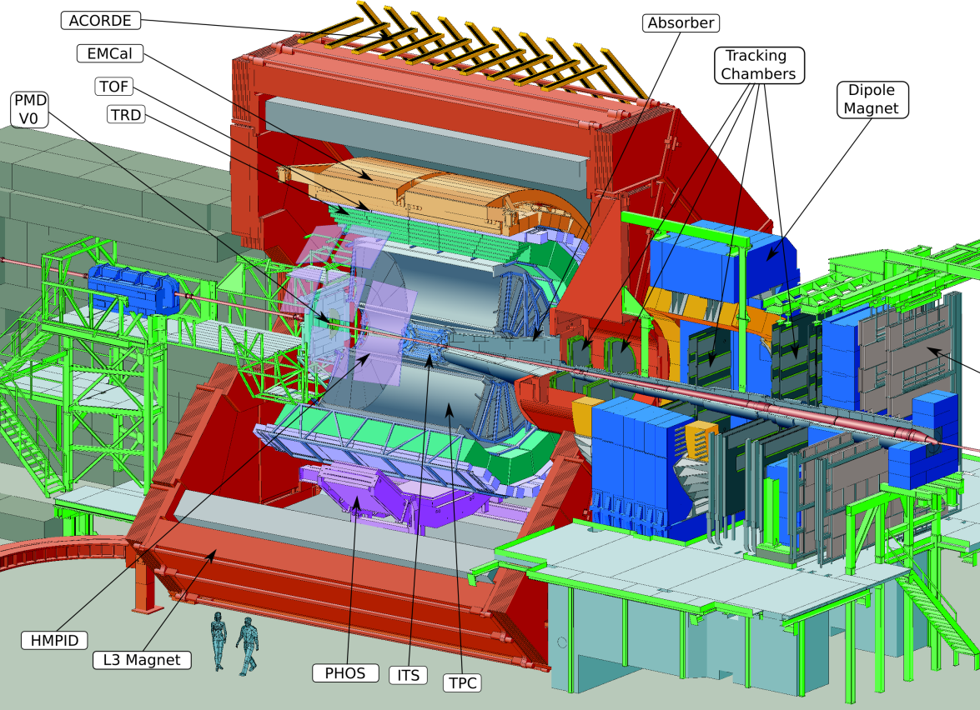
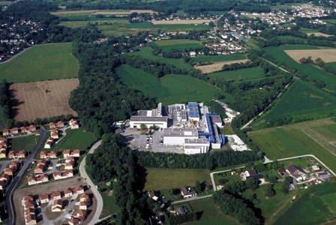

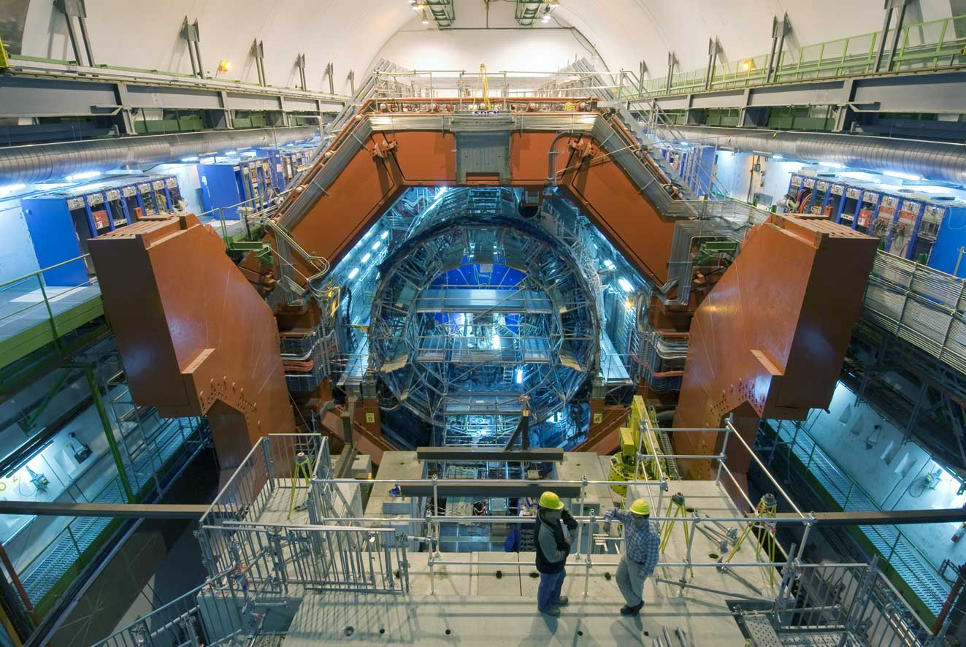
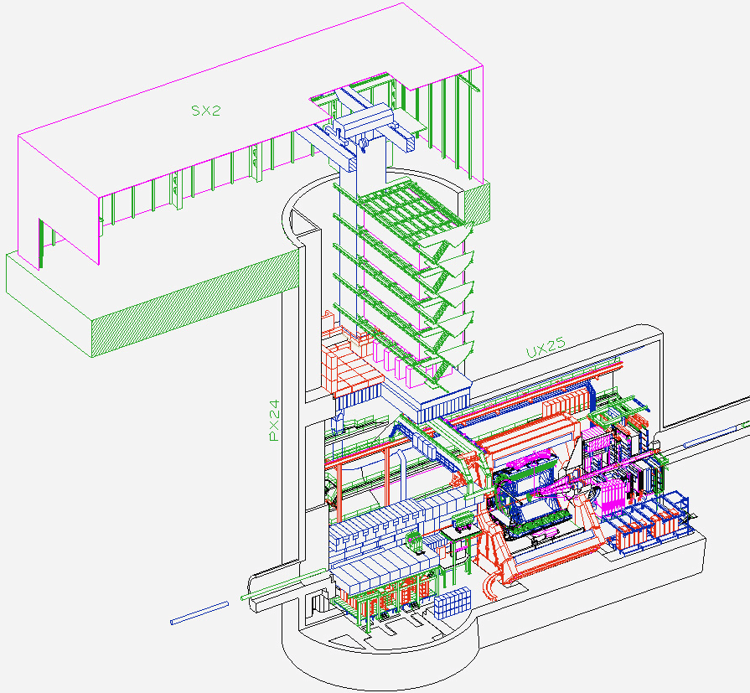
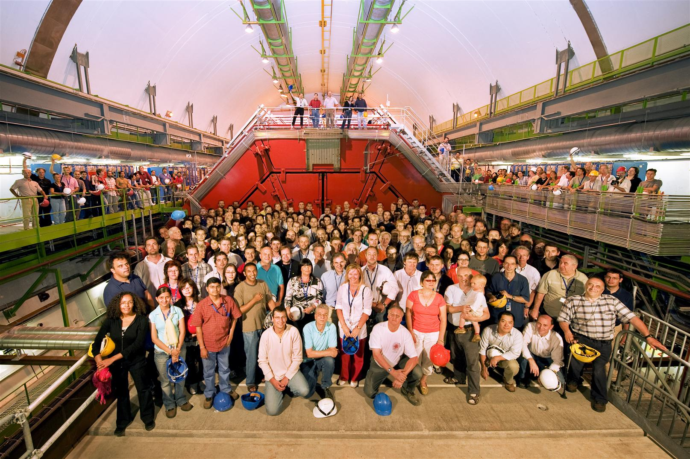
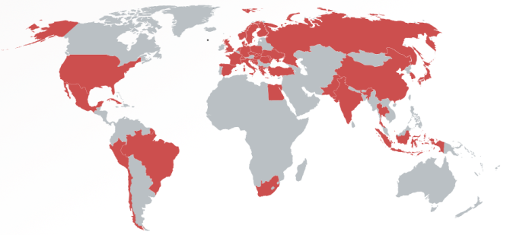
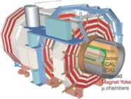
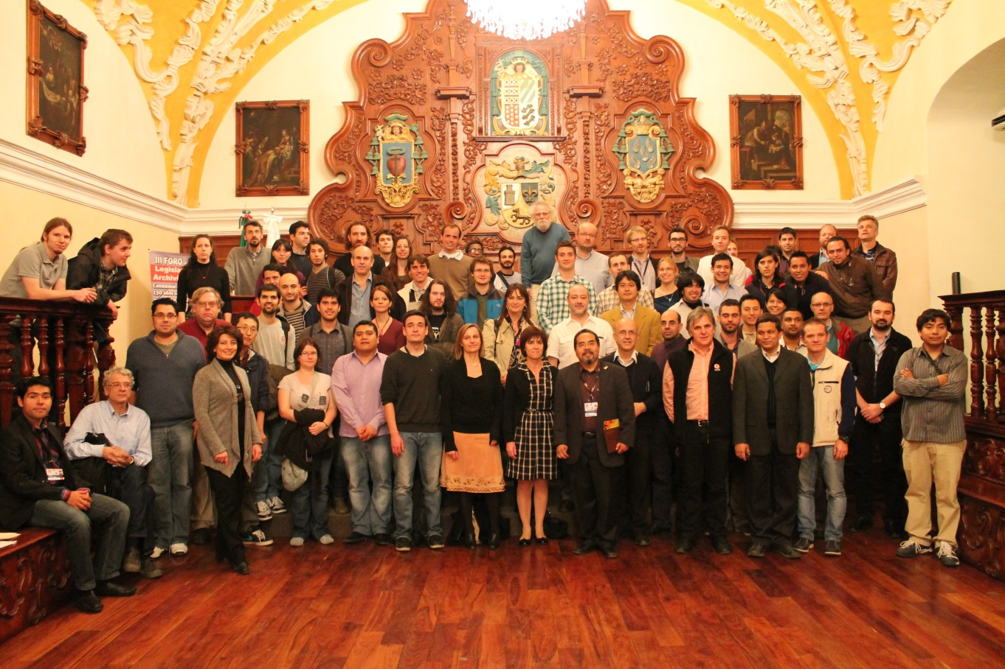
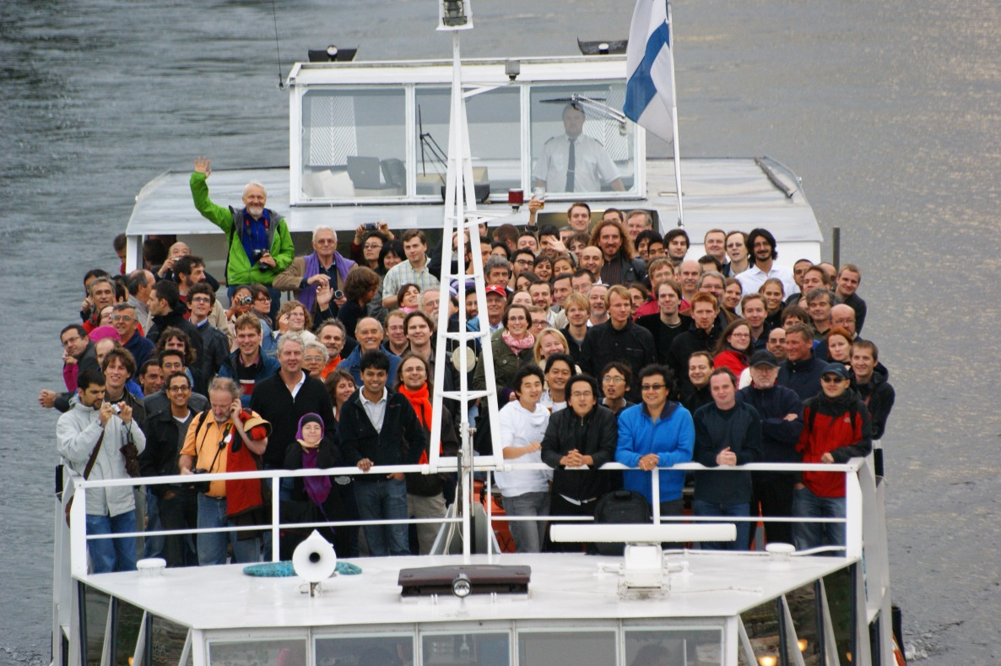


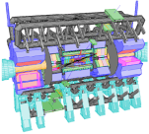


A Large Ion Collider Experiment
the nucleus-nucleus collision experiment at LHC
42 countries; 174 institutes; ~1,800 members
CMS
LHCb
ALICE
ATLAS, LHCf

Slide 20
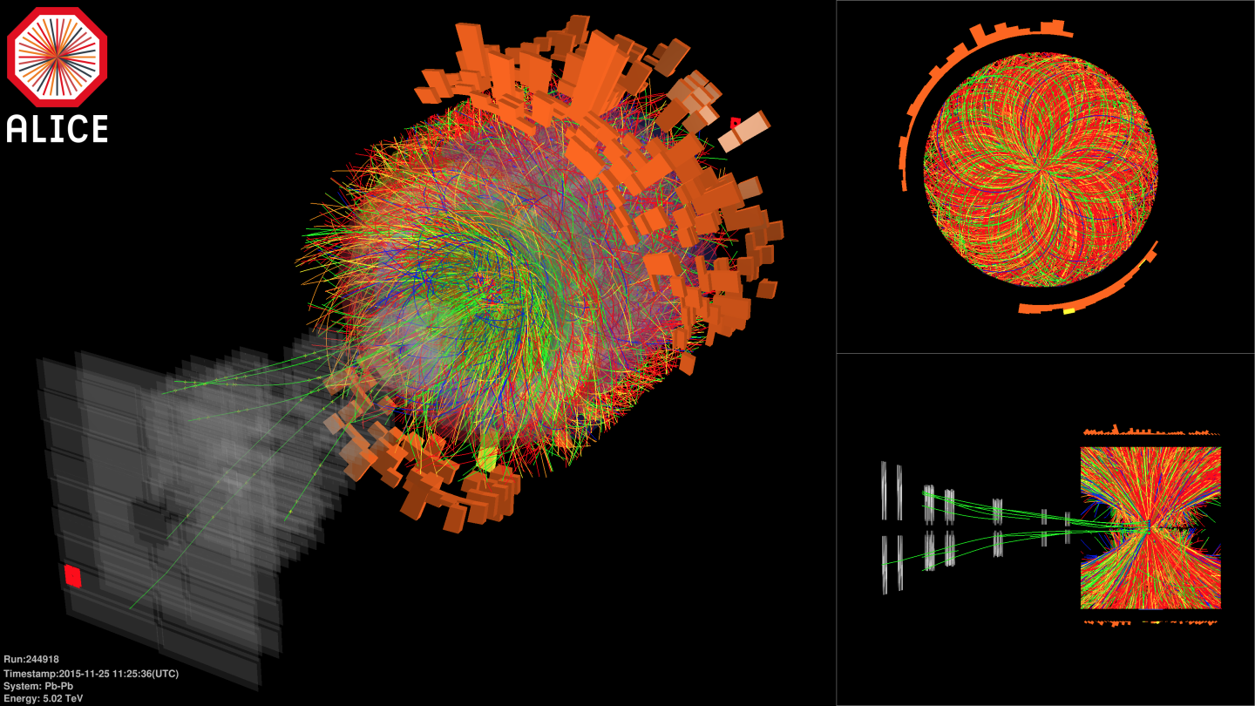

Pb-Pb at Highest Ever Energy
5.02 TeV per nucleon-nucleon pair (√s_{NN}) in 2015
  25 times higher than at RHIC
  design energy at 5.5 TeV
2.76 TeV in 2010 and 2011

Slide 21
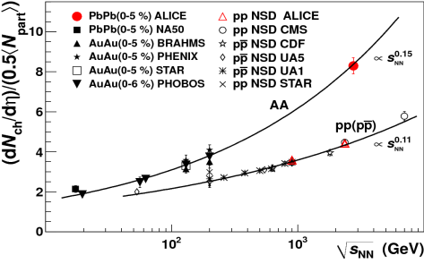
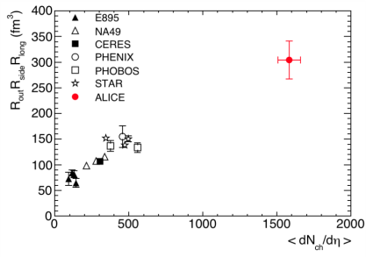
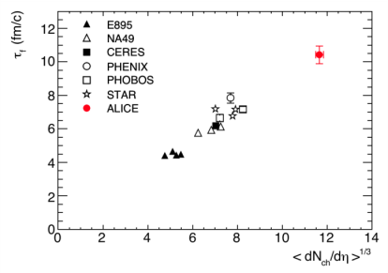
Hotter, Larger, Longer-Lived, and Purer
fireball compared to that at RHIC
  energy density × ~3, volume × ~2, life × 1.2–1.3
    ~ 16 GeV/fm³ (thermalization time ~ 1 fm/c)
    ~ 300 fm³, ~ 10 fm/c
net quark (baryon) density ~ 0
  anti-proton/proton at mid-rapidity
    p+p 900 GeV： 0.957 ± 0.006 (stat) ± 0.014 (sys)
    p+p 7 TeV： 0.990 ± 0.006 (stat) ± 0.014 (sys)
ALICE (K. Aamodt et al.),
PRL 105, 072002 (2010)
ALICE (K. Aamodt et al.),
PLB 696, 328 (2011)

Slide 22
Playground with Extreme Conditions
deconfined quark/gluon phase now in hand
quark behavior in strong QCD field
  energy loss and redistribution
quarks interaction in strong QCD field
  color Debye screening to melt quarkonia
chiral symmetry restoration
  hadron mass modification
more exotics
  physics under ultra-intense magnetic field

Slide 23
Mysteries of Mass
total mass = sum of components’ masses?
astronomical objects
quarks
quark in standard model
universe
quark
proton
matter 5 %
quark mass 1%
quark mass in standard model = 0
dark matter 27 % chiral symmetry breaking BEH mechanism
dark energy 68 %

Slide 24
Uniqueness of Chiral Phase Transition
only possible boundary to experimentally cross
  to prove (or disprove) paradigm of universe evolution
  lost phase within experimental reach
    not just to catch residue
K. Homma, 2008/09

Slide 25
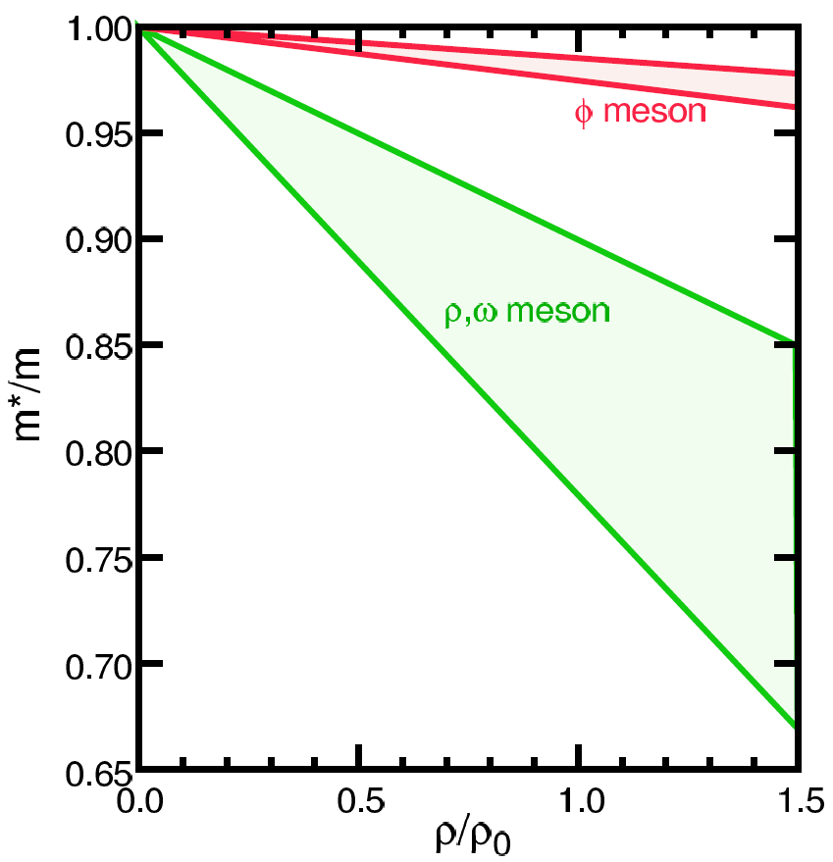
Looking into “Parallel World”
phenomena with restored symmetry
QCD phase transition with chiral symmetry →
  diminishing effective (light) quark masses
  probably lower hadron masses
e.g. light vector meson mass modification
T.Hatsuda, H.Shiomi and H.Kuwabara
Prog. Theor. Phys. 95 (1996) 1009

Slide 26
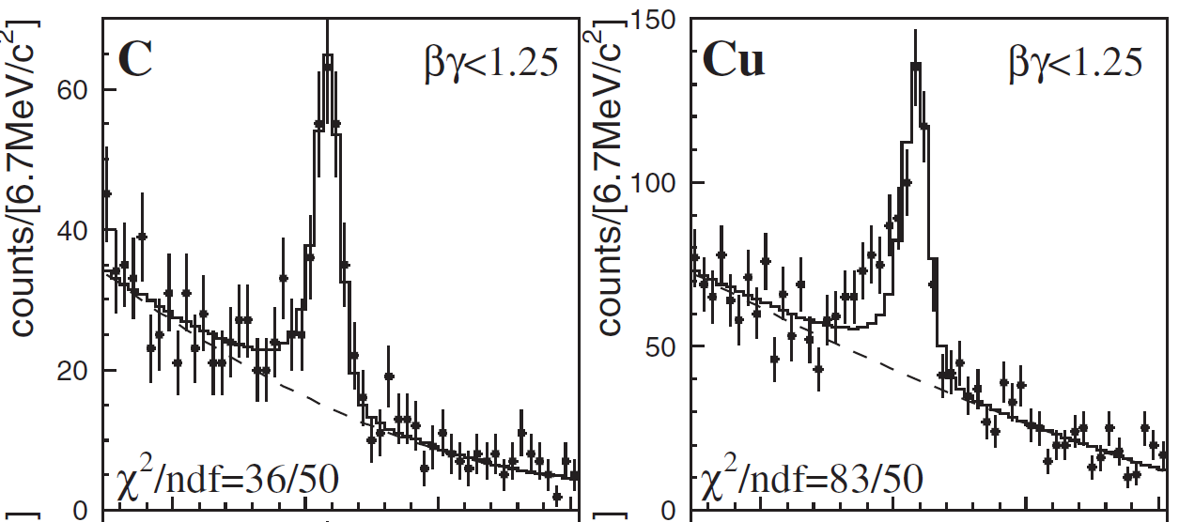
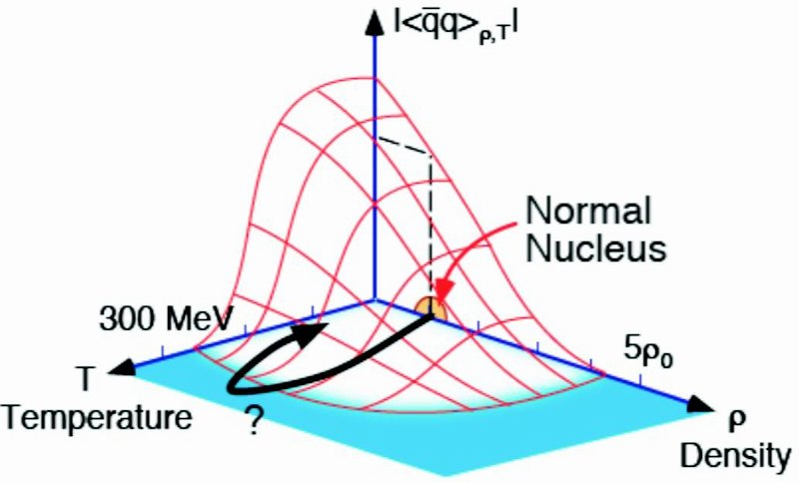
Chiral Symmetry Restoration
“observations” in finite density regime
  φ, ω in nuclei via p+A (KEK E325)
    though apparent contradiction to CB-ELSA/TAPS and CLAS-G7
  π in nuclei via (d, ³He)
no evidence in high temperature regime yet
  challenging dilepton measurements
    e.g. PHENIX with RICH, hadron blind detector, ...

Slide 27
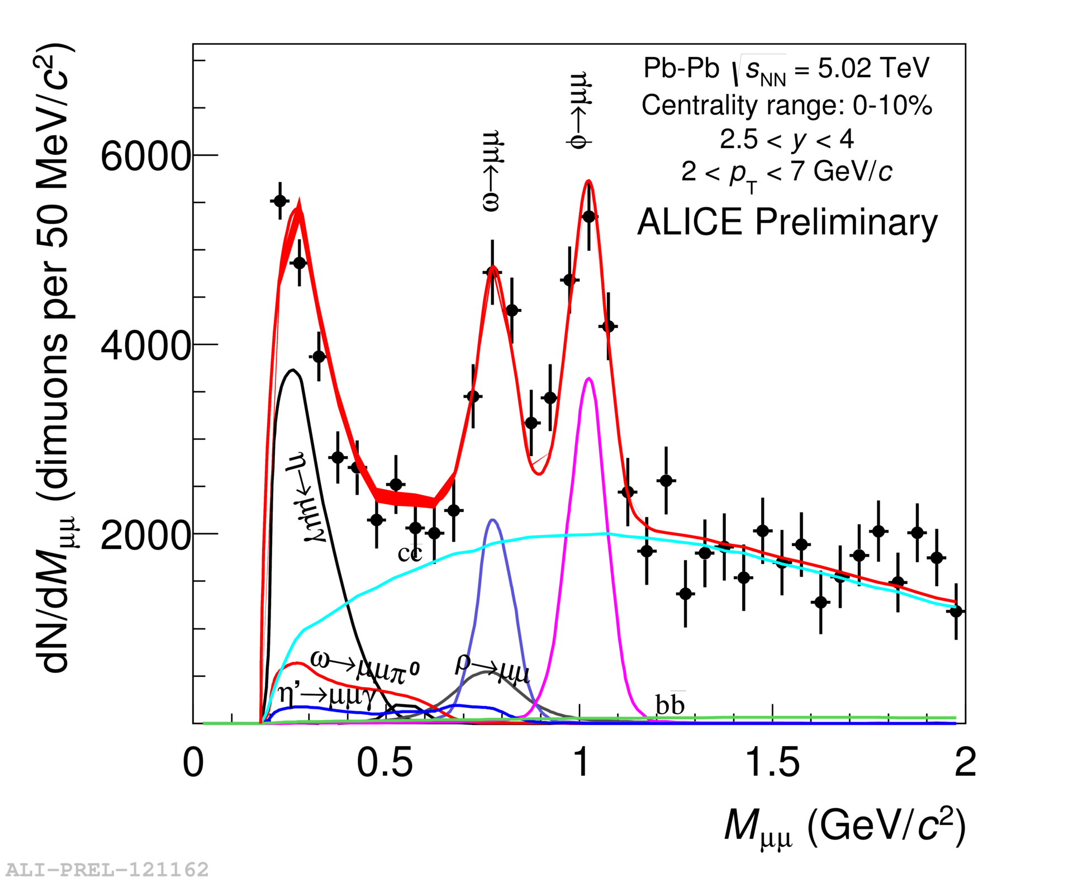
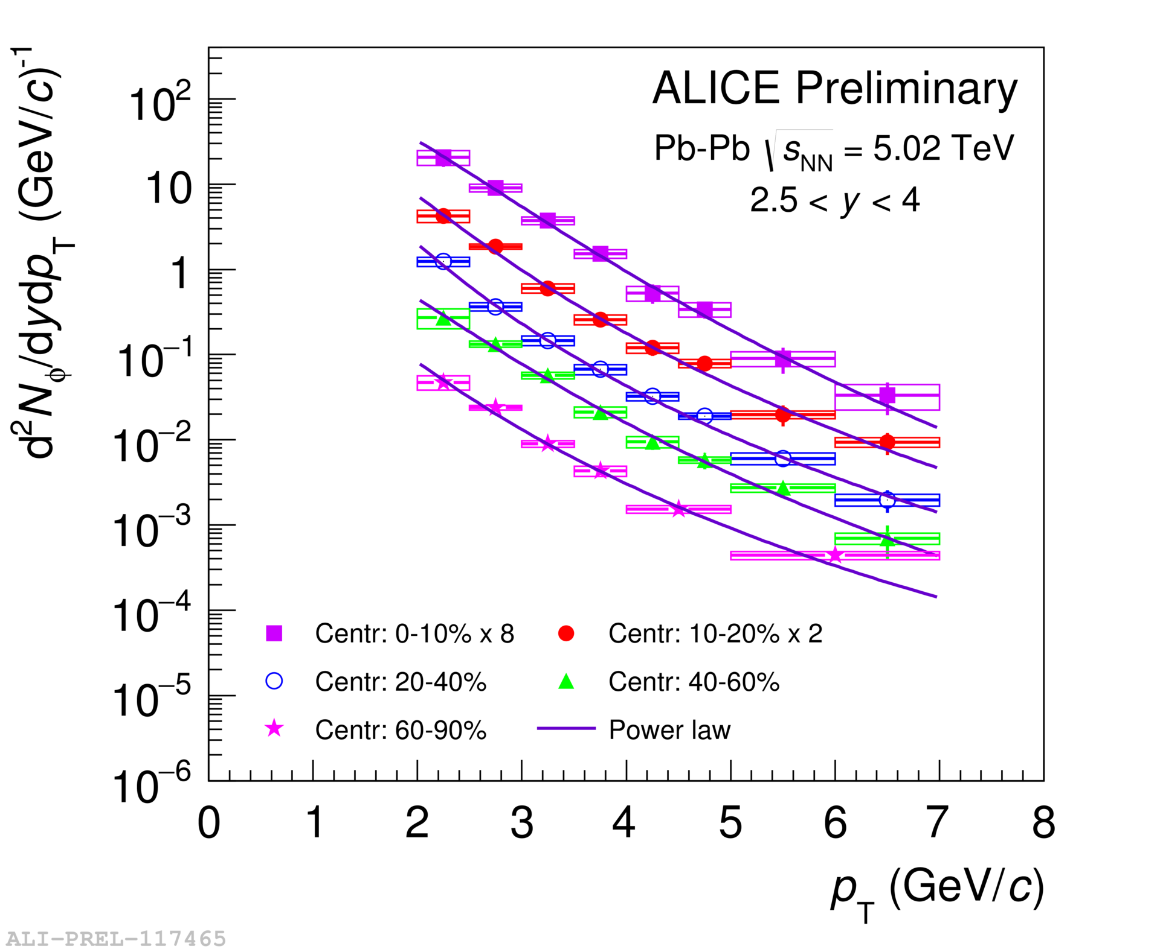

Multiple Probes at ALICE
new low mass (φ, ω, ρ) μ⁺μ⁻ measurement
  to further improve by detector upgrade from 2021
to be combined with more traditional e⁺e⁻

Slide 28

Ultra-Intense Magnetic Field
U(1) magnetic field
  naturally expected with moving charged sources (nuclei)
  ~ 10¹⁵ T at LHC, ~ 10¹⁴ T at RHIC
    cf. magnetar surface ~ 10¹¹ T
  could be long-lived in “perfect fluid”
possible non-linear QED behaviors
  above electron critical magnetic field em_{e}² = 4×10⁹ T
  e.g. γ → γ γ, γ → e⁺e⁻, birefringence, …
various interesting physics under discussion
  chiral magnetic effects
  quark synchrotron radiation
Magnetic Field

Slide 29


Chiral Magnetic Effects
if strong P/CP violation + magnetic field
charge separation, observed at RHIC and LHC
B
correlation between particles with different charges
correlation between particles with same charges

Slide 30


Field Intensity and Time Evolution
common approach: cascade models
  spectator contribution dominant
    10¹⁴ – 10¹⁵ T at LHC
    short life time < 1 fm/c due to Lorentz contraction
    though still above em_{e}² after several fm/c
JAM; Au+Au 200 GeV
(A.Tsuji)
URQMD; Au+Au 200 GeV

Slide 31


Field Intensity and Time Evolution
common approach: cascade models
  spectator contribution dominant
    10¹⁴ – 10¹⁵ T at LHC
possible longer-lived field in “perfect fluid”
  participant contribution
  “static field” approximation
    10¹³ – 10¹⁴ T at LHC
baryon stopping power
taken into account
Pb+Pb 5.5 TeV
Pb+Pb 2.76 TeV
Au+Au 200 GeV
10¹⁴ T
10¹³ T

Slide 32

Experimental Probes of Intense Field
must originate from initial stages
  field life time ~ 0.1 fm/c
must be electro-magnetic
ideal probe: direct γ/γ∗ from pQCD processes
good reference: γ/γ∗ from later stages
  e.g. π⁰ decay γ/γ∗ (Dalitz di-electron)
0 fm/c
~ 4 fm/c
~ 10 fm/c
B > B_{c}
electro-magnetic probes
hadronic probes

Slide 33


γ∗ (Low Mass l⁺l⁻) “Polarization” ?
anisotropic decay w.r.t. magnetic field
feasibility study based on QED calculations
  vacuum polarization tensors under magnetic field
    summation for infinite Landau levels
    photon momentum up to ~ GeV
    ref. K.-I. Ishikawa, K. Shigaki, et al.,
    Int. J. Mod. Phys. A28, 1350100 (2013)
anisotropy ~ o(10⁻¹)
l⁻
γ*
γ*
?
l⁺

Slide 34
ALICE（-Japan） Upgrade Strategies
1st – high p_{T} phenomena (jets), heavy flavors
  ✓ × 2–3 speeding up, new detectors; LS1 2013–2014
    upgrade: TPC readout (Tokyo), PHOS readout (Hiroshima)
    new: di-jet calorimeter (Tsukuba)
2nd – low/mid p_{T} phenomena
  × 100 speeding up, new detectors; LS2 2019–2020
    upgrade: TPC chamber (Tokyo), new vertex trackers
    new: muon forward tracker (Hiroshima + Nagasaki, Nara)
3rd – (further) forward physics
  new detectors; LS3? 2024?
    new: forward calorimeter (Tsukuba + Hiroshima, Nara)

Slide 35

Near-Term LHC Run Schedule
Run 2
Run 3
Long Shutdown 2
6.5 TeV proton beam
p-p, p-Pb, Pb-Pb
7.0 TeV proton beam
p-p, p-Pb, Pb-Pb
LHC luminosity upgrade
ALICE upgrade & speeding up

Slide 36


Major Upgrades for Run 3 (2021–)
new inner tracking system
  7 layers of MAPS silicon pixel detectors
  precise measurement of displaced vertices
    to separate charm/beauty mesons
new TPC readout chambers
  GEM technology with no gating grid
  ~100 times higher data taking rate (50 kHz in Pb-Pb)
    continuous readout without triggering
Muon Forward Tracker (MFT)

Slide 37



Uniqueness of LHC Forward Region
two interesting regimes of quark-gluon phase
  exploration on QCD phase diagram
virtue only at LHC (and above)
  not too forward for “central” physics (2.5 < |η| < 3.6)
  forward enough for muon measurement

Slide 38

Muon Forward Tracker (2021–)
vertex and invariant mass resolutions to improve
IP
Absorber
Dipole

Slide 39
Original Goals Primarily at High Mass
quark behavior in strong QCD field
    current interest: difference between charm and beauty quarks
  charm/beauty meson separation
quarks interaction in strong QCD field
    current interest: sequentially melting of various quarkonia
  feed down (e.g. B → ψ + X) identification

Slide 40

Powerful in Low Mass Region, Too
significant improvement with MFT
  mass resolution by ~4
  signal/background ratio by ~10
ALICE, MFT LOI,
CERN-LHCC-2013-014

Slide 41


MFT Control System by Hiroshima
new architectures in ALICE run 3
  e.g. gigabit transfer slow control adapter (GBT-SCA)
hardware control, finite state machine, interlock

Slide 42
Summary and Concluding Remarks
deconfined quarks and gluons now in hand
  steadily revealing partonic phase properties
uniquely providing extreme conditions
  “Guinness record” temperature > 300 MeV (4×10¹² K)
    early universe phase transition experimentally reverted
  “parallel world” with restored chiral symmetry?
    one of remaining big challenges!
  perfect fluidity (beyond helium and ultra-cold atoms?)
  ultra-intense magnetic field ~ 10¹⁴ T
next steps with France-Japan-More collaboration
  ALICE upgrades, esp. Muon Forward Tracker (2021–)

