Slide 1

高エネルギー原子核偏芯衝突 における
宇宙最高強度磁場生成検出 に向けて
志垣 賢太 （ ）
高エネルギー原子核衝突反応の統合模型構築と QGP 物性物理
2018 年 4 月 28 日 上智大学

Slide 2
Presentation Outline
heavy ion collisions at LHC
physics under ultra-intense magnetic field
    local parity violation and charge dependent correlations
field intensity and time structure
  request to hydro-dynamical modelers
experimental approaches
  past attempts and future prospects
    (direct photon anisotropy)
    direct photon polarization
    femto-spectrometer
summary and concluding remarks

Slide 3
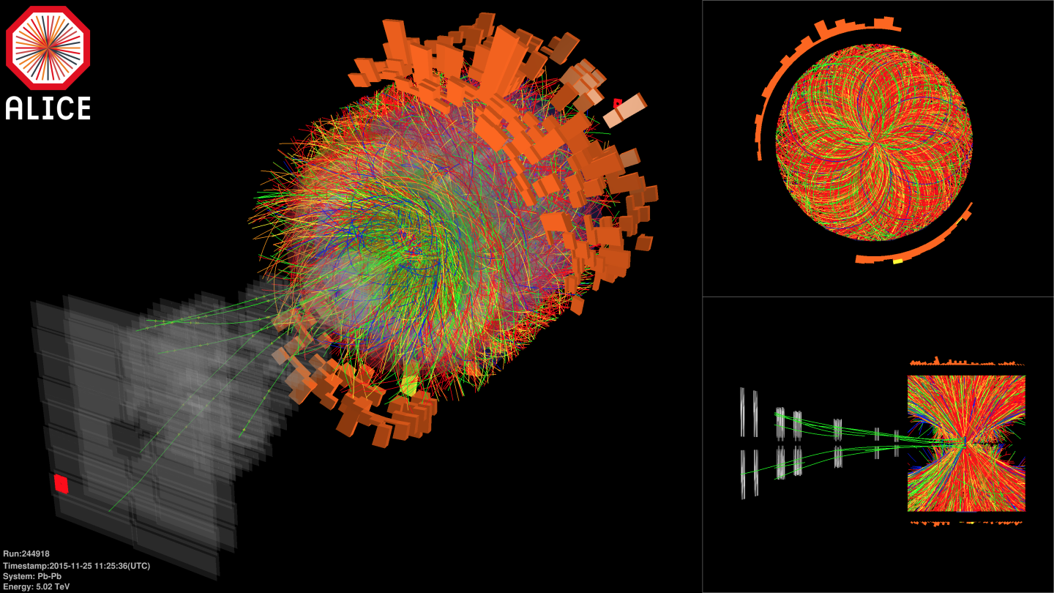

Pb-Pb at Highest Ever Energy
5.02 TeV per nucleon-nucleon pair (√s_{NN}) in 2015
  25 times higher than at RHIC
  design energy at 5.5 TeV
2.76 TeV in 2010 and 2011

Slide 4
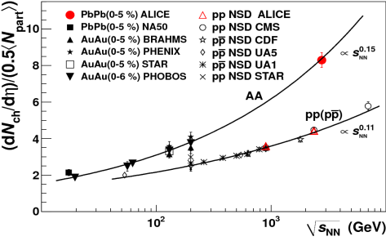
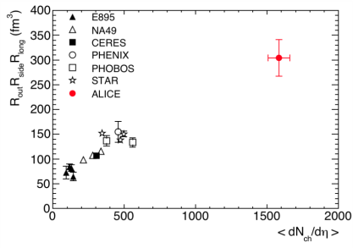
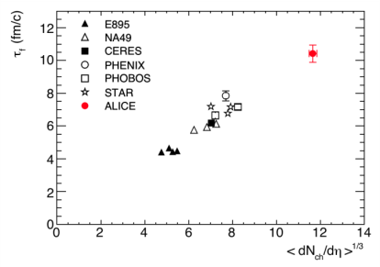
Hotter, Larger, Longer-Lived, and Purer
fireball compared to that at RHIC
  energy density × ~3, volume × ~2, life × 1.2–1.3
    ~ 16 GeV/fm³ (thermalization time ~ 1 fm/c)
    ~ 300 fm³, ~ 10 fm/c
net quark (baryon) density ~ 0
  anti-proton/proton at mid-rapidity
    p+p 900 GeV： 0.957 ± 0.006 (stat) ± 0.014 (sys)
    p+p 7 TeV： 0.990 ± 0.006 (stat) ± 0.014 (sys)
ALICE (K. Aamodt et al.),
PRL 105, 072002 (2010)
ALICE (K. Aamodt et al.),
PLB 696, 328 (2011)

Slide 5
Playground with Extreme Conditions
deconfined quark/gluon phase now in hand
quark behavior in strong QCD field
  energy loss and redistribution
quarks interaction in strong QCD field
  color Debye screening to melt quarkonia
chiral symmetry restoration
  hadron mass modification
more exotics
  physics under ultra-intense magnetic field
  …

Slide 6
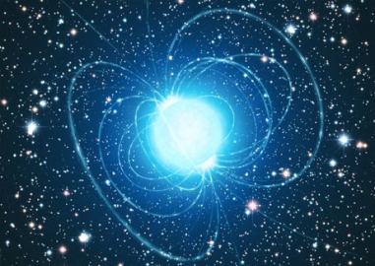
Ultra-Intense Magnetic Field
U(1) magnetic field
  naturally expected with moving charged sources (nuclei)
  ~ 10¹⁵ T at LHC, ~ 10¹⁴ T at RHIC
    cf. magnetar surface ~ 10¹¹ T
  could be long-lived in “perfect fluid”
possible non-linear QED behaviors
  above electron critical magnetic field em_{e}² = 4×10⁹ T
various interesting physics under discussion
  chiral magnetic effects
  quark synchrotron radiation
  lower QCD critical temperature
Magnetic Field

Slide 7
Critical Magnetic Field
critical electric/magnetic field of electron
  energy within Compton radius ≈ own rest mass
  eE_{c}h/m_{e}c = m_{e}c² ; E_{c} = m_{e}²c³/eh ~ 10¹⁷ V/m
  eB_{c}h/m_{e}c = m_{e}c ; B_{c} = m_{e}²c²/eh ~ 10⁹ T
Schwinger mechanism in case of electric field
  e⁺e⁻ pair production
  no sense to condsider E > E_{c}
non-linear QED effects in case of magnetic field
  e.g. γ → γ γ, γ → e⁺e⁻, bi-refringence, …

Slide 8
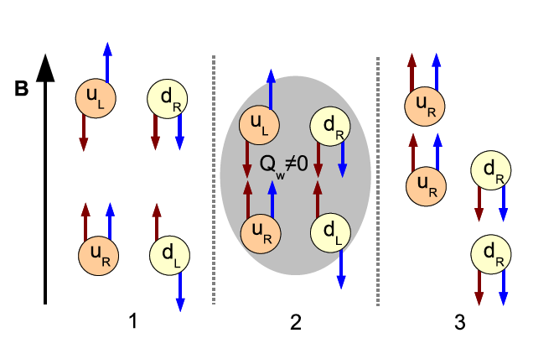
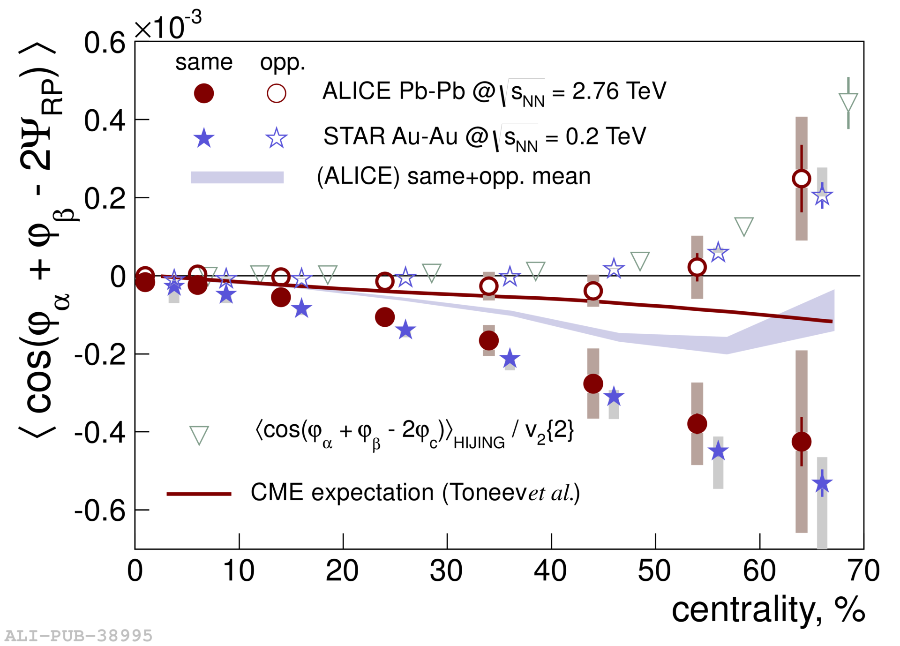
Chiral Magnetic Effects
if strong parity violation and magnetic field
charge separation, observed at RHIC and LHC
B
correlation between particles with different charges
correlation between particles with same charges

Slide 9
LPV Domain Size and Observables
assuming perfect alignment and distribution
if 1 domain, [(n₊↑ − n₊↓)/(n₊↑ + n₊↓)]² is always 1
if 2, it is 1 (50%) or 0 (50%), i.e. average at 1/2
if 3, it is 1 (25%) or 0.11 (75%), i.e. average at 1/3
# domains ↔ width of [(n₊↑ − n₊↓)/n₊]² distribution
large N limit ≈ independent N particle production
btw here, [(n₊↑ − n₋↓)/(n₊↑ + n₋↓)]² is always 0
  note this does mean correlation
large N limit ≠ independent N particle production

Slide 10
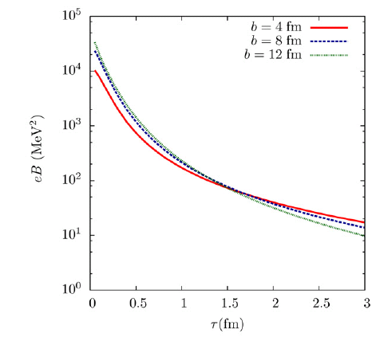
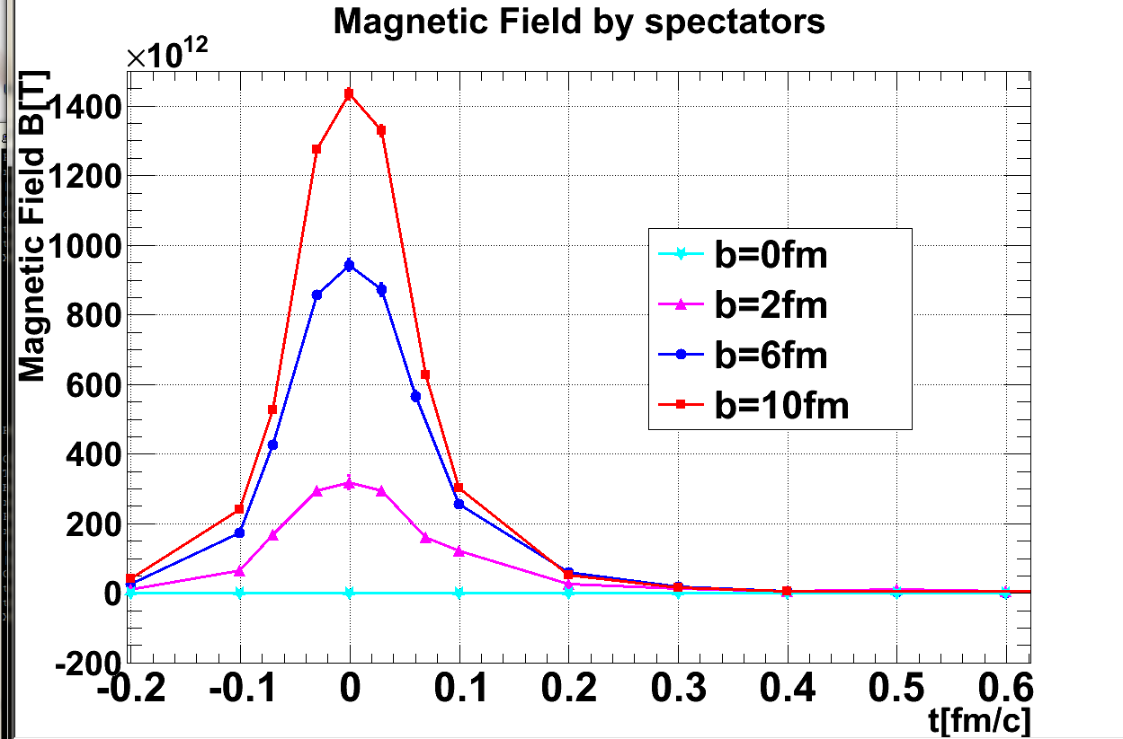
Dominant Spectator Contribution
cascade models: common approach
  spectator contribution dominant
    10¹⁴ – 10¹⁵ T at LHC
    short life time < 1 fm/c due to Lorentz contraction
    though still above m_{e}²/e after several fm/c
JAM; Au+Au 200 GeV
(A.Tsuji)
URQMD; Au+Au 200 GeV

Slide 11
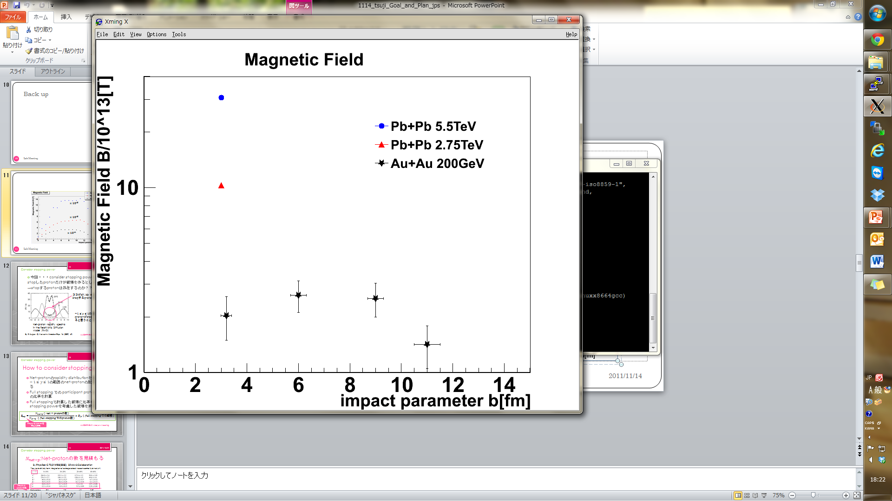
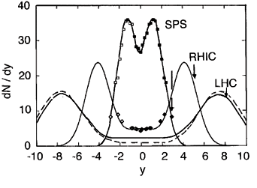
How About Participant Contribution?
possible longer-lived field in “perfect fluid”?
  “static field” approximation w/ Glauber model
    finite baryon stopping taken into account
    10¹³ – 10¹⁴ T at LHC
hydro model with local charge flow wanted
(A.Tsuji)
Pb+Pb 5.5 TeV
Pb+Pb 2.76 TeV
Au+Au 200 GeV
baryon stopping power
from net baryon distribution
10¹⁴ T
10¹³ T

Slide 12
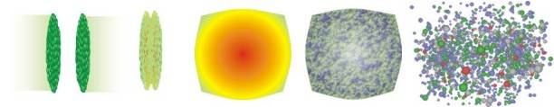
Experimental Probes of Intense Field
must originate from initial stages
  field life time ~ 0.1 fm/c
must be electro-magnetic
ideal probe: direct γ/γ∗ from pQCD processes
good reference: γ/γ∗ from later stages
  e.g. π⁰ decay γ/γ∗ (Dalitz di-electron)
0 fm/c
~ 4 fm/c
~ 10 fm/c
B > B_{c}
electro-magnetic probes
hadronic probes

Slide 13

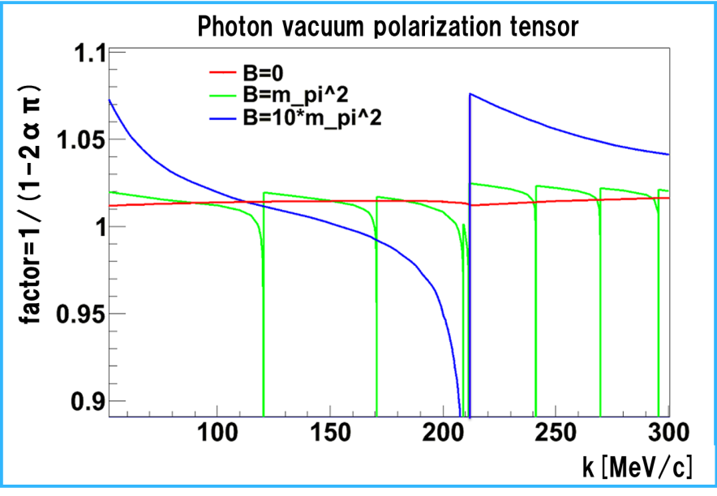



Proposal 1. Direct Photon Anisotropy
polarization tensor in magnetic field
  modification factor to
  seemingly v₂ ~ o(10⁻²)
obvious existence of other contributions to v₂
Y.Akamatsu, H.Hamagaki, T.Hatsuda, T.Hirano Phys. Rev. C 85, 054903 (2012)
Au+Au 200 GeV (PHENIX)
20–40% centrality direct γ v₂
k_{T} = 0 (k // B)
(K.Ishikawa and A.Tsuji)

Slide 14
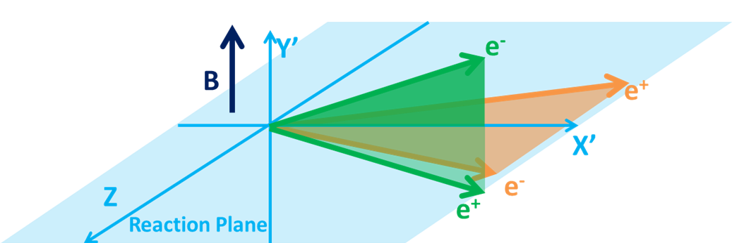
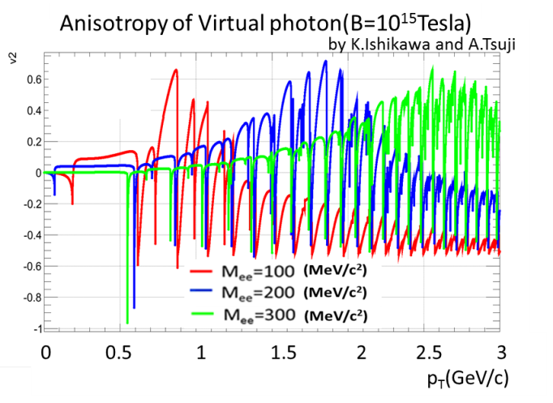
Proposal 2. Direct Photon Polarization
anisotropic decay w.r.t. magnetic field
feasibility study based on QED calculations
  vacuum polarization tensors under magnetic field
    summation for infinite Landau levels
    photon momentum up to ~ GeV
    ref. K.-I. Ishikawa, K. Shigaki, et al.,
    Int. J. Mod. Phys. A28, 1350100 (2013)
anisotropy ~ o(10⁻¹)
l⁻
γ*
γ*
?
l⁺

Slide 15
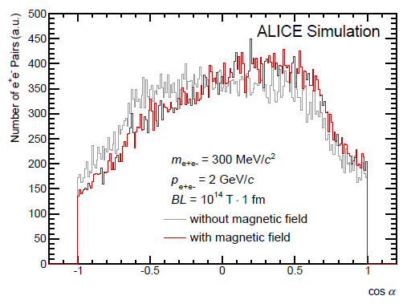
Proposal 3. Femto-Spectrometer
bending power Bdl ~ 10¹⁴ T×10⁻¹⁵ m
→ bending angle ~ 3×10⁻²/p [rad/(GeV/c)]
detectable as opening angle offset
  e⁺/e⁻ bent in opposite way around magnetic field axis
    reaction axis from directional flow (v₁) in forward/backward
  o(1) degree for o(1) GeV/c particles!

Slide 16
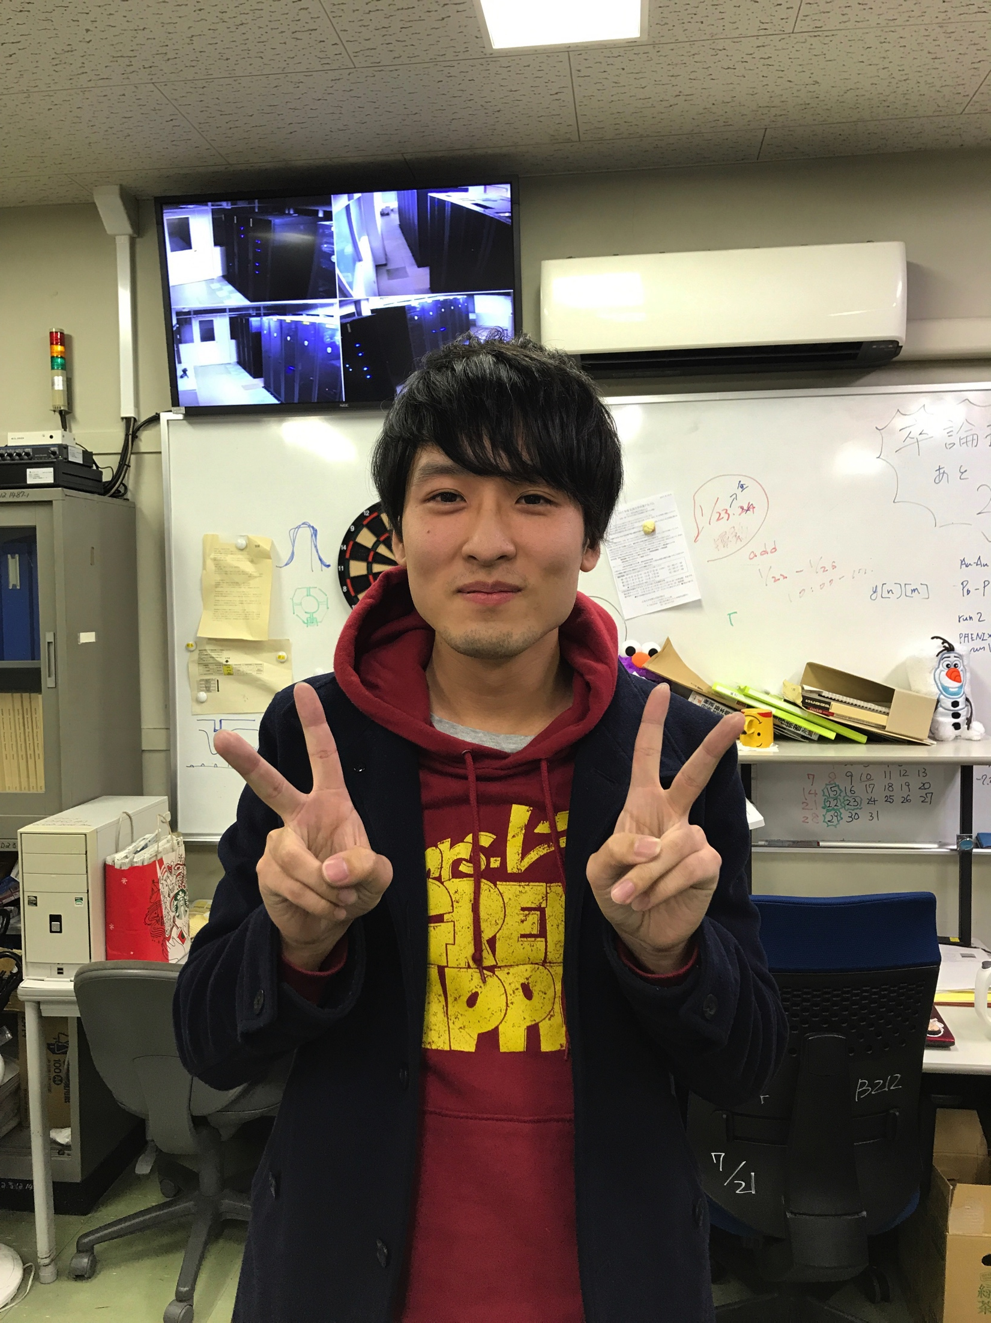
Key Issue: Significance, i.e. Statistics
marginal at best, in 2012–2016
  4 M.Sc. theses in 2013–2016
    T.Hoshino, A.Tsuji, R.Tanizaki, Y.Ueda
  5 B.Sc. theses in 2012–2015
    A.Tsuji, R.Tanizaki, Y.Ueda, A.Nobuhiro, K.Yamakawa
higher statistics data available/coming in
  1 B.Sc. thesis in 2018
    T.Osako
ALICE run 3 (2021–) very promising with ×100 stat.
ALICE 2011
PHENIX 2014

Slide 17
Summary and Concluding Remarks
wide range of interests; not only LPV/CME(/CVE)
field time structure: key for physical significance
  longer-lived participant component in “perfect fluid”?
  hydro-dynamical model with local charge flow wanted
proposals of experimental detection approaches
  seemingly feasible; simulations and real data analysis
    direct photon polarization
    femto-spectrometer
semi-long term visitor on this from China in 2018
high prospects in near-future high statistics data
  both muons and electrons in ALICE run 3 (2021–)

