Slide 1

高エネルギー原子核偏芯衝突 における
高強度磁場生成 の 直接探索
志垣 賢太 （ ）
第 28 回 Heavy Ion Pub 研究会
2019 年 1 月 10 日 奈良女子大学

Slide 2
Presentation Outline
heavy ion collisions at LHC
physics under ultra-intense magnetic field
field intensity and time structure
  implication of long-lived source via vorticity
experimental approaches
  past attempts and key issues
near-future prospects
  electron and muon reunion at LHC
  muon measurement at LHC/ALICE from 2021
summary and concluding remarks

Slide 3
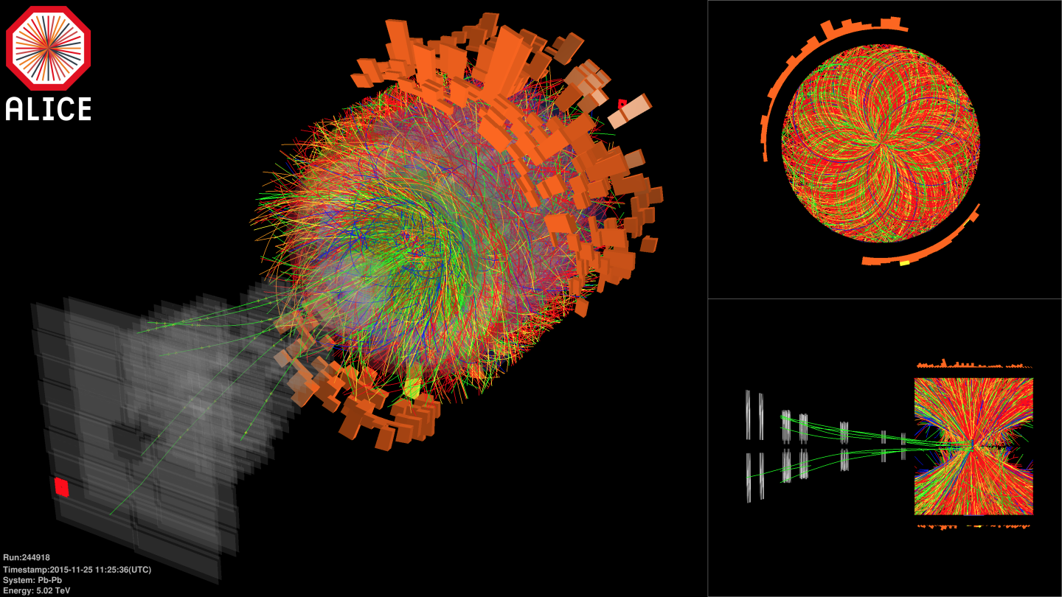

Pb-Pb at Highest Ever Energy
√s_{NN} = 5.02 TeV in 2015, 2018
  25 times higher than at RHIC
  design energy at 5.5 TeV
2.76 TeV in 2010 and 2011

Slide 4
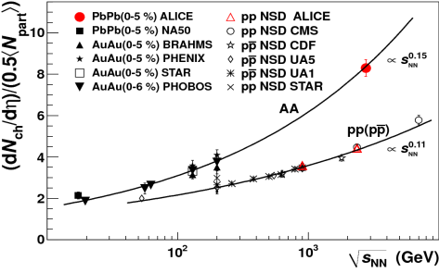
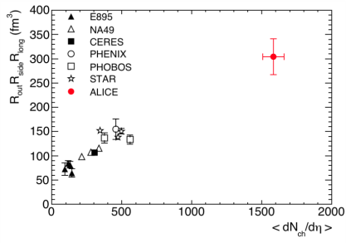
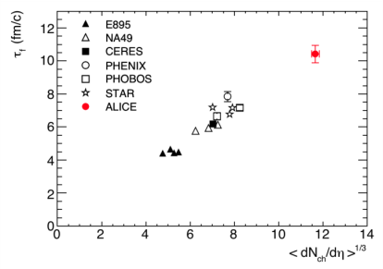
Hotter, Larger, Longer-Lived, and Purer
fireball compared to that at RHIC
  energy density × ~3, volume × ~2, life × 1.2–1.3
    ~ 16 GeV/fm³ (thermalization time ~ 1 fm/c)
    ~ 300 fm³, ~ 10 fm/c
net quark (baryon) density ~ 0
  anti-proton/proton at mid-rapidity
    p+p 900 GeV： 0.957 ± 0.006 (stat) ± 0.014 (sys)
    p+p 7 TeV： 0.990 ± 0.006 (stat) ± 0.014 (sys)
ALICE (K. Aamodt et al.),
PRL 105, 072002 (2010)
ALICE (K. Aamodt et al.),
PLB 696, 328 (2011)

Slide 5
Playground with Extreme Conditions
deconfined quark/gluon phase now in hand
quark behavior in strong QCD field
  energy loss and redistribution
quarks interaction in strong QCD field
  color Debye screening to melt quarkonia
chiral symmetry restoration
  hadron mass modification
more exotics
  physics under ultra-intense magnetic field
  …

Slide 6
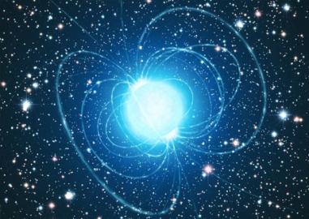
Ultra-Intense Magnetic Field
U(1) magnetic field
  naturally expected with moving charged sources (nuclei)
  ~ 10¹⁵ T at LHC, ~ 10¹⁴ T at RHIC
    cf. magnetar surface ~ 10¹¹ T
  could be long-lived in “perfect fluid”
possible non-linear QED behaviors
  above electron critical magnetic field em_{e}² = 4×10⁹ T
various interesting physics under discussion
  chiral magnetic effects
  quark synchrotron radiation
  lower QCD critical temperature
Magnetic Field

Slide 7
Critical Magnetic Field
critical electric/magnetic field of electron
  energy within Compton radius ≈ own rest mass
  eE_{c}h/m_{e}c = m_{e}c² ; E_{c} = m_{e}²c³/eh ~ 10¹⁷ V/m
  eB_{c}h/m_{e}c = m_{e}c ; B_{c} = m_{e}²c²/eh ~ 10⁹ T
Schwinger mechanism in case of electric field
  e⁺e⁻ pair production
  no sense to consider E > E_{c}
non-linear QED effects in case of magnetic field
  e.g. γ → γ γ, γ → e⁺e⁻, birefringence, …

Slide 8
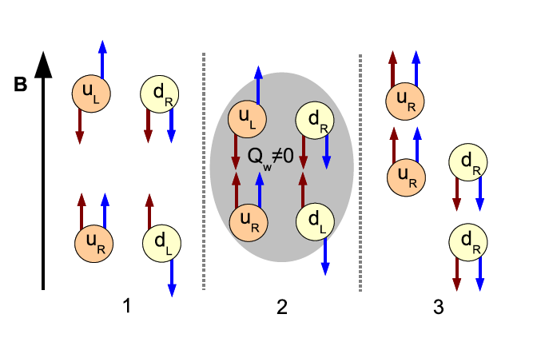
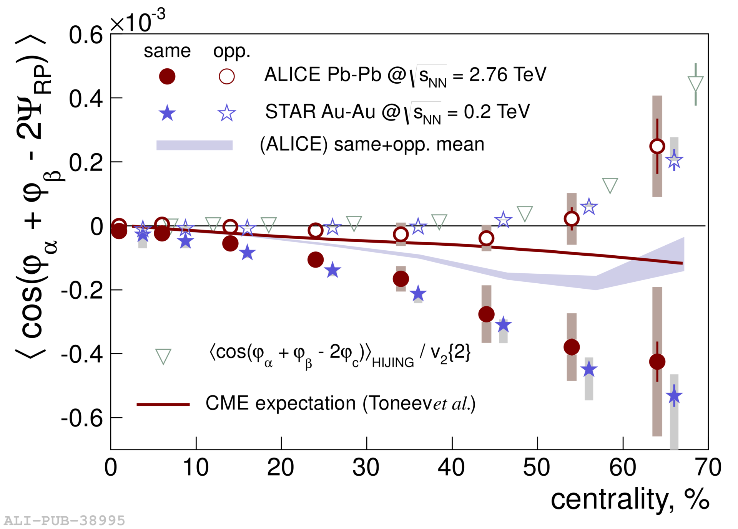
Chiral Magnetic Effects
if strong parity violation and magnetic field
charge separation, observed at RHIC and LHC
B
correlation between particles with different charges
correlation between particles with same charges

Slide 9
LPV Domain Size and Observables
    assuming perfect alignment and distribution
if 1 domain, [(n₊↑ − n₊↓)/(n₊↑ + n₊↓)]² is always 1
if 2, it is 1 (50%) or 0 (50%), i.e. average at 1/2
if 3, it is 1 (25%) or 0.11 (75%), i.e. average at 1/3
# domains ↔ width of [(n₊↑ − n₊↓)/n₊]² distribution
large N limit ≈ independent N particle production
[(n₊↑ − n₋↓)/(n₊↑ + n₋↓)]² is always 0
  note this does mean correlation
large N limit ≠ independent N particle production

Slide 10
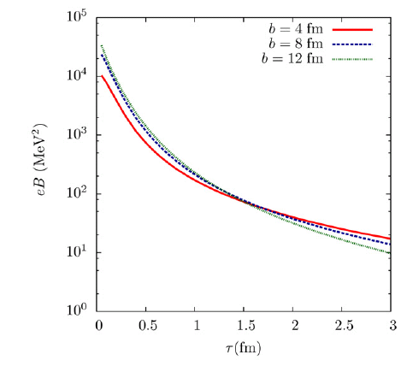
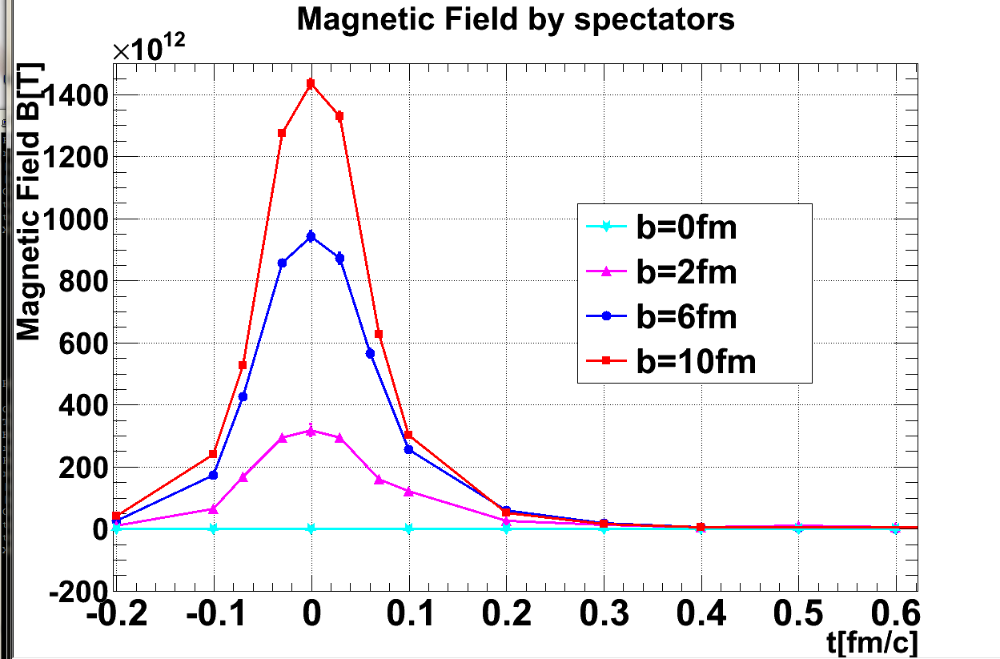
Field Intensity and Time Evolution
cascade models: common approach
  spectator contribution dominant but short lived
    10¹⁴ – 10¹⁵ T at LHC
    life time < 1 fm/c due to Lorentz contraction
    though still above m_{e}²/e after several fm/c
JAM; Au+Au 200 GeV
(A.Tsuji)
URQMD; Au+Au 200 GeV

Slide 11
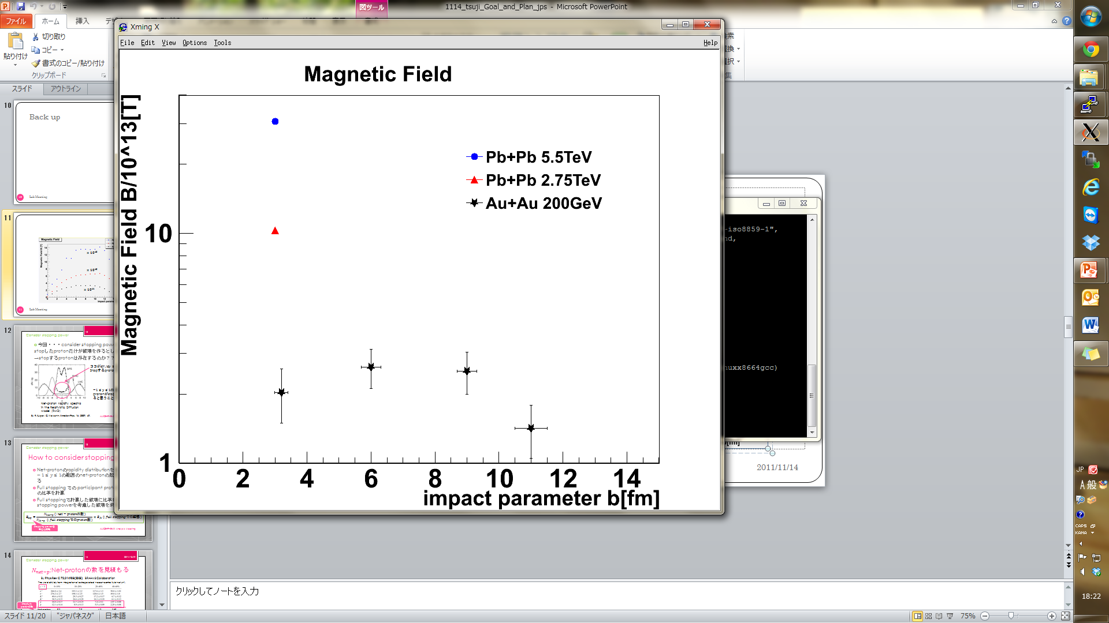
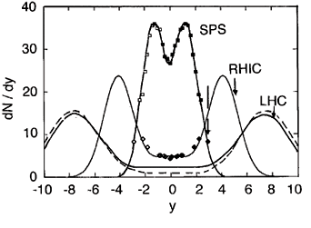
Field Sustainability Unknown
participant contribution in “perfect fluid”?
  “static field” approximation w/ Glauber model
    finite baryon stopping taken into account
    10¹³ – 10¹⁴ T at LHC
hydro model with local charge nearly available (!)
(A.Tsuji)
Pb+Pb 5.5 TeV
Pb+Pb 2.76 TeV
Au+Au 200 GeV
baryon stopping power
from net baryon distribution
10¹⁴ T
10¹³ T

Slide 12
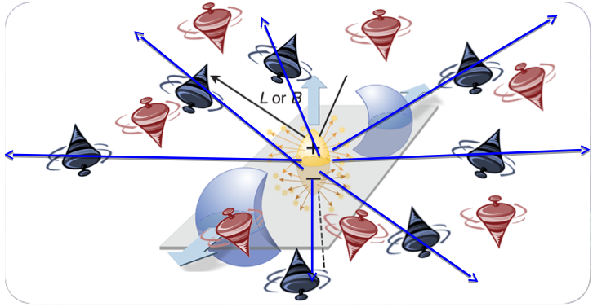
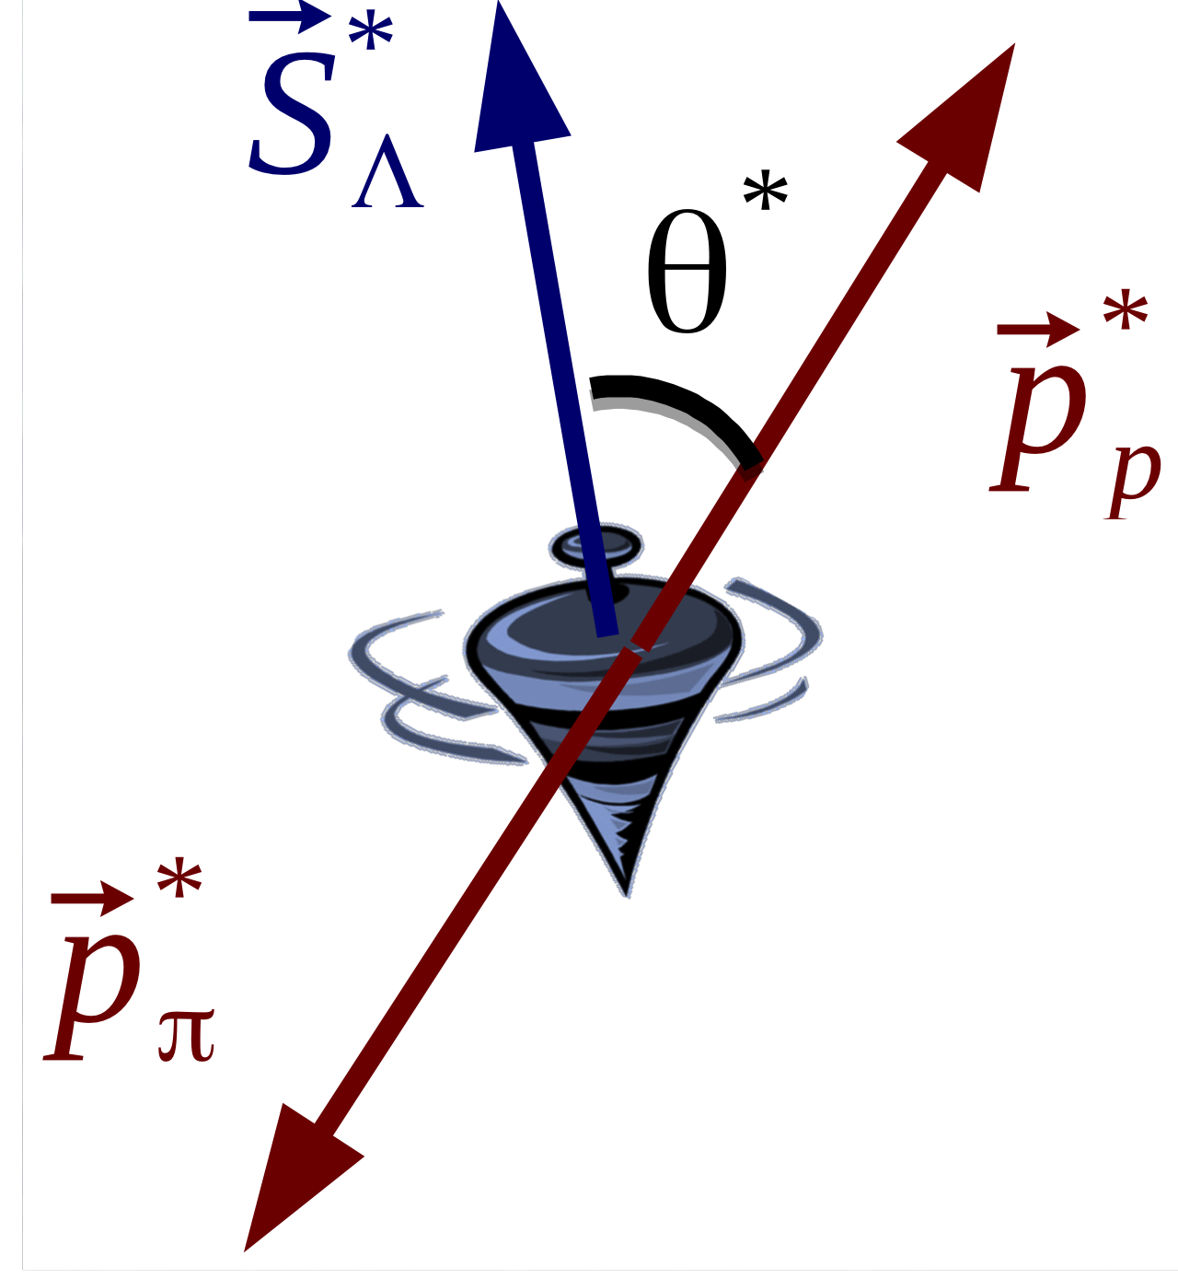
Vorticity (and/or Magnetic Field)
angular momentum transfer to Λ polarization
  spin - orbit coupling
magnetic field also possible Λ polarization source
  opposite alignment of Λ and Λ
detectable via parity violating Λ decay
T.Niida for STAR, IS’17

Slide 13
Λ Polarization Measurements
successful example of precision improvement
  zero consistent with upper limit at 0.2% in 2007
  √s_{NN} dependent polarization found by 2017

Slide 14
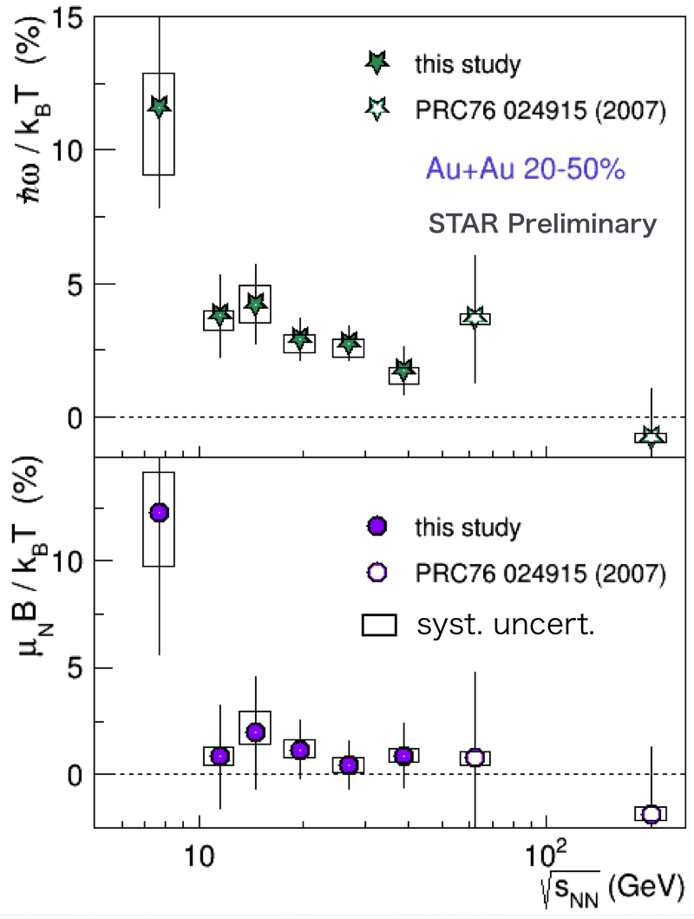
Non-Zero (and Large) Vorticity Found
ω = (9 ± 1) × 10²¹ s⁻¹
  √s_{NN} averaged
  assuming T = 160 MeV
magnetic field?
  implied by Λ and Λ difference
  though still zero consistent
T.Niida for STAR, IS’17

Slide 15
Implications for Magnetic Field Search
magnetic field not yet caught
long-lived medium rotation; very promising source
higher statistics required (and planned) at LHC
T.Niida for STAR, IS’17

Slide 16
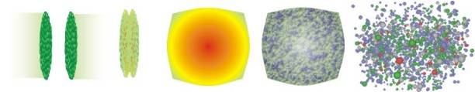
Direct Probes of Intense Field
must originate from initial stages
  field life time ~ 0.1 fm/c
must be electro-magnetic
ideal probe: direct γ/γ∗ from pQCD processes
good reference: γ/γ∗ from later stages
  e.g. π⁰ decay γ/γ∗ (Dalitz di-electron)
0 fm/c
~ 4 fm/c
~ 10 fm/c
B > B_{c}
electro-magnetic probes
hadronic probes

Slide 17

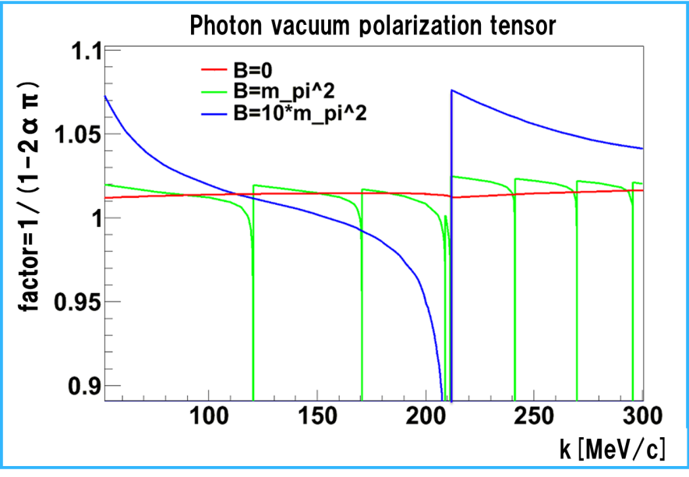



Proposal 1. Direct Photon Anisotropy
polarization tensor in magnetic field
  modification factor to
  seemingly v₂ ~ o(10⁻²)
obvious existence of other contributions to v₂
Y.Akamatsu, H.Hamagaki, T.Hatsuda, T.Hirano Phys. Rev. C 85, 054903 (2012)
Au+Au 200 GeV (PHENIX)
20–40% centrality direct γ v₂
k_{T} = 0 (k // B)
(K.Ishikawa and A.Tsuji)

Slide 18
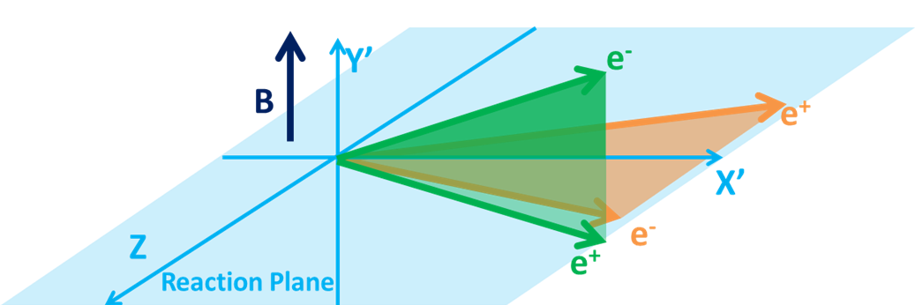
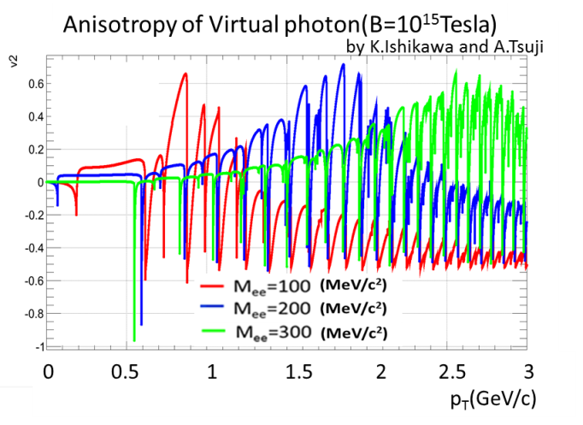
Proposal 2. Direct Photon Polarization
anisotropic decay w.r.t. magnetic field
feasibility study based on QED calculations
  vacuum polarization tensors under magnetic field
    summation for infinite Landau levels
    photon momentum up to ~ GeV
    ref. K.-I. Ishikawa, K. Shigaki, et al.,
    Int. J. Mod. Phys. A28, 1350100 (2013)
anisotropy ~ o(10⁻¹)
l⁻
γ*
γ*
?
l⁺

Slide 19
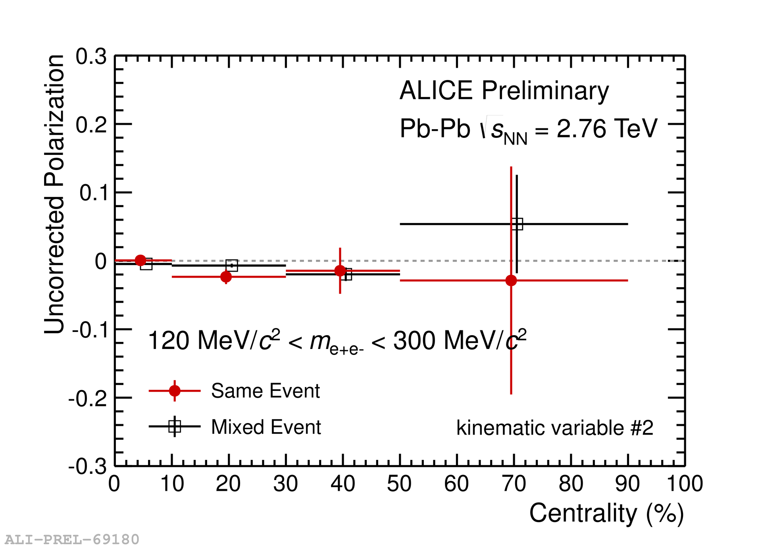
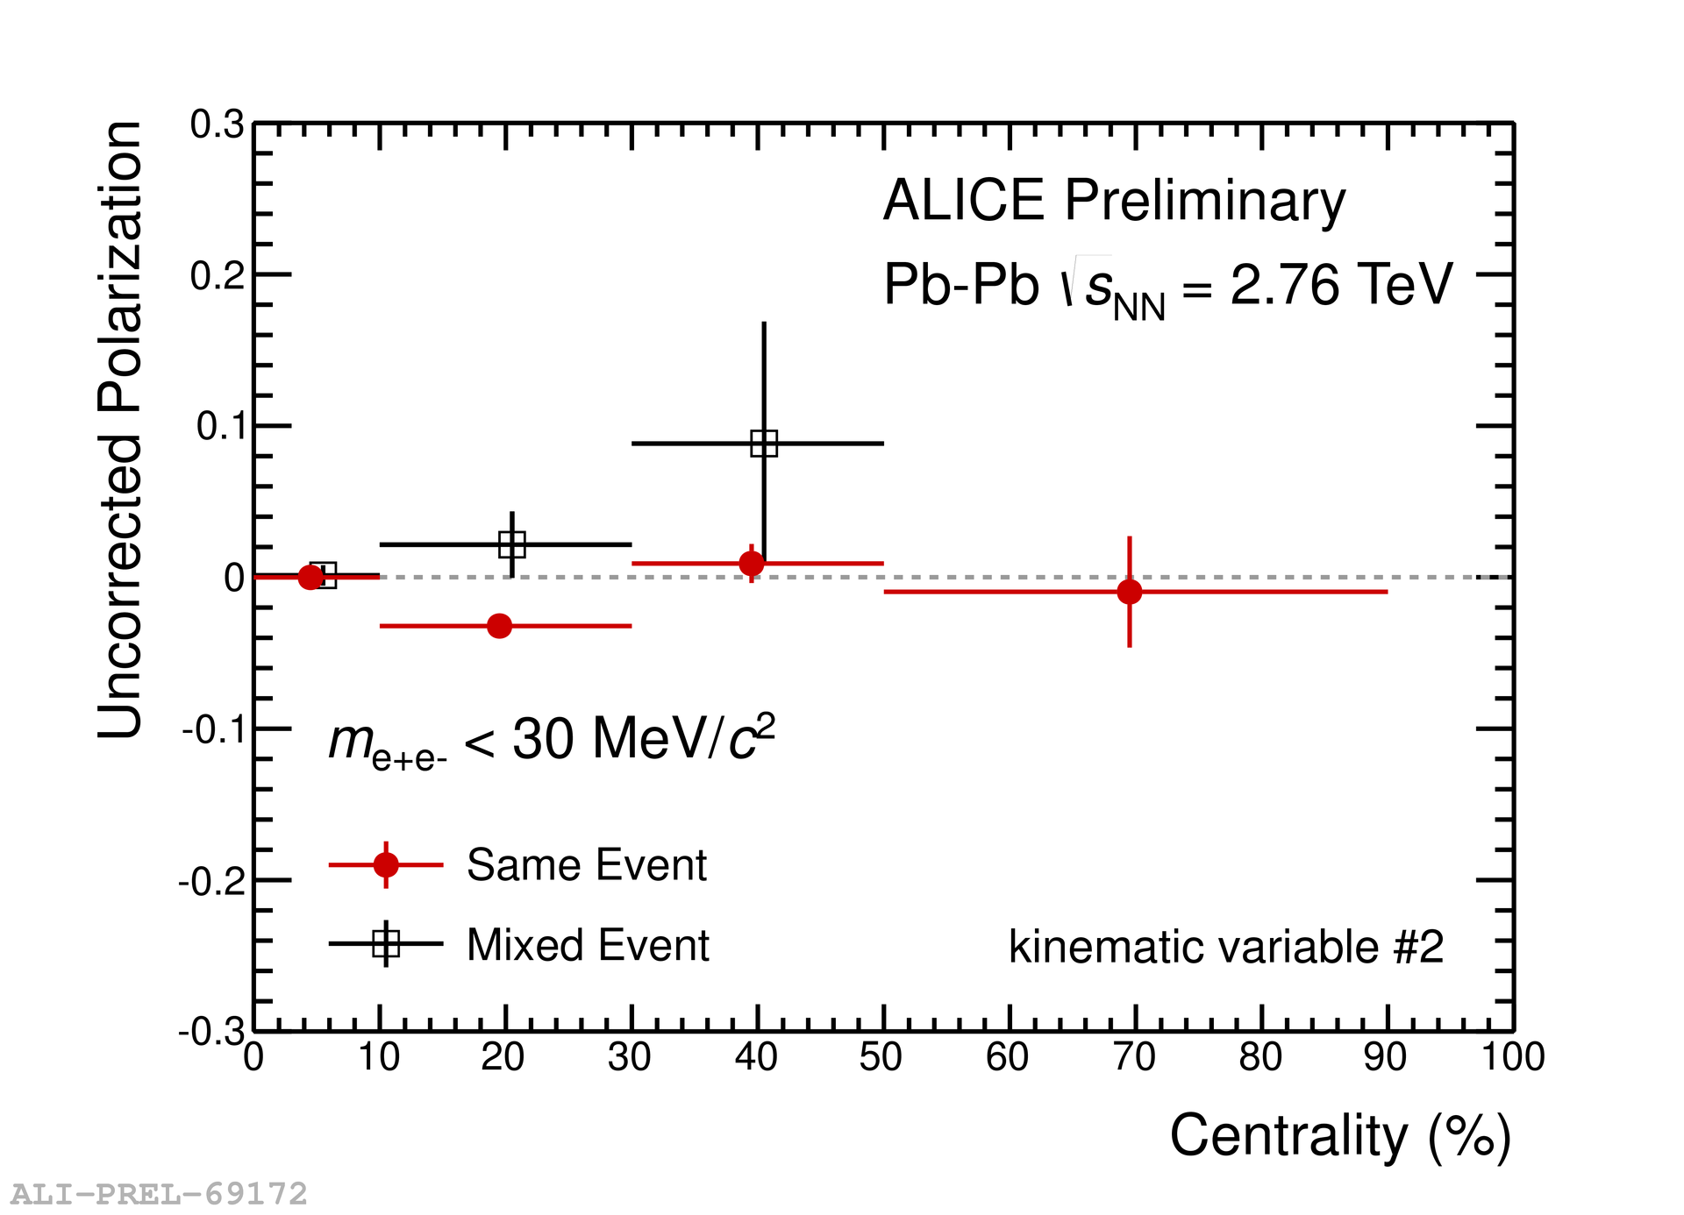
Preliminary Analysis in ALICE Run 1
intermediate mass region containing direct γ*
  though combinatorial dominant
low mass region as reference
  Dalitz decay dominant

Slide 20
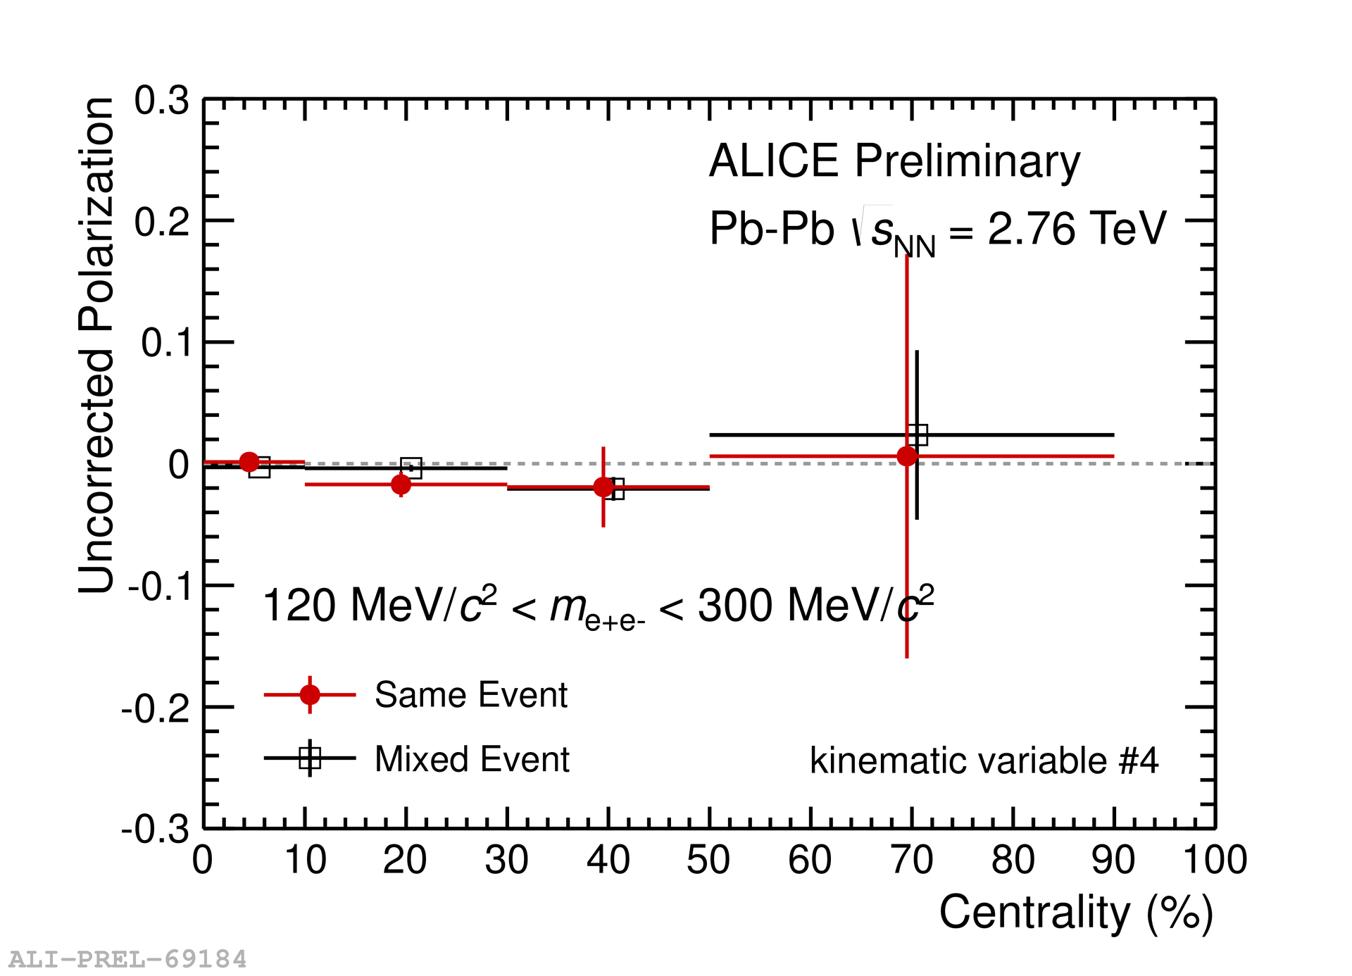
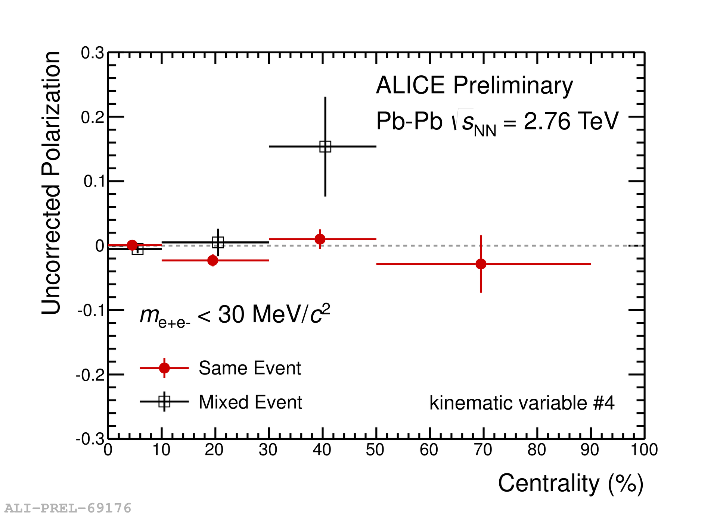
Preliminary Analysis in ALICE Run 1
intermediate mass region containing direct γ*
  though combinatorial dominant
low mass region as reference
  Dalitz decay dominant

Slide 21
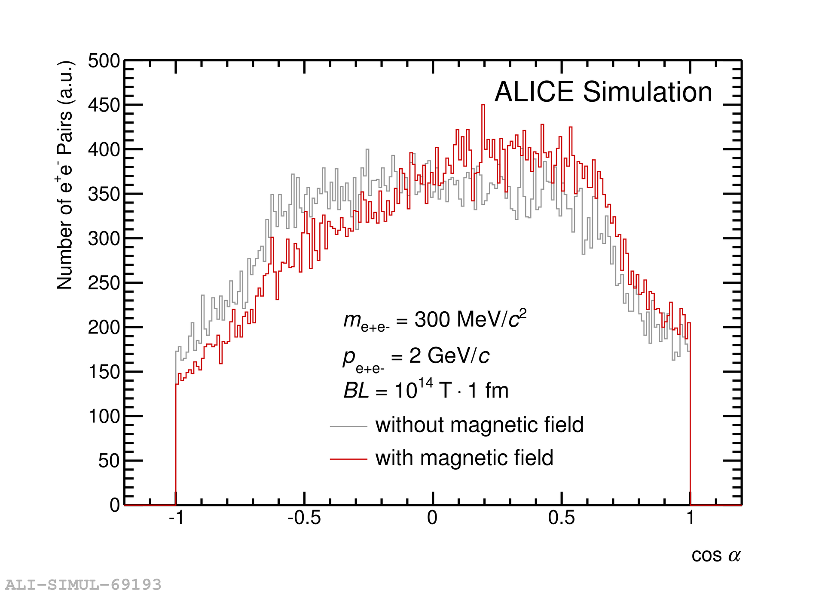
Proposal 3. Femto-Spectrometer
bending power Bdl ~ 10¹⁴ T×10⁻¹⁵ m
→ bending angle ~ 3×10⁻²/p [rad/(GeV/c)]
detectable as opening angle offset
  e⁺/e⁻ bent in opposite way around magnetic field axis
    reaction axis from directional flow (v₁) in forward/backward
  o(1) degree for o(1) GeV/c particles!

Slide 22
Not Even Preliminary
intermediate mass region containing direct γ*
  though combinatorial dominant
low mass region as reference
  Dalitz decay dominant

Slide 23
Not Even Preliminary
intermediate mass region containing direct γ*
  though combinatorial dominant
stronger deflection expected at low p_{T}
R. Tanizaki, master’s thesis, Hiroshima U., 2015

Slide 24
Key Issue: Significance, i.e. Statistics
marginal at best, in 2012–2016
  4 M.Sc. theses in 2013–2016
    T.Hoshino, A.Tsuji, R.Tanizaki, Y.Ueda
  5 B.Sc. theses in 2012–2015
    A.Tsuji, R.Tanizaki, Y.Ueda, A.Nobuhiro, K.Yamakawa
higher statistics data available/coming in
  1 B.Sc. thesis in 2018
    T.Osako; continuing, e.g. ATHIC 2018
ALICE run 3 (2021–2023) even more promising
  ×10 (di-)muons
  ×100 minimum bias (di-)electrons

Slide 25
e and μ Reunion at LHC Energy
parallel approaches to same physics up to SPS
  muons at central (CMS) rapidity in fixed target exp.
    e.g. NA38/50/51/60 dimuon spectrometer
physics emphasis (and people) separated at RHIC
  broad QGP physics with electrons in central barrel
  focused topics, e.g. high mass/p_{T} and spin, with muons
    e.g. PHENIX “forward” arms
    low momentum μ ID technically challenging
reunion at LHC
  low p_{T} muons within prolonged central Bjorken plateau
  parallel and complementary approaches (again)

Slide 26
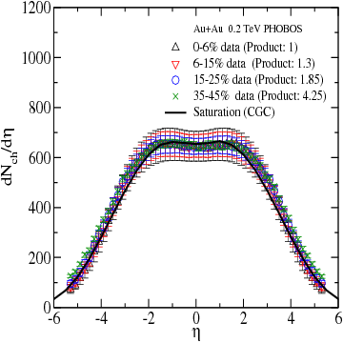
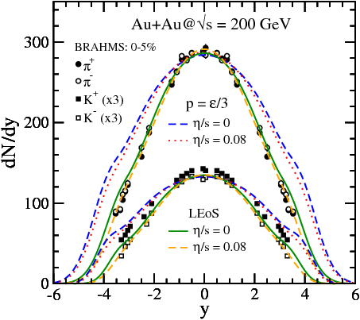
Muon Measurement at PHENIX
muon arms: 1.2 < |η| < 2.4
minimum p_{T} ~ 1.0 - 1.5 GeV/c

Slide 27
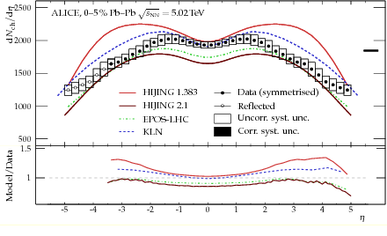
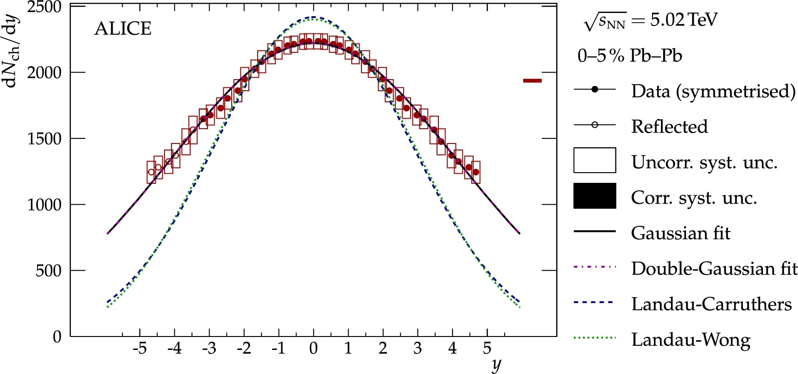
Muon Measurement at ALICE
muon arm: 2.5 < |η| < 4.0
MFT: 2.5 < |η| < 3.6
minimum p_{T} ~ 0.5 GeV/c

Slide 28
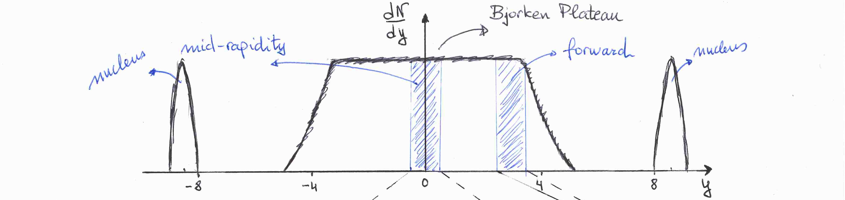
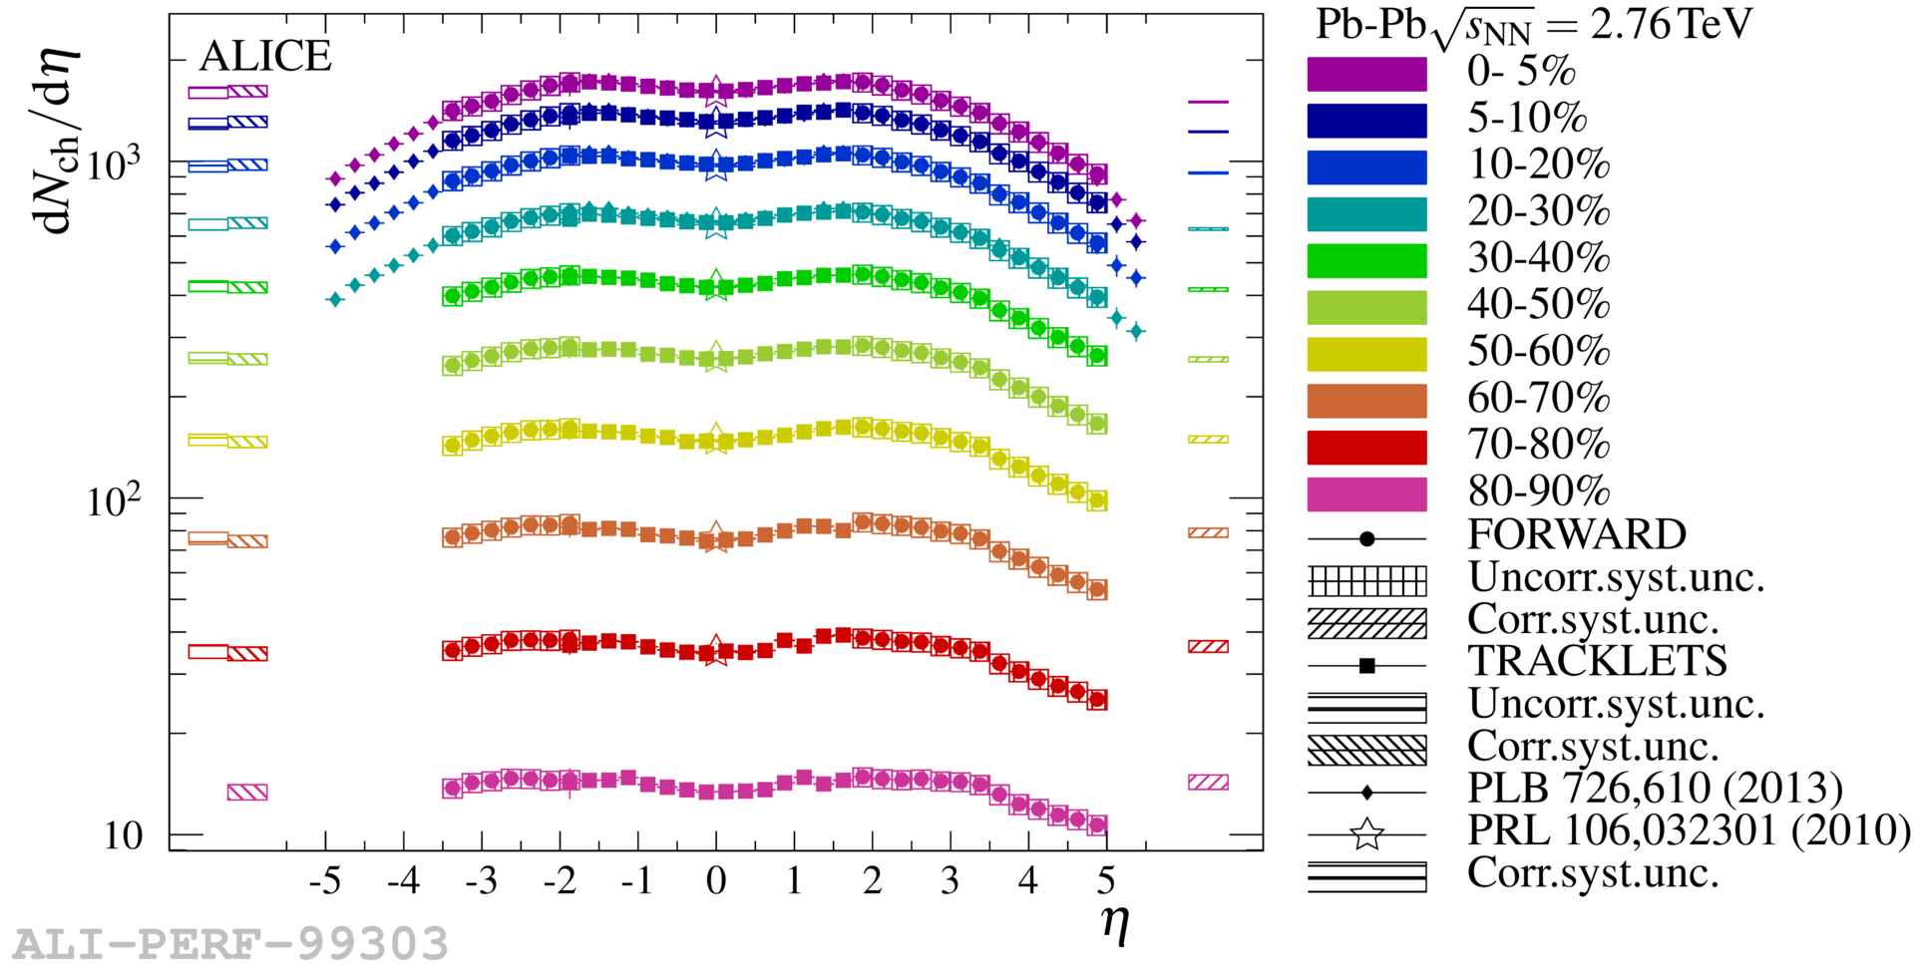
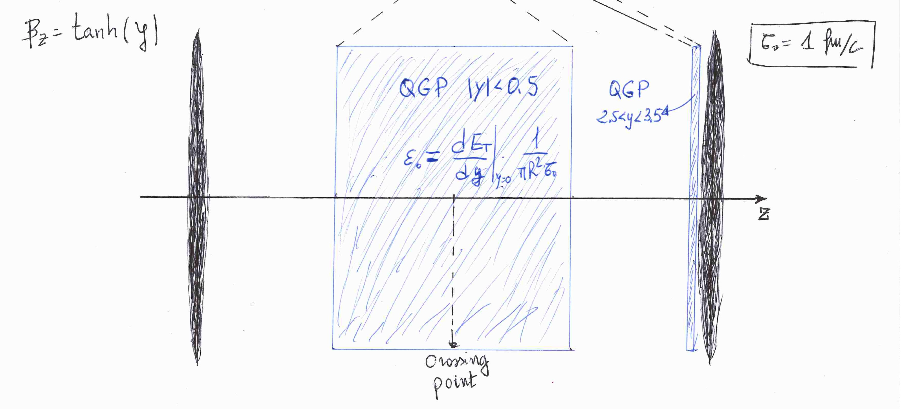
New Relation between e and μ at LHC
two interesting regimes of quark-gluon phase
  exploration on QCD phase diagram
new opportunity only at LHC energy (and above)
  forward enough for (low p_{T}) muon measurement
    e.g. |y| above ~ 3.4 for p_{T} < 0.25 GeV/c, p > 4 GeV/c
  not too forward for “central” physics
    |y| up to ~ 4 at LHC (~ 2 at RHIC)

Slide 29
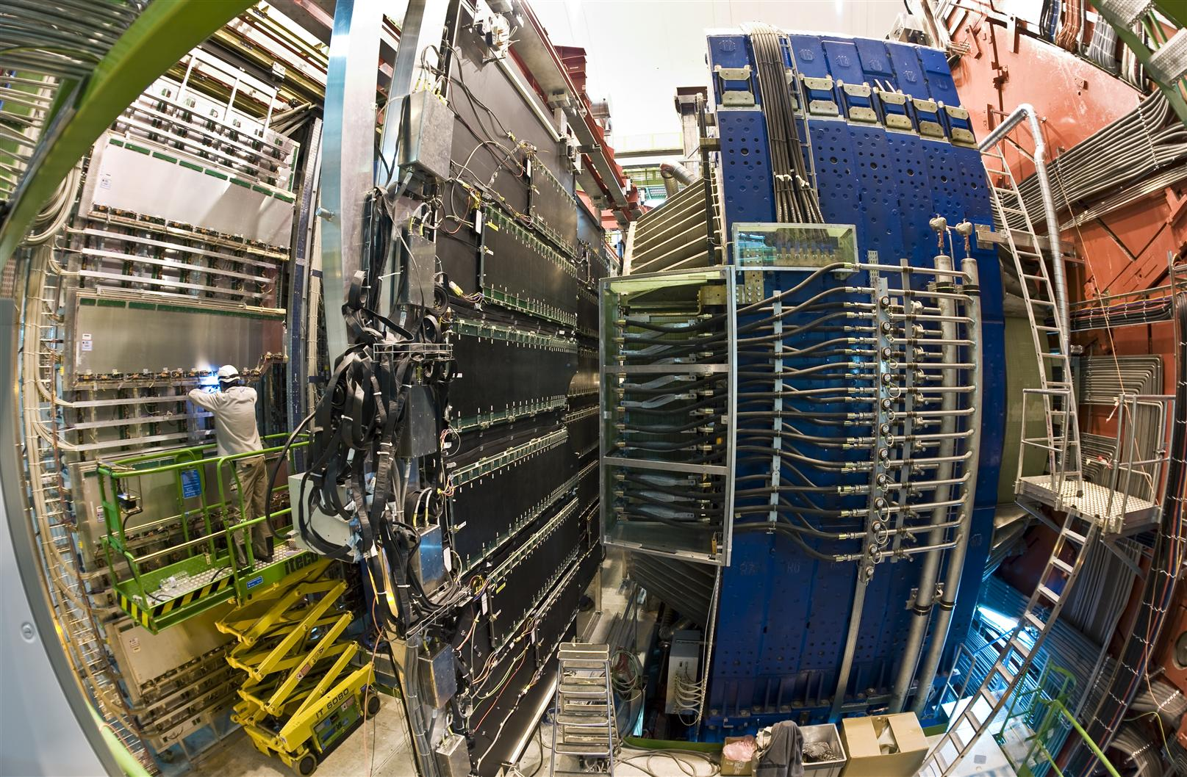

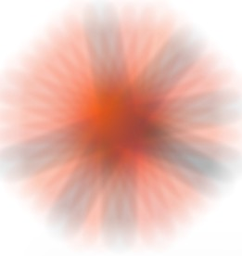


Muon Forward Tracker (2021–)
vertex and invariant mass resolutions to improve
Tracker
Trigger
𝝻
MFT
𝝻
Frontal
Absorber
Dipole
Dipole
Iron Wall

Slide 30
Another Obvious Stage: RHIC BES-II
2019–2021, STAR only
√s_{NN} = 7.7–19.6 GeV, 3.0–7.7 GeV (fixed target)
STAR starting to look into deflection

Slide 31
Summary, Conclusions, and Remarks
wide range of interests; not only LPV/CME(/CVE)
field time structure: key for physical significance
  longer-lived participant component in “perfect fluid”?
proposals of experimental detection approaches
  seemingly feasible, statistics permitting
  simulations and real data analysis
    direct photon polarization
    femto-spectrometer
high prospects in near-future high statistics data
  both muons and electrons in ALICE run 3 (2021–2023)
  RHIC BES-II (2019–2021) at STAR

